Slide 1

Classifying clinically actionable genetic mutations
Cheong Yu Chye – DSI 13 – CAPSTONE Project

Slide 2
Our Problem Statement
Cancer is a top public health issue¹:
Globally, about 1 in 6 deaths is due to cancer
One in every 4-5 people in Singapore may develop cancer in their lifetime
Today, clinical pathologists can perform genomic sequencing on a patient’s tumour sample to determine if it carries mutations that could aid in treatment, or clinical trials²
Once these genes and mutations have been identified, clinical pathologists then have to manually review a growing corpus of related biomedical literature to classify the mutations – this process is tedious and time consuming
Our problem statement: to build a classifier that can help to automate this classification
Metrics: balanced (weighted) accuracy and F1 scores, micro-average AUC
Success measure: beat baseline accuracy (0.287) by ≥ 10%
Sources:
¹ - https://www.nccs.com.sg/patient-care/cancer-types/cancer-statistics, https://www.who.int/news-room/fact-sheets/detail/cancers
² - https://www.mskcc.org/cancer-care/diagnosis-treatment/diagnosing/role-pathology

Slide 3
Challenges
A multi-class scenario with imbalanced classes
Our problem statement is a multi-class scenario involving 9 classes
Just two of the most frequent classes account for ~50% of all the classes
Size of training and testing datasets
Only ~3,300 rows in the training dataset, but each row has a mean of ~63k words, and a maximum of ~526k words
After using one-hot encoding column creation and term frequency creation (TfidfVectorizer), we have >76k features
As-is, downstream model fitting is extremely slow (fitting for all models takes >17 hrs)
Clinical text is difficult to classify effectively
Understanding the context of words is key but it is not easy to find related word embeddings
BioBERT word embeddings look promising but there are constraints to using them

Slide 4
Our Approach – AT A Glance
Baseline Model
Randomised search for optimal classifier parameters
(nn, logreg, mnb, knn, adaboost, dtree, extra trees, rand forest, svm)
Creation of Training and Validation datasets
Generation of word counts
(Tfidf-Vectorizer)
Over-sampling
(ADASYN), scaling and PCA
Visualisation and calculation of metrics (e.g. ROC, AUC)
Data Import
Data Cleaning and EDA
POS Tagging
Selection of final model
Lemma-tisation
Alternative Model
Selection of optimal embeddings
(via cross-validation scoring on all words)
Randomised search for optimal classifier parameters
(nn, logreg, mnb, knn, adaboost, dtree, extra trees, rand forest, svm)
Creation of dummy columns
(for gene & variation)
Loading/ Generation of Alternative Embeddings
(Word2Vec, GloVe)
Creation of Training and Validation datasets
Generation of selected embeddings
(on training words)
Over-sampling
(ADASYN), scaling and PCA
Visualisation and calculation of metrics (e.g. ROC, AUC)

Slide 5
Report Card (as of 15-Apr)
 | Goal | Status | Notes*
1 | Obtain a baseline model | Completed | Logistic Regression Classifier based on Tfidf weighted word counts: Balanced accuracy score: 0.540 Balanced F1 score: 0.618 Micro-average AUC: 0.760
2 | Obtain an alternative model | Completed | Logistic Regression Classifier based on mean Word2Vec word embeddings: Balanced accuracy score: 0.397 Balanced F1 score: 0.443 Micro-average AUC: 0.663
3 | Deal with imbalanced classes | Completed | Used partial ADASYN oversampling
4 | Reduce overfitting (too many features) | Completed | Used PCA (no. of features dropped from ~76k to ~2k!)
5 | Evaluate BERT or BioBERT word embeddings | Abandoned | Abandoned this approach as BERT has 1,024 word limitation
6 | Evaluate ELMo word embeddings | Abandoned | Faced significant difficulty in creating the ELMo embeddings due to slow local processing speed and limited memory
7 | Enhanced neural network with LSTM | In-progress | Attempt to introduce LSTM units into neural network
Legend: BERT = Bidirectional Encoder Representations from Transformers, ELMo = Embedding from Language Models, GloVe = Global Vectors (from Stanford University)
Note: * - all scores shown are based on validation dataset

Slide 6

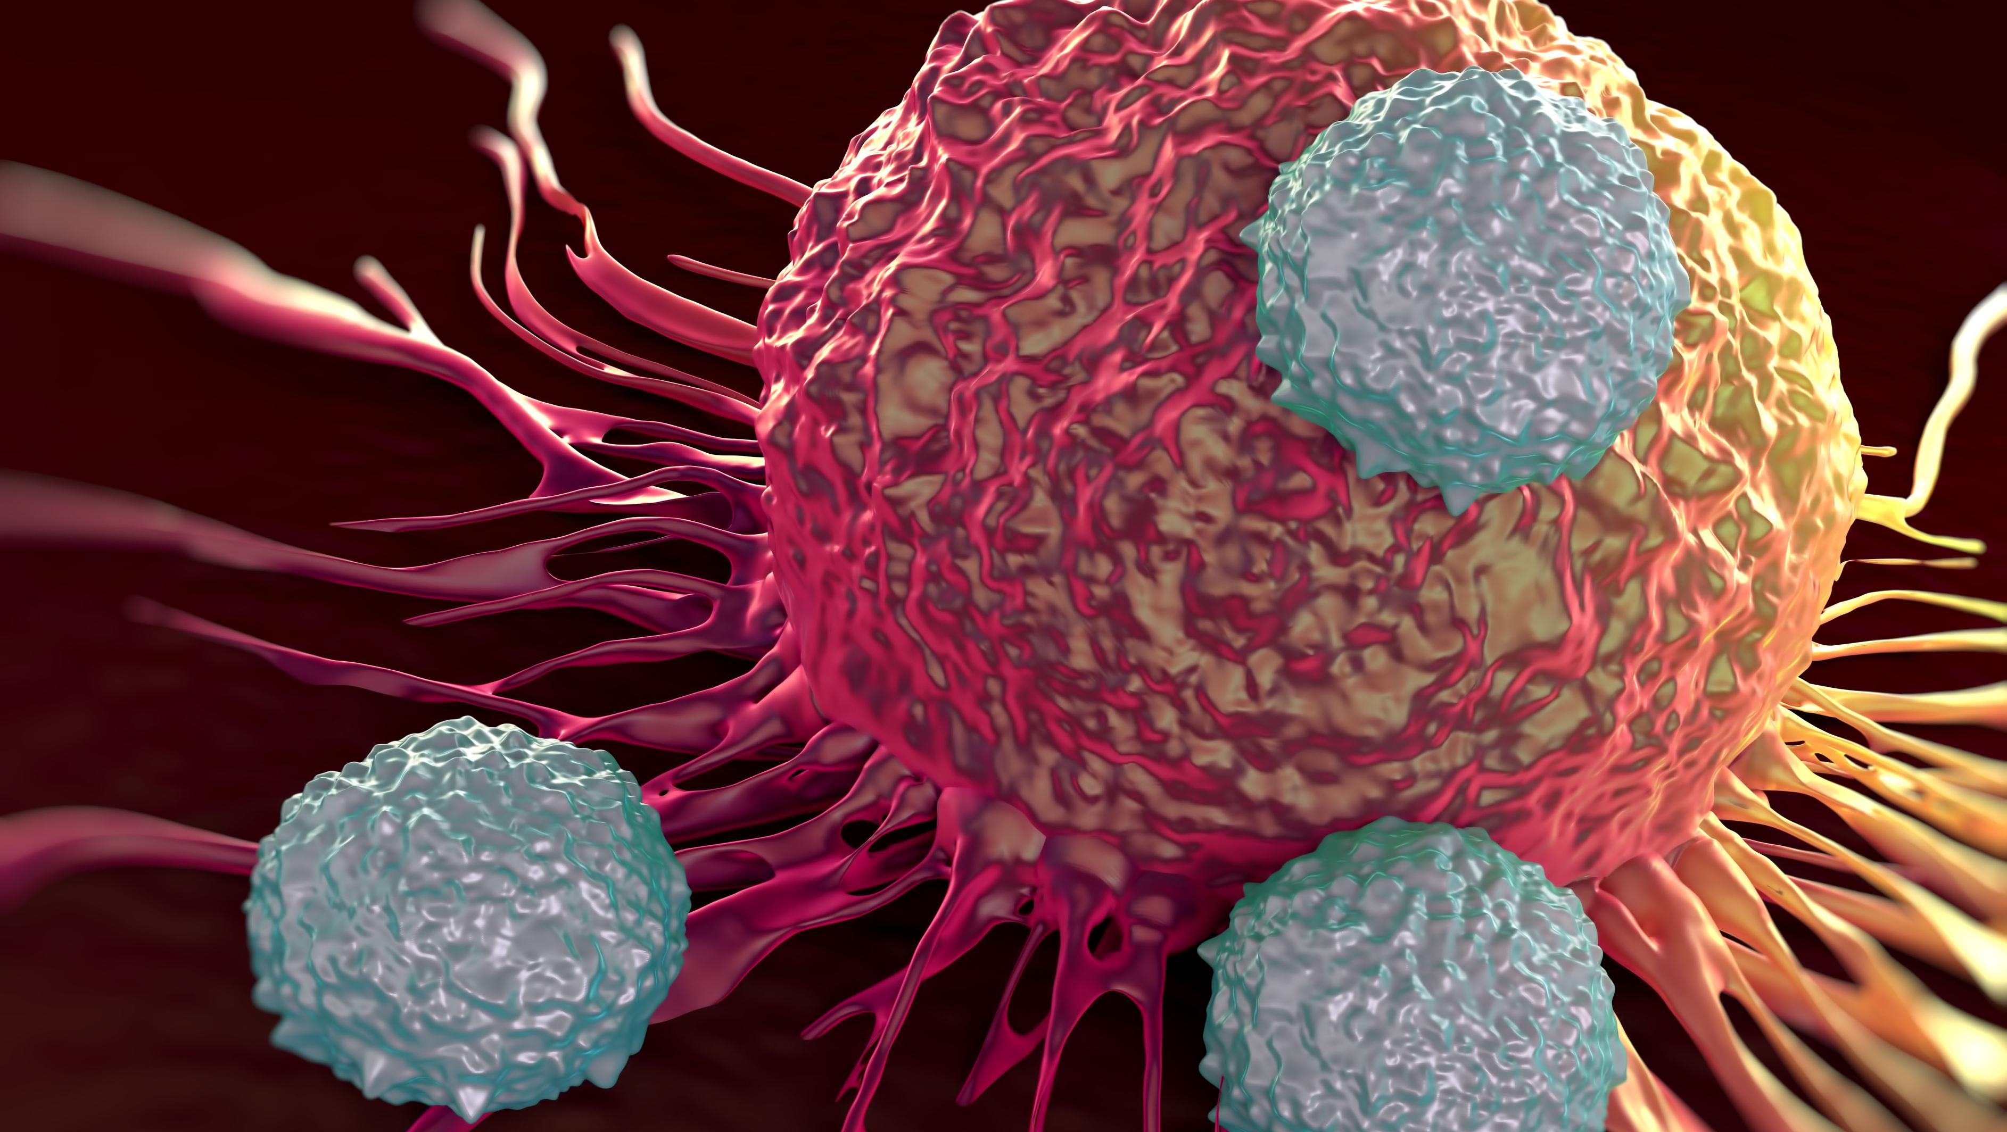
Thank You
yuchye@gmail.com

