Slide 1
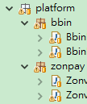
GetsyncThread(读取参数)
work控制器
myPay资料库设定
ContextInfo(Username, WEB_SITE_CONTEXT, OTP)
Config.ini(各种优惠配置啥的) *.properties
取取mypay尚未上分订单资料
排除正在执行上分使用者（订单）
拿订单
Work
Work
Work
解锁
侦测准备资料时间超时，不送单
开始存入
Work
记录成功订单
锁定订单
记录更新API错误订单
查找用户
DataHandler
连接不到上分网站，机器人自动重新连线（session keep）
zonvan
bbin
TBK
WorksControllerThread
AutoPay（always running）

Slide 2
20171011
Add AutoPay4J.exe
Config.ini移除
unLockUser改抓RECHARGE_ACCOUNT_NAME
准备 TODO
Config.ini 新增
//識別码.主机.ip
distinguish.server.01.ip=192.168.0.40
//識別码.主机.port
distinguish.server.01.port=88
distinguish.server.02.ip=192.168.0.42
distinguish.server.02.port=88

Slide 3
1.新增机器人自我保护机制（10秒侦测一次，总共18次）3分钟内都连接不到上分网站，机器人自动关闭
2.修复机器人断线不会清空opt
3.新增安全机制，以mypay订单号准，收到“上分成功”讯息，记录下（不会再次执行此订单），上分失败不在此规则中（防止有收到成功又再次添加）

Slide 4
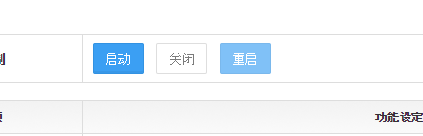
启动，关闭
新版机器人关闭很慢？
因为机器人需要时间把尚未做完的工作，执行完毕，才会停止。
这样才不会出现，重复添加
10~20秒 安全关闭 （不是把进程杀掉）
--更改机器人路径
UPDATE py_system_config SET VALUE = 'C:\AutoPay4J\AutoPay4J.bat'
WHERE TYPE = 'AUTO_RECHARGE' AND KEY = 'ROBOT_EXECUTE_FILE';
COMMIT;
-- 更换mypay com.zonpay.servlet.admin.AutoRechargeMgmtController
AutoRechargeMgmtController.class
手动关闭机器人要在tmp下面创造一个档案，档案名称 server.close

Slide 5
启动，关闭流程
机器人
启动
Mypay.web
创建server.pid
关闭
读取server.pid
创建server.close
发现server.close
启动关闭流程
删除server.pid
server.pid消失
删除server.close
时间

Slide 6
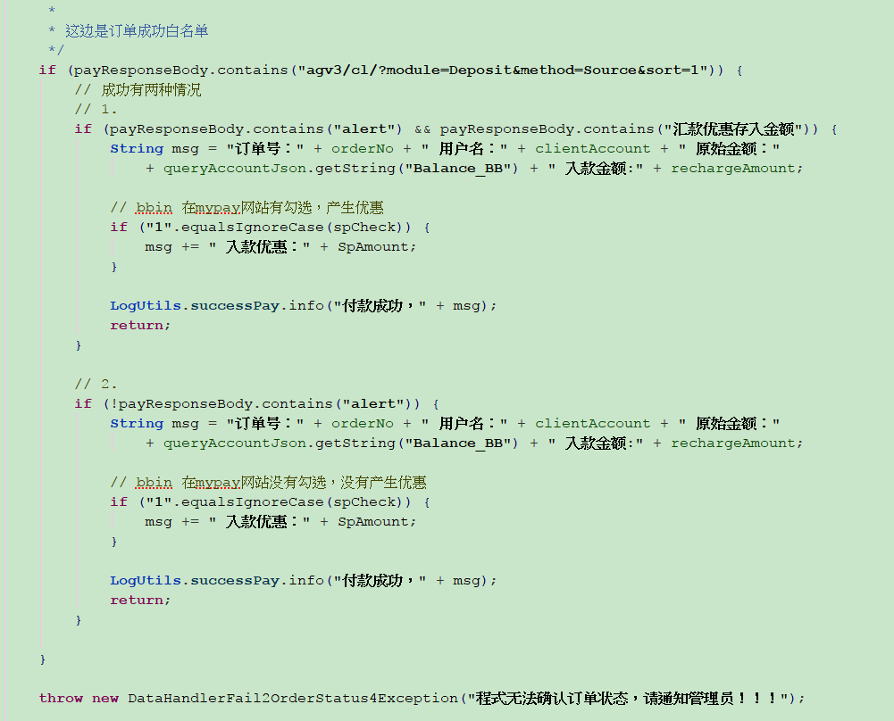
除了白名单，其他都错误

Slide 7
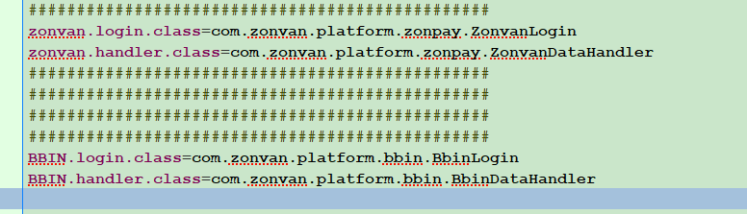
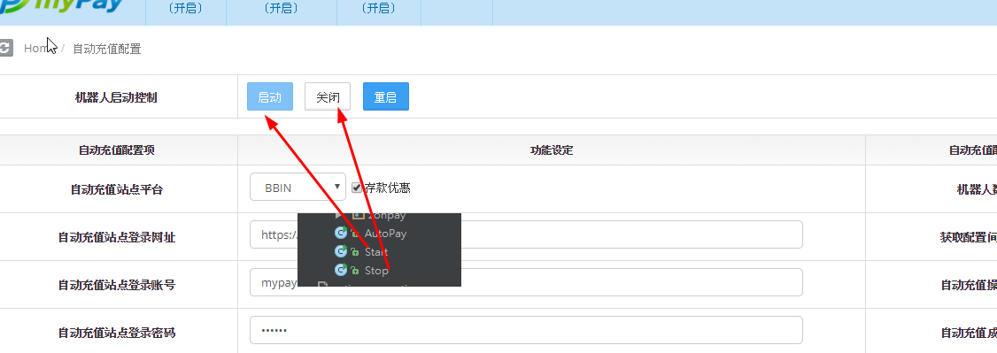
20171005.修正
新增启动关闭
新增重新启动，保持session，免登入
新增successPay.log
修正action.properties
新增启动关闭demo

Slide 8
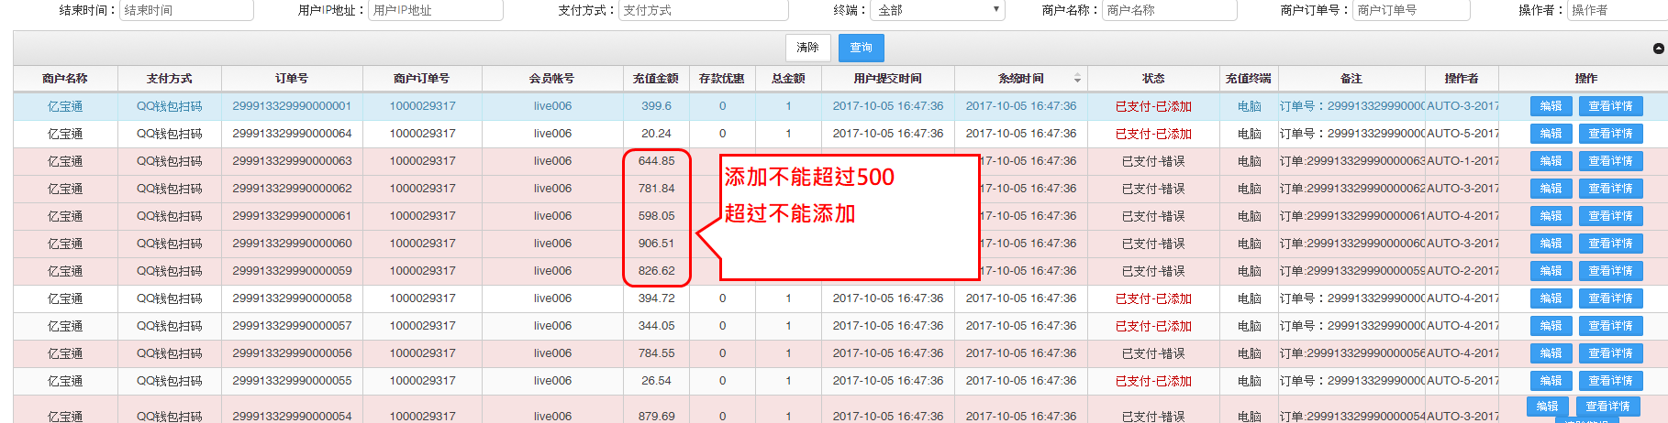
http://www.mypay.la/mypay/admin/index.jsp#ajax/orderListMgmt.jsp

Slide 9
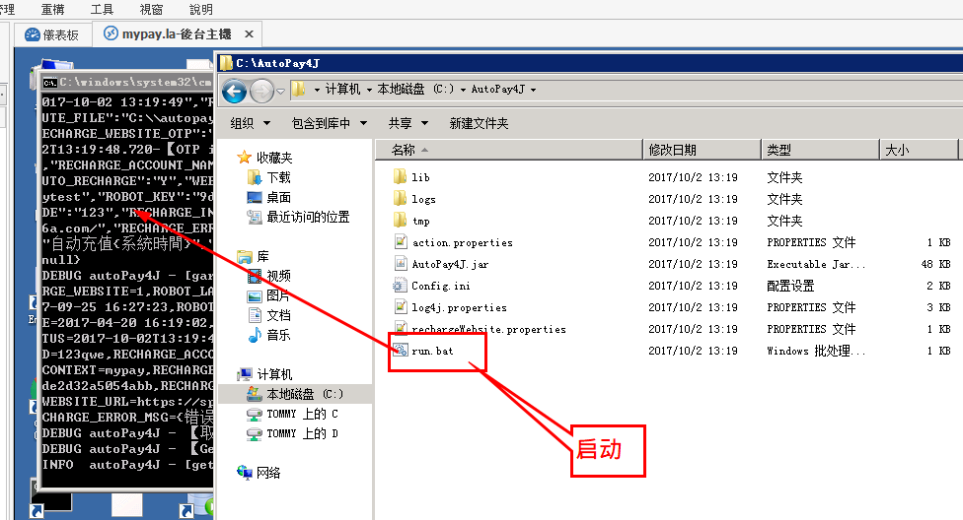
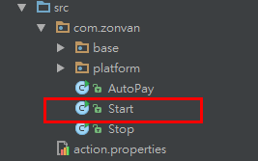
启动AutoPay4J
参考start.java

Slide 10
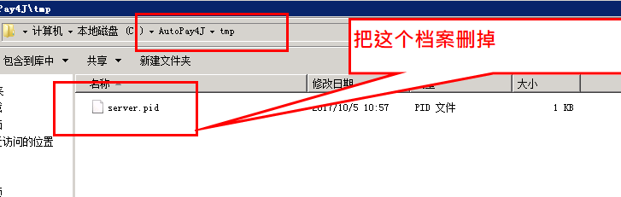
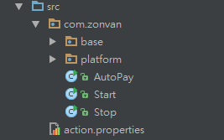
关闭AutoPay4J
参考stop.java

Slide 11
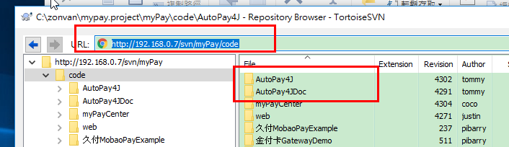
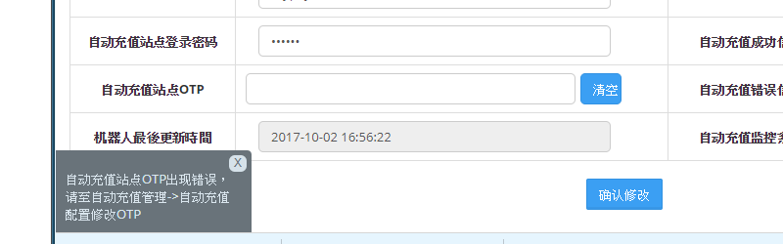
程式码位置
启动方式

Slide 12
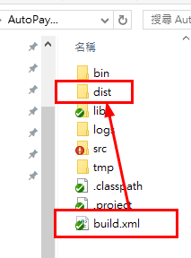
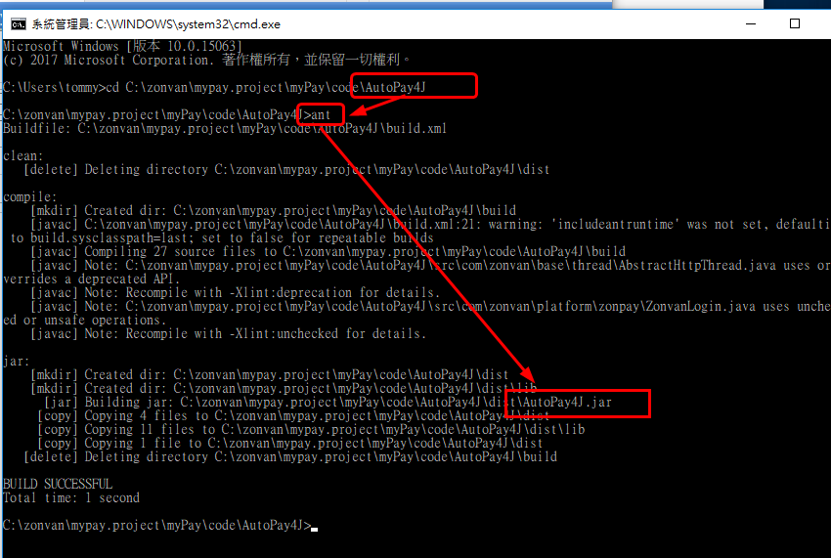
构建方法
使用ant，产生dist资料夹
AutoPay4J.jar

Slide 13
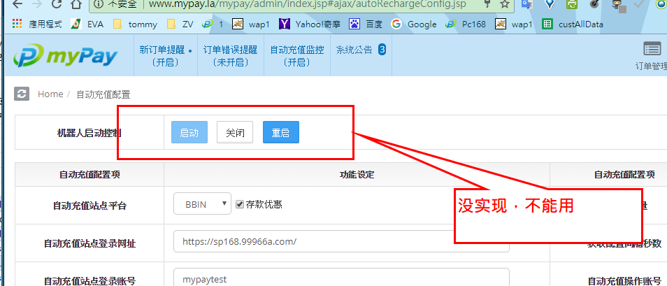

Slide 14
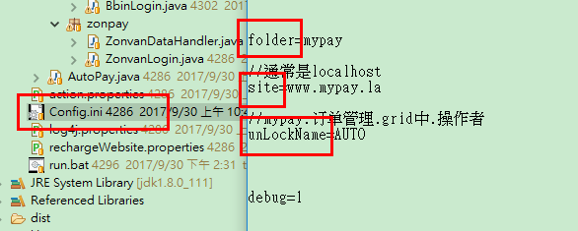
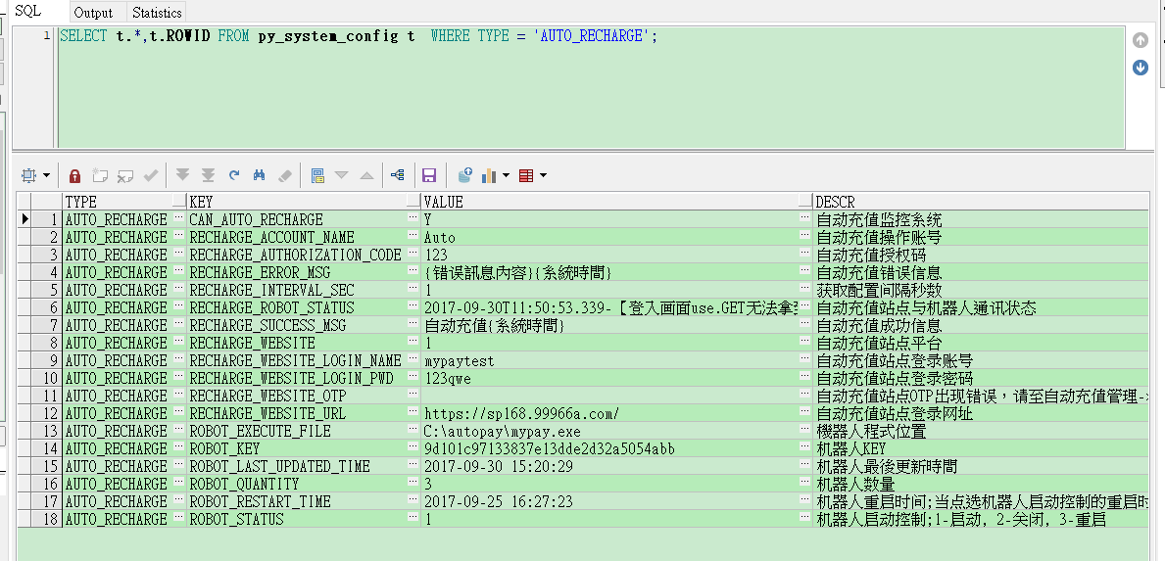
新增2个参数Config.ini：
1.site : localhost
2.unLockName:AUTO

Slide 15
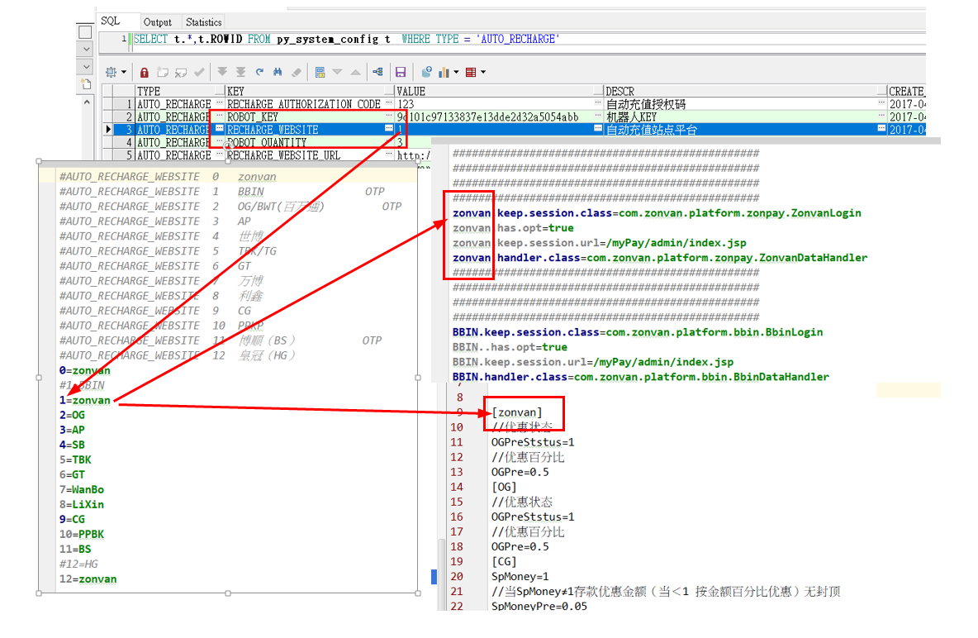
参数对应
action.properties
Config.ini
rechargeWebsite.properties

Slide 16
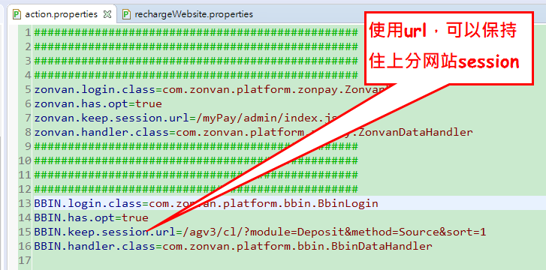
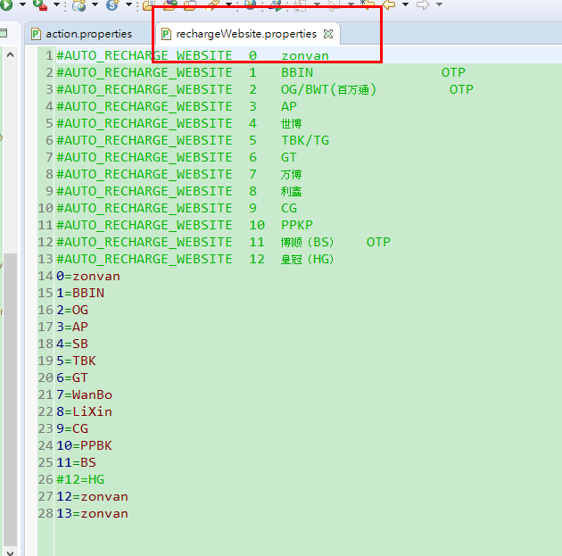

2个properties，1个ini需要设定

Slide 17
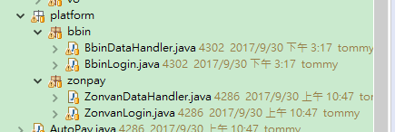
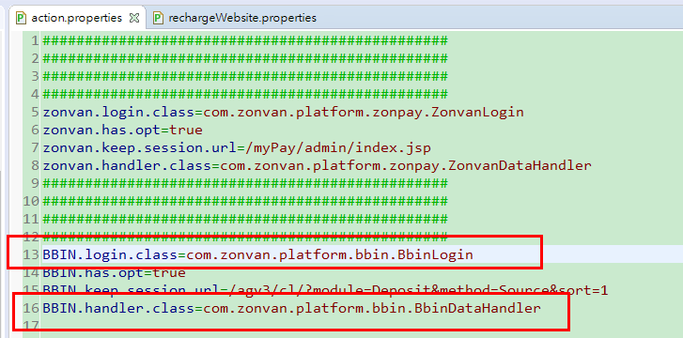
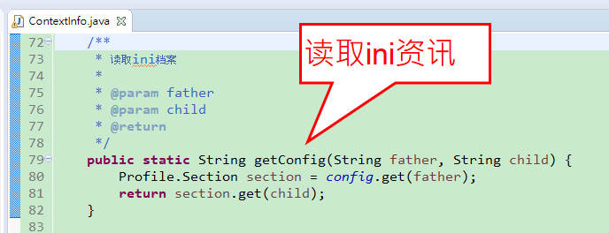
必需处理程式2只
1.BbinLogin.java(处理登入包含opt)
2.BbinDataHandler.java(处理丄分)查询，送单

Slide 18
BBIN（OTP），live006
有綁定ip，login url，status code = 200 ，可以測得是否能登入
BBIN平台
https://sp168.99966a.com/
账号： mypaytest
密码： 123qwe
游戏账号： live006
需要OTP就找001客户提供
添加
https://sp168.99966a.com/agv3/cl/?module=Deposit&method=Source&sort=1
查询添加资讯
https://sp168.99966a.com/agv3/cl/index.php?module=CashSystem

Slide 19
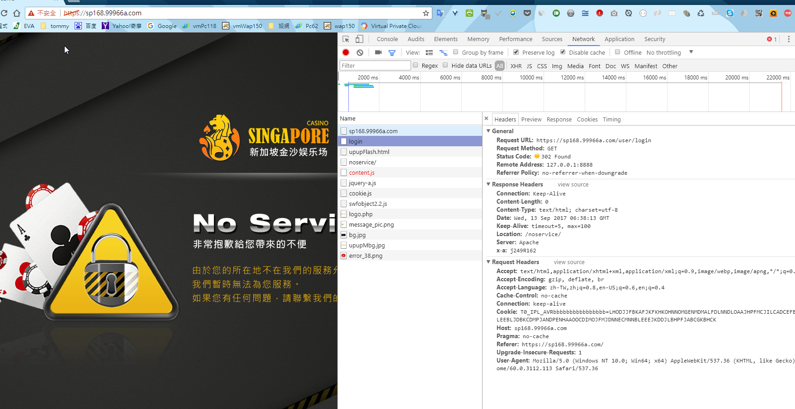
有綁定ip

Slide 20
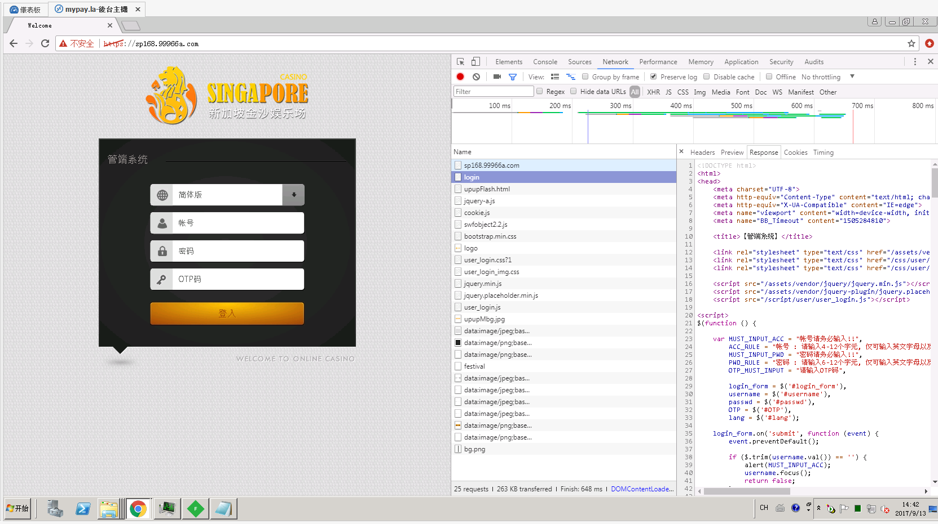

Slide 21
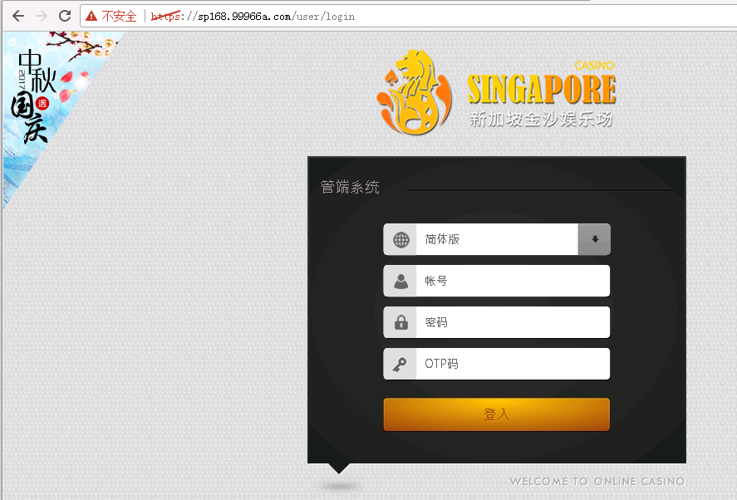
拿到index页面
https://sp168.99966a.com/user/login
HTTP/1.1 200 OK
Date: Fri, 29 Sep 2017 05:06:28 GMT
Keep-Alive: timeout=5, max=100
Connection: Keep-Alive
Content-Type: text/html; charset=utf-8
Server: Apache
x-a: Q243O162
Vary: Accept-Encoding
Content-Length: 12436
<!DOCTYPE html>
<html>
<head>
</body>
</html>
GET https://sp168.99966a.com/user/login HTTP/1.1
Host: sp168.99966a.com
Connection: keep-alive
Upgrade-Insecure-Requests: 1
User-Agent: Mozilla/5.0 (Windows NT 6.1; Win64; x64) AppleWebKit/537.36 (KHTML, like Gecko) Chrome/60.0.3112.113 Safari/537.36
Accept: text/html,application/xhtml+xml,application/xml;q=0.9,image/webp,image/apng,*/*;q=0.8
Referer: https://sp168.99966a.com/
Accept-Encoding: gzip, deflate, br
Accept-Language: zh-TW,zh;q=0.8,en-US;q=0.6,en;q=0.4
Cookie: langx=zh-cn; langcode=zh-cn; T0_IPL_AVRbbbbbbbbbbbbbbbb=PGDDAJBKNPNJINBPNEFPDMFPBHFFJPKPMAFDCCAJNFFNCMOFOMMLIJKEKDGPNOOHCFFDIPEFECCPBLLCGEGANMMPPNILKCCFALODOPMLEBIHNGDLLKLDDFHOJOOGMNEG

Slide 22
Json登入
POST https://sp168.99966a.com/user/login HTTP/1.1
Host: sp168.99966a.com
Connection: keep-alive
Content-Length: 54
Accept: application/json, text/javascript, */*; q=0.01
Origin: https://sp168.99966a.com
X-Requested-With: XMLHttpRequest
User-Agent: Mozilla/5.0 (Windows NT 6.1; Win64; x64) AppleWebKit/537.36 (KHTML, like Gecko) Chrome/60.0.3112.113 Safari/537.36
Content-Type: application/x-www-form-urlencoded; charset=UTF-8
Referer: https://sp168.99966a.com/user/login
Accept-Encoding: gzip, deflate, br
Accept-Language: zh-TW,zh;q=0.8,en-US;q=0.6,en;q=0.4
Cookie: langx=zh-cn; langcode=zh-cn; T0_IPL_AVRbbbbbbbbbbbbbbbb=NABHJOCCNGKOMHLBGGCOGGNEBBHHKKDPLGPPFNNEEOKBOAIDFLFJNFJIEMEJCPMGFGJDKNGHJMIGLFNKJANADJAFKNBAFPJNGPCMMAAAOKCMKKHEMKCJAMCFIGOLFKKD
lang=zh-cn&username=mypaytest&passwd=123qwe&OTP=721902
HTTP/1.1 200 OK
Date: Fri, 29 Sep 2017 05:48:35 GMT
Set-Cookie: sid=bf28e3dfc270a1f81160aade82e6eec795457053; path=/; domain=99966a.com
Set-Cookie: rd3_host=http%3A%2F%2Fsp168.99966a.com; path=/; domain=99966a.com
Content-Length: 137
Keep-Alive: timeout=5, max=100
Connection: Keep-Alive
Content-Type: application/json; charset=utf-8
Server: Apache
x-a: D245O162
{"code":200,"status":"OK","data":{"result":true,"session_id":"bf28e3dfc270a1f81160aade82e6eec795457053","redirect":"\/user\/home\/note"}}

Slide 23
查找用户，用户不存在
POST https://sp168.99966a.com/agv3/cl/?module=Deposit&method=query&sid= HTTP/1.1
Host: sp168.99966a.com
Connection: keep-alive
Content-Length: 19
Accept: application/json, text/javascript, */*; q=0.01
Origin: https://sp168.99966a.com
X-Requested-With: XMLHttpRequest
User-Agent: Mozilla/5.0 (Windows NT 6.1; Win64; x64) AppleWebKit/537.36 (KHTML, like Gecko) Chrome/60.0.3112.113 Safari/537.36
Content-Type: application/x-www-form-urlencoded; charset=UTF-8
Referer: https://sp168.99966a.com/agv3/cl/?module=Deposit&method=Source&sort=1
Accept-Encoding: gzip, deflate, br
Accept-Language: zh-TW,zh;q=0.8,en-US;q=0.6,en;q=0.4
Cookie: T0_IPL_AVRbbbbbbbbbbbbbbbb=BHMGNHMCNNNPKCIDFLBHNBGIEJLGIGFLEKEKJLEIEHDFNOJNDDIEJAGFMPPJHNBOODMDAMDNFFBKNLLOGJGAOLHCGOFLLBFJPKBJFFBKMEPJCIMKCBBMCHCOGBHOPJLE; langx=zh-cn; langcode=zh-cn; sid=bf28e3dfc270a1f81160aade82e6eec795457053; rd3_host=http%3A%2F%2Fsp168.99966a.com; PHPSESSID=t55gmbh6cbps6igdcjiov66o64; aglvl=bf28e3dfc270a1f81160aade82e6eec7954570h3; T0_IPL_AVRbbbbbbbbbbbbbbbb=ICAEBGAMAMHKEOBHNHGCEEEBILBGGGOPFDJMHPGCOCOKNFLILMHILCJNPHNICHAPCNEDJIBJGFOAHKNFCBDADGELGOONPOECHJIOJOBHAPBOFMMMMPAHCJFCBCLDKLAD; lang=zh-cn
search_name=ytuetyu
HTTP/1.1 200 OK
Date: Fri, 29 Sep 2017 06:26:18 GMT
Expires: Thu, 19 Nov 1981 08:52:00 GMT
Cache-Control: no-store, no-cache, must-revalidate, post-check=0, pre-check=0
Pragma: no-cache
Set-Cookie: lang=zh-cn; path=/
Set-Cookie: aid=deleted; expires=Thu, 01-Jan-1970 00:00:01 GMT; Max-Age=0; path=/
Content-Length: 18
Keep-Alive: timeout=5, max=100
Connection: Keep-Alive
Content-Type: text/html; charset=utf-8
Server: Apache
x-a: I245Y162
{"LoginName":null}

Slide 24
查找用户，用户存在
POST https://sp168.99966a.com/agv3/cl/?module=Deposit&method=query&sid= HTTP/1.1
Host: sp168.99966a.com
Connection: keep-alive
Content-Length: 19
Accept: application/json, text/javascript, */*; q=0.01
Origin: https://sp168.99966a.com
X-Requested-With: XMLHttpRequest
User-Agent: Mozilla/5.0 (Windows NT 6.1; Win64; x64) AppleWebKit/537.36 (KHTML, like Gecko) Chrome/60.0.3112.113 Safari/537.36
Content-Type: application/x-www-form-urlencoded; charset=UTF-8
Referer: https://sp168.99966a.com/agv3/cl/?module=Deposit&method=Source&sort=1
Accept-Encoding: gzip, deflate, br
Accept-Language: zh-TW,zh;q=0.8,en-US;q=0.6,en;q=0.4
Cookie: T0_IPL_AVRbbbbbbbbbbbbbbbb=BHMGNHMCNNNPKCIDFLBHNBGIEJLGIGFLEKEKJLEIEHDFNOJNDDIEJAGFMPPJHNBOODMDAMDNFFBKNLLOGJGAOLHCGOFLLBFJPKBJFFBKMEPJCIMKCBBMCHCOGBHOPJLE; langx=zh-cn; langcode=zh-cn; sid=bf28e3dfc270a1f81160aade82e6eec795457053; rd3_host=http%3A%2F%2Fsp168.99966a.com; PHPSESSID=t55gmbh6cbps6igdcjiov66o64; aglvl=bf28e3dfc270a1f81160aade82e6eec7954570h3; T0_IPL_AVRbbbbbbbbbbbbbbbb=ICAEBGAMAMHKEOBHNHGCEEEBILBGGGOPFDJMHPGCOCOKNFLILMHILCJNPHNICHAPCNEDJIBJGFOAHKNFCBDADGELGOONPOECHJIOJOBHAPBOFMMMMPAHCJFCBCLDKLAD; lang=zh-cn
search_name=live006
HTTP/1.1 200 OK
Date: Fri, 29 Sep 2017 06:27:04 GMT
Expires: Thu, 19 Nov 1981 08:52:00 GMT
Cache-Control: no-store, no-cache, must-revalidate, post-check=0, pre-check=0
Pragma: no-cache
Set-Cookie: lang=zh-cn; path=/
Set-Cookie: aid=deleted; expires=Thu, 01-Jan-1970 00:00:01 GMT; Max-Age=0; path=/
Content-Length: 750
Keep-Alive: timeout=5, max=100
Connection: Keep-Alive
Content-Type: text/html; charset=utf-8
Server: Apache
x-a: I245M162
Vary: Accept-Encoding
{"flag":"<img src=tpl\/common\/images\/flag\/RMB.gif alt=\"flag\" width=\"26\" height=\"15\">","Balance_AG":"0.0000","Balance_AB":"0.0000","Balance_OG":"0.0000","Balance_GD":"0.0000","Balance_BG":"0.0000","Balance_PT":"0.0000","Balance_MG":"0.0000","Balance_GS":"0.0000","Balance_ISB":"0.0000","Balance_Sunplus":"0.0000","Balance_HB":"0.0000","user_id":287820135,"user_name":"live006","Balance_BB":"132.6100","JsAuditValue":1,"SpLimit":10,"SpRate":0.5,"SpMax":0,"AbLimit":10,"AbRate":0,"AbMax":0,"ComplexAudit":"N","ComplexAuditValue":1,"NormalityAudit":"Y","NormalityAuditValue":100,"DailyAbsorbMax_Co":0,"AbTotal":0,"Currency":"RMB","LoginName":"live006","HallID":3819829,"CHK_ID":"a7f0caa2e1caad0d1146d2b0c358a948","date":"2017-09-29 02:27:07 PM"}

Slide 25
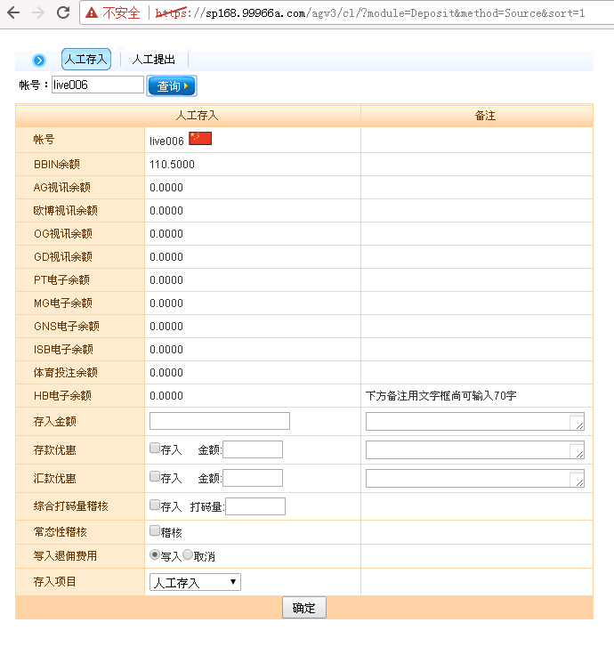
登入後，添加網址
https://sp168.99966a.com/agv3/cl/?module=Deposit&method=Source&sort=1

Slide 26
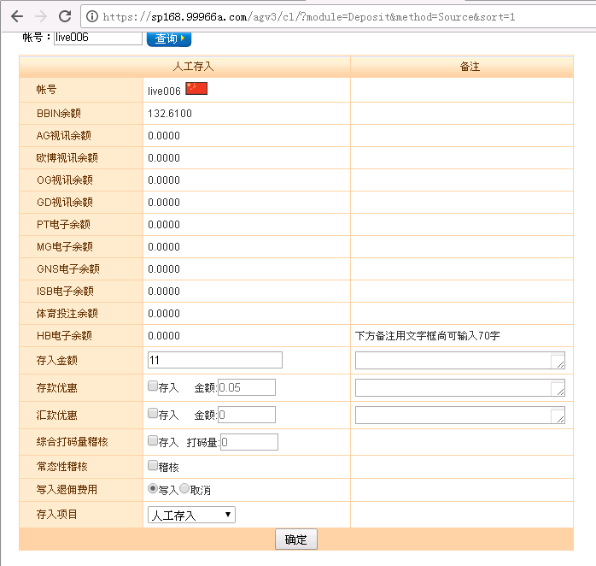
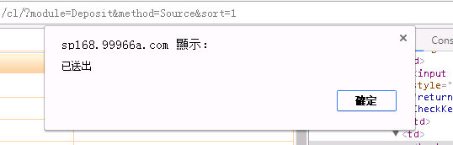
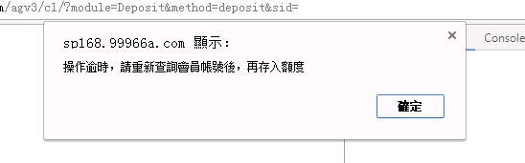
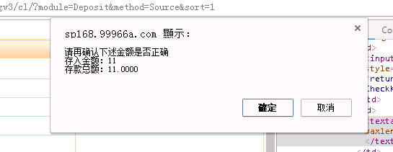
存入金额amount
存款优惠SpAmount
汇款优惠AbAmount
综合打码量稽核complex
下方备注用文字框尚可输入70字amount_memo

Slide 27
POST https://sp168.99966a.com/agv3/cl/?module=Deposit&method=deposit&sid= HTTP/1.1
Host: sp168.99966a.com
Connection: keep-alive
Content-Length: 275
Cache-Control: max-age=0
Origin: https://sp168.99966a.com
Upgrade-Insecure-Requests: 1
User-Agent: Mozilla/5.0 (Windows NT 6.1; Win64; x64) AppleWebKit/537.36 (KHTML, like Gecko) Chrome/60.0.3112.113 Safari/537.36
Content-Type: application/x-www-form-urlencoded
Accept: text/html,application/xhtml+xml,application/xml;q=0.9,image/webp,image/apng,*/*;q=0.8
Referer: https://sp168.99966a.com/agv3/cl/?module=Deposit&method=Source&sort=1
Accept-Encoding: gzip, deflate, br
Accept-Language: zh-TW,zh;q=0.8,en-US;q=0.6,en;q=0.4
Cookie: T0_IPL_AVRbbbbbbbbbbbbbbbb=BHMGNHMCNNNPKCIDFLBHNBGIEJLGIGFLEKEKJLEIEHDFNOJNDDIEJAGFMPPJHNBOODMDAMDNFFBKNLLOGJGAOLHCGOFLLBFJPKBJFFBKMEPJCIMKCBBMCHCOGBHOPJLE; langx=zh-cn; langcode=zh-cn; sid=bf28e3dfc270a1f81160aade82e6eec795457053; rd3_host=http%3A%2F%2Fsp168.99966a.com; PHPSESSID=t55gmbh6cbps6igdcjiov66o64; aglvl=bf28e3dfc270a1f81160aade82e6eec7954570h3; T0_IPL_AVRbbbbbbbbbbbbbbbb=ICAEBGAMAMHKEOBHNHGCEEEBILBGGGOPFDJMHPGCOCOKNFLILMHILCJNPHNICHAPCNEDJIBJGFOAHKNFCBDADGELGOONPOECHJIOJOBHAPBOFMMMMPAHCJFCBCLDKLAD; lang=zh-cn
user_id=287820135&hallid=3819829&CHK_ID=948c8772f9aa1e4981602370f86bef34&user_name=live006&date=2017-09-29+02%3A34%3A41+PM&Currency=RMB&abamount_limit=0&amount=11&amount_memo=&SpAmount=0.05&SpAmount_memo=&AbAmount=0&AbAmount_memo=&complex=0&CommissionCheck=Y&DepositItem=ARD1
HTTP/1.1 200 OK
Date: Fri, 29 Sep 2017 06:41:11 GMT
Expires: Thu, 19 Nov 1981 08:52:00 GMT
Cache-Control: no-store, no-cache, must-revalidate, post-check=0, pre-check=0
Pragma: no-cache
Set-Cookie: lang=zh-cn; path=/
Set-Cookie: aid=deleted; expires=Thu, 01-Jan-1970 00:00:01 GMT; Max-Age=0; path=/
Content-Length: 297
Keep-Alive: timeout=5, max=100
Connection: Keep-Alive
Content-Type: text/html; charset=utf-8
Server: Apache
x-a: E242x162
<meta http-equiv="Content-Type" content="text/html; charset=UTF-8"><script>
alert('操作逾時，請重新查詢會員帳號後，再存入額度')
</script>
<script type="text/javascript">
self.location.href = " /agv3/cl/?module=Deposit&method=Source&sort=1";
</script>

Slide 28
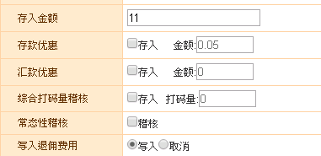
成功
POST https://sp168.99966a.com/agv3/cl/?module=Deposit&method=deposit&sid= HTTP/1.1
Host: sp168.99966a.com
Connection: keep-alive
Content-Length: 279
Cache-Control: max-age=0
Origin: https://sp168.99966a.com
Upgrade-Insecure-Requests: 1
User-Agent: Mozilla/5.0 (Windows NT 6.1; Win64; x64) AppleWebKit/537.36 (KHTML, like Gecko) Chrome/60.0.3112.113 Safari/537.36
Content-Type: application/x-www-form-urlencoded
Accept: text/html,application/xhtml+xml,application/xml;q=0.9,image/webp,image/apng,*/*;q=0.8
Referer: https://sp168.99966a.com/agv3/cl/?module=Deposit&method=Source&sort=1
Accept-Encoding: gzip, deflate, br
Accept-Language: zh-TW,zh;q=0.8,en-US;q=0.6,en;q=0.4
Cookie: T0_IPL_AVRbbbbbbbbbbbbbbbb=BHMGNHMCNNNPKCIDFLBHNBGIEJLGIGFLEKEKJLEIEHDFNOJNDDIEJAGFMPPJHNBOODMDAMDNFFBKNLLOGJGAOLHCGOFLLBFJPKBJFFBKMEPJCIMKCBBMCHCOGBHOPJLE; langx=zh-cn; langcode=zh-cn; sid=bf28e3dfc270a1f81160aade82e6eec795457053; rd3_host=http%3A%2F%2Fsp168.99966a.com; PHPSESSID=t55gmbh6cbps6igdcjiov66o64; aglvl=bf28e3dfc270a1f81160aade82e6eec7954570h3; T0_IPL_AVRbbbbbbbbbbbbbbbb=ICAEBGAMAMHKEOBHNHGCEEEBILBGGGOPFDJMHPGCOCOKNFLILMHILCJNPHNICHAPCNEDJIBJGFOAHKNFCBDADGELGOONPOECHJIOJOBHAPBOFMMMMPAHCJFCBCLDKLAD; lang=zh-cn
user_id=287820135&hallid=3819829&CHK_ID=29c2df6e80476485807eed750984377b&user_name=live006&date=2017-09-29+02%3A45%3A22+PM&Currency=RMB&abamount_limit=0&amount=11&amount_memo=test&SpAmount=0.05&SpAmount_memo=&AbAmount=0&AbAmount_memo=&complex=0&CommissionCheck=Y&DepositItem=ARD1
HTTP/1.1 200 OK
Date: Fri, 29 Sep 2017 06:45:42 GMT
Expires: Thu, 19 Nov 1981 08:52:00 GMT
Cache-Control: no-store, no-cache, must-revalidate, post-check=0, pre-check=0
Pragma: no-cache
Set-Cookie: lang=zh-cn; path=/
Set-Cookie: aid=deleted; expires=Thu, 01-Jan-1970 00:00:01 GMT; Max-Age=0; path=/
Content-Length: 136
Keep-Alive: timeout=5, max=100
Connection: Keep-Alive
Content-Type: text/html; charset=utf-8
Server: Apache
x-a: K247X162
<script type="text/javascript">
self.location.href = " /agv3/cl/?module=Deposit&method=Source&sort=1";
</script>

Slide 29
成功
POST https://sp168.99966a.com/agv3/cl/?module=Deposit&method=deposit&sid= HTTP/1.1
Host: sp168.99966a.com
Connection: keep-alive
Content-Length: 279
Cache-Control: max-age=0
Origin: https://sp168.99966a.com
Upgrade-Insecure-Requests: 1
User-Agent: Mozilla/5.0 (Windows NT 6.1; Win64; x64) AppleWebKit/537.36 (KHTML, like Gecko) Chrome/60.0.3112.113 Safari/537.36
Content-Type: application/x-www-form-urlencoded
Accept: text/html,application/xhtml+xml,application/xml;q=0.9,image/webp,image/apng,*/*;q=0.8
Referer: https://sp168.99966a.com/agv3/cl/?module=Deposit&method=Source&sort=1
Accept-Encoding: gzip, deflate, br
Accept-Language: zh-TW,zh;q=0.8,en-US;q=0.6,en;q=0.4
Cookie: T0_IPL_AVRbbbbbbbbbbbbbbbb=BHMGNHMCNNNPKCIDFLBHNBGIEJLGIGFLEKEKJLEIEHDFNOJNDDIEJAGFMPPJHNBOODMDAMDNFFBKNLLOGJGAOLHCGOFLLBFJPKBJFFBKMEPJCIMKCBBMCHCOGBHOPJLE; langx=zh-cn; langcode=zh-cn; sid=bf28e3dfc270a1f81160aade82e6eec795457053; rd3_host=http%3A%2F%2Fsp168.99966a.com; PHPSESSID=t55gmbh6cbps6igdcjiov66o64; aglvl=bf28e3dfc270a1f81160aade82e6eec7954570h3; T0_IPL_AVRbbbbbbbbbbbbbbbb=ICAEBGAMAMHKEOBHNHGCEEEBILBGGGOPFDJMHPGCOCOKNFLILMHILCJNPHNICHAPCNEDJIBJGFOAHKNFCBDADGELGOONPOECHJIOJOBHAPBOFMMMMPAHCJFCBCLDKLAD; lang=zh-cn
user_id=287820135&hallid=3819829&CHK_ID=a29e1dc5f4b621ecb091c00401413bb9&user_name=live006&date=2017-09-29+02%3A46%3A24+PM&Currency=RMB&abamount_limit=0&amount=11&amount_memo=test&SpAmount=0.05&SpAmount_memo=&AbAmount=0&AbAmount_memo=&complex=0&CommissionCheck=Y&DepositItem=ARD1
HTTP/1.1 200 OK
Date: Fri, 29 Sep 2017 06:46:50 GMT
Expires: Thu, 19 Nov 1981 08:52:00 GMT
Cache-Control: no-store, no-cache, must-revalidate, post-check=0, pre-check=0
Pragma: no-cache
Set-Cookie: lang=zh-cn; path=/
Set-Cookie: aid=deleted; expires=Thu, 01-Jan-1970 00:00:01 GMT; Max-Age=0; path=/
Content-Length: 136
Keep-Alive: timeout=5, max=100
Connection: Keep-Alive
Content-Type: text/html; charset=utf-8
Server: Apache
x-a: x243A162
<script type="text/javascript">
self.location.href = " /agv3/cl/?module=Deposit&method=Source&sort=1";
</script>

Slide 30
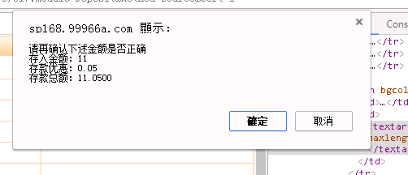
成功
HTTP/1.1 200 OK
Date: Fri, 29 Sep 2017 06:54:20 GMT
Expires: Thu, 19 Nov 1981 08:52:00 GMT
Cache-Control: no-store, no-cache, must-revalidate, post-check=0, pre-check=0
Pragma: no-cache
Set-Cookie: lang=zh-cn; path=/
Set-Cookie: aid=deleted; expires=Thu, 01-Jan-1970 00:00:01 GMT; Max-Age=0; path=/
Content-Length: 136
Keep-Alive: timeout=5, max=100
Connection: Keep-Alive
Content-Type: text/html; charset=utf-8
Server: Apache
x-a: O245i162
<script type="text/javascript">
self.location.href = " /agv3/cl/?module=Deposit&method=Source&sort=1";
</script>
POST https://sp168.99966a.com/agv3/cl/?module=Deposit&method=query&sid= HTTP/1.1
Host: sp168.99966a.com
Connection: keep-alive
Content-Length: 19
Accept: application/json, text/javascript, */*; q=0.01
Origin: https://sp168.99966a.com
X-Requested-With: XMLHttpRequest
User-Agent: Mozilla/5.0 (Windows NT 6.1; Win64; x64) AppleWebKit/537.36 (KHTML, like Gecko) Chrome/60.0.3112.113 Safari/537.36
Content-Type: application/x-www-form-urlencoded; charset=UTF-8
Referer: https://sp168.99966a.com/agv3/cl/?module=Deposit&method=Source&sort=1
Accept-Encoding: gzip, deflate, br
Accept-Language: zh-TW,zh;q=0.8,en-US;q=0.6,en;q=0.4
Cookie: T0_IPL_AVRbbbbbbbbbbbbbbbb=BHMGNHMCNNNPKCIDFLBHNBGIEJLGIGFLEKEKJLEIEHDFNOJNDDIEJAGFMPPJHNBOODMDAMDNFFBKNLLOGJGAOLHCGOFLLBFJPKBJFFBKMEPJCIMKCBBMCHCOGBHOPJLE; langx=zh-cn; langcode=zh-cn; sid=bf28e3dfc270a1f81160aade82e6eec795457053; rd3_host=http%3A%2F%2Fsp168.99966a.com; PHPSESSID=t55gmbh6cbps6igdcjiov66o64; aglvl=bf28e3dfc270a1f81160aade82e6eec7954570h3; T0_IPL_AVRbbbbbbbbbbbbbbbb=ICAEBGAMAMHKEOBHNHGCEEEBILBGGGOPFDJMHPGCOCOKNFLILMHILCJNPHNICHAPCNEDJIBJGFOAHKNFCBDADGELGOONPOECHJIOJOBHAPBOFMMMMPAHCJFCBCLDKLAD; lang=zh-cn
search_name=live006

Slide 31
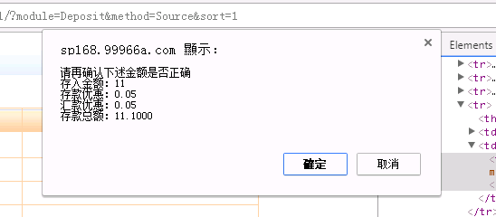
POST https://sp168.99966a.com/agv3/cl/?module=Deposit&method=deposit&sid= HTTP/1.1
Host: sp168.99966a.com
Connection: keep-alive
Content-Length: 321
Cache-Control: max-age=0
Origin: https://sp168.99966a.com
Upgrade-Insecure-Requests: 1
User-Agent: Mozilla/5.0 (Windows NT 6.1; Win64; x64) AppleWebKit/537.36 (KHTML, like Gecko) Chrome/60.0.3112.113 Safari/537.36
Content-Type: application/x-www-form-urlencoded
Accept: text/html,application/xhtml+xml,application/xml;q=0.9,image/webp,image/apng,*/*;q=0.8
Referer: https://sp168.99966a.com/agv3/cl/?module=Deposit&method=Source&sort=1
Accept-Encoding: gzip, deflate, br
Accept-Language: zh-TW,zh;q=0.8,en-US;q=0.6,en;q=0.4
Cookie: T0_IPL_AVRbbbbbbbbbbbbbbbb=LOBBODOBNHGFHGKDHACMJPHOOBMLEGOKCNDDKPBGJILEDFOLCCDBJHFCMKABCAMBIHKDANONABPFAECEKCBANJELAPLKLKFMKCAECBKLJGPNLNCPINLCFAEBKFCMFPLB; langx=zh-cn; langcode=zh-cn; sid=bf28e3dfc270a1f81160aade82e6eec795457053; rd3_host=http%3A%2F%2Fsp168.99966a.com; PHPSESSID=t55gmbh6cbps6igdcjiov66o64; aglvl=bf28e3dfc270a1f81160aade82e6eec7954570h3; T0_IPL_AVRbbbbbbbbbbbbbbbb=ICAEBGAMAMHKEOBHNHGCEEEBILBGGGOPFDJMHPGCOCOKNFLILMHILCJNPHNICHAPCNEDJIBJGFOAHKNFCBDADGELGOONPOECHJIOJOBHAPBOFMMMMPAHCJFCBCLDKLAD; lang=zh-cn
user_id=287820135&hallid=3819829&CHK_ID=7b224a5cd2c8ab8d6e418d801d4a3937&user_name=live006&date=2017-09-29+03%3A14%3A14+PM&Currency=RMB&abamount_limit=0&amount=11&amount_memo=&SpCheck=1&SpAmount=0.05&SpAmount_memo=&AbCheck=1&AbAmount=0.05&AbAmount_memo=&ComplexAuditCheck=1&complex=0.05&CommissionCheck=Y&DepositItem=ARD1
HTTP/1.1 200 OK
Date: Fri, 29 Sep 2017 07:15:20 GMT
Expires: Thu, 19 Nov 1981 08:52:00 GMT
Cache-Control: no-store, no-cache, must-revalidate, post-check=0, pre-check=0
Pragma: no-cache
Set-Cookie: lang=zh-cn; path=/
Set-Cookie: aid=deleted; expires=Thu, 01-Jan-1970 00:00:01 GMT; Max-Age=0; path=/
Content-Length: 263
Keep-Alive: timeout=5, max=100
Connection: Keep-Alive
Content-Type: text/html; charset=utf-8
Server: Apache
x-a: a244g162
Set-Cookie: T0_IPL_AVRbbbbbbbbbbbbbbbb=CGGKJIMMLAFCEFOMMBENIHMOHPHEPPLLOHKHFLOGLAEAMKLGOMDBGIDHLPLGKOBINNFDPFNKGBBDHBLMHPDABGPJEPBBHGMACANHMLNHLBHIMCKCGEGMMKDIJPOENALK; HttpOnly
<meta http-equiv="Content-Type" content="text/html; charset=UTF-8"><script>
alert('汇款优惠存入金额:0.05')
</script>
<script type="text/javascript">
self.location.href = " /agv3/cl/?module=Deposit&method=Source&sort=1";
</script>

Slide 32
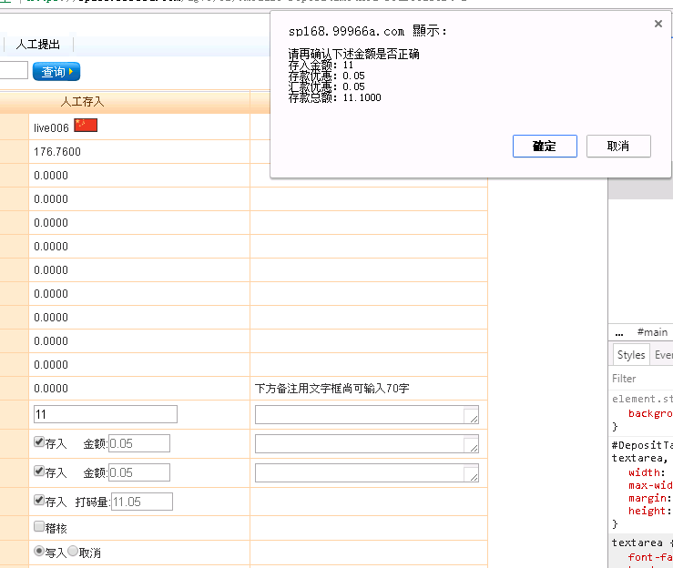
HTTP/1.1 200 OK
Date: Fri, 29 Sep 2017 07:19:31 GMT
Expires: Thu, 19 Nov 1981 08:52:00 GMT
Cache-Control: no-store, no-cache, must-revalidate, post-check=0, pre-check=0
Pragma: no-cache
Set-Cookie: lang=zh-cn; path=/
Set-Cookie: aid=deleted; expires=Thu, 01-Jan-1970 00:00:01 GMT; Max-Age=0; path=/
Content-Length: 263
Keep-Alive: timeout=5, max=100
Connection: Keep-Alive
Content-Type: text/html; charset=utf-8
Server: Apache
x-a: U250Y162
Set-Cookie: T0_IPL_AVRbbbbbbbbbbbbbbbb=BAACKHIMLKFGDNFLHDGMMLPHGMKKNMBKEOICLODOEODBJNECHPNPCLKINNAKKAOIOBEDOFNJBCCKLPDMEOEAMJHDEPBGPABDCHHOFKMKIPLBMPAPPLFBHPKENKOILMCN; HttpOnly
<meta http-equiv="Content-Type" content="text/html; charset=UTF-8"><script>
alert('汇款优惠存入金额:0.05')
</script>
<script type="text/javascript">
self.location.href = " /agv3/cl/?module=Deposit&method=Source&sort=1";
</script>
POST https://sp168.99966a.com/agv3/cl/?module=Deposit&method=deposit&sid= HTTP/1.1
Host: sp168.99966a.com
Connection: keep-alive
Content-Length: 322
Cache-Control: max-age=0
Origin: https://sp168.99966a.com
Upgrade-Insecure-Requests: 1
User-Agent: Mozilla/5.0 (Windows NT 6.1; Win64; x64) AppleWebKit/537.36 (KHTML, like Gecko) Chrome/60.0.3112.113 Safari/537.36
Content-Type: application/x-www-form-urlencoded
Accept: text/html,application/xhtml+xml,application/xml;q=0.9,image/webp,image/apng,*/*;q=0.8
Referer: https://sp168.99966a.com/agv3/cl/?module=Deposit&method=Source&sort=1
Accept-Encoding: gzip, deflate, br
Accept-Language: zh-TW,zh;q=0.8,en-US;q=0.6,en;q=0.4
Cookie: T0_IPL_AVRbbbbbbbbbbbbbbbb=FBEGBKHNPKEBAIILOFJGGPFIKCDHBGOBKMAOKJFGFHFEIFJOJEADOFLNDMKLNGHHBDNDDIEDNCJKHHCDJGAAAIGLAPOJNPBMJPJDJOKOGPCOFLBCFNNEDIBGFLCCCJKA; langx=zh-cn; langcode=zh-cn; sid=bf28e3dfc270a1f81160aade82e6eec795457053; rd3_host=http%3A%2F%2Fsp168.99966a.com; PHPSESSID=t55gmbh6cbps6igdcjiov66o64; aglvl=bf28e3dfc270a1f81160aade82e6eec7954570h3; T0_IPL_AVRbbbbbbbbbbbbbbbb=ICAEBGAMAMHKEOBHNHGCEEEBILBGGGOPFDJMHPGCOCOKNFLILMHILCJNPHNICHAPCNEDJIBJGFOAHKNFCBDADGELGOONPOECHJIOJOBHAPBOFMMMMPAHCJFCBCLDKLAD; lang=zh-cn
user_id=287820135&hallid=3819829&CHK_ID=c5afe5def19e71083ddfdf921c70e12a&user_name=live006&date=2017-09-29+03%3A18%3A42+PM&Currency=RMB&abamount_limit=0&amount=11&amount_memo=&SpCheck=1&SpAmount=0.05&SpAmount_memo=&AbCheck=1&AbAmount=0.05&AbAmount_memo=&ComplexAuditCheck=1&complex=11.05&CommissionCheck=Y&DepositItem=ARD1

Slide 33
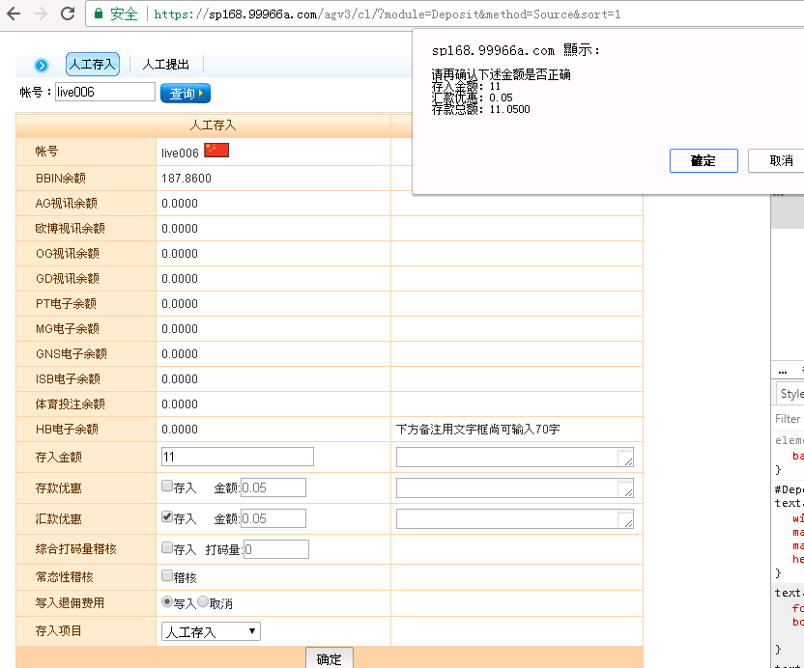
POST https://sp168.99966a.com/agv3/cl/?module=Deposit&method=deposit&sid= HTTP/1.1
Host: sp168.99966a.com
Connection: keep-alive
Content-Length: 288
Cache-Control: max-age=0
Origin: https://sp168.99966a.com
Upgrade-Insecure-Requests: 1
User-Agent: Mozilla/5.0 (Windows NT 6.1; Win64; x64) AppleWebKit/537.36 (KHTML, like Gecko) Chrome/60.0.3112.113 Safari/537.36
Content-Type: application/x-www-form-urlencoded
Accept: text/html,application/xhtml+xml,application/xml;q=0.9,image/webp,image/apng,*/*;q=0.8
Referer: https://sp168.99966a.com/agv3/cl/?module=Deposit&method=Source&sort=1
Accept-Encoding: gzip, deflate, br
Accept-Language: zh-TW,zh;q=0.8,en-US;q=0.6,en;q=0.4
Cookie: T0_IPL_AVRbbbbbbbbbbbbbbbb=PINKNJAGNGCIEELJGPGBDLMIAIMCJKNNIEDHGHPDBNCFDPCBKFNPDECINECMLPPMFCNDFELDIDGHAKKDFBIAPHFAEPONNPKDKLCBCBEDOHICGLBAFDGJIJBFNDBJDAGL; langx=zh-cn; langcode=zh-cn; sid=bf28e3dfc270a1f81160aade82e6eec795457053; rd3_host=http%3A%2F%2Fsp168.99966a.com; PHPSESSID=t55gmbh6cbps6igdcjiov66o64; aglvl=bf28e3dfc270a1f81160aade82e6eec7954570h3; T0_IPL_AVRbbbbbbbbbbbbbbbb=ICAEBGAMAMHKEOBHNHGCEEEBILBGGGOPFDJMHPGCOCOKNFLILMHILCJNPHNICHAPCNEDJIBJGFOAHKNFCBDADGELGOONPOECHJIOJOBHAPBOFMMMMPAHCJFCBCLDKLAD; lang=zh-cn
user_id=287820135&hallid=3819829&CHK_ID=0efe39e68d666708b7f29db816636f4d&user_name=live006&date=2017-09-29+03%3A23%3A58+PM&Currency=RMB&abamount_limit=0&amount=11&amount_memo=&SpAmount=0.05&SpAmount_memo=&AbCheck=1&AbAmount=0.05&AbAmount_memo=&complex=0&CommissionCheck=Y&DepositItem=ARD1
HTTP/1.1 200 OK
Date: Fri, 29 Sep 2017 07:24:34 GMT
Expires: Thu, 19 Nov 1981 08:52:00 GMT
Cache-Control: no-store, no-cache, must-revalidate, post-check=0, pre-check=0
Pragma: no-cache
Set-Cookie: lang=zh-cn; path=/
Set-Cookie: aid=deleted; expires=Thu, 01-Jan-1970 00:00:01 GMT; Max-Age=0; path=/
Content-Length: 263
Keep-Alive: timeout=5, max=100
Connection: Keep-Alive
Content-Type: text/html; charset=utf-8
Server: Apache
x-a: M245C162
Set-Cookie: T0_IPL_AVRbbbbbbbbbbbbbbbb=KLDPNJJFNPICHHCIJAOFBANPCIMPONDJGEHMJMODFEJIADCCMLGLEGJJNFIJKIEMELEDPBIMADDOCMCHKIKANFNAHPDJEMJGFGKOCICIMLANOCFGOMPCDJMAOEKIMOPD; HttpOnly
<meta http-equiv="Content-Type" content="text/html; charset=UTF-8"><script>
alert('汇款优惠存入金额:0.05')
</script>
<script type="text/javascript">
self.location.href = " /agv3/cl/?module=Deposit&method=Source&sort=1";
</script>

Slide 34
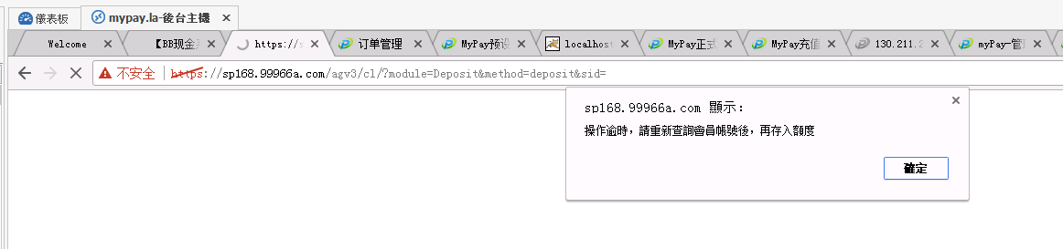
操作逾時，

Slide 35
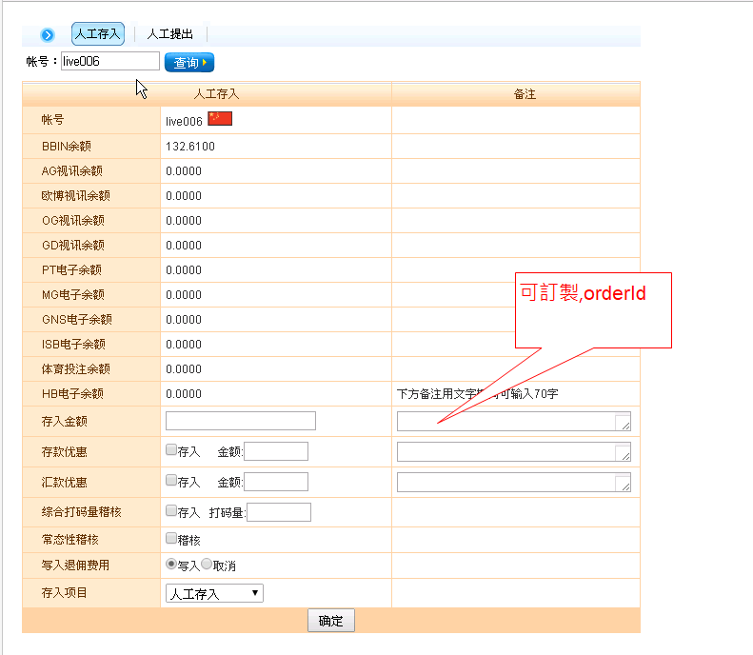

Slide 36
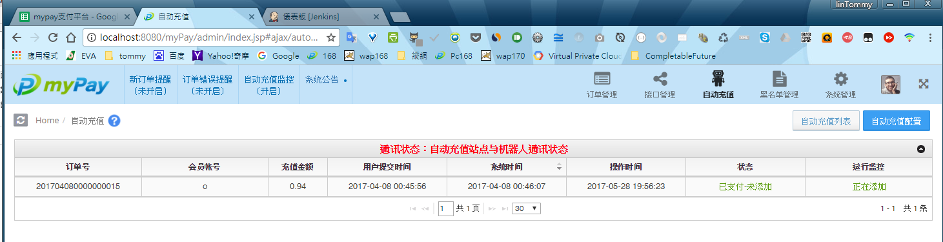
SELECT *
FROM PY_ORDER
WHERE ROBOT_PROCESS_STATUS = '1'
AND STATUS = '2'
ORDER BY CREATE_DATE DESC
2.鎖定訂單.updateOrderLock
3.修改訂單狀態.updateOrderStatus
4.解鎖訂單.updateOrderUnlock
抓Status = 1 2
参考：MyPayApi.java MyPayApiTest.java

Slide 37
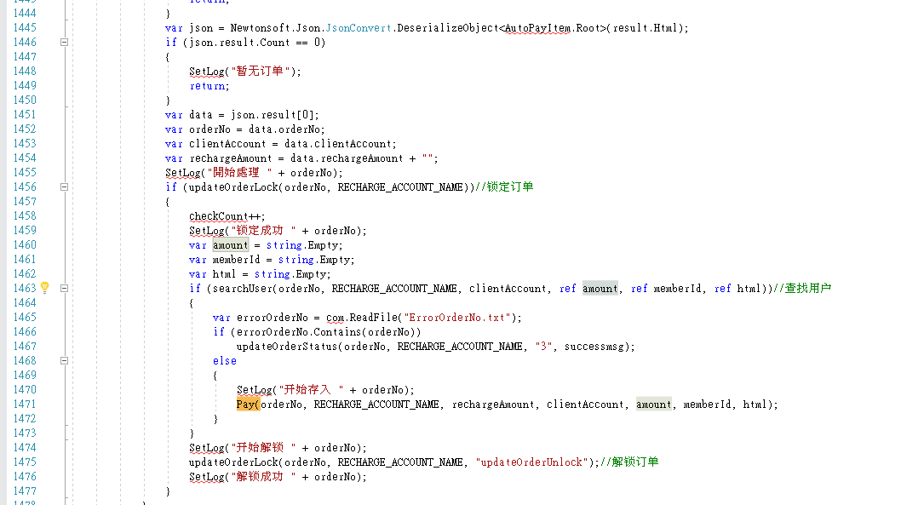

Slide 38
