Slide 1
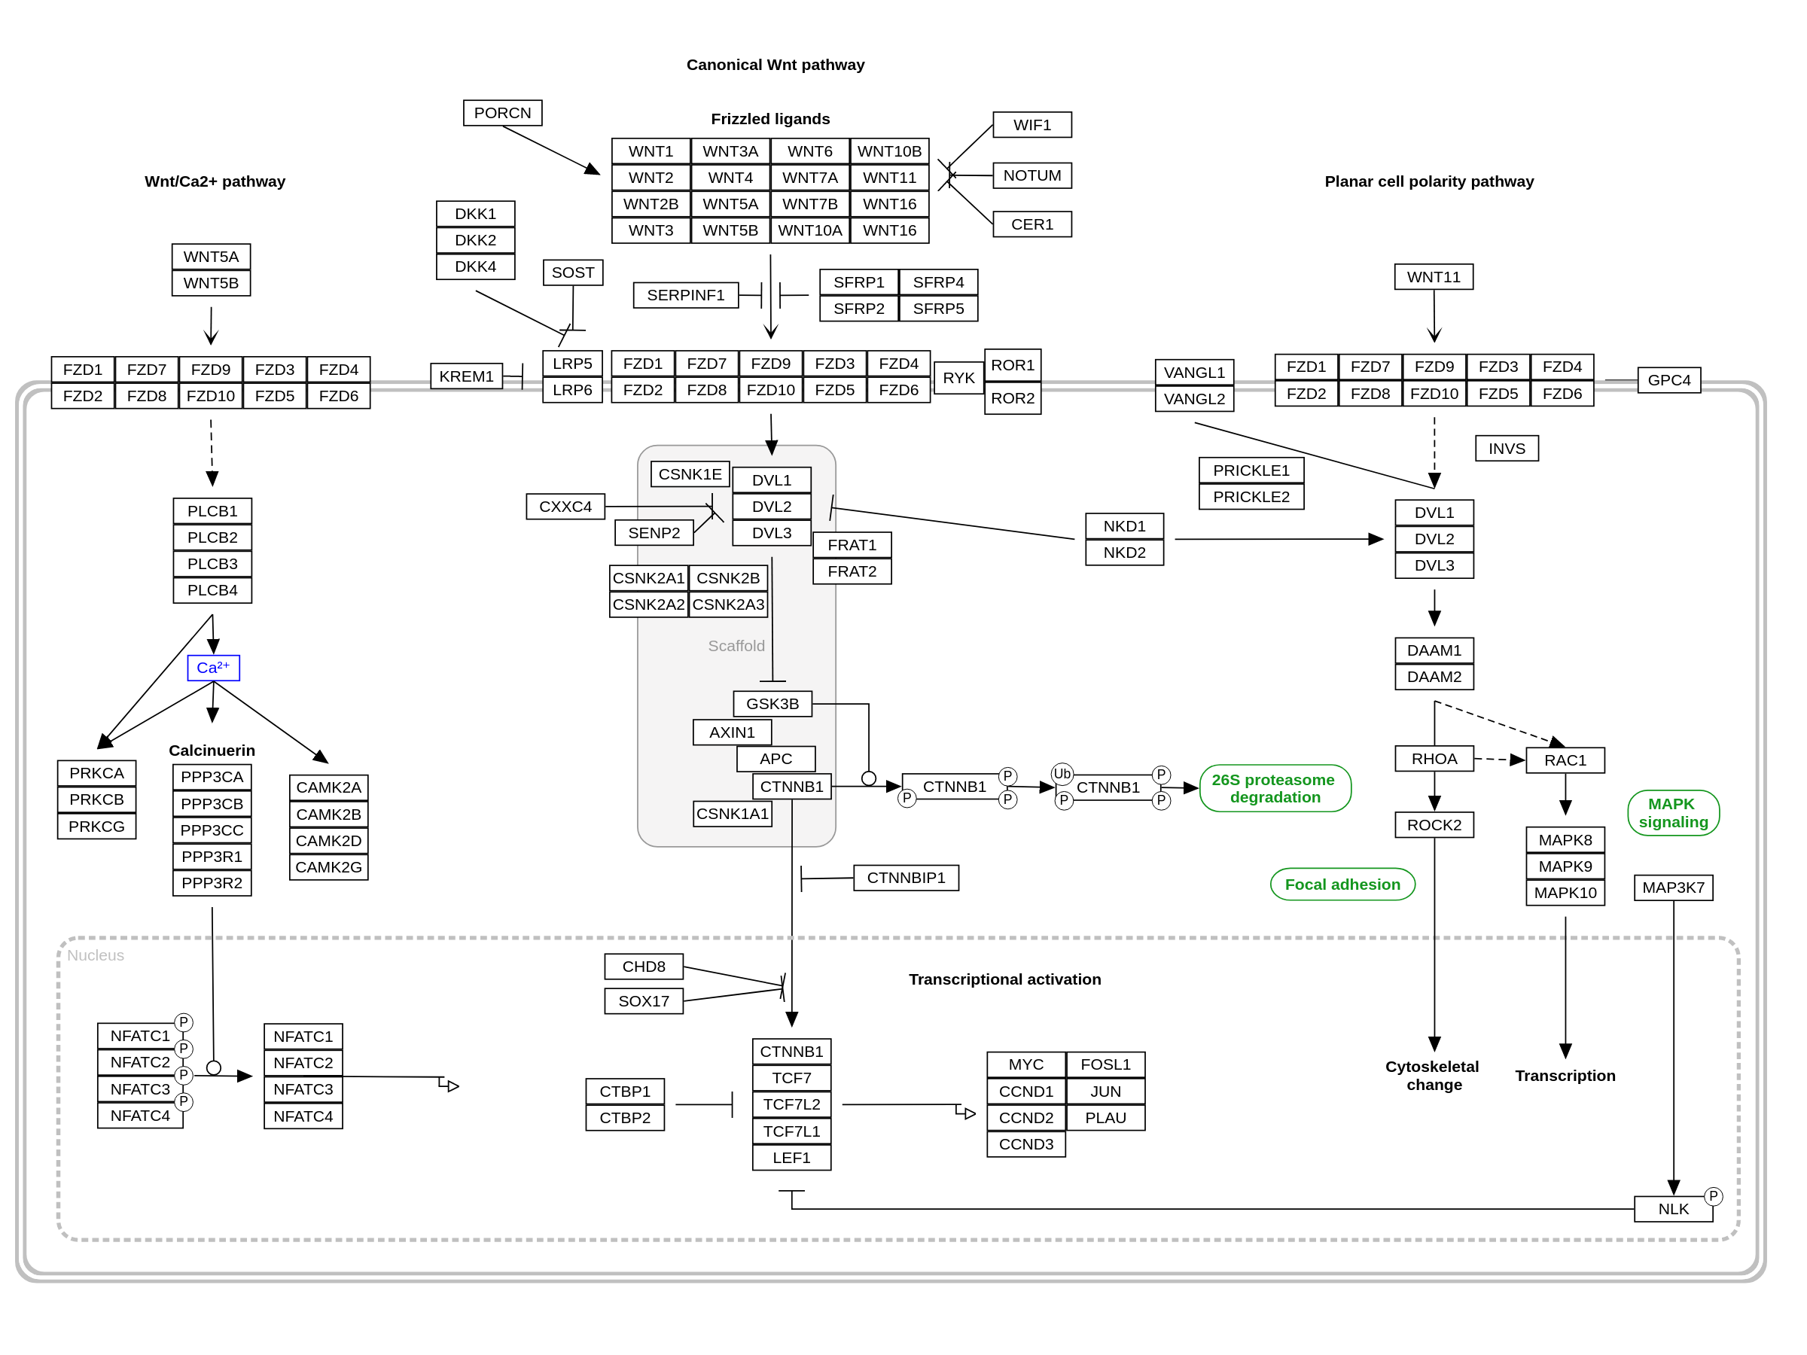
WP428 | Homo sapiens | WikiPathways CC0
Static reference image; teaching counts do not recolor this diagram.

