Slide 1
BabyBus Money+
The Utilization of ScalarDB on Bank Transaction System
Team: BabyBus
Member: Junjie GAO
Shengze WANG
Xiang MENG
Danyuan YU
Jingyu Liu

Slide 2
System Overview -1/1-
BabyBus Money+
Application: Personal Asset Management Platform
Users can use the platform to manipulate their bank account funds
The GUI of the platform is very simple and user-friendly
The platform has two databases that store user ID information and asset information respectively
User ID information: My SQL
Transaction-related information: Postgre SQL

Slide 3
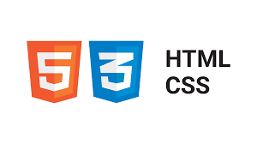

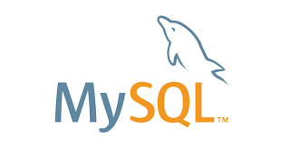

System Composition -1/1-
Webpage
API
Database
User ID DB
BabyBus Money+ Platform
Transaction DB

Slide 4
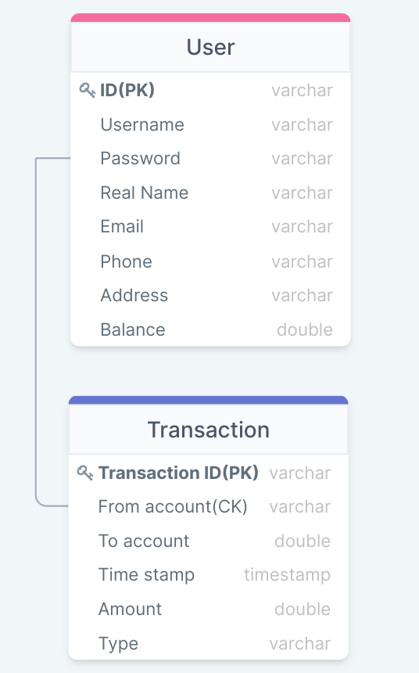
ER Diagram -1/1-
User ID DB
Transaction DB
PK: Partition Key
CK: Clustering Key

Slide 5
Motivation -1/1-
Economic development drives the need for simple and convenient asset management systems
Safe, Fast, Good GUI are needed
ScalarDB can work on many popular databases
Merits:
Universal
Non-invasive - no modifications to the underlying databases
Flexible Scalability - Transaction layer and storage layer can be independently scaled

Slide 6
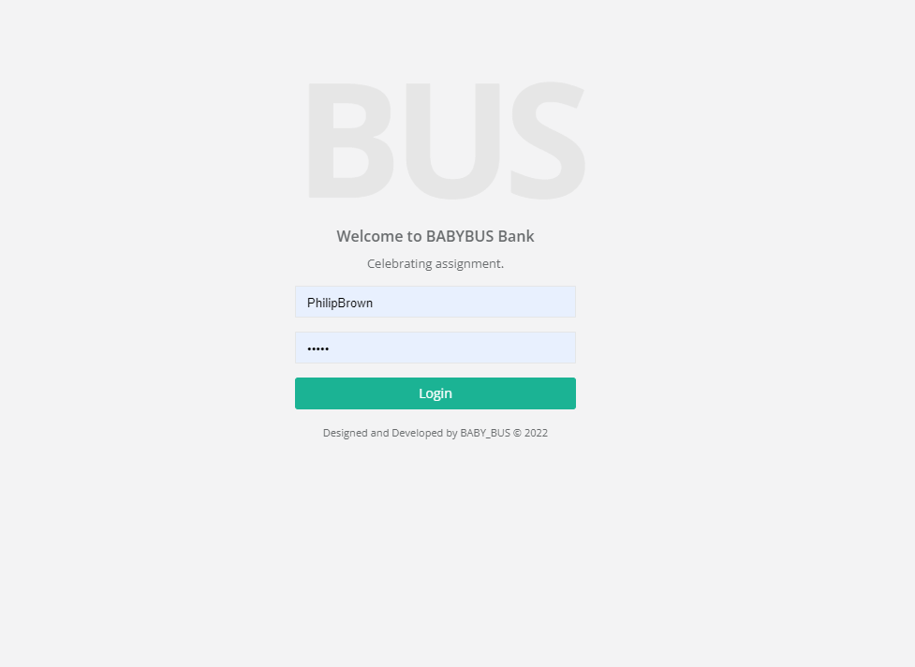
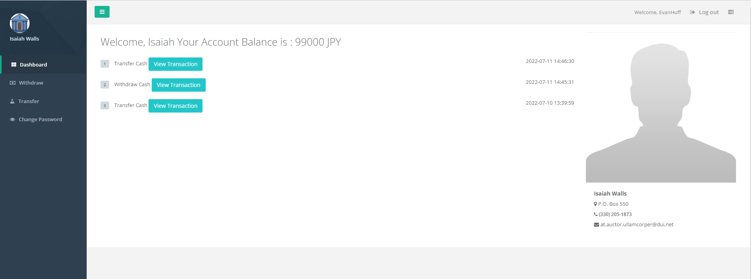
Platform Demo -1/1-
Login interface
User information interface

Slide 7
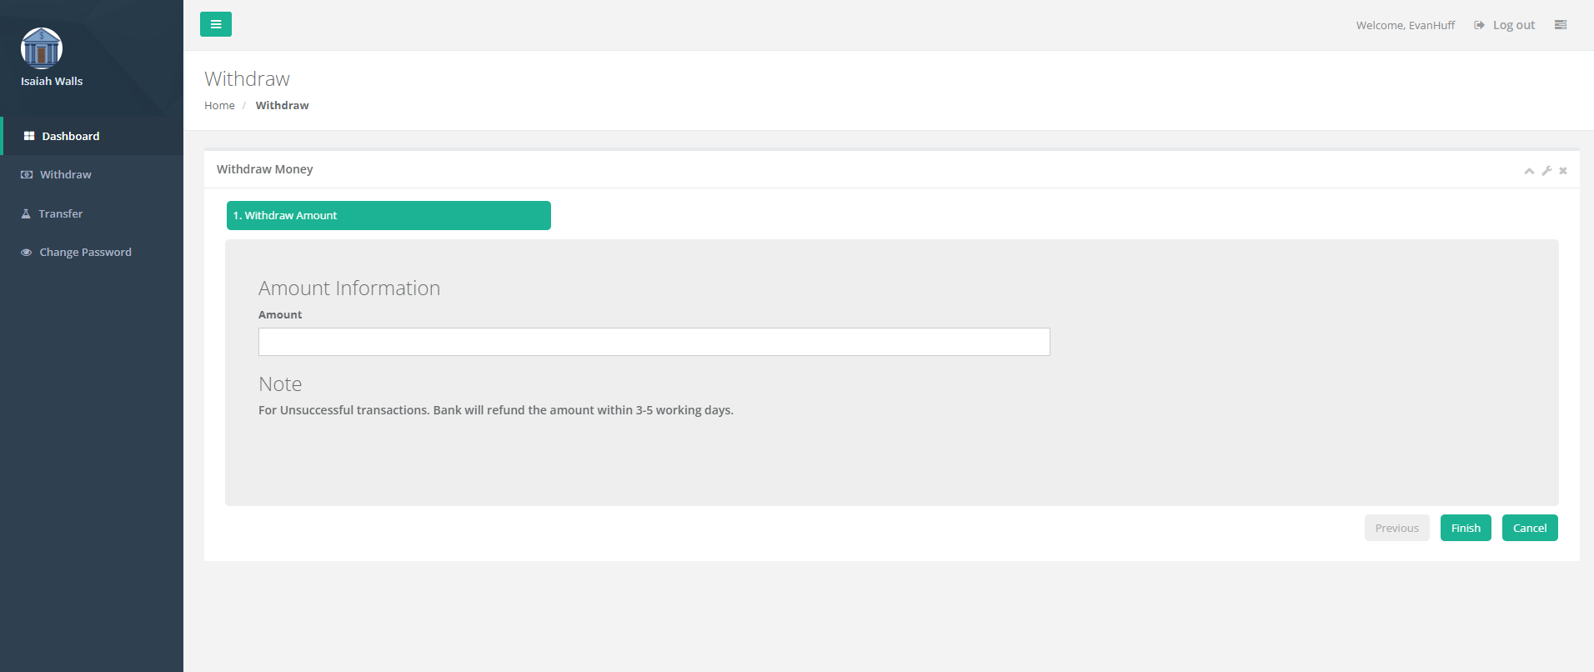
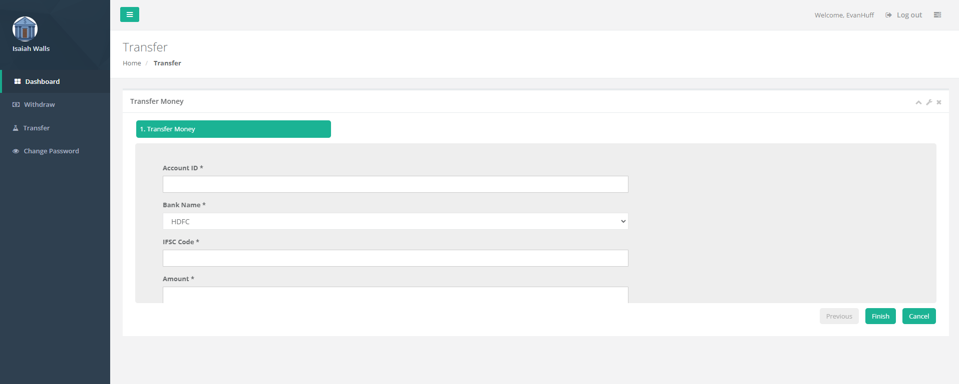
Functions -1/3-
Withdraw and transfer
Users can enter any amount on the proposed platform to withdraw and transfer assets to others
Withdraw
Transfer

Slide 8
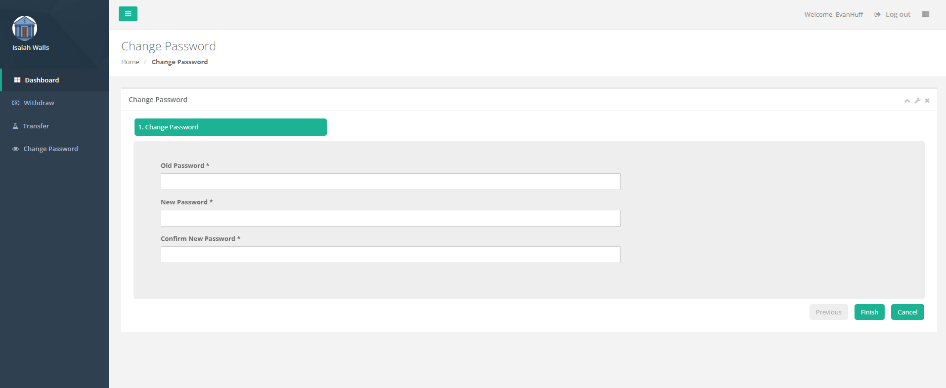
Functions -2/3-
Password change
Users can easily change their account passwords
Password change

Slide 9
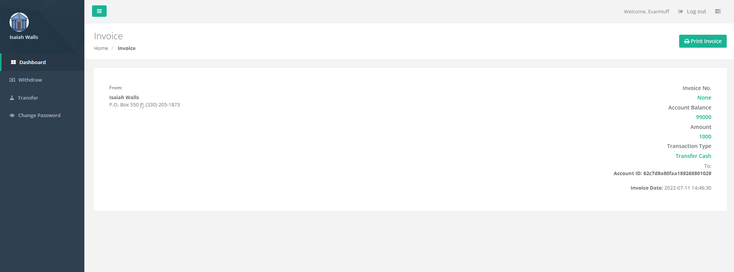
Functions -3/3-
Real-time transaction records
Users can check their transfer transactions at any time, and the platform records detailed personal information of both parties to the transaction as well as the amount

Slide 10
Demonstration -1/1-
Show sign-in of two accounts
Show our GUI of the platform
Show functions of the platform: withdraw, transfer, password change, transaction records
Check the effectiveness of the system

Slide 11
Thank you for your attention!

