Slide 1
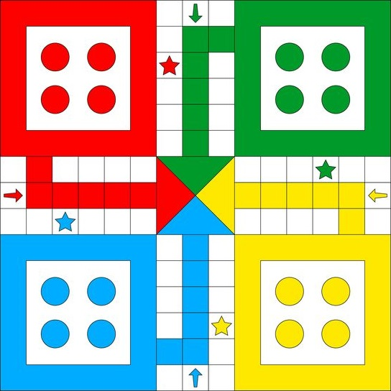
PLAYER 4
PLAYER 2
PLAYER 1
PLAYER 3

Slide 2
(x)
(x, y)
(0,0)
PLAYER 4
(6,0)
(7,0)
(8,0)
PLAYER 2
Home Position
(6,1)
(7,1)
(8,1)
Safe
Cell
Home Position
(2,2)
(3,2)
Safe
Cell
(6,2)
(7,2)
(8,2)
(11,2)
(12,2)
(2,3)
(3,3)
(6,3)
(7,3)
(8,3)
(11,3)
(12,3)
(6,4)
(7,4)
(8,4)
Safe
Cell
(6,5)
(7,5)
(8,5)
Safe
Cell
(0,6)
(1,6)
(2,6)
(3,6)
(4,6)
(5,6)
(7,6)
(9,6)
(10,6)
(11,6)
(12,6)
(13,6)
(14,6)
(y)
(0,7)
(1,7)
(2,7)
(3,7)
(4,7)
(5,7)
(6,7)
Final
Cell
(8,7)
(9,7)
(10,7)
(11,7)
(12,7)
(13,7)
(14,7)
(0,8)
(1,8)
(2,8)
(3,8)
(4,8)
(5,8)
(7,8)
(9,8)
(10,8)
(11,8)
(12,8)
(13,8)
(14,8)
Safe
Cell
(6,9)
(7,9)
(8,9)
Safe
Cell
Home Position
(6,10)
(7,10)
(8,10)
Home Position
(2,11)
(3,11)
(6,11)
(7,11)
(8,12)
(11,11)
(12,11)
(2,12)
(3,12)
(6,12)
(7,12)
(8,12)
Safe
Cell
(11,12)
(12,12)
Safe
Cell
(6,13)
(7,13)
(8,13)
PLAYER 1
(6,14)
(7,14)
(8,14)
PLAYER 3
(14,14)

