Slide 1

Finance Pulse Analytics
Enterprise Financial Performance Intelligence
and Profitability Optimization Analytics Platform
A local-first financial workbench pairing 3-pillar narrative intelligence briefs with interactive charts, target-margin optimization, isolated user/admin workspaces, and standalone macOS, Windows, and Android deliverables.
Intelligence UI
Workspaces
Optimization
Distributions
3-Pillar Narratives + Offline Charts
Isolated User & Admin Portals
Target-Margin Solver & Levers
Web · macOS .app · Windows · Android
Version 1.0.0 · Verified Multi-Platform Release

Slide 2
Finance Pulse Analytics
01 · Problem & Positioning
Why Local-First Enterprise Financial Intelligence Matters
Replacing raw chart clutter and cloud exposure with structured narratives and deterministic local math.
Traditional Pain Points
Finance Pulse Solution
Fragmented & Unexplained Tools
Narrative-First Precision
● Chart Overload: Dashboards showing identical graphs in every tab leave teams guessing what actually changed or why.
● Spreadsheet Drift: Inconsistent CSV/XLSX headers, malformed dates, and duplicate IDs distort P&L accuracy.
● Black-Box Estimates: Generic BI views obscure IQR outlier formulas, forecast error bounds, and target-margin gaps.
● Cloud Leakage: Uploading sensitive financial ledgers to third-party SaaS servers creates governance risk.
● 3-Pillar Briefs First: Every view leads with What it is, What happened, and What could have happened before rendering plots.
● 100% On-Host Execution: Runs privately via Flask, SQLite, Pandas, NumPy, ReportLab, and offline Chart.js across devices.
● Multi-Workspace Isolation: Dedicated User & Admin sessions with immutable audit logs and active/suspended controls.
● Optimization & Portability: Target-margin solver, segment profit levers, plus standalone macOS, Windows, and Android builds.
Finance Pulse Analytics: Enterprise Financial Performance Intelligence and Profitability Optimization Analytics Platform
2 / 12

Slide 3
Finance Pulse Analytics
02 · System Architecture
Modular End-to-End Cross-Platform Architecture
Shared analytical definitions powering web portals, desktop bundles, isolated owner Admin tools, and offline Android.
data/importer.py
database/db.py
analytics/*.py
Desktop & Mobile
1. Ingestion Layer
2. Storage & Security
3. Intelligence Engine
4. Multi-Platform UI
CSV, XLSX, JSON up to 16 MB
→
SQLite per-workspace isolation
→
3-pillar narrative briefs (01-03)
→
Offline Chart.js + ReportLab PDF
Alias detection (Sales Date, COGS)
PBKDF2-SHA256 + .flask_secret keys
4D profitability & IQR anomalies
PyWebView/PyInstaller macOS & Win
Quality validation & 8-row staging
Immutable audit_logs & user status
Regression forecasts & target solver
Android APK offline JS + live sync
Portable Bundle & Writable Data Separation (config.py + app_launcher.py)
BUNDLE_DIR (sys._MEIPASS) serves read-only templates and static Chart.js bundles while persistent SQLite ledgers, uploads, and sample fallbacks resolve to writable OS Application Support / %APPDATA% directories with loopback /health polling.
Finance Pulse Analytics: Enterprise Financial Performance Intelligence and Profitability Optimization Analytics Platform
3 / 12

Slide 4
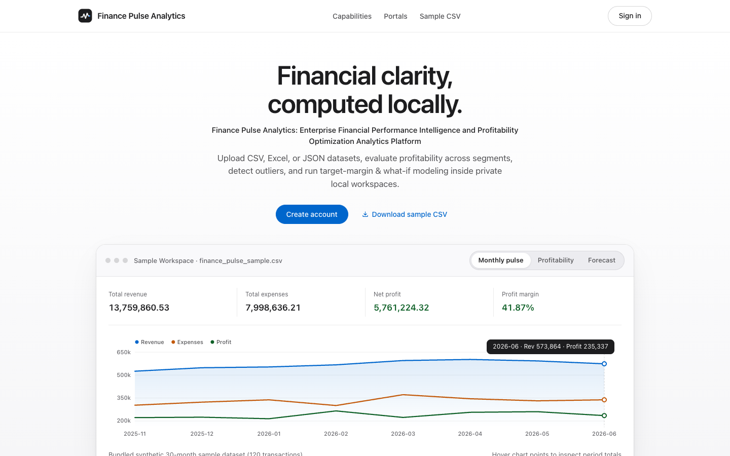
Finance Pulse Analytics
03 · Editorial Showcase & Auth Gate
Decluttered Hero Entry & Interactive Sample Workspace
UX & Entry Refinements
● Streamlined Entry CTAs: Primary Create Account sits in the hero, Sign In sits top-right, and Admin Login rests quietly in the footer.
● Skeleton Canvas & Retina Sync: Shimmer skeleton loader and ResizeObserver prevent layout shift and blurry Chart.js surfaces.
● Interactive 30-Month Sample: Inspect Monthly Pulse, Profitability, and Forecast previews immediately before signing in.
● Session Boundary Safety: Visiting /register, /login, or /admin/login automatically clears any stale role session.
Finance Pulse Analytics: Enterprise Financial Performance Intelligence and Profitability Optimization Analytics Platform
4 / 12

Slide 5
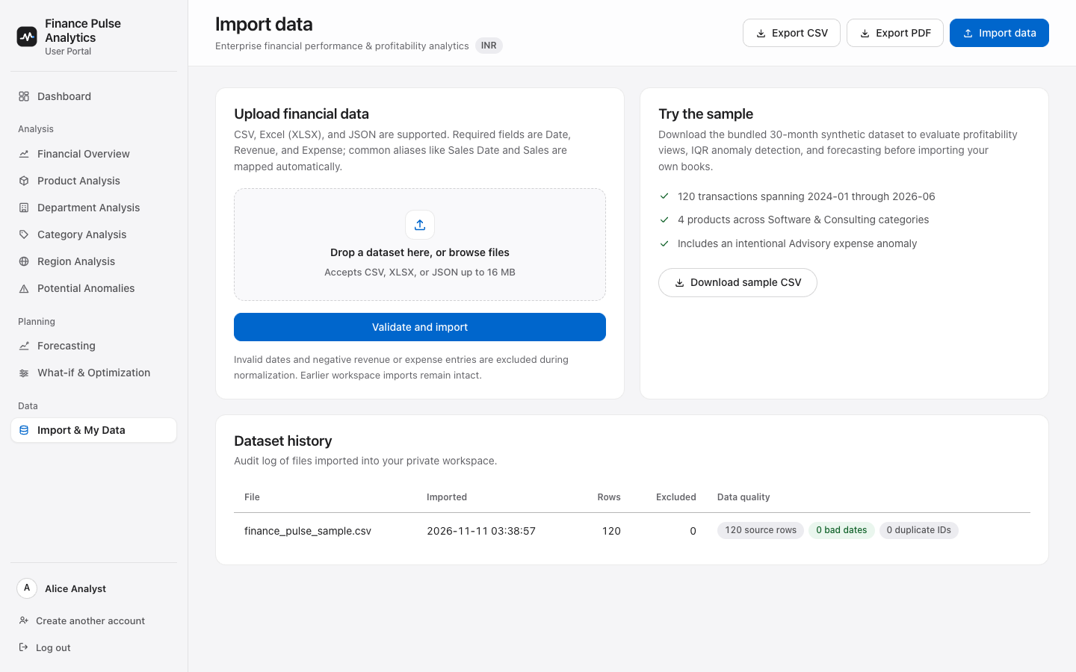
Finance Pulse Analytics
04 · Multi-Format Ingestion
Resilient Import Pipeline with Pre-Commit Verification
Import Guarantees
● CSV, XLSX & JSON Support: Drag-and-drop ingestion up to 16 MB plus 1-click sample dataset downloads.
● Smart Column Aliasing: Maps Sales Date, Sales, Income, COGS, Dept, and Item into canonical ledger fields automatically.
● Data Quality Pre-Check: Surfaces invalid dates, negative financials, missing required fields, and duplicate IDs.
● Two-Step Staging Commit: Validates an 8-row mapping preview before inserting normalized rows into SQLite.
Finance Pulse Analytics: Enterprise Financial Performance Intelligence and Profitability Optimization Analytics Platform
5 / 12

Slide 6
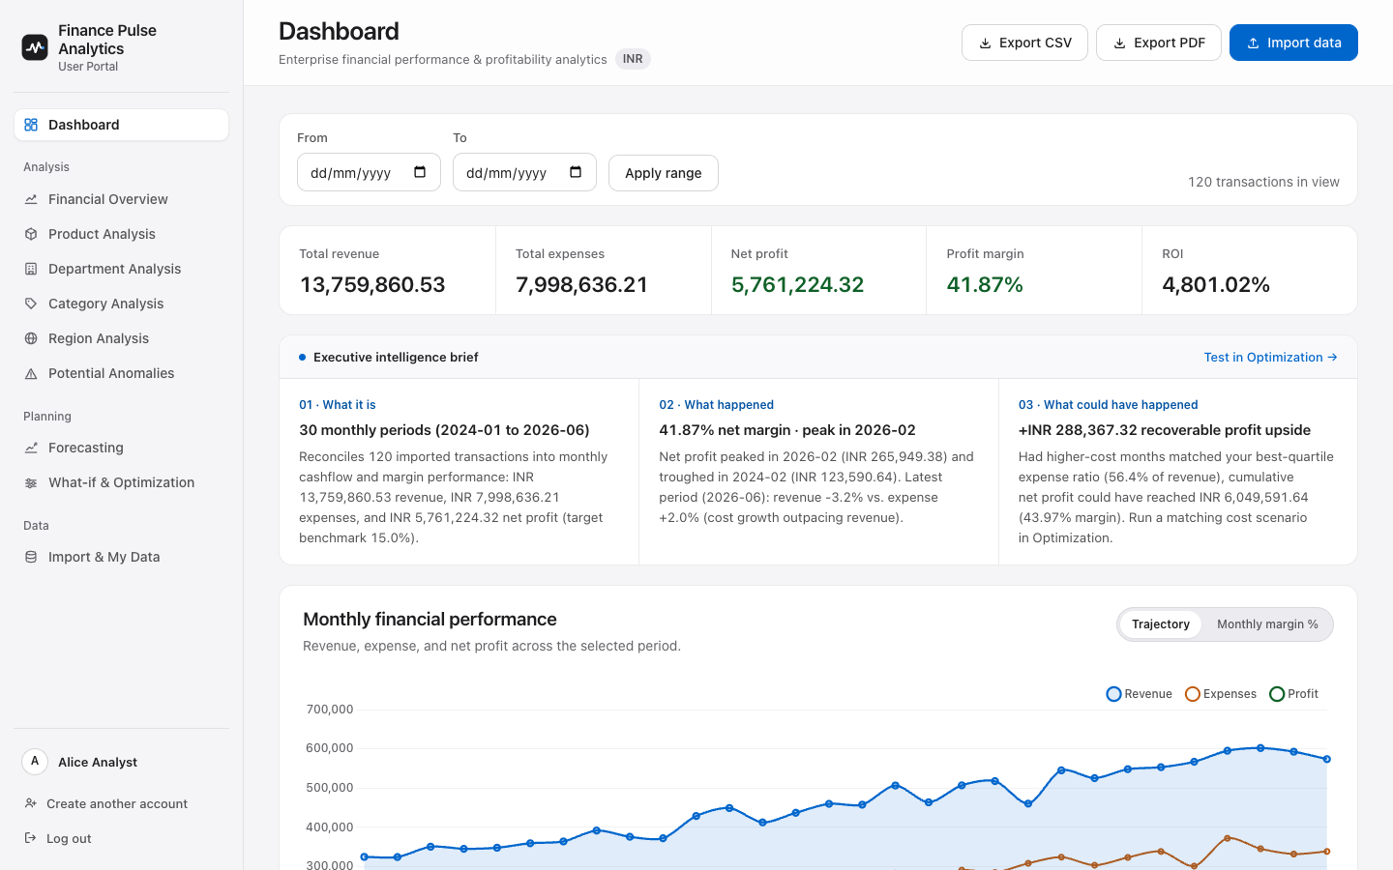
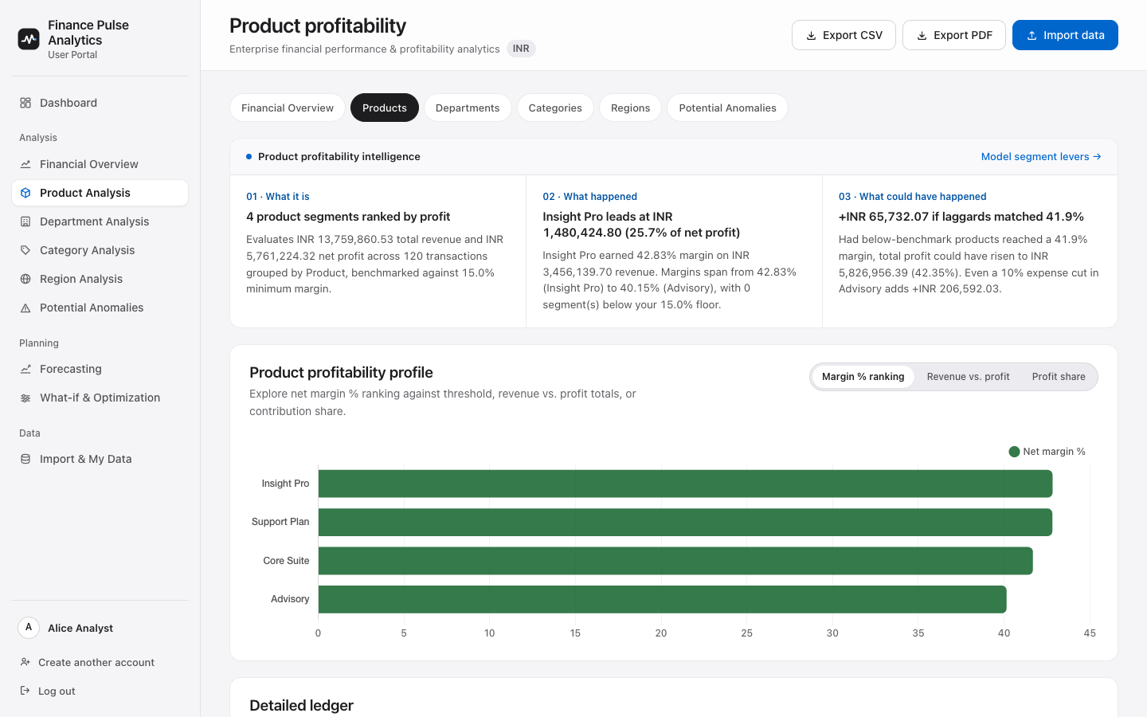
Finance Pulse Analytics
05 · Narrative Intelligence & Chart Variety
3-Pillar Intelligence Briefs Before Switchable Visualizations
● Explain First (01 · 02 · 03): analytics/intelligence.py synthesizes What it is, What happened, and What could have happened above every graph.
● Visual Diversity Per Menu: Interactive Chart.js toggles switch between Trajectory, Margin %, Horizontal Rankings, Rev vs. Profit, and Profit Share Doughnuts.
Finance Pulse Analytics: Enterprise Financial Performance Intelligence and Profitability Optimization Analytics Platform
6 / 12

Slide 7
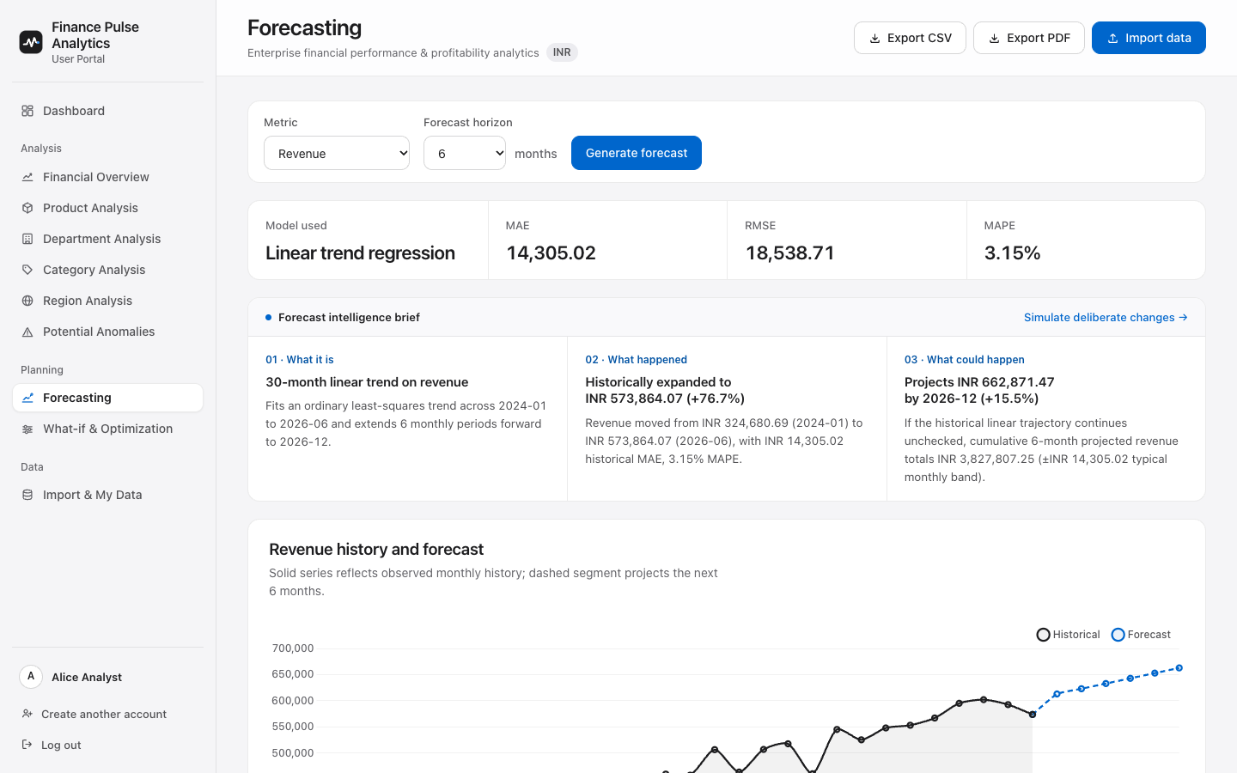
Finance Pulse Analytics
06 · Anomalies & Trend Forecasting
Explainable IQR Outliers & Linear Regression Forecasting
analytics/forecasting.py
Linear Trend Forecasting (3–24 Months)
● Configurable Horizon: Projects revenue, expense, or net profit via NumPy OLS regression whenever ≥ 4 months exist.
● Honest Backtesting: Displays historical MAE, RMSE, and MAPE accuracy metrics beside every narrative brief.
analytics/anomalies.py
Explainable IQR Outlier Detection
● Transparent Cutoff Math: Flags transactions exceeding Q3 + k × (Q3 − Q1) using admin-configured IQR multipliers.
● Excess Margin Impact: Quantifies recoverable profit if excess expense outliers had remained inside statistical cutoffs.
Finance Pulse Analytics: Enterprise Financial Performance Intelligence and Profitability Optimization Analytics Platform
7 / 12

Slide 8
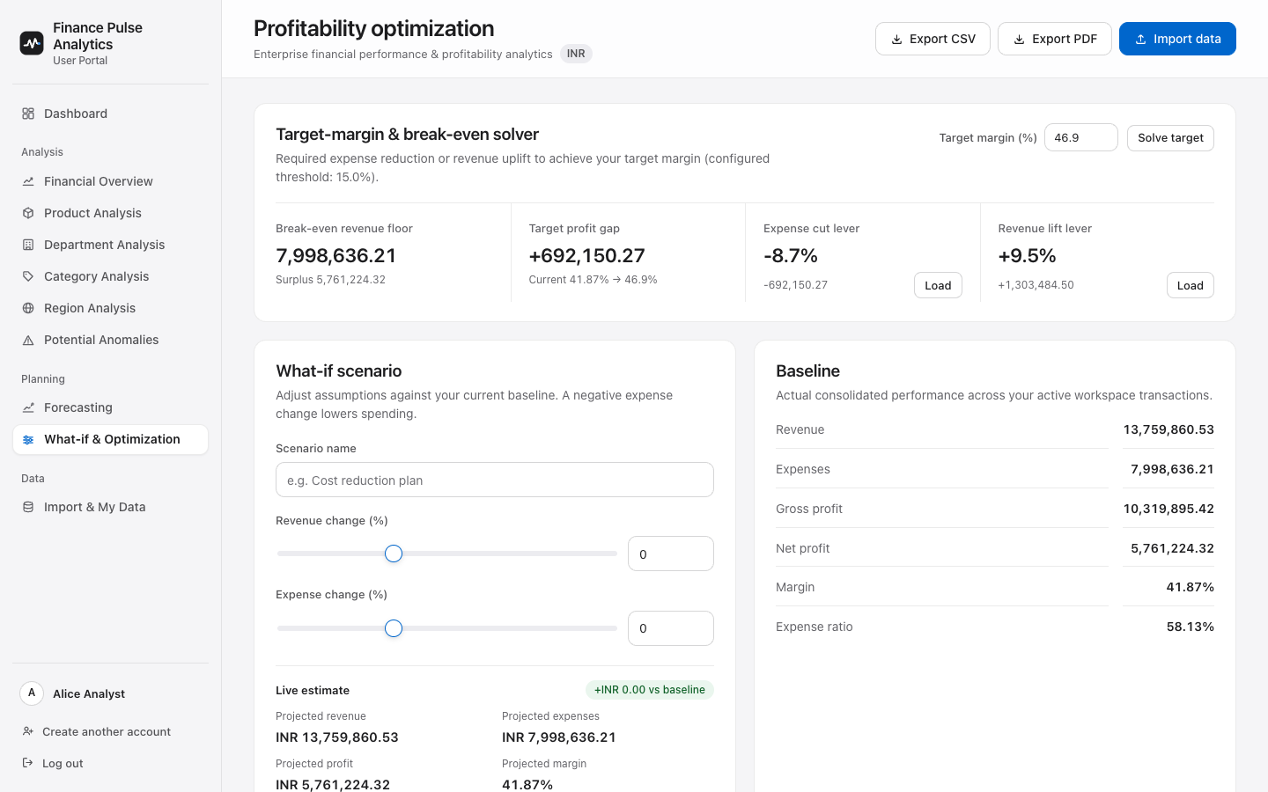
Finance Pulse Analytics
07 · Profitability Optimization Engine
Target-Margin Solver, Segment Levers & What-If Modeling
Optimization Capabilities
● Break-Even & Target Solver: Computes exact break-even floor, margin gap, expense cut %, and revenue lift % for any target.
● 1-Click Lever Presets: Loads calculated cost cuts or revenue targets directly into interactive sliders.
● 4D Segment Profit Levers: Ranks top margin opportunities across Product, Department, Category, and Region.
● Persisted Scenario Ledger: Saves named simulations with assumptions and baseline profit deltas per workspace.
Finance Pulse Analytics: Enterprise Financial Performance Intelligence and Profitability Optimization Analytics Platform
8 / 12

Slide 9
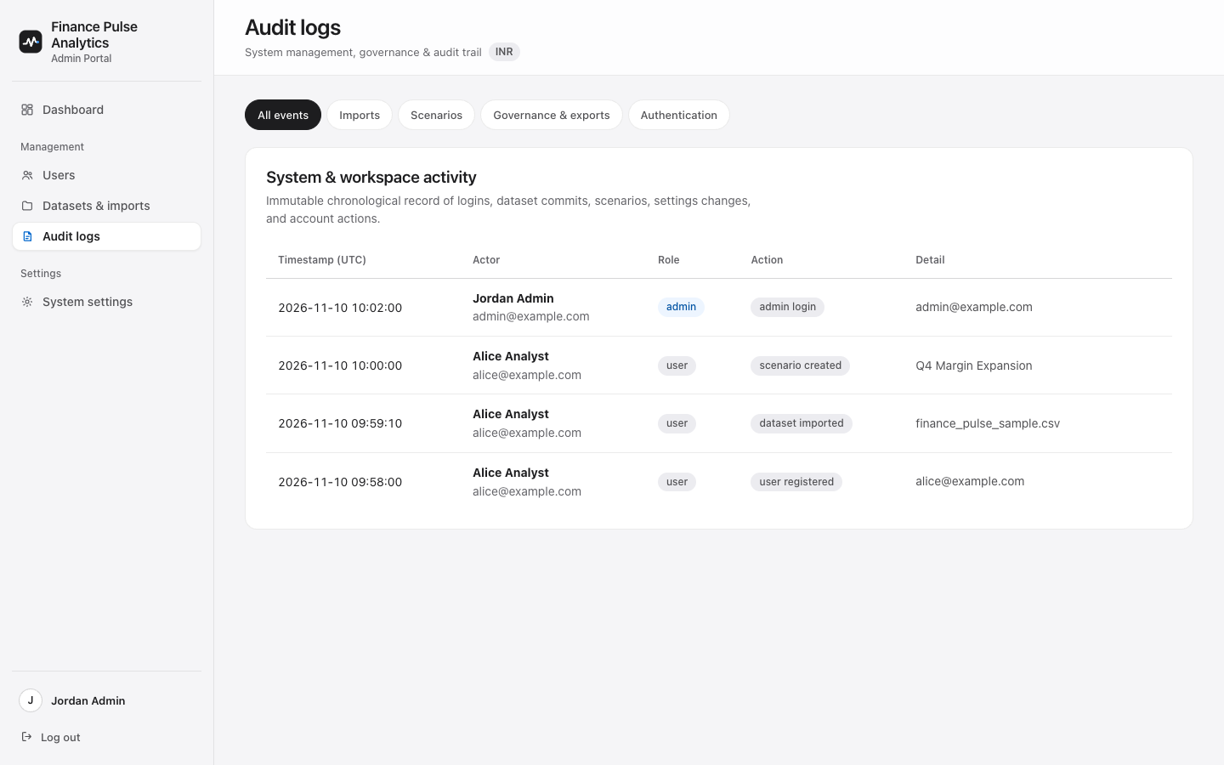
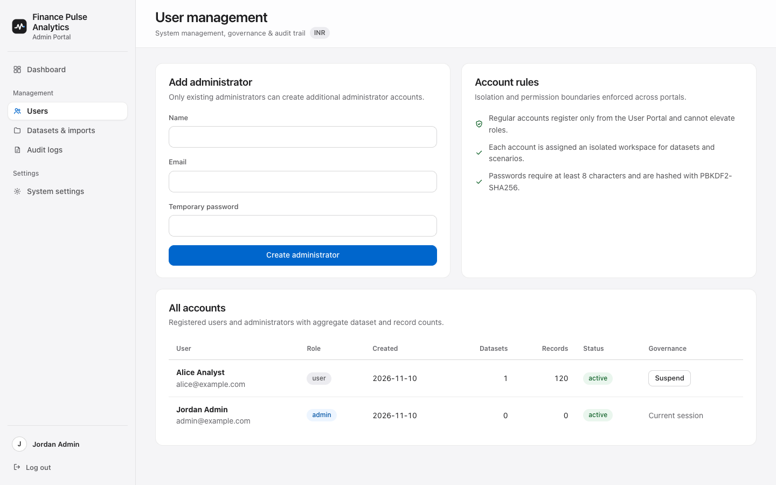
Finance Pulse Analytics
08 · Enterprise Governance & Reporting
Administrator Oversight, Audit Trail & Local Exports
● Governance & Security: Role-separated Admin console supports account suspend/activate toggling, system thresholds, and category-filtered Audit Logs.
● Desktop-Compatible Exports: HTML download filenames + PyWebView ALLOW_DOWNLOADS enable 1-click CSV exports and A4 ReportLab PDF summaries.
Finance Pulse Analytics: Enterprise Financial Performance Intelligence and Profitability Optimization Analytics Platform
9 / 12

Slide 10
Finance Pulse Analytics
09 · Standalone Desktop & Private Admin
Desktop Packaging (macOS & Windows) + Private Owner Admin App
Public GitHub Release Builds
Private Owner Build · Gitignored
FinancePulseAnalytics
macOS (.app) & Windows (.exe)
Isolated Local Admin Desktop Application (dist_private/)
● Unified Brand Packaging: 4x supersampled .icns, .ico, and Android mipmaps matching the exact graphite pulse & blue beacon mark.
● Ephemeral Loopback & /health: app_launcher.py binds 127.0.0.1 dynamically, polls JSON /health readiness, and tolerates macOS -psn_0_* flags.
● Native Window & Downloads: PyWebView 5.4 renders native Cocoa/EdgeWebView2 windows with ALLOW_DOWNLOADS=True and browser fallback.
● 1-Click Source Launchers: Run_FinancePulse_Mac.command and Run_FinancePulse_Windows.bat bootstrap .venv automatically.
● Strictly Excluded from GitHub: packaging/private/ and dist_private/FinancePulseAdmin.app remain excluded in .gitignore for exclusive owner use.
● Direct /admin/login Entry: Opens the native console straight into Administrator authentication with CLI --create-admin provisioning.
● Local vs. Hosted User Tracking: Offline desktop/APK installs store SQLite databases strictly on each user's local device without telemetry.
● Remote Server Mode (--remote-url): Point FINANCE_PULSE_REMOTE_URL (or --remote-url) to a central hosted Flask server to inspect remote registrations.
Finance Pulse Analytics: Enterprise Financial Performance Intelligence and Profitability Optimization Analytics Platform
10 / 12

Slide 11
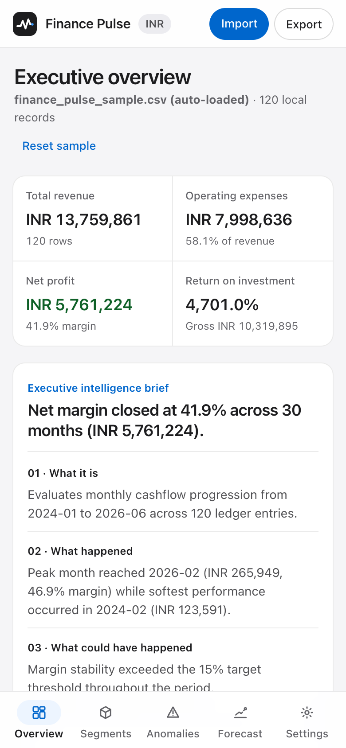
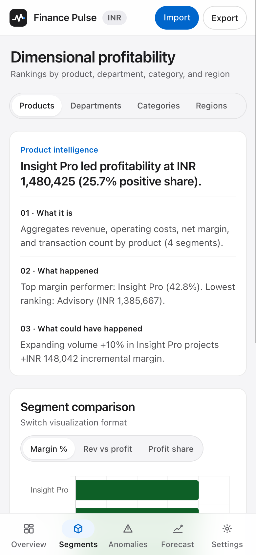
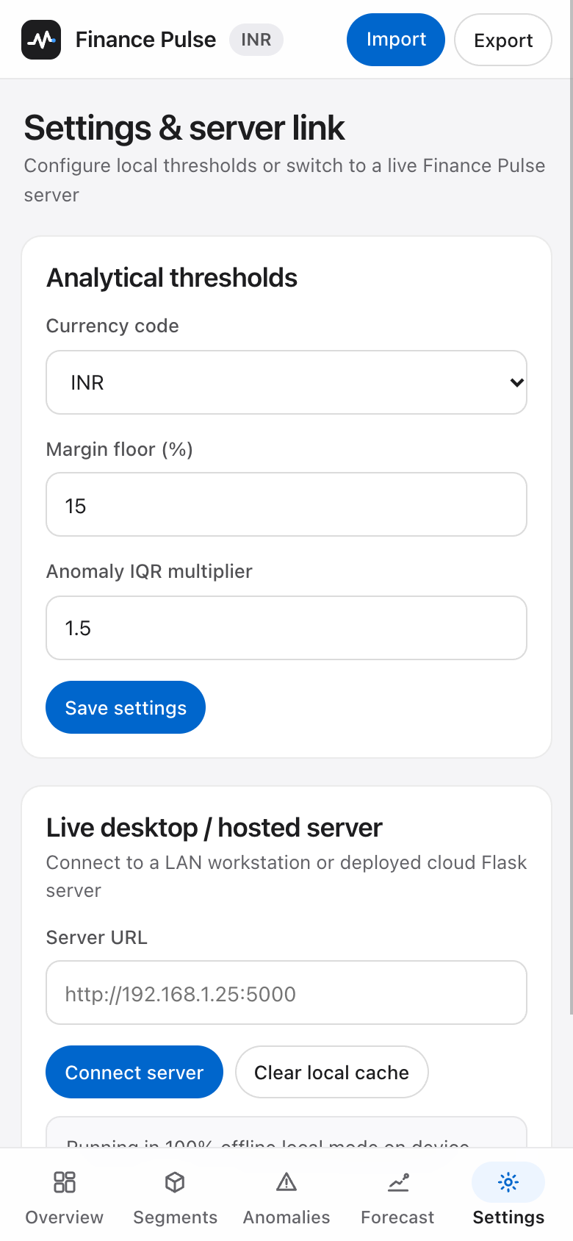
Finance Pulse Analytics
10 · Native Mobile Android APK
Purpose-Built Android APK with Offline Engine & Live Server Bridge
SDK 26–34 · Zero Overflow
Mobile-Native Architecture
● Thumb-Zone Navigation: Slim 54px frosted top bar, bottom 5-tab bar with Material pill indicator, and responsive >=720px side rail.
● 100% Offline JS Analytics: Bundled Chart.js + financial engine computes KPIs, 4D segments, IQR outliers, OLS forecasts, and What-If sliders on-device.
● Native Android I/O: WebChromeClient FileChooser imports CSV/JSON files and AndroidBridge downloads local exports seamlessly.
● Live Server Connector: ServerUrlValidator validates http/https LAN or hosted Flask URLs with fallback to offline mode.
Finance Pulse Analytics: Enterprise Financial Performance Intelligence and Profitability Optimization Analytics Platform
11 / 12

Slide 12
Finance Pulse Analytics
11 · Quality Verification & CI/CD Release
End-to-End Test Verification & Automated Multi-OS Release Pipeline
18 / 18 Automated Tests
0 Layout Issues (rc=0)
3 Signed/Checked Builds
15 Python unit & E2E tests (auth, importer, 3-pillar briefs, audit logs, launcher) + 3 Android JUnit validator tests.
impeccable audit & headless Chrome verify 0 horizontal overflow across 20 web views and all 5 Android tabs (390×844).
Verified locally on macOS (.app + .apk) and scripted for cross-platform Windows (.exe) builds with SHA256 digests.
Automated GitHub Actions Pipeline (.github/workflows/ci.yml)
Job 1 · macos-build
Job 2 · windows-build
Job 3 · android-build
Job 4 · publish-release
macos-latest · Python 3.11
pytest + PyInstaller .app +
headless /health smoke test
+ ditto archive & SHA256.
windows-latest · Python 3.11
pytest + PyInstaller .exe +
PowerShell /health check
+ ZIP archive & SHA256.
ubuntu-latest · JDK 17 + SDK 34
./gradlew testDebugUnitTest
assembleDebug -> APK
+ sha256sum verification.
Triggers on push to main:
collects macOS, Windows & APK
artifacts into GitHub Release
v1.0.0 automatically.
Finance Pulse Analytics: Enterprise Financial Performance Intelligence and Profitability Optimization Analytics Platform
12 / 12

