Slide 1

Employee Payroll Management System
Presented by:
T.K.Vedhavarsan(1911260037)
D.A.Yudhisht Ram(1921260052)
H.Deva(1972260003)
S.Sahana(1911260083)
M.Sri Harini(1921260088)
Python programming
GUIDED BY : DR.U.SAMSON EBENEZAR

Slide 2
Introduction
Employee Payroll Management System is a software that helps companies calculate and pay employee salaries easily. It also keeps records of attendance, leaves and tax deductions.
Problem
Doing payroll by hand takes a lot of time. Mistakes can happen in salary, tax or leave calculations. It is also hard to keep all records in one place.
Solution
This system does the salary calculation automatically. It uses attendance data, applies tax rules and makes payslips. Everything is stored in one database.
Why it is useful
It saves time, reduces errors, follows labour laws and lets both HR and employees see the information they need.

Slide 3
Objectives
1. Calculate salary automatically using attendance, leave and overtime data.
2. Keep all employee details in one safe place (name, department, salary structure).
3. Create monthly payslips and useful reports for management.
4. Give different access levels to Admin, HR and normal employees.
5. Reduce time and mistakes compared to doing payroll by hand.
6. Let employees check their payslips and apply for leave online.

Slide 4
Literature Survey
Existing payroll systems and their features - review of commercial and open-source solutions.
Database design patterns for HR and payroll systems - entity-relationship models and best practices.
3. Tax calculation algorithms and compliance - Indian tax rules, PF, ESI and deduction mechanisms.
4. User authentication and role-based access control in web applications - security best practices.
5. Web development frameworks - Python Django/Flask, HTML/CSS/JavaScript for responsive UI design.
6. PDF generation and report creation in web applications - libraries and best practices.

Slide 5
Methodology
The main steps are:
1. Requirement Analysis – Understand what the system should do.
2. System Design – Make diagrams (ER diagram, DFD) and plan the screens.
3. Implementation – Write the code for all five modules.
4. Testing – Check each part and the full system for errors.
5. Deployment – Install the system and collect feedback.

Slide 6
System Design
Architecture (3 layers)
1. Presentation Layer – Website screens for Admin and Employees
2. Application Layer – Logic that calculates salary and applies rules
3. Data Layer – Database that stores all employee and payroll data
Important design points
• Database has tables for Employees, Attendance, Leaves, Salary and Payslips
• Different users have different access rights (Admin, HR, Employee)
• Screens are simple and work on computer and tablet
• Data flow: Attendance → Salary calculation → Tax → Payslip → Reports

Slide 7
Module 1 – Employee Management
This module keeps all information about employees.
• Add new employees with name, phone, joining date, department and job title.
• Edit or remove employee details when needed.
• Assign each employee to a department and designation.
• Give different roles: Admin, HR or normal Employee.
• Search employees by name, ID or department.
• See who is active, resigned or on hold.

Slide 8
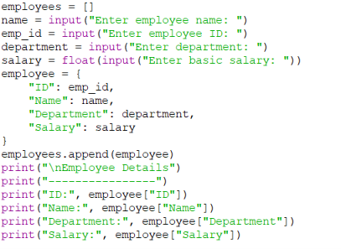
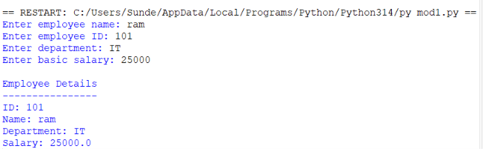
Code:
Result:

Slide 9
Module 2 – Attendance & Leave
This module records who came to work and who took leave.
• Mark daily attendance: Present, Absent, Half-day or Late.
• Employees can apply for leave (casual, sick or earned leave).
• Manager or HR can approve or reject the leave request.
• Add company holidays and weekly offs.
• Record overtime hours for extra pay.
• Make monthly attendance and leave reports.

Slide 10
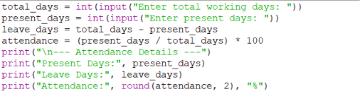
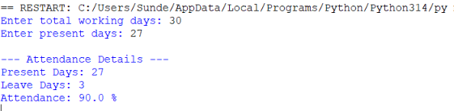
Code:
Result:

Slide 11
Module 3 – Payroll Processing
This is the main part that calculates the salary every month.
• Set salary structure: Basic pay, HRA, DA and other allowances.
• System calculates gross and net salary using attendance days.
• Add bonus or special payments when needed.
• Handle salary for people who joined or left in the middle of the month.
• Run payroll for the selected month after attendance is locked.
• Track if salary is pending, processed or already paid.

Slide 12
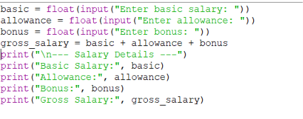
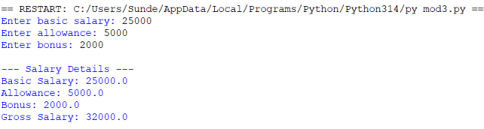
Code:
Result:

Slide 13
Module 4 – Tax & Deductions
This module calculates all money that must be cut from salary.
• Provident Fund (PF) – Employee and company contribution.
• ESI – Insurance deduction for eligible employees.
• Professional Tax – As per state rules.
• Income Tax (TDS) – Monthly tax based on salary and tax slabs.
• Loan or advance recovery – Cut EMI from salary if any.
• Other deductions – Insurance, union fee or any custom cut.

Slide 14
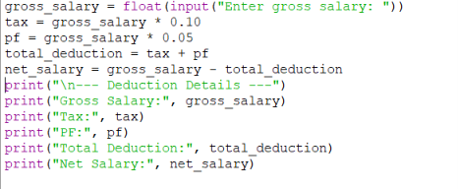
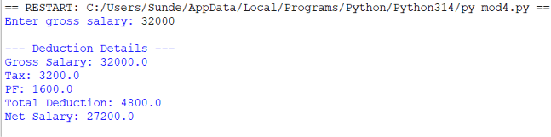
Code:
Result:

Slide 15
Module 5 – Reports & Payslips
This module makes payslips and reports that people can download.
• Create monthly payslip showing earnings, deductions and net pay (PDF).
• Department-wise salary reports for management.
• Yearly tax summary and help for Form-16.
• Attendance summary linked to payroll.
• Export reports to PDF or Excel.
• Employees can log in and download their own payslips anytime.

Slide 16
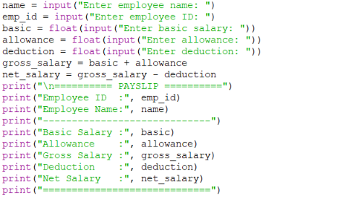
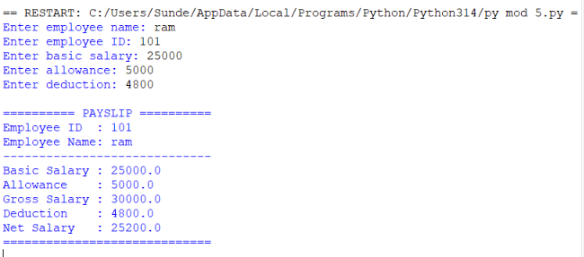
Code:
Result:

Slide 17
Implementation
Technology used
Backend → Python (Django / Flask)
Database → MySQL / SQLite
Tools → VS Code, Git, Pip
References also updated with Django & Flask docs
What was built
• Login page with different roles
• Add / edit / delete employee records
• Attendance and leave approval system
• Automatic salary calculation
• PDF payslip generation
• Reports for admin
• Form validation and error messages

Slide 18
Results & Discussion
Results
• Salary calculation was correct and matched manual checking.
• Payroll work that took days now takes only a few hours.
• Mistakes in data entry and calculation became very less.
• HR and employees found the system easy to use.
Discussion
The system shows that computer-based payroll is faster and more accurate than doing it by hand. Connecting attendance to salary calculation is the most important part. Different login levels keep salary data safe.

Slide 19
Challenges
1. Salary rules are complex – many components and different formulas.
2. Connecting attendance status correctly to salary days.
3. Tax calculation with different slabs and PF / ESI rules.
4. Keeping employee and salary data secure.
5. Making clean PDF payslips that look good when printed.
6. Helping non-technical staff shift from Excel to the new system.

Slide 20
Limitations
1. Works for one company only (not multi-company).
2. No mobile app – only website that works on phone browser.
3. Tax rules are basic; very complex cases are not covered.
4. No live connection with biometric machines yet.
5. Needs internet – does not work offline.
6. Reports are simple; advanced graphs and predictions are missing.

Slide 21
Future Scope
1. Make a mobile app for attendance and payslip download.
2. Connect directly with biometric attendance machines.
3. Add better charts and salary trend reports.
4. Support multiple companies in one system.
5. Use AI to find mistakes in payroll automatically.
6. Put the system on cloud and connect with accounting software.

Slide 22
Conclusion
The Employee Payroll Management System makes salary work easy, fast and accurate. It reduces mistakes and saves time for the HR team.
Main points
• All main goals of the project were achieved.
• The system can be used in real companies to reduce manual work.
• We learned full-stack development, database design and testing.
• With future improvements it can become a complete payroll product.

Slide 23
References
1. Pressman, R. S. – Software Engineering: A Practitioner’s Approach.
2. Elmasri & Navathe – Fundamentals of Database Systems.
3. Sommerville, I. – Software Engineering (10th Edition).
4. Ministry of Labour & Employment, Government of India.
5. Income Tax Department of India – TDS Rules.
6. Bootstrap Documentation – getbootstrap.com
7. MySQL Official Documentation – dev.mysql.com
8. PHP / Node.js Official Documentation.
9. IEEE 830 – Software Requirements Specification.
10. Research papers on payroll systems from IEEE / Google Scholar.

Slide 24
Thank You

