Slide 1
Body Fat Measurement Model
Group 4

Slide 2
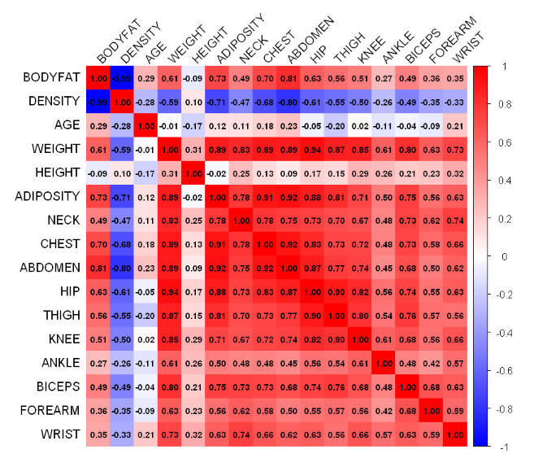
Data Cleaning
First, We check the corr. and lof scores.
Individual (IDNO) | LOF Scores(>2)
39 | 5.616425
42 | 3.042846

Slide 3
We impute some individuals.
Individual (IDNO) | Abnormal column | Original Obs. | Imputed Obs. | Reasons | Imputation Method
31 | ANKLE | 33.9(cm) | 23.8(cm) | ANKLE‘s histogram distribution anomaly, Leverage and Cook’s distance check | KNN
86 | ANKLE | 33.7(cm) | 22.5(cm) | ANKLE‘s histogram distribution anomaly, Leverage and Cook’s distance check | KNN
221 | WEIGHT | 153.25(lbs) | 173.20(inches) | Mismatch between BMI, HEIGHT, and WEIGHT | BMI and HEIGHT calculate
42 | HEIGHT | 29.5(inches) | 69.43(inches) | Mismatch between BMI, HEIGHT, and WEIGHT | BMI and WEIGHT calculate

Slide 4
Individual (IDNO) | Abnormal column | Original Obs. | Imputed Obs. | Reasons | Imputation Method
172 | BODYFAT DENSITY | 1.9(%) 1.0983(gm/cm3) | 6.99(%) 1.083(gm/cm3) | BODYFAT and DENSITY calculated using ‘Siri’s equation’ mismatch, Abnormal BODYFAT | Regression by other columns
182 | BODYFAT DENSITY | 0(%) 1.1089(gm/cm3) | 4.53(%) 1.089(gm/cm3) | BODYFAT and DENSITY calculated using ‘Siri’s equation’ mismatch, Abnormal BODYFAT | Regression by other columns
48 | BODYFAT | 6.4(%) | 14.14(%) | BODYFAT and DENSITY calculated using ‘Siri’s equation’ mismatch | DENSITY calculate
76 | BODYFAT | 18.3(%) | 14.09(%) | BODYFAT and DENSITY calculated using ‘Siri’s equation’ mismatch | DENSITY calculate
96 | DENSITY | 1.0991(gm/cm3) | 1.059(gm/cm3) | BODYFAT and DENSITY calculated using ‘Siri’s equation’ mismatch | BODYFAT calculate

Slide 5
We deleted five individuals (39,54,163,175,216.) due to Leverage and Cook’s distance check.
Individual (IDNO) | Leverage | Cook’s distance
39 | 0.466 | 0.409
54 | 0.172 | 0.020
163 | 0.167 | 0.018
175 | 0.273 | 0.025
216 | 0.134 | 0.030

Slide 6
Final Cleaned Data: n=247 (from n=252) with p = 13 predictors
Remove IDNO
Remove DENSITY
Remove BMI – highly collinear
Predictors: Age (years),Weight (lbs),Height (inches), Adioposity (bmi), Neck circumference (cm), Chest circumference (cm), Abdomen 2 circumference (cm), Hip circumference (cm), Thigh circumference (cm), Knee circumference (cm), Ankle circumference (cm), Biceps (extended) circumference (cm), Forearm circumference (cm), Wrist circumference (cm)

Slide 7
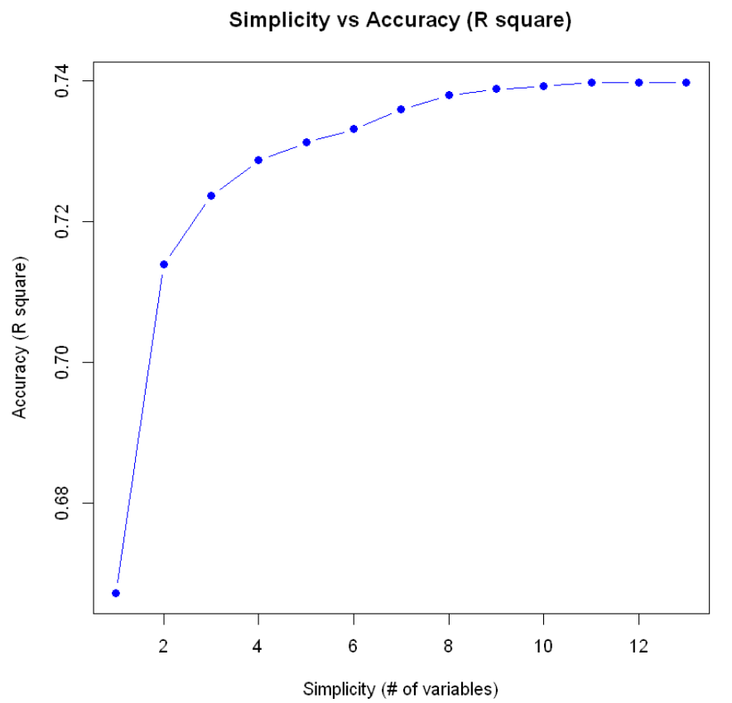
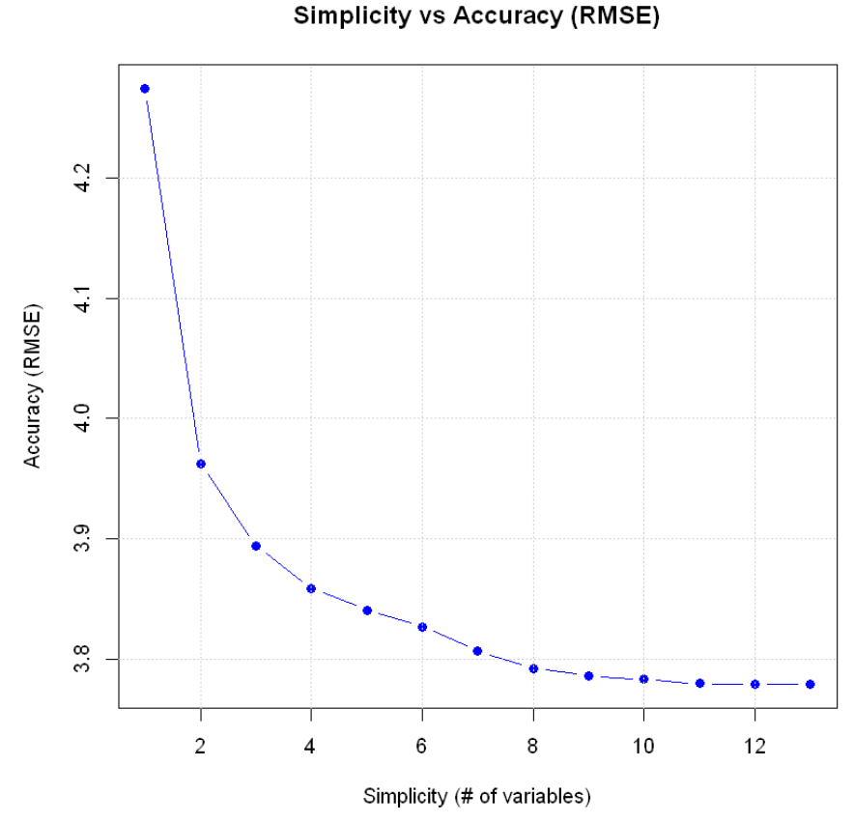
Final Model
BODYFAT = - 41.547 - 0.124*WEIGHT (lbs) + 0.894*ABDOMEN (cm)
3.96
0.71

Slide 8
Model Diagnostics
Consider the assumptions of linear regression:
Assumption | Test | criteria
Normality of residuals | Shapiro-Wilk test / Q-Q plot | p-value = 0.240 > 0.05
Independence of residuals | Durbin-Watson test | p-value = 0.134 > 0.05
Homoscedasticity | Breusch-Pagan test / residual plot | p-value = 0.496 > 0.05
Multicollinearity | Variance Inflation Factor (VIF) | VIF = 4.27 < 10

Slide 9
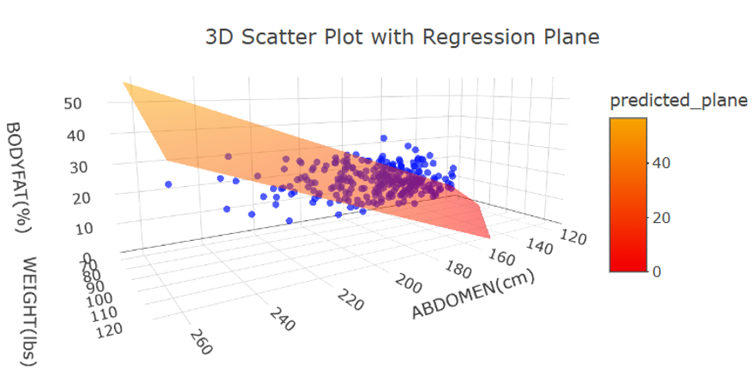
Statistical Analysis
Predictors | P-value
WEIGHT | 1.27e-09
ABDOMEN | <2e-16
Overall Model(under F-test) | <2.2e-16
Residual Standard Error | 3.987
R^2 | 0.714

Slide 10
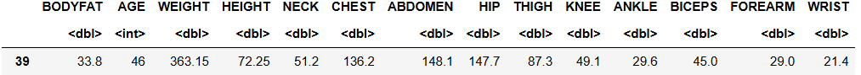

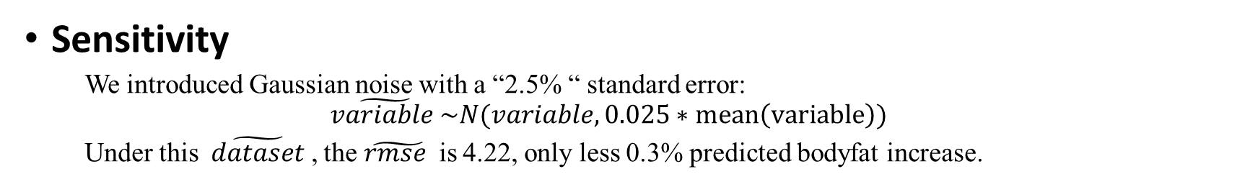
Robustness and Sensitivity
Robustness
Sensitivity
We introduced Gaussian noise with a “2.5% “ standard error:
$$\tilde{variable }\sim N(variable,0.025∗mean\left(variable\right))$$
Under this$\tilde{ dataset }$, the $\tilde{rmse }$ is 4.22, only less 0.3% predicted bodyfat increase.

Slide 11
Strengths and Weaknesses
Final Model:
Body Fat ~ -41.547 - 0.124* WEIGHT(lbs) + 0.894*ABDOMEN(cm)
Strengths
A linear model with only two variables
Explains ABDOMEN of variation in body fat
Satisfies all the fundamental assumptions of linear regression
Weaknesses
Less intuitively when interprete the coef. of WEIGHT

Slide 12
Conclusion
Fight with mess data.
Correlation
Histogram
LOF
Relationship between data
KNN
Setting range
Regression
Outlier detection
Checked one by one
Is this data correct?
How it can be wrong?
Why is value is so strange?
Which one is wrong among these 3?
How to impute it?
Why can't we delete it?
......

Slide 13
Conclusion
Compared RMSE in 8 different models
Forward model
Stepwise selection
Best subset selection
LASSO
Ridge
Elastic Net
Random forest
XGBoost
Abdomen
Weight
13 models
Leave one out
Knee
Forearm

Slide 14
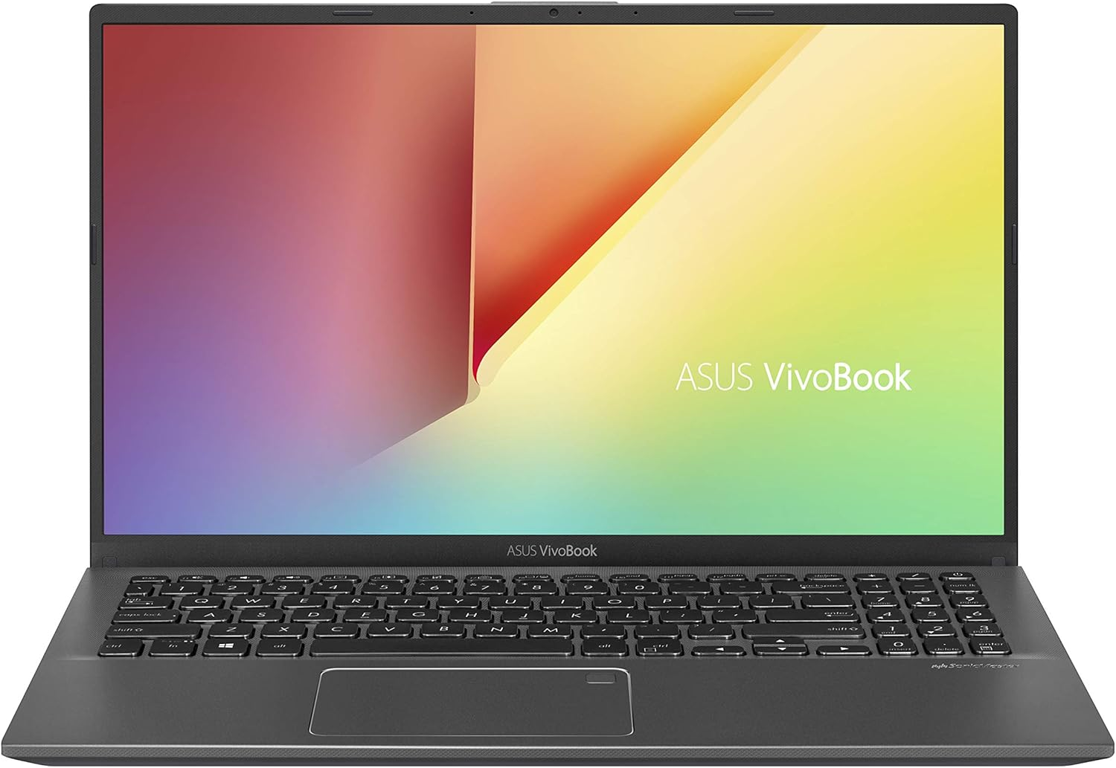
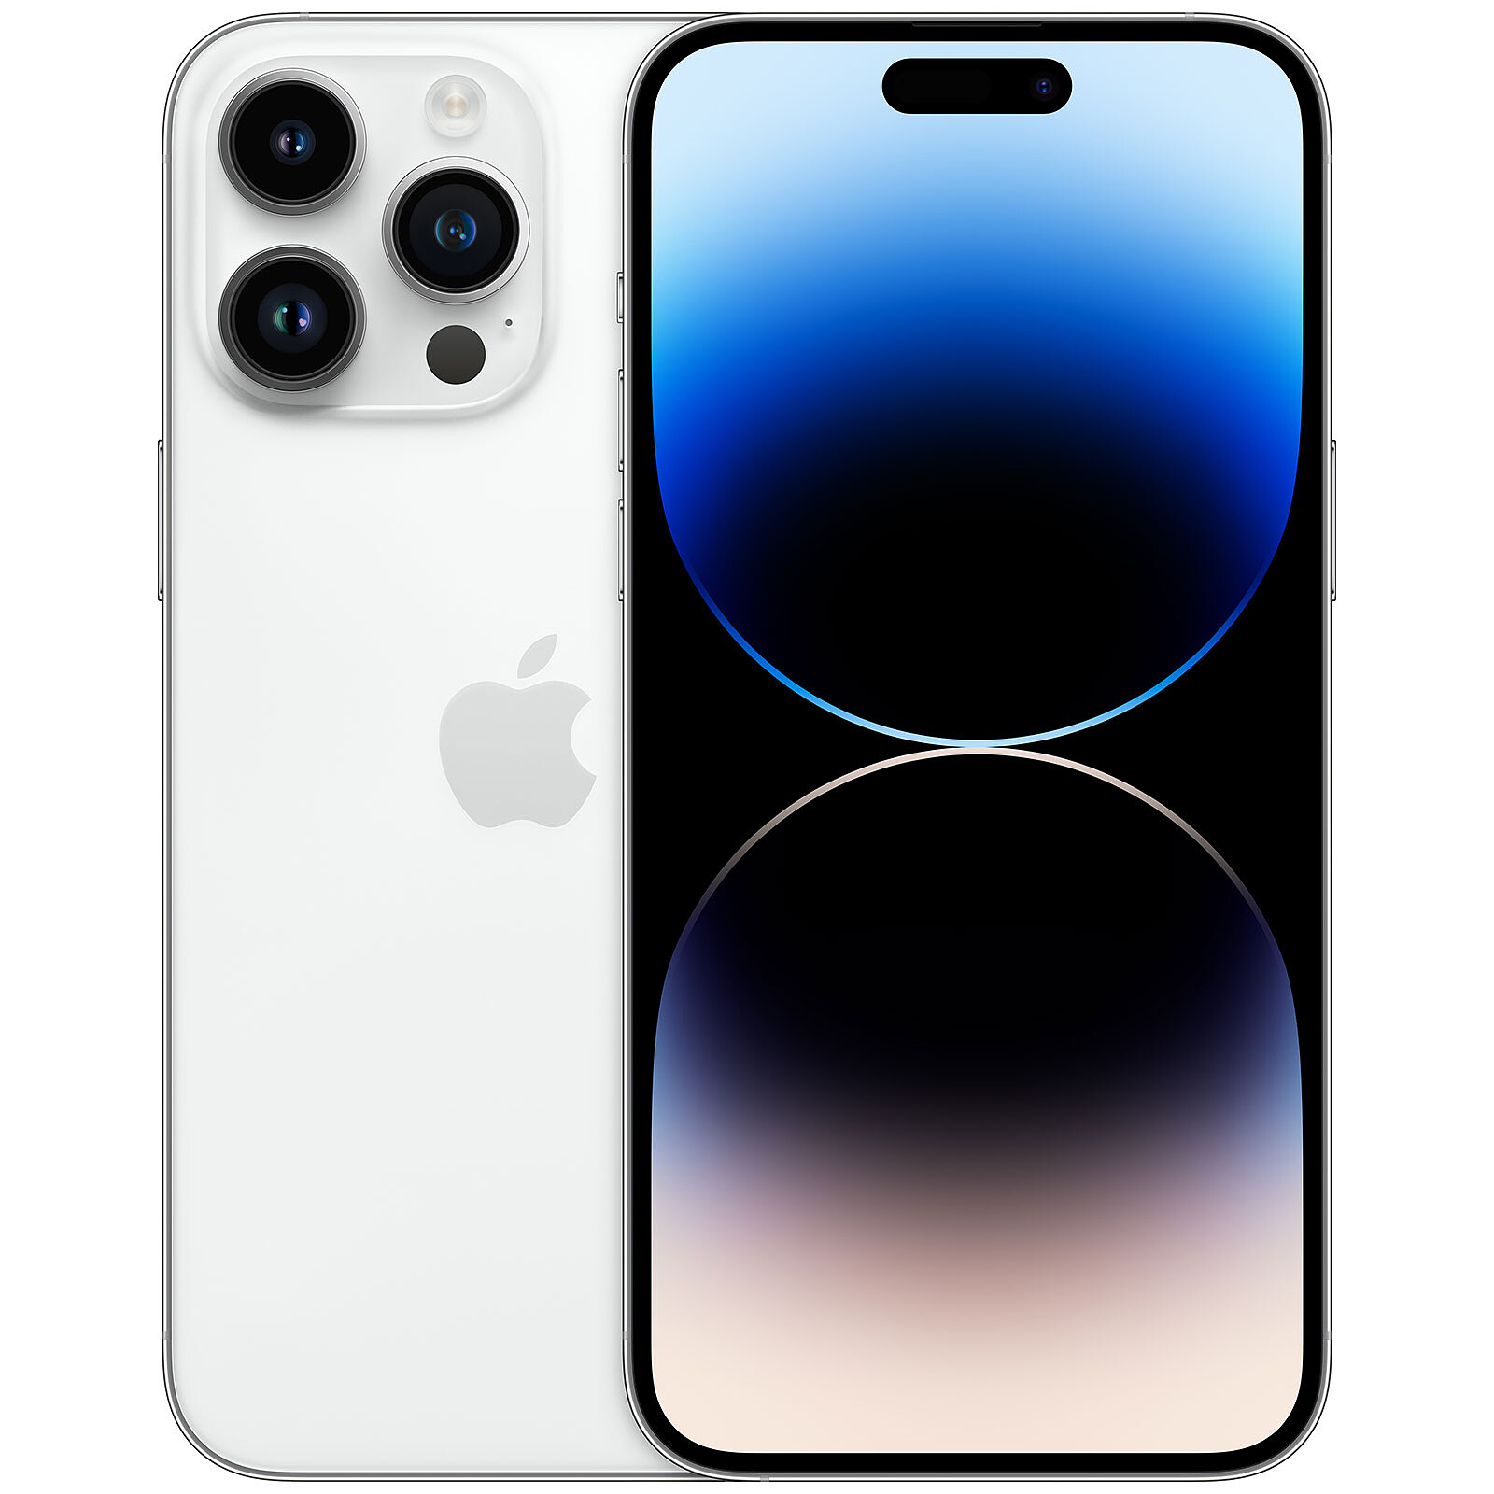
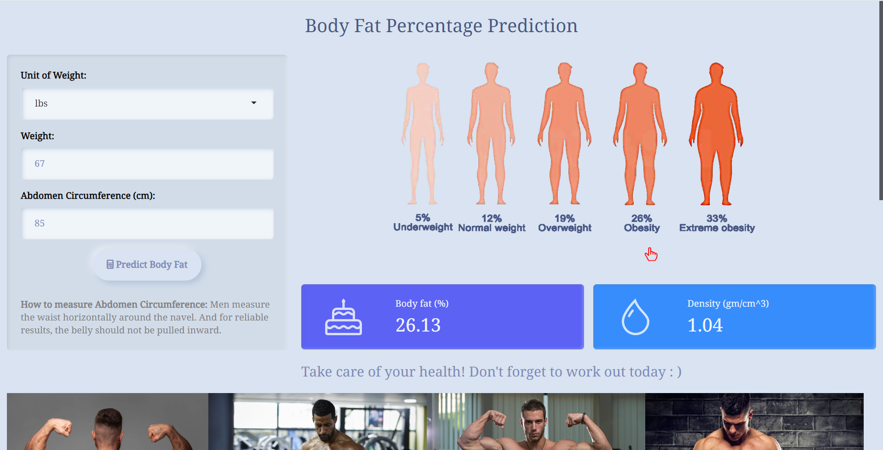
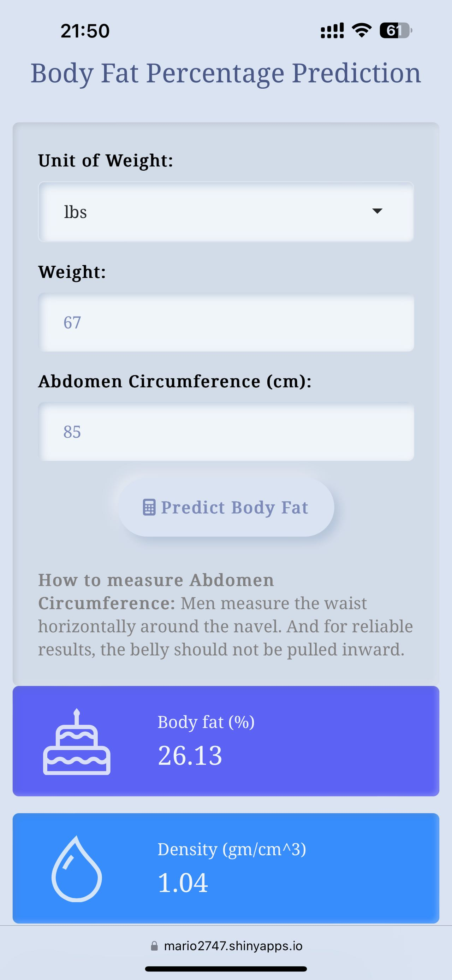
Conclusion
Measure your body fat at any time (with our model) !

Slide 15
Body Fat Measurement Model
Group 4

