Slide 1
Yudina M. N., Zadorozhnyi V. N., Yudin E. B. Mixed Random Sampling of Frames method for counting number of motifs arXiv:1904.02483

Slide 2
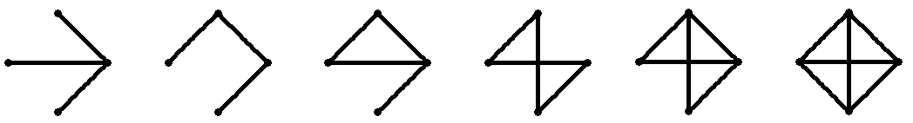
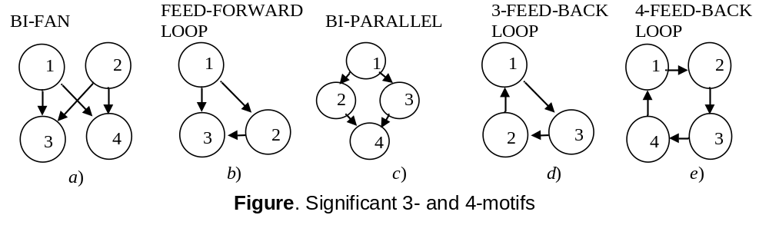
Network motifs
Network motifs are connected subgraphs that occur in the network far more often
than in randomized networks (Milo et al.)
Figure. All 6 types of three-node connected undirected subgraphs
«evolution preserves modules that define specific […]. . ._x0002_ functions»
  Milo et al. Network motifs: Simple building blocks of complex networks. Science, 2002 (IF 15.85) >3619 cites

Slide 3
Calculating the number of all connected subgraphs
Table 1. Time (in seconds) of calculation of frequencies for 3- and 4-subgraphs using R (igraph) and Fanmod program
Network | Nodes | Time of calculation
 |  | R |  | Fanmod
 |  | 3-motifs | 4-motifs | 3-motifs | 4-motifs
Protein-protein interactions network (Homo Sapience) | 22036 | 35 | 18824 | 381.026 | 182161
Gene network GenReg | 16859 | 44 | 15163 | 513.986 | 188820
Molecular network PathwayCommons | 19987 | 300 | 388056 | 323.9 | –
Fragment of social network (Google Plus) | 107614 | 39442 | – | – | –
Fragment of social network (Twitter) | 81306 | 76 | 35217 | 1075.69 | –
We used the HP Z1 G2 Workstation with a 4-core Intel Xeon E3-1245 3.3 GHz CPU with Hyper-Threading technology and 8 GB DDR3-1333 RAM as a test bench.

Slide 4
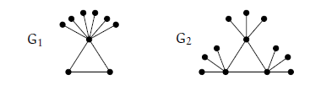
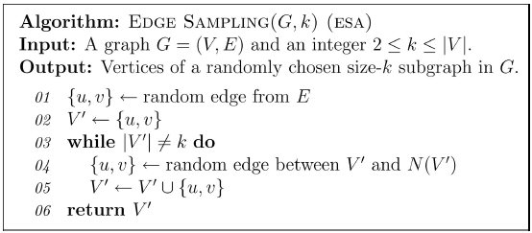


Statistical approach (State of Arts)
  ESA (edge sampling)
    Kashtan, N., et al. Efficient sampling algorithm for estimating subgraph concentrations and detecting network motifs//(2004) Bioinformatics, 20 (11), pp. 1746-1758. (IF 7.84) 3785 cites (Scopus)
1
2
1
2
3
3
Graphs G1 and G2 have 1 triangle and 28 forks
    ESU Rand (enumerate subgraphs uniformly)
    Wernicke S. and F. Rasche FANMOD: a tool for fast network motif detection. PDF // Bioinformatics, 22(9): 1152–1153, 2006. 345 cites (Scopus)
    Smoly, I.Y.,et al. MotifNet: A web-server for network motif analysis // 2017 Bioinformatics, 33(12), 1907-1909
2
3
1
1 (2, 3, 4, 5)
2 (3, 5)
3 (4)
4 (5)
5 (∅)
vertices
5
4
1, 2 (3, 4, 5)
1, 3 (4, 5)
1, 4 (5)
1,5 (∅)
2, 3 (4, 5)
2, 5 (4)
3, 4 (5)
4,5 (∅)
edges
234
235
254
345
triples
123
124
125
134
135
145
…

Slide 5
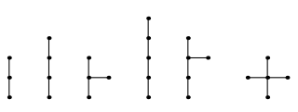
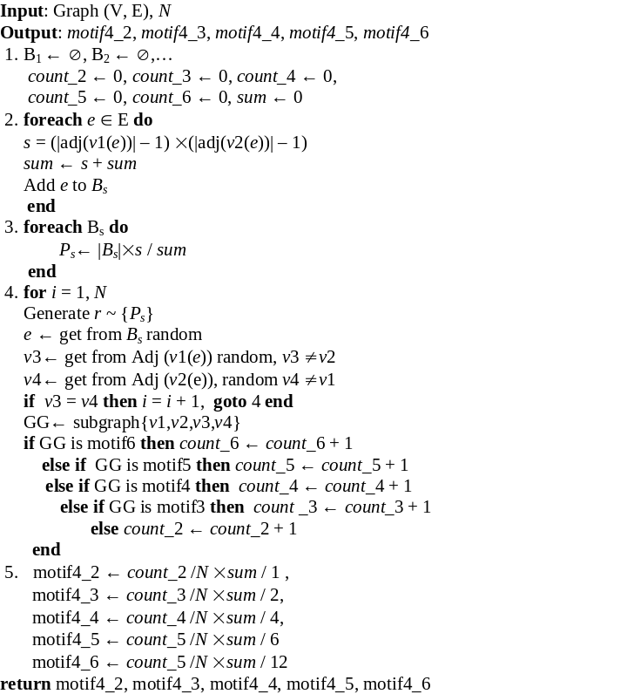
Random Sampling of Frames
а)
b)
3
4
5
Figure. Bold lines are frames with three (a) and four (b) vertices. Dotted lines are edges that can be found in 4-subgraph using the frame
Frames (no isomorphic spanning tree) are containing 3, 4 and 5 vertices
Input: Graph (V, E), N Output: motif3_1, motif3_2 A₁← ∅, A₂← ∅,… count_1 ← 0, count _2← 0, sum ← 0 foreach v ∈ V do k ← |Adj(v)| sum←sum + k×(k – 1)/2 Add v to A_{k} end foreach A_{k} do P_{k} ← |A_{k}|× k×(k – 1)/2/sum end for i = 1, N do Generate r~{P_{k}} v ← get from A_{r} random v1, v2 ← get from Adj(v) random (v2 ≠ v1) if v1 ∈ adj (v2) then count _2 = count _2 + 1 else count _1 = count _1 + 1 end motif3_1← count_1/N×sum, motif3_2← count 2 / N×sum return motif3_1, motif3_2
Algorithm for calculating of 3-subgraphs
Algorithm for calculating 4-subgraphs

Slide 6
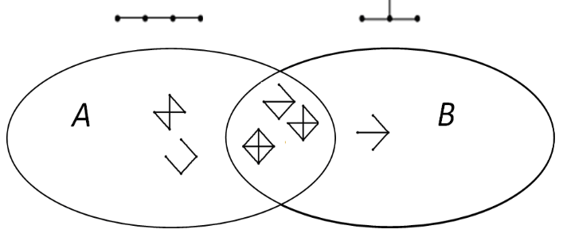



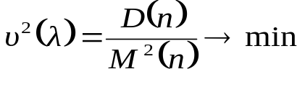
Efficient estimator for counting number of 4-motifs
‘Chain’ frame ‘Branch’ frame
We get two different estimates n_{A} and n_{B} for the number of the subgraph
Figure. A diagram of the coverage of two different 4-motifs by frames: A is a set of motifs containing a ‘chain’ frame, B is a set of motifs containing a ‘branch’ frame
The mixed estimate n of the number of the motif in the graph will be constructed as a linear combination of estimates
, where
n_{B}, n_{А} – the number of the motif estimate be obtained from the results of experiment B and A statistical experiments.
The optimal
is determined from the condition of minimizing the coefficient of the variation

Slide 7










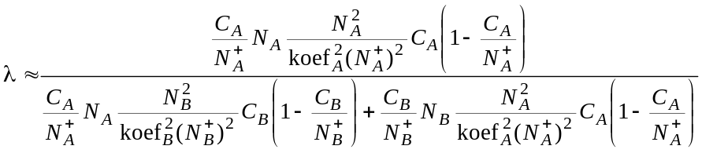
Efficient estimator for counting number of 4-motifs
are relative frequencies of this motif in two experiments,
N_{А} and N_{B} are the exact number of all frame A and B instances in the graph,
C_{А} , C_{B}– detections of the motif in A and B experiments,
are number of samples in experiment A and B
We find the optimal in the form

Slide 8
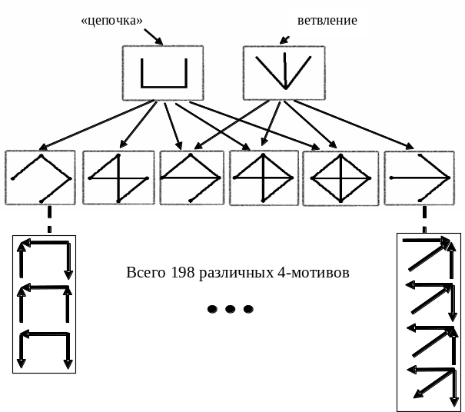
Сalculation of directed graphs
1
2
3
4
5
6
7
8
9
10
11
12
13
Случайный
выбор экземпляра каркаса
Идентификация
мотива

Slide 9
Table. Comparison of the calculation time for the 4-motifs
Experimental results
Network | Time of calculation, seconds
 | Rand-ESU igraph | Rand-ESU Fanmod | Our method
Protein-protein interactions network (Homo Sapience) | 338 | 451 | 67
Molecular network PathwayCommons | 3337 | 315 | 48
Gene network GenReg | 677 | 756 | 15
Fragment of social network (Twitter) | 1354 | 1255 | 36
Fragment of social network (Google Plus) | 719333 | 386828 | 2642

Slide 10
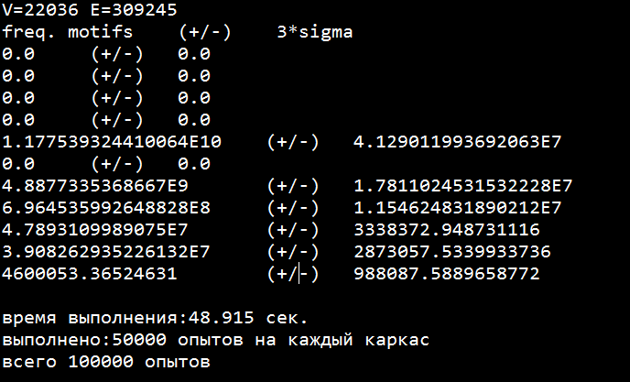
Examples of calculations
https://github.com/MNYudina/MotifsLib

