Slide 1
Pennok graph
Evgeniy Yudin
Vladimir Zadorozhniy

Slide 2
State of Arts : Extensions of BA model
1. Linear preferential attachment (L graphs)
p_{i} ∝ k_{i} + s
S. N. Dorogovtsev, J. F. F. Mendes, A. N. Samukhin. "Structure of Growing Networks with Preferential Linking". Phys. Rev. Lett. 85 (2000), 4633-4636. (IF 8.839, Q1)
2. Nonlinear preferential attachment
p_{i} ∝ f (k_{i} )
Zadorozhnyi V. N., Yudin E. B. Growing network: models following nonlinear preferential attachment rule // Physica A: Statistical Mechanics and its Applications. 2015. Т. 428, С. 111–132. (IF 2.132, Q2)
3. Hybrid Pennok Graphs (P Graphs)
Preferential attachment rule
with probability (1 - а)
with probability а
p_{i} ∝ 1
p_{i} ∝ k_{i}
Pennock, D.M., G.W. Flake, S. Lawrence, E.J. Glover, and C.L. Giles (2002) Winners don’t take all: Characterizing the competition for links on the web, PNAS, 99:8, pp. 5207-5211, (IF 9.504, Q1)

Slide 3







Final vertex degree distributions of P- and L-graphs
  P-graphs
  L-graphs
(1)
(3)
(2)
(4)
Theorem 1. Every hybrid graph of P class is equivalent in the final vertex degree distribution to a certain graph of L class.
Proof. The graph of P class and its vertex degree distribution is uniquely determined by the values of the parameters m and a. In accordance with any selected P- graph with the parameter a < 1 we put a L-graph with the same m and with the parameter
Substituting these m and s into formulas (3), (4) and simplifying them, we obtain formulas that coincide, respectively, with formulas (1), (2). Hence, the vertex degree distribution of the L-graph with such m, s coincides with the VDD of the selected P-graph. Let the hybrid graph with the parameter a = 1 correlate with the L-graph having a weight function . In this case, the vertex degree distribution of the L-graph (3), (4) also coincides with the vertex degree distribution (1), (2) of the selected hybrid graph for which a = 1.

Slide 4
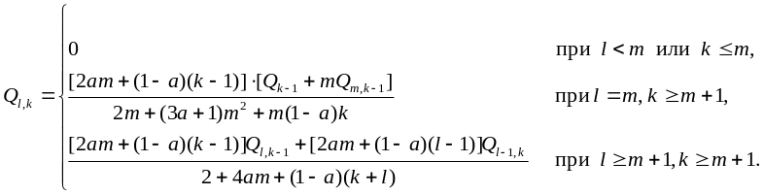
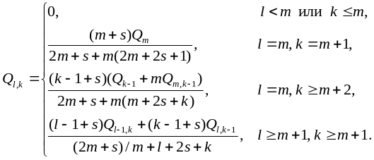
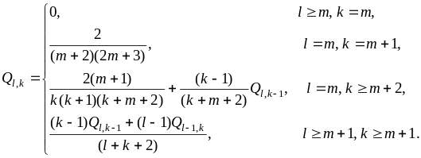

Final arc/edge endpoints degrees distributions of P- and L-graphs
  P-graphs
  L-graphs
a = 0
s = 0
  BA-model
. (18)
Zadorozhnyi V.N., Yudin E.B. Structural properties of the scale-free Barabasi-Albert graph // Automation and Remote Control. 2012. Т. 73. № 4. С. 702-716. (IF 0.562, Q3)
Theorem 2. Every hybrid graph of P class, equivalent in the final vertex degree distribution to a definite graph of L class, is also equivalent to this graph in the final arc/edge endpoints degrees distribution.
m = 1
  BA-tree
L. Krapivsky, S. Redner, and F. Leyvraz, Connectivity of growing random networks, Physical Review Letters 85 (2000), 4629–4632. (IF 8.839, Q1)

Slide 5
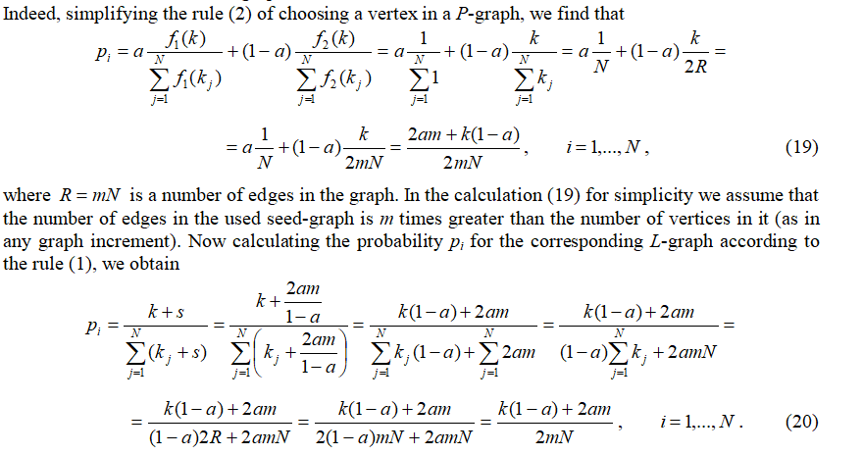
Isomorphism of P- and L-models with displacements s ≥ 0
Graphs with the same vertex degree distribution and
with the same vertex degree correlations
Theorem 3. Every P-graph is equivalent to a certain L-graph

Slide 6
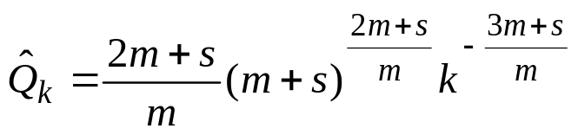
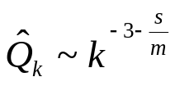
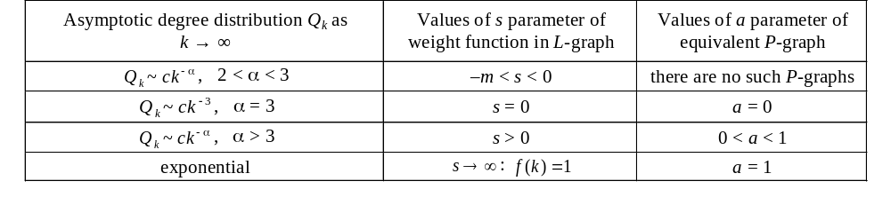
Approximate vertex degree distribution of L-graphs in closed form
L-graphs
p_{i} ∝ s + k_{i}
S. N. Dorogovtsev, J. F. F. Mendes, A. N. Samukhin. "Structure of Growing Networks with Preferential Linking". Phys. Rev. Lett. 85 (2000), 4633-4636. (IF 8.839, Q1) цитирований в Scopus – 890
Asymptotics of degree distribution analisys
Table . Asymptotic degree distribution Q_{k} of P- and L-graphs

Slide 7
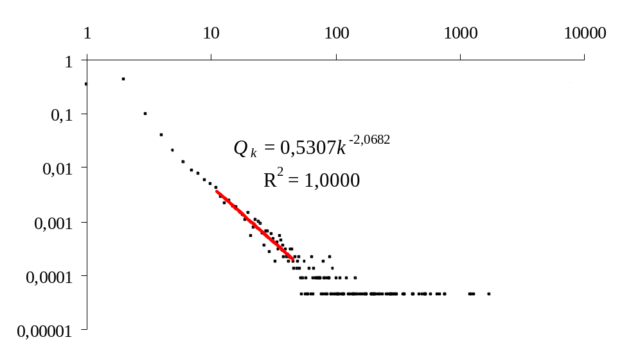
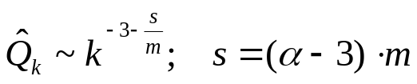
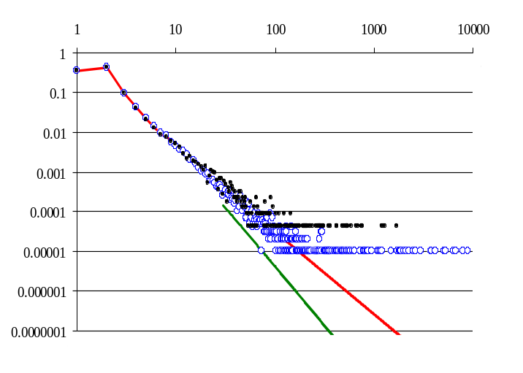

NPA graph calibration
m=E/N = 2.1093
α = 2.0682 =>
s = –1.9655
NPA graph calibration
Distribution of Q_{k} on the Internet
Zadorozhnyi V. N., Yudin E. B. Growing network: models following nonlinear preferential attachment rule // Physica A: Statistical Mechanics and its Applications. 2015. Т. 428, С. 111–132. (IF 2.132, Q2)
As a result, the autonomous system network model is now defined as a graph with preferential attachment, whose weight function when k ≥ 11 is given by the formula
and for k = 1, …, 10 takes values 0, 0, 0, 1.38802, 2.40613, 5.28966, 6.67, 6.71098, 7.79545, 8.10619 respectively. The stochastic increment is formed as a vertex with a random number x of arcs, which can take the values x = 1, …, 6 with probabilities 0.34145, 0.42246, 0.09664, 0.09433, 0.01504, 0.03008 respectively (meanwhile, the average value of x is m = 2.1093).
Figure. Degree distribution Qk of a graph with a size of 100 thousand vertices, grown in a simulation model (blue round markers) and degree distribution calculated by the exact formulas (the upper red solid line). Black dots represent the Qk in the network of autonomous systems. The green bottom solid line shows the slope angle of the Qk, which is realized with the traditional use of the weight function that implements the asymptotics distribution . With this asymptotics distribution by changing the coefficient c the green line can be replaced higher, but its slope angle cannot be changed.

Slide 8
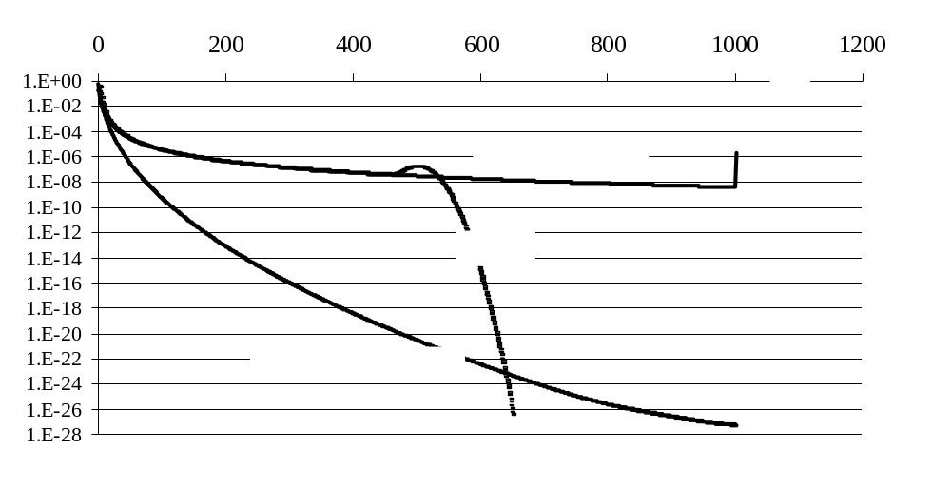
NPA graph with loss of arcs or vertices
Final vertex degree distributions for three modes of a graph development
For all model the preferential function f(k)=k if k<1000 else f(k) = 0.
Lossless arcs regime is generation of NPA graph with fixed x ≡ m = 1
Lossy arcs regime is generation of NPA graph with fixed x ≡ m = 2 and with the randomly removing an edge at each step
Sieved regime is NPA graph with x ≡ m = 2 and the edge collection turned out to be the same, as in case of continuous arc loss (half of the edges are eliminated)

Slide 9
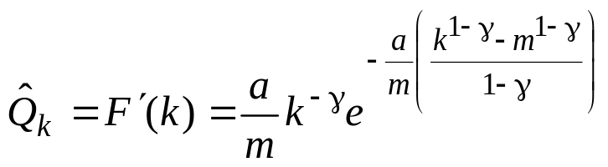
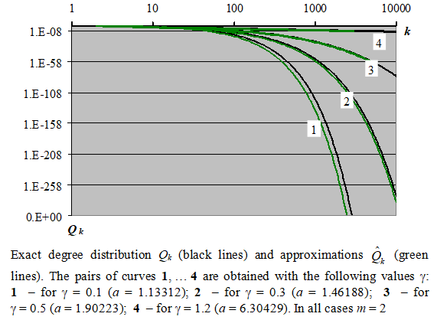
Results using «Mean field» theory
Linear preferential attachment
p_{i} ∝ s + k_{i}
S. N. Dorogovtsev, J. F. F. Mendes, A. N. Samukhin. "Structure of Growing Networks with Preferential Linking". Phys. Rev. Lett. 85 (2000), 4633-4636.
Power preferential attachment
p_{i} ∝ k_{i} ^{γ}
Zadorozhnyi, V.N., Yudin, E.B. Construction of Growing Graphs with Given Power-Law Asymptotics of Vertex Degree Distributions //12th International Scientific and Technical Conference "Dynamics of Systems, Mechanisms and Machines", Dynamics 2018. DOI: 10.1109/Dynamics.2018.8601491.
More accurate results than in
L. Krapivsky, S. Redner, and F. Leyvraz, Connectivity of growing random networks, Physical Review Letters 85 (2000), 4629–4632.

