Slide 1
Growing graph with the nonlinear rule of preferential attachment
Evgeniy Yudin
Vladimir Zadorozhniy

Slide 2
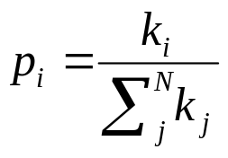
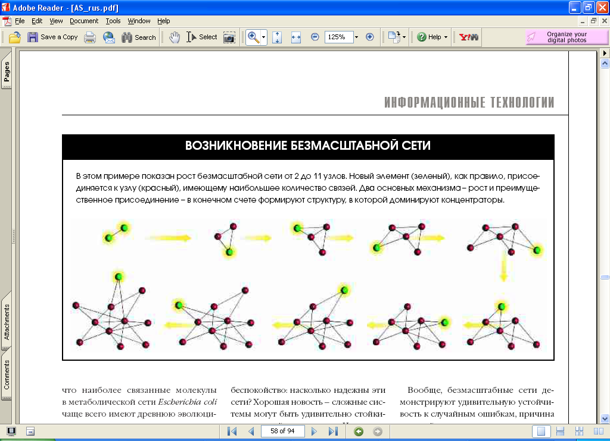
BA model
A.-L. Barabási, R. Albert Emergence of scaling in random networks// (1999) Science 286, 509–512.
R. Albert, A.-L. Barabási Statistical mechanics of complex networks // (2002) Reviews of Modern Physics 74, 47-97.
p_{i} ∝ k_{i}

Slide 3
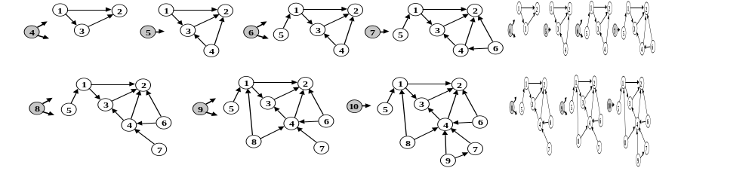
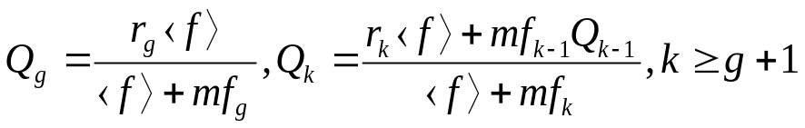
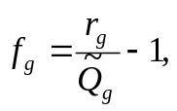
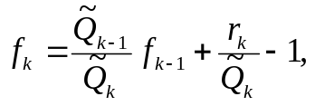


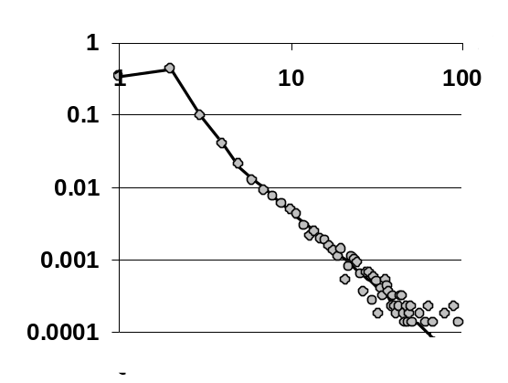
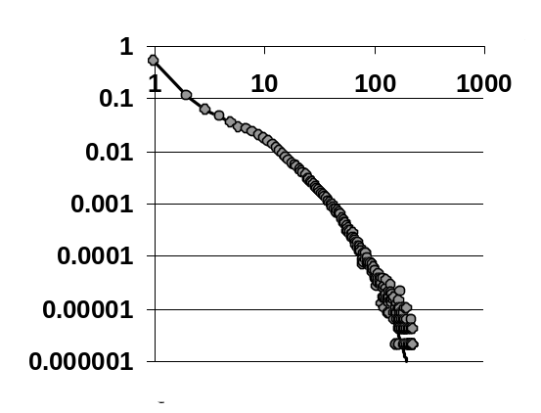


Nonlinear preferential attachment graphs (NPA graphs)
p_{i} ∝ f (k_{i} )
Graph analysis task
Calibration task
where Q_{k} is probability of a randomly selected vertex has degree k; g is minimal vertex degree, M is a maximal vertex degree, m = Σ_{k}(kr_{k}) is the average degree, the average preferential function
If f(k) = k and f_{g}= g = m (the BA graph) then ⟨f⟩=⟨k⟩=2m; and the
or in closed form
S. N. Dorogovtsev, J. F. F. Mendes, A. N. Samukhin, Structure of growing networks: Exact solution of the Barabasi-Albert’s model, Phys.Rev. Lett. 85 (2000) 4633–4636.
Degree distribution of the Internet at the level of autonomous systems
(M. Newman)
Degree distribution of the movie actors networks
(Barabasi and Albert)
Zadorozhnyi V. N., Yudin E. B. Growing network: models following nonlinear preferential attachment rule // Physica A: Statistical Mechanics and its Applications. 2015. Т. 428, С. 111–132.

Slide 4
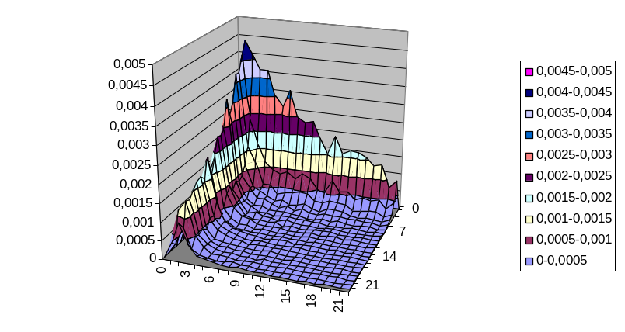
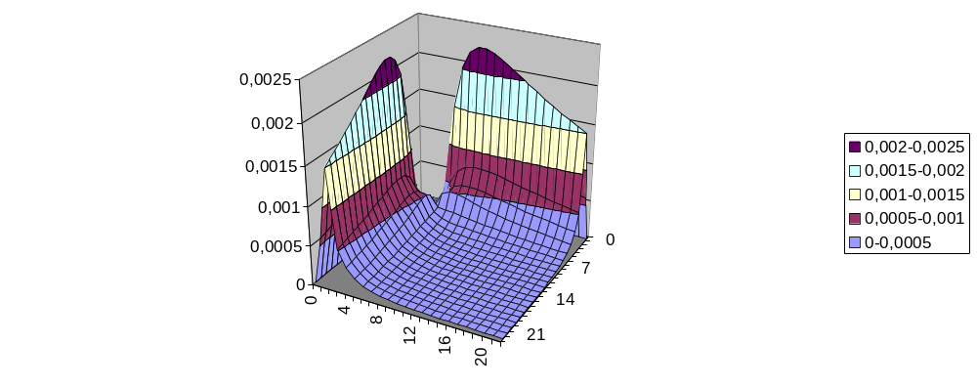
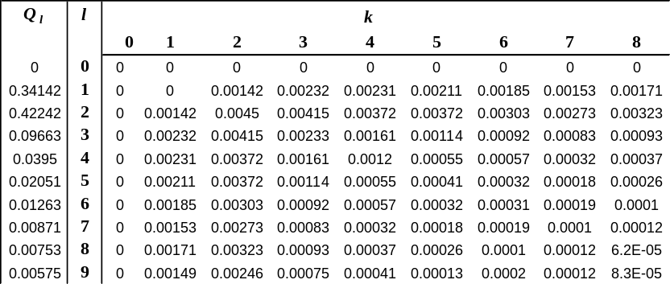

Complex calibration of NPA graphs
Vertex degree distribution of calibrated graph and autonomous Internet systems network
Vertex degree correlations of the NPA graph (after the calibration by the vertex degree distribution – on the left) and the node degree correlations of the autonomous Internet systems network (on the right)
Vertex degree correlations of the NPA graphs
k = g, g + 1, g + 2, …,
If f(k) = k and f_{g}= g = m (the BA graph) then ⟨f⟩ = ⟨k⟩=2m; and
Node degree correlations of the autonomous Internet systems network
L. Krapivsky, S. Redner, and F. Leyvraz, Connectivity of growing random networks, Physical Review Letters 85 (2000), 4629–4632.

Slide 5
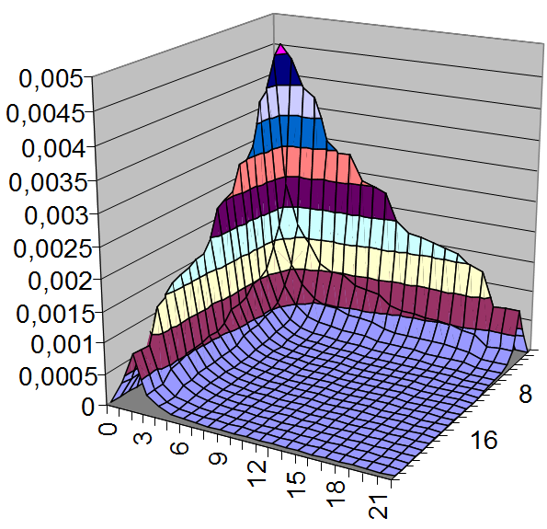






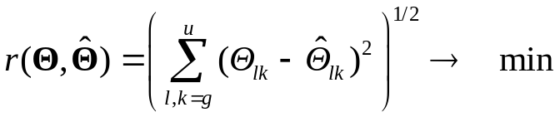
Complex calibration of NPA graphs
We have
or
If undirected graph we have
We must find {r_{k}} and preference function f(k), which implement given vertex degree distribution {Q_{k}} and deliver minimum deviation of vertex degree correlations from given node degree correlations .
Vertex degree correlations of the NPA graph after the complex calibration – on the left and the node degree correlations of the autonomous Internet systems network (on the right).
Zadorozhnyi V. N., Yudin E. B., Yudina M.N., Analytical and Numerical Methods of Calibration for Preferential Attachment Random Graphs // International Siberian conference on control and communications (SIBCON–2017), Kazakhstan, Astana expo–2017, June 29–30, 2017 DOI: 10.1109/SIBCON.2017.7998461

Slide 6
NPA graphs with Complex Stochastic Increments
Step 1
Step 2
Step 3
5
6
1
5
1
1
1
1
2
2
2
2
2
1
2
4
1
2
4
1
2
6
7
4
3
5
3
3
3
3
3
3
3
common increment
complex increment
common increment
Growing of the NPA graphs with Complex Stochastic Increments
Graphs, grown by adding common increments (monads), having one vertex, and complex increments , having two (or n) connected vertices. At each graph growth step, a dyad (n-ad) appears with the specified probability γ and a monad does with the probability (1 – γ). The graph growth starts with the given "seed" graph.
Analytic solutions of various calibration (synthesis) problem due to the given final degrees distribution of vertices and edge endpoints distribution are derived for the NPA graphs with complex stochastic increments. Numerical method is developed for a complex graph calibration by vertex degree distributions together with edge degrees and clustering coefficient.
Zadorozhnyi V.N., Yudin E.B., Yudina M.N. Graphs with complex stochastic increments // 2017 11th International IEEE Scientific and Technical Conference Dynamics of Systems, Mechanisms and Machines Dynamics. – P.1-8. DOI: 10.1109/Dynamics.2017.8239525.

Slide 7
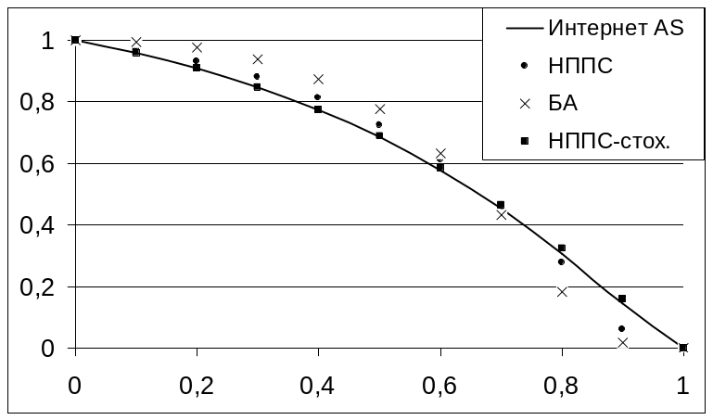
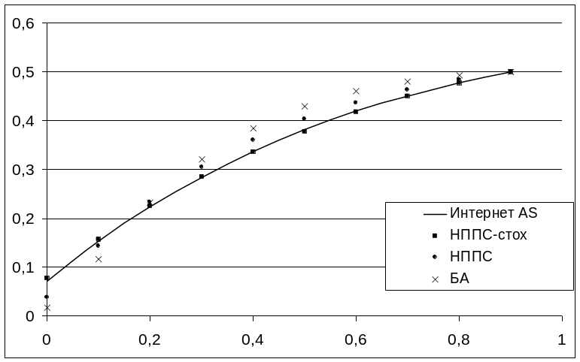
Network processes simulation
Random edge removal
SIS model simulation
AS is The snapshot of the structure of the Internet at the level of autonomous systems (Newman)
Network has 22 963 nodes and 48 436 edges
BA is Barabasi-Albert model (m = 2)
NPA is NPA graph calibrated by Q_{k} and Q_{lk})
NPA-complex is– NPA graphs with complex stochastic increments calibratad by Q_{k} , Q_{lk}
and clustering coefficient
Calibrated NPA-complex graph parameters are
γ = 0.04096; {r'₁, …, r'₄} = {0.3936, 0.4945, 0.1062, 0.00577}; {r''₁, …, r''₃₀} = {0.0773, 0, 0.2658, 0.3285, 0, 0.127, 0, 0, 0.0465, 0, 0, 0.0706, 0, 0, 0, 0, 0, 0.0055, 0, 0.0036, 0, 0, 0, 0, 0, 0.0063, 0, 0, 0, 0.0687}; {f₁, …, f₃₁} = {0.0737, 0.1416, 0.7014, 1.455, 2.546, 3.393, 4.198, 4.490, 5.122, 5.783, 6.047, 7.216, 8.516, 8.861, 9.306, 9.704, 10.07, 10.57, 11.06, 11.49, 11.92, 12.18, 12.44, 12.66, 12.86, 13.43, 13.98, 14.11, 14.27, 20.21, 26.2}; f_{k} = 0.829353∙k for k ≥ 32.

Slide 8
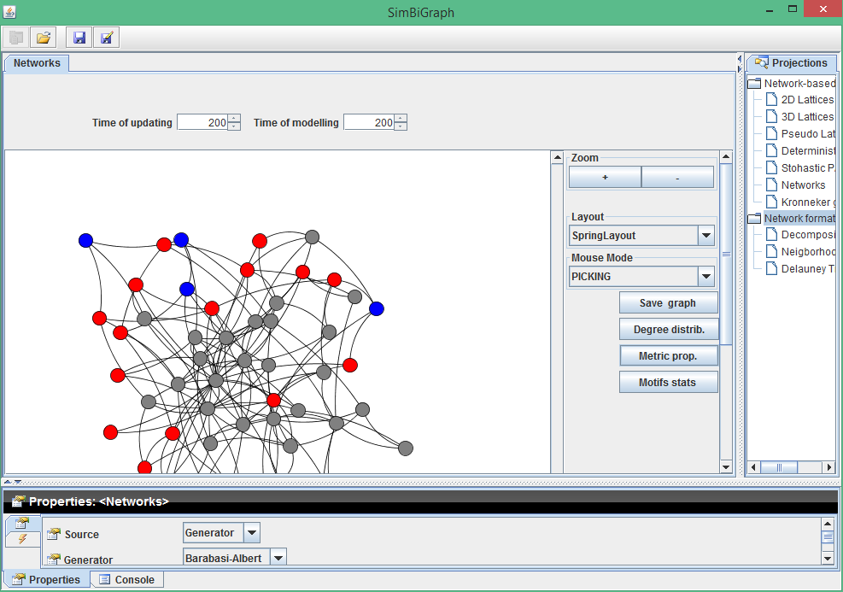
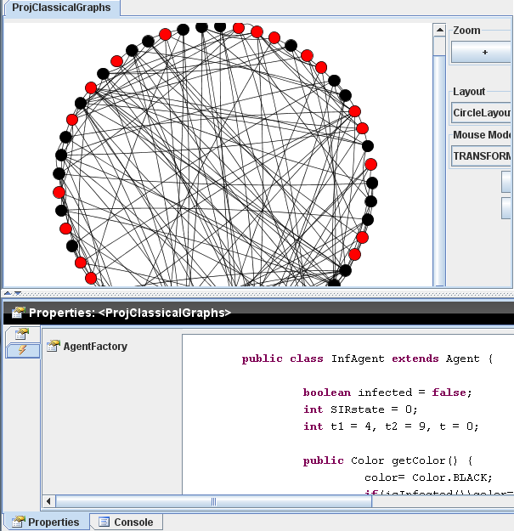
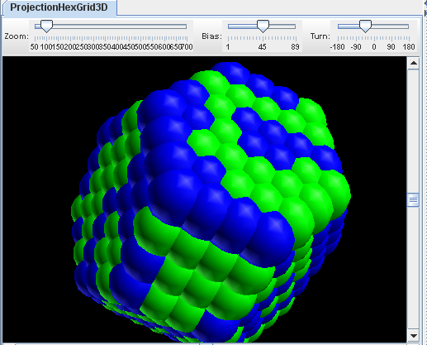
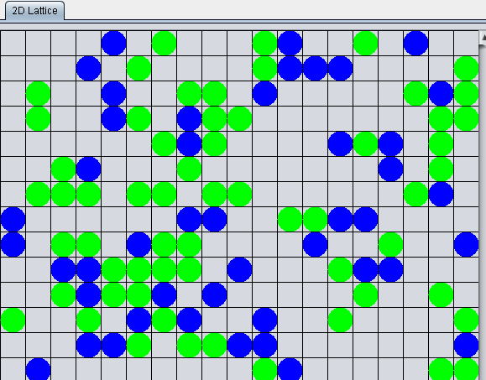
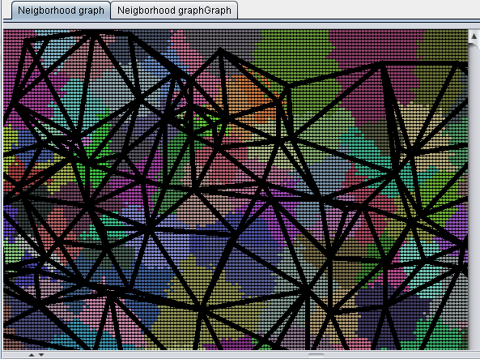
SIMBIGRAPH
https://github.com/yudinev/Simbigraph2
a)
b)
c)
d)
e)
a) main window; б) agent behavior editor; в) г) 3D and 2D lattice; д) planar graph growing.

Slide 9
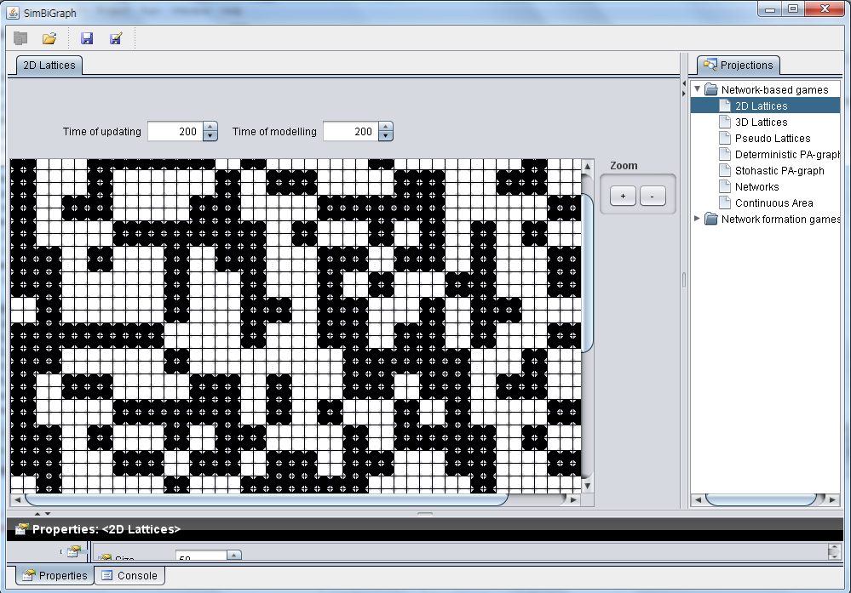
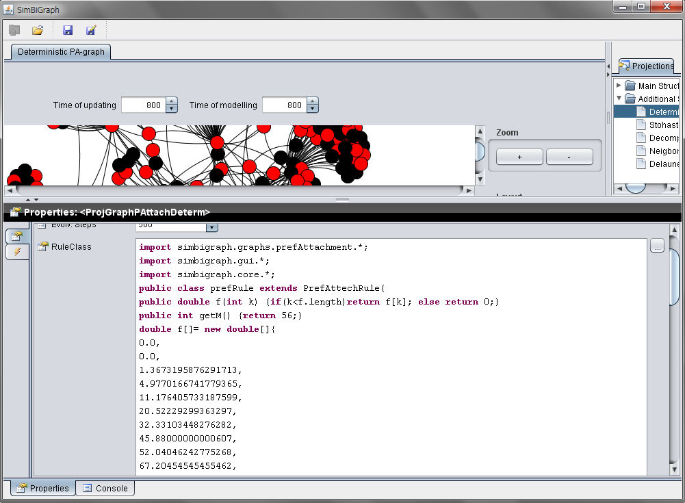
SIMBIGRAPH

Slide 10
Additional slides…
Notes:
Добавлены новые модули, доработаны старые, результаты представлены на конференциях, даже получена премия и награда на Конференции в Санкт-Петербурге

Slide 11






Balance equation
A_{k+n}
We get a balance equation setting equal to the expressions for Q_{k} before and after the step of generating in a stationary regime of the graph development (i.e. N → ∞). At each step of the graph growing, a n-ad is appear with the probability γ, common increment is appear with the probability (1 – γ).
A_{k+1}
A_{k+1}
–mP_{k}
–(n⋅m–n⋅μ)P_{k}
–μP_{k}
A_{k}
A_{k}
+mP_{k–1}
+(n⋅m–n⋅μ) P_{k–1}
+μP_{k–n}
A_{k–1}
A_{k–1}
A_{k–n}
Changing the number of vertices in A_{k} by adding of monad (left) and n-ad (right)
Then we get
.
Let us reduce the identical terms |A_{k}|N and divide the equality by N. As a result, the expression |A_{k}|((γ – 1) + γ⋅n) in the left part is transformed into Q_{k}((γ–1) + γ⋅n), and the multipliers N in the right part are reduced. Replacing all P_{k} in the right part of equality with the expression, we obtain the balance equation for Q_{k}:
where
,

Slide 12



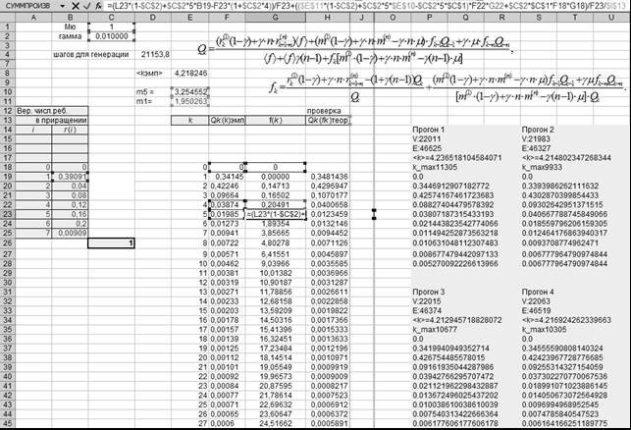
NPA graph calibration by degree distribution
Calibration of the graph by the vertex degree distribution. In the problem of graph calibration it is necessary to find the parameters { },{ }, {f_{k}}, γ, μ at which the graph will have a given vertex degree distribution {Qk}. This problem can be solved using following equations
where
Figure shows a graph calibration using pentads (complete graphs in increments that contain 5 vertices) and monads. The probability of pentad occurrence γ = 0.01. As a basic vertex degree distribution we get a smoothed distribution, obtained from data on the network of autonomous Internet systems. Figure shows the results of generating a graph with given parameters after adding 50 thousand graph increments, a complete graph containing 4 vertices was used as a seed graph.
Figure. Calibration of a random graph using spreadsheets

