Slide 1
What would we do
Notes:
What would we do coding online – https://replit.com/ https://replit.com/@yudit12/datastructuresalgorithmscpp

Slide 2
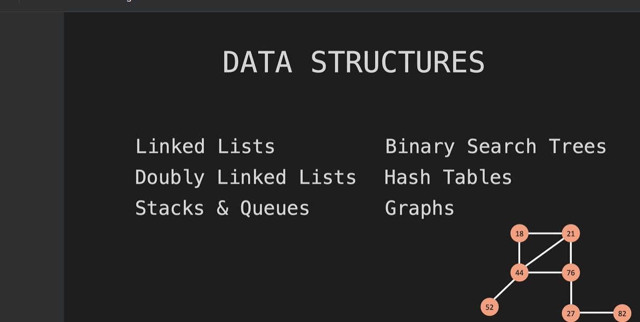

Slide 3

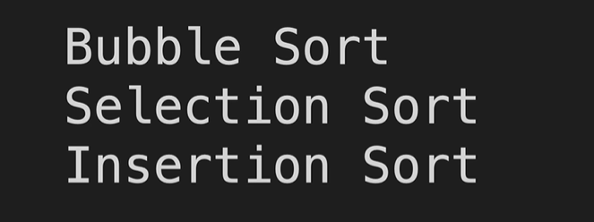
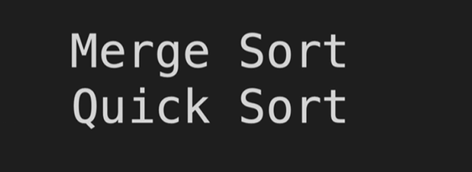

Slide 4
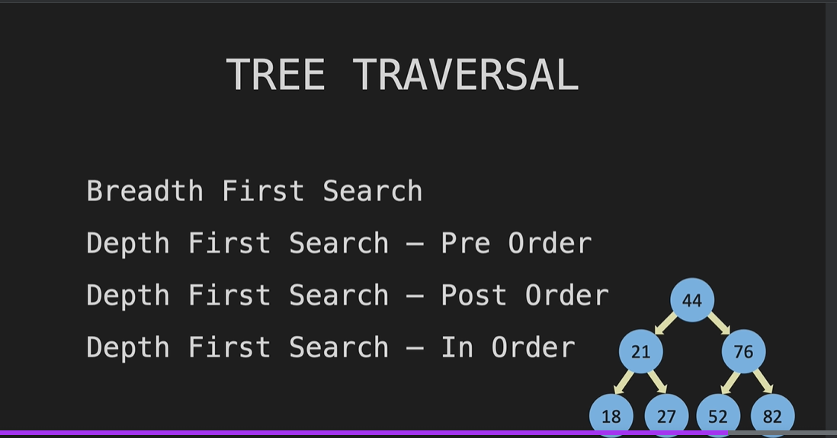

Slide 5
Big O So what is big O?
Big O is a way of comparing two sets of code.
Big O is a way of comparing code one and code two mathematically about how efficient they run. Keys - time complexity. -time complexity that is interesting is that it is not measured in time.
- it is measured in the number of operations that it takes to complete something.
-space complexity.
- memory space
Notes:
Big O So what is big O?
Big O is a way of comparing two sets of code.
Big O is a way of comparing code one and code two mathematically about how efficient they run. Keys - time complexity. -time complexity that is interesting is that it is not measured in time.
- it is measured in the number of operations that it takes to complete something.
-space complexity.
- memory space
when dealing with time and space complexity, you will see these three Greek letters.
They are omega, theta and Omicron.
Omicron is better known as O as in big O.
So when we're looking at how many times that we have to run the for loop, ( in sort array 1..7) best case would be if we're looking for the number one,
worst case - would be if we were looking for the number seven.
average case - would be if we were looking for the number four.
best case - with the number one for that we use omega.
average case - we use the Greek letter theta.
worst case - we use the Greek letter omicron or O. So one of the things people will say when you talk about your big O being a particular time complexity
is they'll say things like, yeah, but what is your average big O or your best case, big O?
Well, technically there is no average case or best case.
Big O average case would be theta and best case would be omega.
But you will hear people use it in that way.
But technically big O is always worst case.

Slide 6
when dealing with time and space complexity, you will see these three Greek letters.
They are omega, theta and Omicron.
Omicron is better known as O as in big O.
So when we're looking at how many times that we have to run the for loop, ( in sort array 1..7) best case would be if we're looking for the number one,
worst case - would be if we were looking for the number seven.
average case - would be if we were looking for the number four.
best case - with the number one for that we use omega.
average case - we use the Greek letter theta.
worst case - we use the Greek letter omicron or O. So one of the things people will say when you talk about your big O being a particular time complexity
is they'll say things like, yeah, but what is your average big O or your best case, big O?
Well, technically there is no average case or best case.
Big O average case would be theta and best case would be omega.

Slide 7
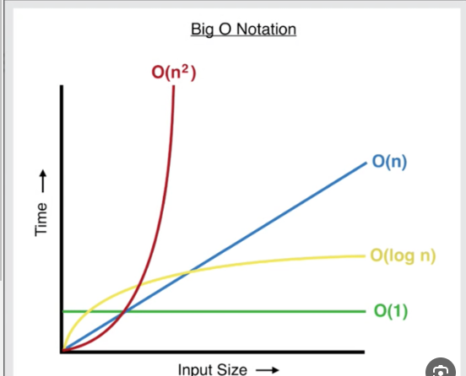
https://www.bigocheatsheet.com/
https://www.bigocheatsheet.com/
Notes:
time complexity – graph On the bottom, x axis - this is n
on the y axis this is the number of operations O(n) o of n is always going to be a straight line.
It is what is called proportional.
O(n^2)
O(1)
- first big O where the number of operations does not change as n becomes larger.
- in this situation, if n was one we would have one operation which is the addition.
if n went all the way to a million, we would still have one operation, which is the addition. and that Is o of one.
O(log(N))
process of cutting it in half repeatedly to find an element
Senereio
- you have to have sorted data. ( for example, list 1..8)
- we're not going to know where it is in the list.
-we're going to do is find the most efficient way of finding a number in this list.
Solution
- We're going to take the list.
- We're going to cut it in half and say is it in the first half or is it in the second half.
- Well it's not in the second half.
- So we can remove that.
- And now we only have to search through this many numbers and then we'll do it again.
- It's not in the second half.
- And we can remove those.
- And we do it a third time.
And we find the number that we're looking for.
Explanation
we had eight items in the list and it took us three steps to find a number.
2^3 =8
2^3 =8 -> log(2)8 = 3
Can be explain as -
you're basically saying is two to the what power equals eight
- how many times you have to take the number eight and divide it by two to get down to one item.
Advantage –
- if you think about a list with a billion items in it, if you're going to iterate through that linearly from beginning to end, you could have over a billion operations.
But if you do this process of cutting it in half repeatedly, you can find any number in that list in
31 steps.
And that is the power of O of log n.
with big O, we have a few rules for simplification.
- drop constants.
- drop non dominance.
- different terms for inputs.
drop constants- o (2n) -> o (n) And you might wonder why would we do that?
Isn't it different to have something run two n times versus one n time?
answer -
we're trying to do with big O is figure out the broad category that the growth rate is
in. So even at 100 N, it is growing linearly. drop non dominance o (n^2 +n) -> o (n^2)
different terms for inputs. O(a+b) is not o(n+n) therefore we cant minimize it case a and b are different input big O of vectors. Using pushback() or popback() to add / remove something to the end, we don't have to touch any of these other items. -> o(1)
using erase() –
removing from the begging / middle of the vector require change the remain vector items indexes therefore -> o(n) find() - search for value in the vector - by value - iterate from from the first value -> o(n)
- by index – going immediately to the needed index o(1)
https://www.bigocheatsheet.com/

Slide 8
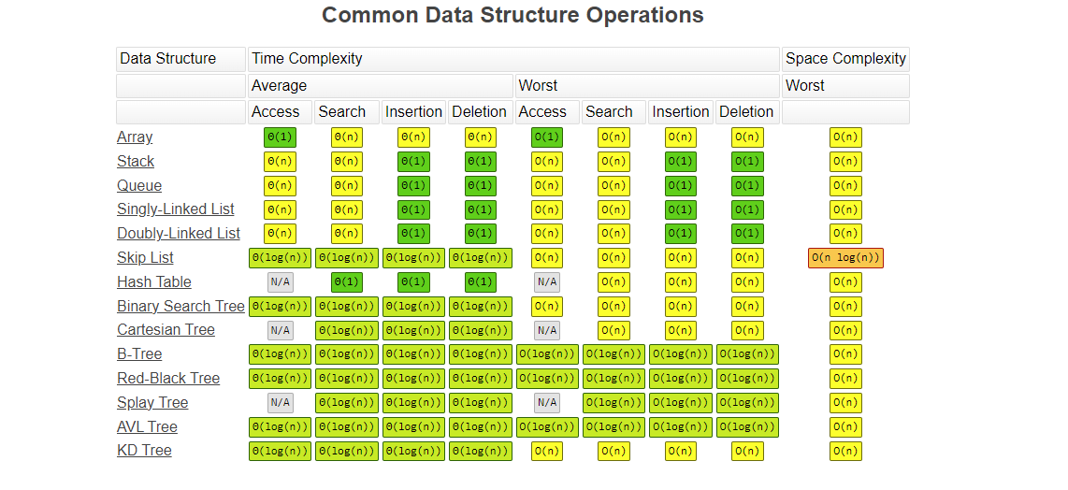
https://www.bigocheatsheet.com/

Slide 9
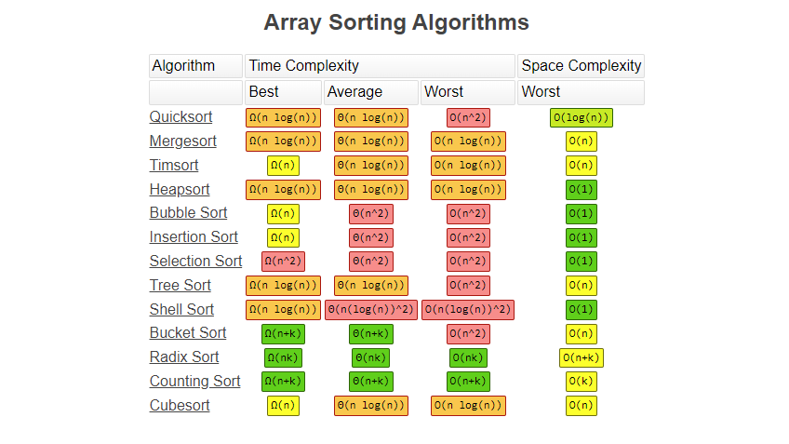
https://www.bigocheatsheet.com/

Slide 10
Pointers
Notes:
Pointers int *num1 = new int(11) So num one is pointing to this integer in memory.

Slide 11
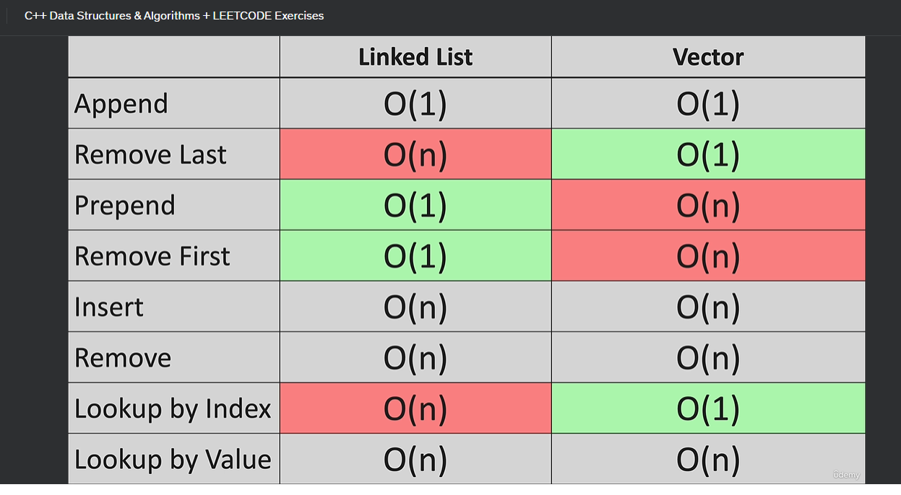
Notes:
Vector is continual memory list is not

Slide 12
Notes:
Link list deleteLast edge case:
Empty list
1 node
many node in the list

