Slide 1
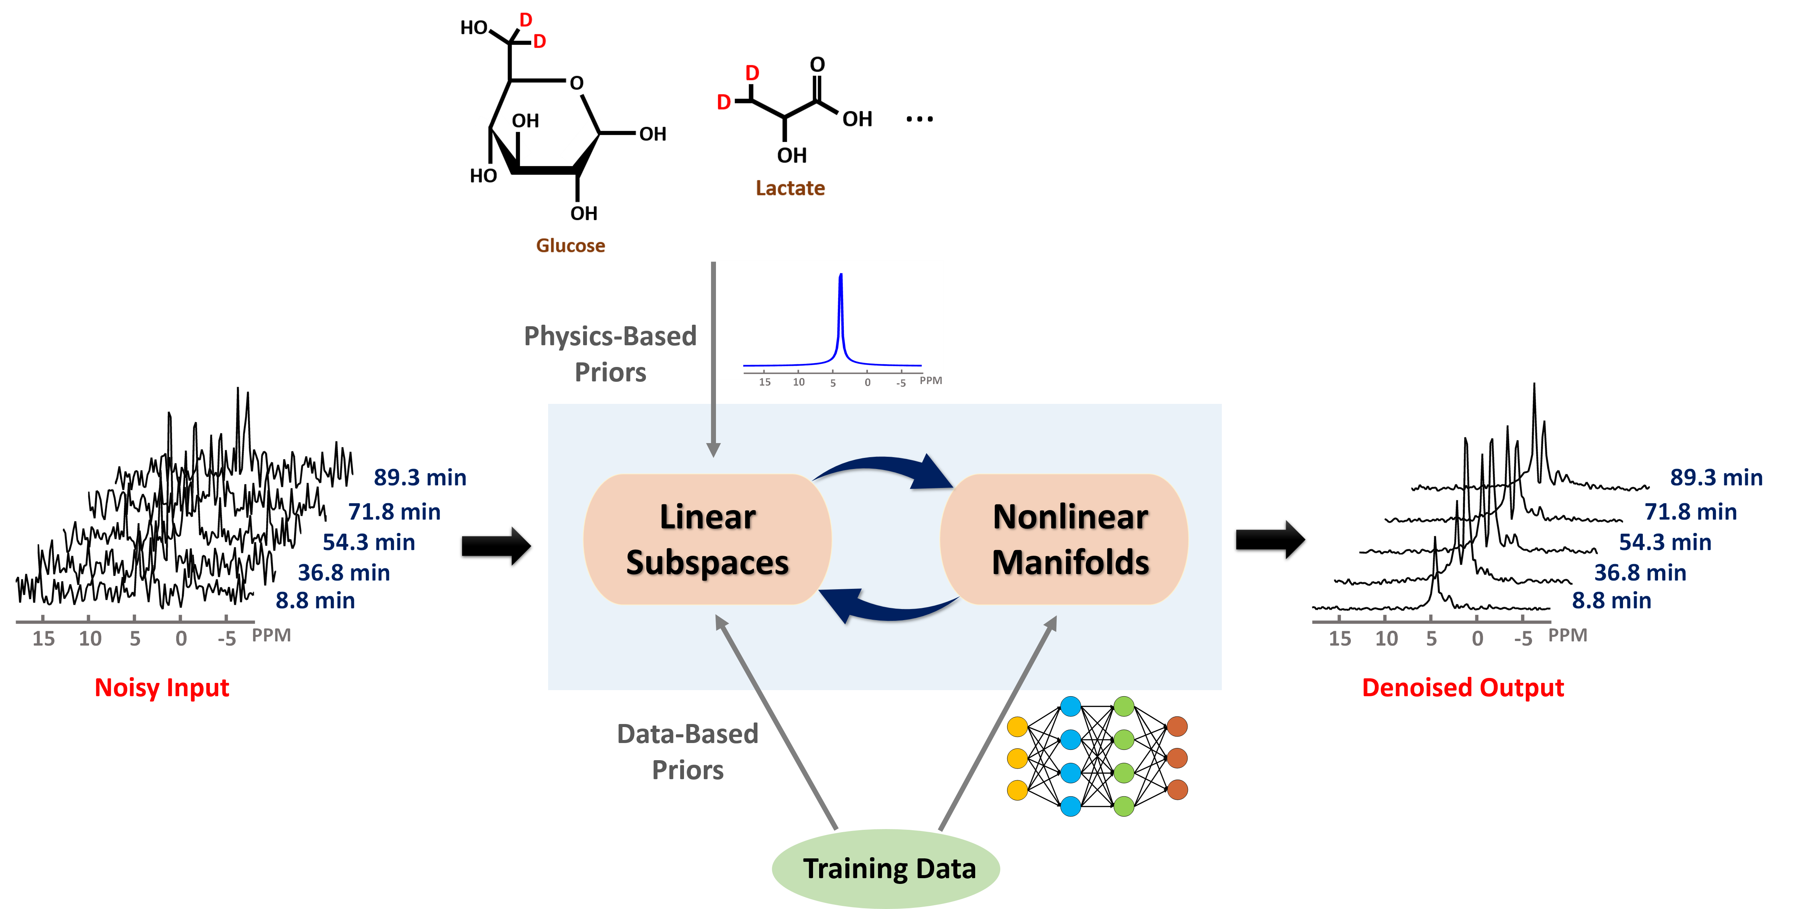
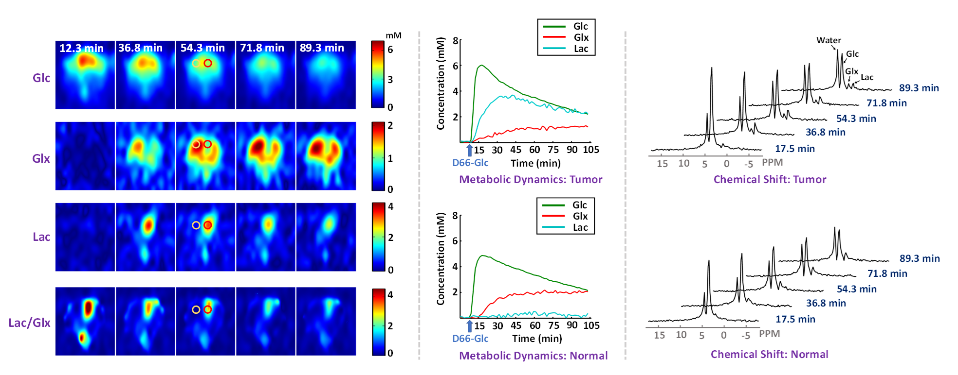
Schematic overview of the proposed learning-based processing framework that enables high-resolution dynamic DMRSI.
High-resolution (10 $μ$L; 1 min) dynamic DMRSI results of rat brain with a small tumor.

