Slide 1
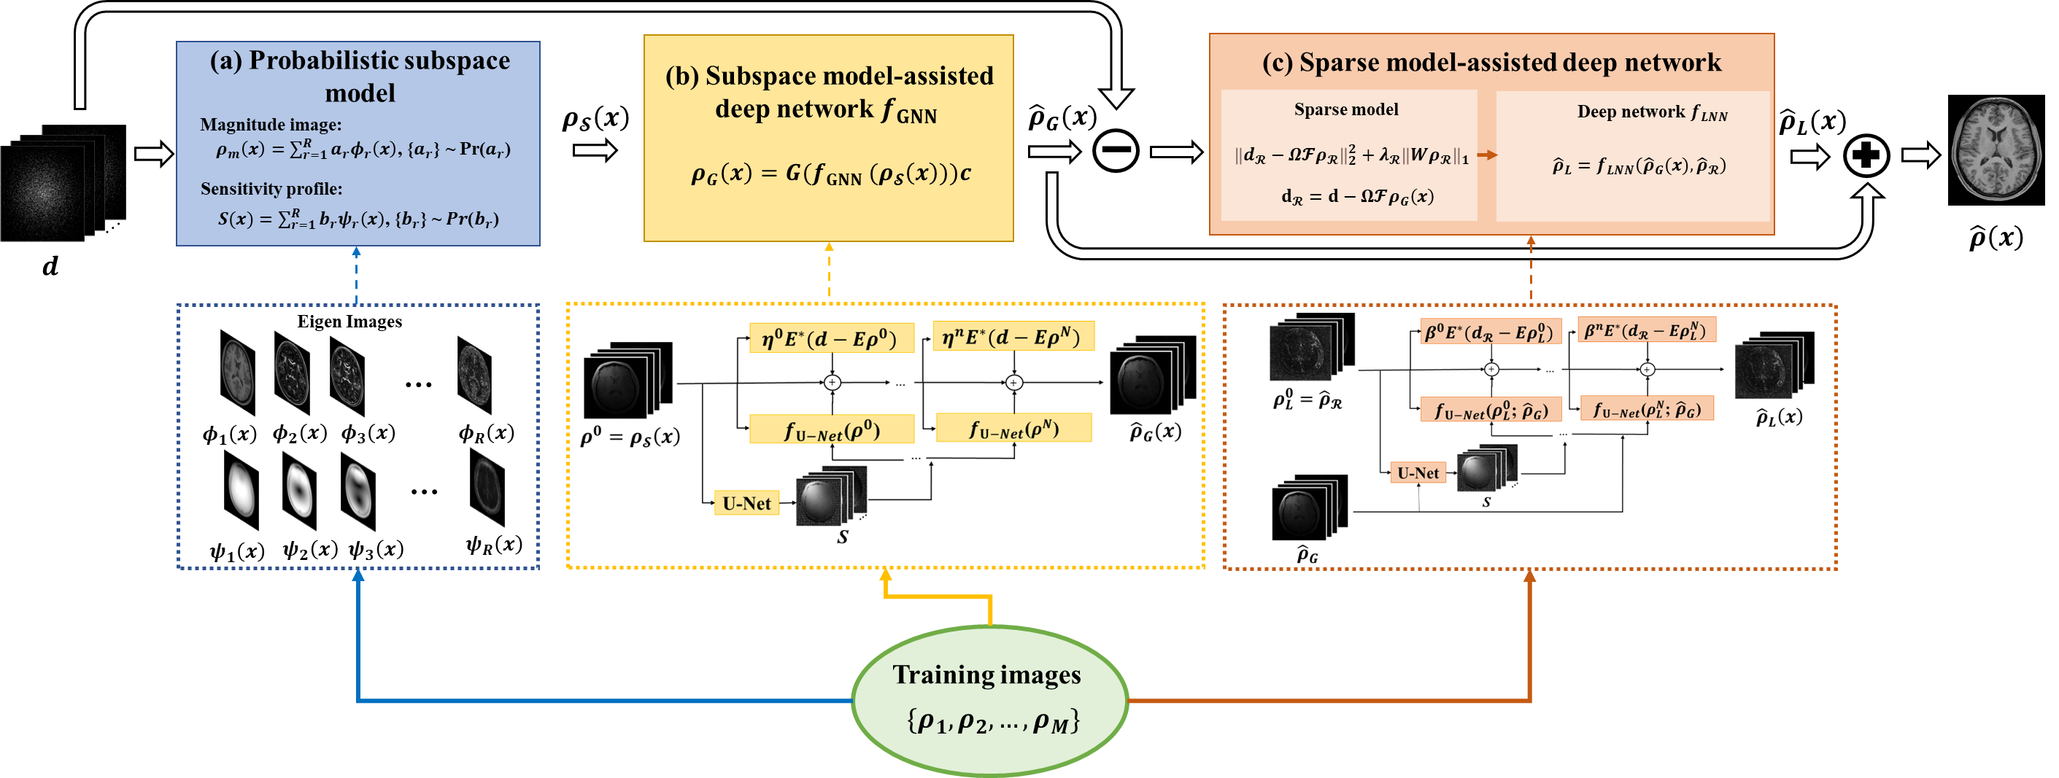
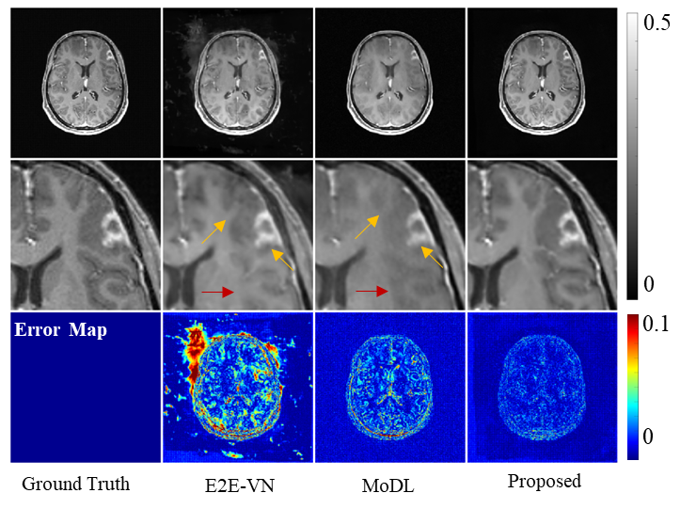
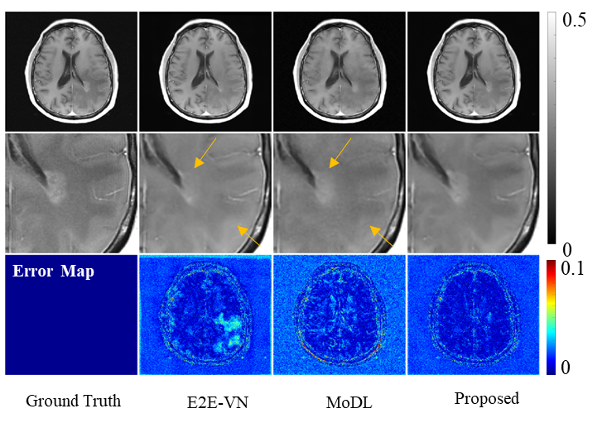
A schematic overview of the proposed method for stabilizing DL-based image reconstruction.
Representative reconstructions from E2E-VN, MoDL and the proposed method for lesion data.

