Slide 1
LAB 2 TA 陳昱丞
yucheng.cs11@nycu.edu.tw

Slide 2
Deadline: 2023/04/11(Tue) 12:00 Demo: 2023/04/11(Tue)

Slide 3
Must use sample code, otherwise no credit.
In this lab,

Slide 4
Outline
2048 Game Rule
Game State
Temporal Difference Learning
n-tuple Network
Modify and Run Sample Code
Scoring Criteria
Reminders

Slide 5
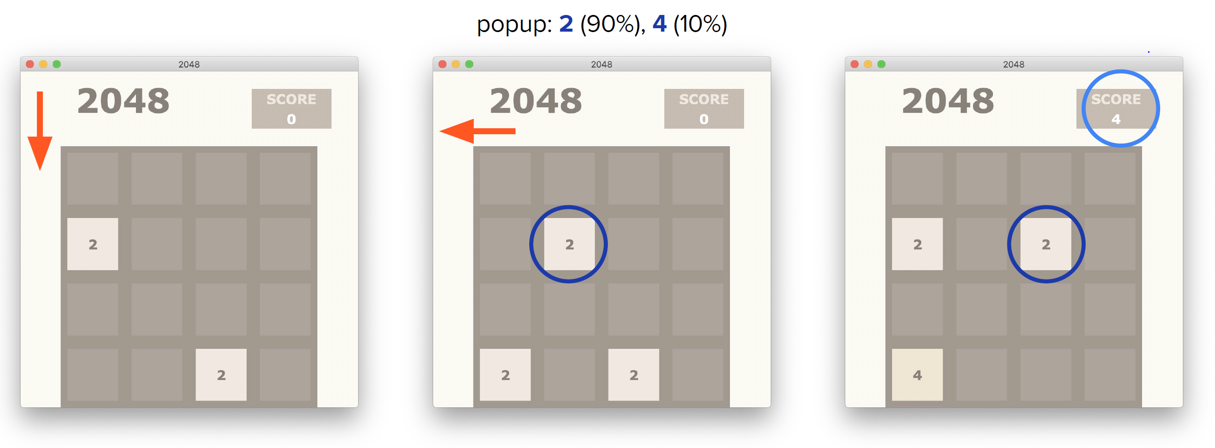
2048 Game Rules (1/2)

Slide 6
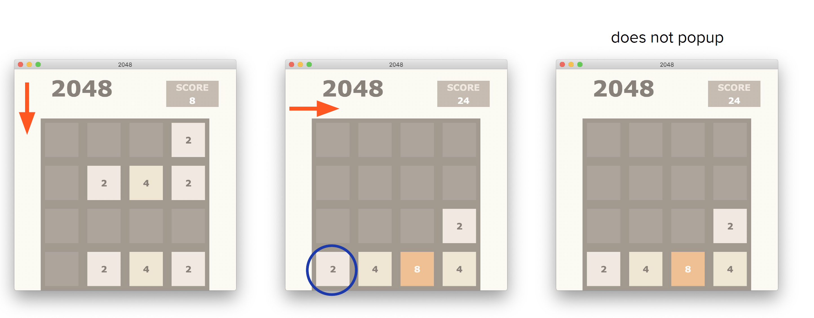
2048 Game Rules (2/2)

Slide 7
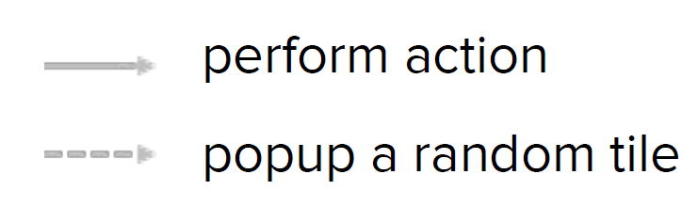

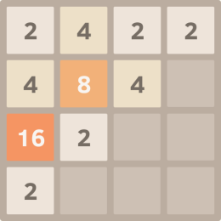
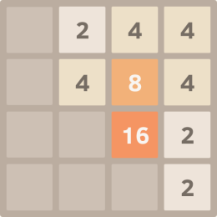
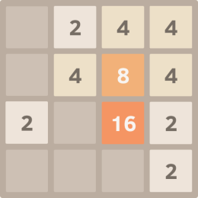




Game State
beforestate
afterstate
$$S^{ }$$
$$a_{t}$$
$$S^{′}$$
$$S^{′′}$$
r

Slide 8
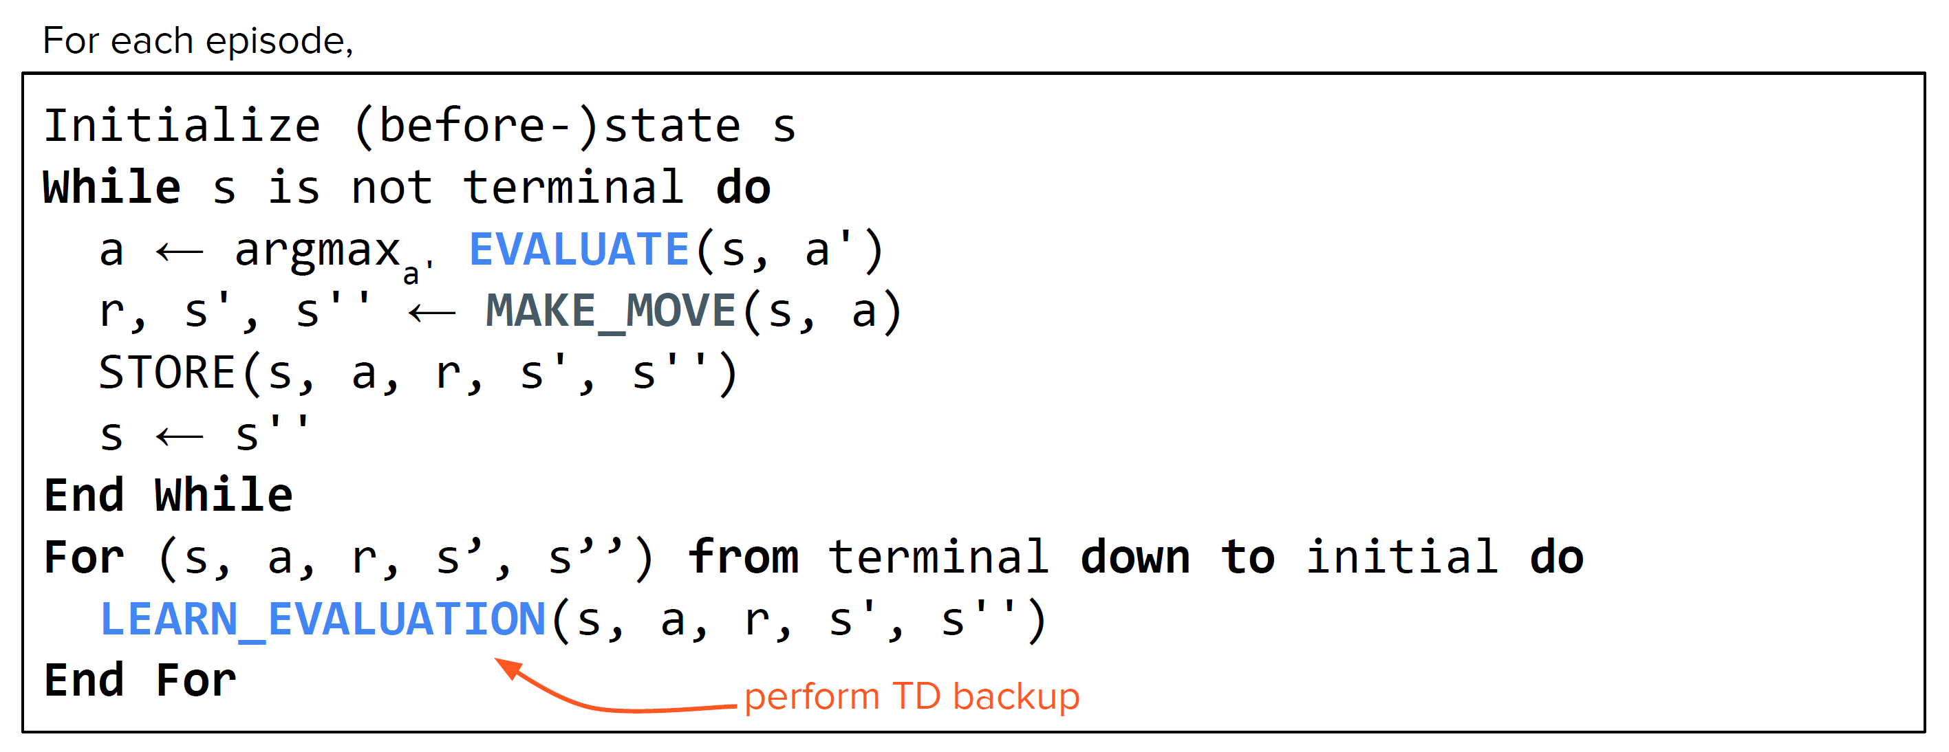
Temporal Difference Learning (TD)

Slide 9
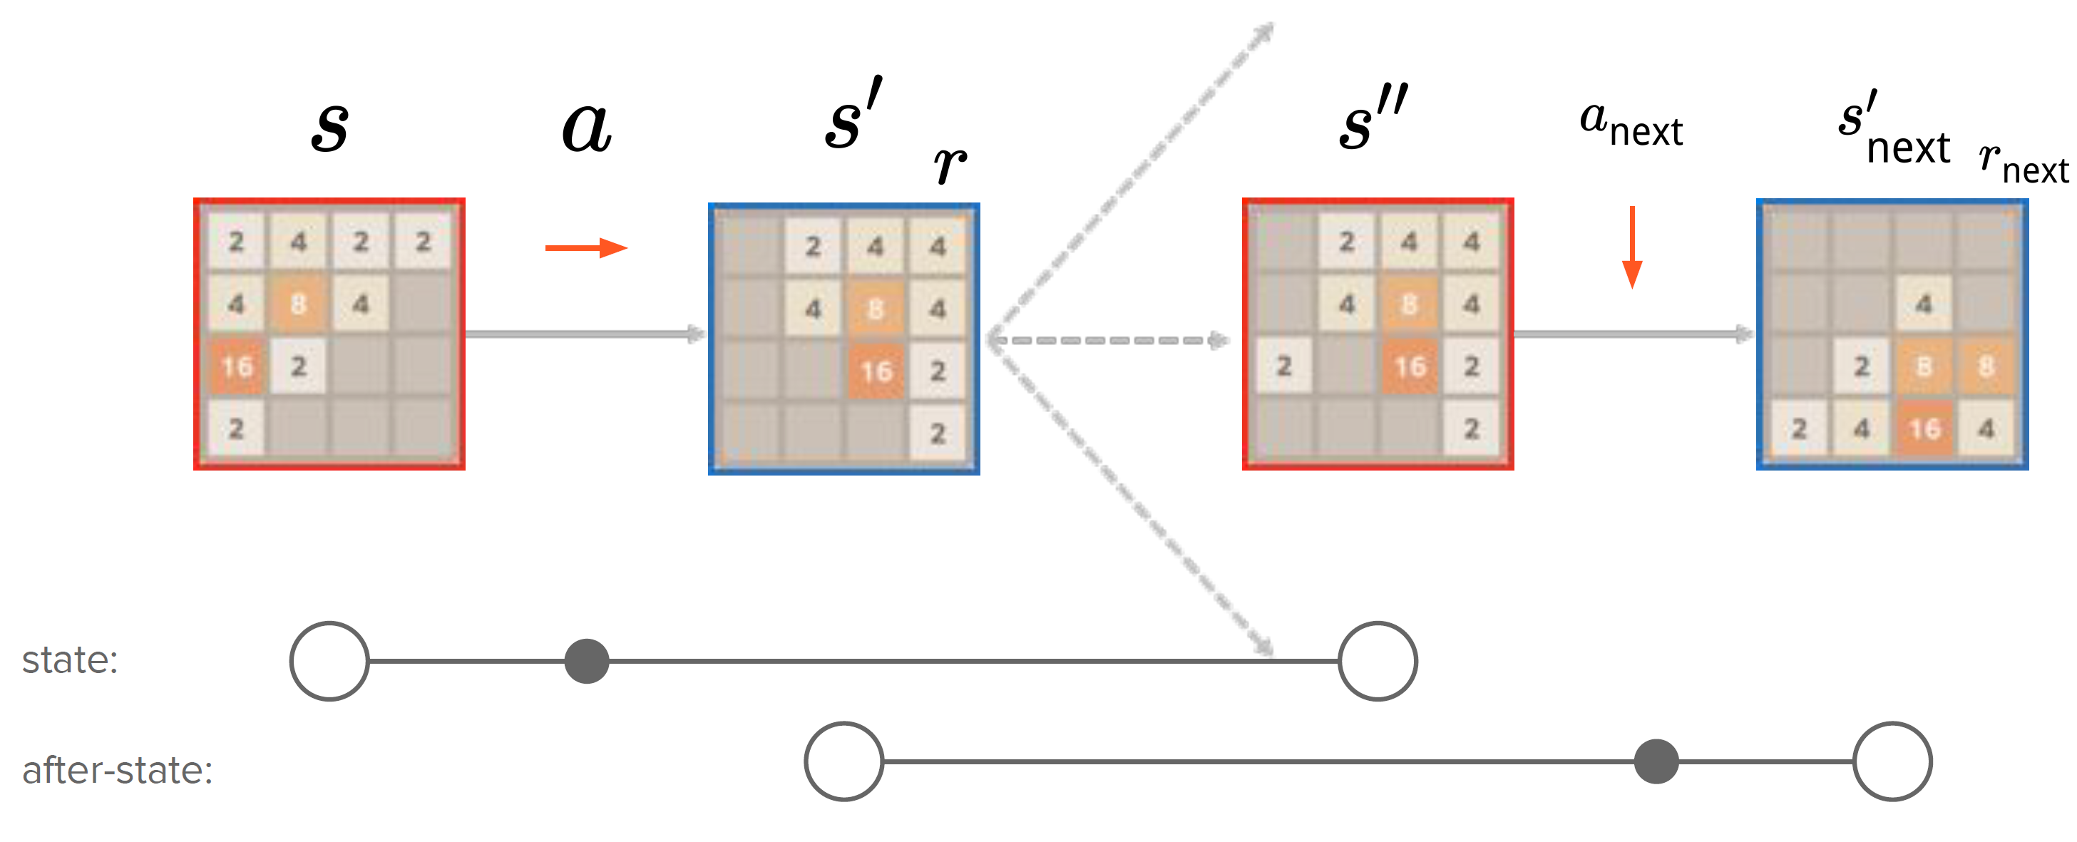
TD Backup Diagram
beforestate
afterstate
r

Slide 10
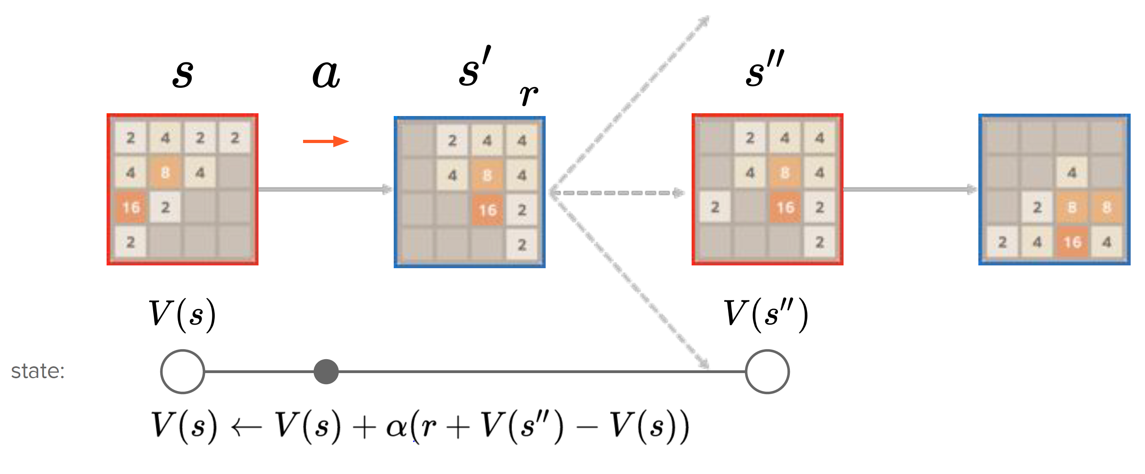
TD Backup: State
beforestate
afterstate
r

Slide 11
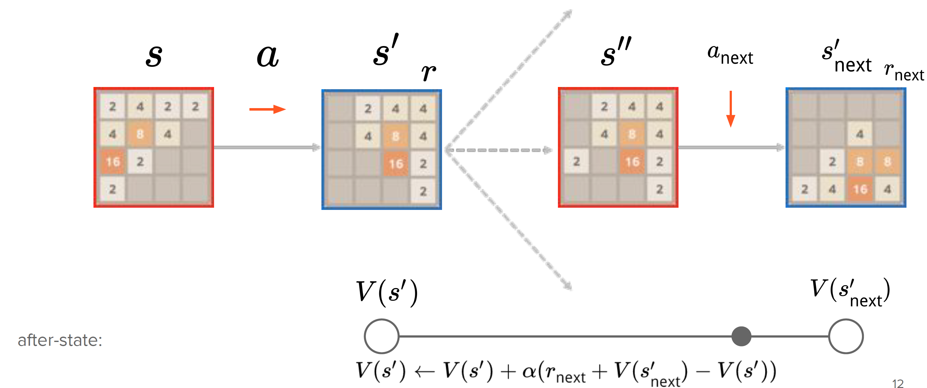
TD Backup: After-State
beforestate
afterstate
r

Slide 12
Why use n-tuple network?
The expected score/return 𝐺_𝑡 from a board 𝑆
But, #states is huge
About 17¹⁶ (=10²⁰).
Empty (→ 0), 2 (=2¹ → 1), 4 (=2² → 2), 8 (=2³ → 3), …, 65536 (=2¹⁶ → 16).
Need to use value function approximator.

Slide 13
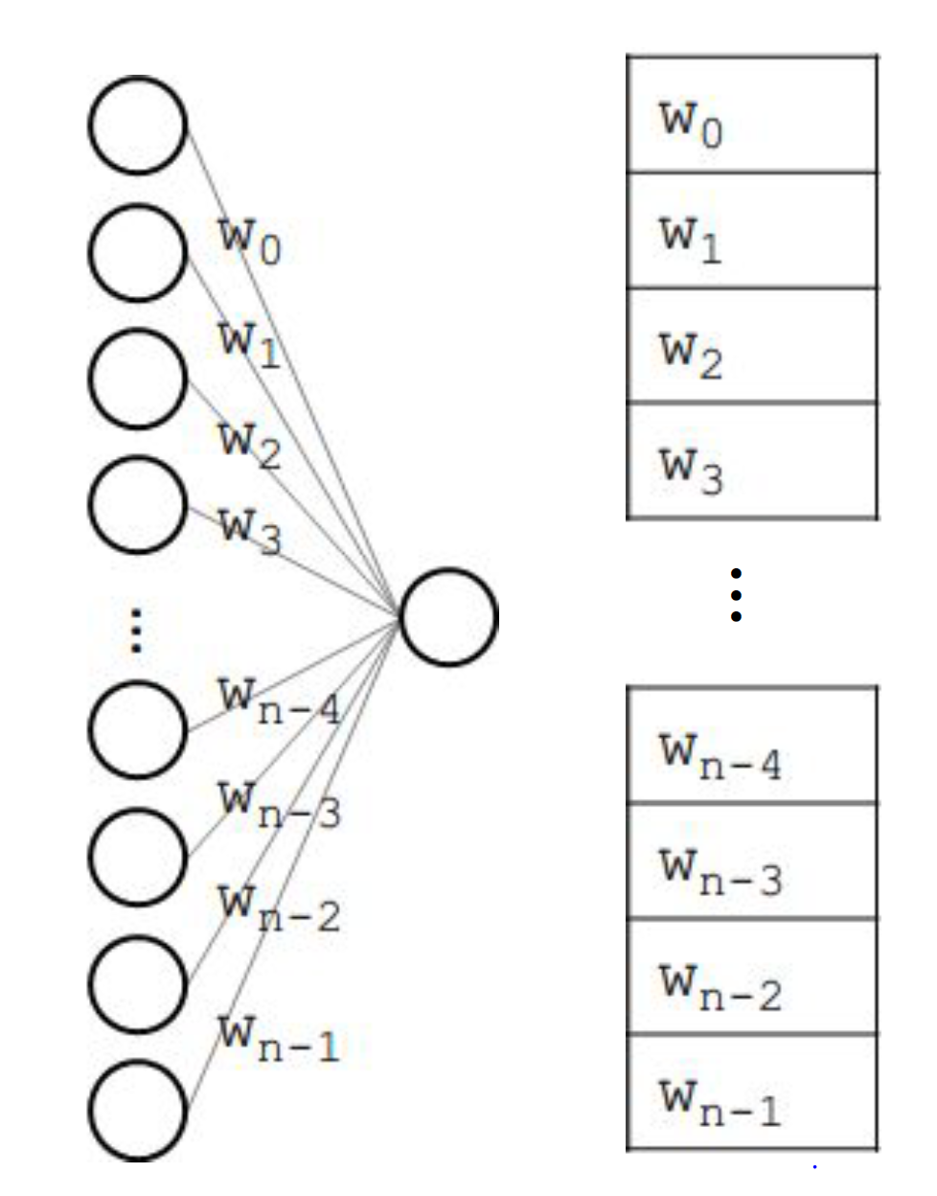
n-tuple network
n-tuple network (a.k.a. RAM-based neural network) is a type of artificial neural network.
A large number of input nodes.
Input values are either 1 or 0.
Input is a sparse vector.
No hidden layers.
Only 1 output node.

Slide 14
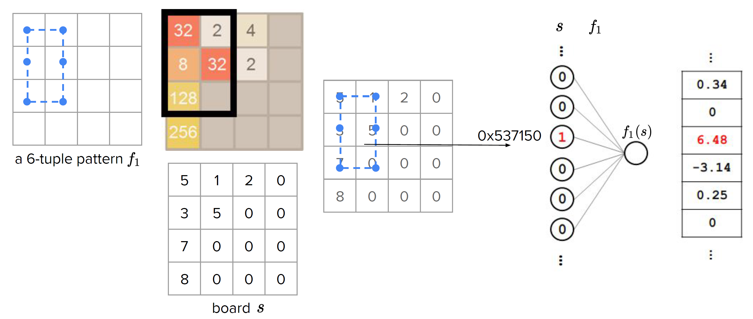
Example: 2048 with n-tuple network

Slide 15
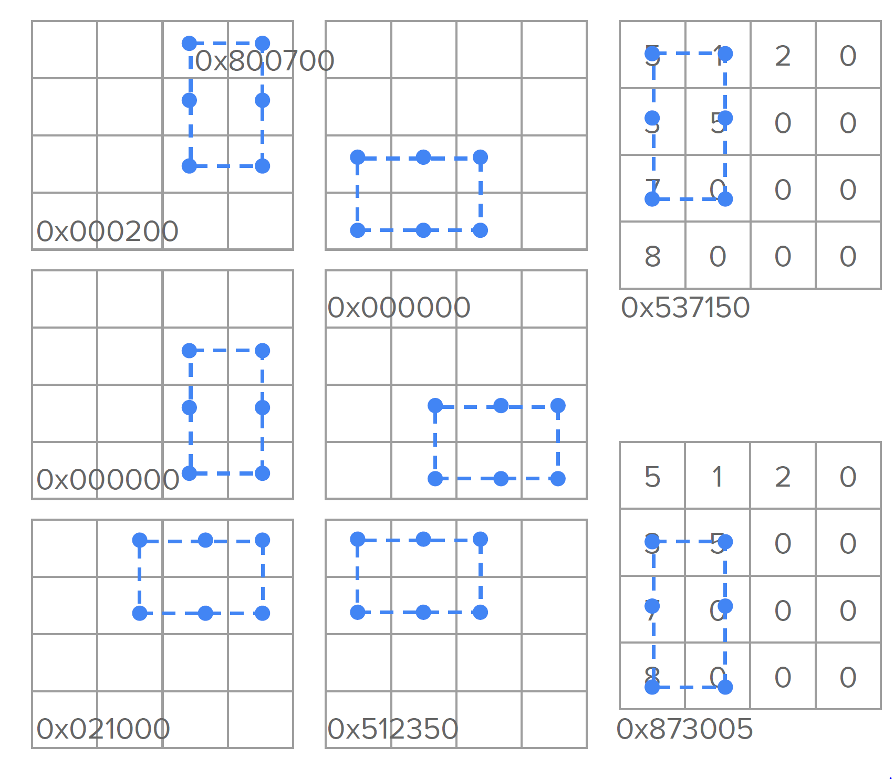
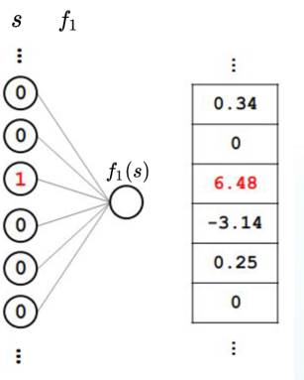
All Isomorphism
Rotations and Reflections
The sum of the eight values can ​​represents the board.

Slide 16
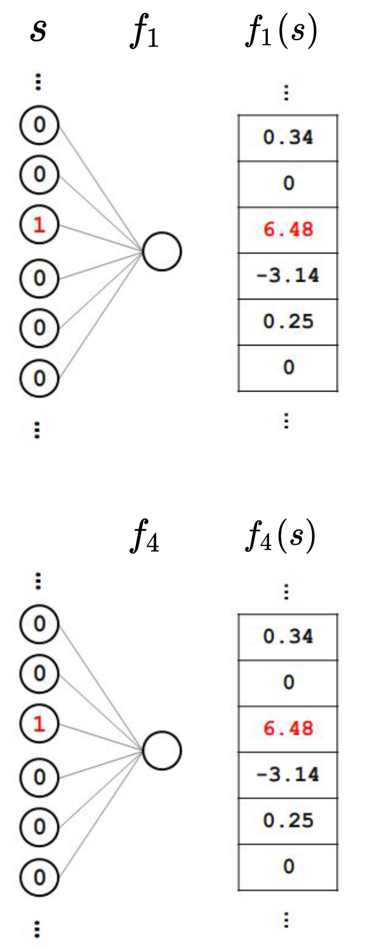
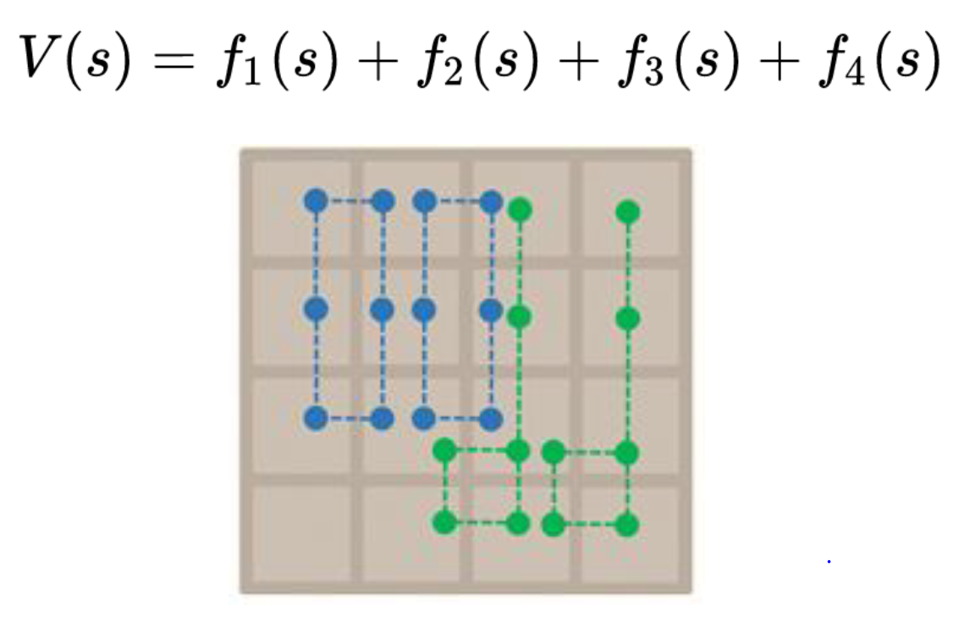
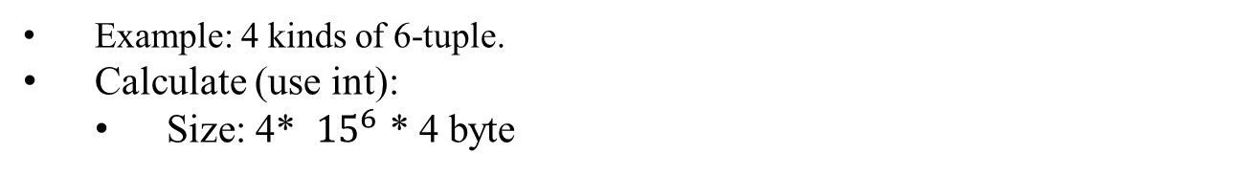
Multiple n-tuple
Example: 4 kinds of 6-tuple.
Calculate (use int):
Size: 4* ${15}^{6}$ * 4 byte
Notes:
使用內建format函數

Slide 17
Sample Code
Implement V(state)
Compile with C++11 support
g++ -std=c++11 -O3 -o 2048 2048.cpp

Slide 18
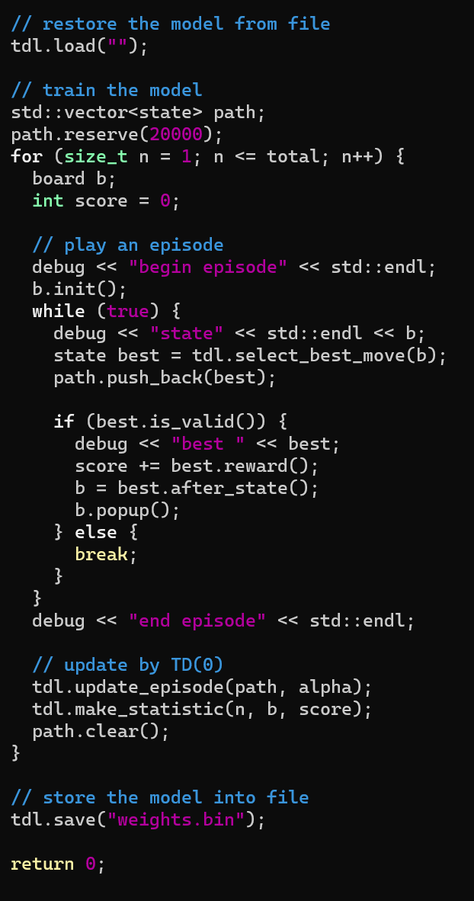
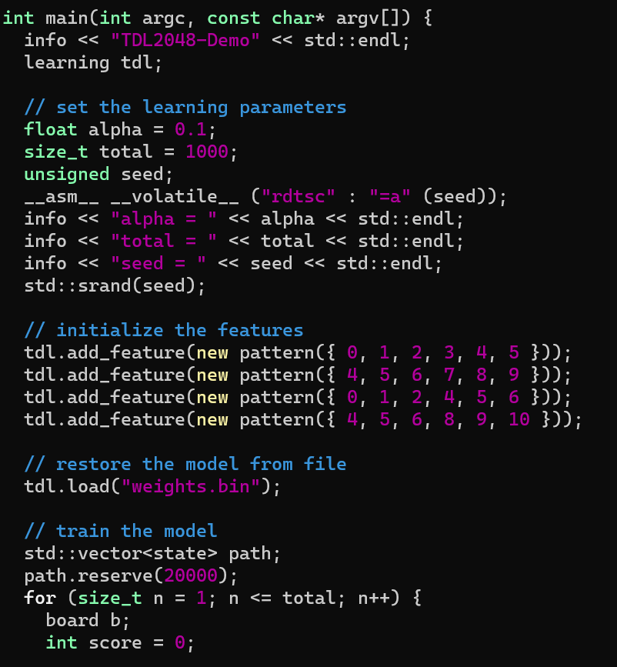
Training:
Evaluating
(demo):
Set total count
to 1000 games
Load your
model weight
Save your
model weight

Slide 19
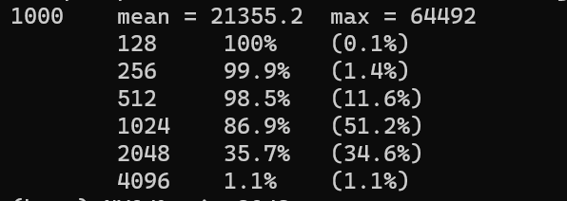
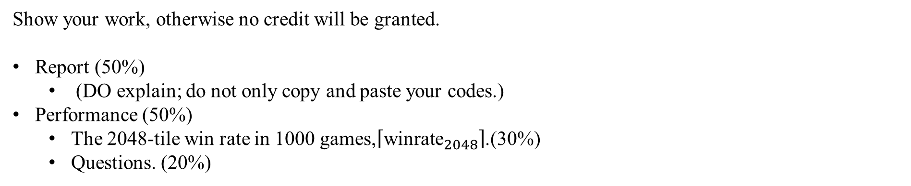
Scoring Criteria
Show your work, otherwise no credit will be granted.
Report (50%)
(DO explain; do not only copy and paste your codes.)
Performance (50%)
The 2048-tile win rate in 1000 games,$\left\lceil {\text{winrate}}_{2048}\right\rceil$.(30%)
Questions. (20%)

Slide 20
Reminders
You can design your n-tuple.
You should avoid using CNN in this lab.
2048-tile should appear within 10,000 episodes.
You have to load your weight while demo.

Slide 21
References
1. Szubert, Marcin, and Wojciech Jaśkowski. "Temporal difference learning of N-tuple networks for the
game 2048." 2014 IEEE Conference on Computational Intelligence and Games. IEEE, 2014.
2. Kun-Hao Yeh, I-Chen Wu, Chu-Hsuan Hsueh, Chia-Chuan Chang, Chao-Chin Liang, and Han Chiang,
Multi-Stage Temporal Difference Learning for 2048-like Games, accepted by IEEE Transactions on
Computational Intelligence and AI in Games (SCI), doi: 10.1109/TCIAIG.2016.2593710, 2016.
3. Oka, Kazuto, and Kiminori Matsuzaki. "Systematic selection of n-tuple networks for 2048."
International Conference on Computers and Games. Springer International Publishing, 2016.
4. moporgic. “Basic implementation of 2048 in Python.” Retrieved from Github:
https://github.com/moporgic/2048-Demo-Python .
5. moporgic. “Temporal Difference Learning for Game 2048 (Demo).” Retrieved from Github:
https://github.com/moporgic/TDL2048-Demo .
6. lukewayne123. “2048-Framework” Retrieved from Github:
https://github.com/lukewayne123/2048-Framework

