Slide 1
A peek into word embeddings using word2vec
Yue Ka Leung (1155214424 - CSCI)
Tang Yu Hin (1155211754 - AIST)

Slide 2
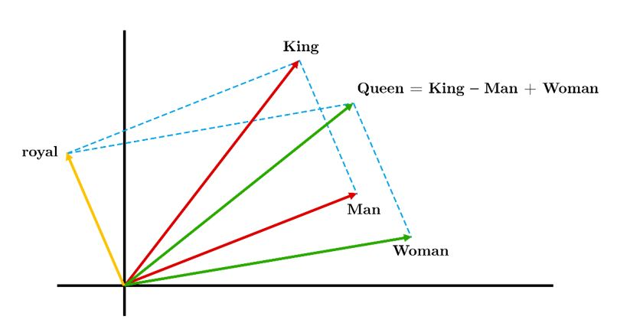
Word embeddings & Word2Vec
Represent words as vectors. (String → double[])
Here we have an example.
Basis: <👑, ⚥> (instead of the standard <1, 1>)
Man = <1, 1>
Woman = <1, 2>
King = <2, 1>
Queen = King – Man + Woman = <2, 1> - <1, 1> + <1, 2> = <2, 2>
The word vectors depend on the words frequently appearing near the word in the data.
In real life applications, the vector spaces usually have much higher dimensions.

Slide 3
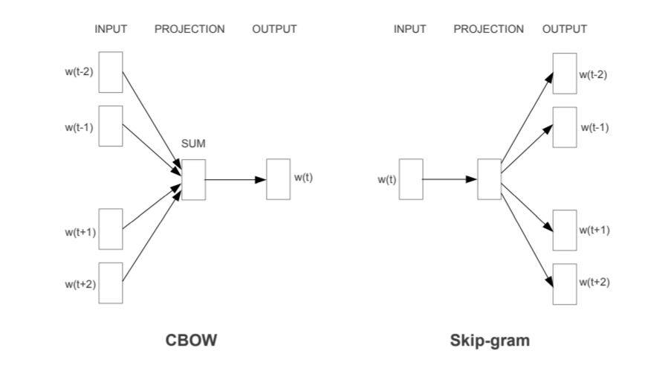
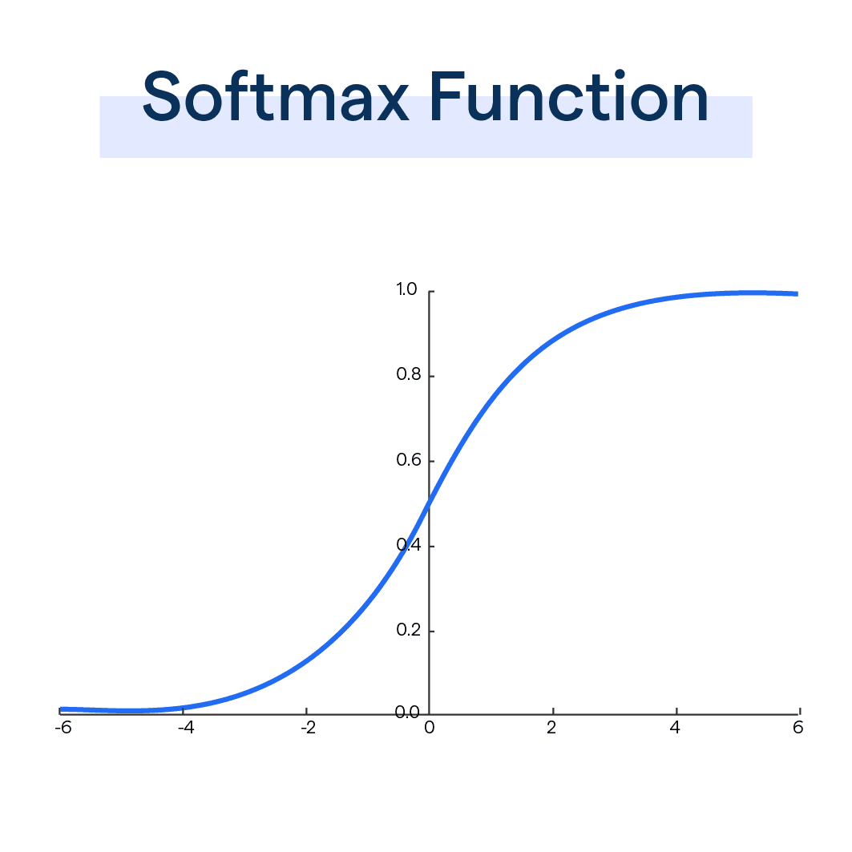
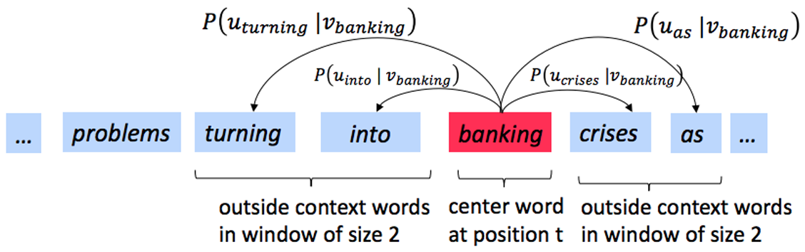
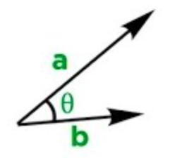
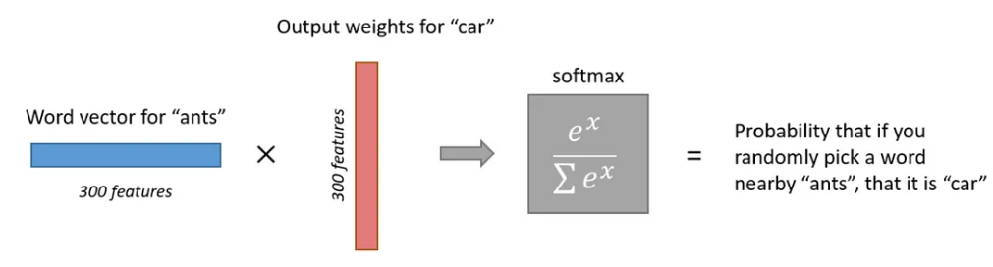
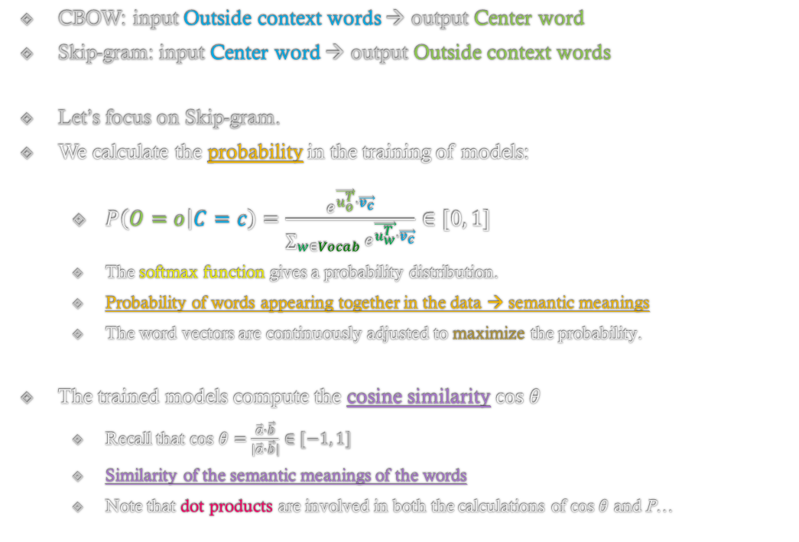

Probability in Word2Vec models
CBOW: input Outside context words → output Center word
Skip-gram: input Center word → output Outside context words
Let’s focus on Skip-gram.
We calculate the probability in the training of models:
$P\left(O=o | C=c\right)=\frac{e^{\vec{u_{o}^{T}}∙\vec{v_{c}}}}{\sum_{w∈Vocab}{e^{\vec{u_{w}^{T}}∙\vec{v_{c}}}}}∈[0, 1]$
The softmax function gives a probability distribution.
Probability of words appearing together in the data → semantic meanings
The word vectors are continuously adjusted to maximize the probability.
The trained models compute the cosine similarity $cos θ$
Recall that $cos θ=\frac{\vec{a}∙\vec{b}}{|\vec{a}∙\vec{b}|}∈[−1, 1]$
Similarity of the semantic meanings of the words
Note that dot products are involved in both the calculations of $cos θ$ and P…

Slide 4
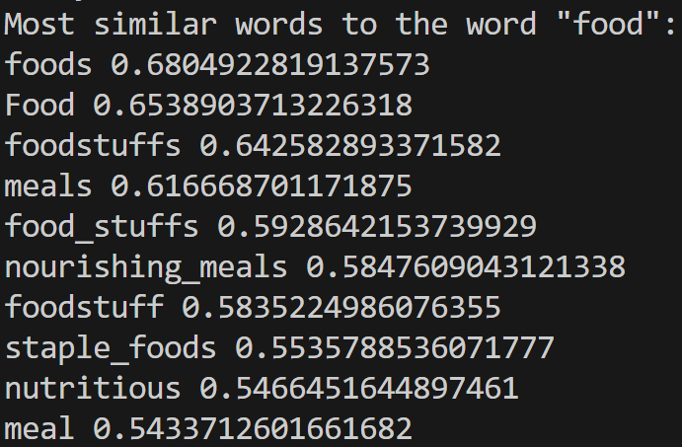
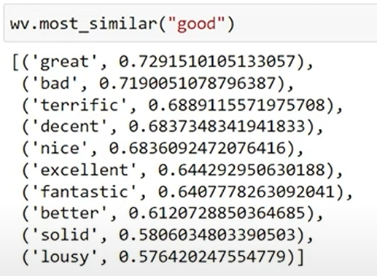
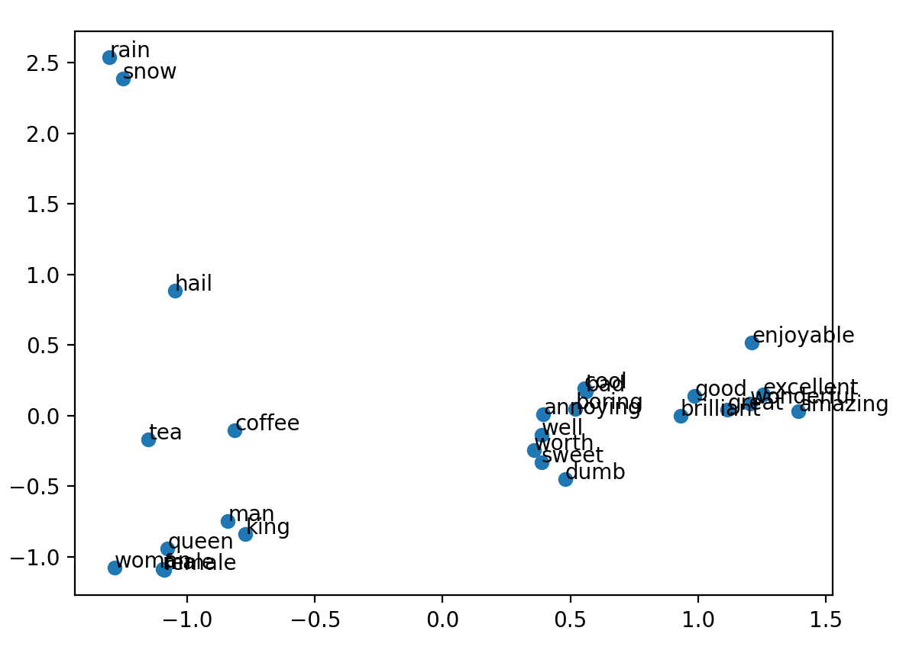
Code implementation
Implementing a basic Skip-Gram model:
Using a pre-trained model (Google’s Gensim library):
Factors affecting prediction: size of corpus, preprocessing techniques (stop word removal, tokenization), epochs, sampling etc.
Please visit the GitHub Repository to read the more detailed explanation and download the full source code. Thank you.

