Slide 1
A peek into word embeddings using word2vec
Yue Ka Leung (1155214424 - CSCI)
Tang Yu Hin (1155211754 - AIST)

Slide 2
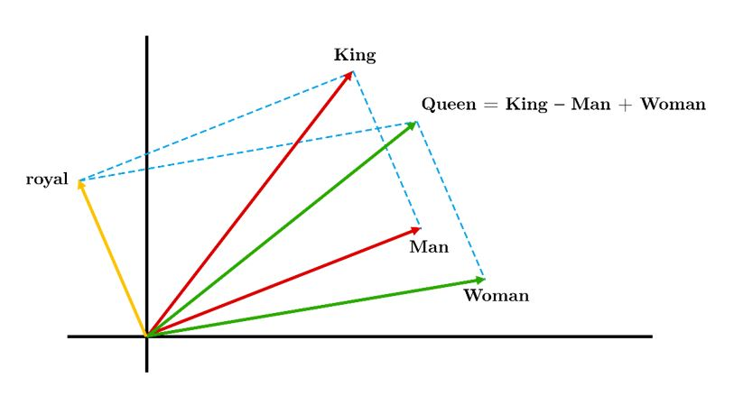
Word embeddings & Word2Vec
Represent words as vectors. (String → double[])
Here we have an example.
Basis: <👑, ⚥> (instead of the standard <1, 1>)
Man = <1, 1>
Woman = <1, 2>
King = <2, 1>
Queen = King – Man + Woman = <2, 1> - <1, 1> + <1, 2> = <2, 2>
The word vectors capture the semantic meanings* of words.
In real life applications, the vector spaces usually have much higher dimensions.

Slide 3
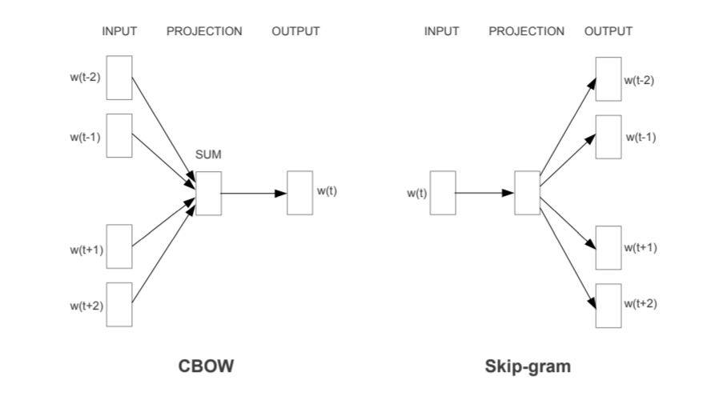
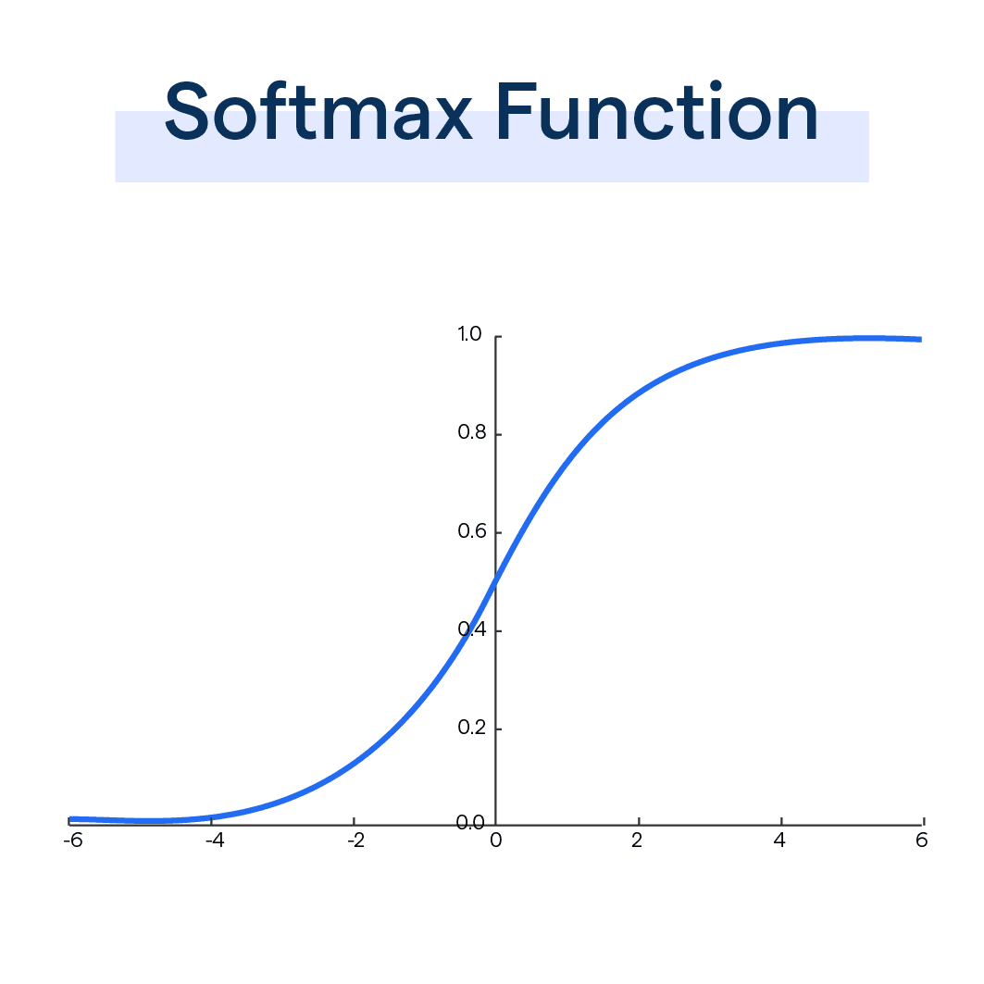
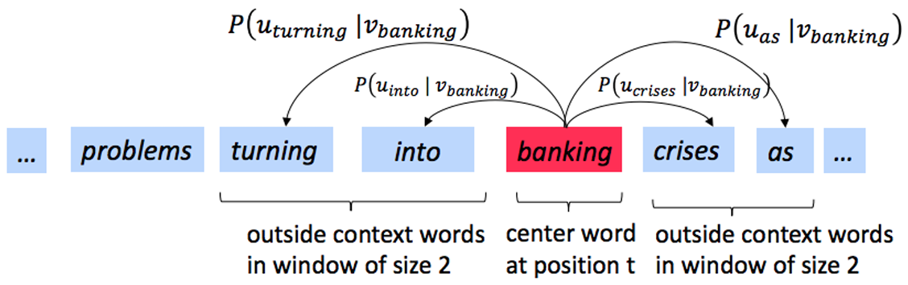
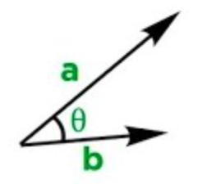
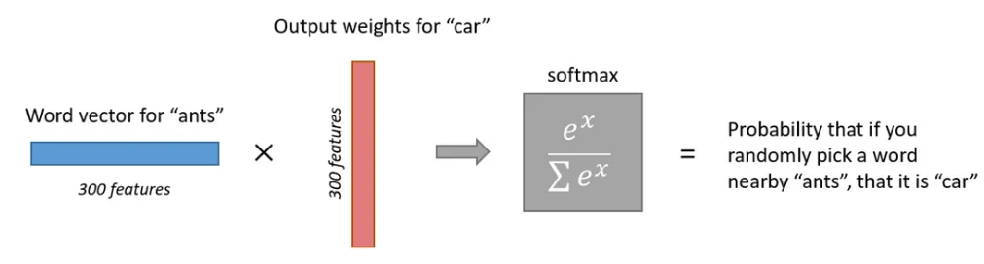
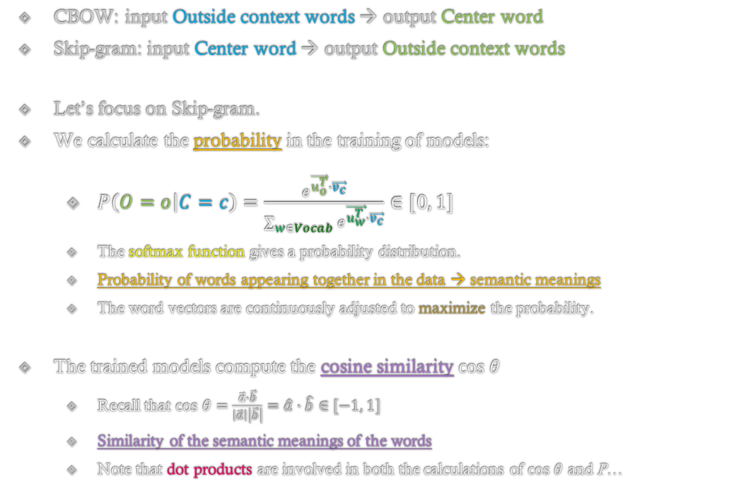

Probability in Word2Vec models
CBOW: input Outside context words → output Center word
Skip-gram: input Center word → output Outside context words
Let’s focus on Skip-gram.
We calculate the probability in the training of models:
$P\left(O=o | C=c\right)=\frac{e^{\vec{u_{o}^{T}}∙\vec{v_{c}}}}{\sum_{w∈Vocab}{e^{\vec{u_{w}^{T}}∙\vec{v_{c}}}}}∈[0, 1]$
The softmax function gives a probability distribution.
Probability of words appearing together in the data → semantic meanings
The word vectors are continuously adjusted to maximize the probability.
The trained models compute the cosine similarity $cos θ$
Recall that $cos θ=\frac{\vec{a}∙\vec{b}}{\left|\vec{a}\right|\left|\vec{b}\right|}=\hat{a}∙\hat{b}∈[−1, 1]$
Similarity of the semantic meanings of the words
Note that dot products are involved in both the calculations of $cos θ$ and P…

Slide 4
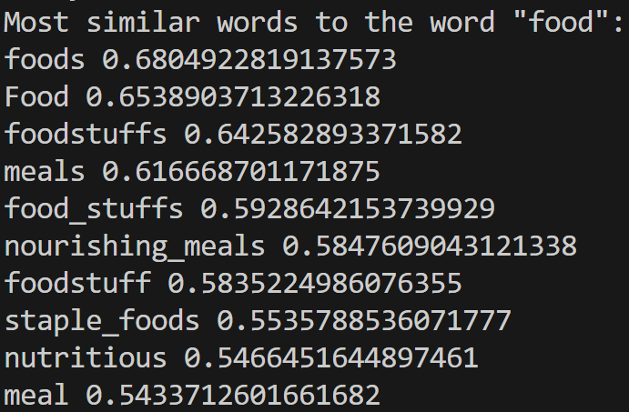
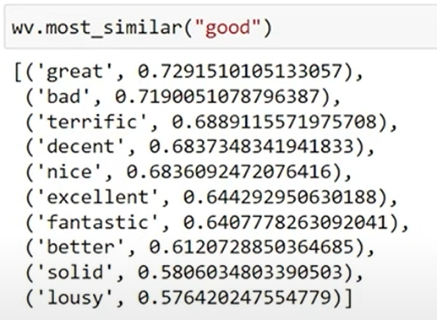
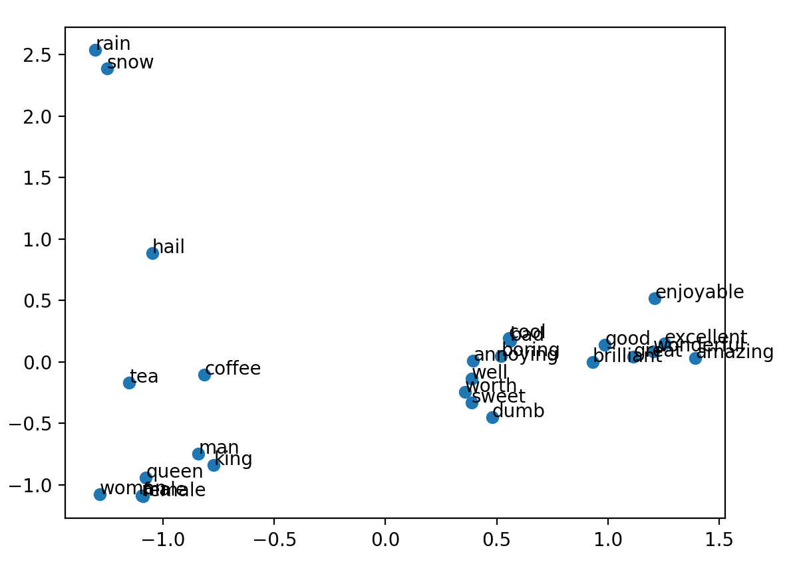
Code implementation
Implementing a basic Skip-Gram model:
Using a pre-trained model (word2vec-google-news-300):
Factors affecting prediction: size of corpus, preprocessing techniques (stop word removal, tokenization), epochs, sampling etc.
Please visit the GitHub Repository* to read the more detailed explanation and download the full source code. Thank you.

