Slide 1
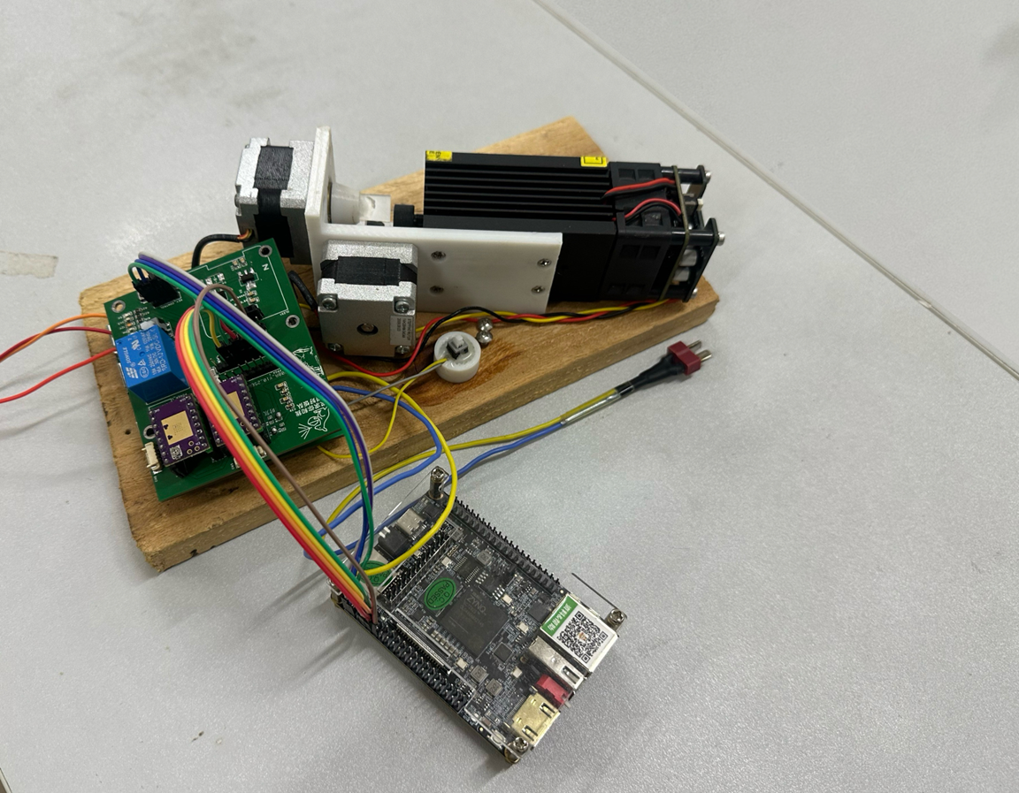

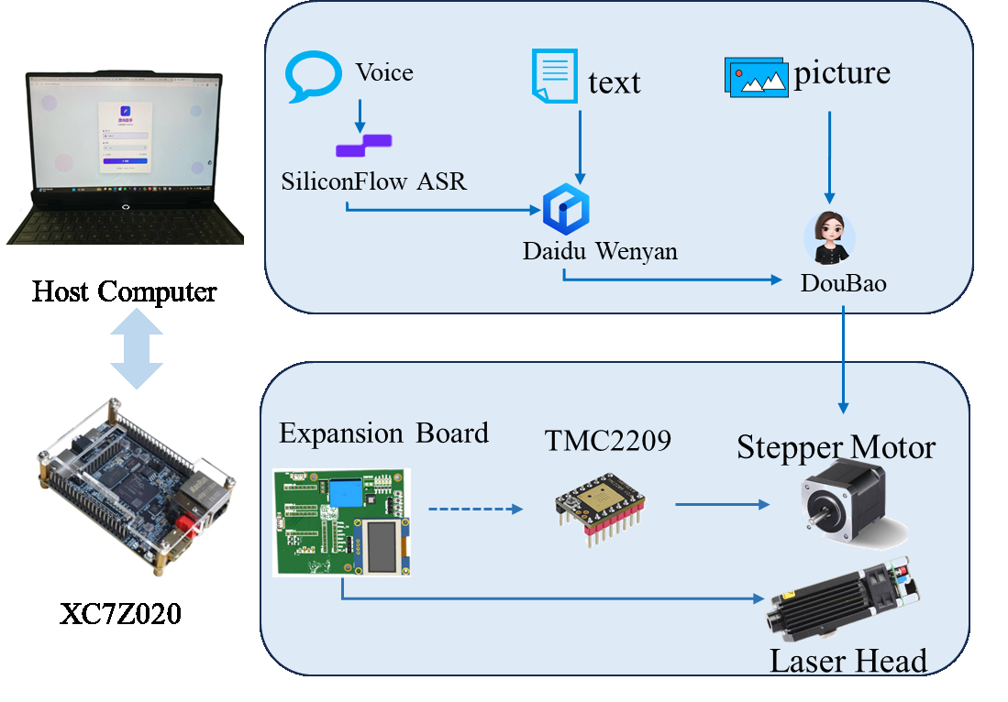

INTRODUCTION
Title :
Radiance Imprinted in Seal-Script Heart
OpenHW2025
Physical Thumbnails of the Work
On board test by AMD ZYNQ7020
The "Guangyin Zhuanxin" (Radiance Imprinted in Seal-Script Heart) System takes the AMD Zynq-7020 SoC FPGA as its core, integrates AI large model technology, and through natural language processing and image recognition, automatically generates corresponding engraving patterns.
It also accurately drives high-speed galvanometers and focusing lenses to control the 2D position of the laser beam on the workpiece surface, enabling fast and precise marking and pattern processing.
The system uses AI large models for intelligent creative generation and FPGA hardware for high-precision motion control, forming an end-to-end solution with "intelligence, personalization, diversification."Key technical issues addressed:
1. Multimodal-Multimodel Collaboration2. Data receiving and processing, AMD-Xilinx 7 series Zynq System on a Chip (SoC) devices.
2.Galvanometer-Based Laser Engraving and 3D Milling
3. Hardware-Level Real-Time Control and Motion Optimization 4.Hardware-Level Safety Protection
C
Work Test Platform Information
R
R
1.Software: Windows 10/11 (64-bit), Ubuntu 20.04 LTS; Python 3.8+, Node.js 14+; Chrome/Edge 90+; Baidu ERNIE API v4.0, Doubao Open API v2.0, OpenRouter protoco
2.Hardware: Xilinx Artix-7/Altera Cyclone IV FPGA; industrial XY galvo laser engraver (±0.01mm accuracy, 10W-30W); DC 24V power supply, USB-to-UART adapter (115200bps); acrylic, wood, thin metal (0.5mm-3mm).
E
E
A
S
T
U
I
L
Typical application case
V
T
System Architecture
E
TMC2209 Driver:
1.Converts coords (start_x/y, target_x/y) to stepping pulses via Bresenham line interpolation.
2.Outputs step_x/y pulses & dir_x/y signals, sending motion control commands to TMC2209 driver.
3.Adjusts pulse frequency for motor speed, enables start/stop via motor_en, ensures hardware-level real-time performance & micron-level accuracy.
D
E
Test Results
Functionality Test: Multi-modal inputs (text/speech/image) can stably generate engraving patterns. The output diversity of AI models (Baidu ERNIE, Doubao, etc.)
Performance
AI pattern generation takes 3-8 seconds per image; engraving speed reaches 500mm/s.
Outlook
Deepen AI complex pattern generation; expand hardware format and material adaptation.
Background, Brief Introduction & Abstract
S
I
N
G
42 Stepper Motor:
1.Pairing TMC2209 driver; 1.8° step angle; 1/256 microstepping; 51200 microsteps/turn;
2.Based on state machine (5 states); Dual-axis linear control; Adopting Bresenham algorithm;
Test Results, Performance, Outlook

