Slide 1
SKY Investments
Sam Fisher, Karl Krehbiel, Yuechen Zhao
Dec 12, 2013

Slide 2
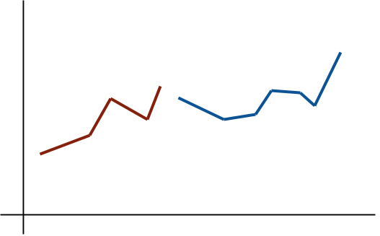
The Data

Slide 3
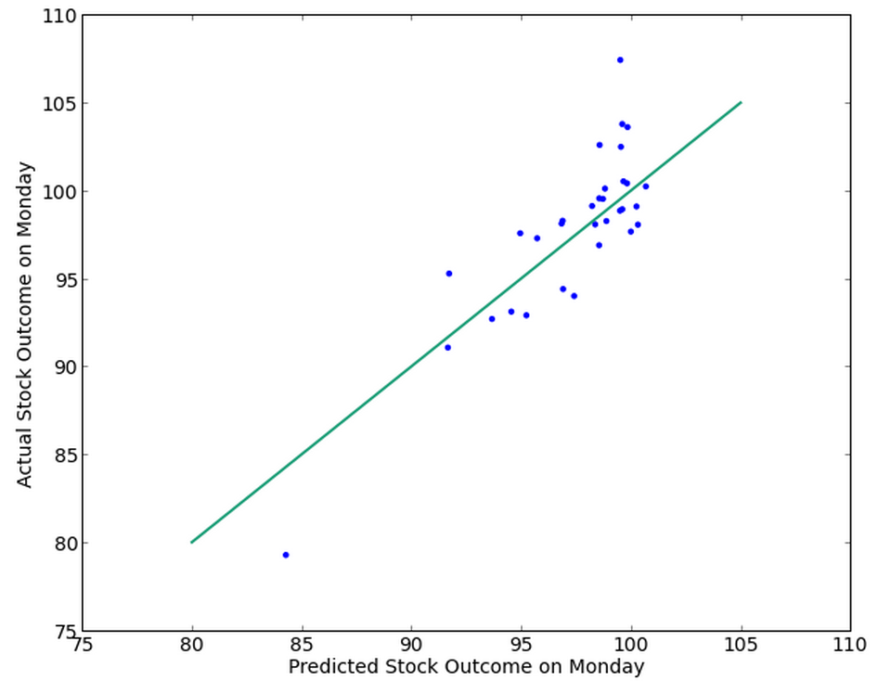
The Method

Slide 4
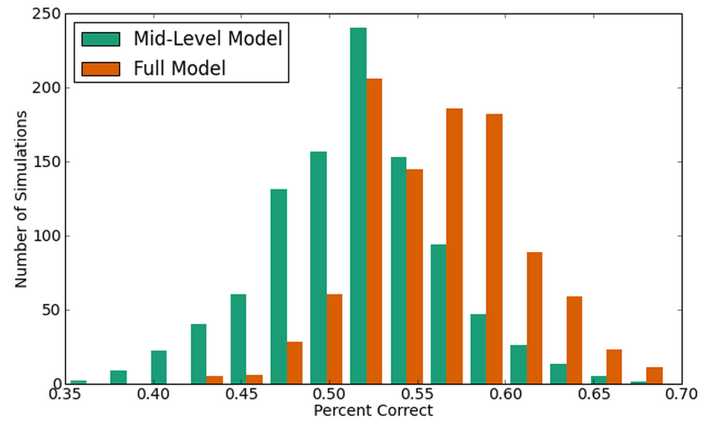
The Results

Slide 5
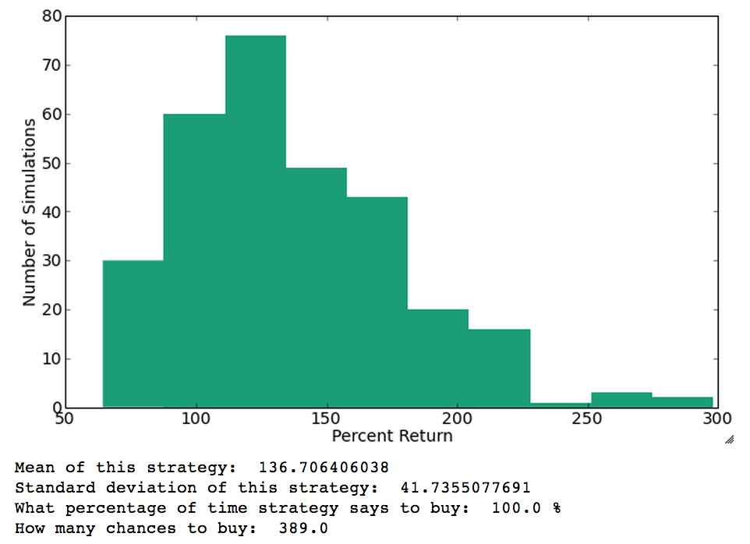
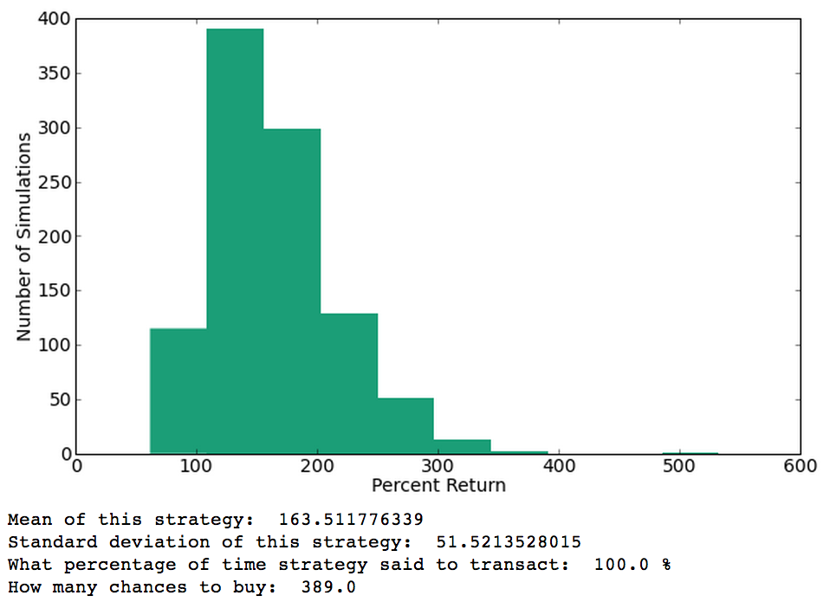
The Results

