Slide 1

Facial Expression Detection
Heyuan Zhang
Yuechen Zhao

Slide 2
Guideline
Background & Motivation
Approach
Result

Slide 3
Emotion recognition through facial expression detection is one of the important fields of study for human-computer interaction. To detect a facial expression one system need to come across various variability of human faces such as color, posture, expression, orientation, etc.
Background
Since facial detection is increasingly used in many aspects in our life such as cell phones and security. In this project we place emphasis on classifying images.
Motivation

Slide 4



Approach
SELECT DATASET
The dataset is called CMU Face Image. It is an open source dataset from UCI Repository.
The data consists of 640 black and white face images of people taken with varying pose, expression, eyes and size.

Slide 5
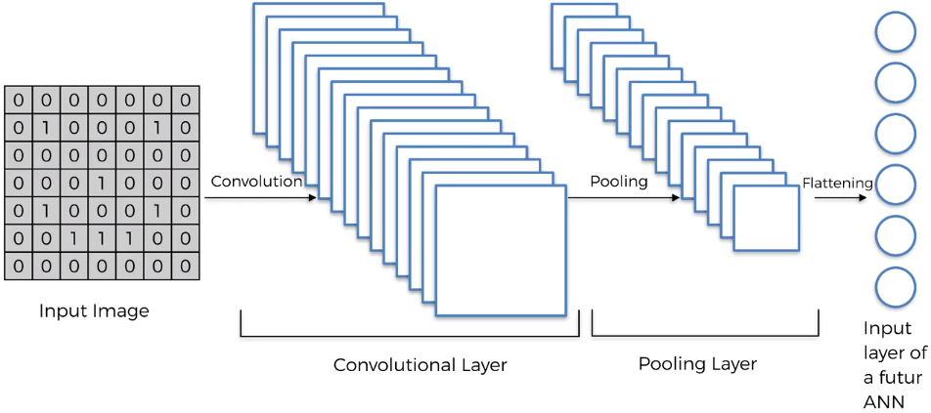
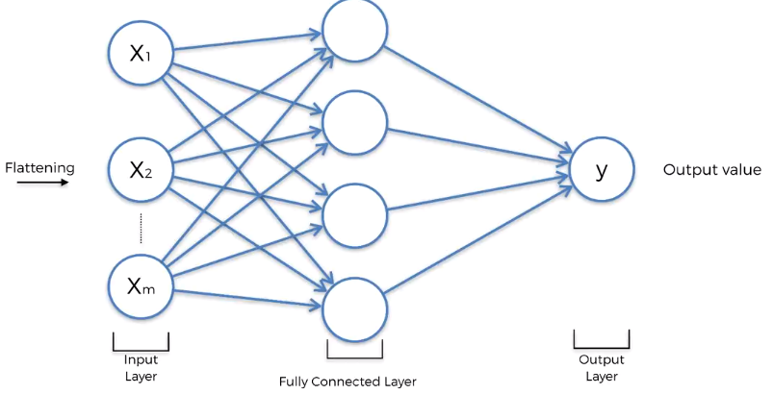
Normally，
Data Preprocessing

Slide 6
In our project，
Convolutional
happy
neutral
Max pooling
Fully connected
Data Preprocessing
Flattening
sad
Convolutional
angry
Max pooling

Slide 7
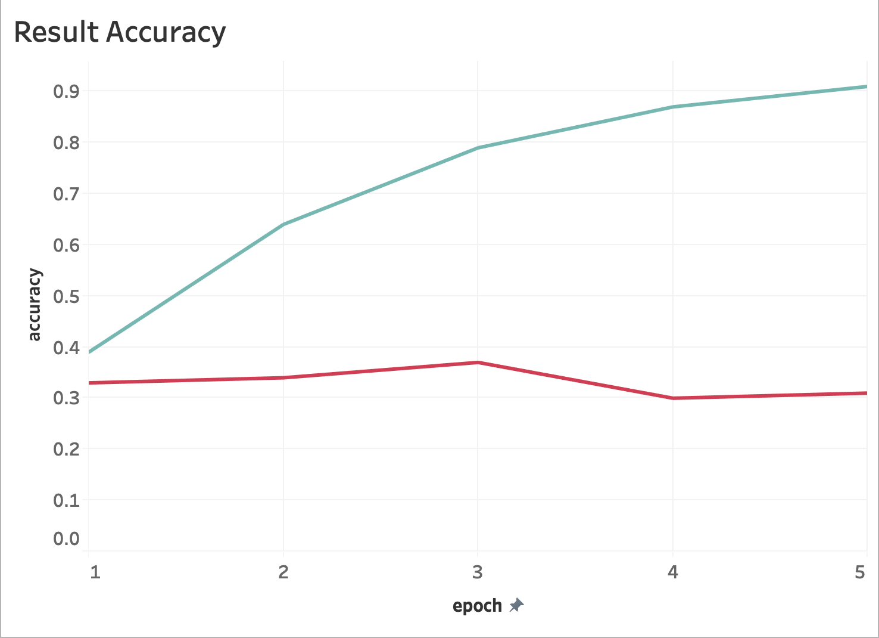
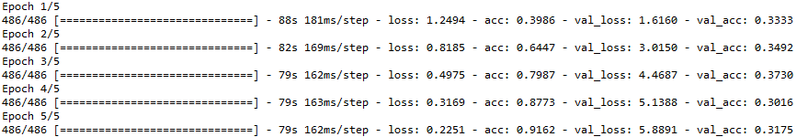


Initial Result:
Single image prediction:

Slide 8
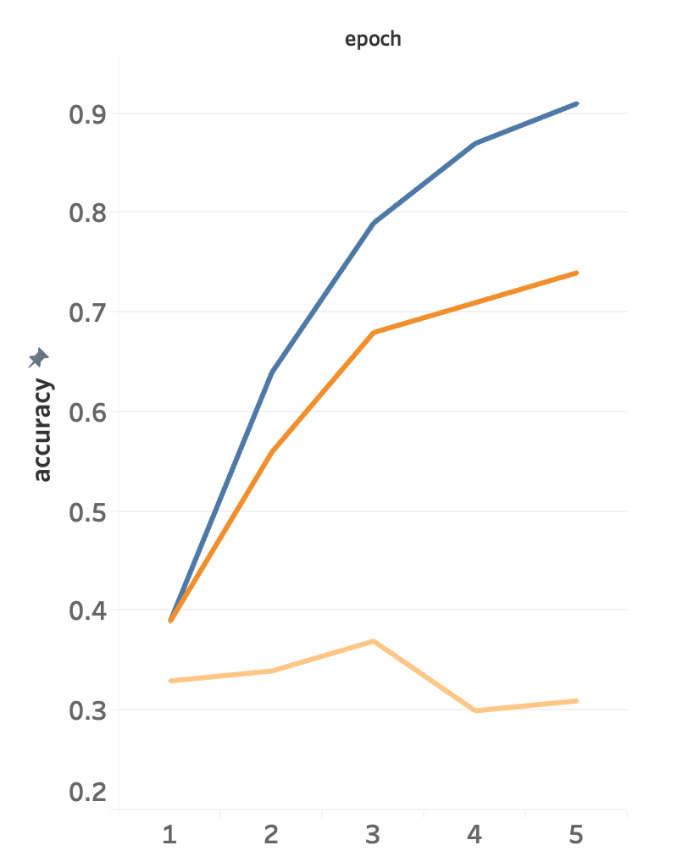
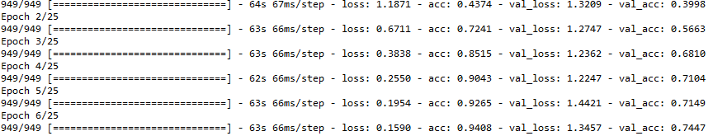
Improvement Result
One possible reason for low accuracy is that the training dataset and testing dataset are not uniform. In the first time, the data sets are split by users. In order to be uniformed, images need to break its names constrain, and randomly select into two sets. After getting new data set, same procedures are applied to the images. After some epochs of computing, the validation accuracy increasing to 75%.

Slide 9
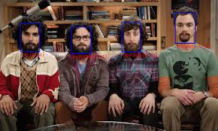
Any question???
Thanks!!!

