Slide 1
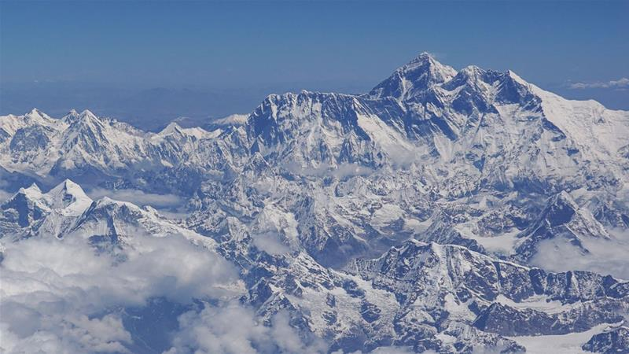
NEPAL(ネパール）
Country of mountains
（山の国）
Introduction
Mountains
Menu
Contact us
Mountains 1
Mountains 2
Mountains 3
Mountains 4
Mountains 5
Mountains 6
Mountains 7

