Slide 1
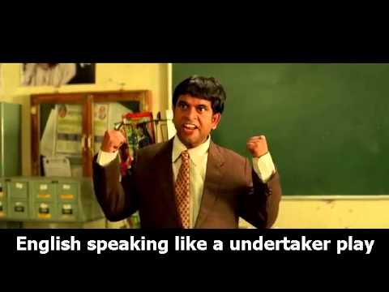
English sikho America jaao consultancy
Contact NO:9849860522
Class time:
9AM to 5 PM

