Slide 1

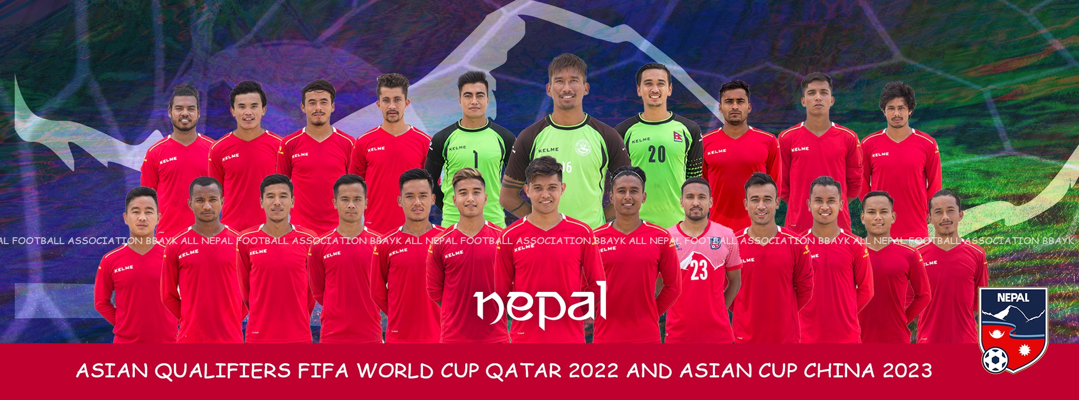
Home | About | Live TV | News/Event | Contact
It was situated in satdobato, lalitpur,Nepal
TEL +977 1-5201060
ANFA is established in 1972BS.

Slide 2
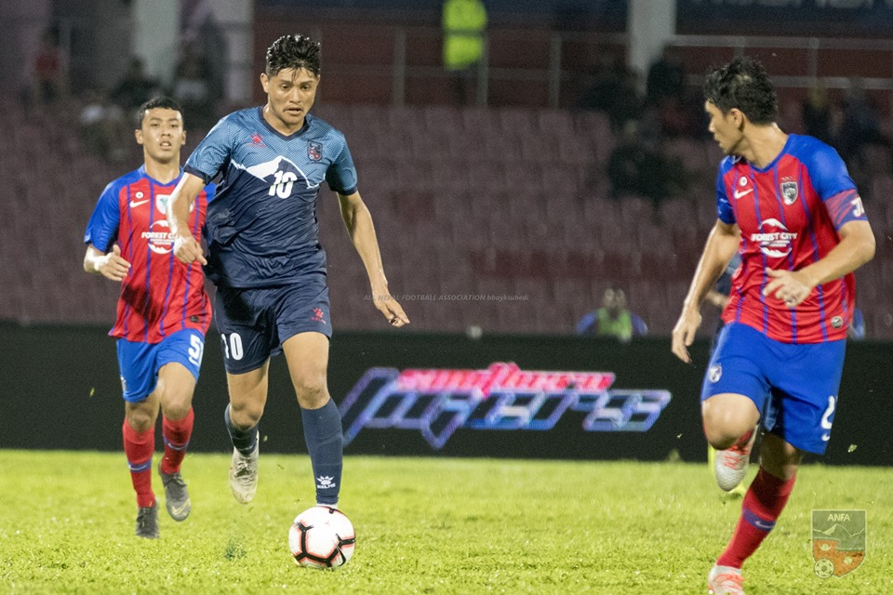
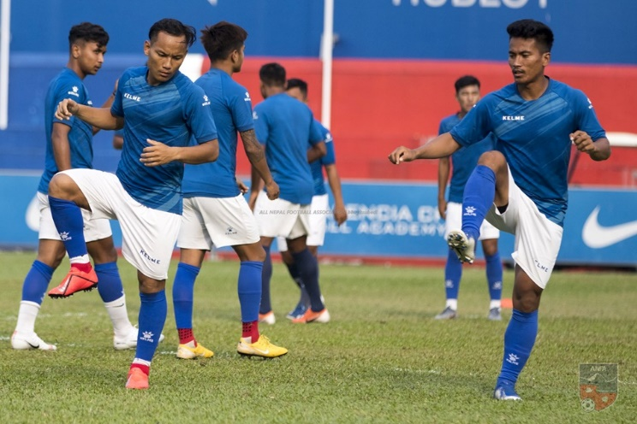
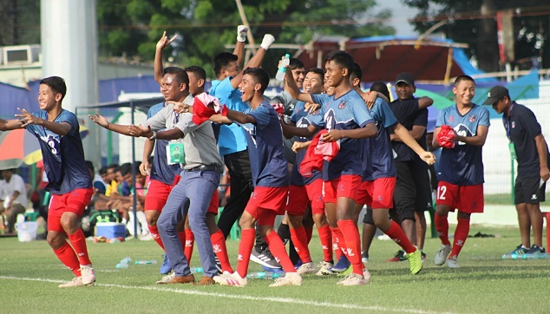
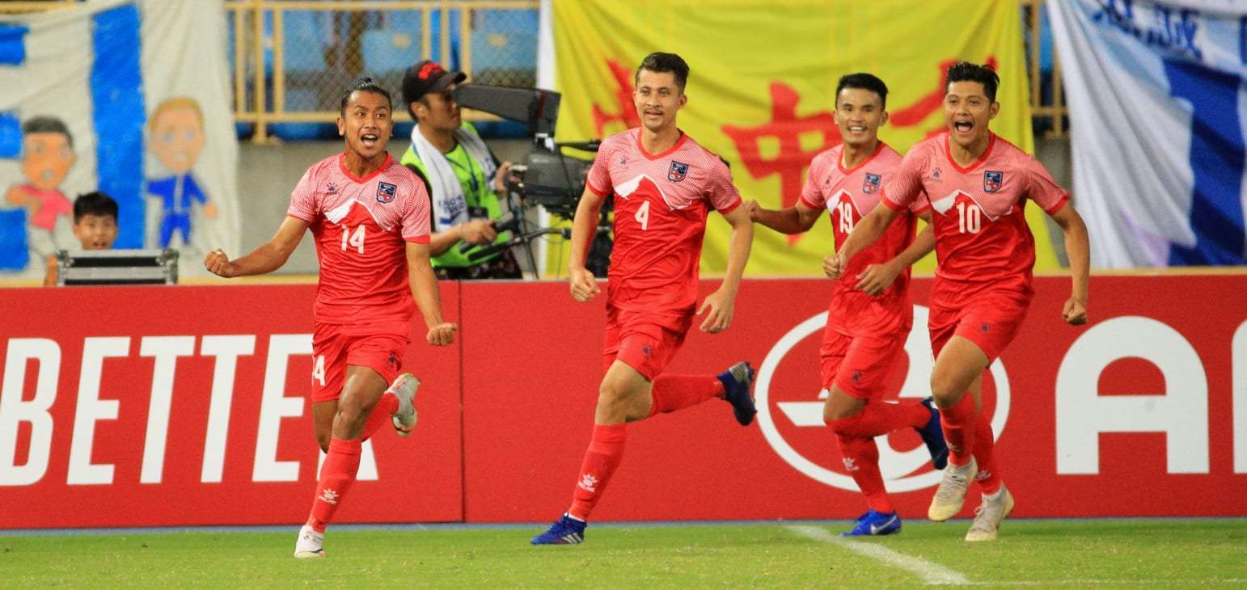
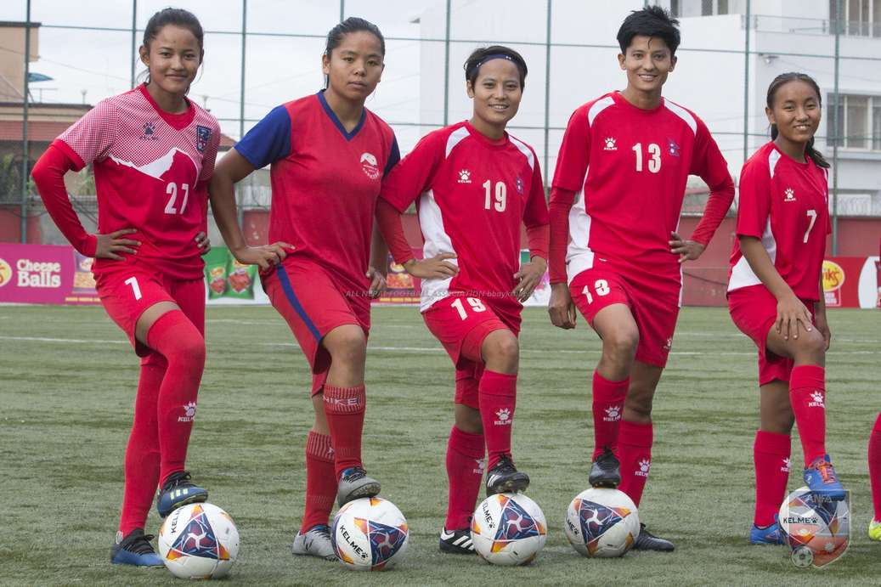
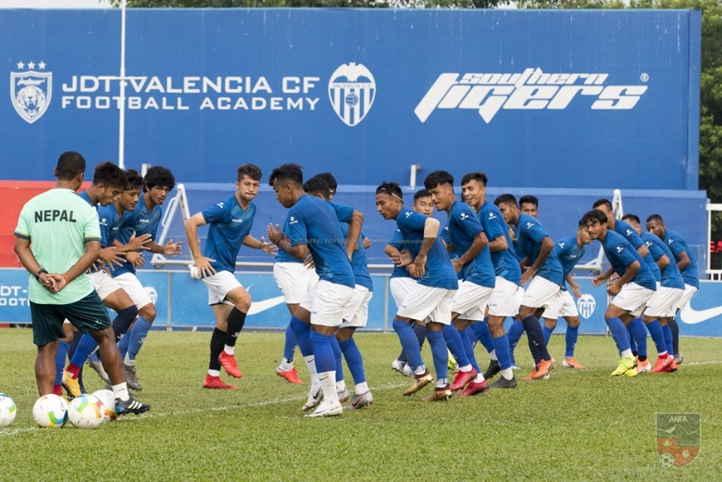
Home

Slide 3
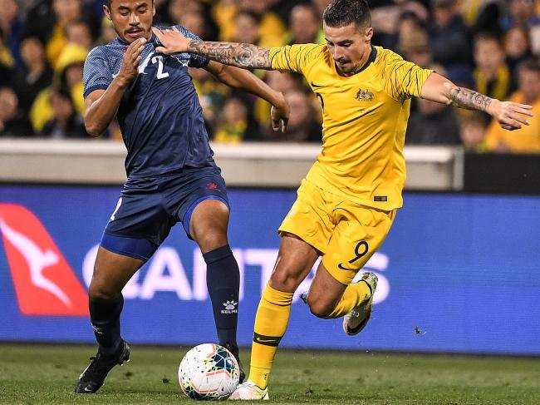
Team news
Australia trounce Nepal in World Cup 2022 qualifier
Jamie Maclaren joined an elite, exclusive group after scoring his first international hat-trick as put Nepal to the sword.

Slide 4
About
About Us
The All Nepal Football Association (ANFA) is the national football governing body in Nepal which oversees national as well as club level competitions. Founded in 1951, ANFA got affiliation from International Federation of Association Football, FIFA, in 1972. The association is currently under the leadership of President Karma T-shering Sherpa. Its headquarters is located at the ANFA House in ANFA Complex, Satdobato, Lalitpur .
Leave a Message
FLASH NEWS
Follow us on : facebook,twitter,Wikipedia,google
Notes:
……………………………….

Slide 5
News
Nepal Goalie Kiran Chemjong Plays Important Match For Fujieda MYFC JAPAN
2020 AFC U16 Championship Qualifiers: Nepal Vs Kuwait
Australia: Nepalese United FC Wins Title Of Metropolitan South Division 2 League 2019
AFC/FIFA
FIFA World Cup Qatar 2022™ Official Emblem Revealed
Nepal Women's Team Returning Home Tonight:Nepal women's team is returning home from Karakol, Kyrgyz Republic tonight. Cheli finished runners up in Nadezhda cup 2019, losing 3-2 to Uzbekistan in the final played on Thursday. Team is preparing for upcoming SA Games that Nepal is hosting in December, 2019. Nepal have never won gold in SA Games. Former Nepal international and skipper, Hari Khadka is leading the team.

Slide 6
Live/TV
Nadezhda cup 2019: Nepal Vs Uzbekistan - WATCH THE MATCH LIVE
FIFA World Cup 2022 Asian quafiers NEPAL VS AUSTRALIA- WATCH THE LIVE MATCH
SAFF U-18 CHAMPIONSHIP Nepal 2019 –live match
BANGABANDHU GOLD CUP Bangladesh 2019- live all matches
AAHA RARA gold Cup pokhara 2076 Live match
Saff women`s championship 2019 Nepal –LIVE MATCH

