Slide 1
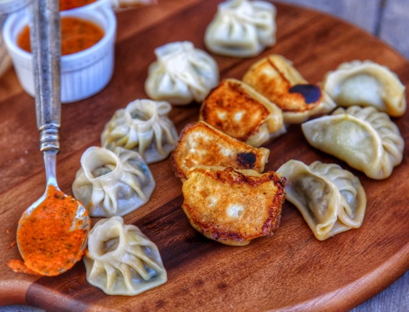
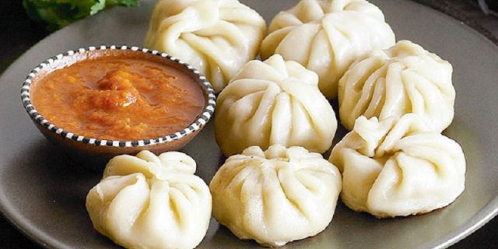
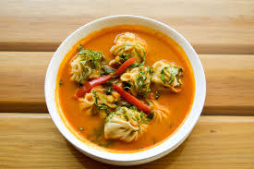
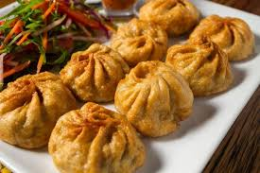
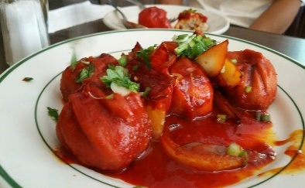
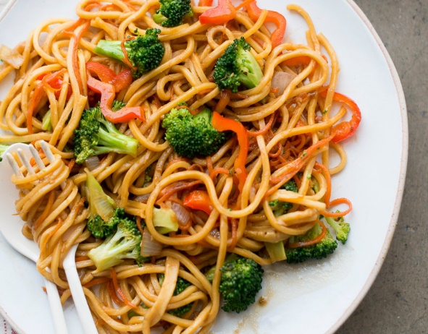
FOODS
The craving for the food keeps changing with the mood. There are many varieties in the Nepali foods. You can choose what to eat. Some of the popular and the highly preferred foods among the Nepalis….
MO:MO:
One of the most popular and liked food by every Nepalis. Easy to get locally so can be eaten as a snack ,lunch , dinner…upon you!!
You can order it in your own style either the Steam ,the Fried or diped in the soup or chilly momo. If you are a vegetarian they have a veg-momo too. Dont worry!
CHOWMEIN
The noodles boiled in water and prepared with the mixing of different spices .You can have it on your iown choice either mixed with chicken or the vegetarian way.
17311 All Rights Reserved Peekay

Slide 2
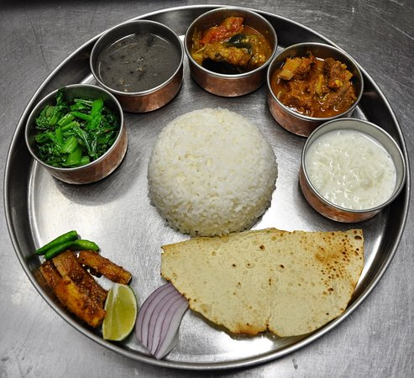
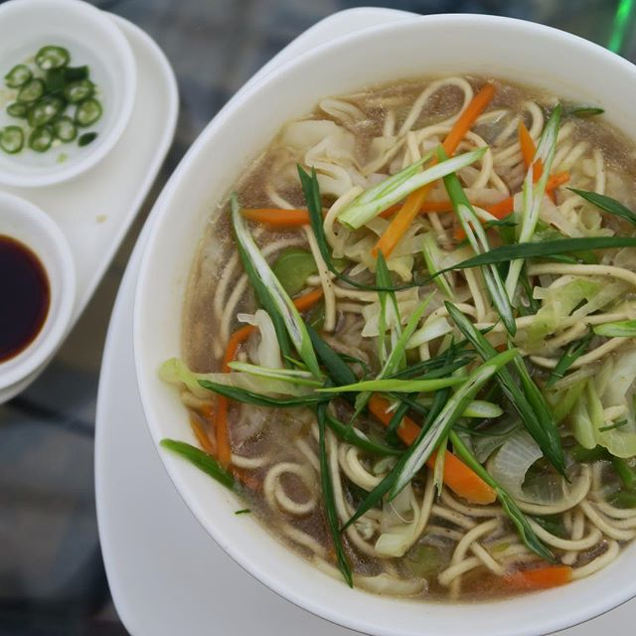
DAL BHAT POWER
The authentic nepali cuisine. Nepalis are used to eat it everyday . Either the lunch or dinner its suitable the either way. It is like an everyday food for the nepalis family. Even the foreigners living in Nepal loves it too. Cooked in the nepali way which includes rice .dal ,meat vegetable curry , pickles, salads. If you are very hungry you can always go for the dal bhat.
THUKPAA
A thick noodle soup that can include meat, egg or
just vegetables, thukpa is a winter delicacy from
the mountains of Nepal that is often served with
an accompanying dish of momo. Influenced by
both Tibetan and Chinese cuisine
DHINDO
ディンドーはネパールで用意された食事です。お湯を鍋に入れて沸騰させ、小麦粉を加えながら混ぜながら攪拌します。ネパールのさまざまな場所での主要な食事です。 ディンドーは伝統的にそばやキビから作られますが、小麦、コーンフラワーも一般的です。

Slide 3
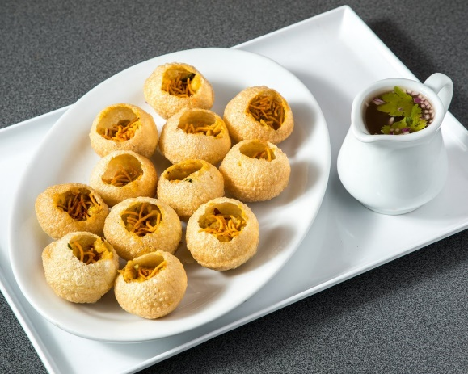
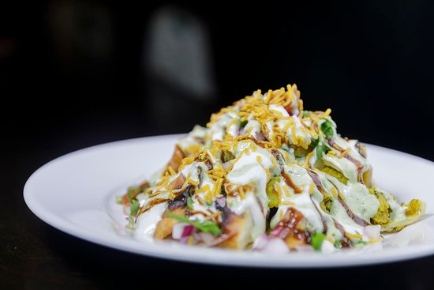
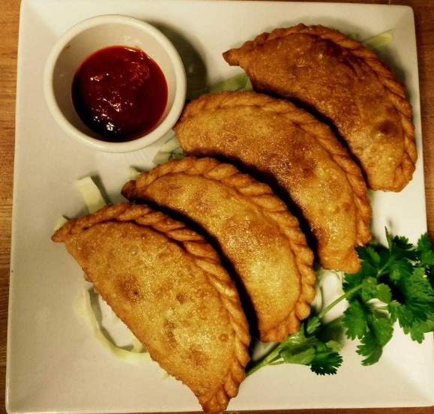
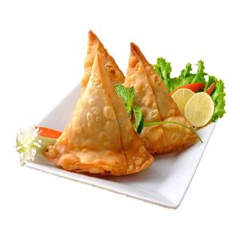
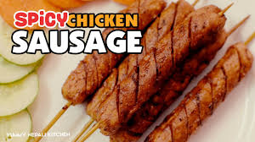
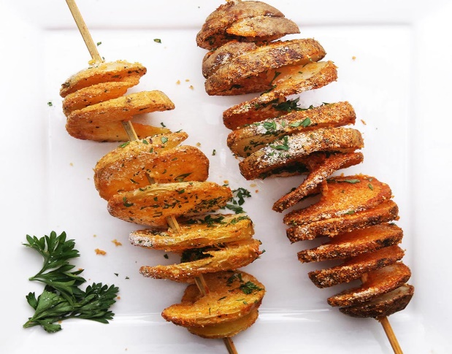
OTHER STREET FOODS

Slide 4
DAL BHAT POWER
The authentic nepali cuisine. Nepalis are used to eat it everyday . Either the lunch or dinner its suitable the either way. It is like an everyday food for the nepalis family. Even the foreigners living in Nepal loves it too. Cooked in the nepali way which includes rice .dal ,meat vegetable curry , pickles, salads. If you are very hungry you can always go for the dal bhat.
THUKPAA
A thick noodle soup that can include meat, egg or
just vegetables, thukpa is a winter delicacy from
the mountains of Nepal that is often served with
an accompanying dish of momo. Influenced by
both Tibetan and Chinese cuisine

Slide 5

MO:MO:
One of the most popular and liked food by every Nepalis . Easy to get locally so can be eaten as a snack ,lunch , dinner…upon you!!
You can order it in your own style either the Steam ,the Fried or dipped in the soup or chilly momo .
CHOWMEIN
The noodles boiled in water and prepared with the mixing of different spices .You can have it on your iown choice either mixed with chicken or the vegetarian way.
THUKPAA
A thick noodle soup that can include meat, egg or
just vegetables, thukpa is a winter delicacy from
the mountains of Nepal that is often served with
an accompanying dish of momo. Influenced by
both Tibetan and Chinese cuisine

Slide 6
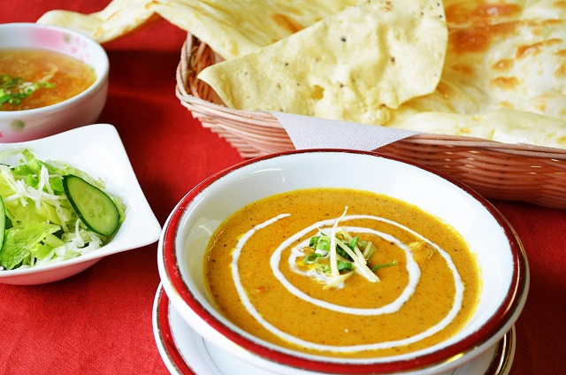
STREET FOODS NEPAL

