Slide 1






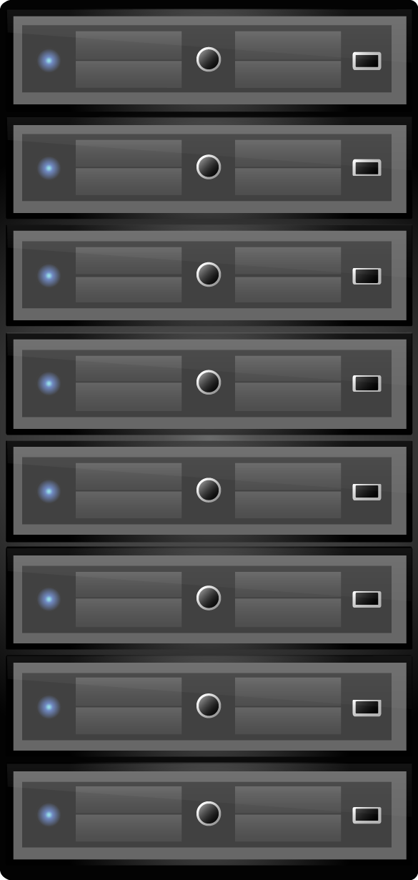




NetAlytics:
Flexible and Dynamic Network Analysis Framework
Guyue Liu, Timothy Wood
Motivation
NetAlytics
Background
Hardware-based Monitoring
Expensive appliance
Fixed deployment
Limited monitoring fields
Offline Analysis
Take time and space to process a large amount of data
10Gb/s for a hour requires 4.5Tb of storage
Can we do network and application analysis
in real time with
commodity servers?
Scalable Architecture
Independent tiers for
collection, aggregation
and processing
No application modifications
Real Time Analysis
SDN redirect certain traffic flows to monitors
Collect minimal data to process
Query Language
SQL like syntax to define an analysis task
Automatically deploy analysis tasks
Network Function Virtualization
Run network services as software on commodity servers or virtual machines
NetVM
High performance NFV platform
Can scale to 36Gbps using four ports for forwarding data
NetAlytics Architecture
Monitors
NFV-based applications
Aggregators
Queuing services that store measurements
Processors
Read and process data
in real time
Controller
Steer traffic flow and control the network
Live Popularity Detection and Caching
Web Performance Debugging
Video CDN
App Replica 1
MySQL DB
Web Frontend
App Replica 2
Mem cached
What is the most popular content right now?
How the popularity of this content changed over time?
How to allocate cache resources for this content?
Why the average response time is large?
How many requests are being sent between each tier?
What are the average response times
for each path?

