Slide 1




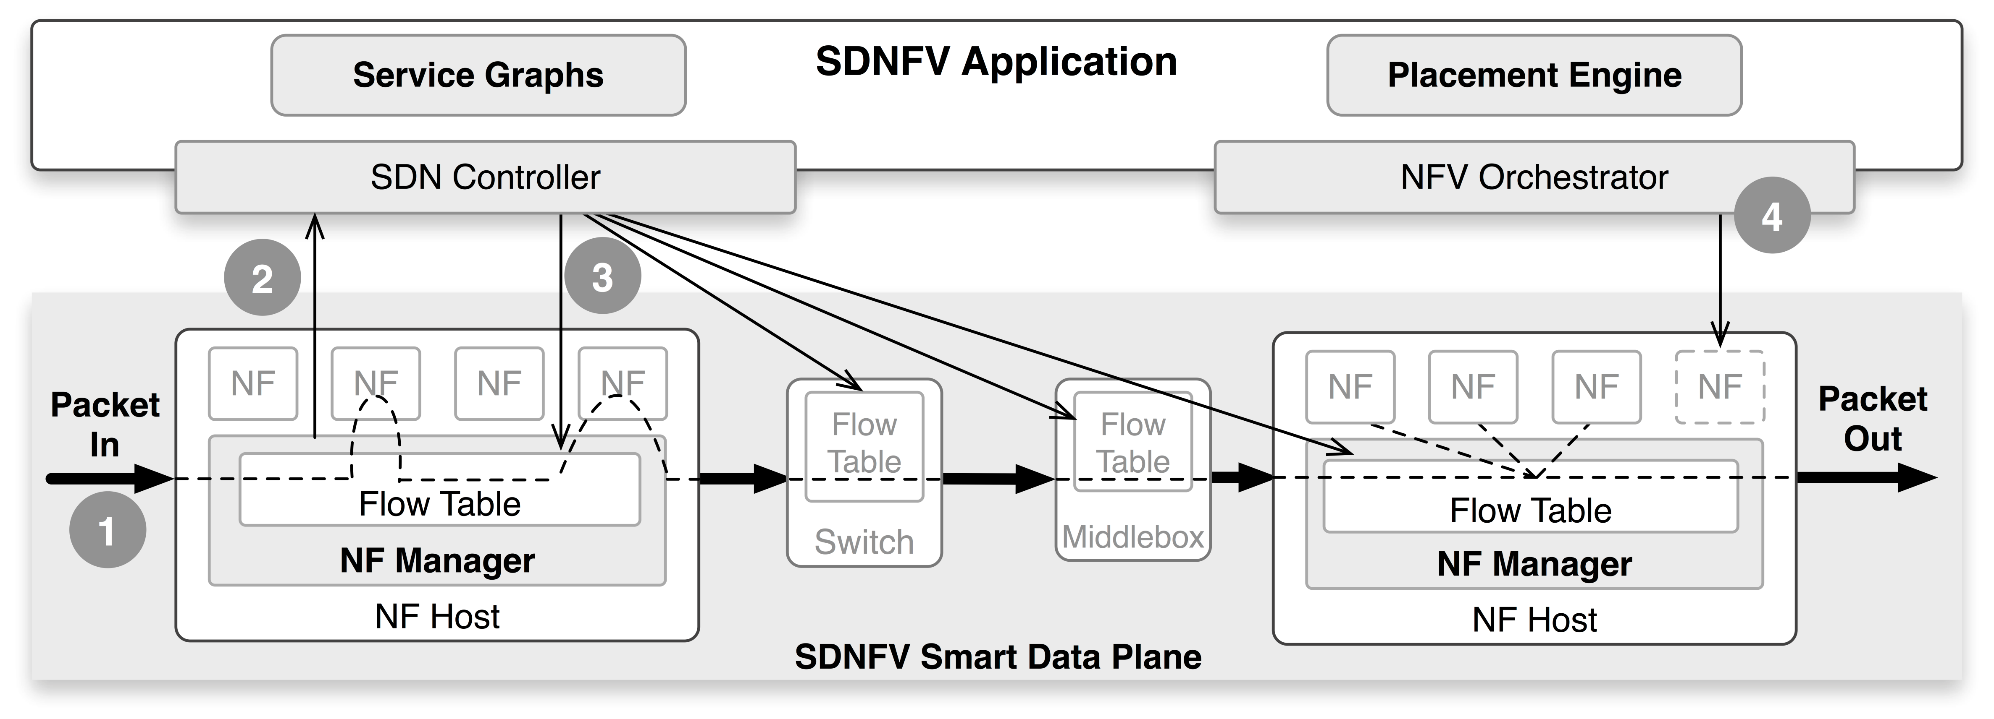
SDNFV:
Towards a Flexible and Dynamic Smart Data Plane
Wei Zhang*, Guyue Liu*, Ali Mohammadkhan†, Jinho Hwang‡, K.K. Ramakrishnan†, Timothy Wood*
*The George Washington University †University of California Riverside ‡IBM T.J. Watson Research Center
Motivation
SDNFV
The current SDN model is stateless
A priori rule for “dumb” switches
Rule based on the first packet in a flow
What is lost?
Data plane state. Lose flexibility and agility!
Complex middleboxes
Need to dynamically and flexibly route packets
Flow content
Flow Characteristics
How to integrate SDN and NFV to manage complex network services dynamically?
Flexibly support complex service chains
Define a default flow path based on NF graph
Configure the flow rules to properly route flows through designated services
Automatically place NFs across hosts to minimize cost and path latency
Permit NFs to dynamically route flows and enable flexible coordination between NFs and the SDNFV controller
NFs change the flow path based on
Temporal characteristics of flows
Application-level packet data
Server state such as NF queue lengths
Allow VMs to update local flow table
Allow NFs to contact the SDNFV controller
SDNFV Architecture
DDoS Detection and Mitigation System
Video Flow Management
Detector NF monitors incoming traffic patterns
Suspicious traffic is automatically rerouted
to Scrubber
Malicious traffic is dropped by the Scrubber
Detector -> Policy Engine -> Transcoder
Policy Engine reroutes the flows to transcoder to achieve the target bandwidth
SDNFV reacts quickly to policy changes
SDN can only influence new flows

