Slide 1
Fuzzing Aided Static Analyzer
Name: Bin Xie
Advisor : Professor Yue

Slide 2
Overview
1. Introduction
2. Motivation
3. Methods

Slide 3
Static analysis vs Dynamic analysis
1. Reasoning about the behavior of programs without executing them.
2. White box security testing
3. Can’t discover run-time error and environment-related issues.
4. false positive and false negative
1. Analysis of programs by executing them.
2. Black box security testing
3. Can discover run-time and environment-related issues.

Slide 4
Practical Static Analysis
A static analysis tool S analyzes the source code of a program P to determine whether it satisfies a property φ, such as:
P never deferences a null pointer
P does not leak file handles
No cast in P will lead to a ClassCastException
…

Slide 5
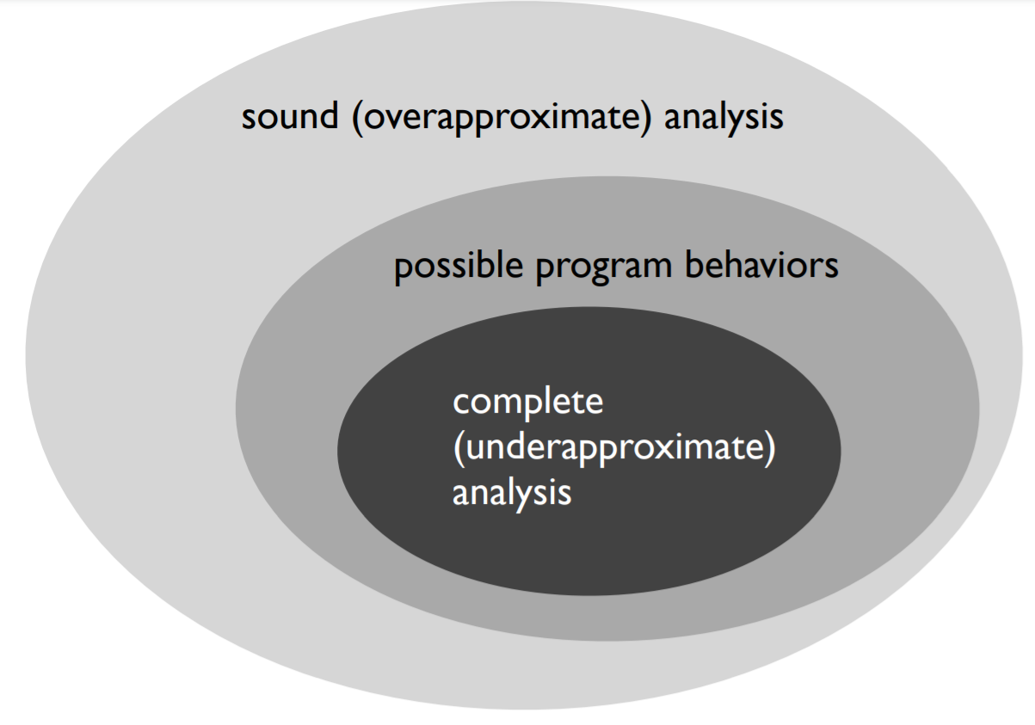
False positive and false negative
But a static analysis tool S can be wrong in one of two ways
If S is sound, it will never miss any violations, but it may say that P violates φ even though it doesn’t (resulting in false positives).
If S is complete, it will never report false positives, but it may miss real violations of φ (resulting in false negatives).

Slide 6
What Causes False Positive and False Negative?
1. Tools make mistakes: Tools aren’t perfect, since tools relies on abstract models and representations of program data flows and logic.
2. Therefore, it needs a human double check any vulnerable code detected by the tool.

Slide 7
Runtime Error and Environment-related Issues
1. Runtime error: static analysis can’t find runtime error since it analyzes programs without execution them.
2. Environment-related Issues: static analysis alone is not enough to guarantee environmental configure, like third-party libraries.

Slide 8
Motivation
1. Decrease the proportion of false positive and false negative.
2. Detect runtime errors and environment-related errors

Slide 9
Design
Based on Static Analysis, combination with Dynamic Analysis improves performance of results from Static Analysis.
1. Using Dynamic Analysis to verify all errors detected by Static Analysis to decrease false positive
2. Using Dynamic Analysis to detect more errors not detected by Static Analysis, such as false negative, runtime error, and environment-related errors.
Static Analysis tool: CodeQL
Dynamic Analysis tool: AFL-Fuzzing

Slide 10
Dynamic Analysis: AFL-Fuzzing
Firstly, AFL will use the source code to do instrumentation that will insert a unique number to identify each basic block during compiling.
Secondly, the input cases will be inserted into Seed Queue.
Thirdly, AFL will select one seed to mutate a lot of seeds. And then execute binary program using all mutated seeds.
Finally, if there is any new path to cover by any seed, the seed will be added Seed Queue. Else, it will be discarded
Instrumentation(afl-gcc)
seed
Mutate Input
Seeds
Binary Program
Seed Queue
ADD
IsInteresting?
Discard
Seed Inputs S

Slide 11
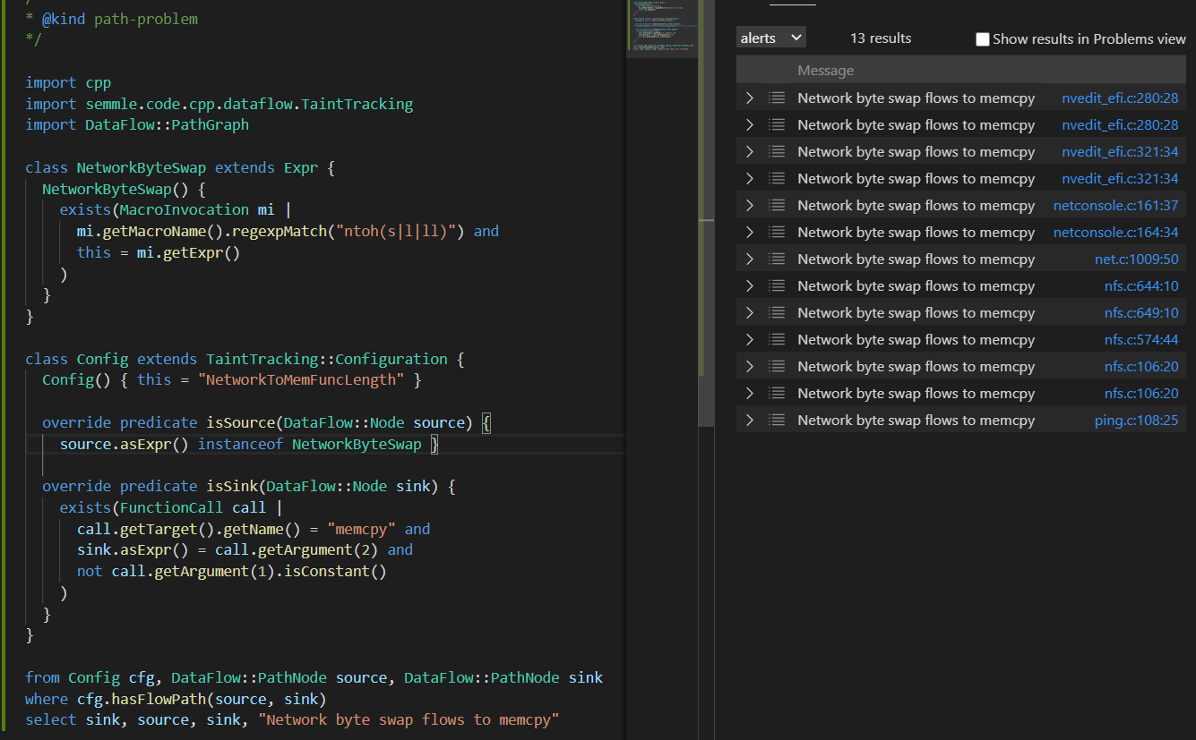
Static Analysis: CodeQL
1. CodeQL is a static analysis tool. It uses source code to build a database, and then query attributes from source code to find bugs.
2. Find all unsafe calls to memcpy that are influenced by remote input that are ntoh, ntohll, or ntohs.

Slide 12
Design overview
1. Firstly, Static analysis tool, CodeQL, will be implemented to produce locations of vulnerable code and input AFL-Fuzzing.
2. Secondly, AFL will receive several input cases and implement to cover basic blocks as much as possible.
3. Finally, the results of vulnerabilities will be output.
Static Analysis
(CodeQL)
vulnerabilities results
Locations of vulnerable code
Dynamic Analysis
(AFL-Fuzzing)
Input cases

Slide 13
Thank you
Questions

