Slide 1
Smart Contract Reentrancy Attack Detection
Yitao Jiang, Yanfeng Qu
CS 595 Software Security

Slide 2
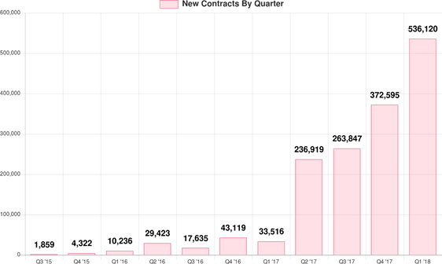
Smart Contract
A smart contract is a self-executing contract with the terms of the agreement between buyer and seller being directly written into lines of code[1]
is contained in a blockchain network
controls the execution, and transactions are trackable and irreversible
Number of smart contract is increasing rapidly
Figure 1 # of New Smart-Contracts Created Each Q
[1] https://www.investopedia.com/terms/s/smart-contracts.asp​
Figure Source: https://hackernoon.com/ethereum-smart-contracts-most-of-them-are-rarely-used-f45749730d3
Notes:
a quick review of smart contract and reentrancy attack
trackable and irreversible
a program, correctnessenforced by the consensus protocol.
Ethereum

Slide 3
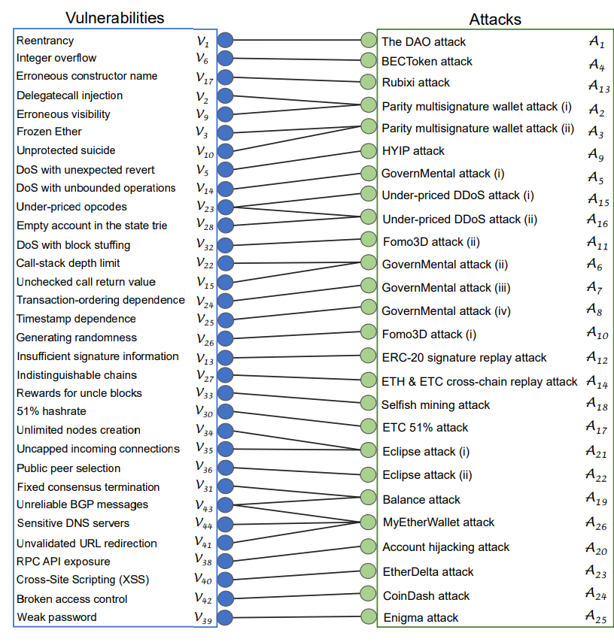
Smart Contract Vulnerabilities
Two properties:
Openness
Immutability
44+ vulnerabilities
Picture Source: https://www.dhs.gov/criticalinfrastructure-sectors
Notes:
its unique security issues, because of its two properties
openness and immutability

Slide 4
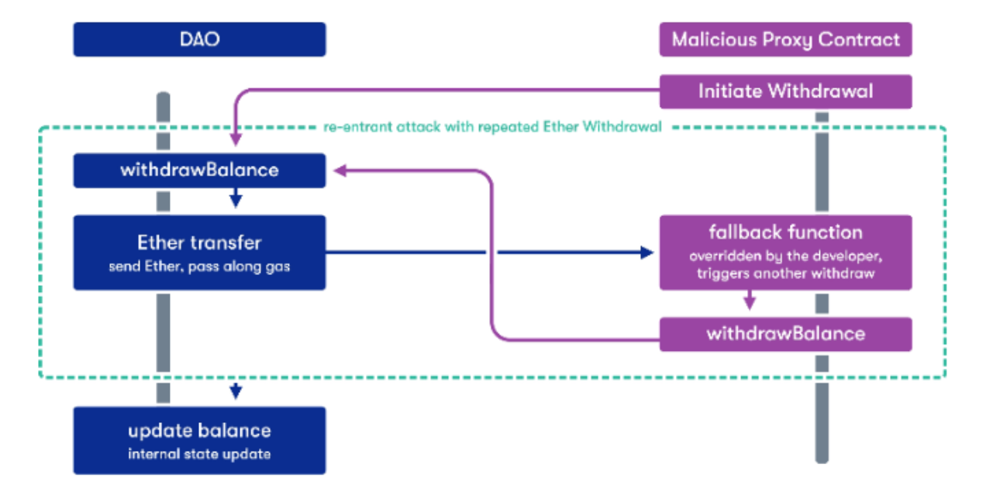
Reentrancy Attacks
Picture Source: https://cointelegraph.com.br/news/the-vulnerabilities-of-smart-contracts
Notes:
define a function is reentrant
if a malicious contract calls reentrant function iteratively by using its fallback function, it can be a reentrancy attack.
make use of the intermediate state and take over control flow
Imagine a function that withdraws money from the balance

Slide 5


Reentrancy Attack Detection
Motivation
Essential to analyze the code before
implementation
Can cause serious consequences
Method
Static analysis
Notes:
Our work is to build a simple tool that can detect reentrancy attack vulnerbility inside a smart contract.
once the smart contract is applied, the code cannot be updated
reentrancy attack can lead to serious consequences
How to achieve our goal?
use static analysis technique
compare the performance between calling normal function and fallback function
cannot be done by dynamic analysis
static analysis has the disadvantage of high false positive rate.

Slide 6
Related Works
Tools
Oyente: is a symbolic execution tool detect four types of vulnerabilities
Octopus: is a static security analysis framework for WebAssembly module and blockchain smart contract
VERISMART
ZEUS, etc
Papers
Making Smart Contracts Smarter, CCS'16
Securify: Practical Security Analysis of Smart Contracts, CCS'18
Sereum: Protecting Existing Smart Contracts Against Re-Entrancy Attacks, NDSS'19
Notes:
mainly refer to the first two tools to implement our idea.
Oyente is a tool based upon symbolic execution.
So we plan to learn from it and use its result to compare with ours in later work
Octopus, is a static analyzer. It supports disassembling and control flow analysis on smart contract.

Slide 7
Implementation and Evaluation
Implementing detection logic in Octopus, a static analyzer
Dataset
Test data in Oyente
19, 366 smart contract ; May 5, 2016
Tool
Static analysis tool; Oyente
Evaluation Metrics
Effectiveness
Number of buggy contracts
Performance
Execution time
Notes:
two following metrics:
1 Given the input of contracts Oyente already flagged as vulnerable, evaluate how many buggy contracts can be successfully detected.
2 average time spent on analyzing a contract

Slide 8
Team Work and References
Team work:
Detection logic design; data preprocessing; implementation;
proposal and final presentation
Implementation and evaluation; midterm and final presentation
Reference:
Oyente https://github.com/melonproject/oyente
Octopus https://github.com/pventuzelo/octopus
Bamboo https://github.com/pirapira/bamboo.

Slide 9
References
M. Coblenz, “Obsidian: a safer blockchain programming language,” in Proceedings of the 39th International Conference on Software Engineering Companion, pp. 97–99, IEEE Press, 2017.
F. Schrans, S. Eisenbach, and S. Drossopoulou, “Writing safe smart contracts in flint,” in Conference Companion of the 2nd International Conference on Art, Science, and Engineering of Programming, pp. 218–219, ACM, 2018.
R. O’Connor, “Simplicity: A new language for blockchains,” in Proceedings of the 2017 Workshop on Programming Languages and Analysis for Security, pp. 107–120, ACM, 2017.
“Welcome! | the coq proof assistant.” https://coq.inria.fr/. [127] I. Sergey, A. Kumar, and A. Hobor, “Scilla: a smart contract intermediate-level language,” arXiv preprint arXiv:1801.00687.
L. Luu, D.-H. Chu, H. Olickel, P. Saxena, and A. Hobor, “Making smart contracts smarter,” in Proceedings of the 2016 ACM SIGSAC Conference on Computer and Communications Security, pp. 254–269, ACM, 2016.
S. Kalra, S. Goel, M. Dhawan, and S. Sharma, “Zeus: Analyzing safety of smart contracts,” NDSS, 2018.
J. Chang, B. Gao, H. Xiao, J. Sun, and Z. Yang, “scompile: Critical path identification and analysis for smart contracts,” arXiv preprint arXiv:1808.00624, 2018.
S. Grossman, I. Abraham, G. Golan-Gueta, Y. Michalevsky, N. Rinetzky, M. Sagiv, and Y. Zohar, “Online detection of effectively callback free objects with applications to smart contracts,” Proceedings of the ACM on Programming Languages, vol. 2, no. POPL, p. 48, 2017.

