Slide 1
Smart Contract Reentrancy Attack Detection Yitao Jiang, Yanfeng Qu CS 595 Software Security

Slide 2
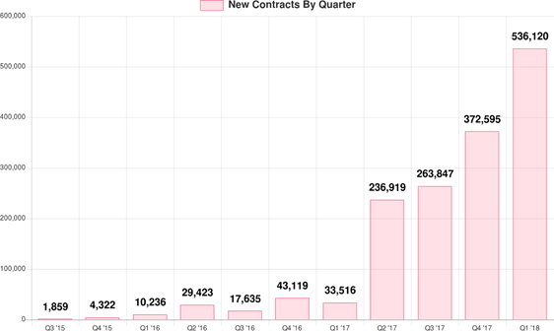
Introduction - Smart Contract
A smart contract is a self-executing contract with the terms of the agreement between buyer and seller being directly written into lines of code[1]
is contained in a blockchain network
controls the execution, and transactions are trackable and irreversible
Number of smart contract is increasing rapidly
Figure 1 # of New Smart-Contracts Created Each Q
[1] https://www.investopedia.com/terms/s/smart-contracts.asp​
Figure Source: https://hackernoon.com/ethereum-smart-contracts-most-of-them-are-rarely-used-f45749730d3
Notes:
A quick review to smart contract
IN a smrt contract, agreement written into lines of code.
The code and the agreements contatined in a distributed, decentralized blockchain network.
The code controls the execution, and transactions are trackable and irreversible.
Number of smart contract is increasing rapidly
%
A smart contract is a self-executing contract with the terms of the agreement between buyer and seller being directly written into lines of code.
The code and the agreements contatined in distributed, decentralized blockchain network.
The code controls the execution, and transactions are trackable and irreversible.
From the chart, we can see the number of smart contract is growing rapidly.

Slide 3
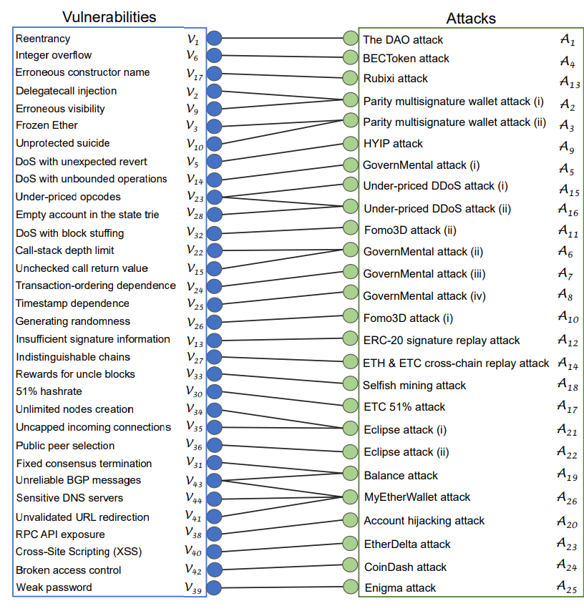
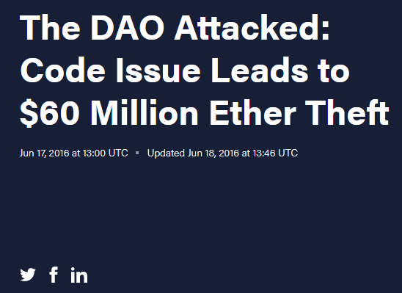
Smart Contract Vulnerabilities
Two properties:
Openness
Immutability
44+ vulnerabilities
The DAO Attack
2016/06/07
one-third of the DAO’s funds
Picture Source: https://www.dhs.gov/criticalinfrastructure-sectors
Notes:
It involves challenges as well
smart contract has its unique security issues, because of its two properties: openness and immutability. T
44 vulnerabilities in smart contract. Reentrancy attack On Apprilation 1ayer
The DAO (stylized Đ) was a digital decentralized autonomous organizatio
The platforms operate in open, so it is vulnerable to attempted manipulation by arbitrary adversaries.
And once the contract is applied, its code can never be modified.
Although users in Ethereum have to follow a predefined protocol when participating in the network, there is considerable room for manipulation of a smart contract’s execution by the network participants. \\
44 kinds of vulnerabilities in smart contract. On Apprilation 1ayer
The DAO (stylized Đ) was a digital decentralized autonomous organizatio

Slide 4
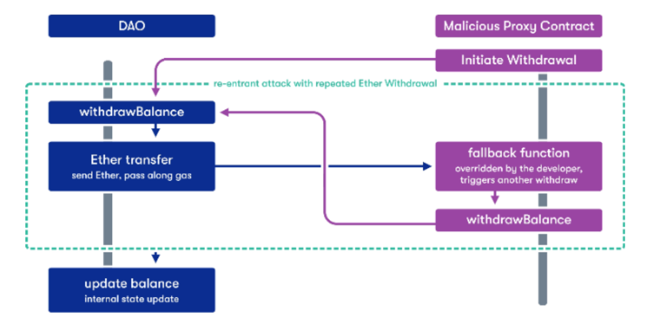
DAO Attacks
In Ethereum, when there is a function call
- The caller has to wait for the call to finish
- A malicious callee might take advantage of this
Picture Source: https://cointelegraph.com.br/news/the-vulnerabilities-of-smart-contracts
Notes:
In Ethereum, when there is a function call
- The caller has to wait for the call to finish
- A malicious callee might take advantage of this
This simplest example is when a contract does internal accounting with a balance variable and exposes a withdraw function. If the vulnerable contract transfers funds before it sets the balance to zero, the attacker can recursively call the withdraw function repeatedly and drain the whole contract.
Let me introduce fallback The fallback function is triggered if someone tries to call a function that does not exist in the contract, and is often utilized for re-entrancy attacks
A reentrancy attack can occur when you create a function that makes an external call to another untrusted

Slide 5

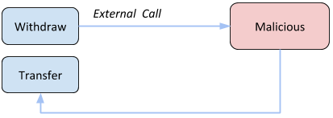
4 Types of Reentrancy Attacks
Single Function Reentrancy
The DAO Attack
the fallback function recursively calling withdraw
Cross-function Reentrancy
the fallback function call function transfer
Notes:
4 types of reentrancy attack
Single Function Reentrancy
The DAO Attack
the fallback function
Cross-function Reentrancy
is harder to detect. A cross-function reentrancy attack is possible when a vulnerable function shares state with another function that has a desirable effect for the attacker.
In this example, withdraw calls the attacker’s fallback function same as with the single function reentrancy attack.
The difference is the fallback function makes a call to transfer instead of recursively calling withdraw. Because the balance has not been set to 0 before this call, the transfer function can transfer a balance that has already been spent.
Cross-function Reentrancy
the fallback function call function transfer

Slide 6
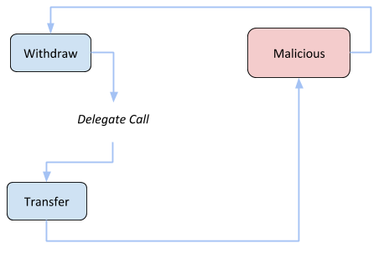
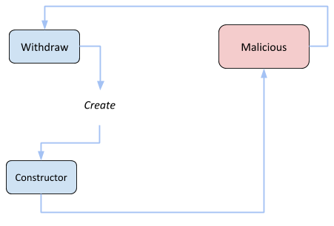
4 Types of Reentrancy Attacks
Delegated Reentrancy
a contract invokes another contract as a library
Create-Based Reentrancy
issue further calls in its constructor to other contracts, including malicious contracts
Notes:
As for delegated re-entrancy attacks, it ussuay happens when a contract invokes another contract as a library
CREATE is an instruction that creates a new contract during execution of a contract
CREATE can issue further calls in its constructor to other contracts, including malicious contracts

Slide 7
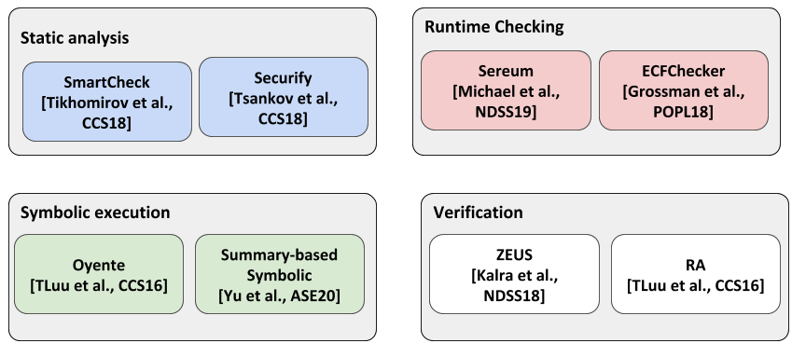
Related works - Reentrancy Attack Detection
Notes:
Here are papers Related to Reentrancy Attack Detection based on Static/ Dyanmic analysis ysmbioc and verifcation

Slide 8

Static Analysis
Smartchecker[S Tikhomirov · ‎2018]
Pattern example
Bad
Good
External contracts
should be called after
all local state updates
pragma solidity 0.4.19;
contract Fund {
mapping ( address => uint ) balances ;
function withdraw () public {
if ( msg . sender . call . value ( balances [ msg . sender ]) ())
balances [ msg . sender ] = 0;
}
}
function withdraw () public {
uint balance = balances [ msg . sender ];
balances [ msg . sender ] = 0;
msg . sender . transfer ( balance );
// state reverted , balance restored if transfer fails
}
Notes:
Static analysis, also called static code analysis, is a method of computer program debugging that is done by examining the code without executing the program
SmartCheck,in2018 is an extensible static analysis tool for discovering vulnerabilities and other code issues in Ethereum smart contract based on attack patterns analysis
%Here is the pattern example
When we look at the pattern for a entrancy issues
External contracts should be called after all local state updates
the disadvantage of Static analysis has high false positive rate.
They cannot provide a dynamic view of contract interactions (or transactions)
Static analysis usually includes three stages: 1. building an intermediate representation (IR) 2. enriching the IR with additional information 3. vulnerability detection
SmartCheck uses: I ANTLR parser generator I custom Solidity grammar I XPath queries Example parse tre

Slide 9
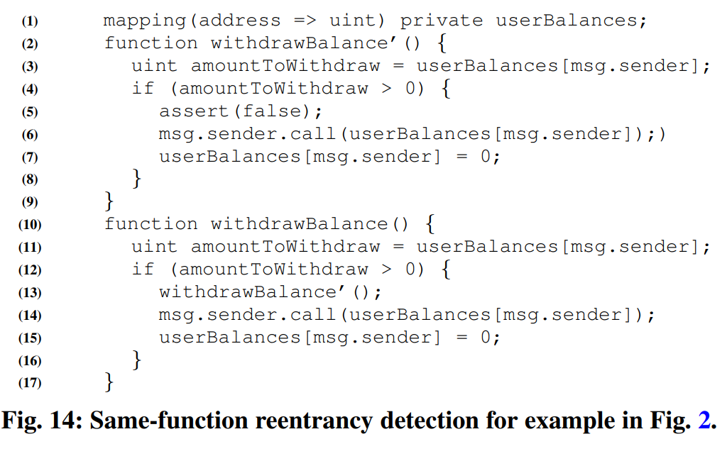
Verification
ZEUS [Sukrit., NDSS18]
Same-function reentrancy
insert a call
assert false
Cross-function reentrancy
Not scalable
Notes:
Achieve Less false positives
ZEUS prosed in 2018
ZEUS handles same-function reentrancy by first cloning the function, and inserting a call to the clone before the invocation to call. Fig shows the patched function. %Note that ZEUS ensures that the patch is done within the same basic block so as to ensure that if the cloned function is called,
%then the invocation to call is also made.
Further, they also assert false before the call code. If the verifier finds a path leading to this assert, it indicates a bug.
Cross-function reentrancy can be handled similarly by patching different functions. However, it is not scalable due to state space explosion even with small number of functions. We leave efficient detection of cross-function reentrancy for the future.

Slide 10
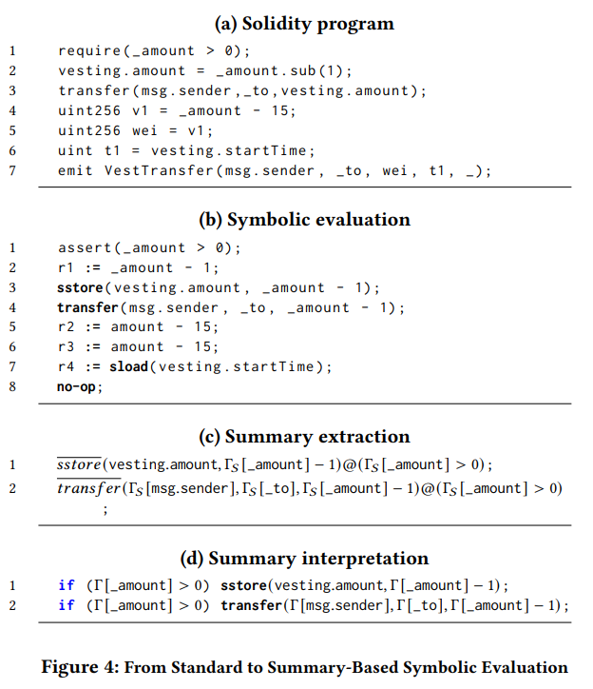

Symbolic Execution
Summary-Based Symbolic [Y. Feng 2020]
if there is no store statement between the two transfer functions that has the minimum gas (i.e., 2300), then there may exist a Reentrancy vulnerability.
Notes:
Symbolic execution is a method that pseudo-executes a program by replacing information unspecified from the program itself with symbolic values to represent any value. S
symbolic execution is used for exploring bytecodes in a depth-first search fashion by extracting control flow graphs (CFGs).
Figure shows the process from solidity program to summary based symbolic
s, let trace R contains a sequence instructions that include multiple transfer statements that share the same program counter, if there is no store statement between the two transfer functions that has the minimum gas (i.e., 2300), then there may exist a Reentrancy vulnerability.
+by reasoning about one path at a time, symbolic execution can achieve better precision (or less false positives) compared to traditional approaches using statict analysis or general data flow analysis.
In particular, analysis results may produce false negatives because of an infeasible path
-- symbolic execution only outputs CFGs from programs to be analyzed and does not support detection of the vulnerabilities themselves. Accordingly, analysis becomes often heuristic if an infeasible path exists in the programs. Many esition Detection methods are a combination of symbolic execution and static analysis symbolic execution techniques suffer from the wellknown path explosion problem for larger programs

Slide 11
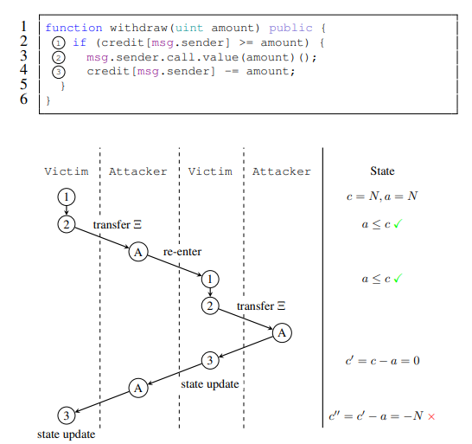
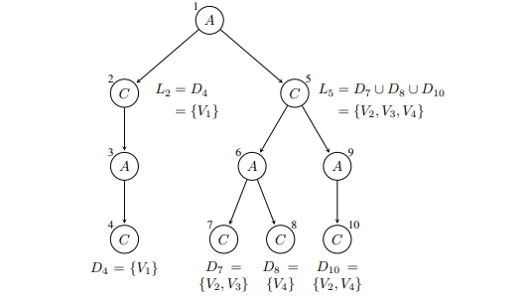
Runtime checking
Sereum [M. Rodler,2018]
Call sequence
Dynamic Call Tree
Notes:
Sample contract vulnerable to re-entrancy attacks [10]: the upper parts shows the Solidity code, whereas the lower part shows the call sequence between the vulnerable contract Victim and the attacker contract, and the state of the variable a (amount) and c (credit[msg.sender]). The amount a has not been updated for the second invocation of Victim thereby allowing a malicious re-entrancy.
Figure 7 depicts an example for Sereum’s generation of a dynamic call tree for a given Ethereum transaction. It is obvious to see, A possibly malicious contract A enters a vulnerable contract C multiple times at different entry points (functions).
+Dynamic analysis has been regarded as an effective complement to the static analysis for security purposes it is tightly coupled with the importing process of blockchain data, and cannot be used to analyze selected transactions to detect attacks.
First, as shown on the left sub-tree, contract A calls C, C calls A, and A finally re-enters C. This sub-tree would be equivalent to a classical re-entrancy attack
Dynamic call tree of a Ethereum transaction. Contract A is re-entered several times. Vk are storage variables. Di is the set of storage variables, which influence control-flow decisions in node i. Li is the set of storage variables, which are locked at node i and cannot be updated anymore

Slide 12
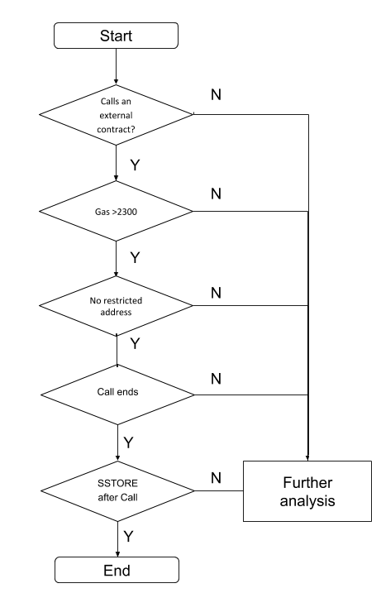
Reentrancy Attack Detection Logic Design
A contract is vulnerable to reentrancy attack if
1. The contract makes a call to an external contract
2. Gas amount > handling fee
3. Call function with no restricted address
4. Finish execution call function
5. All local state updates after call function
Notes:
We also proposed a Reentrancy Attack Detection logic design based on static analysis referred to relate
Remaining gas is enough for one contract to call another contract. All local state updates after call function
(when the gas is less than 2 300, it is not enough for one contract to call another contract);
External contracts should be called after all local state updates

Slide 13
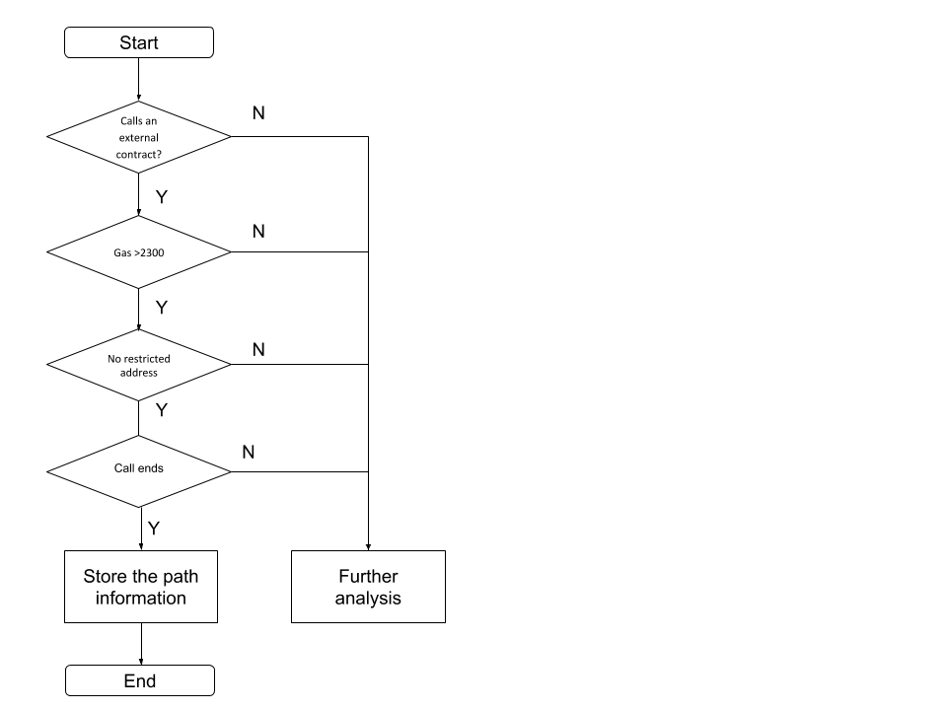
Combination of Static analysis and Symbolic Execution
A contract is vulnerable to reentrancy attack if
1. The contract makes a call to an external contract
2. Gas amount > handling fee
3. Call function with no restricted address
4. Finish execution call function
5. All local state updates after call function
If a path 1-4 is detected in symbolic execution, store the path information. If 5 is executed right after that, report the bug
Notes:
In addition, symbolc execution help to store path 1-4. If 5 is executed right after that, report the bug

Slide 14

Implementation
Control Flow Graph Generation Tool
Octopus: a security analysis framework for WebAssembly module and Blockchain https://github.com/pventuzelo/octopus
Explorer
Disassember
Control Flow Analysis
Call Flow Analysis
IR conversion (SSA)
Symbolic Execution
Notes:
symbolic execution is used for exploring bytecodes in a depth-first search fashion by extracting control flow graphs (CFGs).
We plan to Implement Octopus to generate CFGs

Slide 15
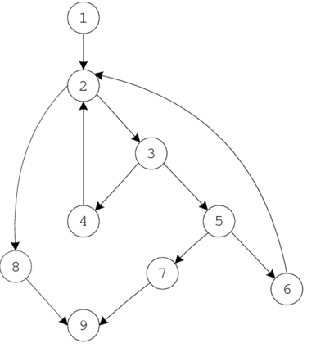
Control Flow Graph (CFG)
The CFG is an abstract representation of a program that captures all possible flows through the program.
A CFG is a graph that consists of basic blocks (nodes) and possible control-flow paths (edges).
A basic block (BB) is a linear sequence of program statements with a single entry and exit.
And edge (i, j) connecting blocks bi and bj implies that control may flow from block bi to block bj 1 .

Slide 16
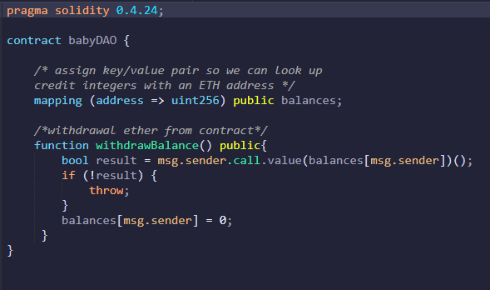
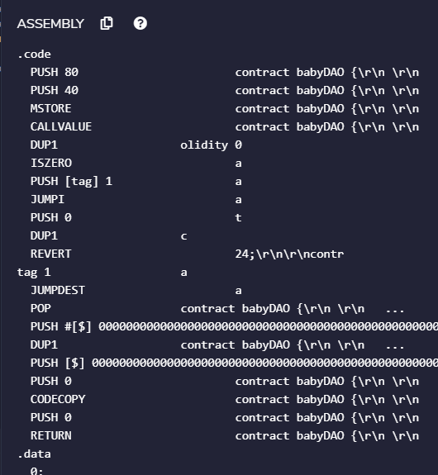
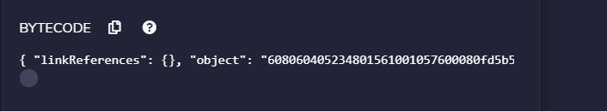
Notes:
We first try to learn what a reentrancy attack's CFG atually looks like. We use the DAO contract code professor introduced during the class. Then we input it on a open-source smart contract platform called Remix. Remix is able to compile the source code into bytecode and assembly code as our input in the next step.

Slide 17
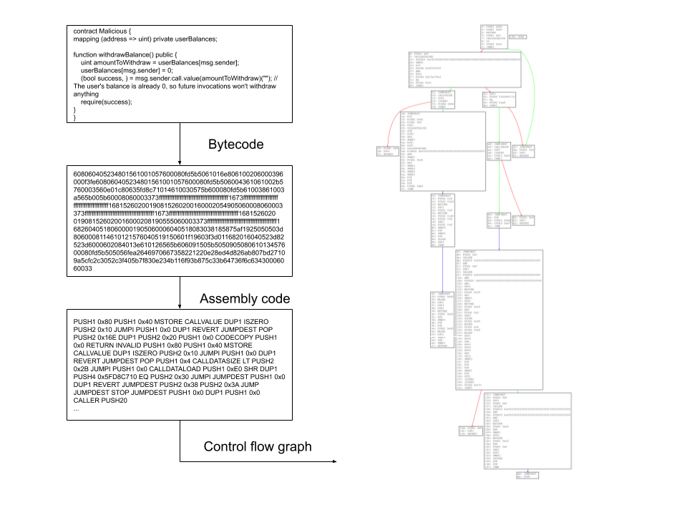
Preliminary Result
CFG Generation
Notes:
Then we use Octupus to generate control flow graph. This vulnerability can actually be discovered in this CFG. The instruction SSTORE is used to update the balance. And it appears after the externel call finishes.
We also runs the example code on Oyente to see how this tool works.

Slide 18
Future Work- Implementation and Evaluation
Implementing detection logic in Octopus
Symbolic execution tool
Detection logic implementation
Data flow graph analysis
Dataset
Test data in Oyente
19, 366 smart contract ; May 5, 2016
Evaluation Metrics
Effectiveness
Number of buggy contracts
Performance
Execution time
Notes:
We try to implement our detection logic in a static analyzer , Octopus is supported on Linux and requires Python >=3.5 .
We plan to measure the efficacy of proposed static analysis tool via two following metrics:
1 Given the input of contracts Oyente already flagged as vulnerable, evaluate how many buggy contracts can be successfully detected.
2 average time spent on analyzing a contract

Slide 19
References
M. Coblenz, “Obsidian: a safer blockchain programming language,” in Proceedings of the 39th International Conference on Software Engineering Companion, pp. 97–99, IEEE Press, 2017.
F. Schrans, S. Eisenbach, and S. Drossopoulou, “Writing safe smart contracts in flint,” in Conference Companion of the 2nd International Conference on Art, Science, and Engineering of Programming, pp. 218–219, ACM, 2018.
R. O’Connor, “Simplicity: A new language for blockchains,” in Proceedings of the 2017 Workshop on Programming Languages and Analysis for Security, pp. 107–120, ACM, 2017.
“Welcome! | the coq proof assistant.” https://coq.inria.fr/. [127] I. Sergey, A. Kumar, and A. Hobor, “Scilla: a smart contract intermediate-level language,” arXiv preprint arXiv:1801.00687.
L. Luu, D.-H. Chu, H. Olickel, P. Saxena, and A. Hobor, “Making smart contracts smarter,” in Proceedings of the 2016 ACM SIGSAC Conference on Computer and Communications Security, pp. 254–269, ACM, 2016.
S. Kalra, S. Goel, M. Dhawan, and S. Sharma, “Zeus: Analyzing safety of smart contracts,” NDSS, 2018.
J. Chang, B. Gao, H. Xiao, J. Sun, and Z. Yang, “scompile: Critical path identification and analysis for smart contracts,” arXiv preprint arXiv:1808.00624, 2018.
S. Grossman, I. Abraham, G. Golan-Gueta, Y. Michalevsky, N. Rinetzky, M. Sagiv, and Y. Zohar, “Online detection of effectively callback free objects with applications to smart contracts,” Proceedings of the ACM on Programming Languages, vol. 2, no. POPL, p. 48, 2017.
Notes:
these systems consist of different components first are generators that convert energy from natural resources into electricity then there are high voltage transmission networks that deliver electricity from generators to distribution system of a town or city and then there are distribution networks
that provide electricity in various voltage levels to industrial commercial and residential consumers . In summarize
transmission network and all the other components are usually lumped into components within these transmission network

Slide 20
Thank you
Questions

