Slide 1
A Closer Look at IoT Devices
By: Darrel Belen and Udit Vasudevan

Slide 2
Types of IoT devices
Connected appliances
Smart home security systems
Autonomous farming equipment
Wearable health monitors
Smart factory equipment
Wireless inventory trackers
Biometric cybersecurity scanners
Shipping container and logistics tracking
and more

Slide 3
Different IoT devices in our homes
Voice assistants (Alexa, Google Home, Siri...)
Smart Plugs
Smart Lights (Philips Hue, Lifx...)
Indoor/Outdoor security cameras
Doorbell
Thermostat
Speakers/Media Devices

Slide 4
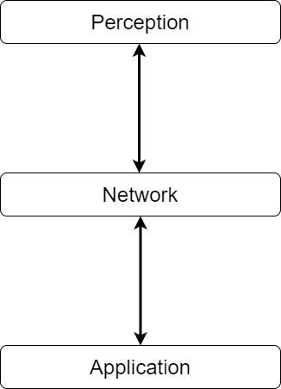
IoT Architecture
Perception Layer
Collection of information from physical devices
Network Layer
Handling of data sent between Smart Devices
Application Layer
Deliver specific services to users

Slide 5
Previous Attacks

Slide 6
Previous Attacks
The Mirai Botnet (aka Dyn Attack)
The Hackable Cardiac Devices from St. Jude
The TRENDnet Webcam Hack
The Jeep Hack

Slide 7
Previous Attacks
The Mirai Botnet (aka Dyn Attack)
The Hackable Cardiac Devices from St. Jude
The TRENDnet Webcam Hack
The Jeep Hack

Slide 8
Mirai Botnet
Botnet: Collection of internet-connected computers under remote control.
Scan open ports and attempt to login using default username/password combos
Initially used to take down game servers
Dyn attacked
Easily accessible
Mirai is not the only botnet

Slide 9
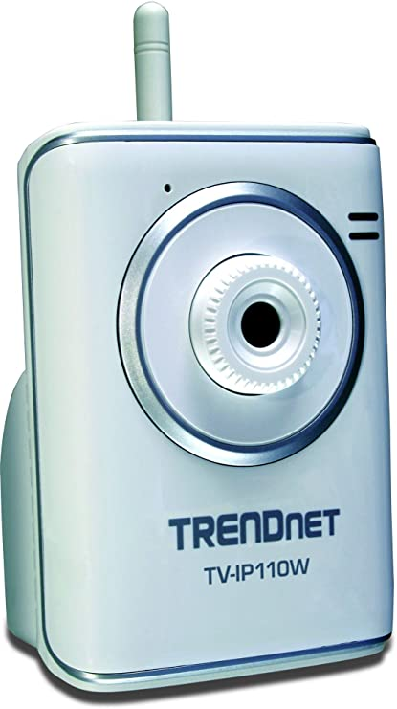
TRENDnet Webcam Hack
Cameras used for various reasons (home, business, etc.)
TRENDnet website breach
Breach information posted
Roughly 700 camera feeds posted online!
TRENDnet required to create a patch
Security review process established

Slide 10
Investigation of Smart Plugs and IP Cameras

Slide 11
Tools Used
Home Assistant - open-source home automation platform running on Python to track and control all devices at home and automate them.
Cameradar - An RTSP stream access tool that comes with its library
Notes:
HA - Can be run on a raspberry pi, windows app or on a VM
Cameradar scans the network for cameras. Has database of default credentials and stream URLs

Slide 12
Smart Plugs
Home Network
Internet/Cloud Service
Input Voice assistant/Mobile app
Smart Plug
Notes:
Example flow of a smart plug when you ask google to turn on the lights
Voice assistant triggers the action and it goes through the home network to Google
Google processes the data and sends back a command to the appropriate device back through the network

Slide 13
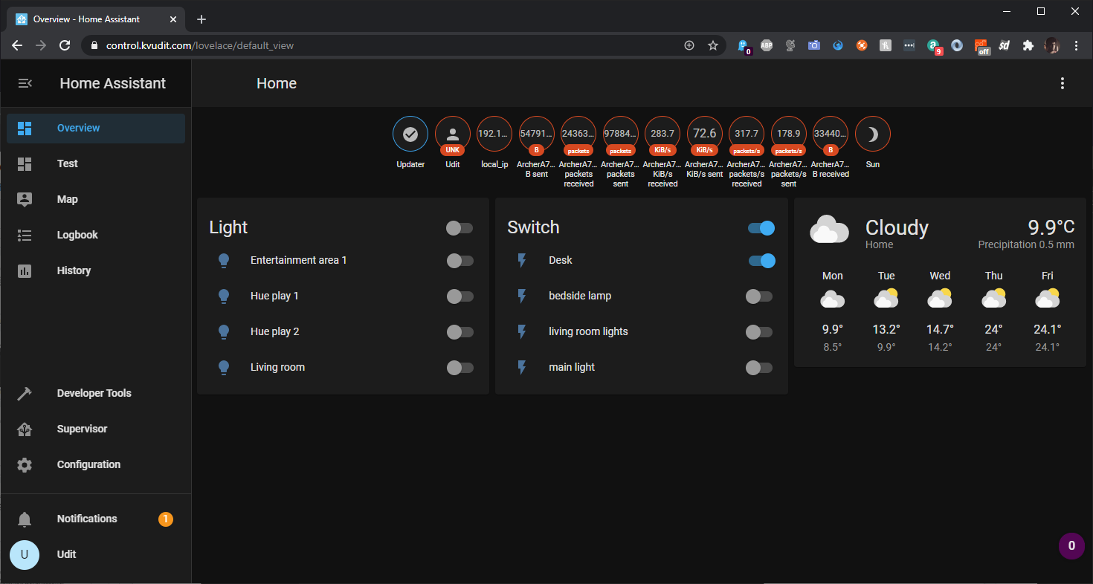
Home assistant and TP-Link Plugin
Uses a TP-Link integration plugin that can communicate with TP-Link devices
All TP-Link devices are controllable irrespective of owner
Notes:
I have an instance on home assistant running on the VM
All the available smart plugs are visible when the TP link integration is enabled in the software - irrespective of account

Slide 14
Smart Plug vulnerability
All accessible devices within the network can be controlled bypassing account/login.
Uses TP-Link’s TSHP (TP-Link Smart Home Protocol) weaknesses to gain control .
Tried and tested on TP-Link HS-103 and HS-105
Home Network
Internet/Cloud Service(TP-Link Cloud Service)
Input Home Assistant
(using TSHP)
TSHP - TP-Link Smart Home Protocol
Smart Plug
Notes:
How it works is by using weakness in the propriety TSHP to get info and gain control

Slide 15
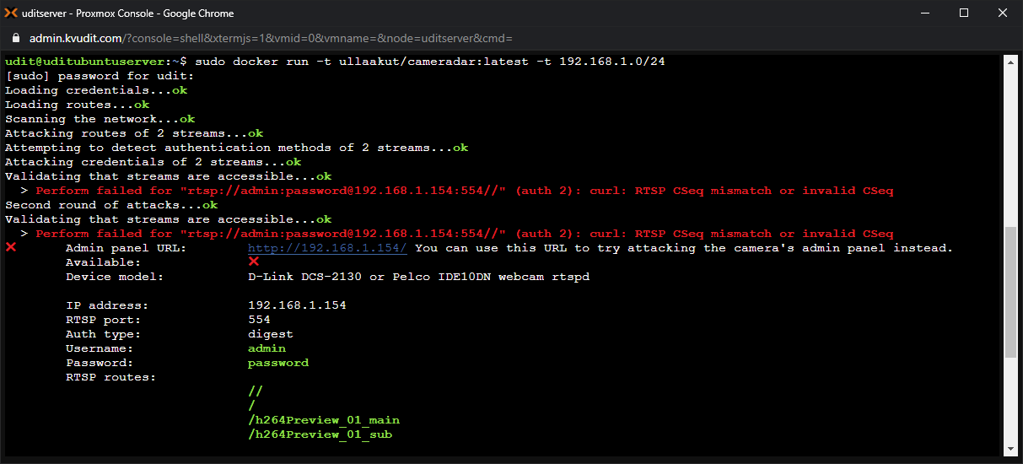
RTSP protocol & Cameradar
Example URL:
rtsp://username:pwd@IP:port/videoMain
Some cameras use digest authentication where the passwords are not sent as plaintext. These streams cannot be directly accessed by curl.
You can use any RTSP stream viewer instead.
Cameradar give us the credentials and the stream URLs available
Notes:
Rtsp - real time streaming protocol
Not directly supported by browsers. It requires the video to be transcoded.
Any media player including VLC can capture the stream

Slide 16
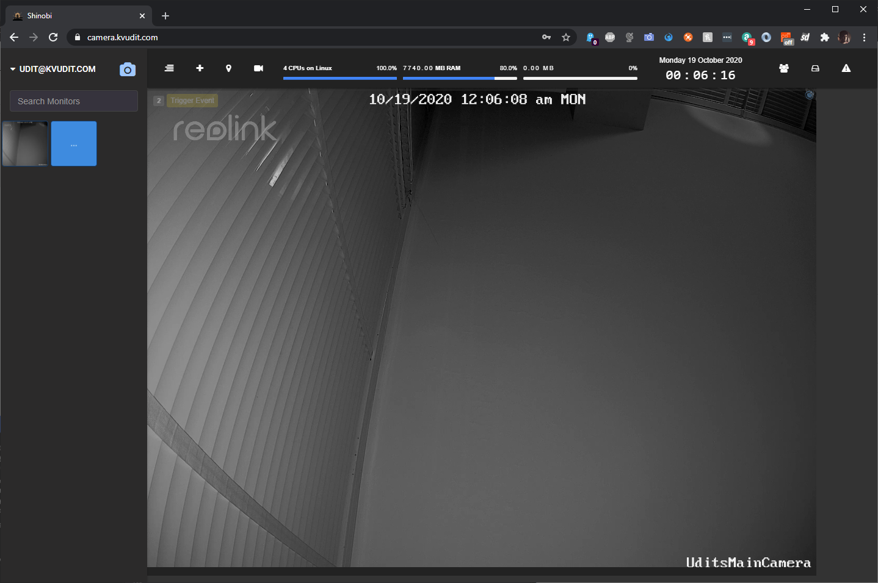
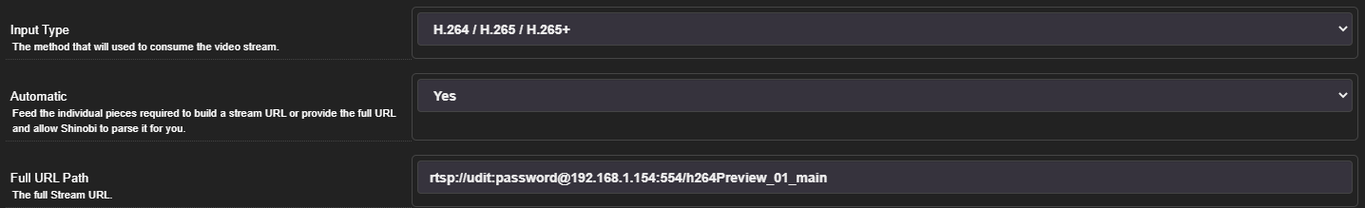
Accessing the camera
Here were using an open source NVR software to access the stream.
The URL is the one we got from cameradar
Notes:
Using shinobi open source NVR Software. We could also just use VLC media player and it will work.

Slide 17
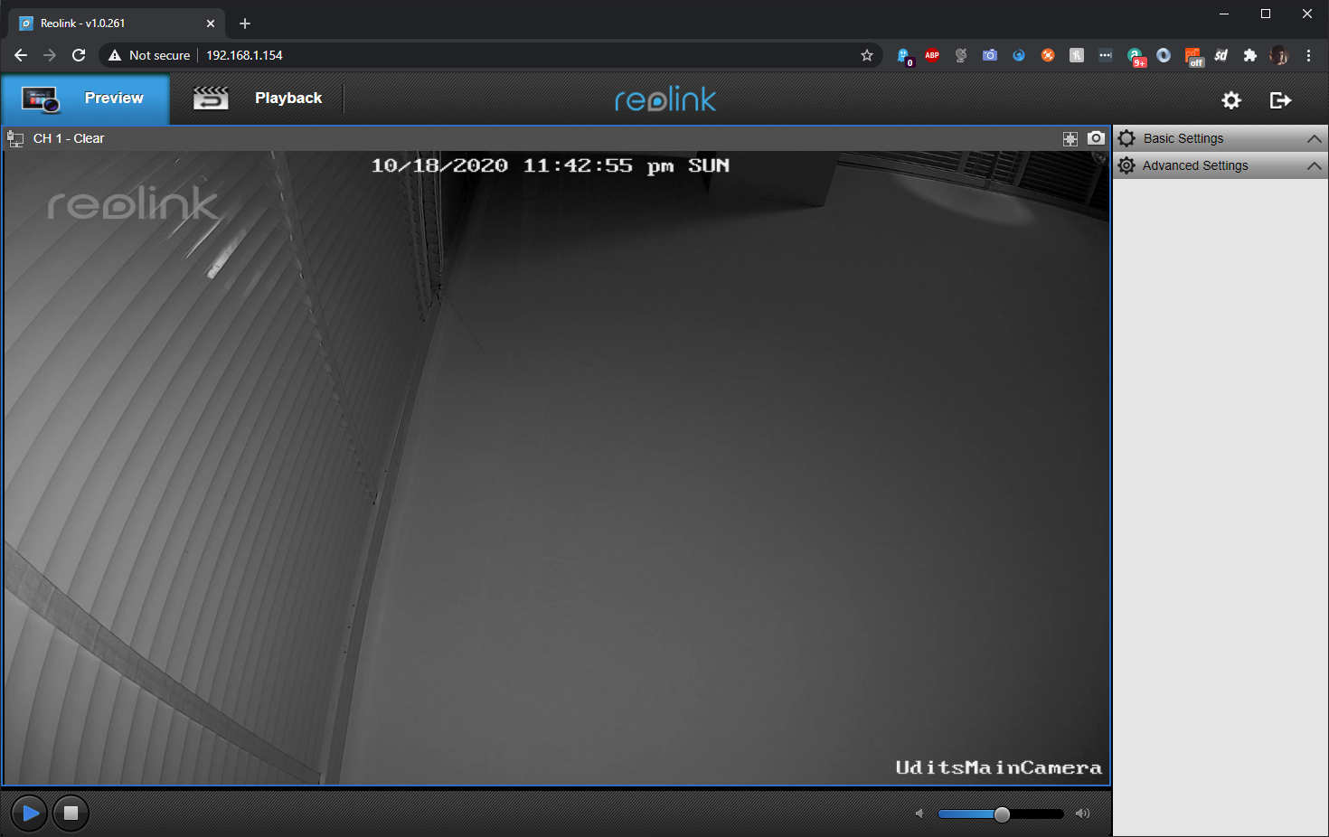
Accessing the Camera from the web console
Some cameras have a web viewer to watch the stream on a browser.
Using the credentials we can login and access the stream
Here we don’t require additional software to access the camera
Notes:
Some cameras have a small web server running that basically transcodes the rtsp stream to http. This one actually used adobe flash.
With the credentials from cameradar we can access the web console.

Slide 18
IP Camera vulnerability
The RTSP stream is accessible by anyone one the network if they know the stream’s link
Link URL depends on the camera model but is publicly available once it is known
Most cameras use digest authentication but some still use plaintext
Cameradar uses dictionaries to try various expressions and credentials
Notes:
Link URL available on manufacturers page.

Slide 19
IP camera - CVR vs Motion detection
Home security cameras broadly run in 2 distinct modes
Continuous Video Recording (CVR)
Motion Detection
In CVR the stream is always on and accessible.
Wireless and battery operated Cameras usually only start recording when motion is detected to save power
When motion is detected, the RTSP stream is accessible.
We can induce/force the motion detection on the camera to access the stream
Our tests used a Reolink RLC-520 poe camera

Slide 20
Philips Hue
Similar to the smart plug but an added security feature that forces the user to physically press a button on the HUE bridge to control from a new device.
Devices can controlled only if physical access to the HUE bridge is possible

Slide 21
What can we learn?
Physical devices are most vulnerable
Access to devices is often easy
Tampering/Interference of devices
Need some way to inform users of potential threats
Inform users to change default login credentials
Users need to be more aware of their own IoT devices

Slide 22
Future Plans
Keep exploring other vulnerabilities
Vulnerabilities that do not need access to the network
Expand to other devices
Wi-Fi deauther
disconnect devices from a network even if you're not connected to it

Slide 23
References
Dean, Andrew & Opoku Agyeman, Michael. (2018). “A Study of the Advances in IoT Security,” pp. 1-5, doi: 10.1145/3284557.3284560.
Fruhlinger, Josh. “The Mirai Botnet Explained: How IoT Devices Almost Brought down the Internet.” CSO Online, CSO, 9 Mar. 2018, www.csoonline.com/article/3258748/the-mirai-botnet-explained-how-teen-scammers-and-cctv-cameras-almost-brought-down-the-internet.html.
J. Zhang, H. Chen, L. Gong, J. Cao and Z. Gu, "The Current Research of IoT Security," 2019 IEEE Fourth International Conference on Data Science in Cyberspace (DSC), Hangzhou, China, 2019, pp. 346-353, doi: 10.1109/DSC.2019.00059.
Kerr, Dara. “FTC and TrendNet Settle Claim over Hacked Security Cameras.” CNET, CNET, 5 Sept. 2013, www.cnet.com/news/ftc-and-trendnet-settle-claim-over-hacked-security-cameras/.
Newman, Lily Hay. The Botnet That Broke the Internet Isn't Going Away. 3 June 2017, www.wired.com/2016/12/botnet-broke-internet-isnt-going-away/.

Slide 24
References
6. https://github.com/Ullaakut/cameradar
7. https://www.home-assistant.io/
8. https://shinobi.video/
9.https://support.reolink.com/hc/en-us/articles/360007010473
10.https://lib.dr.iastate.edu/cgi/viewcontent.cgi?article=1424&context=creativecomponents

Slide 25
Thank you very much!

