Slide 1
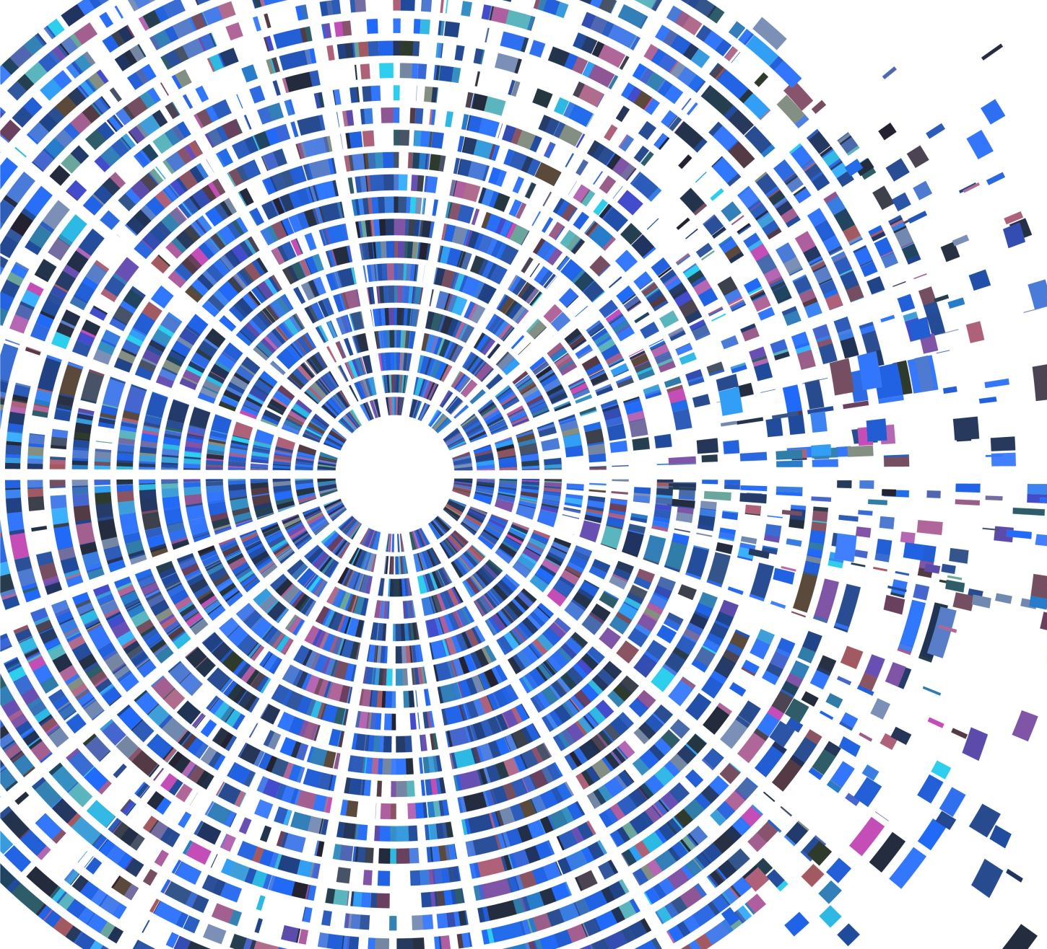
All Things Considered: An Analysis of IoT Devices on Home Networks
Original Authors
Deepak Kumar | Kelly Shen | Benton Case | Deepali Garg | Galina Alperovich | Dmitry Kuznetsov | Rajarshi Gupta | Zakir Durumeric |
Stanford University | Avast Software | University Of Illinois Urbana-champaign
Udit Vasudevan
A20451854
Illinois Institute of Technology

Slide 2
Overview
Conducted the first large-scale empirical analysis of IoT devices on real-world home networks, leveraging internal network scans
Analyzed the types and vendors of commonly purchased devices and provided a landscape of the global IoT ecosystem.
Further analyzed the security profile of these devices and networks and showed that a significant fraction of devices
use weak passwords on FTP and Telnet,
are vulnerable to known attacks
use default HTTP administration passwords that are left unchanged by users

Slide 3
Why is this analysis required?
Get more visibility into the devices consumers are putting into their homes
We need to investigate the security posture of devices, detailing their open services, weak default credentials, and vulnerability to known attacks
It is vital that the security community understands the types of IoT devices that consumers install, and their respective regional distributions given their increasing security and privacy implications.

Slide 4
What does the home IoT ecosystem look like?
We need to get information about the different devices on people’s home networks
Partnered with Avast using their Wi-Fi Inspector Software
Performs internal network scans and checks devices for weak security
Device identification
Checks weak default credentials
Checks network for vulnerability in CVEs (Common Vulnerabilities and Exposures)

Slide 5
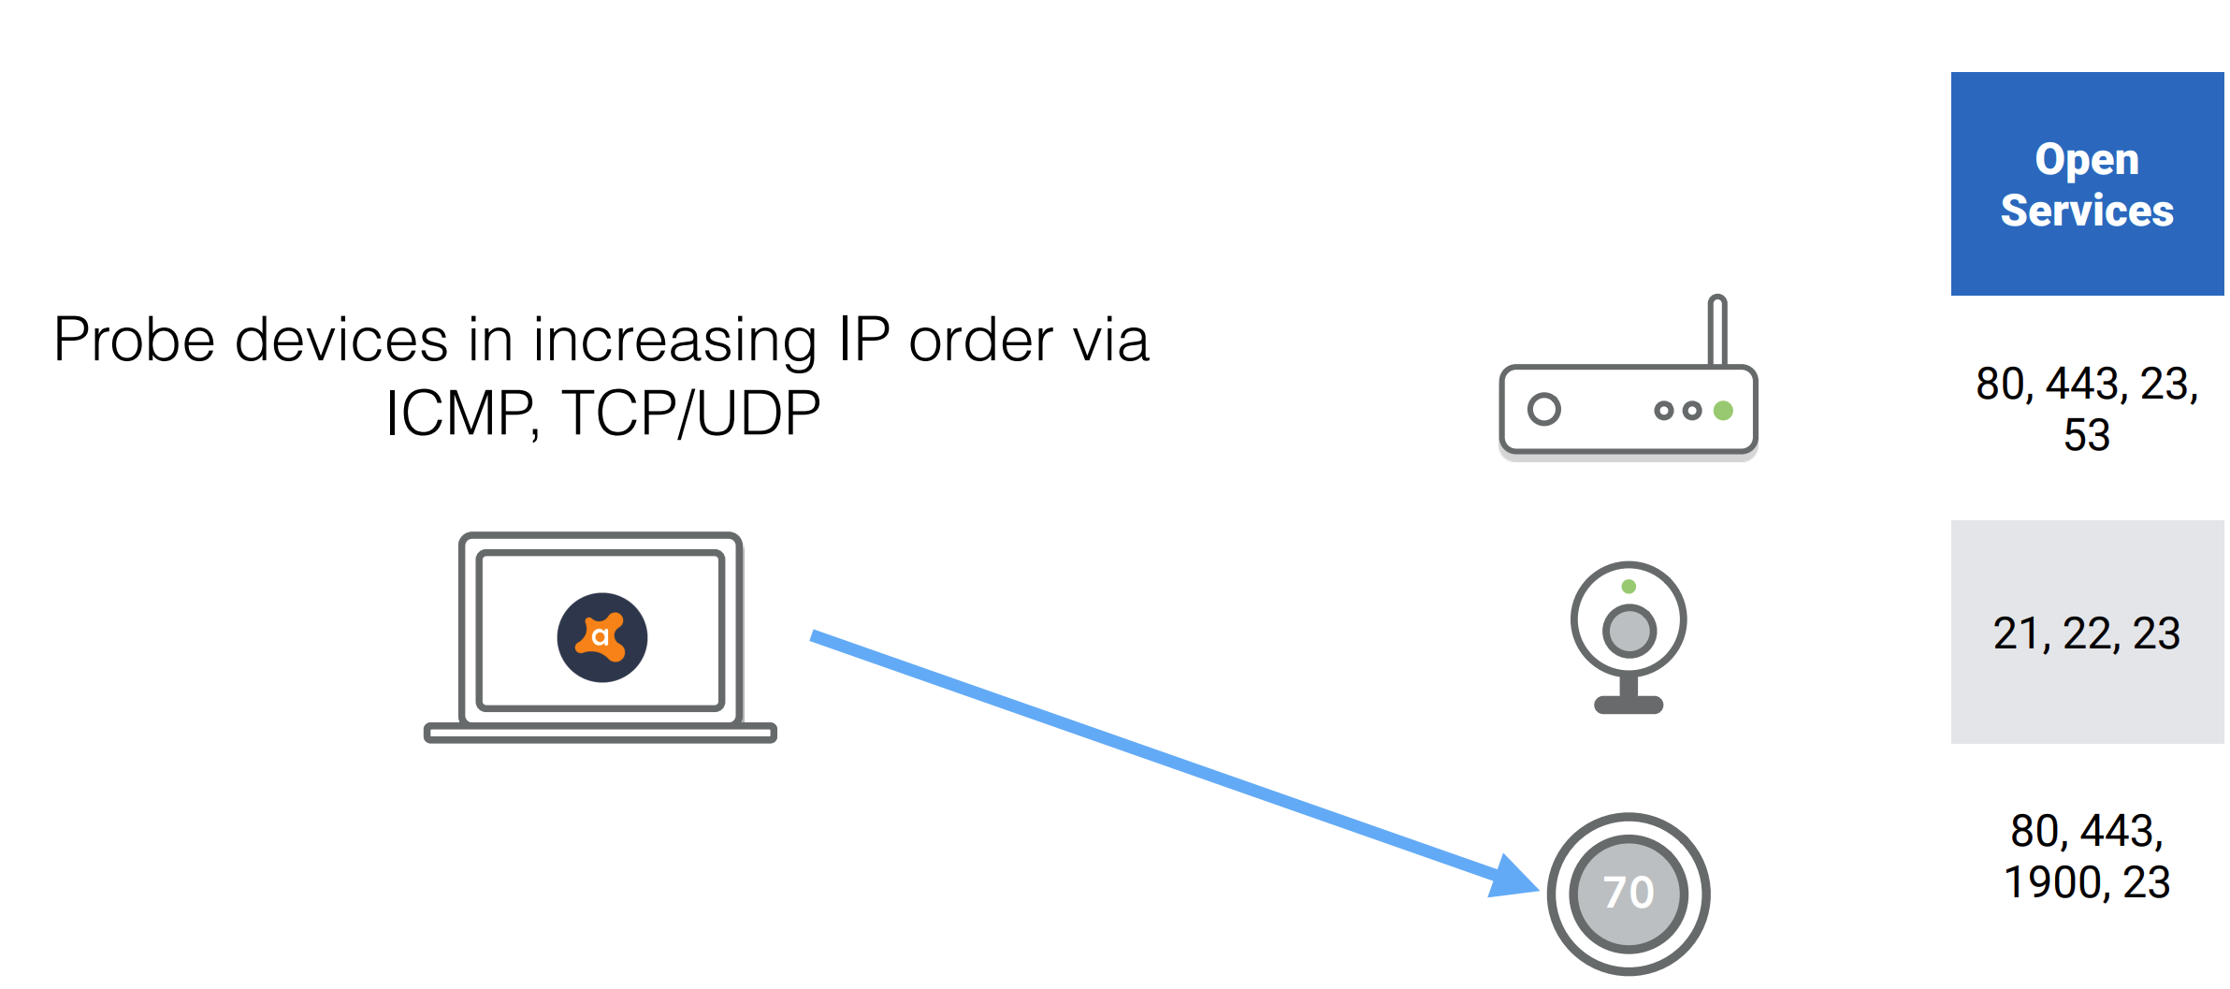
Acquiring the Data
Network Scanning to inventory the local network
Generates a list of scan candidates from entries in the local ARP table as well through active ARP, SSDP, and mDNS scans.
Probes targets in increasing IP order over ICMP and common TCP/UDP ports to detect listening services.
Scans terminate after the local network has been scanned or a timeout occurs.
After the discovery process completes, the scanner attempts to gather application layer data (e.g., HTTP root page, UPnP root device description, and Telnet banner) from listening services.

Slide 6
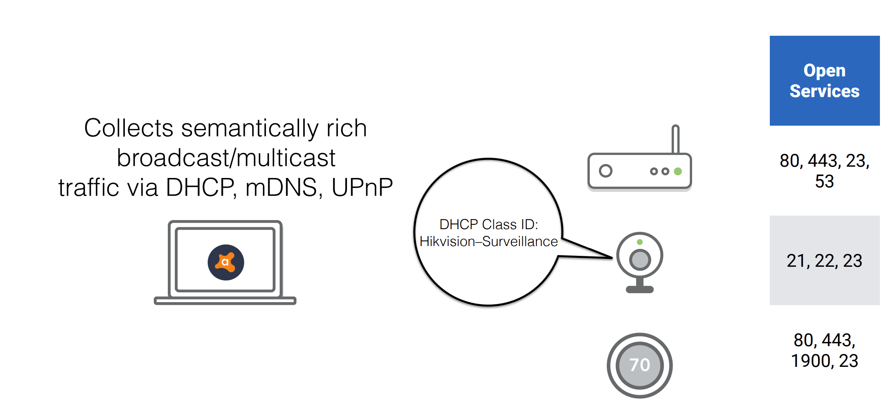
Acquiring the Data

Slide 7
Organizing the data
1. Computer
2. Network Node (e.g., home router)
3. Mobile Device (e.g., iPhone or Android)
4. Wearable (e.g., Fitbit, Apple Watch)
5. Game Console (e.g., Xbox)
6. Home Automation (e.g., Nest Thermostat)
7. Storage (e.g., home NAS)
8. Surveillance (e.g., IP camera)
9. Work Appliance (e.g., printer or scanner)
10. Home Voice Assistant (e.g., Alexa)
11. Vehicle (e.g., Tesla)
12. Media/TV (e.g., Roku)
13. Home Appliance (e.g., smart fridge)
14. Generic IoT (e.g., toothbrush)
Determine device vendor
Fit device into one of 14 device classes

Slide 8
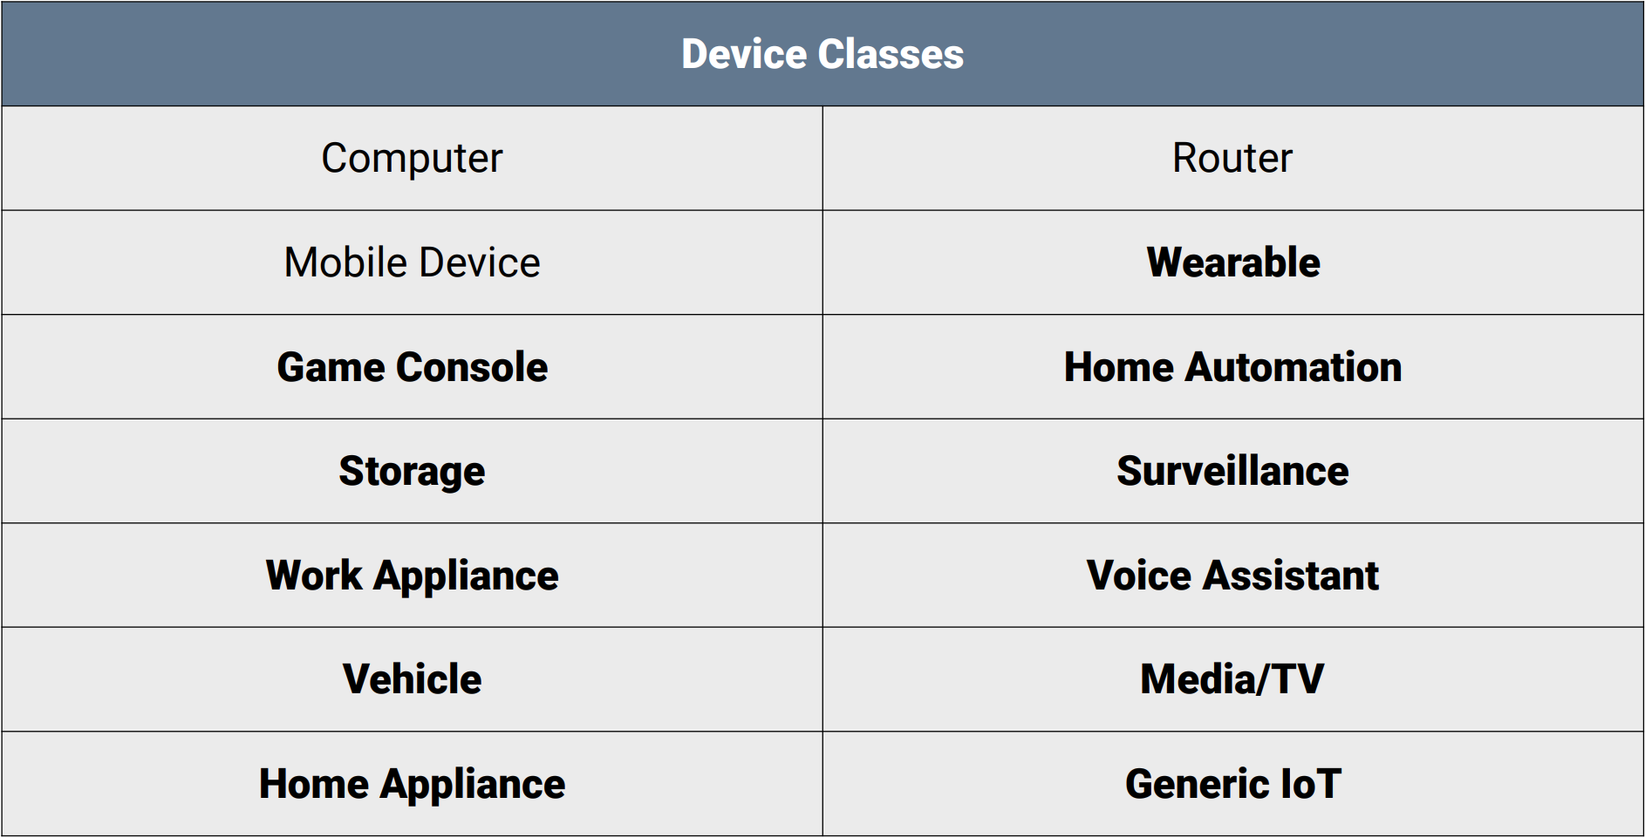
IoT DeviceID Classes
Not all devices classified as IoT
How to determine the device class?
Network Rules (regex)
Supervised ML

Slide 9
Network Classifier
The network classifier is built using a random forest which aggregates the following network features of a device:
MAC address
Local IP address
Listening services (i.e., port and protocol)
Application-layer responses on each port
DHCP class_id and hostname
The UPnP, mDNS and HTTP classifiers leverage raw text responses

Slide 10
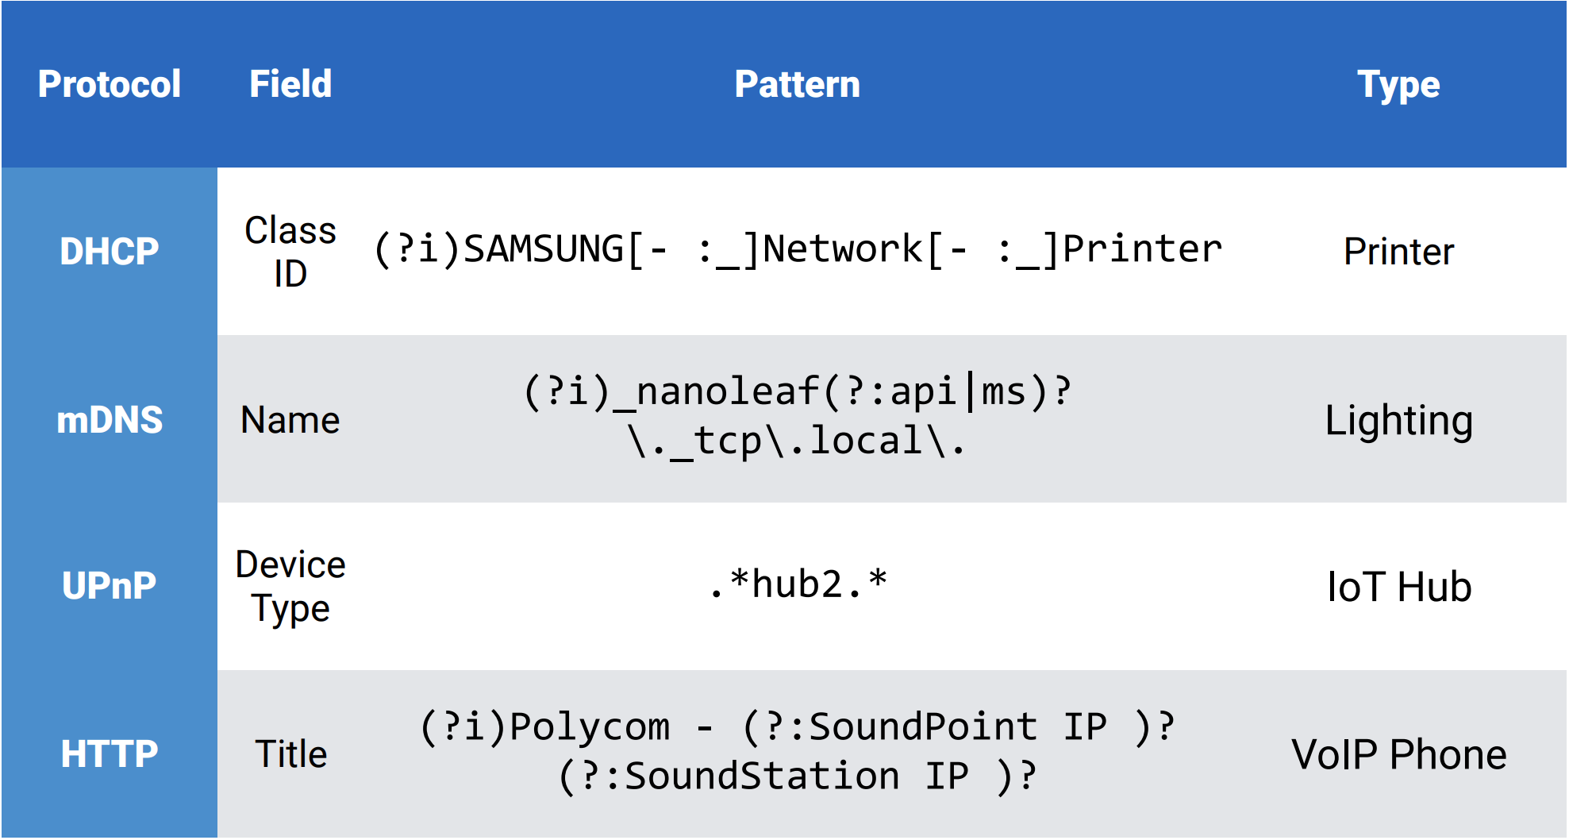
Network Rules (regex)
Use regular expressions to determine device class
Patterns used from various protocols
Individually classify devices using network layer-data
Even parses telnet banner and HTML titles
Requires extensive list of devices for labelling

Slide 11
Training and evaluation
Leverages several network features
Trained on 500K devices from real world scans
300K labels from network rules
200K manually labeled
Tested on a set of 1K manually labeled unseen devices

Slide 12
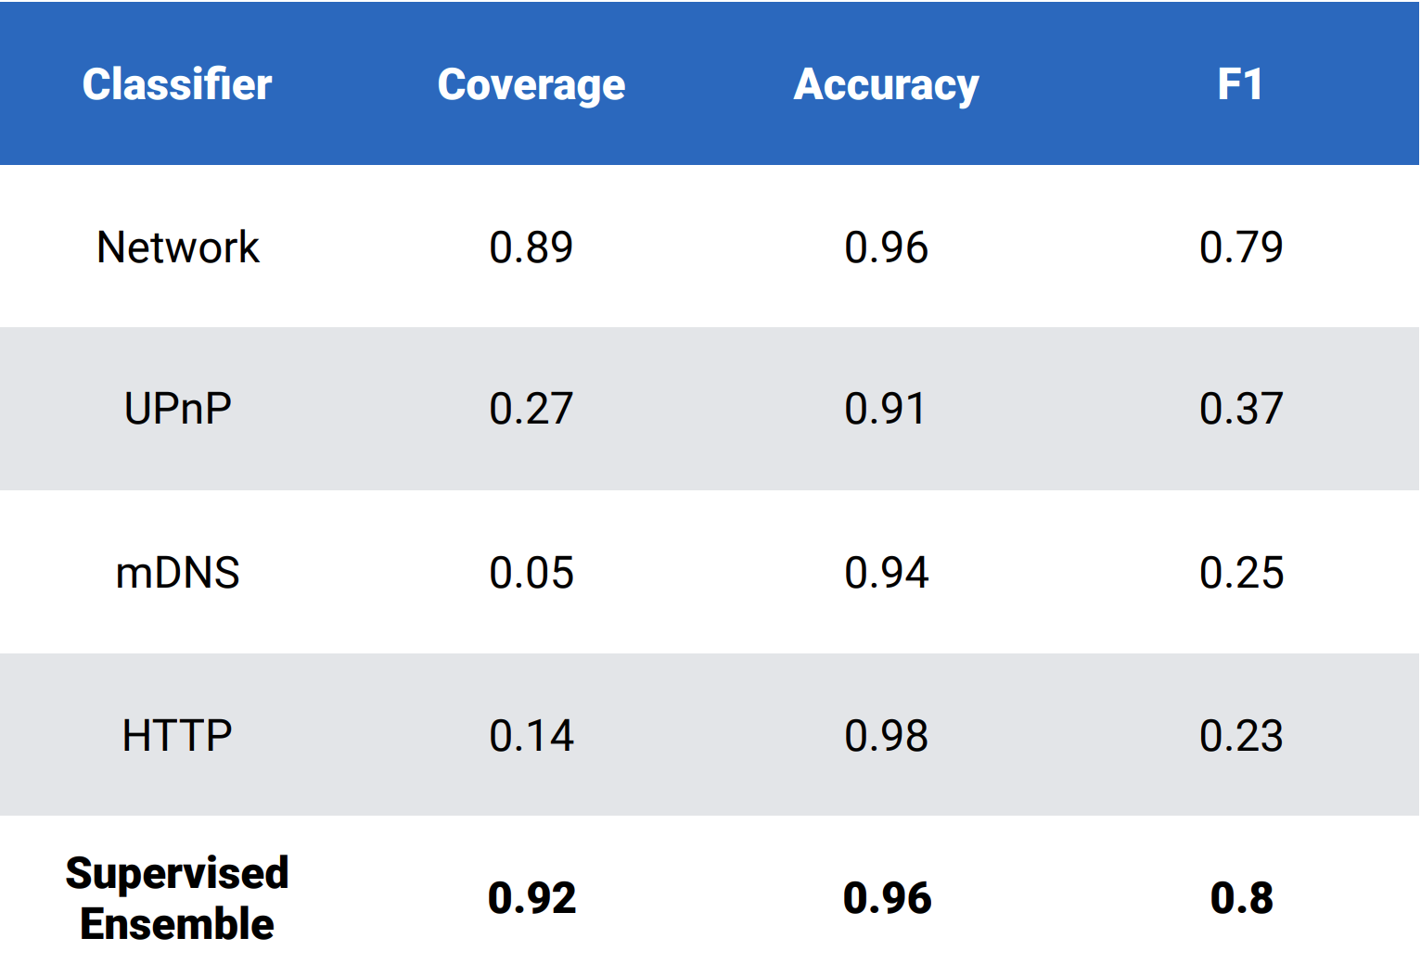
Final device classifier performance
Combines the supervised classifier and expert rules and achieves 92% coverage and 96% accuracy against a manually labeled set of 1,000 devices.

Slide 13
Privacy/Ethical concerns
Aren’t these scans themselves an invasion of privacy?
Avast only shared aggregate data
aggregated by device manufacturer, region, and device type
No personally identifiable data was shared, including IP addresses.
Excluded scans of public networks by only analyzing networks that were marked as home networks
All scans were user initiated. Not automated. (You can choose not to send telemetry data)

Slide 14
Acquired Dataset
83 M devices
15.5 M homes
241 countries and territories
14.3 K unique manufacturers
For installations with multiple scans, the latest scan that found the maximum number of devices was used.
Countries were aggregated into 11 regions

Slide 15
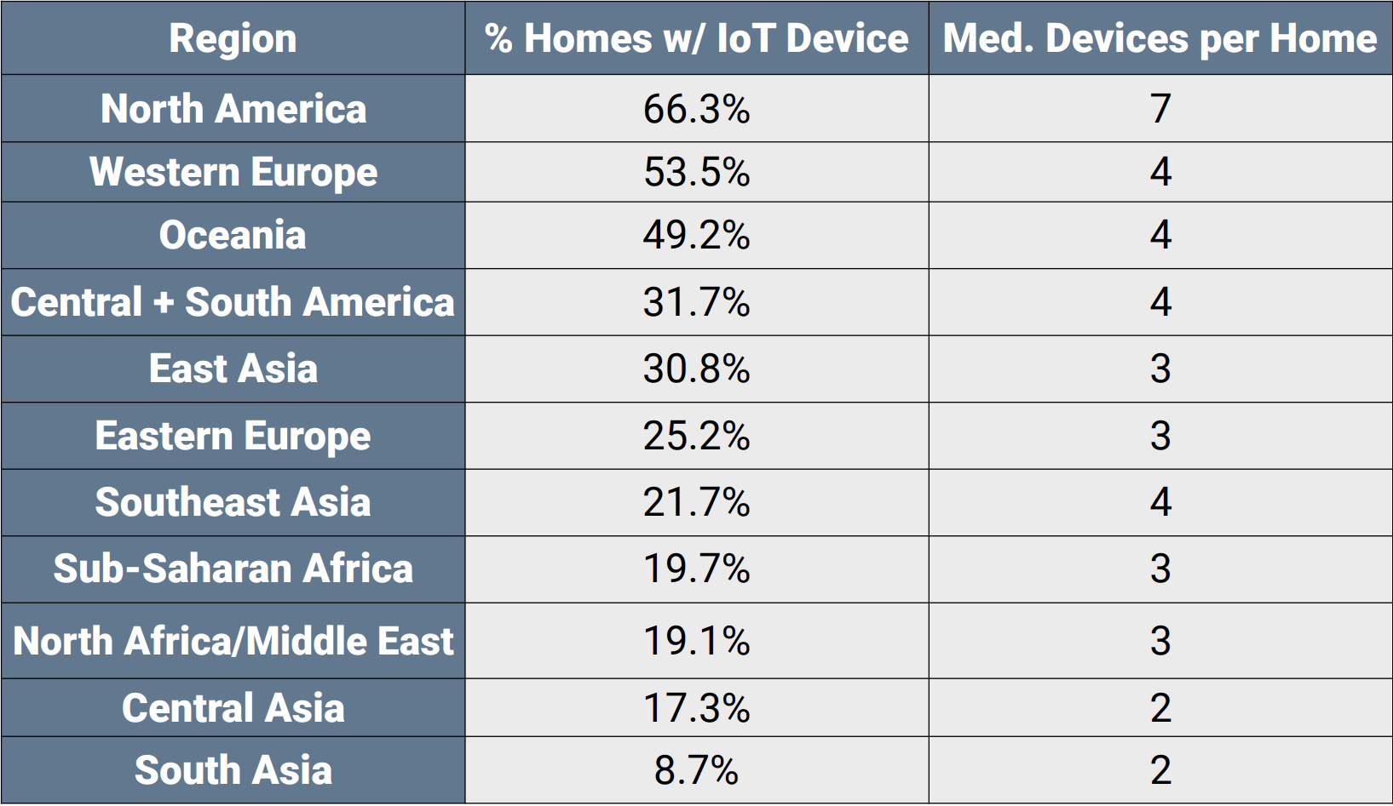
IoT in homes
It is vital that the security community understands the types of IoT devices that consumers install
It is also important to understand the demographics
the most popular types of devices are similar across regions
Each region has unique device type preferences

Slide 16
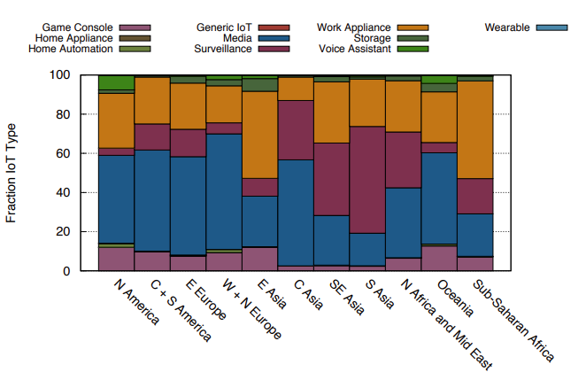
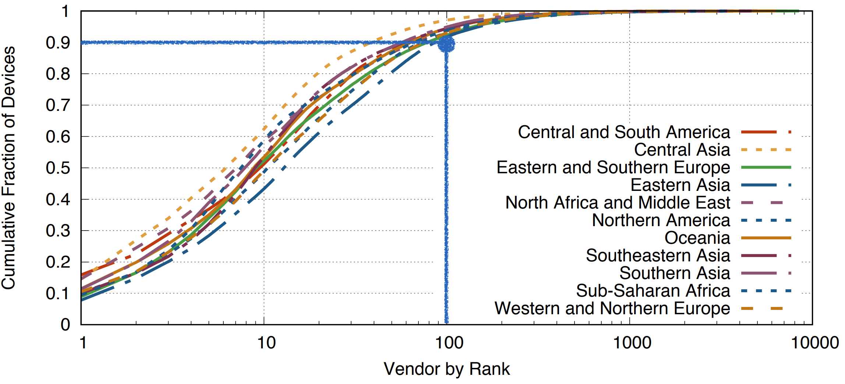
IoT Vendors by Region
90% of IoT devices in every region are manufactured by ~100 vendors
400 vendors account for 99%
Media devices are the most heterogeneous by vendor: the top 10 vendors only account for 60% of devices.
Vendor diversity depends on device type
Amazon and Google produce 91.9% of voice assistants and Hikvision produces 18.6% of surveillance devices
IoT device type distributions vary between different geographic regions
regional differences in vendor preferences may cause the observed variance in vendor distributions across device types.

Slide 17
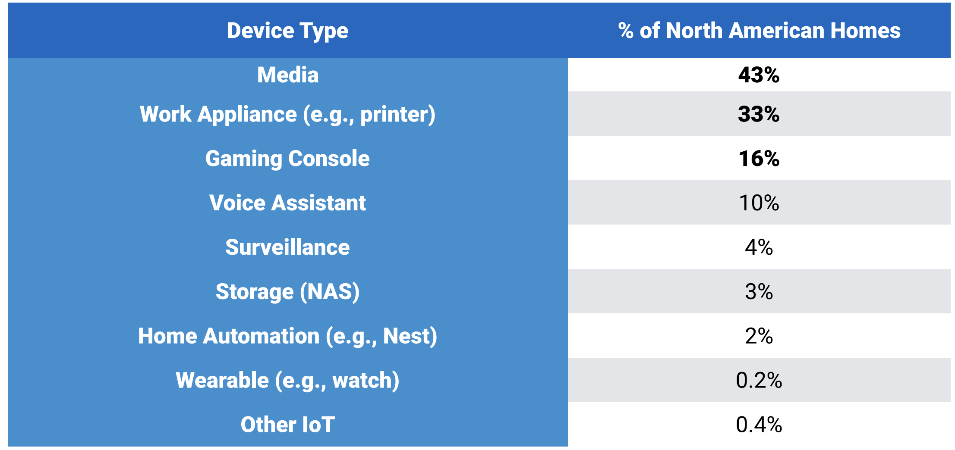
A Typical North American Home
North America has the highest density of IoT devices of any region
71.8% of homes have an IoT device compared to the global median of 40.2%
Media devices (e.g., TVs and streaming boxes) and work appliances account for the most devices
Considerably higher number of homes in North America contain a game console
Two thirds of home assistants are Amazon produced, the remaining one third are Google devices
Intelbras accounts for 11% of the surveillance cameras in the region, though they are third to Hikvision and Dahua.

Slide 18
What does the data mean for IoT Security?
“Security” is hard to measure in such a heterogeneous ecosystem
Beyond understanding the landscape of IoT devices, we investigate the security profile of devices in homes, including
devices that allow weak authentication
the security profile of home routers
the presence of homes that exhibit scanning behavior.

Slide 19
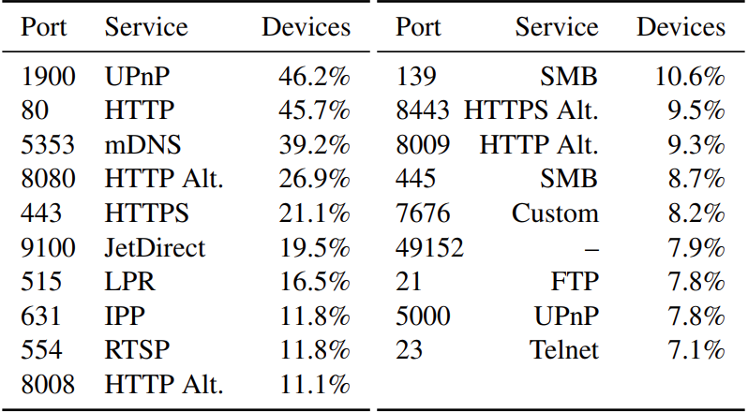
Popular IoT services
Many IoT devices act as embedded servers: 67.5% of devices provide at least one TCP- or UDP-based service.
The most common protocol is Universal Plug and Play (UPnP), which is prevalent on 46.2% of devices
We also note that devices commonly support older protocols like Telnet (7.1% of IoT devices) and FTP (7.8%).
Unlike FTP, there is little reason for any IoT devices to support Telnet in 2019. Yet, we find both that surveillance devices and routers consistently support the protocol.

Slide 20
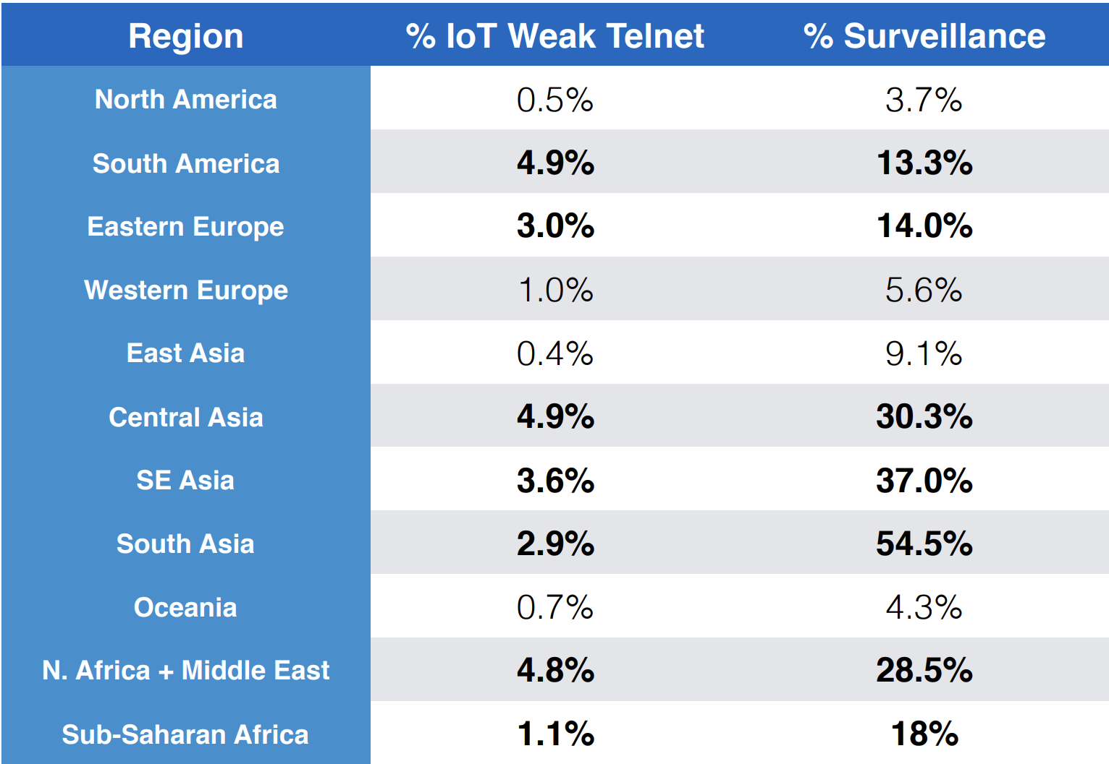
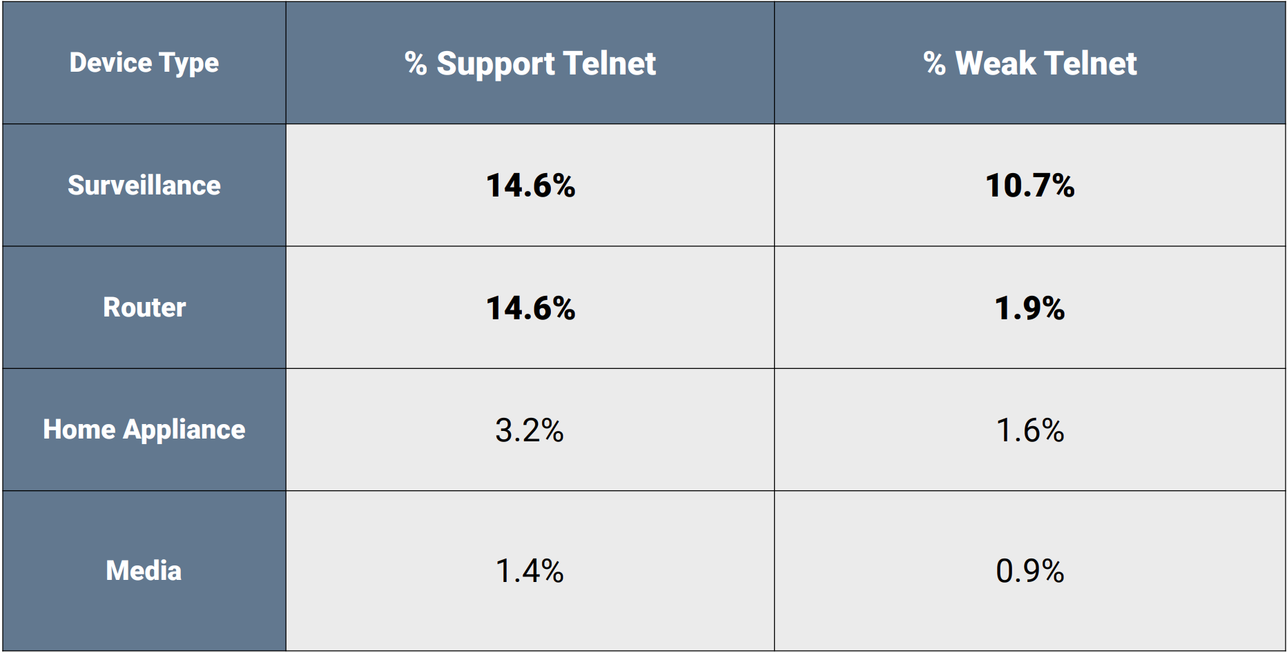
Weak Device Credentials
We check weak credentials as a proxy for security
7.8% devices support FTP, 7.1% devices support Telnet
17.4% exhibit weak FTP credentials
2.1% exhibit weak Telnet credentials

Slide 21
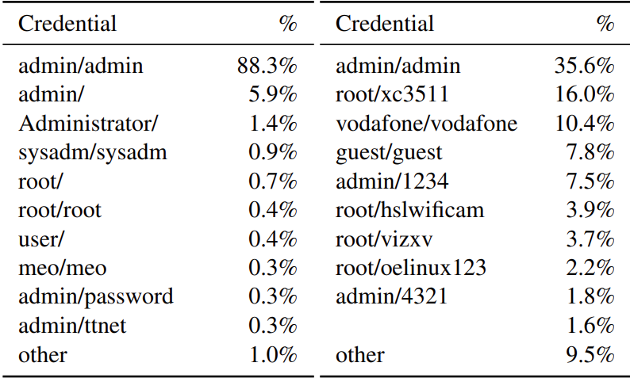
Popular weak credentials
FTP
Telnet
admin/admin accounts for the 88.3% and 35.6% of the weak FTP and Telnet credentials.

Slide 22
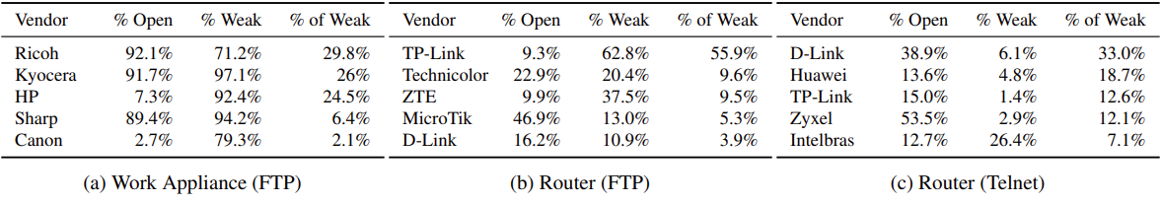
Home Routers
Nearly every home in our dataset has a home router
More than 93% of routers have HTTP administration interfaces on port 80.
Many routers support DNS over UDP (66.5%), UPnP (63.4%), DNS over TCP (42.1%), HTTPS (42.2%), SSH (19.7%), FTP (10.8%), and Telnet (14.6%).
Of the devices that support FTP and/or Telnet, 12% have weak FTP and 1.6% have weak Telnet credentials.
The below table shows the vendors that exhibit weak default credentials across each device type in our dataset sorted by the fraction of weak devices they contribute to their respective device types

Slide 23
Network Telescope
Scan data can provide insight into the vulnerability of hosts, it typically does not indicate whether hosts have been compromised.
To understand whether devices are infected and scanning to compromise other devices (e.g., as was seen for Mirai ), we consider the IP addresses scanning in a large network telescope
composed of approximately 4.7 million IP addresses
We consider an IP address to be scanning if it contacts at least 25 unique addresses in our telescope on the same port within a 480 second window.
1.7 M scans from a total of 529 K unique IP addresses
1.4 billion packets measured. 500,716 homes scanned
1,865 (0.37%) were found scanning on the network telescope

Slide 24
Scanning Homes (Compromised homes)
Scans most frequently target TCP/445 (SMB, 26.7% homes) followed by TCP/23 (Telnet, 11.3%), TCP/80 (HTTP, 10.7%), and TCP/8080 (HTTP, 9.4%).
1,156 (62%) of scanning homes contained at least one known vulnerability—conversely, 7.2 M (46.8%) non scanning homes in our dataset contain at least one known vulnerability
Unable to determine why homes without known vulnerabilities were seen scanning. This is likely due to devices being compromised through means outside of our measurement vantage point, for example, vulnerabilities that we do not test for.
Although these homes contain vulnerable devices, we cannot claim that they are scanning as a result of these devices
we do not have full vulnerability coverage
outstanding challenge to attribute device behavior
Nevertheless, presence of any scanning homes in general indicates a threat landscape larger than simply publicly accessible devices, and one that should be considered by the security community

Slide 25
External Exposure
Understand whether routers with weak default credentials are also exposed on the public Internet
A small number of home routers host publicly accessible services
3.4% expose HTTP, 0.8% FTP, 0.7% Telnet, and 0.8% SSH.
Of routers that are externally exposed, we find that 51.2% of them exposed with a vulnerability
This is far higher than the fraction of non-externally available routers in our dataset with a vulnerability (25.8%)
TP-Link, is the vendor responsible for the most externally exposed routers (19.7%).

Slide 26
Current scenario
Recent security research has focused on new home IoT devices, such as smart locks and home automation.
Our results suggest that while these devices are growing in importance in western regions, they are far from the most common IoT devices around the world.
Instead, home IoT is better characterized by smart TVs, printers, game consoles, and surveillance devices—devices that have been connected to our home networks for years.
These are the kinds of devices that still support weak credentials for old protocols:
work appliances are the device type with the highest fraction of weak FTP credentials
surveillance devices are the worst for telnet credentials.
Improving the security posture of these devices remains just as important as ensuring that new technologies are secure—our home networks are only as secure as their weakest link.

Slide 27
Next steps and shortfalls
Most of the devices that support weak credentials are manufactured by a handful of popular vendors across all regions
The security community can start addressing these challenges by encouraging the largest offending vendors to adopt better security practices.
Law enforcement and legal entities have started to provide legal disincentives for weak security practices. E.g. D-link for Mirai
Shortfalls
Regions often have vastly different preferences for vendors across device types
Improving the security of devices based solely on the global distribution may leave smaller regions with divergent preferences less secure
it is not immediately clear how to measure the impact of compromise on home security.
Security challenges vary per region depending on device preferences

Slide 28
Takeaways
Conducted the first large-scale empirical analysis of IoT devices on real-world home networks
In several regions, most homes now have at least one networked IoT device.
Analyzed the types and vendors of commonly purchased devices and provided a landscape of the global IoT ecosystem
Further analyzed the security profile of these devices and networks and showed that a significant fraction of devices use weak credentials
Home IoT ecosystem is diverse and fragmented
Regional differences in # of devices, device types, and device vendors
Quantifying IoT security at scale remains an outstanding challenge

Slide 29
Problems - Dataset Bias
The dataset is likely colored by several biases.
The data is predicated on users installing antivirus software on their computers. There is little work that indicates whether users with antivirus software have secure practices.
We only analyzed data from installations on Windows machines due to differences between Mac and Windows versions of the software. This may skew the households we study to different socioeconomic groups or introduce other biases.
WiFi Inspector actively notifies users about problems it finds. As a result, users may have patched vulnerable hosts, changed default passwords, or returned devices to their place of purchase.
This may skew the results to indicate that homes included in this study are more secure than in practice.

Slide 30
Problems – Weak credentials are only a part of the issue
Weak FTP and Telnet do not represent the entire spectrum of attacks that IoT devices are vulnerable to
Credentials do no ensure security unless encryption is also added.
There are many device specific vulnerabilities
Some devices use proprietary protocols
Scanning homes were inconclusive

Slide 31

Questions?

