Slide 1
Concepts of Database Management
Sixth Edition
Chapter 7
DBMS Functions

Slide 2
Objectives
Introduce the functions, or services, provided by a DBMS
Describe how a DBMS handles updating and retrieving data
Examine the catalog feature of a DBMS
Illustrate the concurrent update problem and describe how a DBMS handles this problem
Explain the data recovery process in a database environment
Concepts of Database Management

Slide 3
Objectives (continued)
Describe the security services provided by a DBMS
Examine the data integrity features provided by a DBMS
Discuss the extent to which a DBMS achieves data independence
Define and describe data replication
Present the utility services provided by a DBMS
Concepts of Database Management

Slide 4
Introduction
Functions of a DBMS
  Update and retrieve data
  Provide catalog services
  Support concurrent update
  Recover data
  Provide security services
  Provide data integrity features
  Support data independence
  Support data replication
  Provide utility services
Concepts of Database Management

Slide 5
Update and Retrieve Data
Fundamental capability of a DBMS
Users don’t need to know how data is stored or manipulated
Users add, change, and delete records during updates
Concepts of Database Management

Slide 6
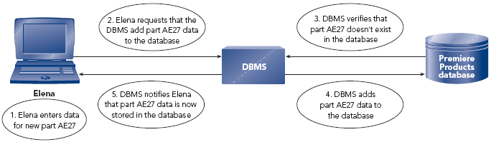
Update and Retrieve Data (continued)
FIGURE 7-1: Adding a new part to the Premiere Products database
Concepts of Database Management

Slide 7
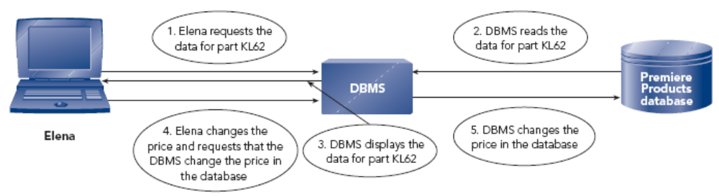
Update and Retrieve Data (continued)
FIGURE 7-2: Changing the price of a part in the Premiere Products database
Concepts of Database Management

Slide 8
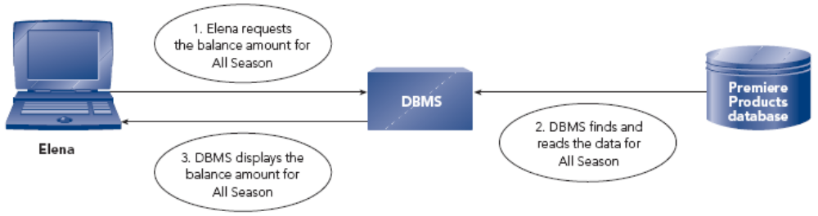
Update and Retrieve Data (continued)
FIGURE 7-3: Retrieving a balance amount from the Premiere Products database
Concepts of Database Management

Slide 9
Provide Catalog Services
Metadata: data about data
Stores metadata and makes it accessible to users
Enterprise DBMSs often have a data dictionary (a super catalog)
Concepts of Database Management

Slide 10
Support Concurrent Update
Ensures accuracy when several users update database at the same time
Manages complex scenarios for updates
Concurrent update: multiple users make updates to the same database at the same time
Concepts of Database Management

Slide 11
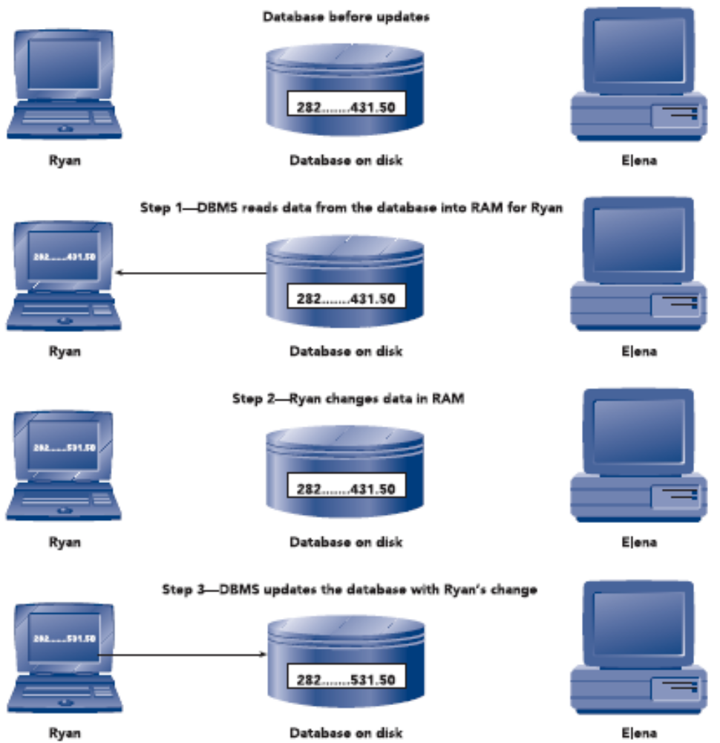
The Concurrent Update Problem
FIGURE 7-4: Ryan updates the database
Concepts of Database Management

Slide 12
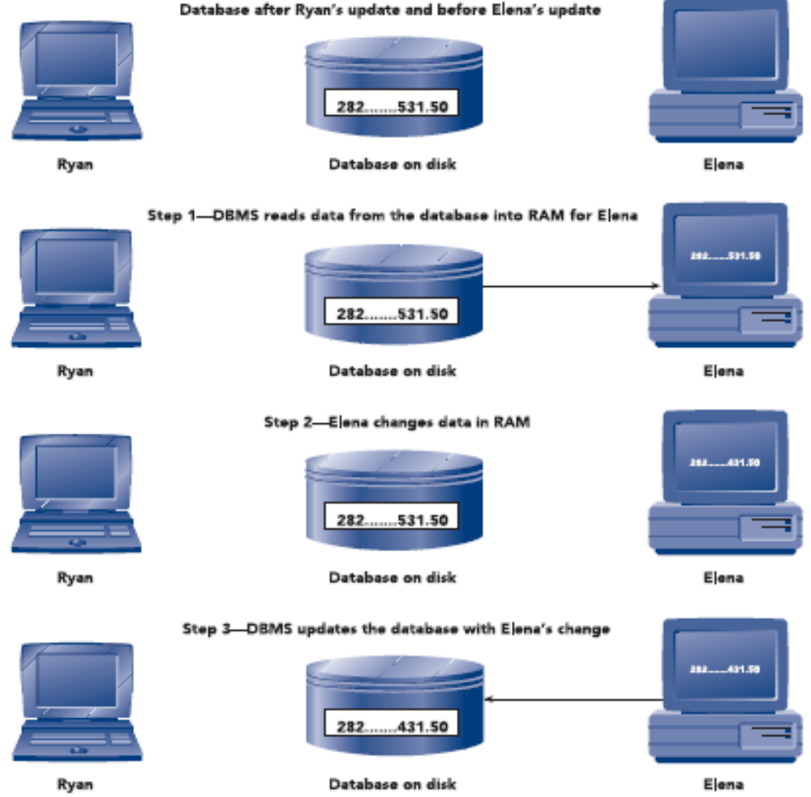
The Concurrent Update Problem (continued)
FIGURE 7-5: Elena updates the database
Concepts of Database Management

Slide 13
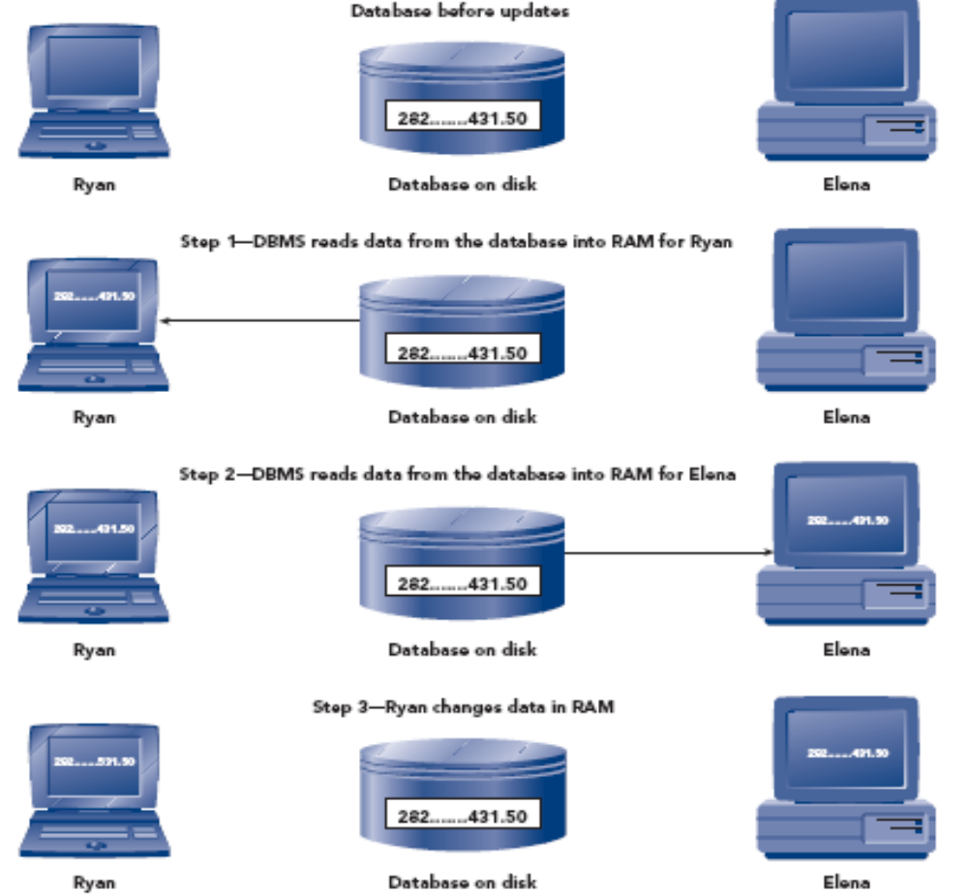
The Concurrent Update Problem (continued)
FIGURE 7-6: Ryan’s and Elena’s updates to the database result in a lost update
Concepts of Database Management

Slide 14
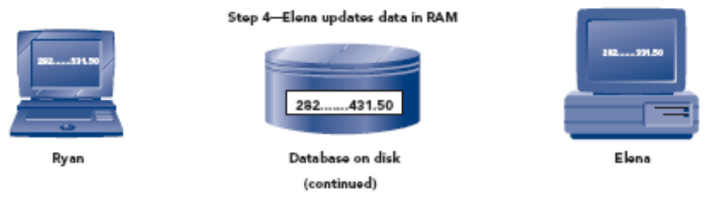
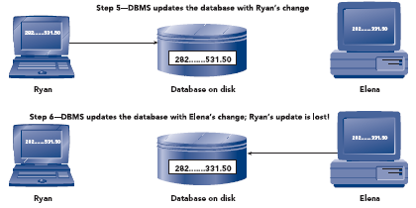
The Concurrent Update Problem (continued)
FIGURE 7-6: Ryan’s and Elena’s updates to the database result in a lost update (continued)
Concepts of Database Management

Slide 15
Avoiding the Lost Update Problem
Batch processing
  All updates done through a special program
  Problem: data becomes out of date
  Does not work in situations that require data to be current
Concepts of Database Management

Slide 16
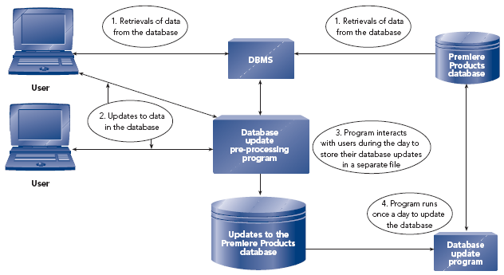
Avoiding the Lost Update Problem (continued)
FIGURE 7-7: Delaying updates to the Premiere Products database to avoid the lost update problem
Concepts of Database Management

Slide 17
Two-Phase Locking
Locking: deny other users access to data while one user’s updates are being processed
Transaction: set of steps completed by a DBMS to accomplish a single user task
Two-phase locking solves lost update problem
  Growing phase: DBMS locks more rows and releases none of the locks
  Shrinking phase: DBMS releases all the locks and acquires no new locks
Concepts of Database Management

Slide 18
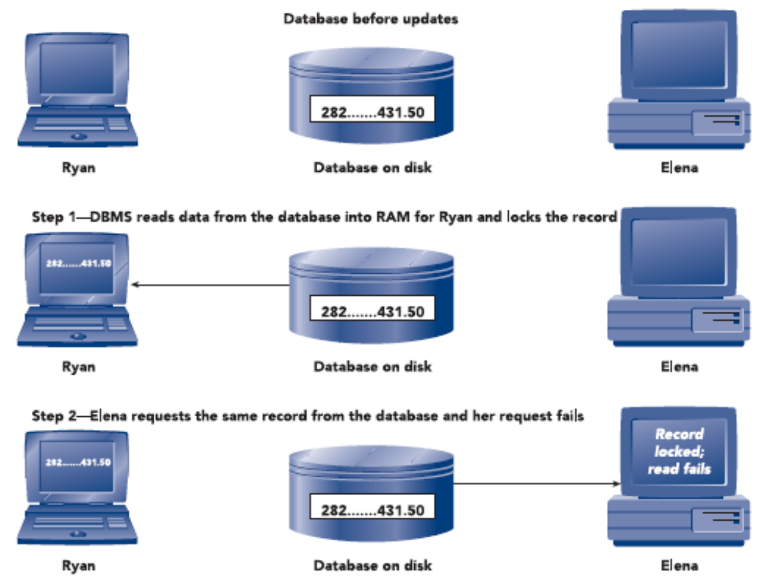
Two-Phase Locking (continued)
FIGURE 7-8: The DBMS uses a locking scheme to apply Ryan’s and Elena’s updates to the database
Concepts of Database Management

Slide 19
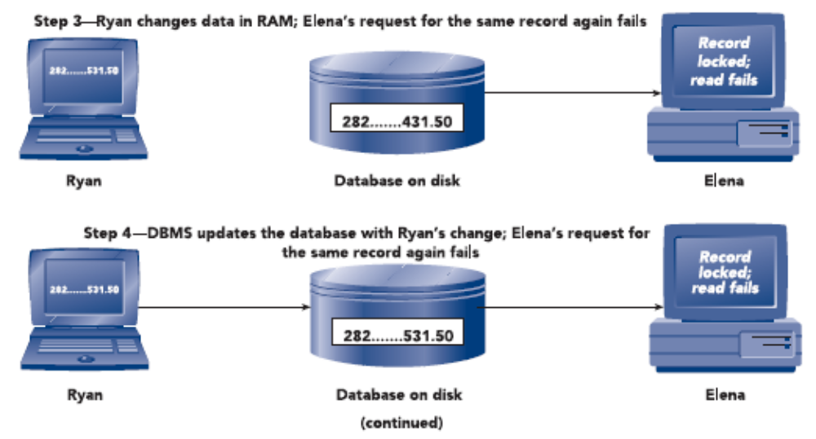
Two-Phase Locking (continued)
FIGURE 7-8: The DBMS uses a locking scheme to apply Ryan’s and Elena’s updates to the database (continued)
Concepts of Database Management

Slide 20
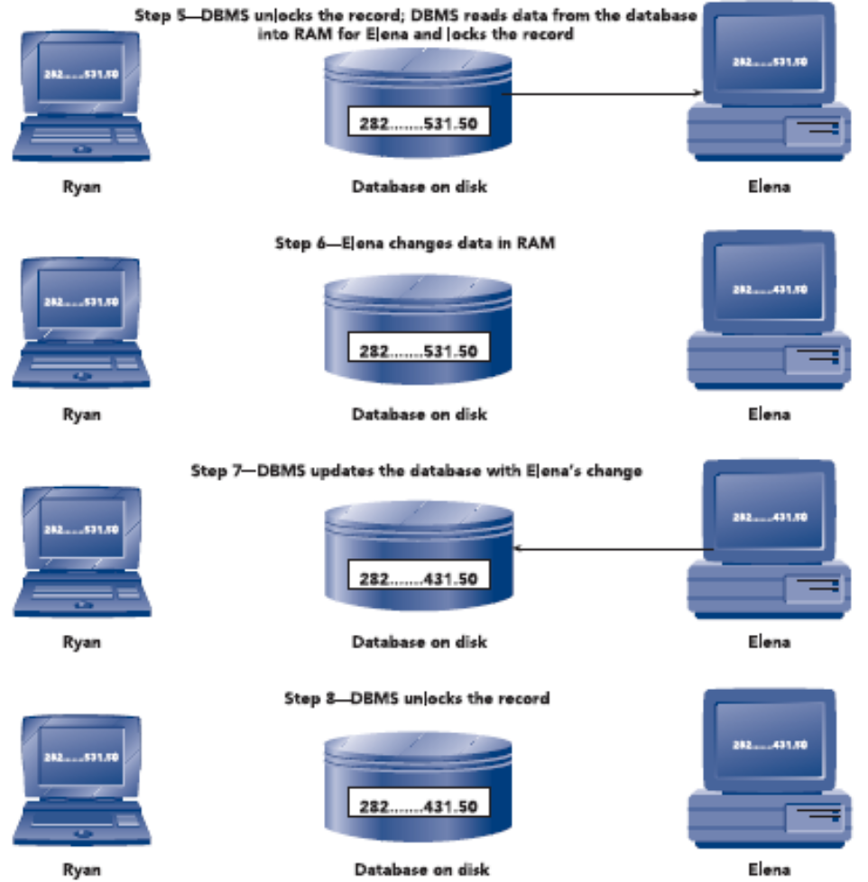
Two-Phase Locking (continued)
FIGURE 7-8: The DBMS uses a locking scheme to apply Ryan’s and Elena’s updates to the database (continued)
Concepts of Database Management

Slide 21
Deadlock
Deadlock or deadly embrace
  Two users hold a lock and require a lock on the resource that the other already has
  To minimize occurrence, make sure all programs lock records in the same order whenever possible
Managing deadlocks
  DBMS detects and breaks any deadlock
  DBMS chooses one user to be the victim
Concepts of Database Management

Slide 22
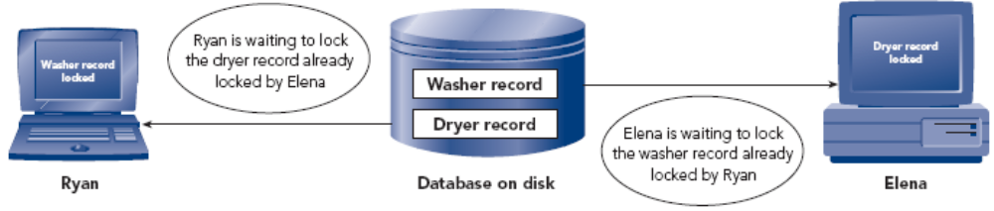
Deadlock (continued)
FIGURE 7-9: Two users experiencing deadlock
Concepts of Database Management

Slide 23
Locking on PC-Based DBMSs
Usually more limited than locking facilities on enterprise DBMSs
Programs can lock an entire table or an individual row within a table, but only one or the other
Programs can release any or all of the locks they currently hold
Programs can inquire whether a given row or table is locked
Concepts of Database Management

Slide 24
Timestamping
DBMS assigns each database update a unique time (timestamp) when the update started
Advantages
  Avoids need to lock rows
  Eliminates processing time needed to apply and release locks and to detect and resolve deadlocks
Disadvantages
  Additional disk and memory space
  Extra processing time
Concepts of Database Management

Slide 25
Recover Data
Recovery: returning database to a correct state from an incorrect state
Simplest recovery involves using backups
  Backup or save: copy of database
Concepts of Database Management

Slide 26
Journaling
Journaling: maintaining a journal or log of all updates
  Log is available even if database is destroyed
Information kept in log for each transaction:
  Transaction ID
  Date and time of each update
  Before image
  After image
  Start of a transaction
  Successful completion (commit) of a transaction
Concepts of Database Management

Slide 27
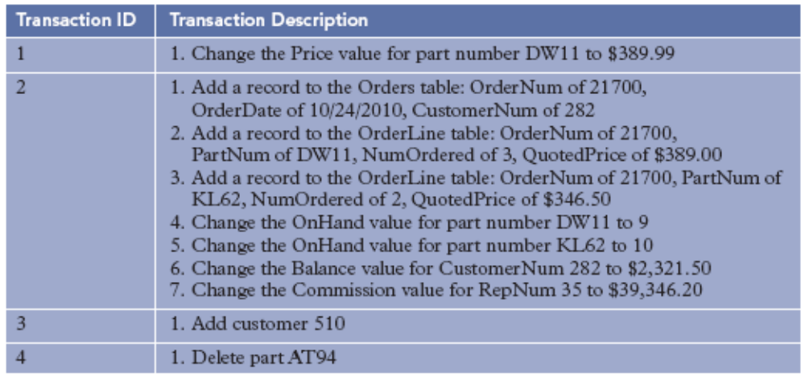
Journaling (continued)
FIGURE 7-10: Four sample transactions
Concepts of Database Management

Slide 28
Forward Recovery
DBA executes a DBMS recovery program
Recovery program applies after images of committed transactions from log to database
Improving performance of the recovery program
  Apply the last after image of a record
Concepts of Database Management

Slide 29
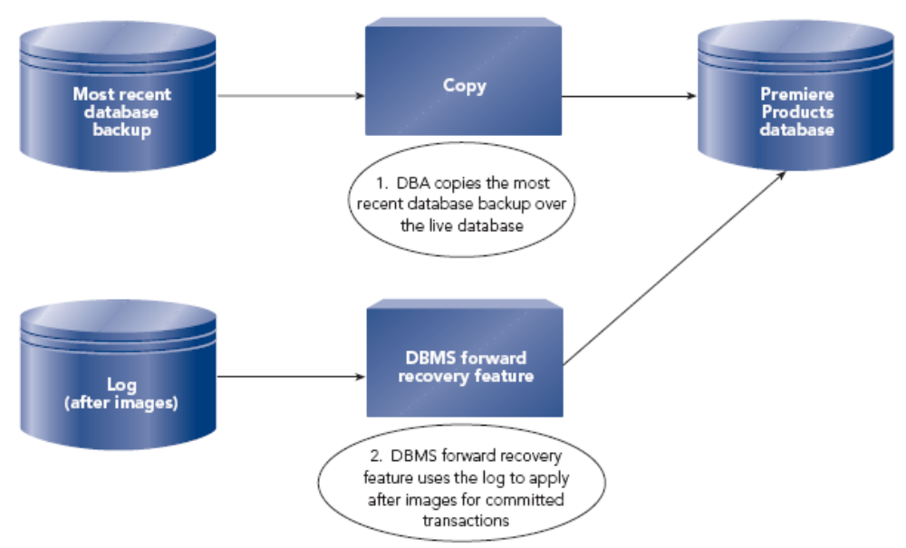
Forward Recovery (continued)
FIGURE 7-12: Forward recovery
Concepts of Database Management

Slide 30
Backward Recovery
Database not in a valid state
  Transactions stopped in midstream
  Incorrect transactions
Backward recovery or rollback
  Undo problem transactions
  Apply before images from log to undo their updates
Concepts of Database Management

Slide 31
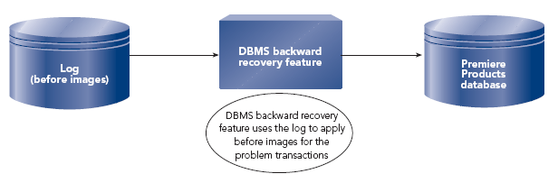
Backward Recovery (continued)
FIGURE 7-13: Backward recovery
Concepts of Database Management

Slide 32
Recovery on PC-Based DBMSs
Sophisticated recovery features not available on PC-based DBMSs
Regularly make backup copies using DBMS
  Use most recent backup for recovery
Systems with large number of updates between backups
  Recovery features not supplied by DBMS need to be included in application programs
Concepts of Database Management

Slide 33
Provide Security Services
Security: prevention of unauthorized access, either intentional or accidental, to a database
Most common security features used by DBMSs:
  Encryption
  Authentication
  Authorizations
  Views
Concepts of Database Management

Slide 34
Encryption
Encryption: converts data to a format indecipherable to another program and stores it in an encrypted format
Encryption process is transparent to a legitimate user
Decrypting: reversing the encryption
In Access, encrypt a database with a password
Concepts of Database Management

Slide 35
Authentication
Authentication: techniques for identifying the person attempting to access the DBMS
Password: string of characters assigned by DBA to a user that must be entered for access
Biometrics: identify users by physical characteristics such as fingerprints, voiceprints, handwritten signatures, and facial characteristics
Smart cards: small plastic cards with built-in circuits containing processing logic to identify the cardholder
Concepts of Database Management

Slide 36
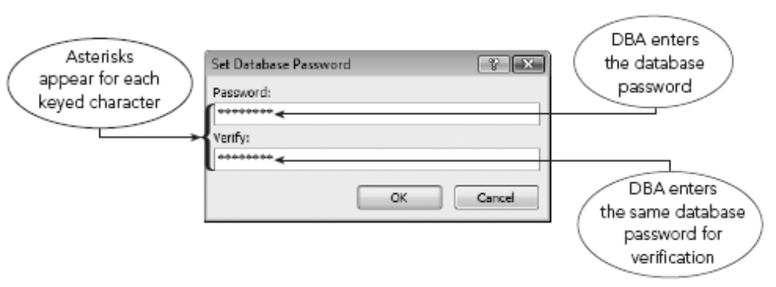
Authentication (continued)
Database password: string of characters assigned to database that users must enter for accessing the database
FIGURE 7-14: Assigning a database password to the Premiere Products database
Concepts of Database Management

Slide 37
Authorizations
DBA can use authorization rules to specify which users have what type of access to which data
Permissions: specify what kind of access the user has to objects in the database
Workgroups: groups of users
Concepts of Database Management

Slide 38
Views
View: snapshot of certain data in the database at a given moment in time
Can be used for security purposes
Concepts of Database Management

Slide 39
Privacy
Privacy: right of individuals to have certain information about them kept confidential
Laws and regulations dictate some privacy rules
Companies institute additional privacy rules
Concepts of Database Management

Slide 40
Provide Data Integrity Features
Rules followed to ensure data is accurately and consistently updated
Key integrity
  Foreign key and primary key constraints
Data integrity
  Data type
  Legal values
  Format
Concepts of Database Management

Slide 41
Provide Data Integrity Features (continued)
Four ways of handling integrity constraints:
  Constraint is ignored
  Responsibility for constraint enforcement placed on users
  Responsibility for constraint enforcement placed on programmers
  Responsibility for constraint enforcement placed on DBMS
Concepts of Database Management

Slide 42
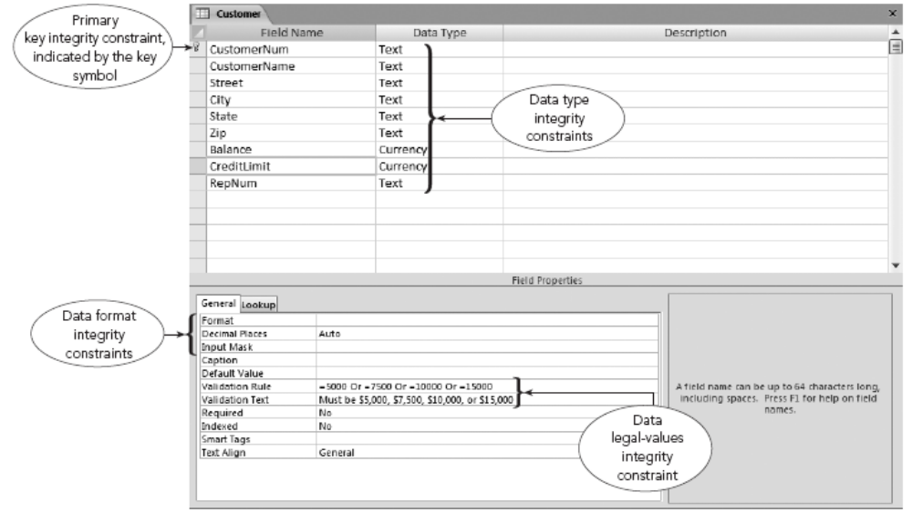
Provide Data Integrity Features (continued)
FIGURE 7-16: Example of integrity constraints in Access
Concepts of Database Management

Slide 43
Support Data Independence
Data independence: can change database structure without needing to change programs that access the database
Types of changes:
  Adding a field
  Changing a field property (such as length)
  Creating an index
  Adding or changing a relationship
Concepts of Database Management

Slide 44
Adding a Field
Don’t need to change any program except those programs using the new field
SQL SELECT * FROM command will present an extra field
  Solution: list the required fields in an SQL SELECT command instead of using *
Concepts of Database Management

Slide 45
Changing the Length of a Field
Generally, don’t need to change programs
Need to change the program if:
  Certain portion of screen or report is set aside for the field and the space cannot fit the new length
Concepts of Database Management

Slide 46
Creating an Index
To create an index, enter a simple SQL command or select a few options
Most DBMSs use the new index automatically
For some DBMSs, need to make minor changes in already existing programs
Concepts of Database Management

Slide 47
Adding or Changing a Relationship
Trickiest of all
May need to restructure database
Concepts of Database Management

Slide 48
Support Data Replication
Replicated: duplicated
Manage multiple copies of same data in multiple locations
Maintained for performance or other reasons
Ease of access and portability
Replicas: copies
Synchronization: DBMS exchanges all updated data between master database and a replica
Concepts of Database Management

Slide 49
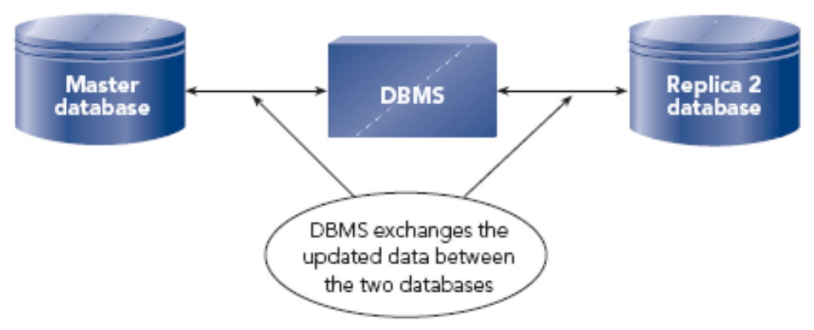
Support Data Replication (continued)
FIGURE 7-18: DBMS synchronizes two databases in a replica set
Concepts of Database Management

Slide 50
Provide Utility Services
Utility services assist in general database maintenance
Change database structure
Add new indexes and delete indexes
Use services available from operating system
Export and import data
Support for easy-to-use edit and query capabilities, screen generators, report generators, etc.
Concepts of Database Management

Slide 51
Provide Utility Services (continued)
Support for procedural and nonprocedural languages
  Procedural language: must tell computer precisely how a given task is to be accomplished
  Nonprocedural language: describe task you want computer to accomplish
Easy-to-use menu-driven or switchboard-driven interface
Concepts of Database Management

Slide 52
Summary
DBMS allows users to update and retrieve data in a database without needing to know how data is structured on disk or manipulated
DBMS must store metadata (data about the data) and make this data accessible to users
DBMS must support concurrent update
Locking denies access by other users to data while DBMS processes one user’s updates
During deadlock and deadly embrace, two or more users are waiting for the other user to release a lock before they can proceed
Concepts of Database Management

Slide 53
Summary (continued)
In timestamping, DBMS processes updates to a database in timestamp order
DBMS must provide methods to recover a database in the event the database is damaged
DBMSs provide facilities for periodically making a backup copy of the database
Enterprise DBMSs maintain a log or journal of all database updates since the last backup; log is used in recovery process
Concepts of Database Management

Slide 54
Summary (continued)
DBMSs provide security features (encryption, authentication, authorizations, and views) to prevent unauthorized access to a database
DBMS must follow rules or integrity constraints (key integrity constraints and data integrity constraints) so that it updates data accurately and consistently
DBMS must support data independence
DBMS must have facility to handle data replication
DBMS must provide utility services that assist in general maintenance of a database
Concepts of Database Management

