Slide 1

A Guide to SQL, Seventh Edition

Slide 2
Objectives
Understand how to use functions in queries
Use the UPPER and LOWER functions with character data
Use the ROUND and FLOOR functions with numeric data
Add a specific number of months or days to a date
Calculate the number of days between two dates
Use concatenation in a query
A Guide to SQL, Seventh Edition

Slide 3
Objectives
Create a view for a report
Create a query for a report
Change column headings and formats in a report
Add a title to a report
Group data in a report
Include totals and subtotals in a report
Send a report to a file that can be printed
A Guide to SQL, Seventh Edition

Slide 4
Using Functions
Using GROUP BY function with aggregate functions will provide sums for each record in a group
Other functions are available that work with single records
Functions vary among applications
A Guide to SQL, Seventh Edition

Slide 5
Character Functions
Several functions work with character data
  UPPER function for changing a value to uppercase letters
  LOWER function changes values to lowercase letters
A Guide to SQL, Seventh Edition

Slide 6
Number Functions
Number functions affect numeric data
  ROUND function rounds values to a specified number of places
    Has two arguments: the value to be rounded and the number of decimal places
  FLOOR function removes values to the right of the decimal point
A Guide to SQL, Seventh Edition

Slide 7
Working With Dates
Functions and calculations are used for manipulating dates
  ADD_MONTHS function allows for adding a specific number of months to a date
    Has two arguments: date to add to and the number of months to add
  In Access, use DATEADD function
  In MySQL, use ADDDATE function
A Guide to SQL, Seventh Edition

Slide 8
Working With Dates
No function is needed to add a specific number of days to a date
  In Access, use the DATEADD function with the letter “d” as the time interval
  In MySQL, use the ADDDATE function with the DAY interval
A Guide to SQL, Seventh Edition

Slide 9
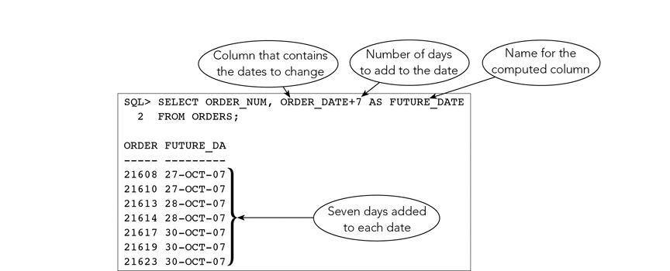
A Guide to SQL, Seventh Edition

Slide 10
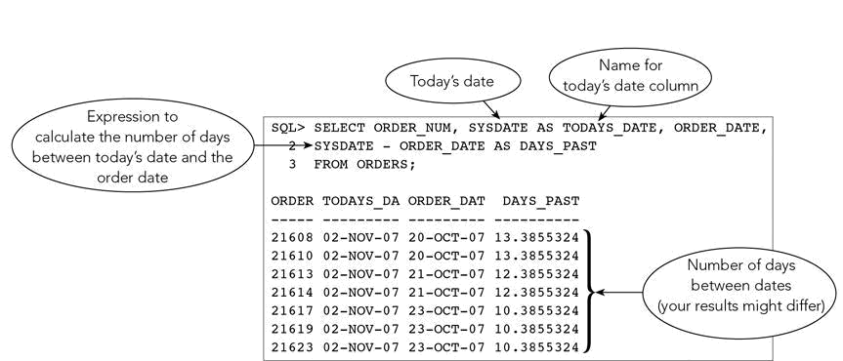
Working With Dates
Use SYSDATE to obtain today’s date
A Guide to SQL, Seventh Edition

Slide 11
Concatenating Columns
Concatenation is the process of combining two or more character columns into a single expression
In Access, use the & symbol
  Select REP_NUM, FIRST_NAME&LAST_NAME FROM REP;
In MySQL, use the CONCAT function
  Select REP_NUM,CONCAT(FIRST_NAME, LAST_NAME) FROM REP;
A Guide to SQL, Seventh Edition

Slide 12
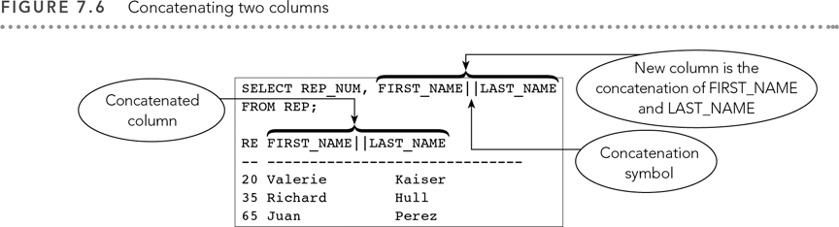
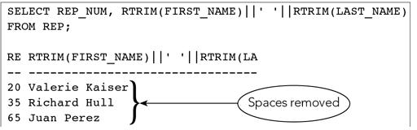
A Guide to SQL, Seventh Edition

Slide 13
Creating and Using Scripts
Saving commands in a script file eliminates retyping
  Creating views
  Entering report formatting command
When creating a report you typically create a view and three files
  Script to create the view
  Script to format the report
  Report output
A Guide to SQL, Seventh Edition

Slide 14
Naming Conventions
Save script to create the view with the view name
  SLSR_REPORT as SLSR_REPORT_VIEW.sql
Save the script to format the view
  SLSR_REPORT as SLSR_REPORT_FORMAT.sql
Save the file with report output
  SLSR_REPORT as SLSR_REPORT_OUTPUT.sql
A Guide to SQL, Seventh Edition

Slide 15
Running Script Files
To run a script file, type @ followed by the file name
  Example: @SLSR_REPORT
Script files can be saved to any storage location
Scripts allow you to develop your report in stages
A Guide to SQL, Seventh Edition

Slide 16
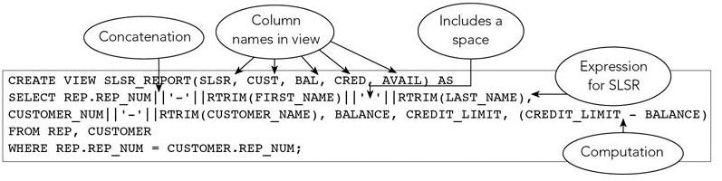
A Guide to SQL, Seventh Edition

Slide 17
Creating the Data for the Report
To produce a report, run a SELECT command to create data to use in report
In the following example, rows in output are wider than the screen
  Each row is displayed on two lines
A Guide to SQL, Seventh Edition

Slide 18
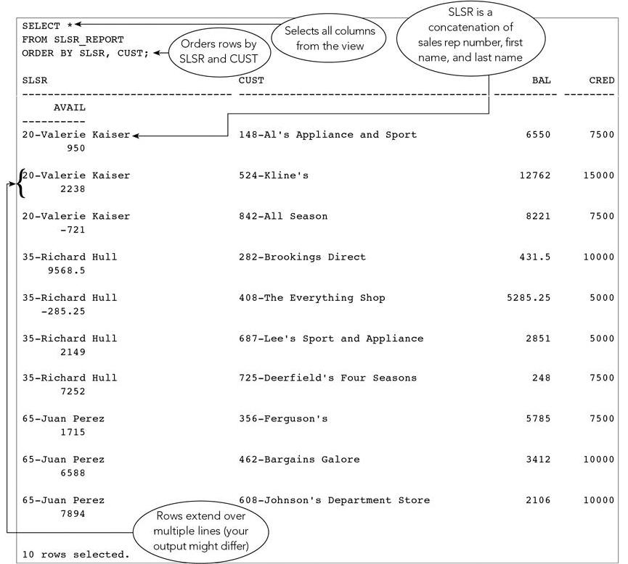
A Guide to SQL, Seventh Edition

Slide 19
Changing Column Headings
Column headings can be changed to improve readability
Type the COLUMN command followed by the name of the column to change
Follow with the HEADING clause and new heading
To break a heading on two lines, use single vertical line (|)
A Guide to SQL, Seventh Edition

Slide 20
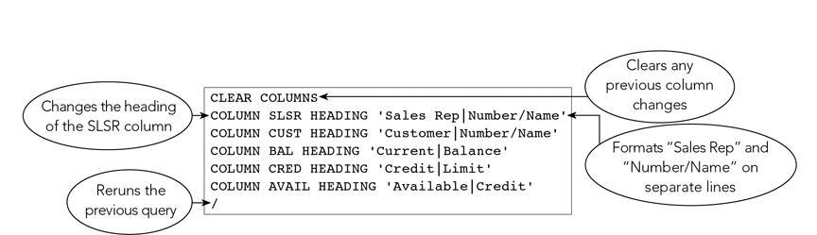
A Guide to SQL, Seventh Edition

Slide 21
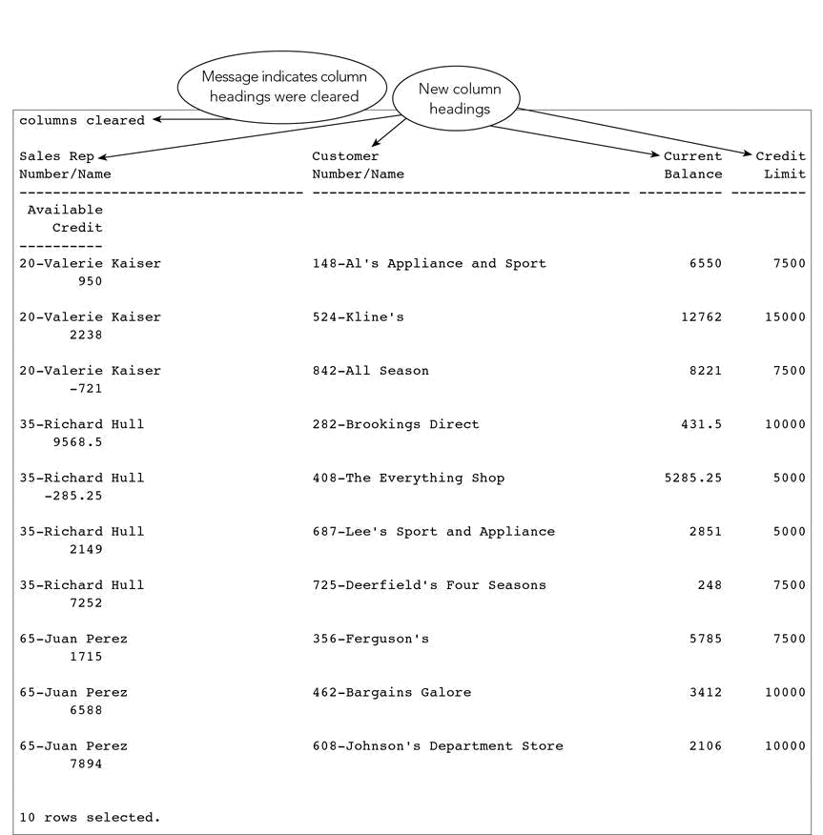
A Guide to SQL, Seventh Edition

Slide 22
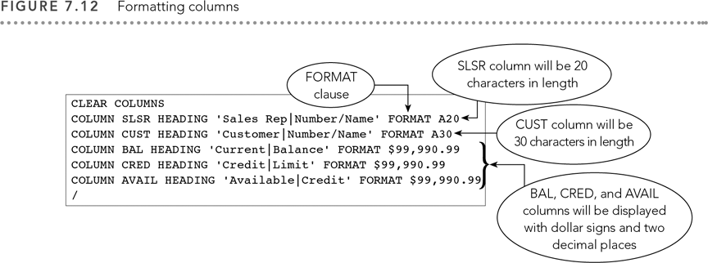
Changing Column Formats
COLUMN command and FORMAT clause work together
A Guide to SQL, Seventh Edition

Slide 23
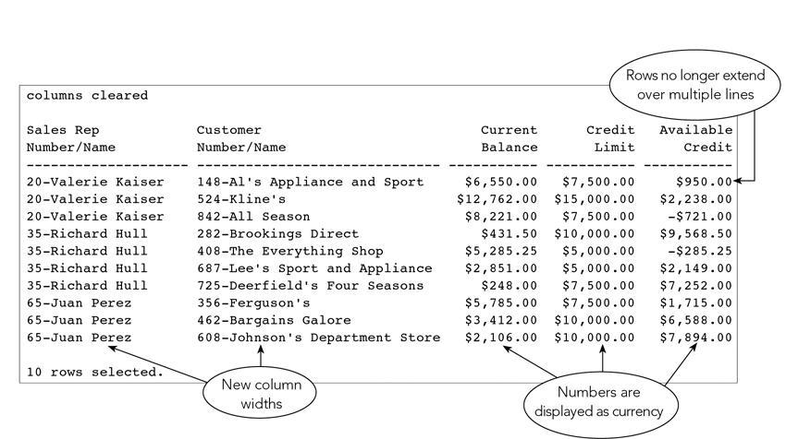
A Guide to SQL, Seventh Edition

Slide 24
Adding a Title to a Report
TTITLE command will place a title at the top
BTITLE command will place a title at the bottom
Desired title is placed within single quotation marks
To format title with line breaks, use single vertical line (|)
A Guide to SQL, Seventh Edition

Slide 25
Adding a Title to a Report
Adjust line size with SET LINESIZE command
  Line size is the maximum number of characters each line can contain
Adjust the number of lines per page with SET PAGESIZE command
A Guide to SQL, Seventh Edition

Slide 26
Grouping Data in a Report
Group data in a report by using BREAK command
  BREAK command identifies a column on which to group data
Value in the column is displayed only at the beginning of the group
It is possible to specify the number of blank lines following a group
A Guide to SQL, Seventh Edition

Slide 27
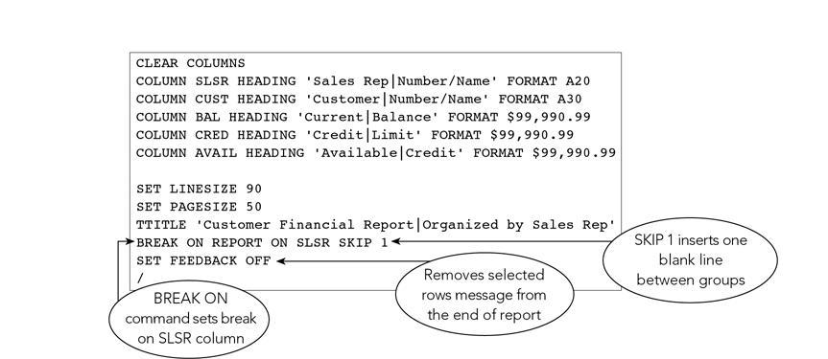
A Guide to SQL, Seventh Edition

Slide 28
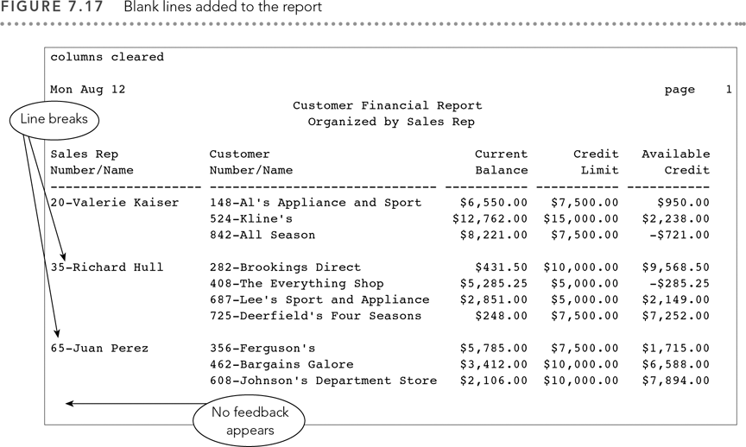
A Guide to SQL, Seventh Edition

Slide 29
Including Totals and Subtotals in a Report
Subtotal is a total that appears after each group
To calculate a subtotal, include BREAK command to group the rows
COMPUTE command indicates computation for subtotal
Statistical functions are used to calculate the values
A Guide to SQL, Seventh Edition

Slide 30
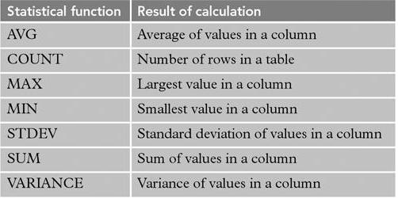
A Guide to SQL, Seventh Edition

Slide 31
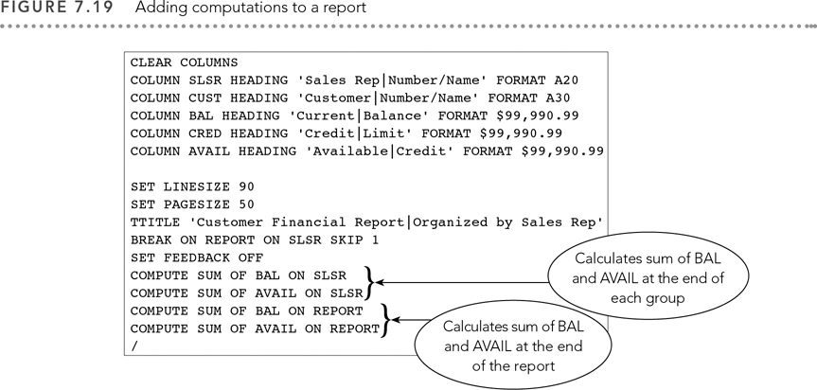
A Guide to SQL, Seventh Edition

Slide 32
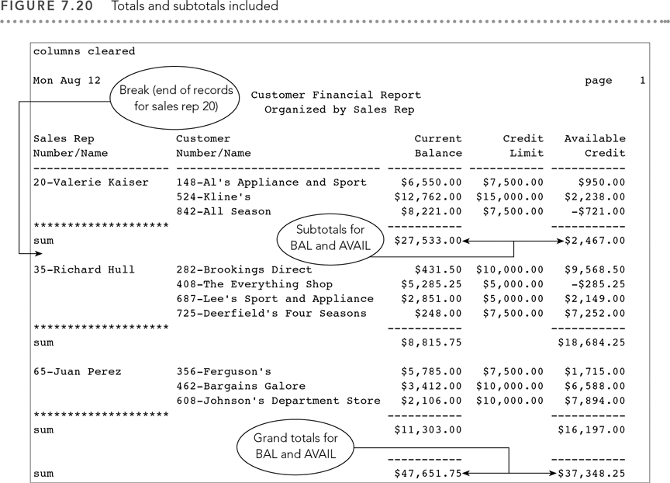
A Guide to SQL, Seventh Edition

Slide 33
Sending the Report to a File
SPOOL command is used in Oracle to create a report output file
This file has many uses:
  Printing
  Editing
  Importing into a document
  Other options
A Guide to SQL, Seventh Edition

Slide 34
The SPOOL Command
Sends output of subsequent commands to designated file
Final command of SPOOL OFF turns off spooling and stops further output to designated file
Include path name to save output file to a specific drive or folder
A Guide to SQL, Seventh Edition

Slide 35
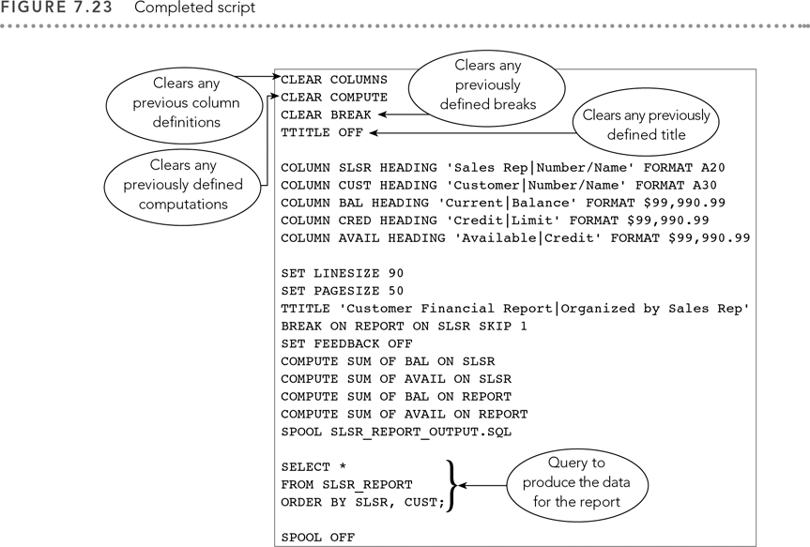
A Guide to SQL, Seventh Edition

Slide 36
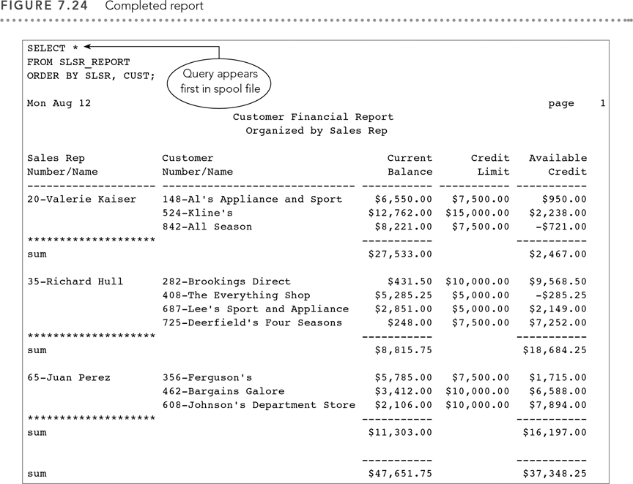
A Guide to SQL, Seventh Edition

Slide 37
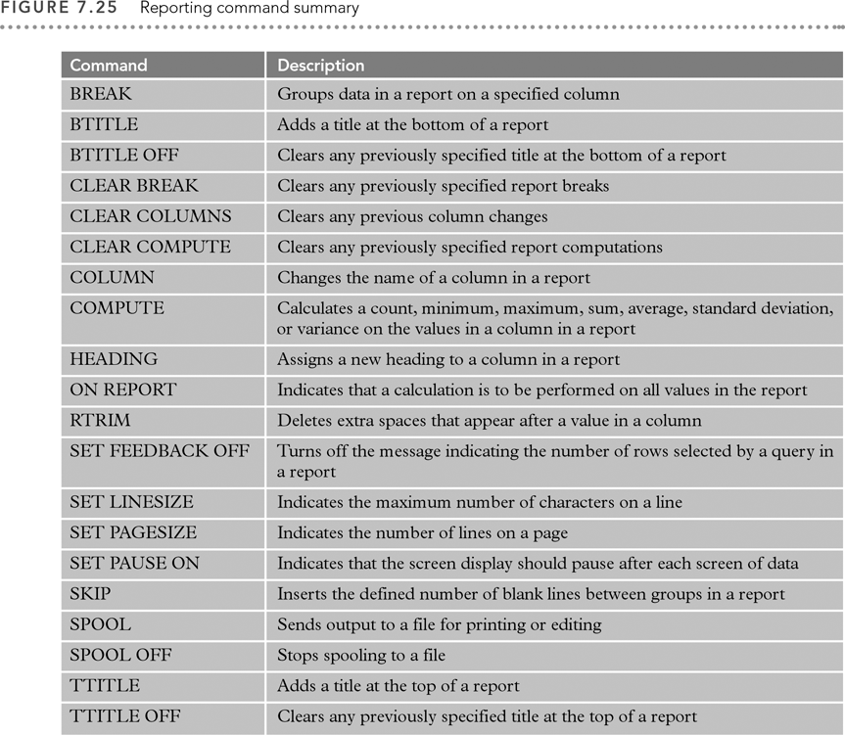
A Guide to SQL, Seventh Edition

Slide 38
Summary
Use of functions
  UPPER and LOWER
  ROUND and FLOOR
Perform calculations with dates
Concatenate columns
Commands to create and format reports
A Guide to SQL, Seventh Edition

