Slide 1
Bottler Scorecard

Slide 2
Content:
Bottler Scorecard Overview
Selection Options
Operational Definitions of Metrics
Charts, Trends and Graphs

Slide 3
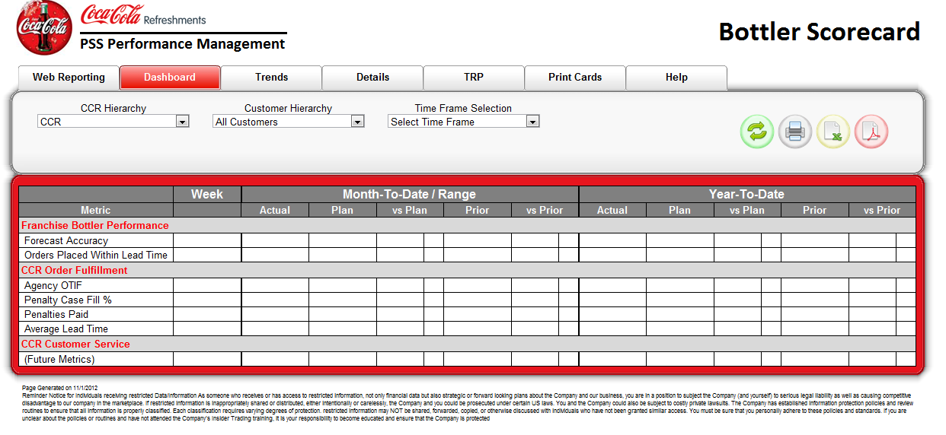
Main Page

Slide 4
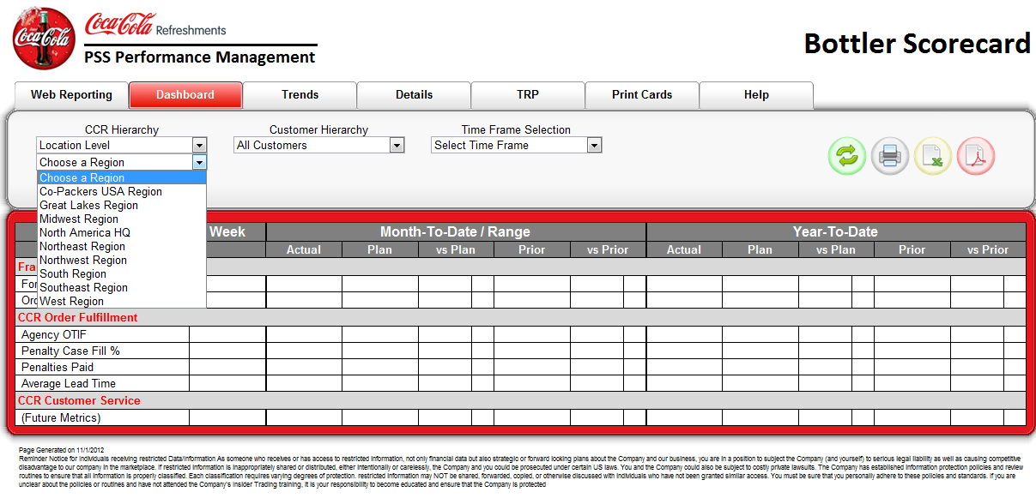
CCR Selection Option
User can select CCR Hierarchy:
Region Level,
Market Unit Level,
Location Level

Slide 5
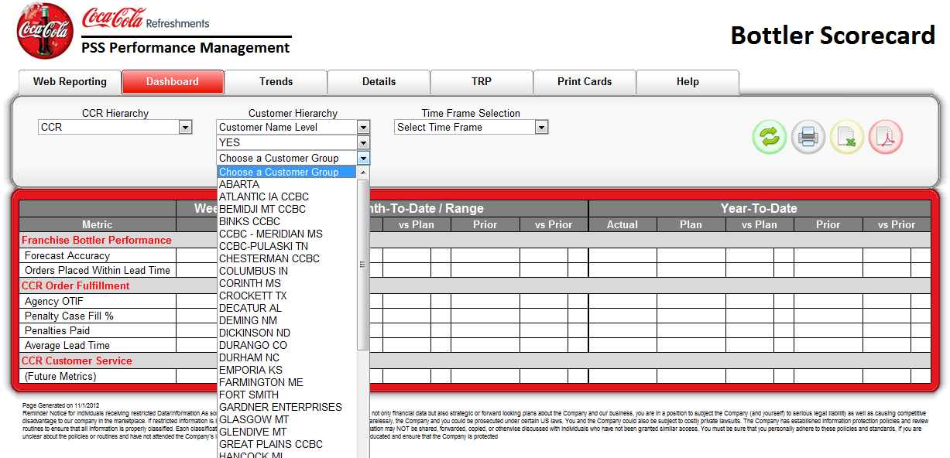
Customer Selection
User can select Customer Selection:
PCF Eligibility,
Customer Grouping Level,
Customer Name Level

Slide 6
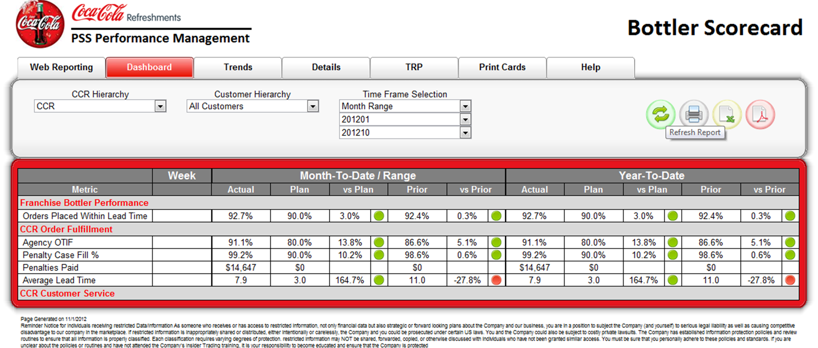
Period Selection
User can select Time Frame Selection:
Month, Week, Month Range and Week Range.
For Month/Week Range, user has to select the starting period at the top and the ending period at the bottom.

Slide 7
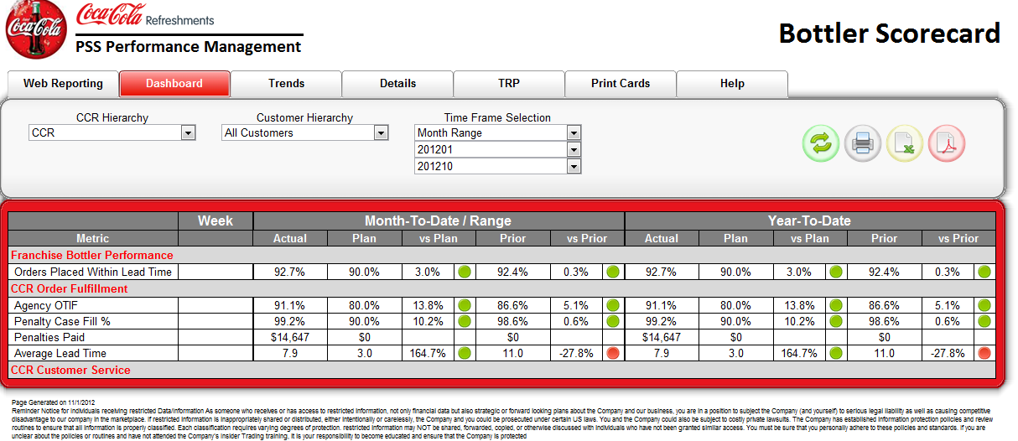
Scorecard

Slide 8
Scorecard – Gap Time
Orders Placed Within LeadTime
Definition: Percentage to measure number of order(s) that meet within Lead Time.
Objective: Maximize number of orders within lead time.
Update Frequency: Weekly
Data Sources: ETCBPSQL150, AT_DIS_CREDIT

Slide 9
Scorecard – Overtime
Agency OTIF
Definition: Percentage of OnTime and InFull for Agency orders
Objective: To measure percentage of all Agency orders OnTime and InFull.
Update Frequency: Weekly
Data Sources: ETCBPSQL150, AT_DISCREDIT

Slide 10
Scorecard – Cases Per Hour
Penalty Case Fill %
Definition: A measure of number cases filled for all the orders that is penalized.
Objective: To measure case fill percentage of all penalized orders .
Update Frequency: Weekly
Data Sources: ETCSPSQL150, AT_DIS_CREDIT
Notes:

Slide 11
Scorecard – Cost Per Case
Penalties Paid
Definition: A measure penalties paid for all orders that PCF% is below 90% for two consecutive period for only eligible customers.
Objective: to measure how much penalties paid for all the orders that has PCF% below 90% for 2 consecutive periods.
Update Frequency: Weekly
Data Sources: ETCBPSQL150, AT_DIS_CREDIT
Notes:

Slide 12
Scorecard – Cash Accountability
Average Lead Time
Definition: measure of Average time from Order received to order delivered.
Objective: to measure Average Lead time of all orders for selected area, selected customer and selected time period.
Update Frequency: Weekly
Data Sources: ETCBPSQL150, AT_DIS_CREDIT
Notes:

Slide 13
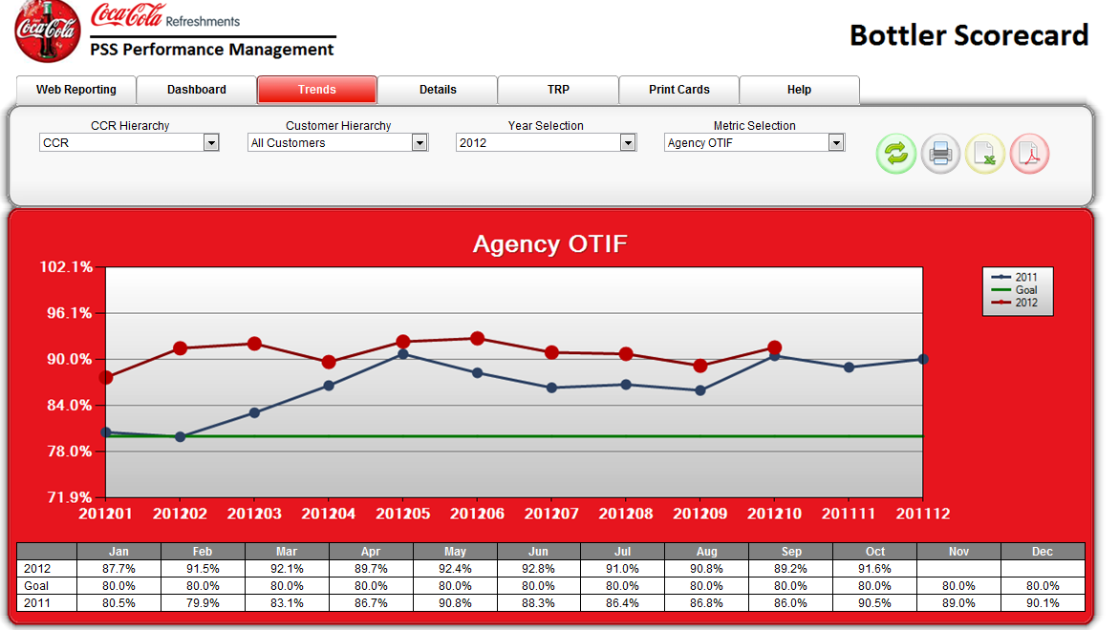
Scorecard – Charts, Trends and Graphs
Charts, Trends and Graphs
Provide the users with ability to generate:
Charts and Graphs
Trending YTD

Slide 14
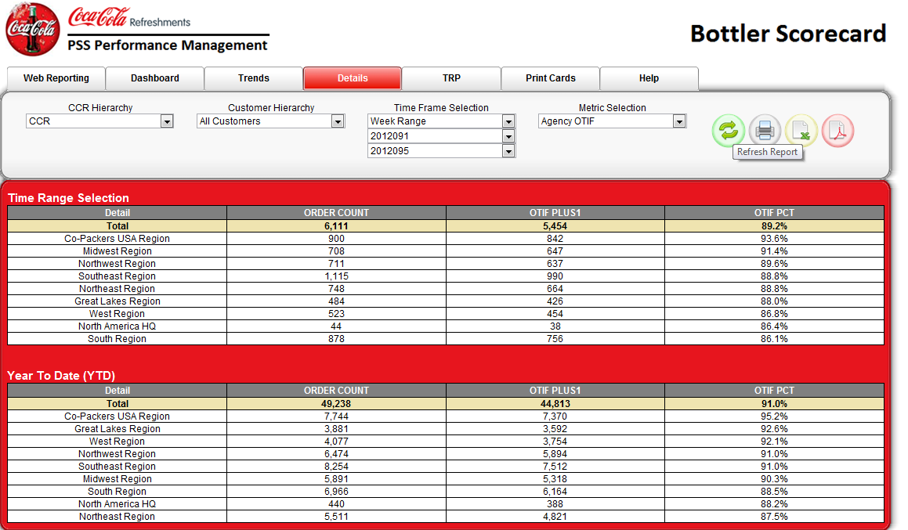
Scorecard – Detail information
Detail Information
Provide the users with ability to generate:
Week/Month To Date Detail info
Year To Date Detail Info

Slide 15
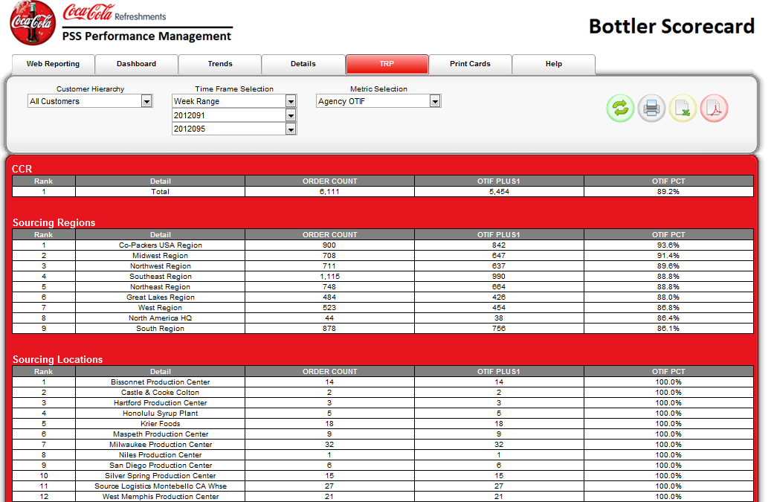
Scorecard – TRP
TRP Information
Provide the users with ability to generate:
Ranking for CCR
Ranking for Regions
Ranking for Locations

Slide 16
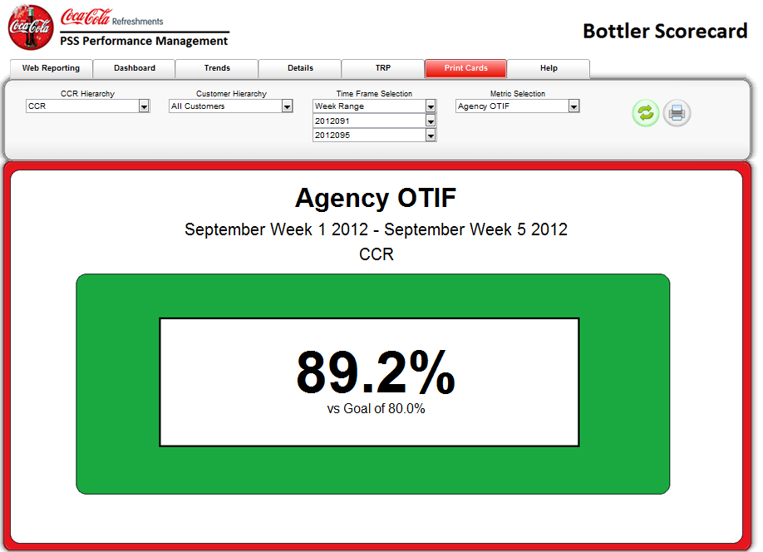
Scorecard – Print Card
Print Card
Provide the users with ability to generate:
Print Card to Display on a Board

Slide 17
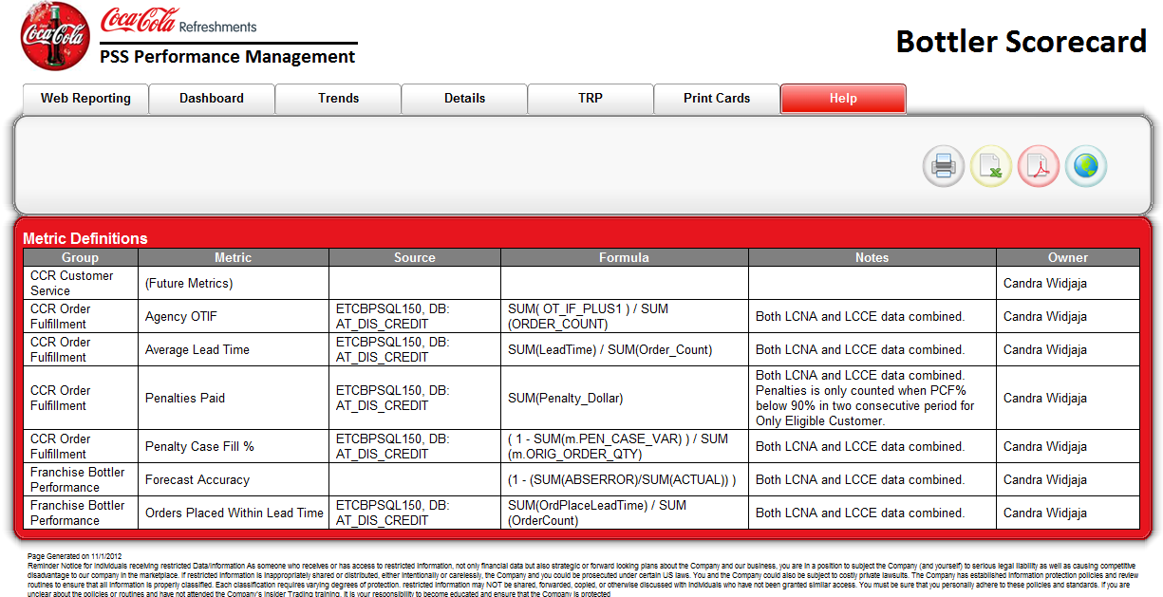
Scorecard – Help Information
Help Info
Provide the users with ability to look:
Formula used in Scorecard

Slide 18
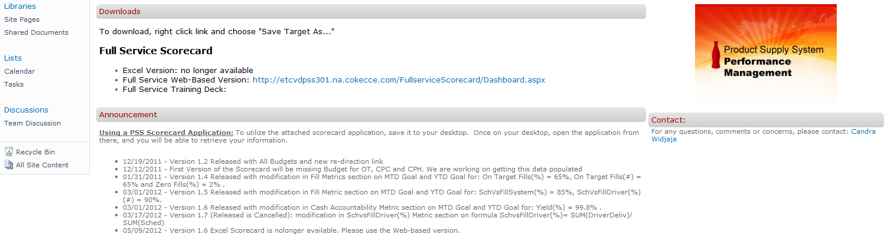
How to get access?
SC Developer: Candra Widjaja
Metrics & Reporting Mgr.: Tom Nguyen
Director: James Roll
Support Tools and Processes:
PSS Performance Management Team
PSS Performance Management SharePoint:
https://teams.cokecce.com/sites/SCVM/default.aspx

Slide 19


