Slide 1
Performance Measurement COE App and Metric Help Center

Slide 2
Agenda:
1. Purpose
2. Live Demo
3. Questions

Slide 3
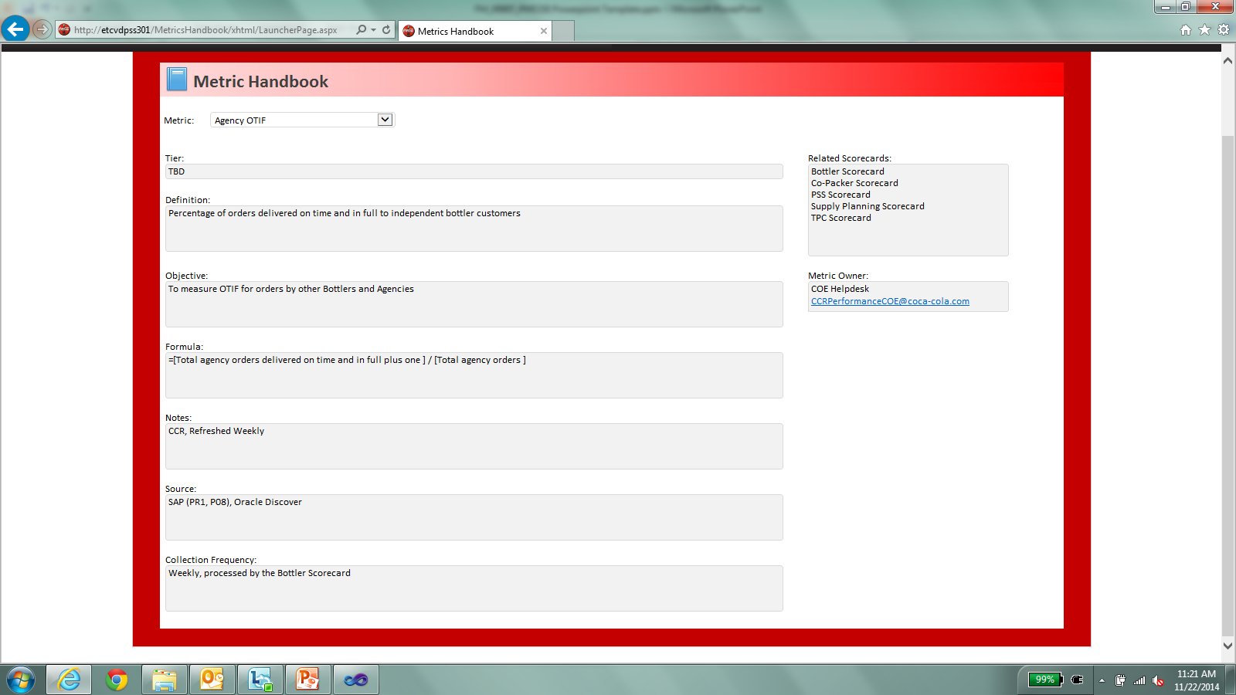
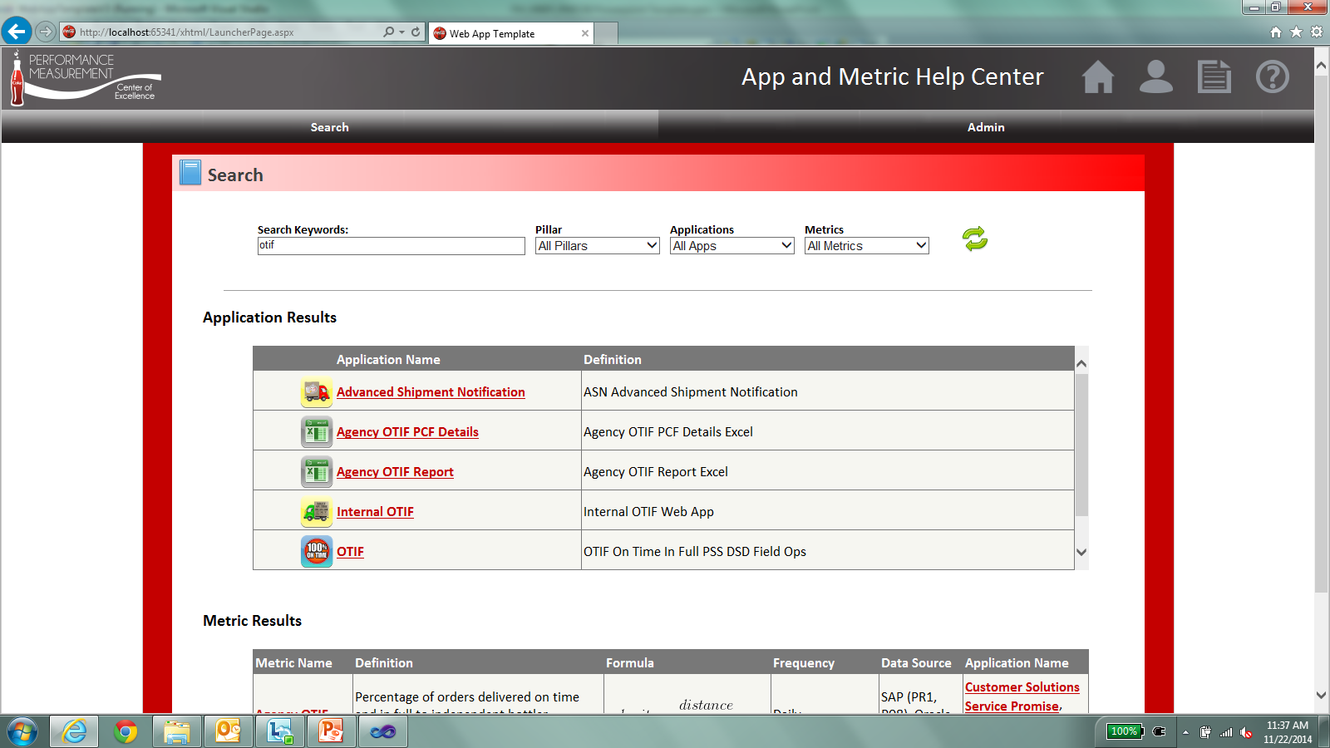
Purpose
Add Search Function and More Filters

Slide 4
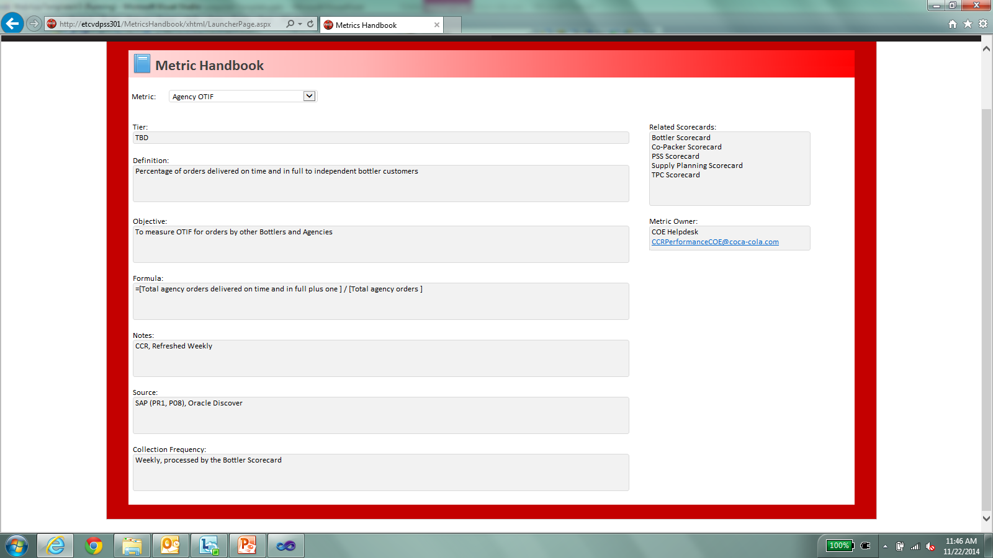
Purpose
More Dynamic and Contains More Information

Slide 5
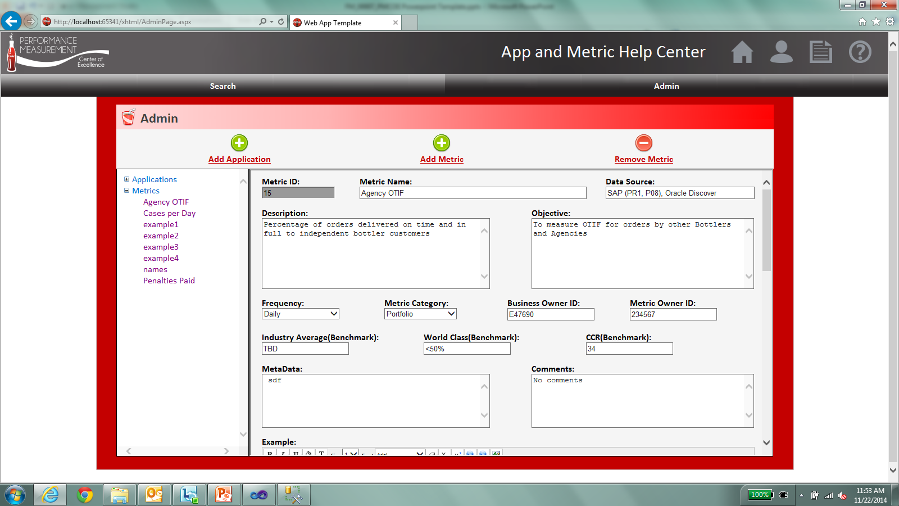
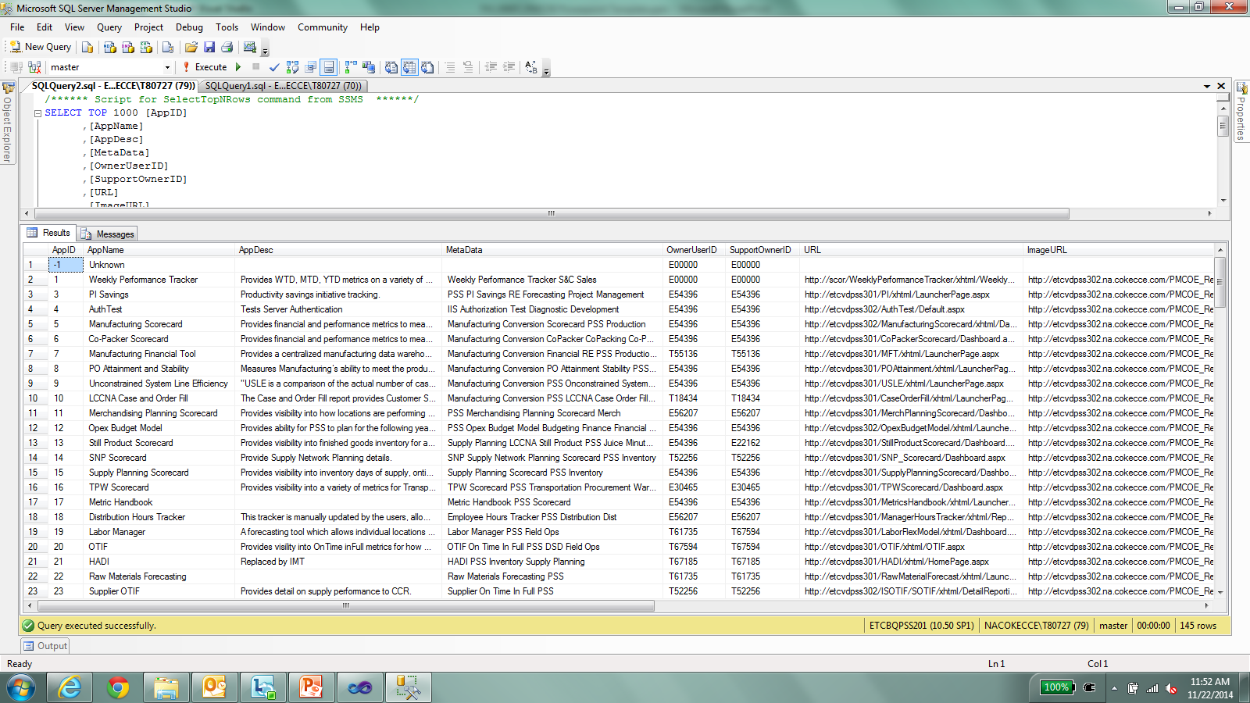
Purpose
Easy to Manage and Maintain

Slide 6
Demo Time!!!

Slide 7

App and Metric Help Center - Questions

