Slide 1
How does video streaming impact box office success?
Tony Allard, Namratha Acharya, Yueh-Ting Wu, Peter Yeu-Shyang Yeh

Slide 2
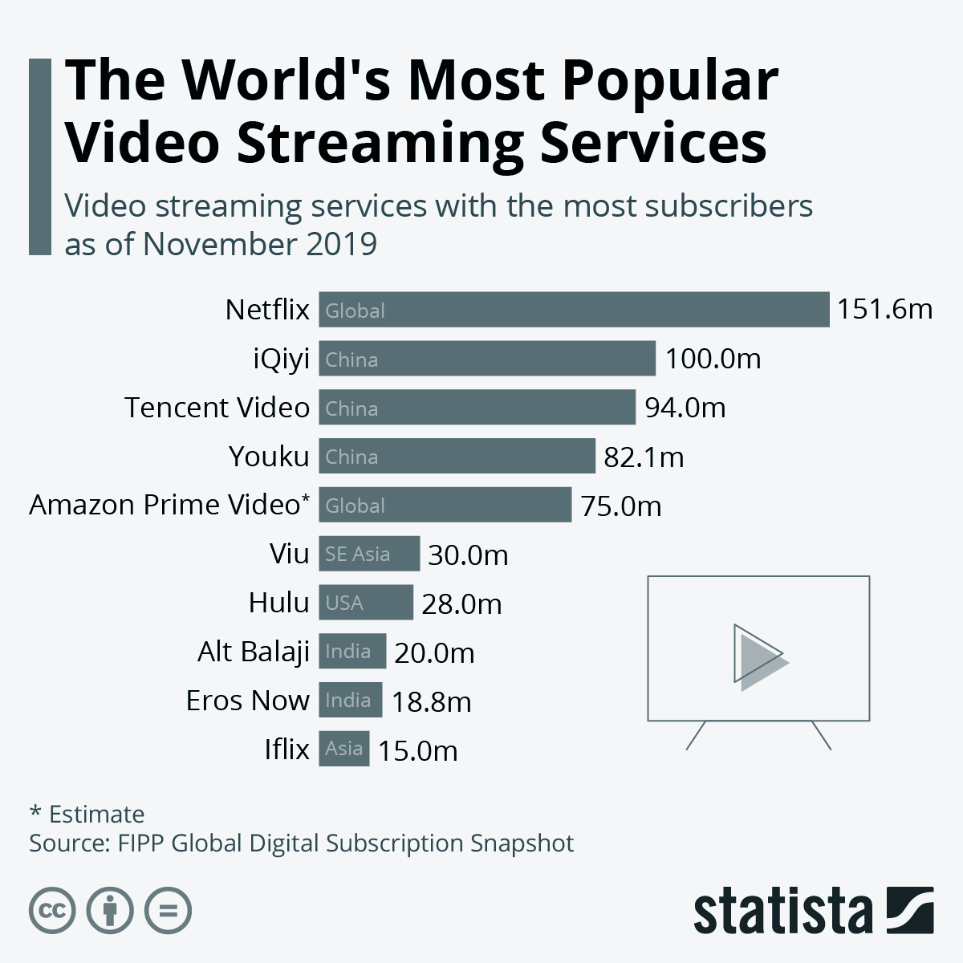

Problem Statement
Notes:
Video streaming services such as netflix, hulu, and disney plus have had a growing popularity over the past 20 years. Since you can stream movies on these video streamin platforms from your house, This growing popularity may have impacted the traditional consumption forms of movies such as movie theaters. Specifically, we think that these video streaming services may have had an impact on the movie theater business and the box office as a whole. The real question is, can movie theaters still be a profitable business endeavor with the growing consumption of video streaming services such as netflix and hulu?
References:
https://www.statista.com/chart/20701/video-streaming-services-with-most-subscribers-global-fipp/
https://deadline.com/2020/08/more-than-half-of-u-s-households-now-subscribe-to-multiple-streaming-services-study-1203025747/
https://hosbeg.com/what-is-a-box-office/

Slide 3
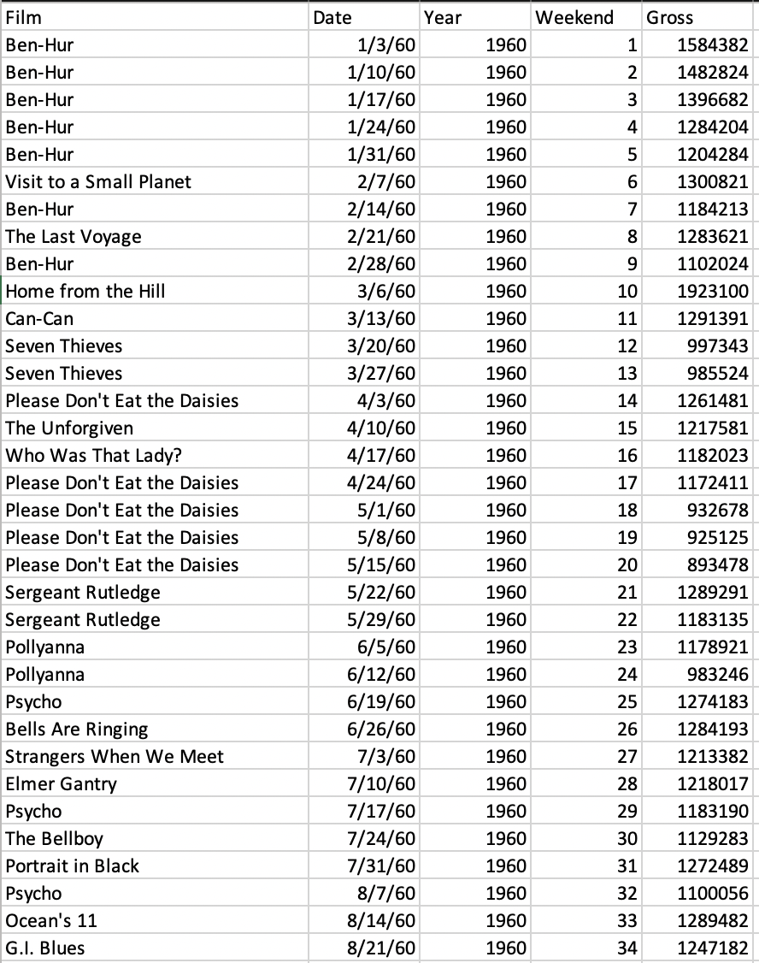
The Dataset
Box-office data - Kaggle.com
3000+ records
Film, Date, Year, Weekend, Gross
Year 1960 to 2021

Slide 4
Initial Data
Variable | Type | Description
Film | Character | Name of the top grossing weekend box office
Date | Date | Sunday of the weekend box office
Year | Numeric | Year of the weekend box office
Weekend | Numeric | Week number of the year (1:53)
Gross | Numeric | Box office earnings of the top film for the weekend

Slide 5
The Variables/Data Preprocessing

Slide 6
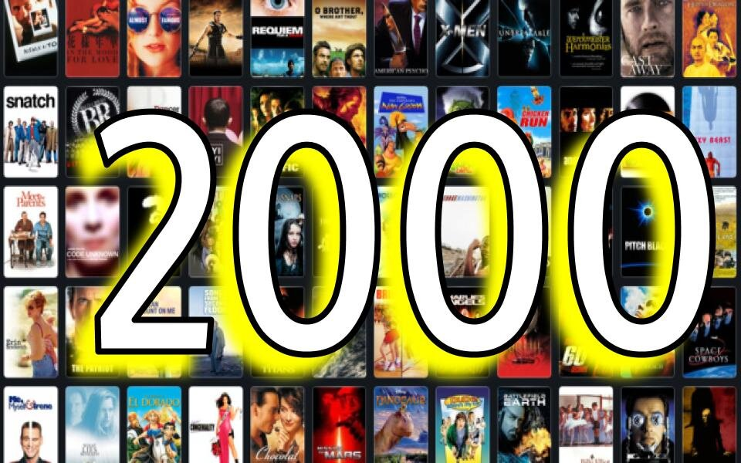
Filtering-2K and Onwards

Slide 7
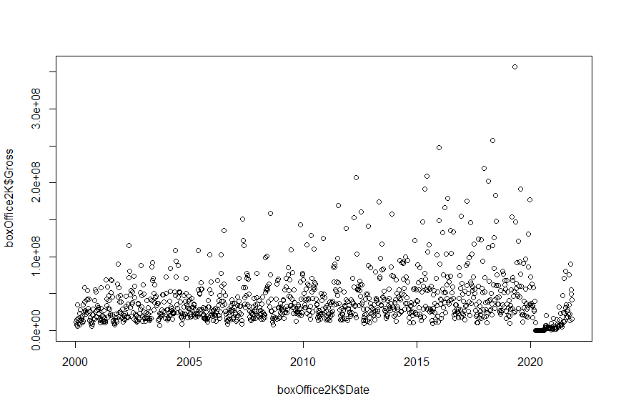
Scatterplot-2K and onwards
Notes:
1139 observations

Slide 8
New Variables
Variable | Type | Description
Month | Numeric | Month of the weekend box office (1:12)
WinterSeason | Logical | 1 = box office in the winter 0 = box office did not occur during the winter
SpringSeason | Logical | 1 = box office in the spring 0 = box office did not occur during the spring
SummerSeason | Logical | 1 = box office in the summer 0 = box office did not occur during the summer
FallSeason | Logical | 1 = box office in the fall 0 = box office did not occur during the fall
MilleniumWeek | Numeric | Week number into the millenium
HolidayWeekend | Logical | 1 = box office was during the holiday weekend 0 = box office did not occur during the holiday weekend
Streaming | Logical | 1 = streaming services were available (2008) 0 = streaming services were not available
OriginalStreaming | Logical | 1 = original streaming content was available (2013) 0 = original streaming content was not available
InternationalStreaming | Logical | 1 = international streaming content was available (2018) 0 = international streaming content was not available
Notes:
1139 observations

Slide 9
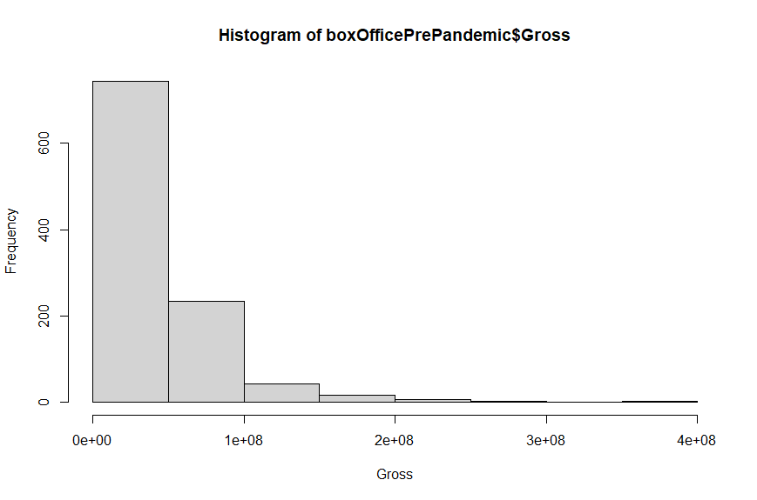
Preprocessing

Slide 10
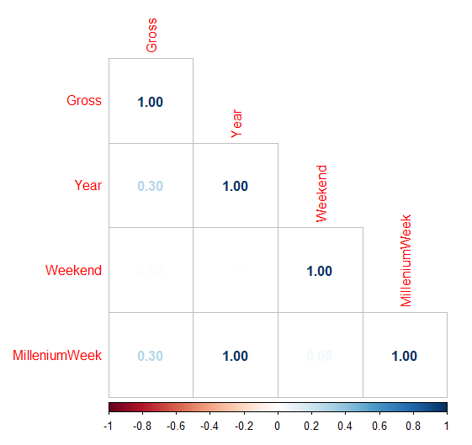
Correlation
Year: 0.2986202
MilleniumWeek: 0.2994507

Slide 11
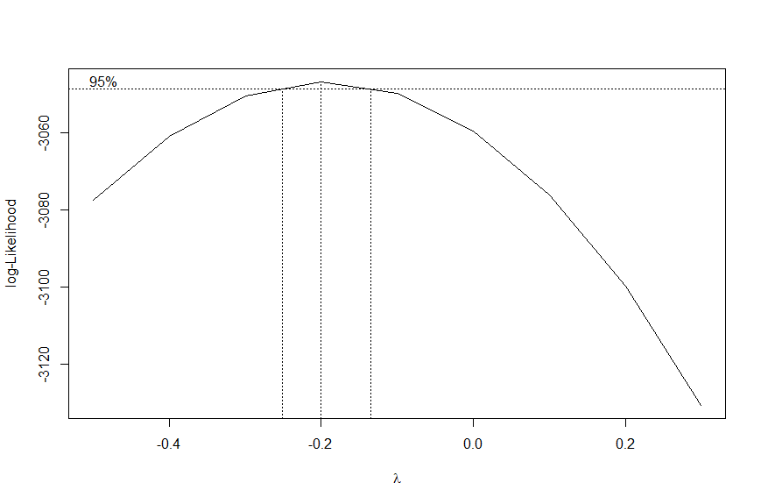
Box Cox Transformation
Notes:
1139 observations

Slide 12
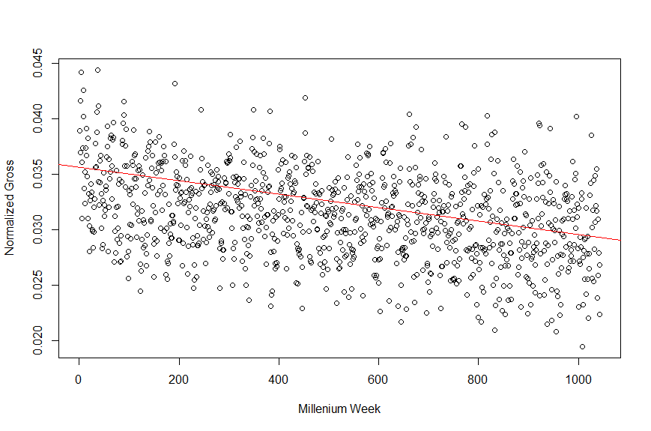
Success Criteria
Notes:
Rsquare about 20%

Slide 13
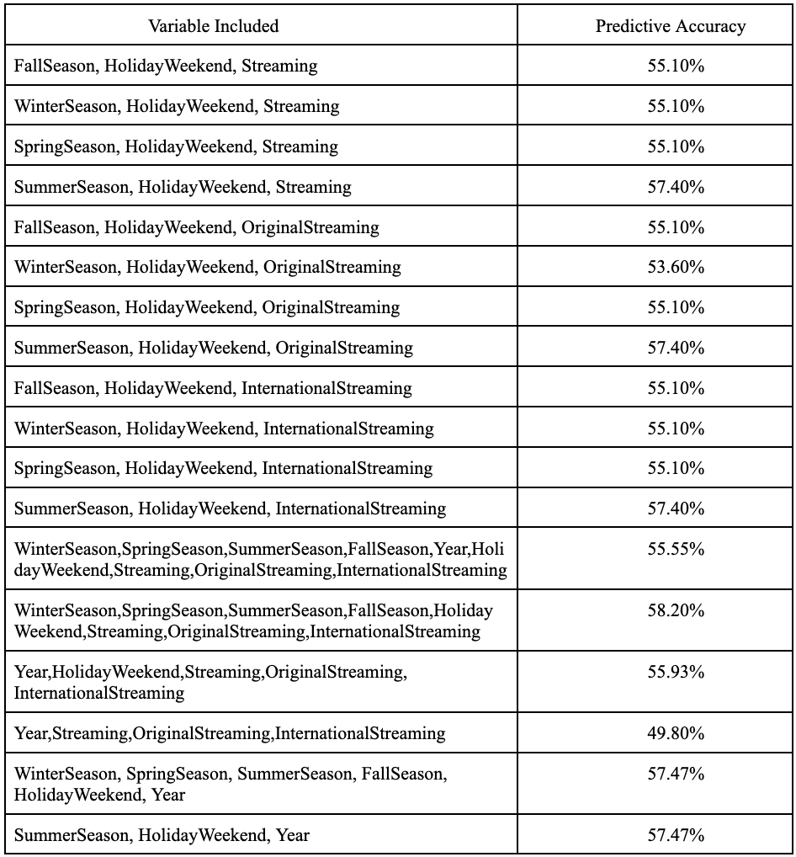
Logistic Regression
Inputs - Seasons, Holiday weekend,
Streaming services
Outputs - Success
Prediction accuracy - 58.2%

Slide 14
Naive Bayes
Variables Included | Predictive Accuracy
FallSeason, HolidayWeekend, Streaming | 49.04%
WinterSeason, HolidayWeekend, Streaming | 49.04%
SpringSeason, HolidayWeekend, Streaming | 49.04%
SummerSeason, HolidayWeekend, Streaming | 50.57%
FallSeason, HolidayWeekend, OriginalStreaming | 49.04%
WinterSeason, HolidayWeekend, OriginalStreaming | 49.04%
SpringSeason, HolidayWeekend, OriginalStreaming | 49.04%
SummerSeason, HolidayWeekend, OriginalStreaming | 50.57%
FallSeason, HolidayWeekend, InternationalStreaming | 50.96%
WinterSeason, HolidayWeekend, InternationalStreaming | 47.89%
SpringSeason, HolidayWeekend, InternationalStreaming | 49.04%
SummerSeason, HolidayWeekend, InternationalStreaming | 50.57%
Fitted using the seasons, holiday weekend, and streaming services
Predictive Accuracy ~ 52%
Violates Independence
So I generated several models with different combinations of the independent variables

Slide 15
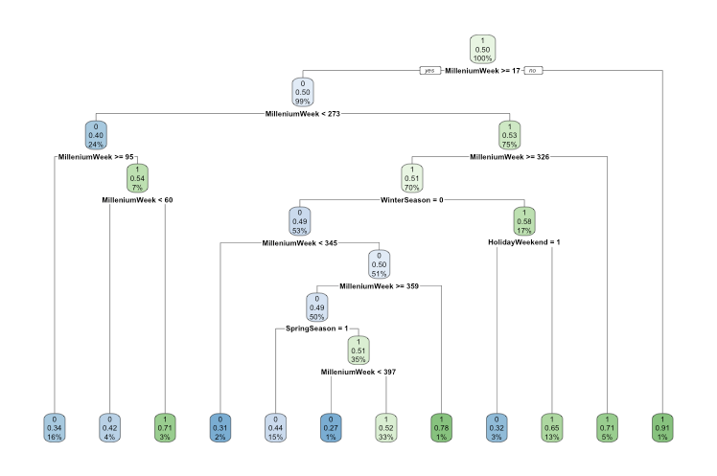
Decision Tree
Predictive Accuracy = 46.74%
Notes:
Here on the screen the decision tree model is presented. We implemented a 0.1 complexity parameter for this model. We can see that MilleniumWeek is the variable that shows up the most in this model. However, this model is not very accurate as it only presented a 46.75% predictive accuracy which is very low so this model will really not show any insights.

Slide 16
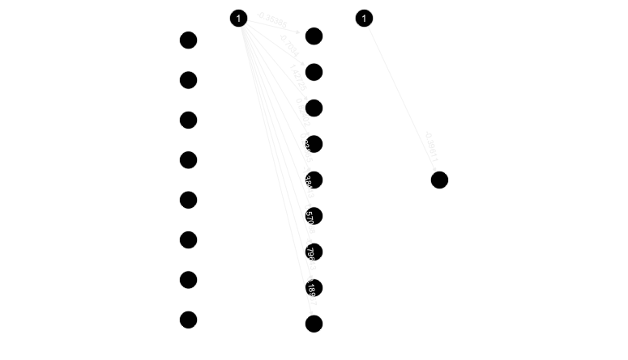
Neural Network
Predictive Accuracy = 54.79%
Notes:
We also ran a Neural Network Algorithm on the dataset. The neural network visual is displayed above. There is an error of 92.06 and it took 972 steps. The predictive accuracy for this model is again low at 54.79%. This means that any predictions from this model are not accurate and don’t really mean anything.

Slide 17
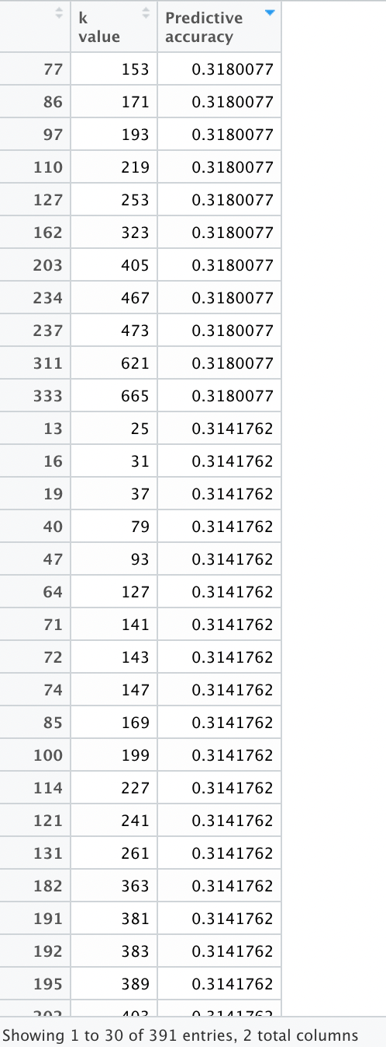
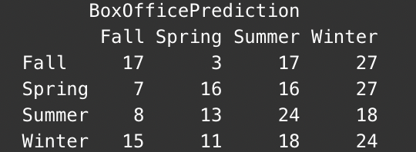
K-Nearest Neighbors
Predictive accuracy: 31.03%

Slide 18
Comparison
The best model for this case:
Logistic Regression
Input: Seasons, Holidays Weekends, and Streaming Services
Predictive Accuracy: 58.20%

Slide 19
Results & Recommendations
Don't shut down movie theaters because of the impact of video streaming on profits.
Because of the cyclical nature of earnings, movie theaters should consider hosting events on non-opening weekends.
Movie theaters should collaborate with streaming services to advertise their trailers for movies to the subscribers to boost movie theater attendance.

Slide 20
Thank you! Any Questions?

