Slide 1
BUSA 649 COMMUNITY PROJECT
SUSTAINABILITY MATTER
Beyond University Rankings
A transparent, student-centered comparison of global sustainability master’s programs
Yuyang Chen · Zhaihan Gong · Alan Yang
July 2026
Notes:
Suggested presenter: Yuyang | Target time: 0:35
Good morning. We are Sustainability Matter: Yuyang Chen, Zhaihan Gong, and Alan Yang. Our project is called Beyond University Rankings. We started with a simple observation: students do not apply to an institution in the abstract. They apply to a specific program, with a specific curriculum, price, format, research environment, and career path. Our goal was to make that choice more transparent for sustainability-focused master’s programs worldwide.
Today we will show the motivation, our scope and design decisions, the data and modeling pipeline we built, what the Reddit analysis adds, how the scoring system protects against false precision, and how we can turn this research prototype into a dynamic decision tool.
[Sources]
- Project Proposal BUSA 649, title and team section

Slide 2
WHY THIS PROJECT
Students choose programs—not institutions
INSTITUTION
PROGRAM FIT
Reputation Sustainability standing Research scale
≠
Curriculum Affordability Experience & outcomes
The gap creates a costly decision problem—especially for international students comparing countries, currencies, formats, and career paths.
02
Notes:
Suggested presenter: Yuyang | Target time: 0:55
The reason for doing this project is the gap shown here. QS Sustainability, THE Impact, AASHE STARS, and UN PRME provide useful institutional signals. But they cannot answer the decision a student is actually making. A highly ranked university may still offer a program that is too expensive, too theoretical, too short, or poorly aligned with a student’s goals.
This is especially difficult for international students. The information is fragmented across program pages, tuition pages, rankings, sustainability reports, research databases, and online communities. Our project brings these layers together, while keeping the distinction between institution-level evidence and program-level evidence explicit.
To close that gap, we needed a team that could connect data, modeling, and user experience.
[Sources]
- Project Proposal BUSA 649, executive summary and problem statement

Slide 3
OUR GROUP
Three complementary roles built one auditable system
YUYANG CHEN
ZHAIHAN GONG
ALAN YANG
Project management Dashboard, UI & visualization
Data cleaning & normalization Data dictionary Missing-data and quality flags
Ranking and weighting model Html Production Final presentation support
Shared mission: make the result searchable, explainable, reproducible—and honest about uncertainty.
03
Notes:
Suggested presenter: Yuyang | Target time: 0:45
Our team name is Sustainability Matter, and our roles were designed to cover the full lifecycle of the project. I coordinated the project, final report structure, and the user-facing dashboard and visualization. Zhaihan focused on data cleaning, normalization, the data dictionary, and missing-data controls. Alan focused on the ranking model, weights, sensitivity analysis, and validation.
These responsibilities overlap in a useful way. The same people who built the data and scoring logic also had to explain it to users. That is why auditability, missing-data labels, and visible sources became design requirements, not afterthoughts.
Our first shared decision was where this comparison should begin—and where it should stop.
[Sources]
- Project Proposal BUSA 649, team roles

Slide 4
SCOPE
A focused global sample made comparison feasible
We defined the analytical universe as 30 QS Sustainability selections plus the 30 highest-ranked nonduplicate THE additions—one program per institution, not a worldwide census.
60
21
COMPLETE
selected programs 30 QS + 30 THE additions
countries represented across the synchronized sample
verification stage closed
exceptions documented in the audit
04
Notes:
Suggested presenter: Zhaihan | Target time: 1:05
Defining the scope was one of the most important project decisions. Our initial source universe produced 97 candidates. We then created a fixed, synchronized analytical sample: the first 30 records in QS Sustainability order, plus the 30 highest-ranked THE records not already selected by QS.
That produces 60 distinct programs in 21 countries. We keep one sustainability-related master’s route per selected institution so every workbook and model uses the same program ID. The verification stage is now complete, with exceptions and judgment calls recorded in the audit trail instead of hidden.
This is a selected global sample, not an attempt to rank every sustainability master’s program in the world. That boundary keeps the comparison manageable and auditable.
A completed verification stage does not mean the work was easy. The next slide shows the difficulties we met.
[Sources]
- program_source_data_top60_qs30_the30.xlsx, Summary sheet
- program_scores.json, synchronized program universe

Slide 5
PROJECT DIFFICULTIES
Verification was the hardest part of the project
The challenge was defining comparable evidence.
04
Name and route matching
01
Inconsistent official pages
Aliases, translated titles, and research/taught routes needed human judgment.
Dynamic pages and changing labels required manual review.
02
Scope and identity ambiguity
05
Coverage was uneven
Campus, school, and institution evidence needed separate checks.
OpenAlex limits and sparse Reddit discussion reduced automation for some schools.
03
Missing did not mean zero
NR, N/P, 200+, blocked, and uncollected values required distinct states.
05
Notes:
Suggested presenter: Zhaihan | Target time: 0:55
Verification was the hardest part of the project. Official pages used inconsistent structures, dynamic content, and changing labels, so automation could not replace manual review.
Scope was another challenge. Evidence published for a campus, school, or institution could not automatically be applied to a specific program. We also had to resolve aliases, translated titles, and the difference between research-oriented and taught routes.
Finally, missing information had several meanings. Not ranked, not published, ranked after 200, blocked, and not collected could not be treated as the same value. OpenAlex limits and uneven Reddit coverage also reduced automation for some institutions.
These difficulties shaped the controls built into the pipeline we show next.
[Sources]
- program_source_data_top60_qs30_the30.xlsx, URL and verification audits
- PROGRAM_SCORING_PIPELINE.md, verification and missing-data rules

Slide 6
DATA COLLECTION
The pipeline turns fragmented sources into auditable outputs
01
02
03
04
05
Select
Collect
Normalize
Analyze
Package
QS / THE candidates Fixed 60-program universe
Official pages Rankings & sustainability OpenAlex · Reddit
IDs and aliases Units and categories Missing-data states
Five-year rankings Sentiment & topics Score components
Verified workbooks QA and audit files Frontend-ready JSON
Reproducibility is part of the product: every stage leaves a source, status, and validation trail.
Source: project build scripts and output packages
06
Notes:
Suggested presenter: Zhaihan | Target time: 1:05
This is the end-to-end process we implemented. We begin by selecting a fixed universe from QS and THE sustainability sources. We collect program-level information from official university pages and institutional context from QS, THE, AASHE STARS, UN PRME, and OpenAlex. Reddit is collected separately for community discussion.
The normalization stage is essential. We align institution aliases, program IDs, categories, and missing-data states before any analysis. Then we build five-year ranking histories, run sentiment and topic models, and calculate validated score components.
Finally, we package the results as auditable Excel workbooks, quality-control files, reproducibility scripts, and a JSON contract for the website. Each stage leaves enough evidence to trace the output back to its source.
With the process established, we can now see exactly what evidence it produced.
[Sources]
- Project build scripts and output packages

Slide 7
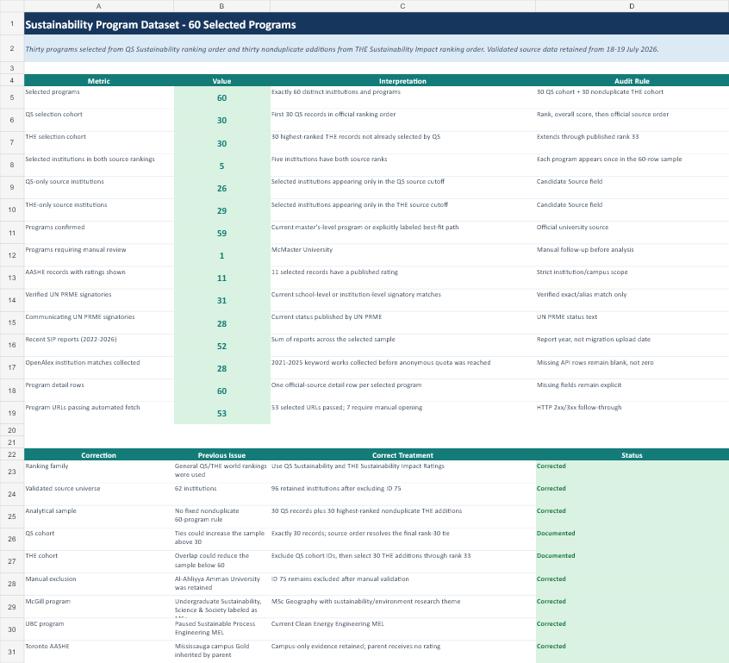
WHAT WE COLLECTED
The evidence base combines breadth with source-level verification
OFFICIAL PROGRAM EVIDENCE
SYNCHRONIZED WORKBOOK
60
program detail rows
53 URLs passed automated checks; 7 remain for manual opening.
INSTITUTIONAL CONTEXT
31 verified UN PRME signatories
11 published AASHE ratings
28 collected OpenAlex institution matches
07
07
Notes:
Suggested presenter: Zhaihan | Target time: 0:55
The synchronized source workbook is the backbone of the project. It contains one official-source program detail row for every selected program, covering fields such as duration, mode, tuition, curriculum, experiential learning, thesis or capstone options, requirements, and source URLs.
Fifty-three program URLs passed automated fetch checks; seven are explicitly marked for manual opening rather than being treated as missing or invalid. At the institutional level, we verified 31 UN PRME signatory matches, 11 published AASHE ratings, and collected 28 OpenAlex institution matches before the anonymous API quota was reached.
The screenshot shows the summary and audit logic inside the workbook. That audit layer is as important as the values themselves.
Official sources show what programs and institutions publish. The next layer shows what the student community discusses.
[Sources]
- program_source_data_top60_qs30_the30.xlsx

Slide 8
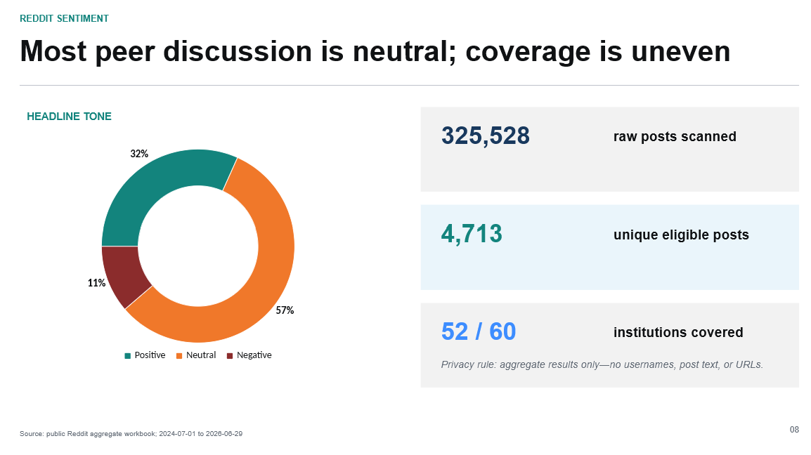

Slide 9
TEXT MODELING
Admissions dominates—so tone alone is not enough
OUTCOMES
873 accepted / offer mentions
Outcome labels are modeled separately from sentiment.
CONCERNS
682 cost · 586 anxiety
Concern flags capture context that can still use neutral language.
VALIDATION
120-row stratified calibration
Manual review remains required before final model claims.
09
Notes:
Suggested presenter: Alan | Target time: 1:05
Sentiment is only one layer of the text analysis. Most of the eligible conversation is about admissions, not sustainability content. That is why we also classify primary topics, explicit admission outcomes, and concern flags.
For example, the analysis identifies 873 accepted or offer mentions. It also distinguishes rejected, waitlisted, pending, and mixed outcomes. Separately, it flags 682 cost concerns and 586 anxiety or uncertainty signals. These can appear in neutral-sounding language, so a simple positive-versus-negative score would miss them.
The primary model is VADER 3.3.2 applied to post titles, with a documented graduate-admissions lexicon extension. A 120-row stratified calibration sample is available locally for human validation before we present automated sentiment as a final result.
These community signals stay separate from the academic model. The next slide shows how the scoring pipeline handles program evidence.
[Sources]
- reddit_topic_summary.csv
- reddit_outcome_summary.csv
- reddit_concern_summary.csv

Slide 10
SCORING MODEL
The pipeline blocks ranks it cannot defend
RESEARCH-ORIENTED
TAUGHT / PROFESSIONAL
PUBLICATION LADDER
Institution strength
30%
Institution strength
30%
Research environment
25%
Curriculum relevance
20%
≥85%
High confidence + rank
Program research design
15%
Experiential learning
15%
70–84.9%
Medium confidence + rank
Entry + English
20%
Entry + English
20%
Sustainability engagement
10%
Delivery, career, engagement
15%
55–69.9%
Provisional score only
<55%
No public score
Missing-data adjustment
Hard gate fails → blocked
Final score = coverage × observed score + (1 − coverage) × 50
Reddit is excluded from the academic score.
10
Notes:
Suggested presenter: Alan | Target time: 1:25
The scoring model separates research-oriented and taught or professional routes. Both include 30 percent institution strength, calculated from four five-year series: QS World, THE World, QS Sustainability, and THE Impact. The remaining weights reflect the route. Research programs emphasize the research environment and research design. Taught programs emphasize curriculum relevance and experiential learning.
For incomplete evidence, we calculate an observed score from available components, then shrink it toward a neutral score of 50 according to coverage. This avoids rewarding or punishing a program simply because data are missing.
Publication gates then control what users can see. Below 55 percent coverage, there is no public score. From 55 to just under 70, the score is provisional and has no ordinal rank. Ranks require at least 70 percent coverage, and hard gates override coverage.
Today all 60 routes remain unclassified, so final scores and ranks are intentionally blank. That is expected behavior, not a failure.
That release discipline creates value even before a ranking is published.
[Sources]
- build_program_scoring_pipeline.mjs
- pipeline_audit_report.json

Slide 11
LIVE DEMO
Demo: trace one program from evidence to decision
1 · SELECT
2 · INSPECT
3 · COMPARE
Search a program
Open its profile
Review source links
Check coverage and components
Follow track-specific logic
ALAN YANG · LIVE DEMO
Source: frontend scoring handoff; program_scores.json
11
Notes:
Presenter: Alan
This slide is an added transition for the live demo. It does not change the timing or pacing of the existing presentation.
Demo flow:
1. Search for one program and open the synchronized profile.
2. Show the official source links, coverage, components, and validation warnings.
3. Explain the track-specific score breakdown and preview how adjustable weights will work in the future dynamic model.
[Sources]
- FRONTEND_HANDOFF.md
- outputs/frontend_scoring_handoff/program_scores.json

Slide 12
BENEFITS AND IMPACT
Value arrives before rankings are published
FOR STUDENTS
FOR SUSANHUB & ADVISORS
FOR MAINTAINERS
Choose by fit, not prestige alone
Explain the evidence, not just the outcome
Refresh data without rebuilding
Compare curriculum, mode, duration, experience, institutional context, coverage, and sources.
Use a reusable global dataset, visible caveats, and separate community context for advising.
Rerun scripts, validate workbooks, and replace one frontend JSON file as evidence improves.
Current state: verification complete · 60 programs loaded · scoring architecture ready for the next build
12
Notes:
Suggested presenter: Yuyang | Target time: 0:55
The benefits extend beyond a final leaderboard. For students, the project supports comparison by fit rather than prestige alone. Users can see the components, coverage, warnings, and sources behind a result.
For SUSANhub and academic advisors, the value is an explainable evidence base with separate institutional, program, and community layers. For future maintainers, the scripts, workbooks, QA files, and frontend JSON form a reusable architecture. The website does not need to read Excel directly; later scoring updates can replace a single verified JSON file.
The current state is useful and honest: verification is complete, 60 programs are loaded, and the scoring architecture is ready for the next build.
Unlocking the full impact now requires a clear path from completed verification to automation and personalization.
[Sources]
- FRONTEND_HANDOFF.md
- project output packages

Slide 13
FUTURE STAGE
Next, automate the pipeline and make the model dynamic
1 · COMPLETE
2 · AUTOMATE
3 · PERSONALIZE
Verified foundation
Refresh without friction
Make the model dynamic
60-program universe locked
Official sources audited
Exceptions documented
Scoring pipeline operational
Scheduled source refreshes API and URL monitoring Entity-match alerts Versioned QA and JSON releases
User-adjustable priorities Sensitivity views Confidence-aware comparisons Feedback and model monitoring
COMPLETE
NEXT
LATER
The goal is not a leaderboard people must accept—it is a decision system they can inspect.
13
Notes:
Suggested presenter: Yuyang | Target time: 0:55
Our verified foundation is complete: the 60-program universe is locked, official sources have been audited, exceptions are documented, and the scoring pipeline is operational.
The next stage is automation. We can schedule source collection, monitor URLs and APIs, alert on entity-match or data-quality changes, and publish versioned workbooks and JSON only after automated QA passes.
The final stage is a dynamic model. Users could adjust priorities for research, cost, experience, career evidence, or sustainability engagement; see sensitivity and confidence views; and compare programs without pretending that one weighting scheme fits everyone.
The final goal is not a leaderboard people must accept. It is a transparent decision system they can inspect, question, and improve.
[Sources]
- PROGRAM_SCORING_PIPELINE.md
- project roadmap

