Slide 1
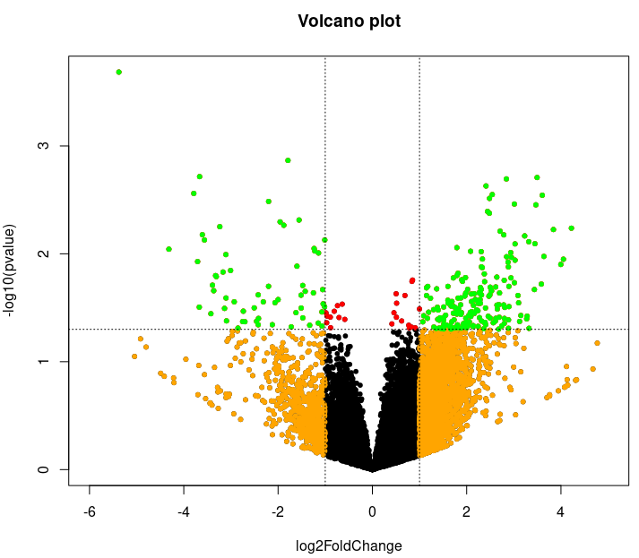
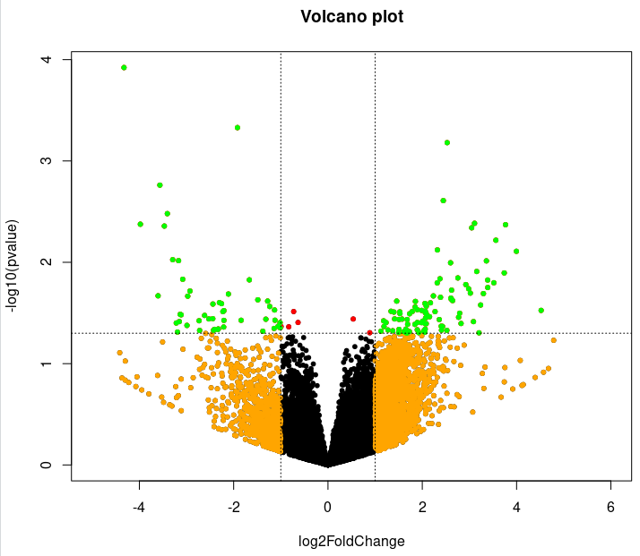
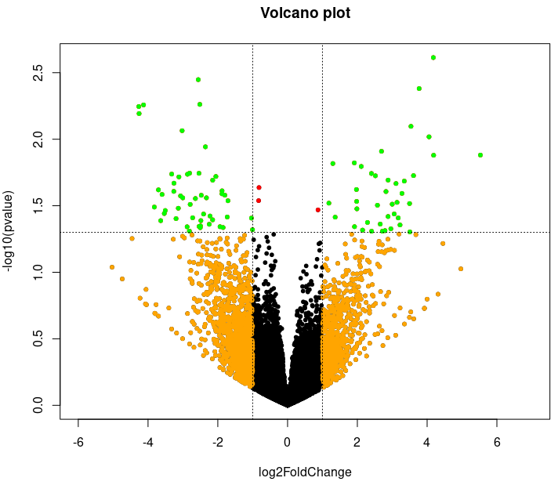
Differentially expressed genes (DEGs) of kshv
Delta11 vs mock (DEGs: 244) delta11 vs wt (139) mock vs wt (90)
Green color: P-value < 0.05, foldchange > 2 or < 0.5

