Slide 1
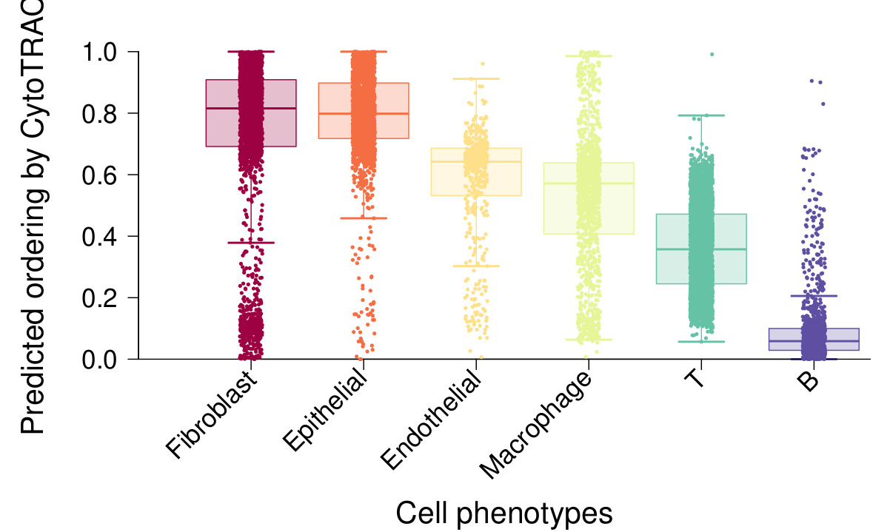
All_cells_cancer_vs_normal

Slide 2
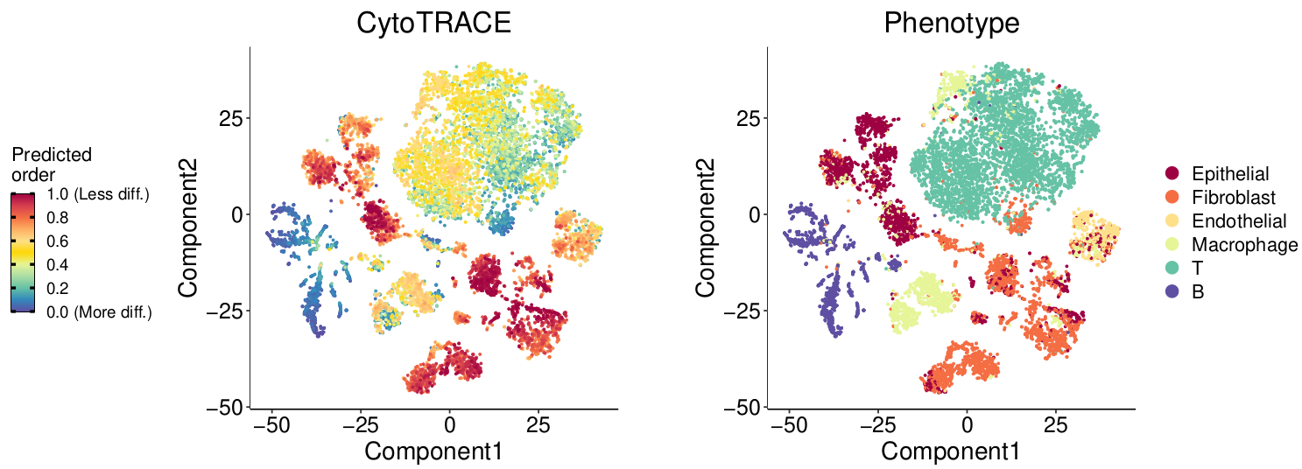
All_cells_cancer_vs_normal

Slide 3
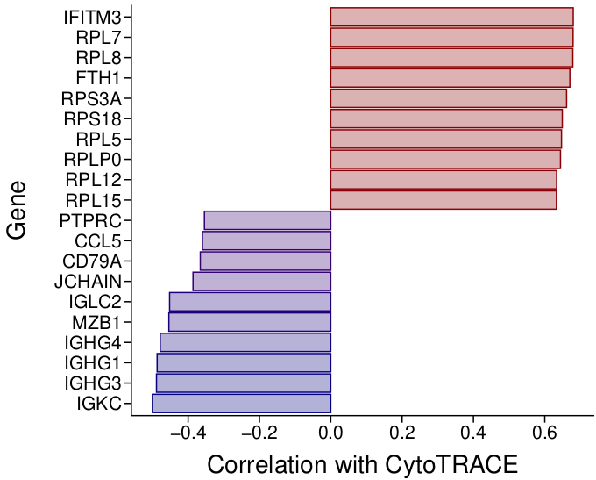
All_cells_cancer_vs_normal

Slide 4
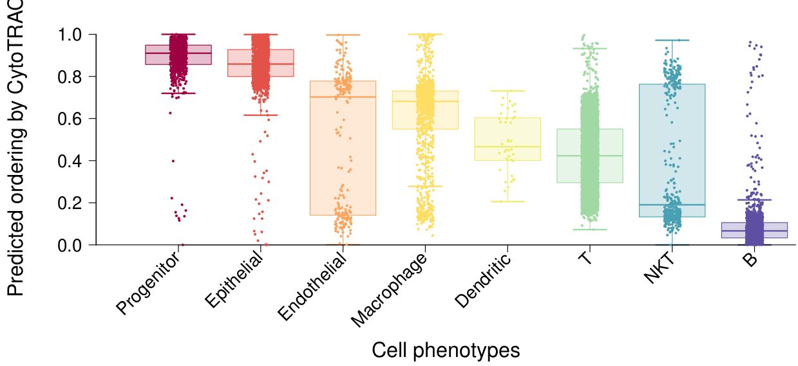
Only_T_cells_cancer_vs_normal

Slide 5
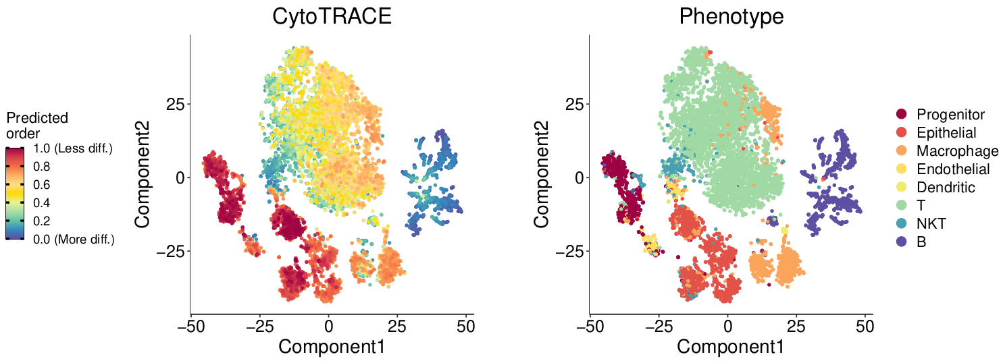
Only_T_cells_cancer_vs_normal

Slide 6
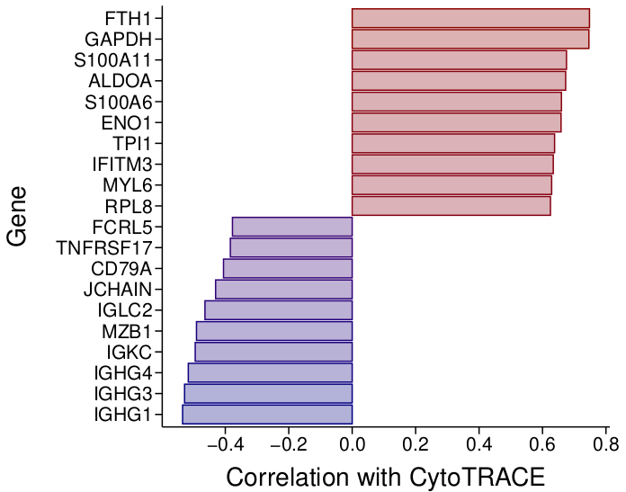
Only_T_cells_cancer_vs_normal

Slide 7
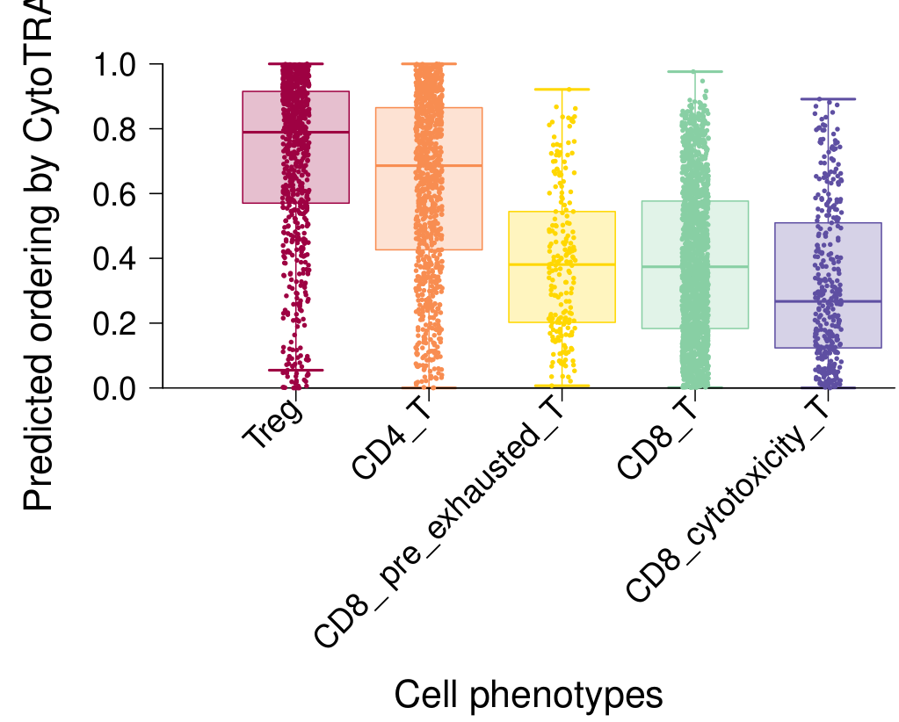
All_cells_late_vs_early

Slide 8
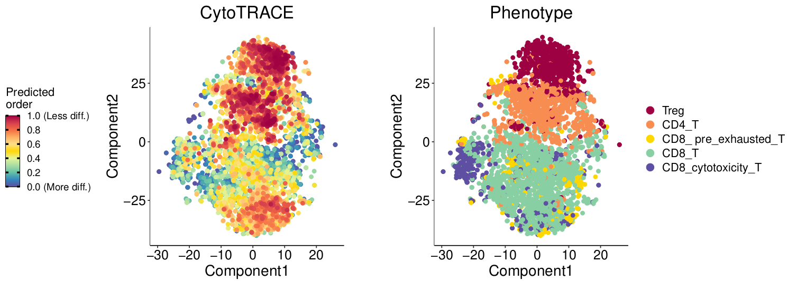
All_cells_late_vs_early

Slide 9
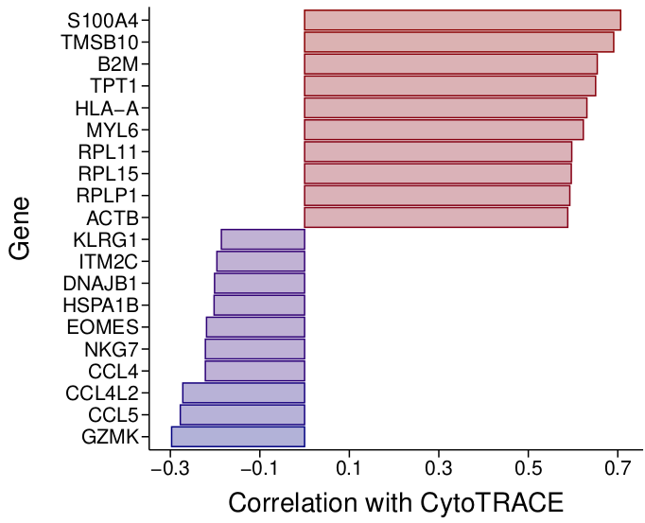
All_cells_late_vs_early

Slide 10
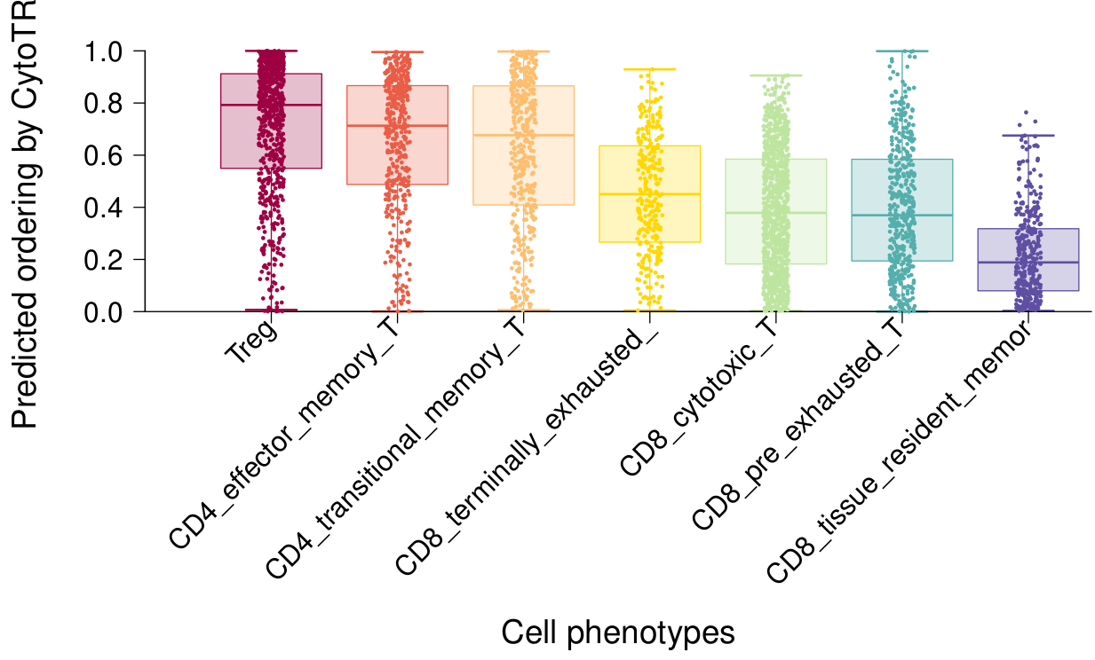
Only_T_cells_late_vs_early

Slide 11
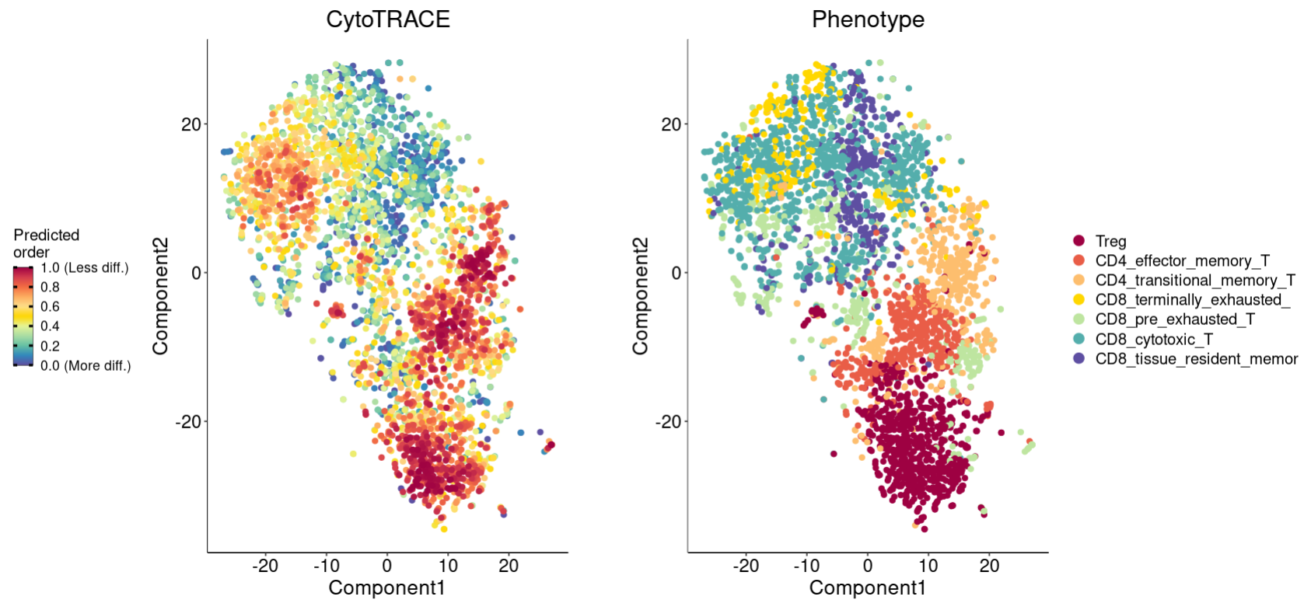
Only_T_cells_late_vs_early

Slide 12
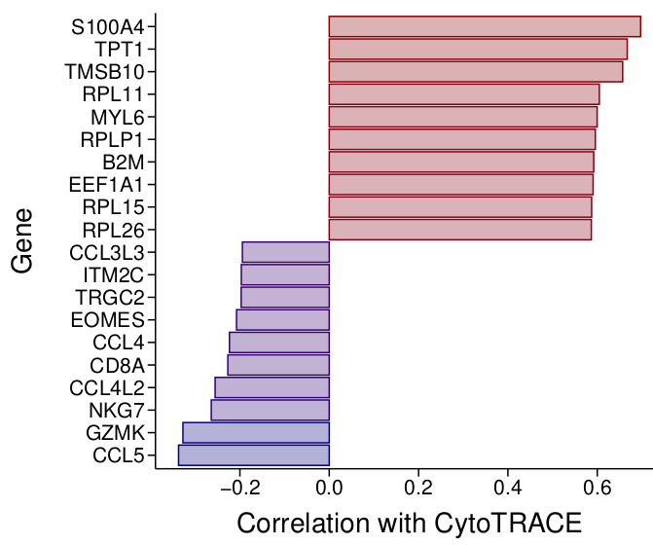
Only_T_cells_late_vs_early

