Slide 1
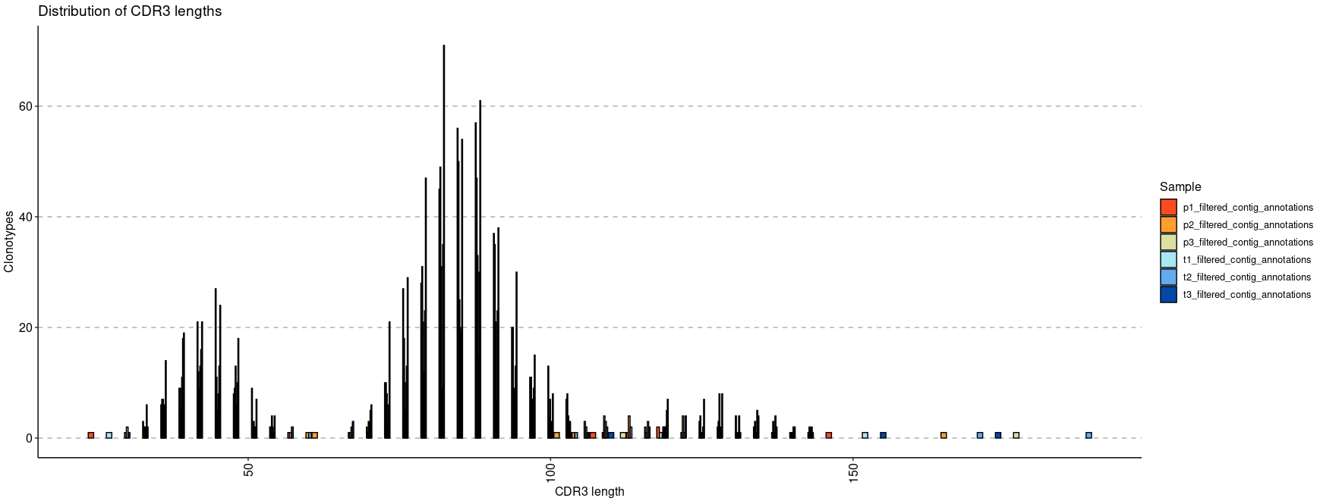
Length Distribution of CDR3(nt)
immunarch
repExplore(immdata$data, "lens") %>% vis()

Slide 2
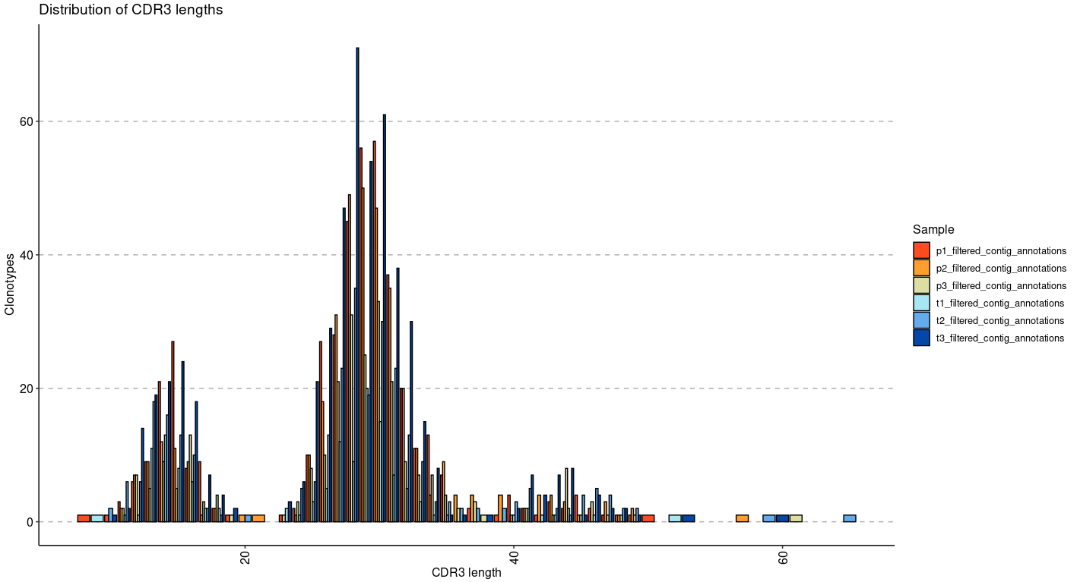
Length Distribution of CDR3(aa)
immunarch
exp_len <- repExplore(immdata$data, .method = "len", .col = "aa")
p1 <- vis(exp_len)
p1

Slide 3
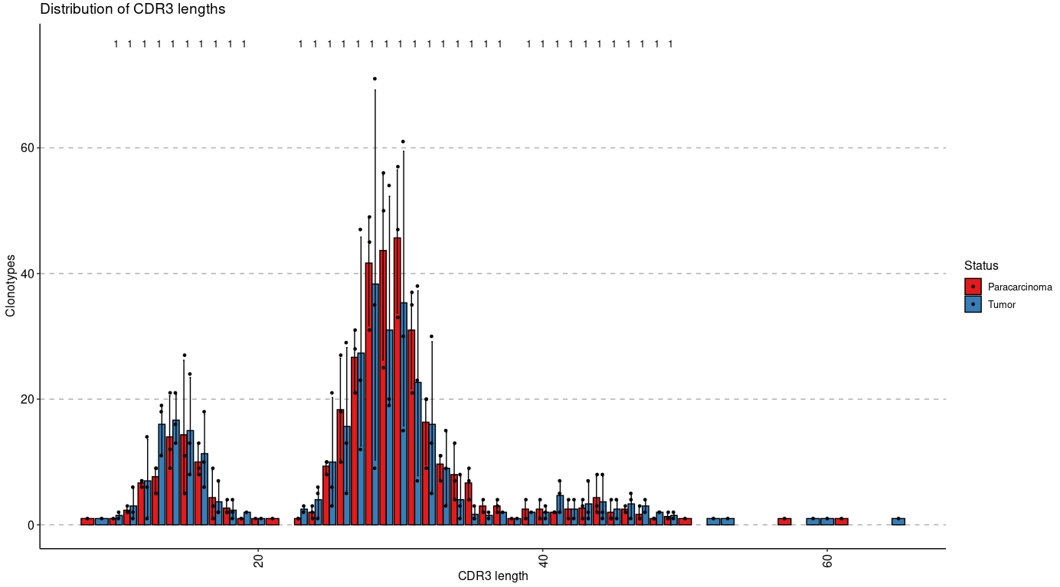
Distribution of CDR3 Length (nt)
immunarch
p4 <- vis(exp_len, .by = "Status", .meta = immdata$meta)
p4

Slide 4
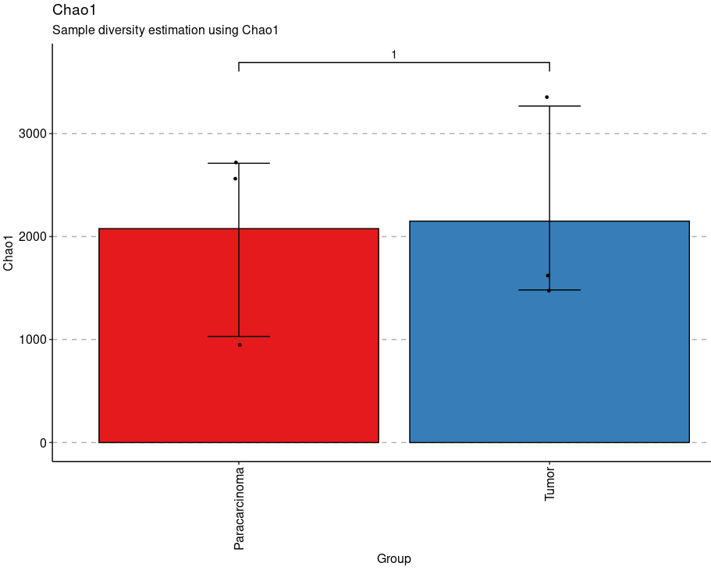
Sample Diversity Estimation using Chao1
immunarch
repDiversity(immdata$data) %>% vis(.by = "Status", .meta = immdata$meta)

Slide 5
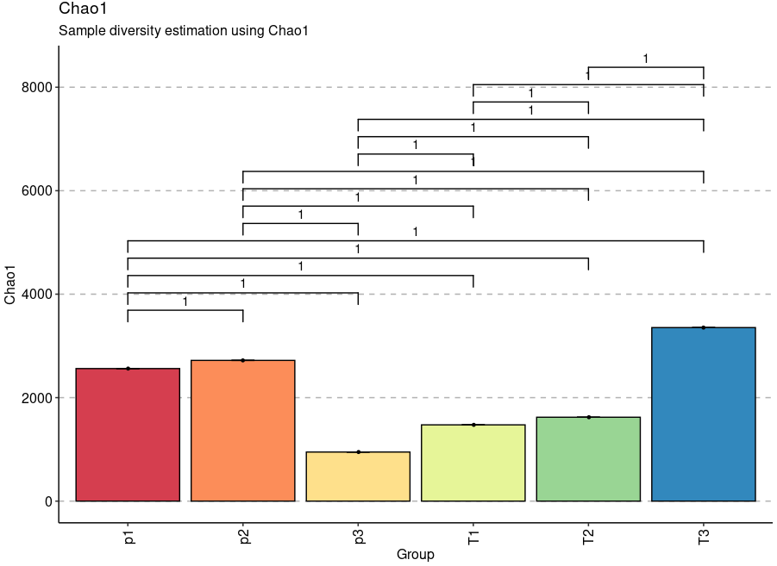
Chao1 Diversity of Repertoires
immunarch
repDiversity(immdata$data) %>% vis(.by = c("Status", "Patient"), .meta = immdata$meta)

Slide 6
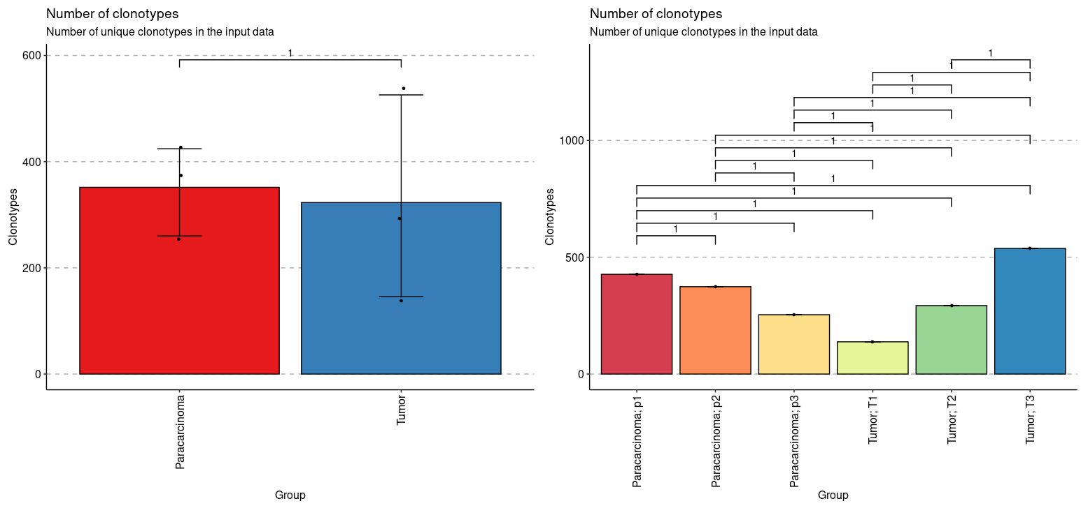
Number of Clonotypes
immunarch
exp_vol <- repExplore(immdata$data, .method = "volume")
p1 <- vis(exp_vol, .by = c("Status"), .meta = immdata$meta)
p2 <- vis(exp_vol, .by = c("Status", "Patient"), .meta = immdata$meta)
p1 + p2

Slide 7
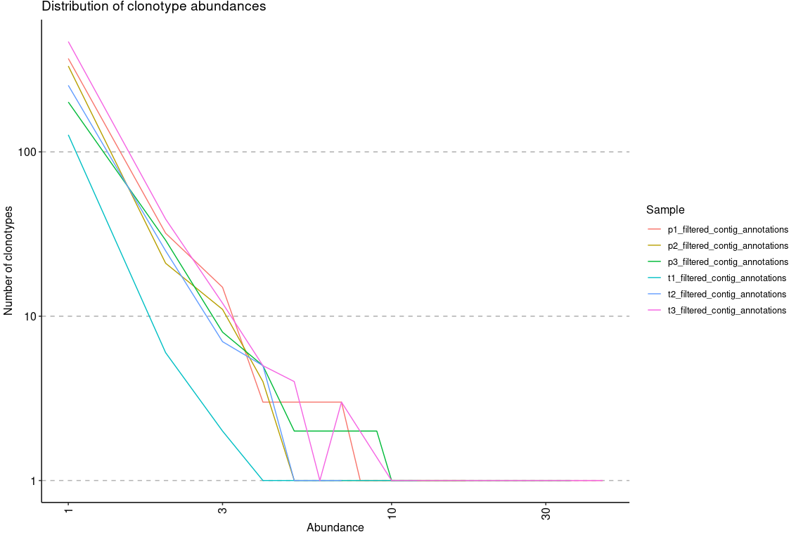
Distribution of Clonotype Abundances
immunarch
exp_cnt <- repExplore(immdata$data, .method = "count")
p2 <- vis(exp_cnt)
p2

Slide 8
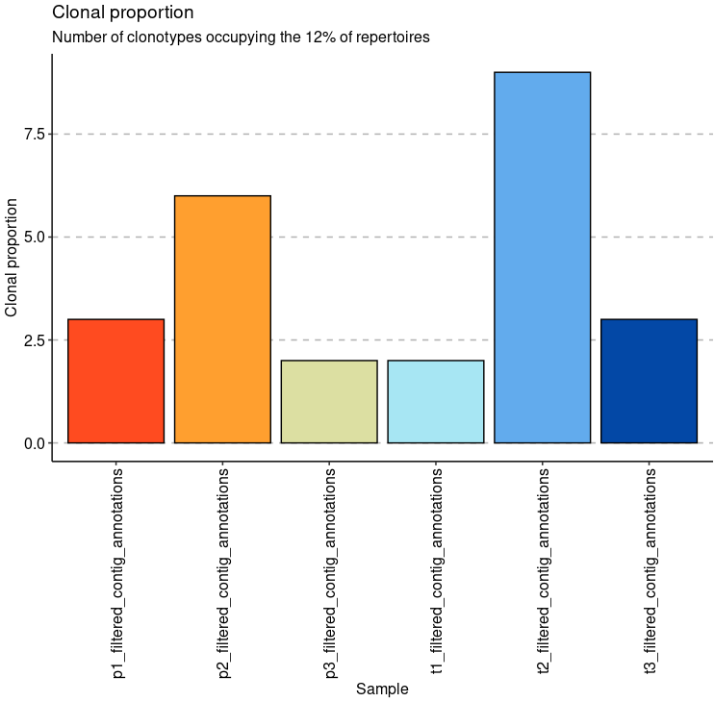
Clonal Proportion
immunarch
Set "clonal.prop" to compute clonal proportions or in other words percentage of clonotypes required to occupy specified by .perc percent of the total immune repertoire.
imm_pr <- repClonality(immdata$data, .method = "clonal.prop")
imm_pr
imm_pr %>% vis()

Slide 9
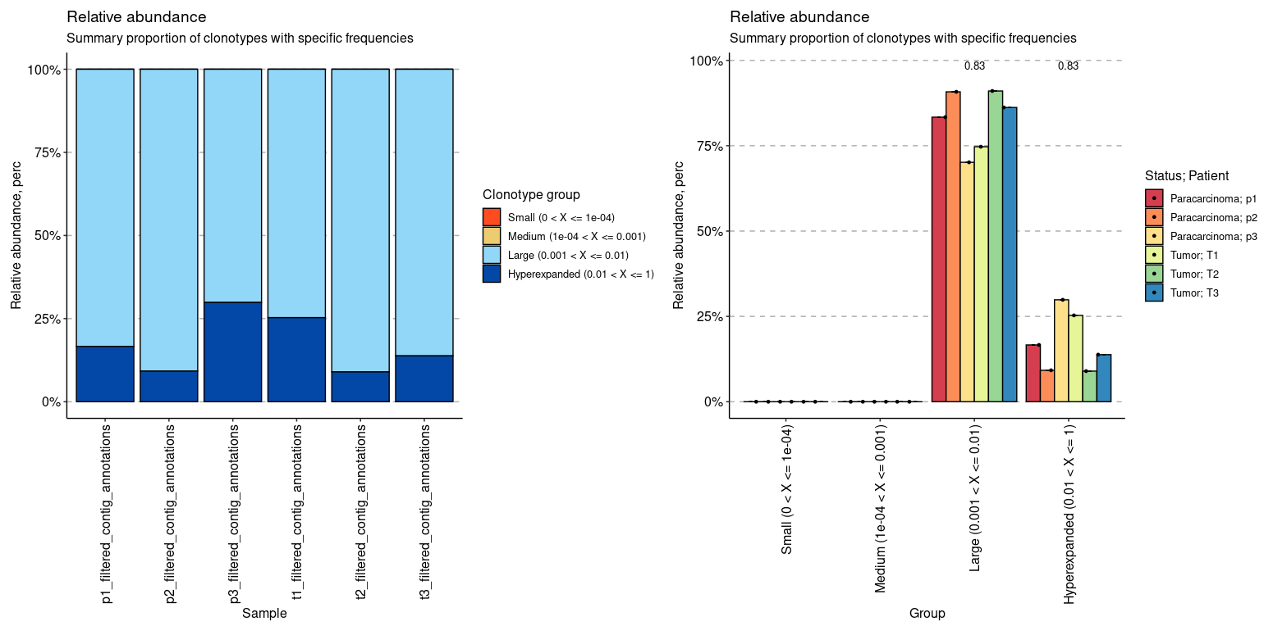
Relative Abundance of Clonotypes
immunarch
Set "homeo" to analyse relative abundance (also known as clonal space homeostasis), which is defined as the proportion of repertoire occupied by clonal groups with specific abundances.
imm_hom <- repClonality(immdata$data, .method = "homeo", .clone.types = c(Small = .0001, Medium = .001, Large = .01, Hyperexpanded = 1))
imm_hom
vis(imm_hom) + vis(imm_hom, .by = c("Status", "Patient"), .meta = immdata$meta)

Slide 10
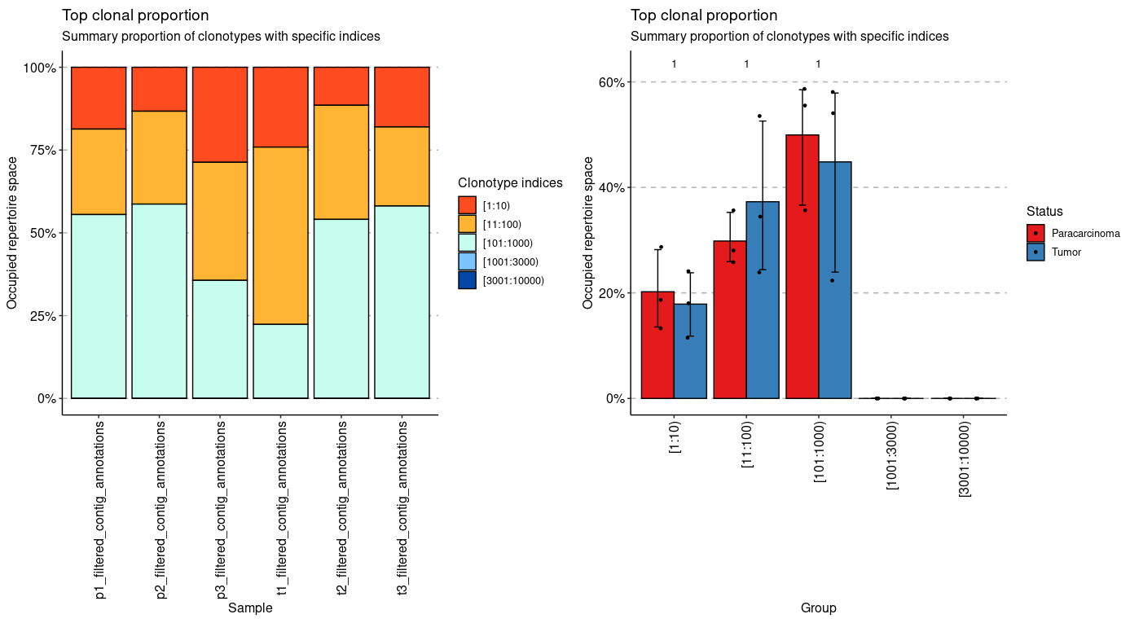
Top Clonal Proportion
immunarch
Set "top" to estimate relative abundance for the groups of top clonotypes in repertoire, e.g., ten most abundant clonotypes. Use ".head" to define index intervals, such as 10, 100 and so on.
imm_top <- repClonality(immdata$data, .method = "top", .head = c(10, 100, 1000, 3000, 10000))
imm_top
vis(imm_top) + vis(imm_top, .by = "Status", .meta = immdata$meta)

Slide 11
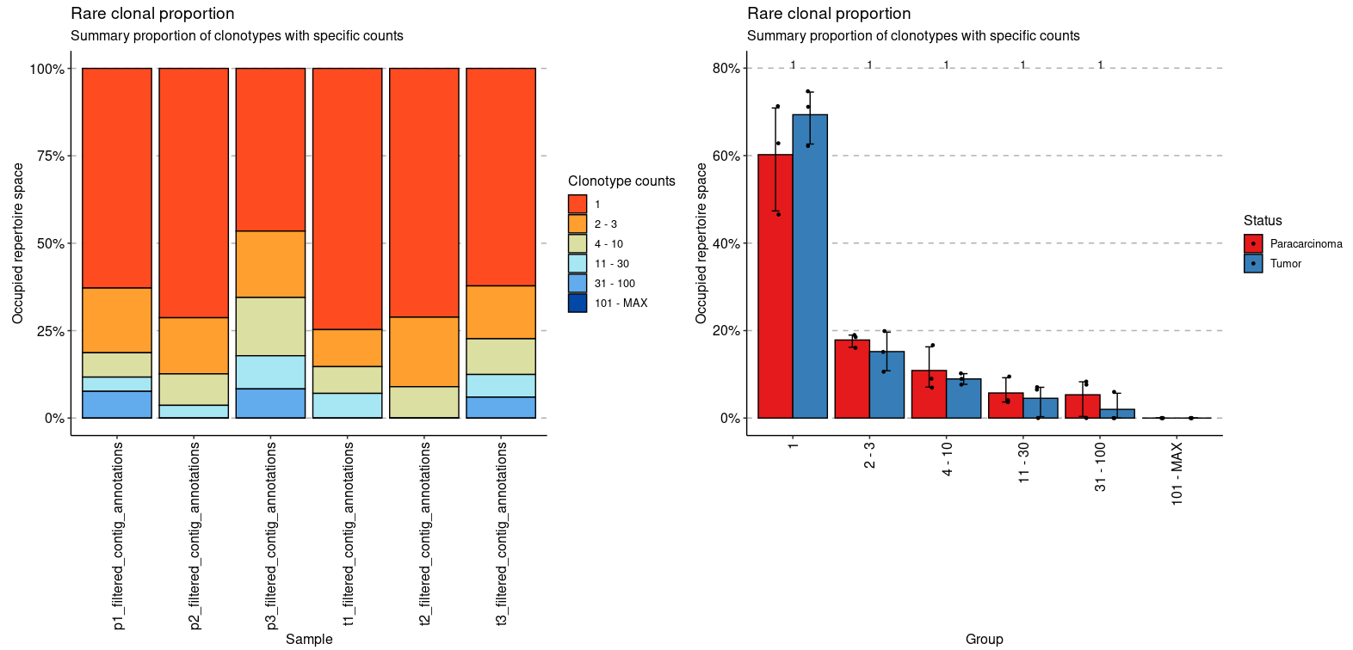
Rare Clonal Proportion
immunarch
imm_rare <- repClonality(immdata$data, .method = "rare")
imm_rare
vis(imm_rare) + vis(imm_rare, .by = "Status", .meta = immdata$meta)

Slide 12
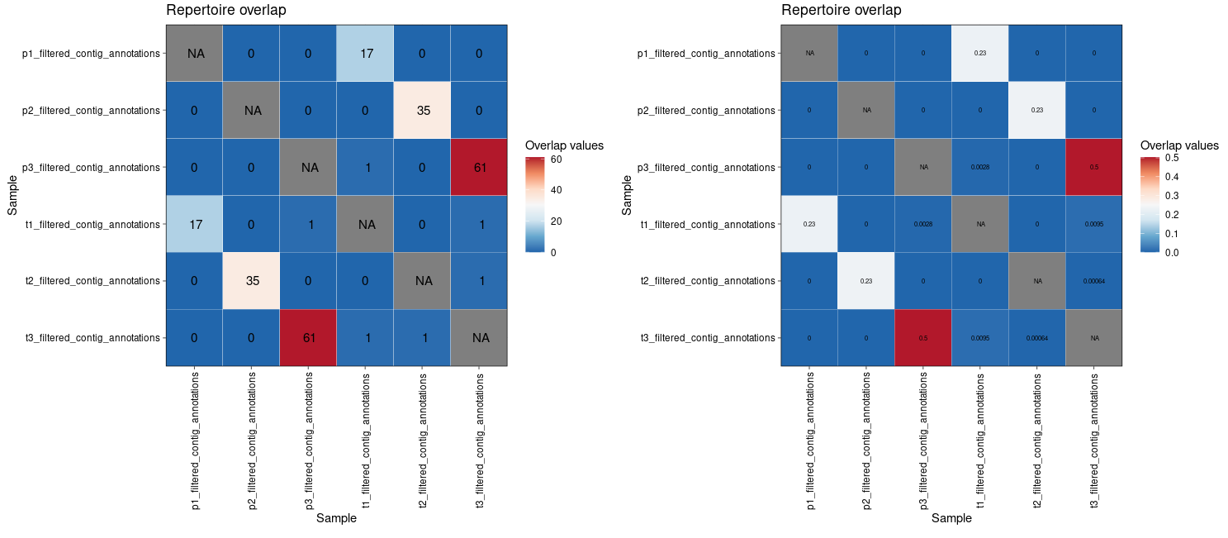
Heatmap of Clonotypes Shared Between Repertoires
immunarch
imm_ov1 <- repOverlap(immdata$data, .method = "public", .verbose = F)
imm_ov2 <- repOverlap(immdata$data, .method = "morisita", .verbose = F)
p1 <- vis(imm_ov1)
p2 <- vis(imm_ov2, .text.size = 2)
p1 + p2

Slide 13
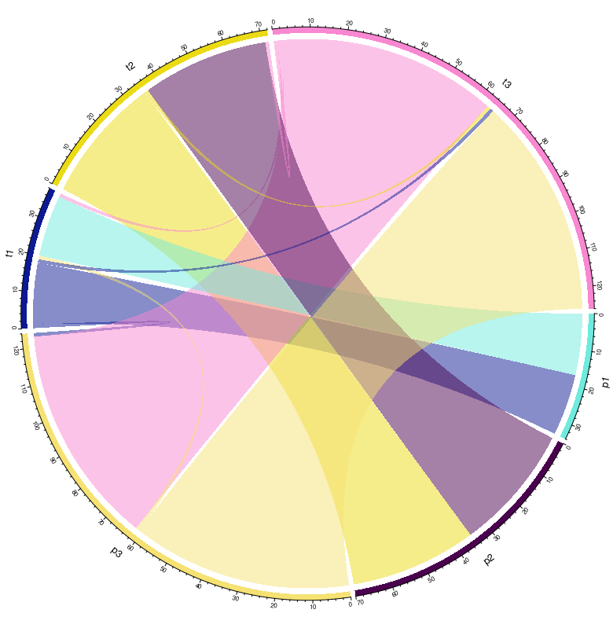
Clonotypes Shared Between Repertoires
vis(imm_ov1, "circos")

Slide 14
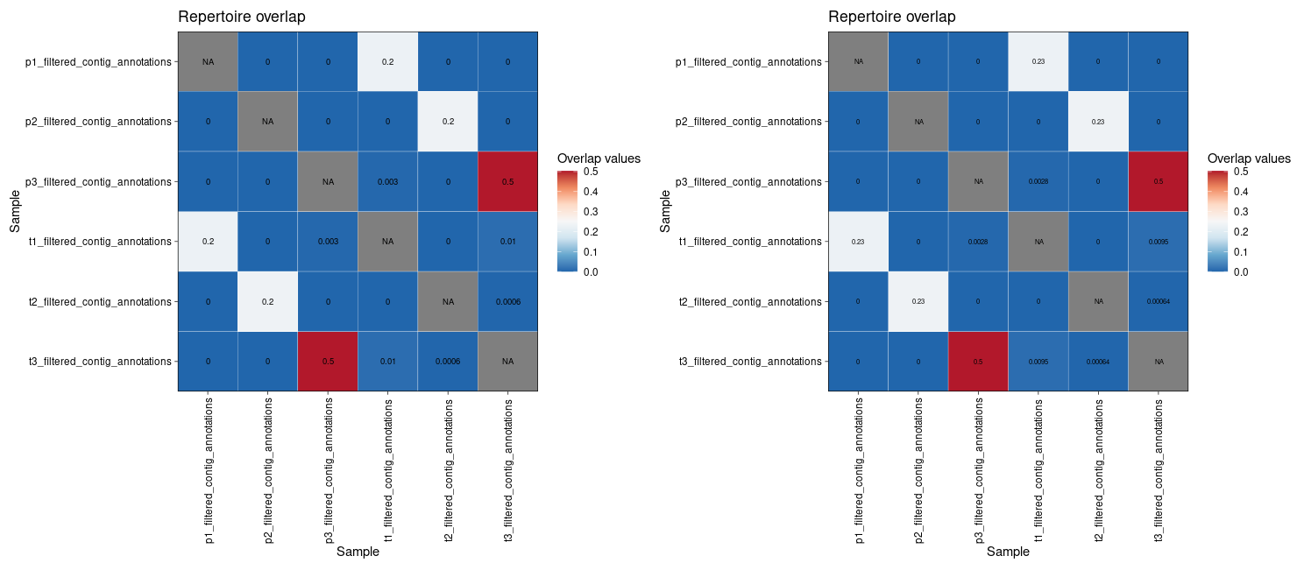
Heatmap of Clonotypes Shared Between Repertoires
immunarch
p1 <- vis(imm_ov2, .text.size = 2.5, .signif.digits = 1)
p2 <- vis(imm_ov2, .text.size = 2, .signif.digits = 2)
p1 + p2

Slide 15
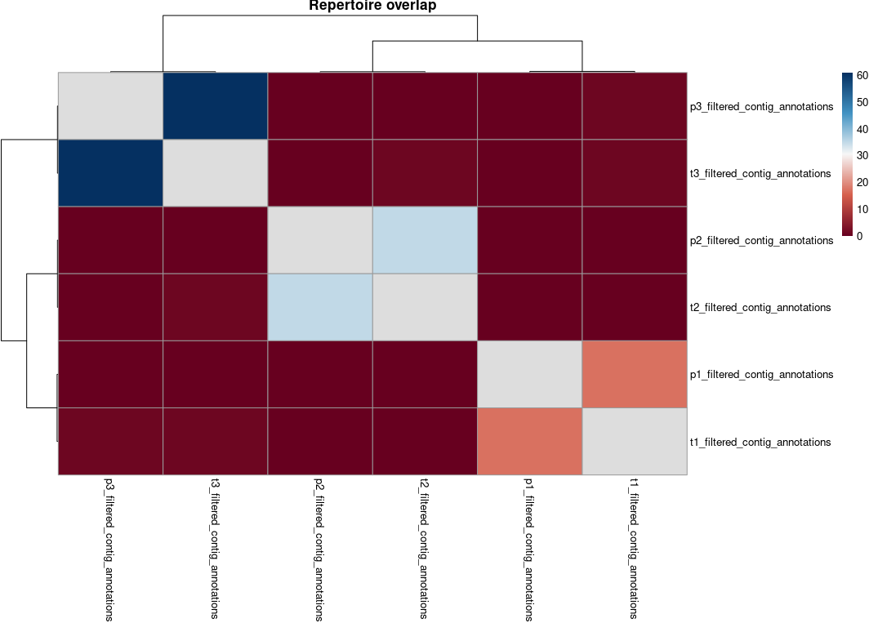
Heatmap of Clonotypes Shared Between Repertoires
immunarch
vis(imm_ov1, "heatmap2")

Slide 16
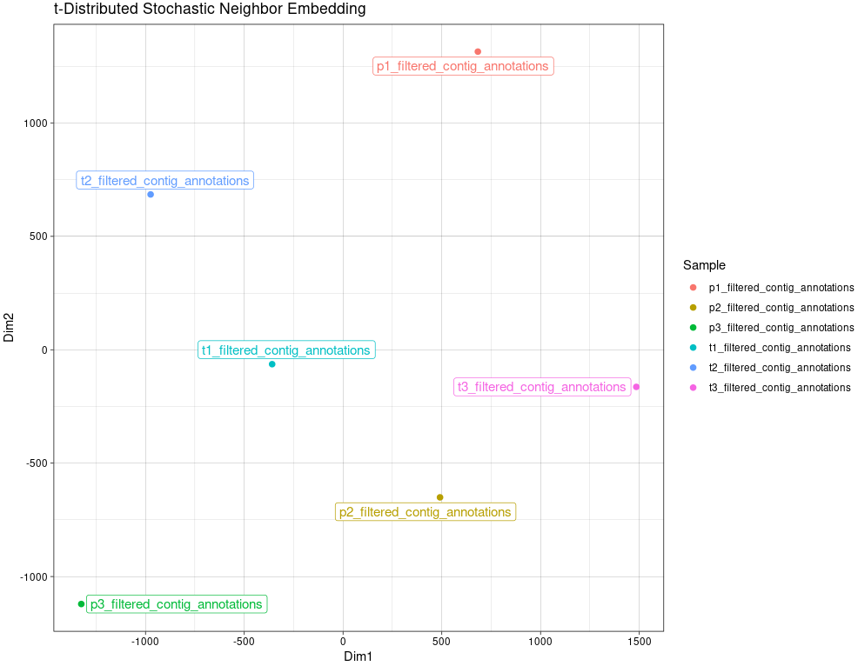
Multidimensional Scaling of TSNE
immunarch
repOverlapAnalysis(imm_ov1, "tsne") %>% vis()

Slide 17
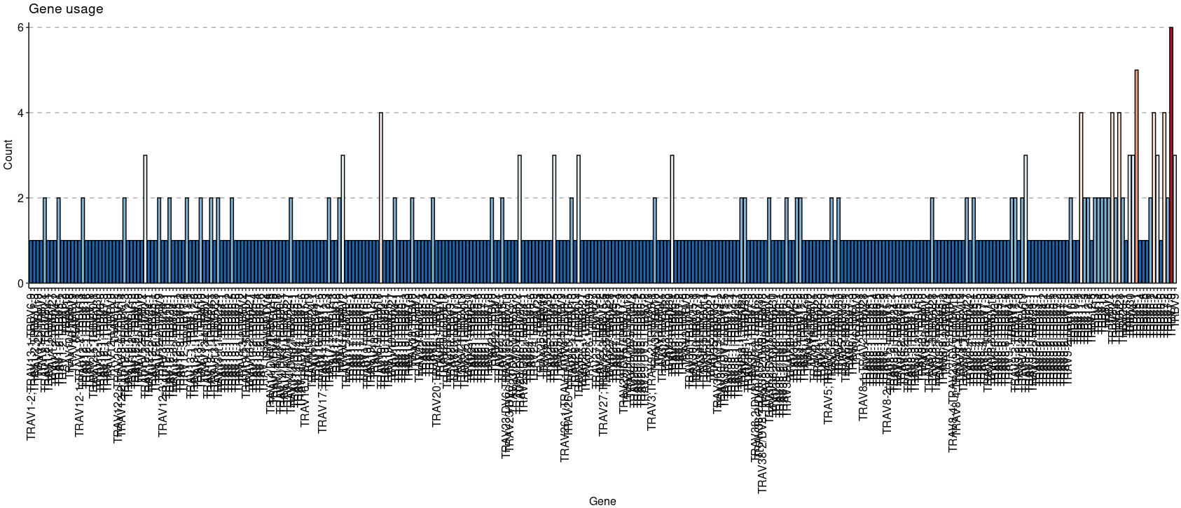
Visualize the V-gene Distribution for the First Repertoire
immunarch
geneUsage(immdata$data[[1]]) %>% vis()

Slide 18
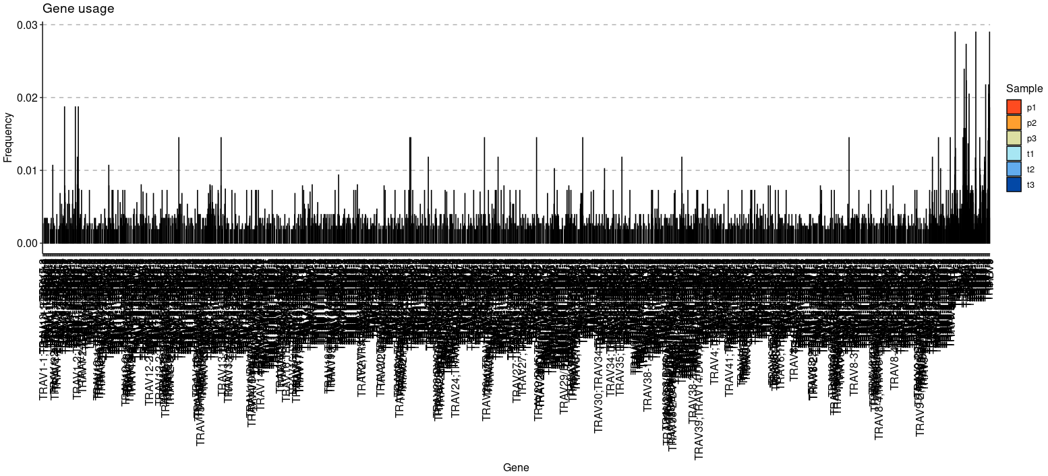
Visualize the V-gene Distribution for all Repertoires
immunarch
imm_gu <- geneUsage(immdata$data, "hs.trbv", .norm = T)
head(imm_gu)
vis(imm_gu, .title = "Gene usage", .text.size = 2)

Slide 19
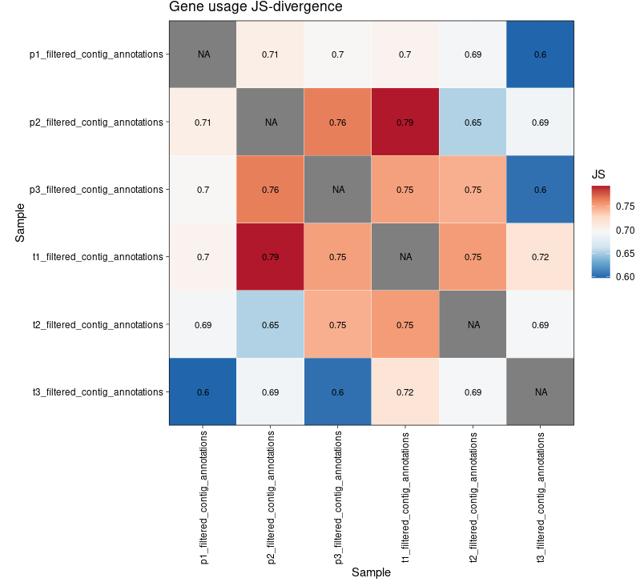
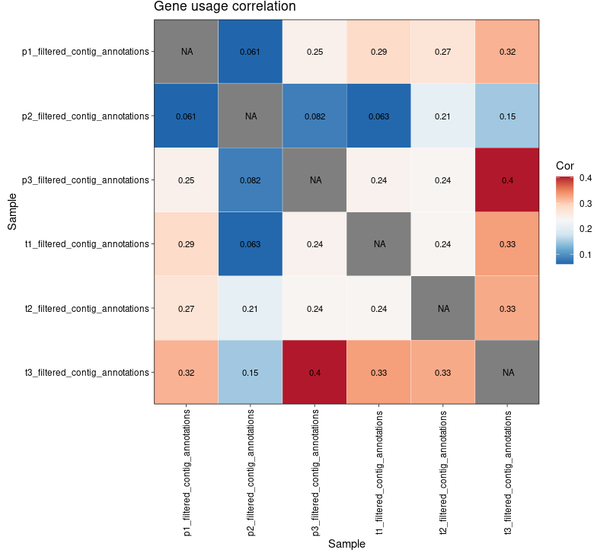
Gene Usage
immunarch
imm_gu <- geneUsage(immdata$data, "hs.trbv", .norm = T)
imm_gu_js <- geneUsageAnalysis(imm_gu, .method = "js", .verbose = F)
imm_gu_cor <- geneUsageAnalysis(imm_gu, .method = "cor", .verbose = F)
vis(imm_gu_js, .title = "Gene usage JS-divergence", .leg.title = "JS", .text.size = 3)
vis(imm_gu_cor, .title = "Gene usage correlation", .leg.title = "Cor", .text.size = 3)

Slide 20
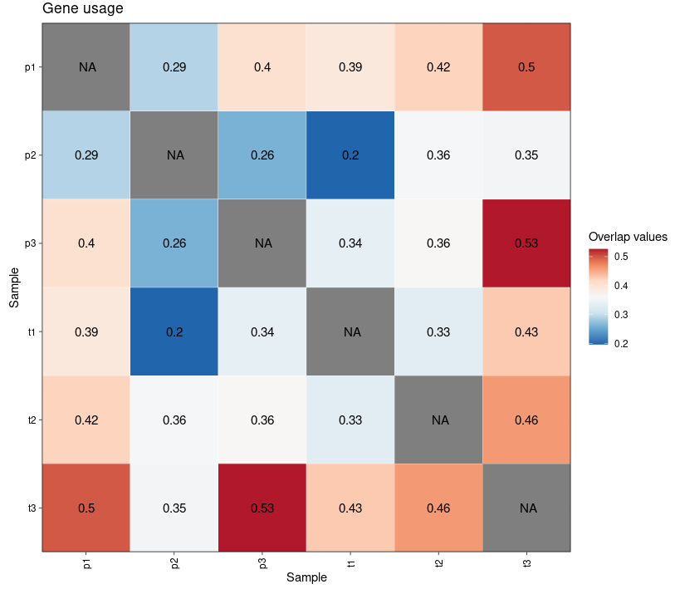
Gene Usage_cosine
immunarch
geneUsageAnalysis ( imm_gu , "cosine" , .verbose = F ))

Slide 21
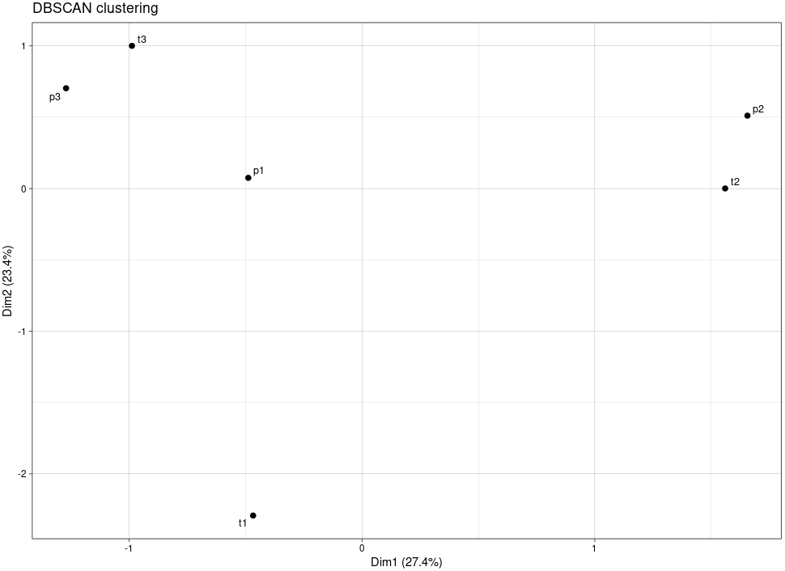
Clustering Samples
immunarch
vis(geneUsageAnalysis(imm_gu, "js+dbscan", .verbose = F))

Slide 22
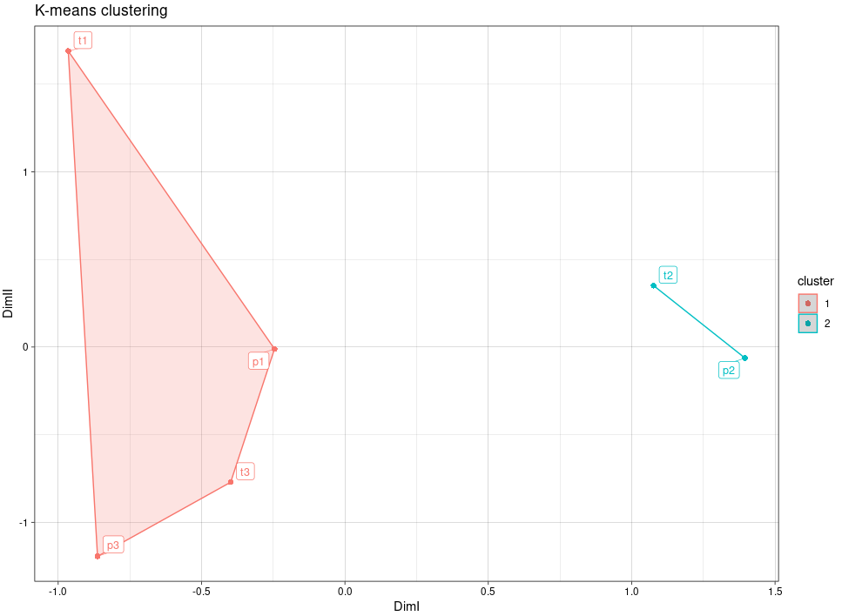
Clustering Samples
immunarch
imm_cl_pca <- geneUsageAnalysis(imm_gu, "js+pca+kmeans", .verbose = F)
p1 <- vis(imm_cl_pca, .plot = "clust")
p1

Slide 23
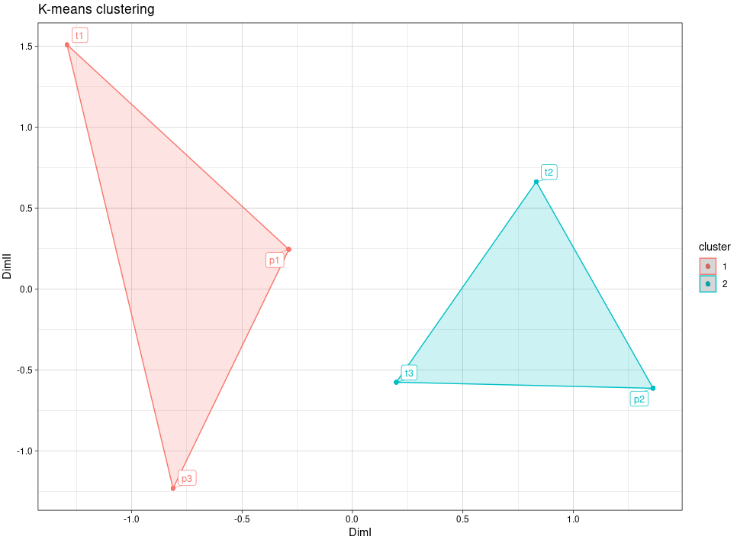
Clustering Samples
immunarch
imm_cl_mds <- geneUsageAnalysis(imm_gu, "js+mds+kmeans", .verbose = F)
p2 <- vis(imm_cl_mds, .plot = "clust")
p2

Slide 24
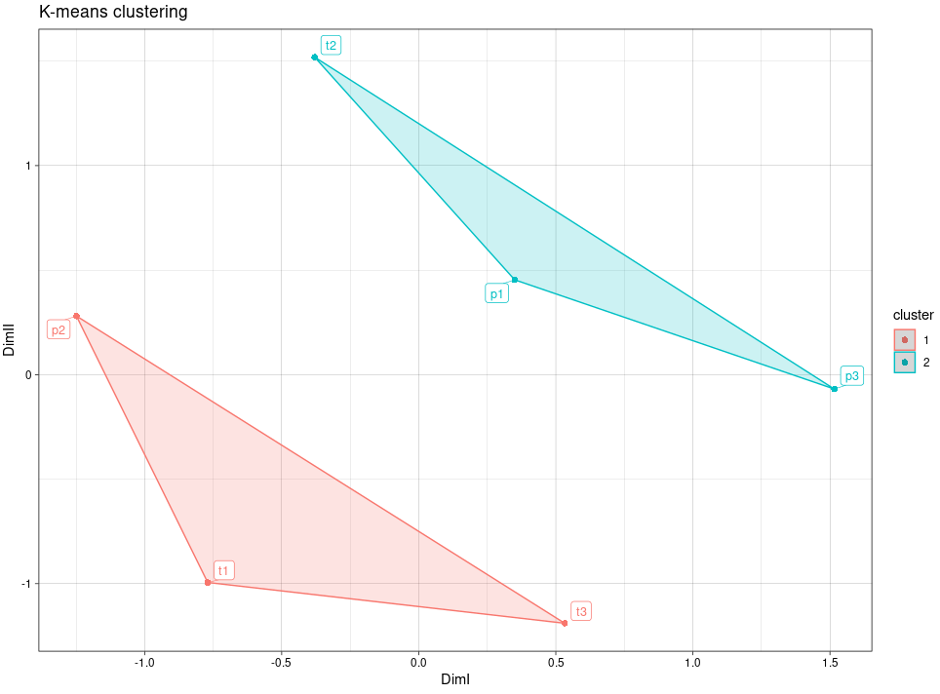
Clustering Samples
immunarch
imm_cl_tsne <- geneUsageAnalysis(imm_gu, "js+tsne+kmeans", .perp = .01, .verbose = F)
p3 <- vis(imm_cl_tsne, .plot = "clust")
p3

Slide 25
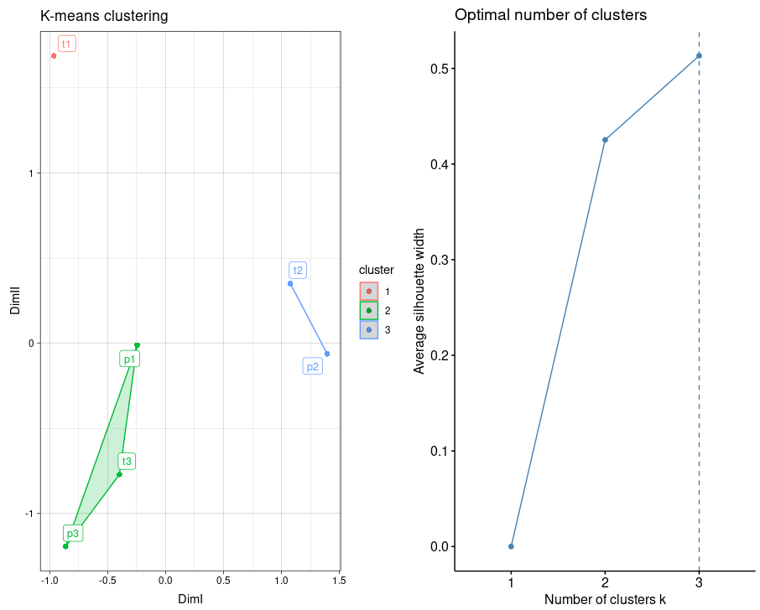
Clustering Samples
immunarch
imm_cl_pca2 <- geneUsageAnalysis(imm_gu, "js+pca+kmeans", .k = 3, .verbose = F)
vis(imm_cl_pca2)

Slide 26
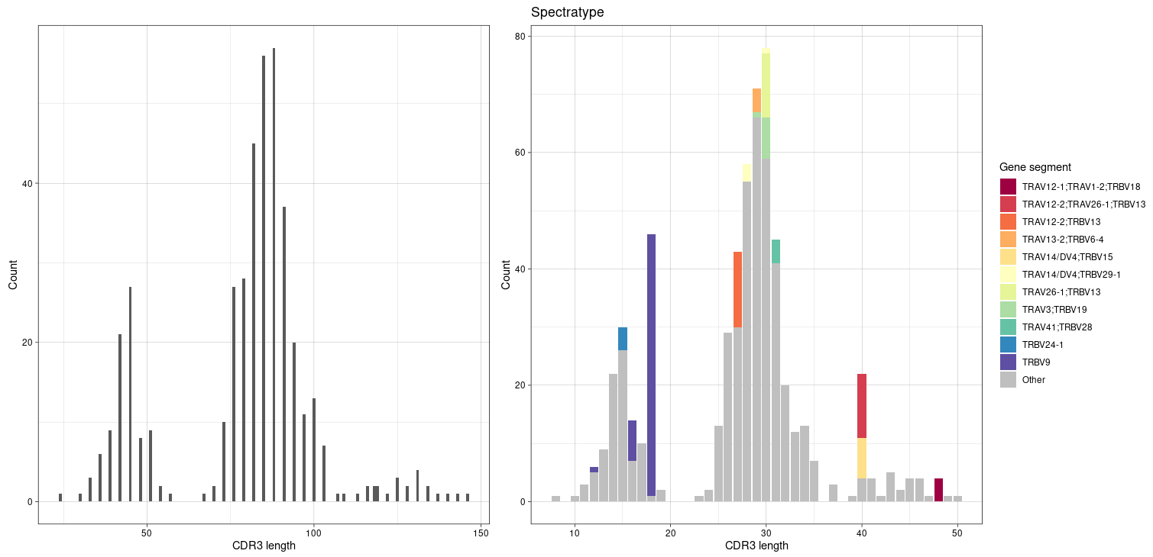
CDR3 Length
immunarch
p1 <- vis(spectratype(immdata$data[[1]], .quant = "id", .col = "nt"))
p2 <- vis(spectratype(immdata$data[[1]], .quant = "count", .col = "aa+v"))
p1+p2

Slide 27
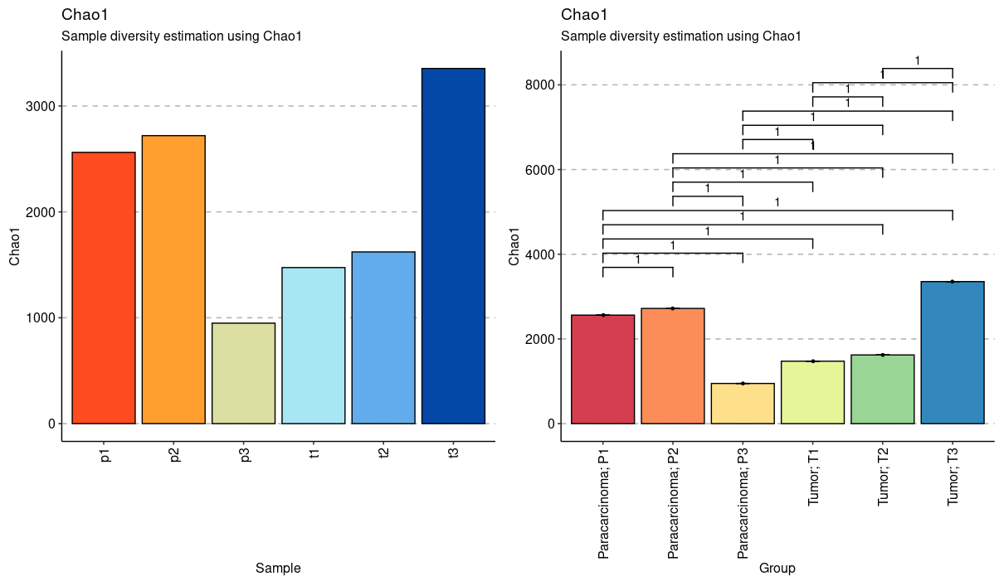
Chao1 Diversity of Repertoires
immunarch
div_chao <- repDiversity(immdata$data, "chao1")
head(div_chao)
p1 <- vis(div_chao)
p2 <- vis(div_chao, .by = c("Status", "Patient"), .meta = immdata$meta)
p1 + p2

Slide 28
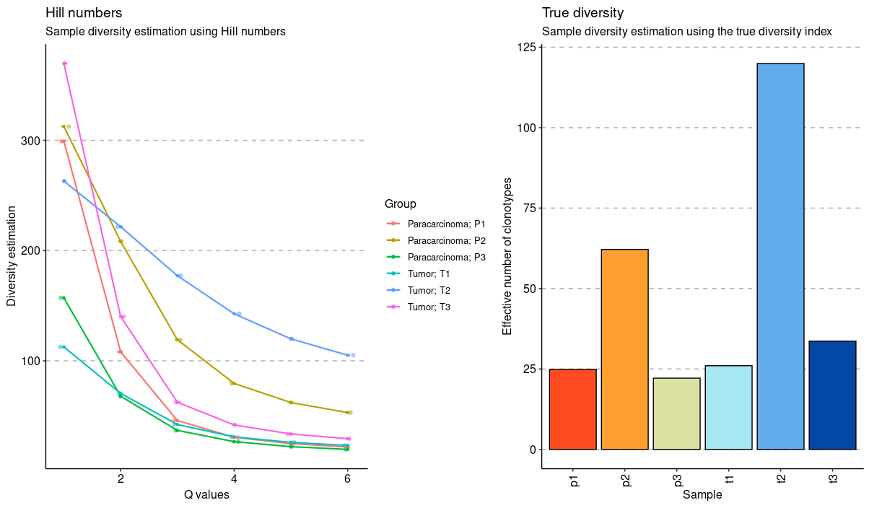
Hill and Div Diversity of Repertoires
immunarch
div_hill <- repDiversity(immdata$data, "hill")
div_div <- repDiversity(immdata$data, "div")
p3 <- vis(div_hill, .by = c("Status", "Patient"), .meta = immdata$meta)
p6 <- vis(div_div)
p3 + p6

Slide 29
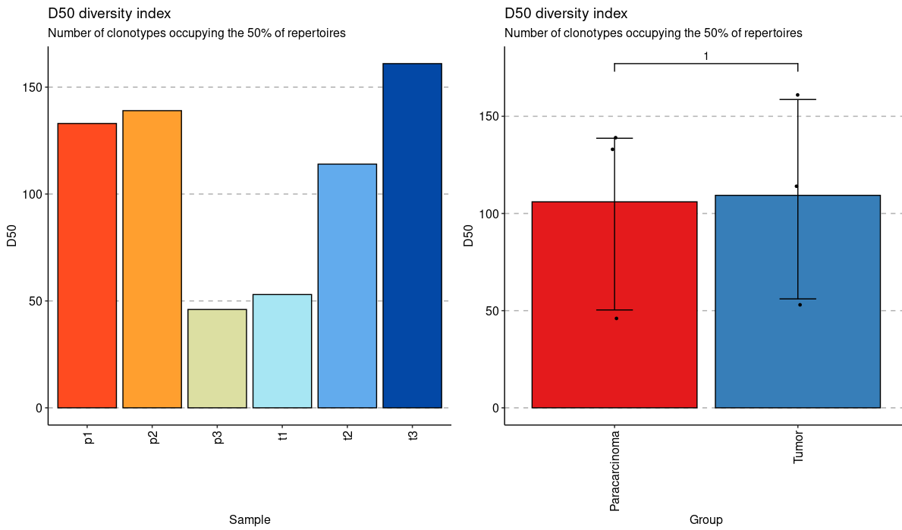
D50 Diversity of Repertoires
immunarch
div_d50 <- repDiversity(immdata$data, "d50")
p4 <- vis(div_d50)
p5 <- vis(div_d50, .by = "Status", .meta = immdata$meta)
p4 + p5

Slide 30
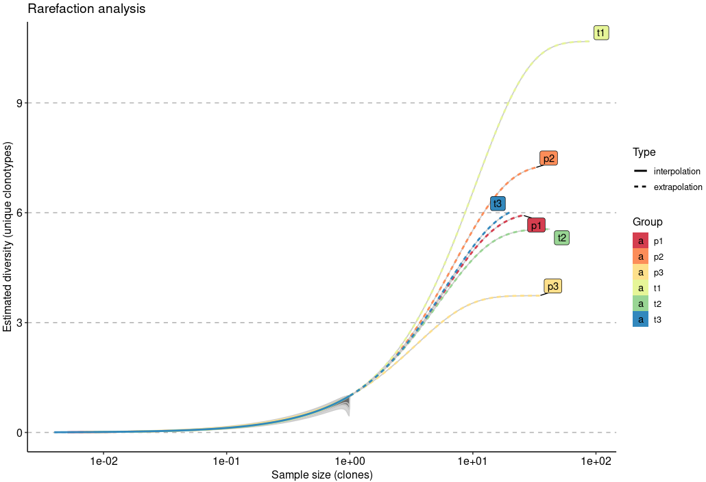
Unique Clonotypes Diversity
immunarch
repDiversity(immdata$data, "raref", .verbose = F) %>% vis(.log = TRUE)

Slide 31
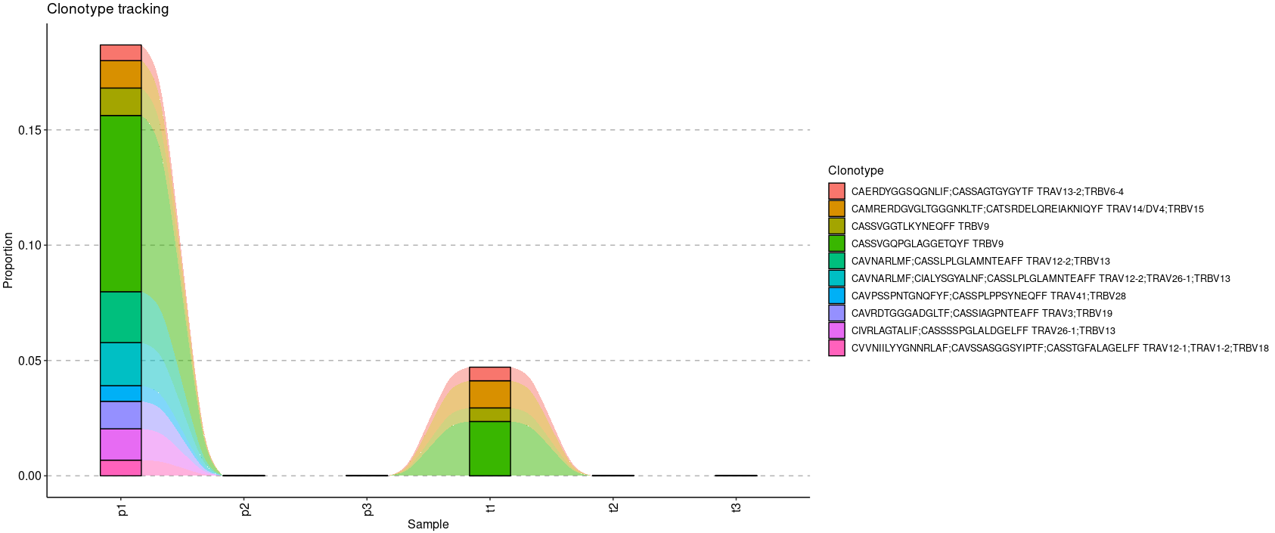
Clonotype Tracking
immunarch
tc1 <- trackClonotypes(immdata$data, list(1, 10), .col = "aa+v")
head(tc1)
p1 <- vis ( tc1 )
p1

Slide 32
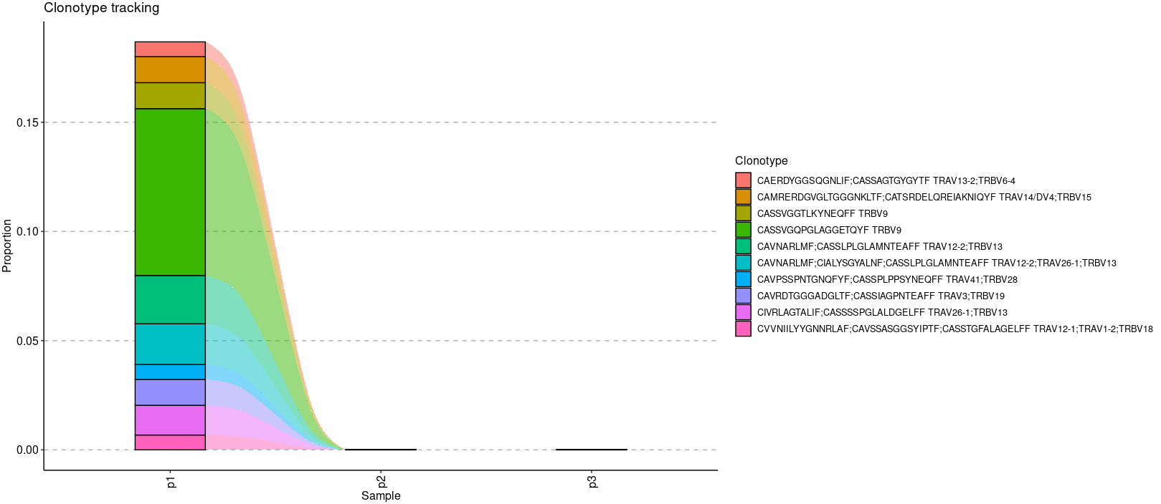
Clonotype Tracking of Paracarcinoma
immunarch
file_path="~/liuzhuqing/immunarch/paracarcinoma“
immdata<-repLoad(file_path)
tc2 <- trackClonotypes ( immdata$data , list (1,10), .col = "aa+v" )
head(tc2)
p2 <- vis ( tc2 )
p2

Slide 33
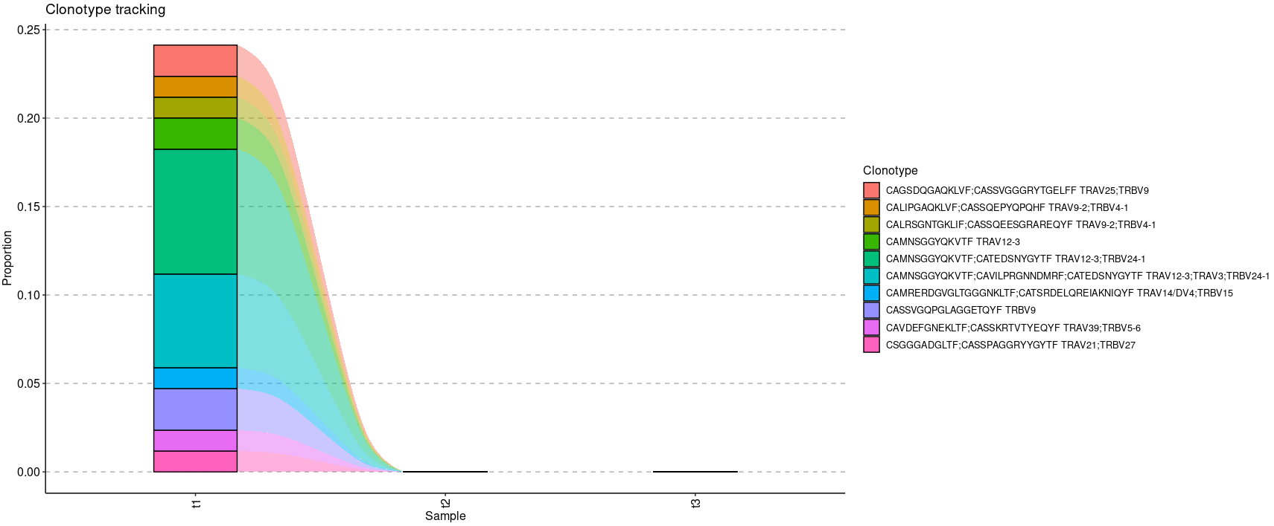
Clonotype Tracking of Tumor
immunarch
file_path="~/liuzhuqing/immunarch/tumor“
immdata<-repLoad(file_path)
tc2 <- trackClonotypes ( immdata$data , list (1,10), .col = "aa+v" )
head(tc2)
p2 <- vis ( tc2 )
p2

Slide 34
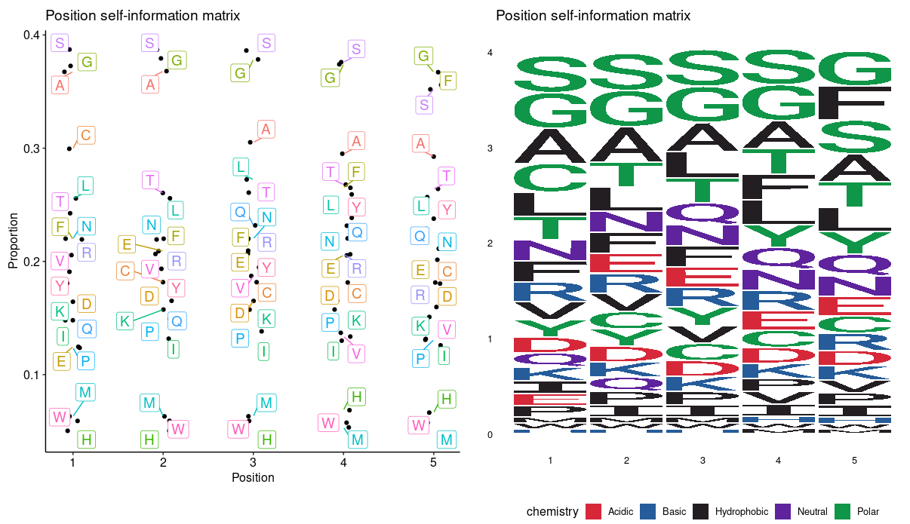
Kmers and Motif
immunarch
kmers <- getKmers ( immdata $ data [[ 1 ]], 5 )
kp <- kmer_profile ( kmers , "self" )
p1 <- vis ( kp )
p2 <- vis ( kp , .plot = "seq" )
p1 + p2

