Slide 1
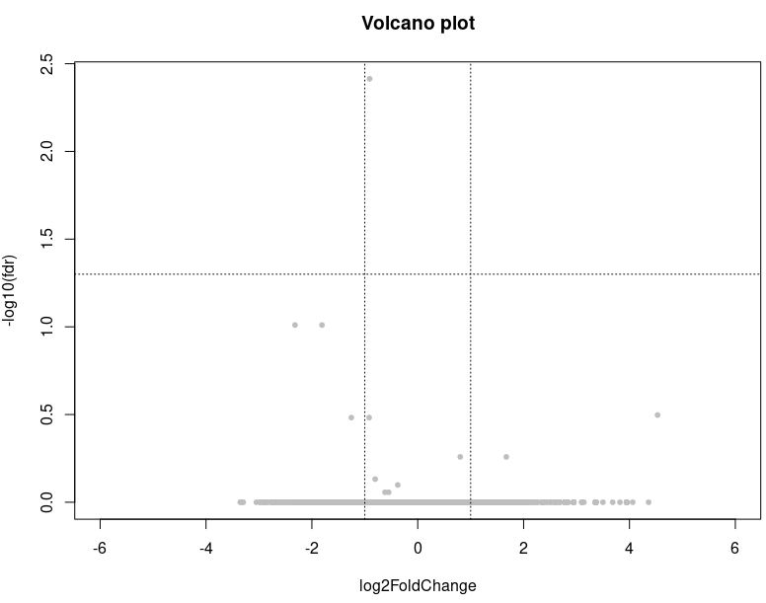
Differentially Expressed Genes of CD4

Slide 2
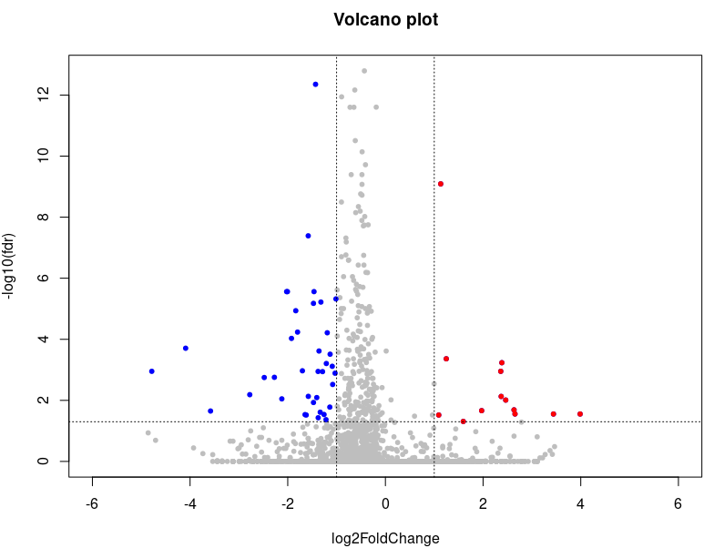
Differentially Expressed Genes of CD8
immune
 | log2FoldChange | fdr
CCL3 | -1.923226312 | 9.3361E-05
IFNG | -1.359538041 | 0.00024201
XCL1 | -1.190612221 | 6.1077E-05
metabolism
 | log2FoldChange | fdr
ACAA2 | -1.37832353 | 0.00112964
AKR1B1 | -1.25682079 | 0.02901128
APOE | 2.65362137 | 0.02787315
CHST12 | -1.07956479 | 0.0030139
DCN | -3.95766696 | 0
IFNG | -1.35953804 | 0.00024201
PTGDS | -1.46220261 | 2.7466E-06
UCP2 | -1.13217868 | 0.00030776

Slide 3
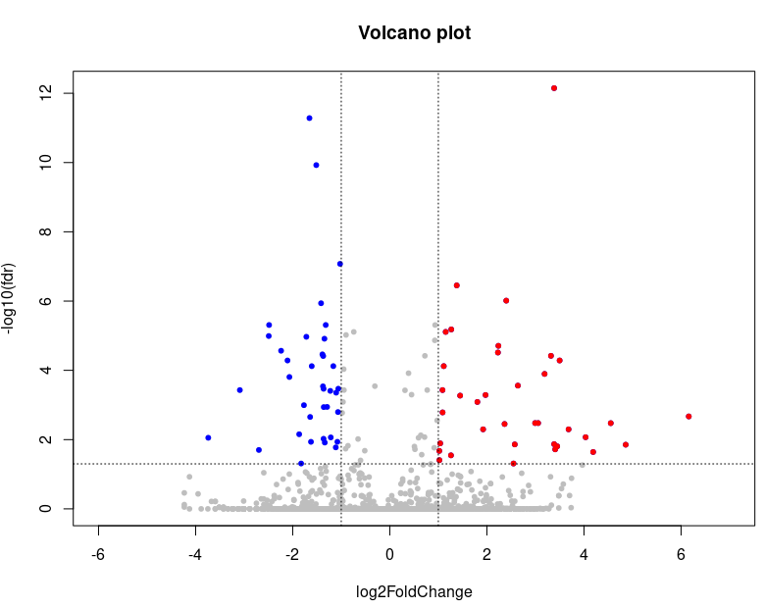
Differentially Expressed Genes of MAIT
immune
 | log2FoldChange | fdr
CCL5 | -1.291535514 | 0.00113799
CD69 | -1.3882892 | 3.4563E-05
CD7 | 1.111670225 | 7.5582E-05
CD82 | 1.972113042 | 0.00051529
ENTPD1 | 3.682760551 | 0.00504914
GZMB | 8.68797826 | 0
GZMK | -2.486305448 | 4.9059E-06
IFNGR1 | -1.338886455 | 0.01217305
IL2RA | 3.407126108 | 0.01912302
KLF2 | -2.239350782 | 2.7164E-05
LAG3 | 2.39902561 | 9.7168E-07
TNFRSF18 | 3.498508768 | 5.1874E-05
TNFRSF9 | 4.188945938 | 0.02280618
metabolism
 | log2FoldChange | fdr
DUSP2 | -1.3195191 | 4.9059E-06
FABP5 | 3.05536278 | 0.00332797
GAPDH | 1.37892183 | 3.5303E-07
IL4I1 | 3.18894594 | 0.00012683
LDHA | 1.08776346 | 0.00163945
PKM | 1.26672706 | 6.5817E-06
SLC2A3 | -1.37154351 | 3.8592E-05
TGFB1 | -1.06076709 | 0.00033968
TPI1 | 1.15166492 | 7.7595E-06

Slide 4
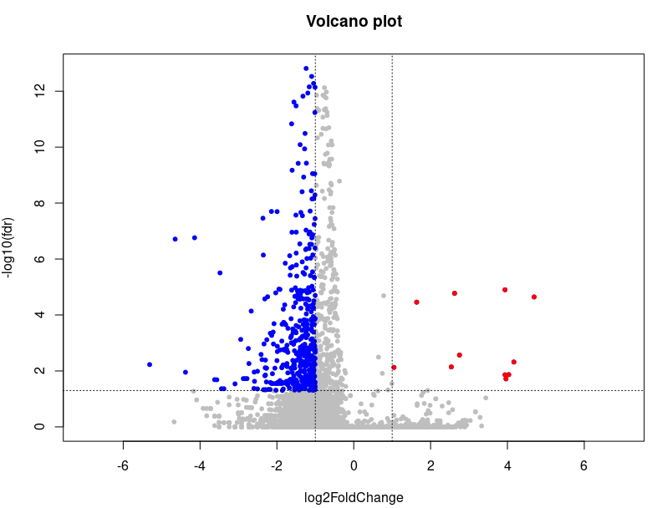
Differentially Expressed Genes of Naive
immune
 | log2FoldChange | fdr
BIRC3 | -1.394986379 | 8.1622E-11
CD8A | -1.250687918 | 0.00544979
CD8B | -1.499159927 | 0.02080468
HLA-DRB1 | -1.136183619 | 0.01404723
IFNGR1 | -1.400139633 | 0.00185217
SELL | -1.208391661 | 4.6807E-05
metabolism
ABCC1 | -1.56650974 | 0.00037053
AHR | -1.24207479 | 0.0256497
BCL2 | -1.47473554 | 0.02581936
COQ10A | -1.67503419 | 0.04086266
CPNE1 | -1.26679722 | 0.00268645
CTNNB1 | -1.00673438 | 0.04653229
CYP51A1 | -2.09848393 | 0.00040951
DCN | -4.14253911 | 1.7348E-07
DCXR | -1.07339295 | 0.00682295
EIF4E | -1.52586775 | 0.03593281
ESYT2 | -1.18484992 | 1.4831E-05
FASN | -2.27378365 | 0.00794674
GCLM | -1.98831819 | 0.00203348
GLS | -1.12918073 | 4.7847E-05
GLUD1 | -1.06180784 | 0.03672085
GLUL | -1.40322958 | 0.00320477
GNAI3 | -1.4197177 | 0.00077815
GNAS | -1.01220725 | 5.7936E-12
GNG2 | -1.12846393 | 3.9215E-06
HADHA | -1.23968819 | 0.00040951
HSD17B4 | -3.37957831 | 0.04341877
HSP90AB1 | -1.09417609 | 0
HSP90B1 | -1.06846944 | 1.3529E-07
IDI1 | -1.0487309 | 0.0203567
JUN | 1.04786319 | 0.00746838
MAP4K4 | -1.49168868 | 0.0024473
MAPKAPK2 | -1.42775031 | 0.00215296
MAT2A | -1.04320509 | 0.02266563
MTHFD2 | -1.15525017 | 0.00940248
NAMPT | -1.22440376 | 0.00653887
NUP153 | -2.09007169 | 0.00108914
NUP98 | -1.07214979 | 0.00746081
OGDH | -1.50510919 | 0.00082137
OSBPL8 | -1.11167815 | 0.00147548
PPM1K | -1.31869607 | 0.00149199
PRNP | -1.25155584 | 4.5894E-07
PTGES3 | -1.03846666 | 3.134E-05
RAB4A | -1.73830837 | 0.00544979
RAP1A | -1.04646314 | 0.00383477
RB1 | -1.3522577 | 0.02222317
RELA | -1.25894861 | 0.02885828
SLC16A3 | -1.52053923 | 0.00037527
SRSF3 | -1.2370038 | 2.6605E-05
TGFB1 | -1.21485878 | 0
TPI1 | -1.10301075 | 3.6462E-09
TRAF4 | -1.80333303 | 0.00019722
UGP2 | -1.28271677 | 0.00031565

Slide 5
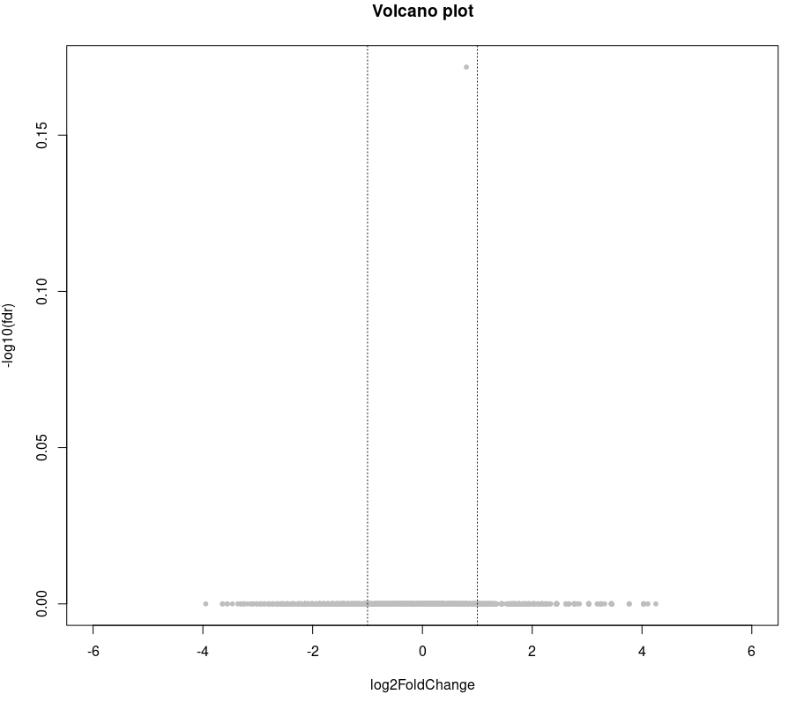
Differentially Expressed Genes of NKT

Slide 6
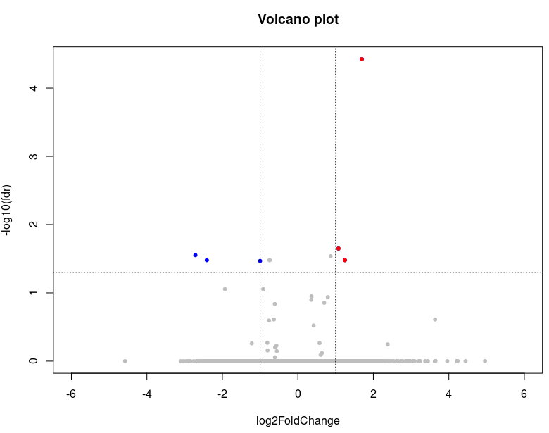
Differentially Expressed Genes of T helper
metabolism
 | log2FoldChange | fdr
YWHAH | -2.41244993 | 0.03317048

Slide 7
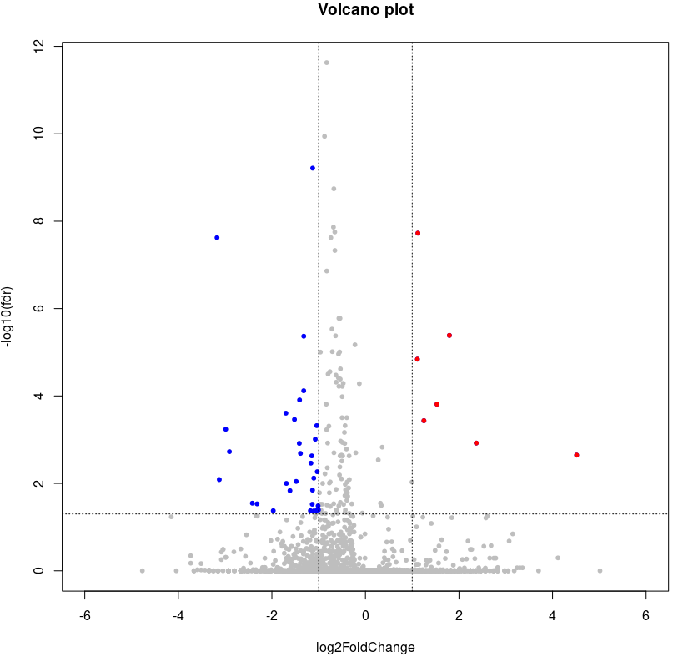
Differentially Expressed Genes of Treg
immune
 | log2FoldChange | fdr
CD7 | 1.121818744 | 1.8798E-08
TNFRSF18 | 1.111146515 | 1.4393E-05
TNFRSF4 | 1.795660725 | 4.1103E-06
metabolism
 | log2FoldChange | fdr
DCN | -2.9865889 | 0.0005782
HPGD | -1.40768815 | 0.00012344

