Slide 1
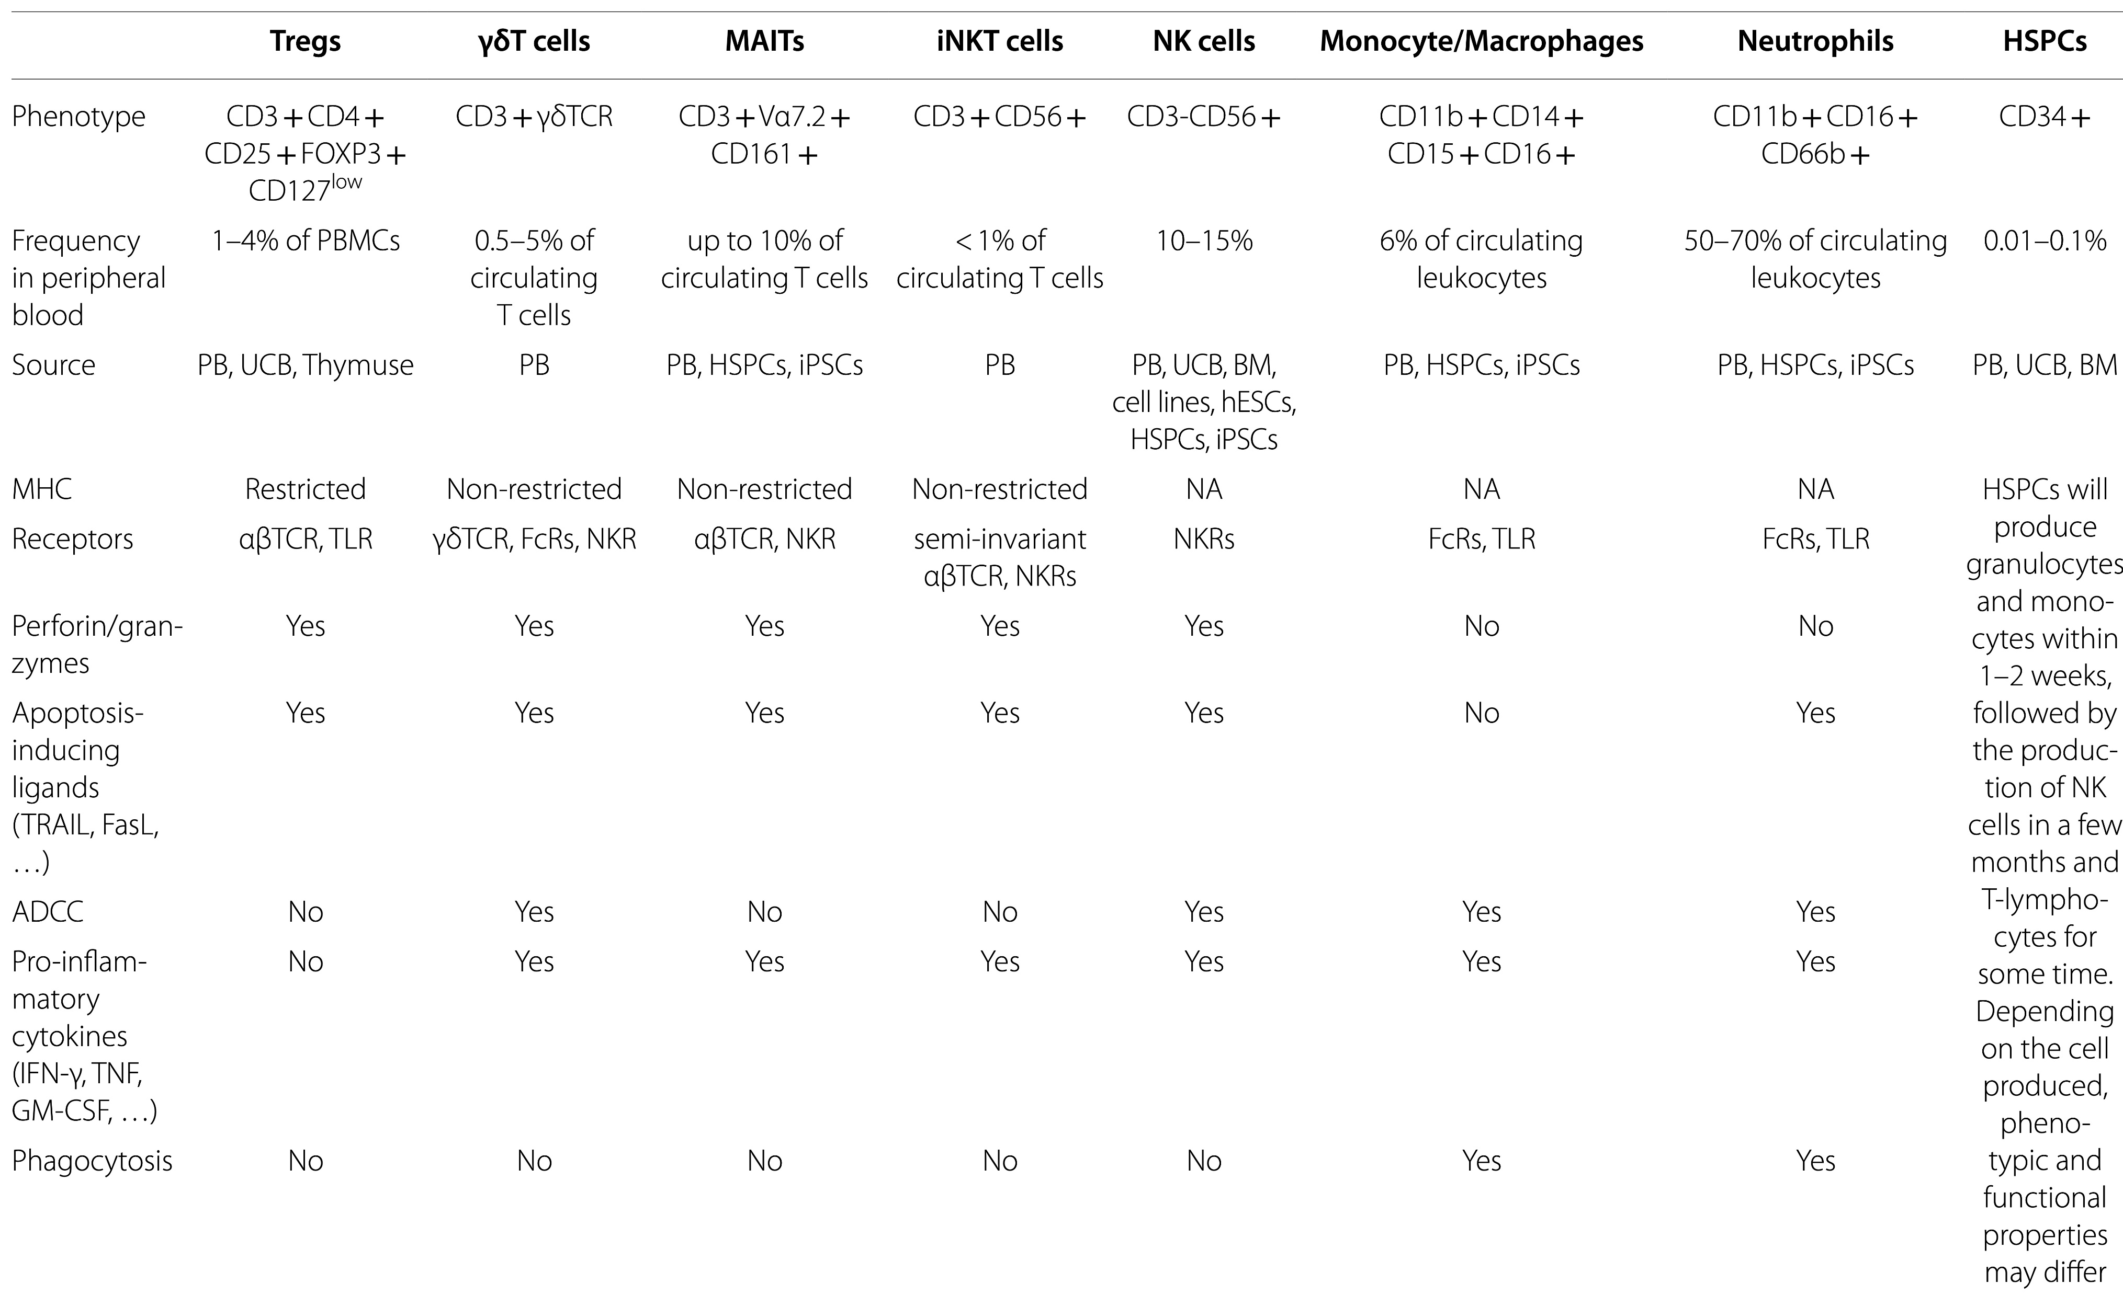
替代免疫细胞
Table 1 Properties of cell sources mentioned in this study
Mazinani, M., Rahbarizadeh, F. New cell sources for CAR-based immunotherapy. Biomark Res 11, 49 (2023). https://doi.org/10.1186/s40364-023-00482-9

Slide 2
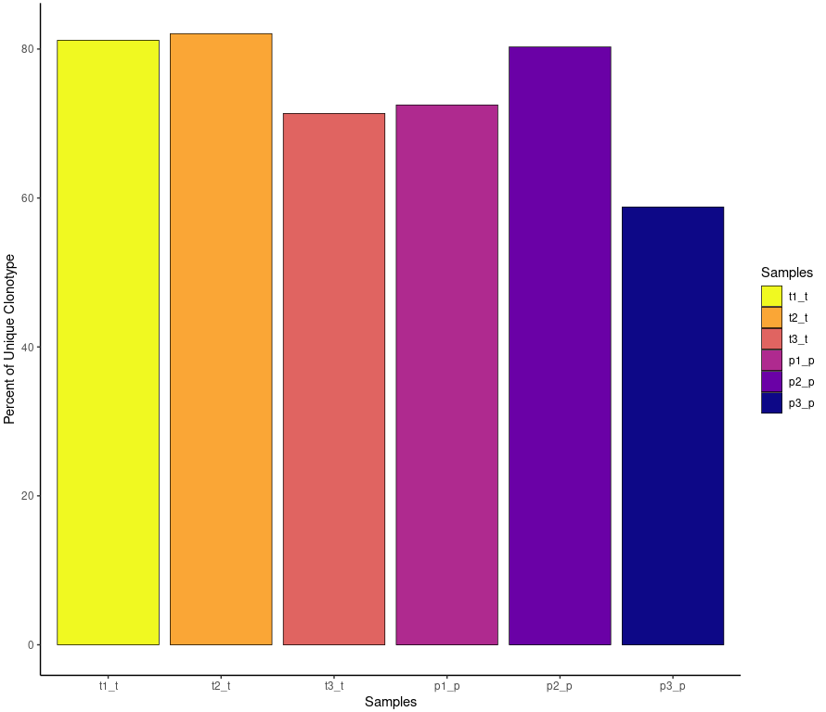
Quantify Clonotypes
scRepertoire
https://ncborcherding.github.io/vignettes/vignette.html
P: para tumor
T: tumor
“gene” - use the VDJC genes comprising the TCR/Ig
“nt” - use the nucleotide sequence of the CDR3 region
quantContig(combined, cloneCall="gene+nt", scale = T)
TRA”, “TRB”, “TRD”, “TRG”, “IGH” or “IGL” to select single chain

Slide 3
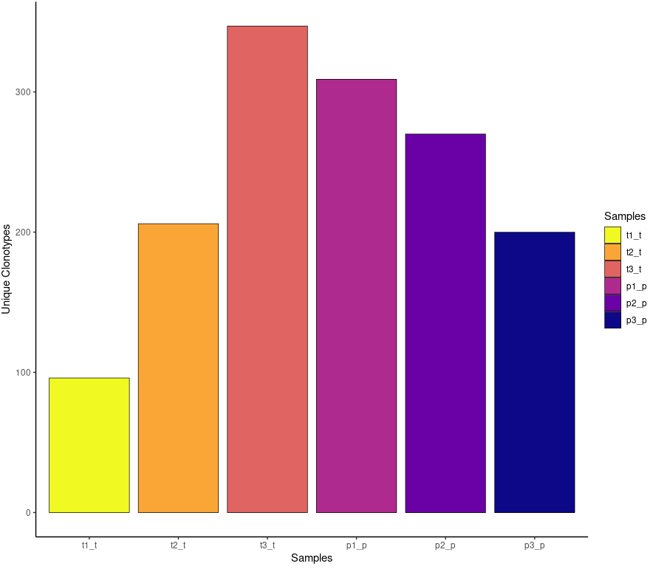
scRepertoire
P: para tumor
T: tumor
quantContig(combined, cloneCall="gene+nt", chain = "TRA")

Slide 4
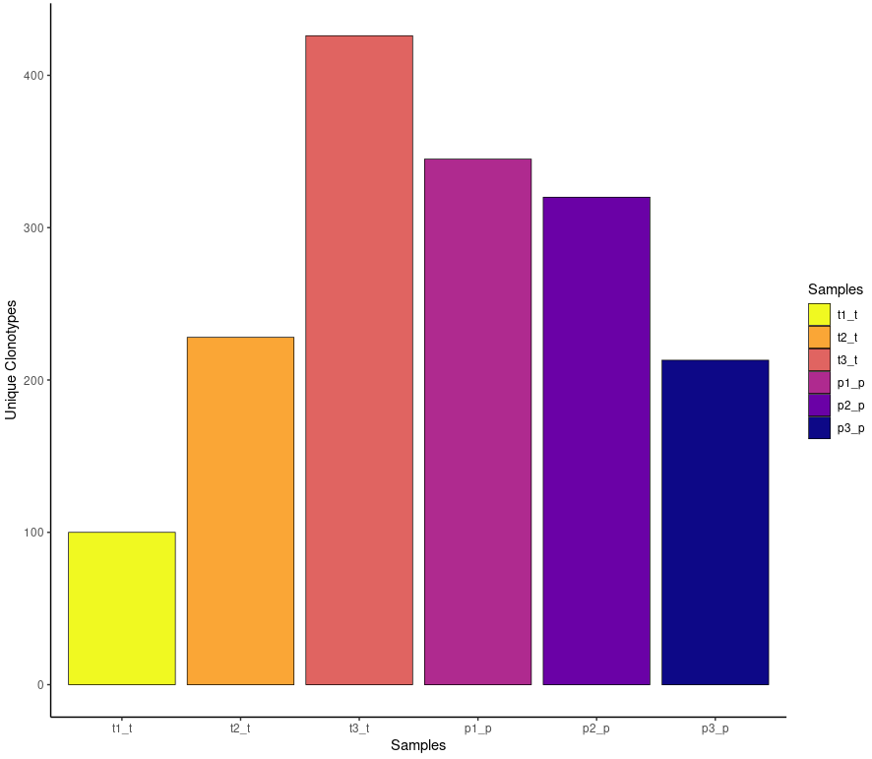
scRepertoire
P: para tumor
T: tumor
quantContig(combined, cloneCall="gene+nt", chain = "TRB")

Slide 5
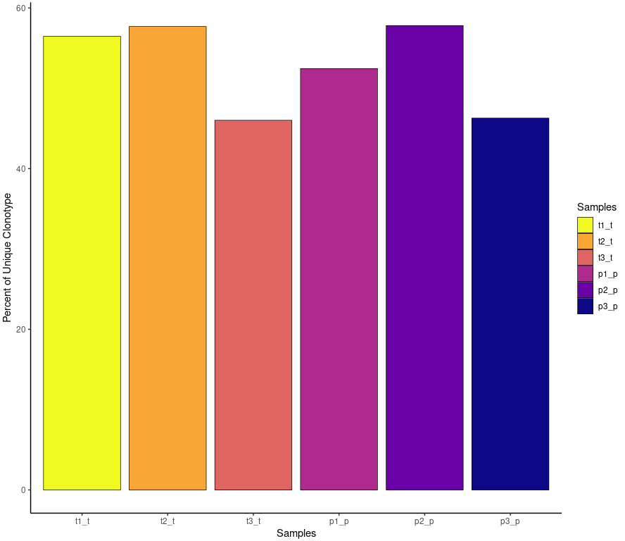
scRepertoire
P: para tumor
T: tumor
quantContig(combined, cloneCall="gene+nt", chain = "TRA", scale = TRUE)

Slide 6
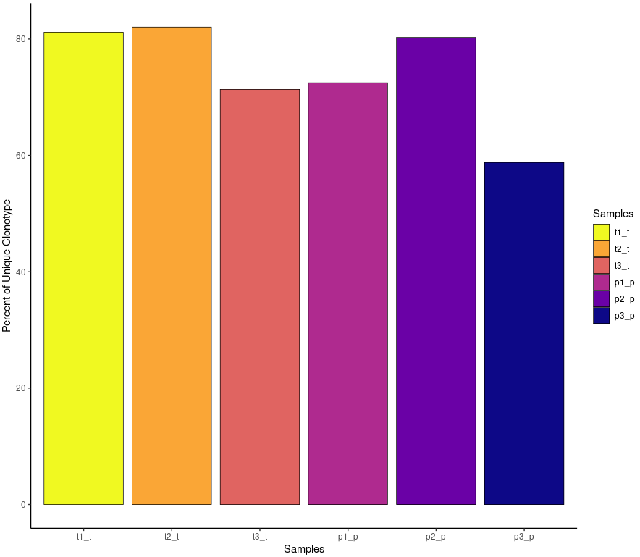
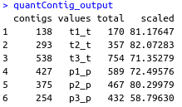
scRepertoire
P: para tumor
T: tumor
quantContig(combined, cloneCall="gene+nt", scale = T, chain = "both")
“both” for combined chain visualization

Slide 7
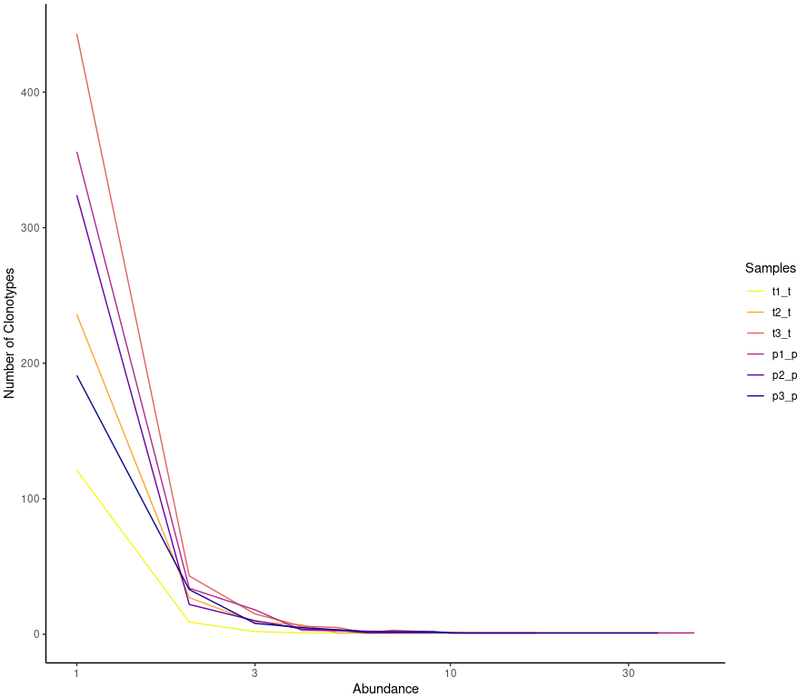
Clonotype Abundance
scRepertoire
abundanceContig(combined, cloneCall="gene", scale = F)

Slide 8
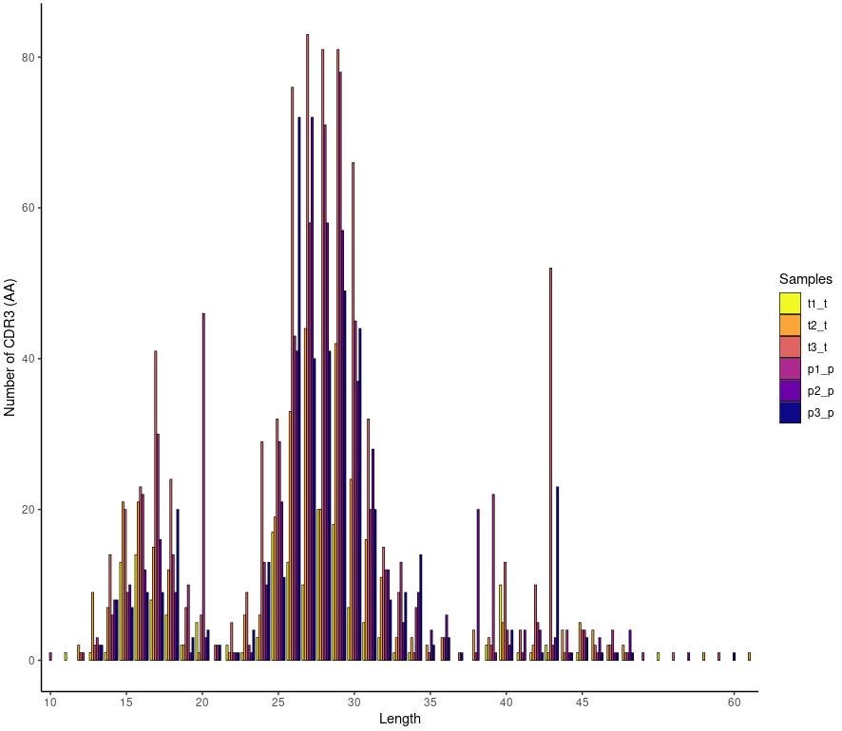
Length of Clonotypes
scRepertoire
lengthContig(combined, cloneCall="aa", chain = "both")

Slide 9
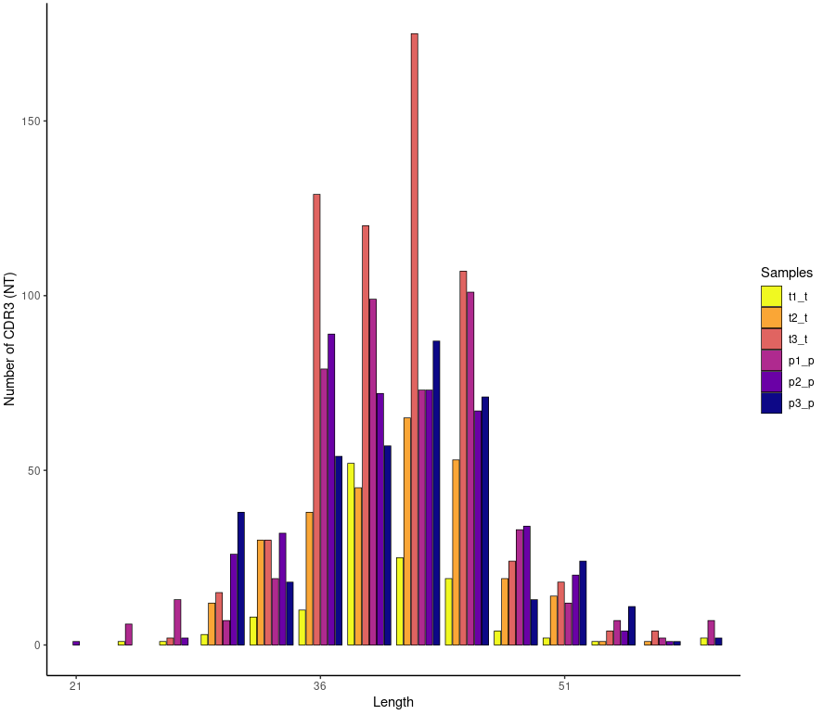
scRepertoire
lengthContig(combined, cloneCall="nt", chain = "TRA")

Slide 10
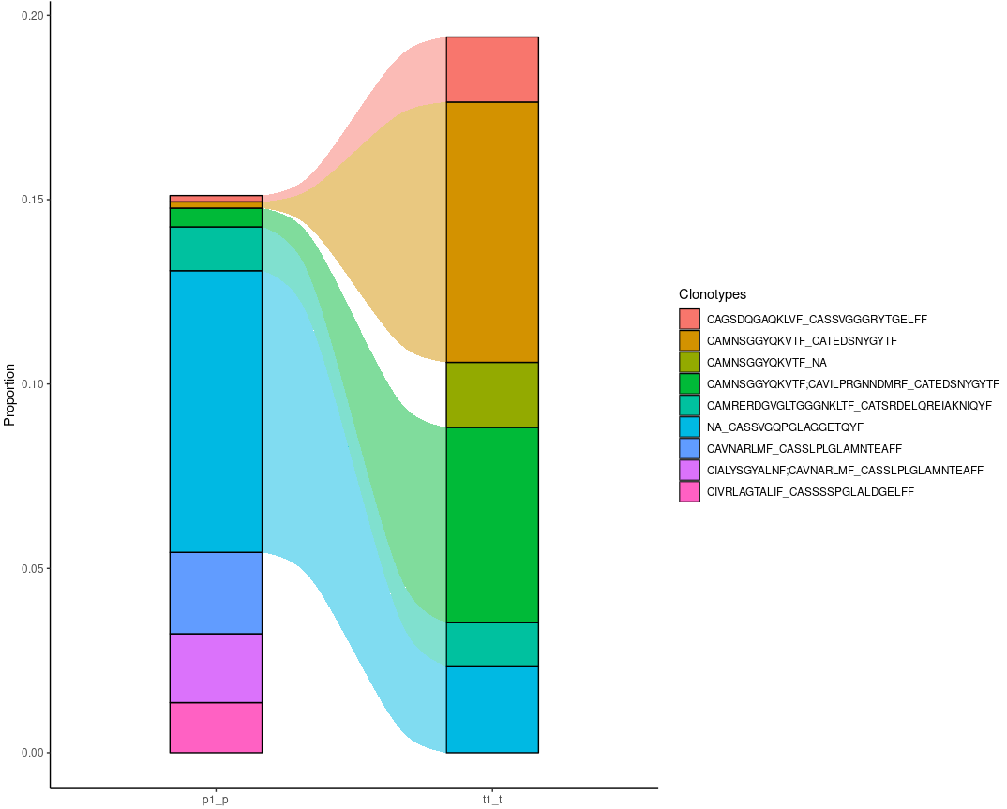
Compare Clonotypes of Patient 1
scRepertoire
compareClonotypes(combined,
numbers = 5,
samples = c("t1_t","p1_p"),
cloneCall="aa",
graph = "alluvial")

Slide 11
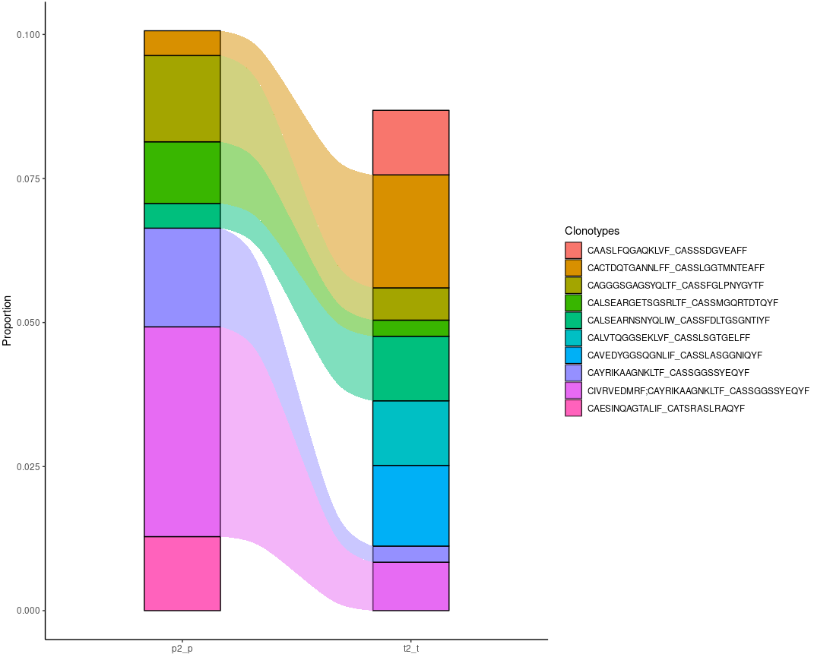
Compare Clonotypes of Patient 2 (Best)
scRepertoire
compareClonotypes(combined,
numbers = 5,
samples = c("t2_t","p2_p"),
cloneCall="aa",
graph = "alluvial")

Slide 12
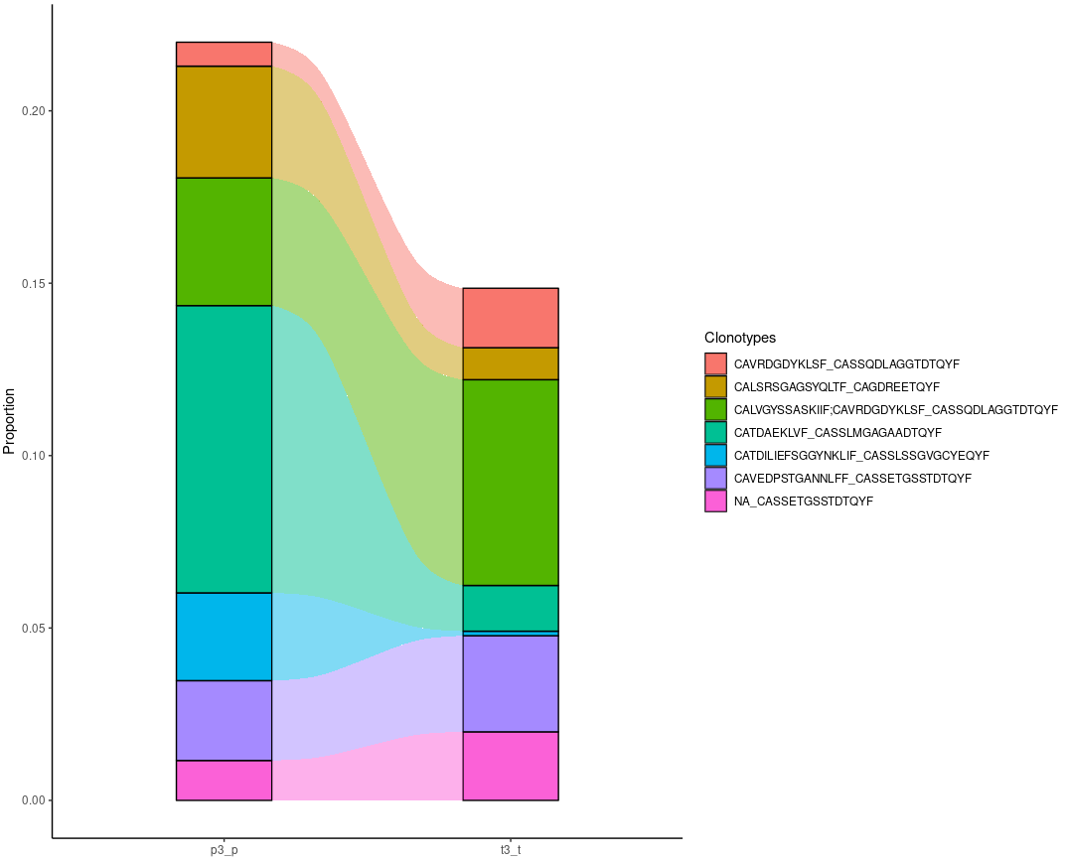
Compare Clonotypes of Patient 3
scRepertoire
compareClonotypes(combined,
numbers = 5,
samples = c("t3_t","p3_p"),
cloneCall="aa",
graph = "alluvial")

Slide 13
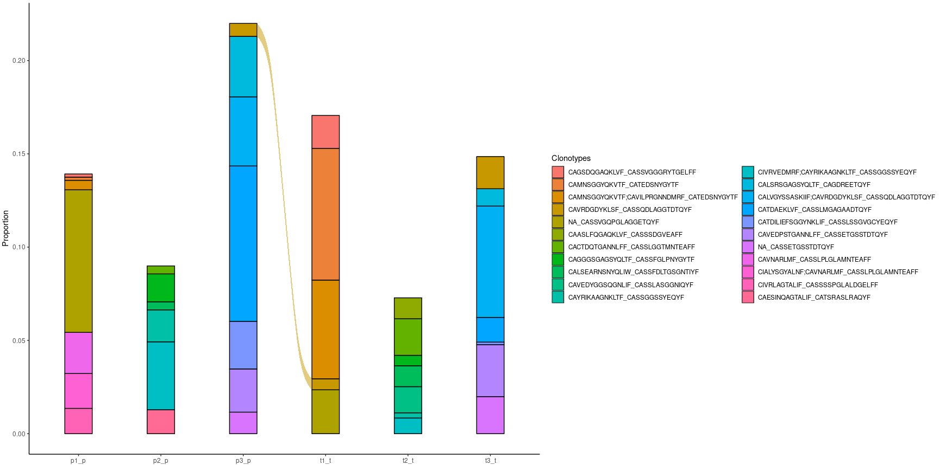
Compare Clonotypes of All Patients
scRepertoire
compareClonotypes(combined,
numbers = 4, samples = c("t1_t","p1_p","t2_t","p2_p","t3_t","p3_p"),
cloneCall="aa", graph = "alluvial")
t1_t CAVRDGDYKLSF_CASSQDLAGGTDTQYF p3_p CAVRDGDYKLSF_CASSQDLAGGTDTQYF

Slide 14
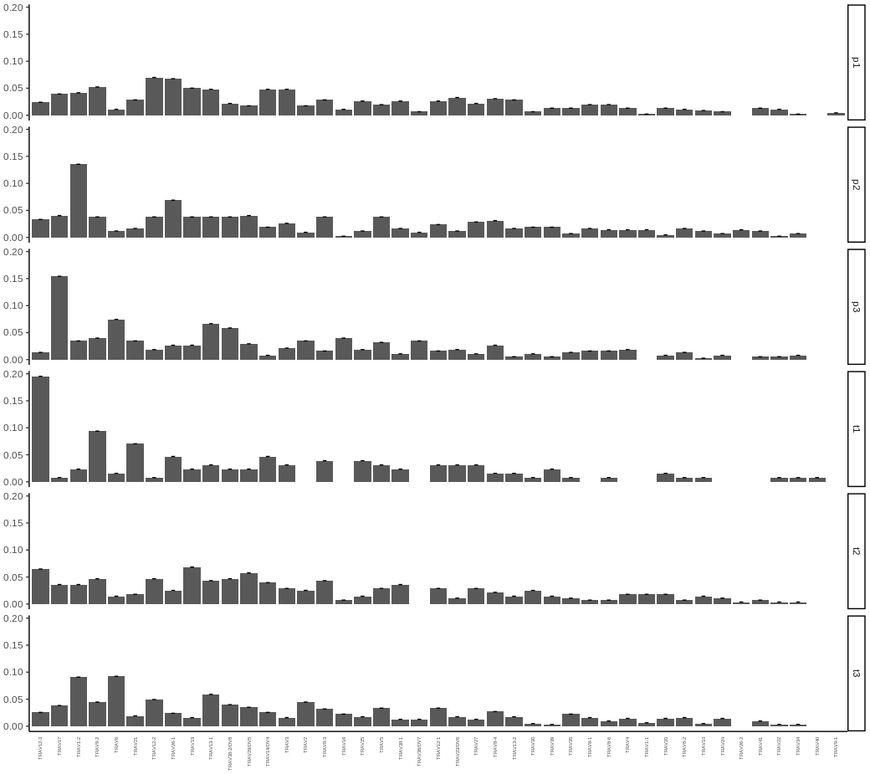
Visualize Gene Usage
scRepertoire
vizGenes(combined, gene = "V", chain = "TRA", plot = "bar", order = "variance", scale = TRUE)

Slide 15
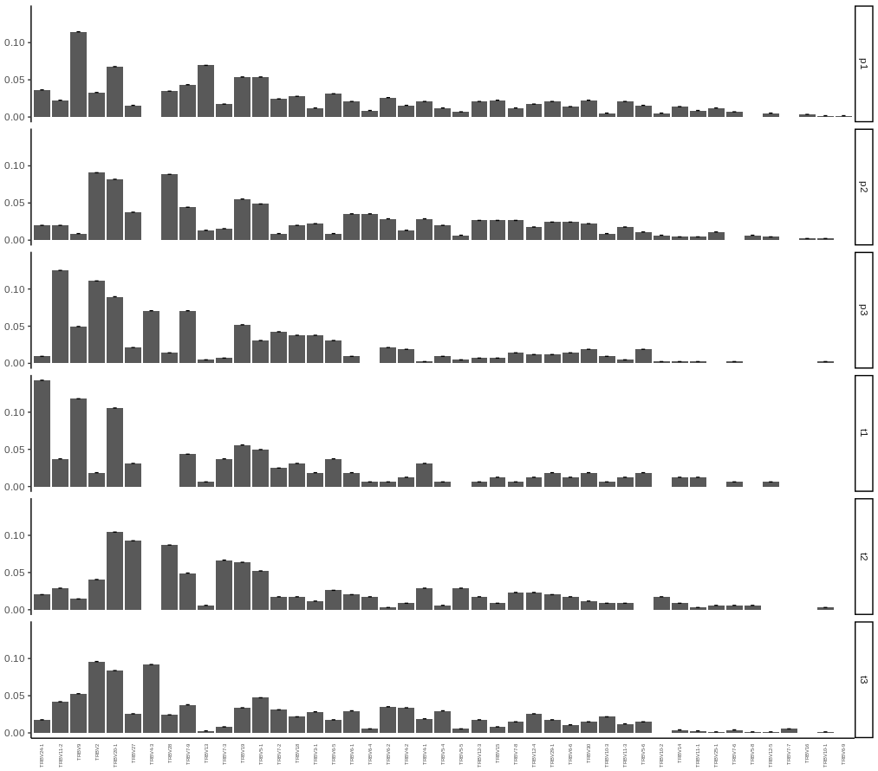
scRepertoire
vizGenes(combined, gene = "V", chain = "TRB", plot = "bar", order = "variance", scale = TRUE)

Slide 16
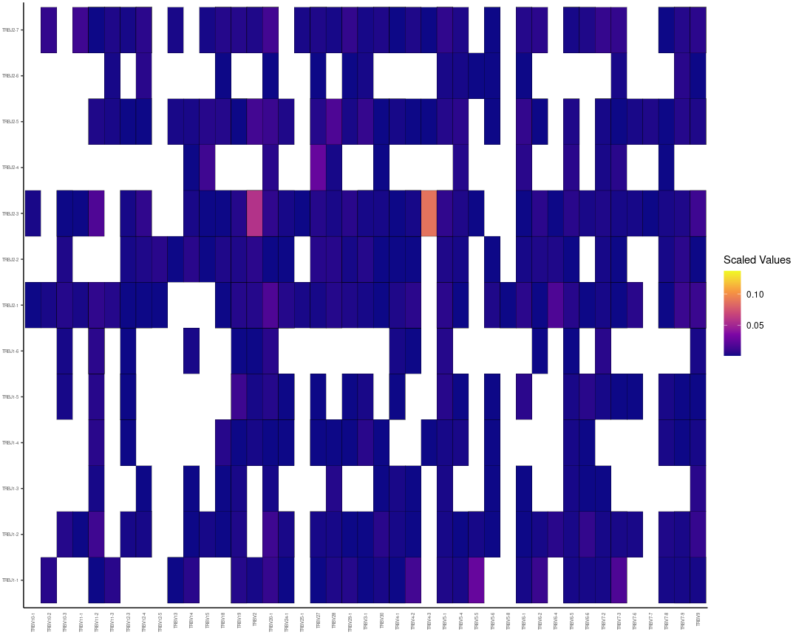
scRepertoire
vizGenes(combined[c(1,2,3)], gene = "V", chain = "TRB", y.axis = "J", plot = "heatmap", scale = TRUE, order = "gene")

Slide 17
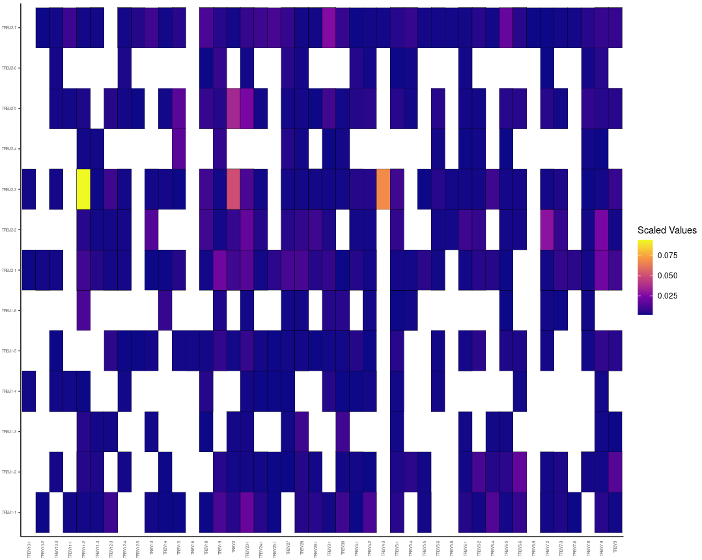
scRepertoire
vizGenes(combined[c(4,5,6)], gene = "V", chain = "TRB", y.axis = "J", plot = "heatmap", scale = TRUE, order = "gene")

Slide 18
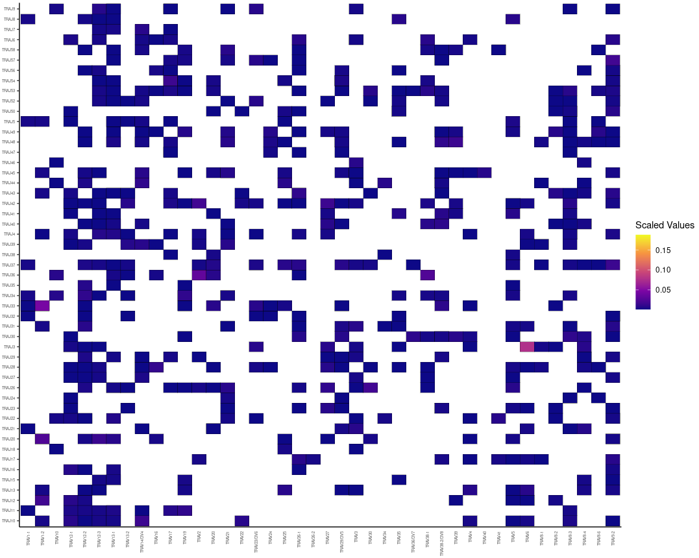
scRepertoire
vizGenes(combined[c(1,2,3)], gene = "V", chain = "TRA", y.axis = "J", plot = "heatmap", scale = TRUE, order = "gene")

Slide 19
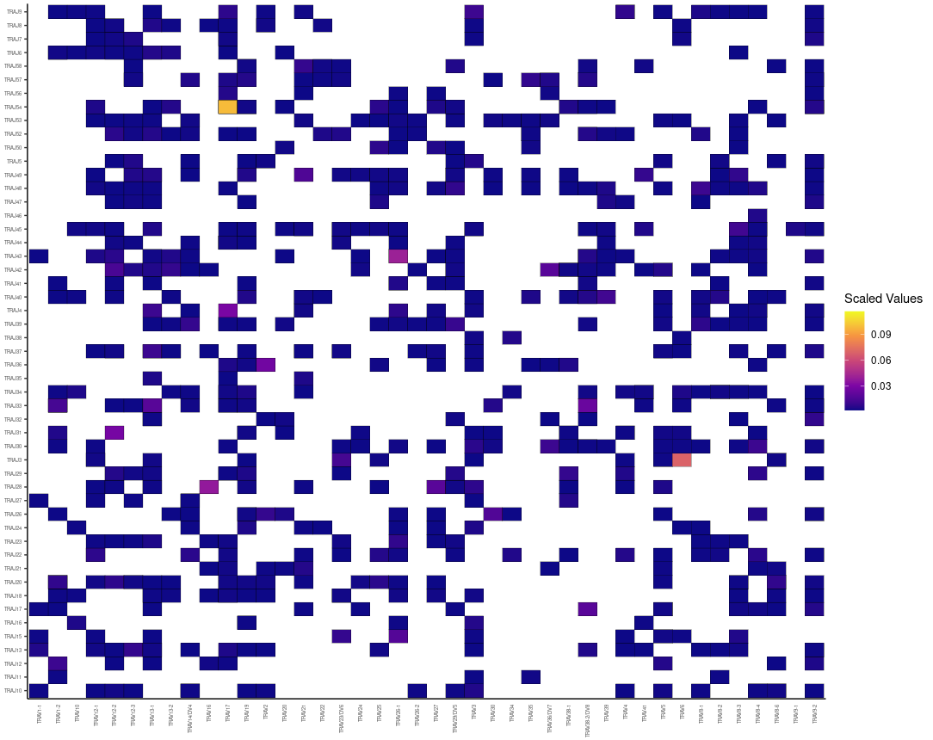
scRepertoire
vizGenes(combined[c(4,5,6)], gene = "V", chain = "TRA", y.axis = "J", plot = "heatmap", scale = TRUE, order = "gene")

Slide 20
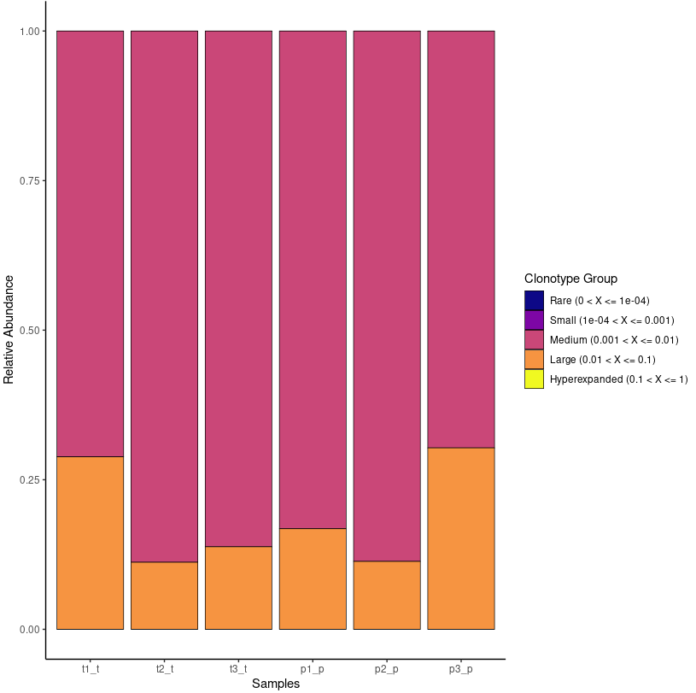
scRepertoire
Clonal Space Homeostasis
clonalHomeostasis(combined, cloneCall = "gene", cloneTypes = c(Rare = 1e-04, Small = 0.001, Medium = 0.01, Large = 0.1, Hyperexpanded = 1))

Slide 21

scRepertoire
clonalHomeostasis(combined, cloneCall = "aa")

Slide 22
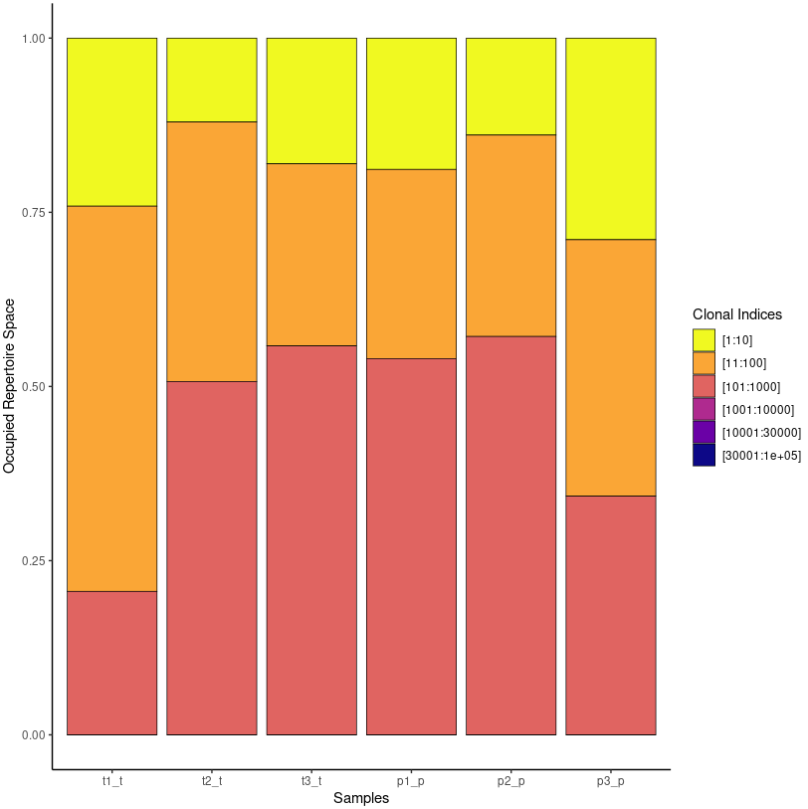
Clonal Proportion
scRepertoire
clonalProportion(combined, cloneCall = "gene", split = c(10, 100, 1000, 10000, 30000, 1e+05))

Slide 23
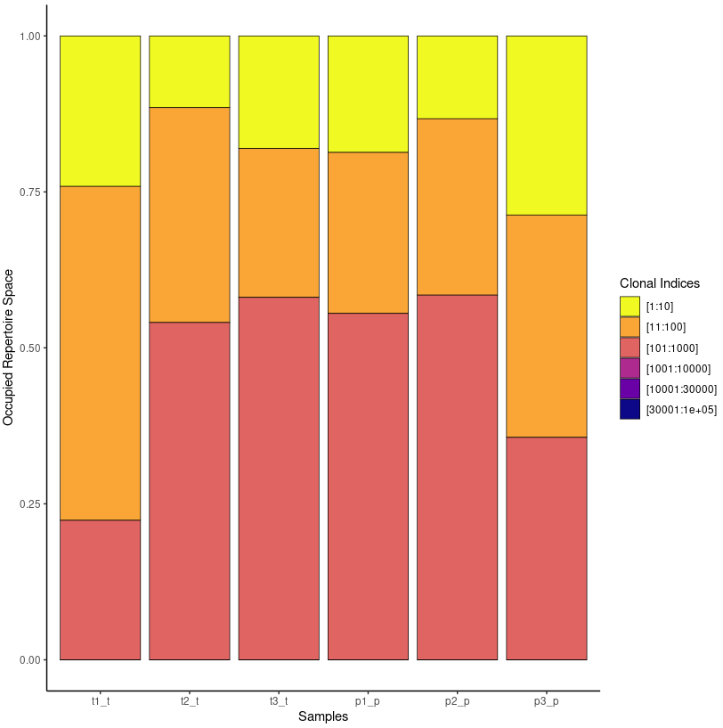
scRepertoire
clonalProportion(combined, cloneCall = "nt")

Slide 24
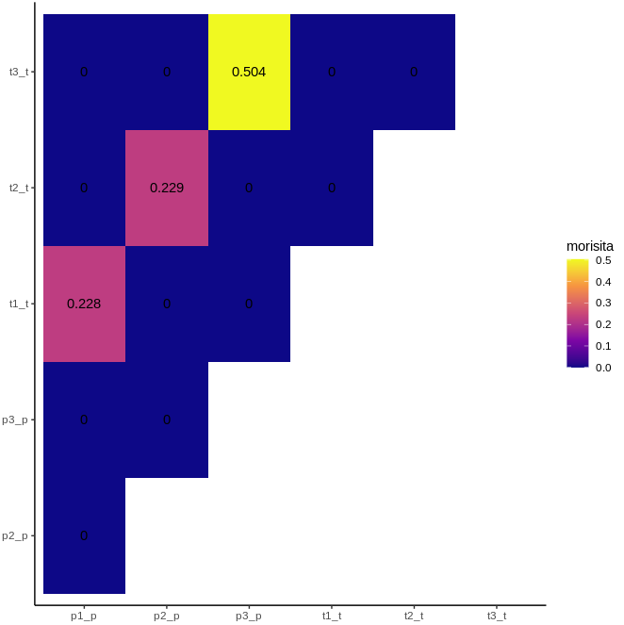
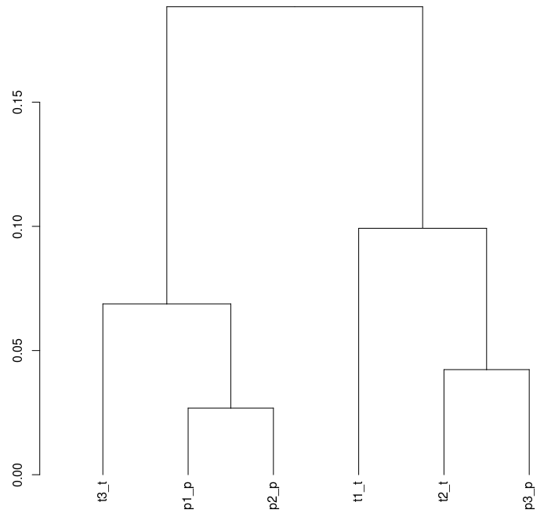
Overlap Analysis
scRepertoire
clonesizeDistribution(combined, cloneCall = "gene+nt", method="ward.D2")
clonalOverlap(combined, cloneCall = "gene+nt", method = "morisita")

Slide 25
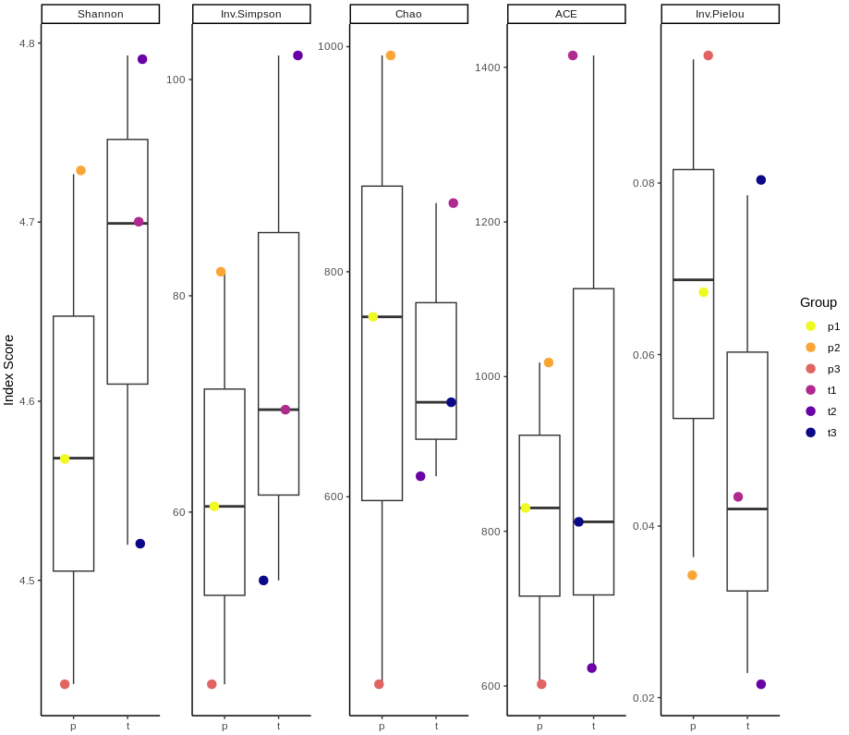
Diversity Analysis
scRepertoire
t2
clonalDiversity(combined, cloneCall = "gene", group.by = "sample", x.axis = "ID", n.boots = 100)
p2
t1
p1
t3
Patient 1, 2, 3谁的预后好？P2最好Diversity越多越好
p3

Slide 26
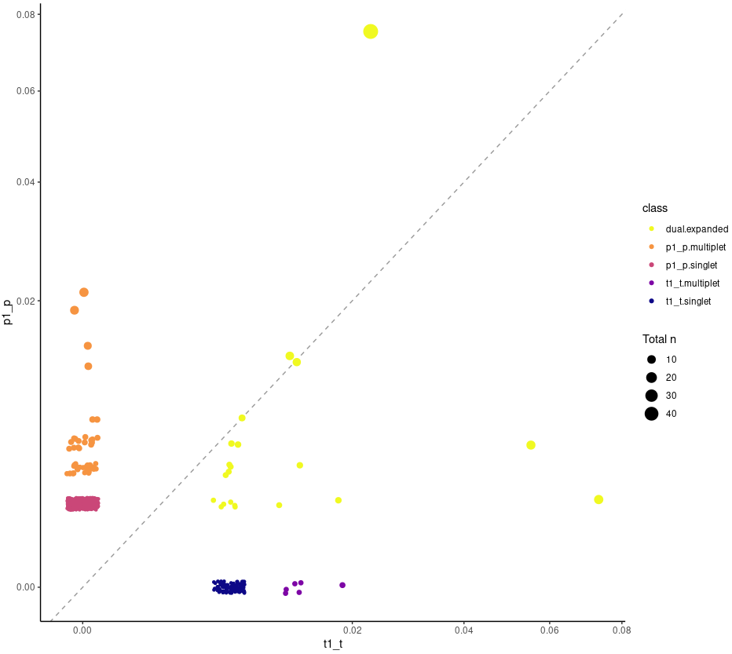
Scatter Compare
scRepertoire
scatterClonotype(combined, cloneCall ="gene", x.axis = "t1_t", y.axis = "p1_p", dot.size = "total", graph = "proportion")

Slide 27
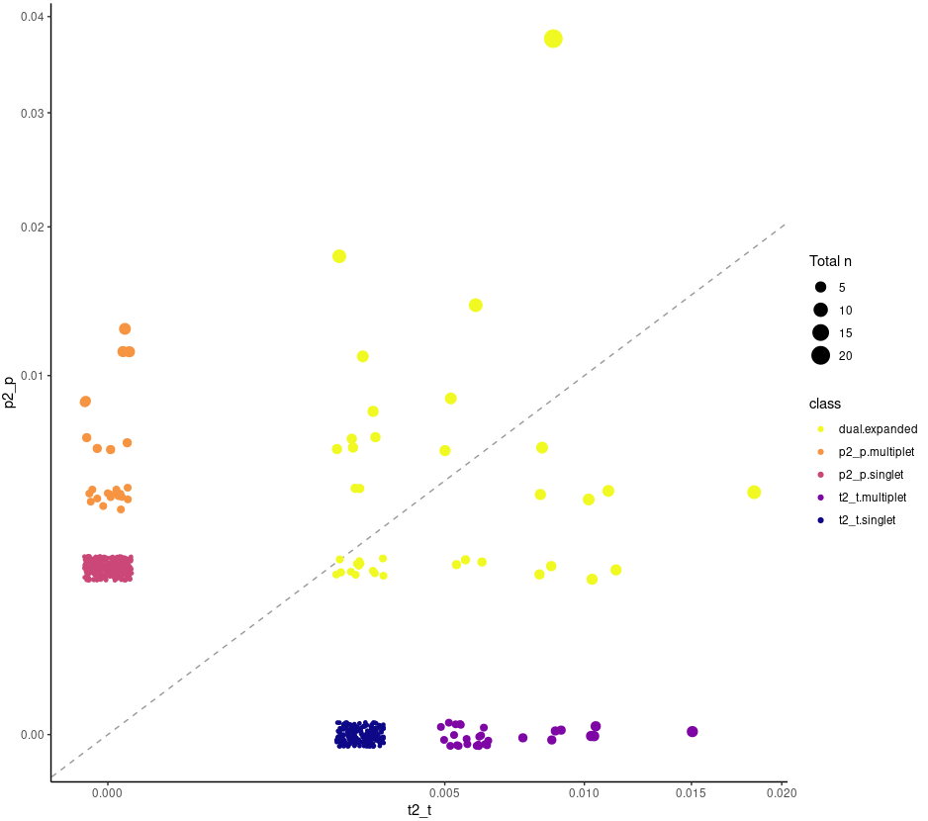
scRepertoire
scatterClonotype(combined, cloneCall ="gene", x.axis = "t2_t", y.axis = "p2_p", dot.size = "total", graph = "proportion")

Slide 28
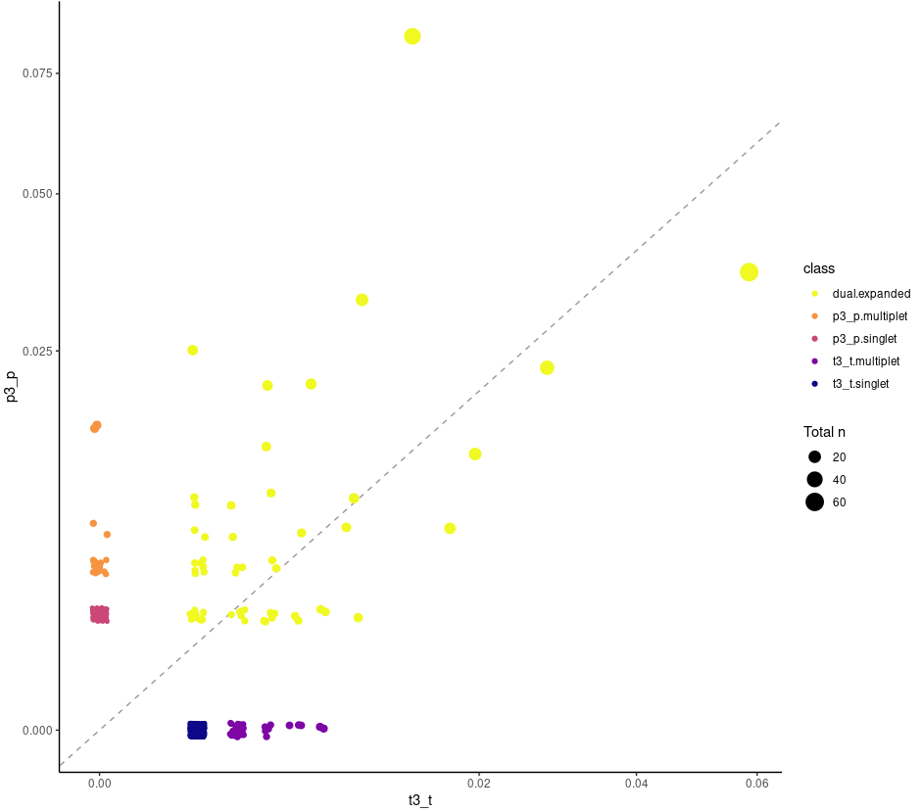
scRepertoire
scatterClonotype(combined, cloneCall ="gene", x.axis = "t3_t", y.axis = "p3_p", dot.size = "total", graph = "proportion")

