Slide 1
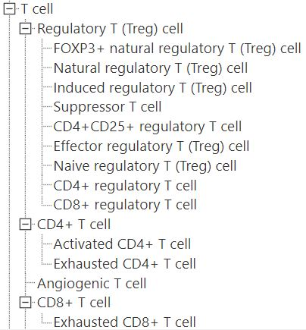
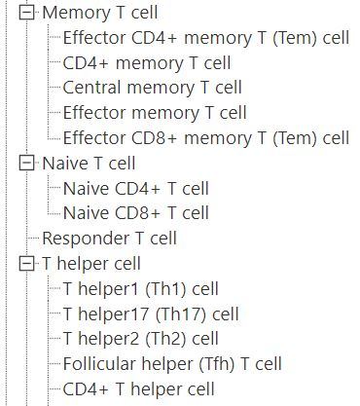
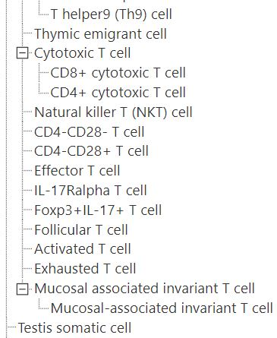

Slide 2
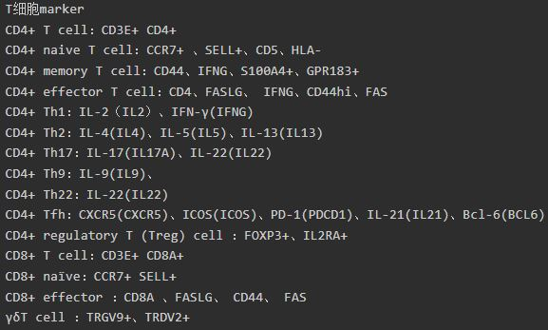

Slide 3
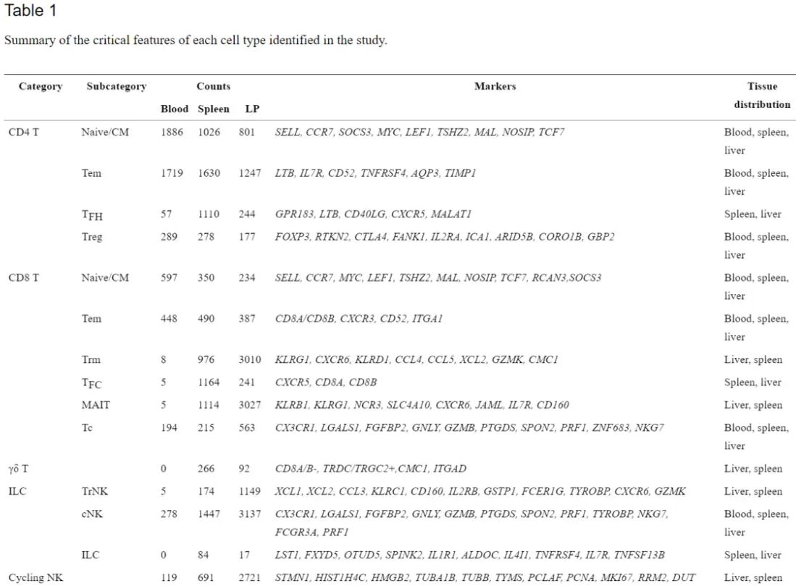

Slide 4
注释思路：
1. Treg: FOXP3, IL2RA, CTLA4 (cluster4, 8)
2. CD4: CD4, CCR6, IL17A, CD40LG (cluster2, 5)
3. CD8: CD8A, GZMK, CCL4,CCL5, ZNF683, CD8B (cluster0, 1, 9, 12)
4. T_helper: CCR6 (cluster7)
5. Naïve T: CCR7 (cluster3）
6. MAIT: TRAV1-2, NCR3 (cluster6)
7. B: IGHG1, IGHG3, JCHAIN (cluster13)
8. Innate lymphoid cells: FCER1G, XCL1, TYROBP, PTGDS (cluster10, 11)

