Slide 1
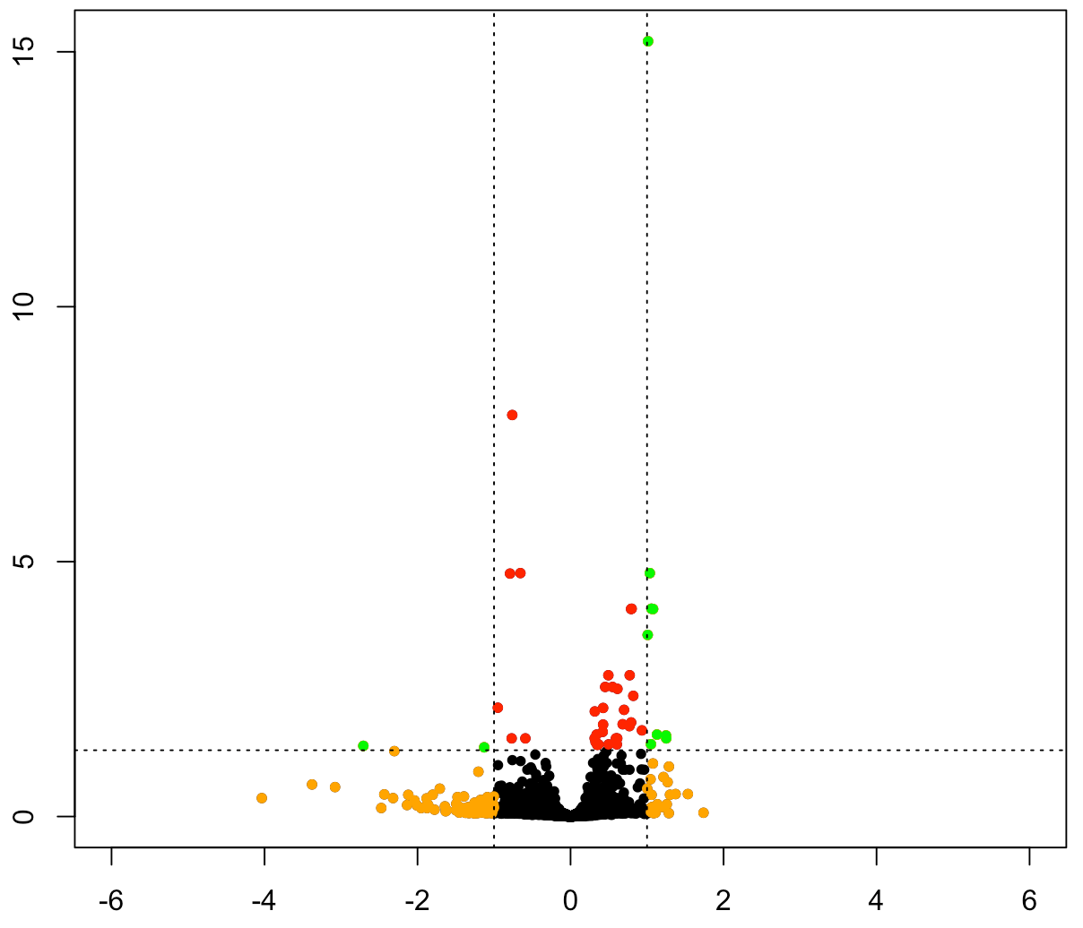
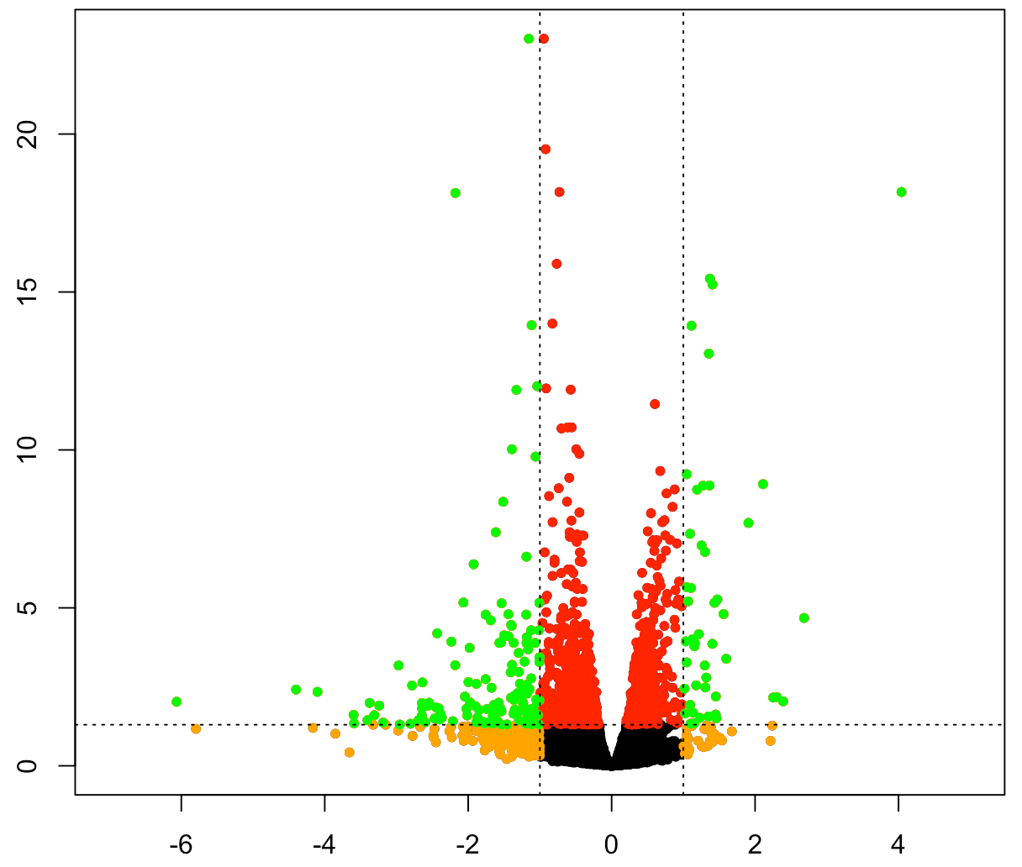
Volcano Plot
a
hcq vs con
b
pcq vs con
-log₁₀padj
-log₁₀padj
log₂foldchange
log₂foldchange
Figure 1
Green: |Log2FoldChange| > 1 FDR q-vaule < 0.05

Slide 2
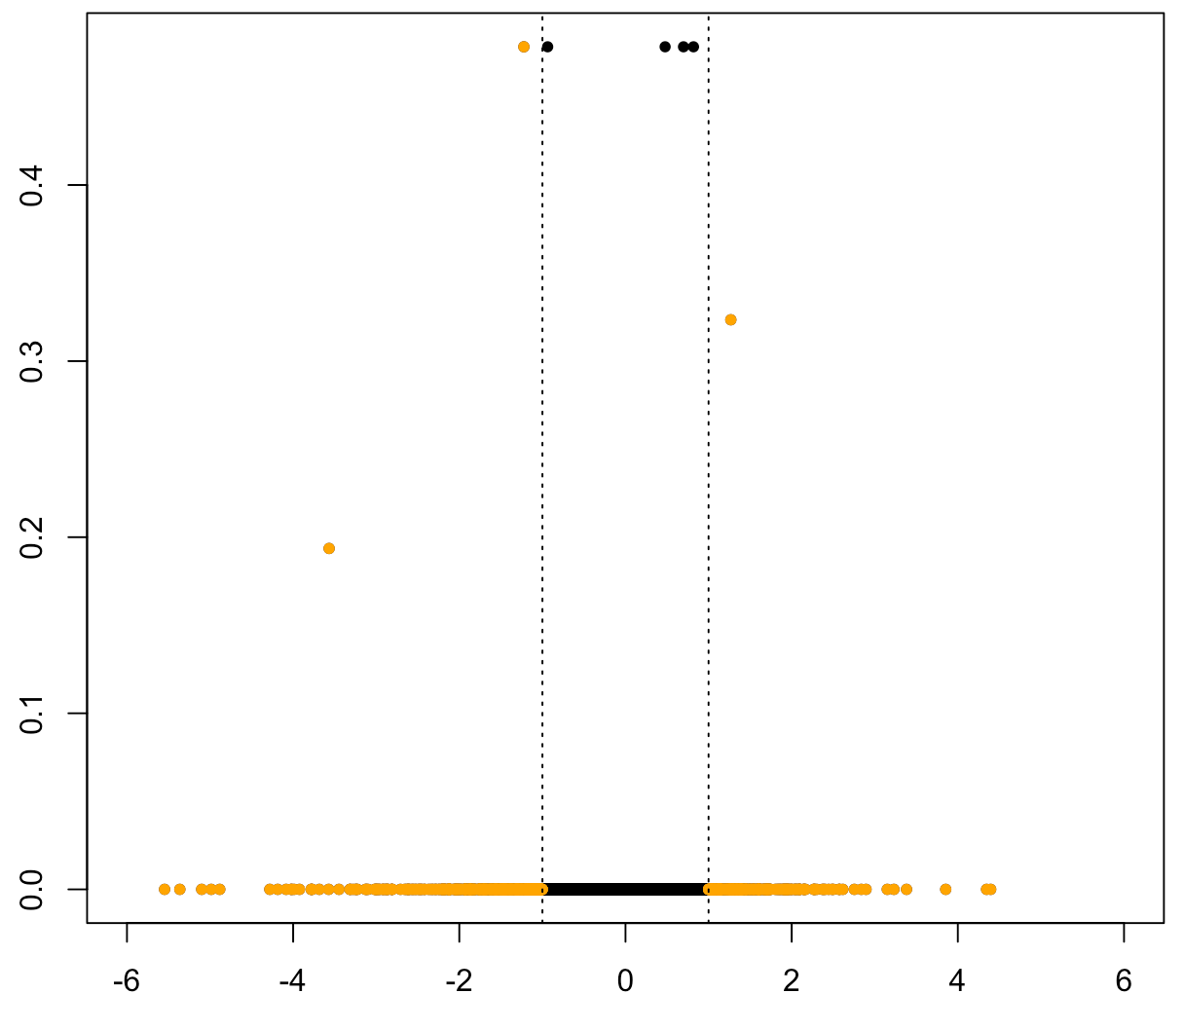
c
phpma vs con
-log₁₀padj
log₂foldchange
Figure 1
Green: |Log2FoldChange| > 1 FDR q-vaule < 0.05

Slide 3
Venn diagram
a
b
hcq vs con
pcq vs con
hcq vs con
pcq vs con
0
2
141
3
6
41
Downregulated genes
Upregulated genes
Figure 2

Slide 4
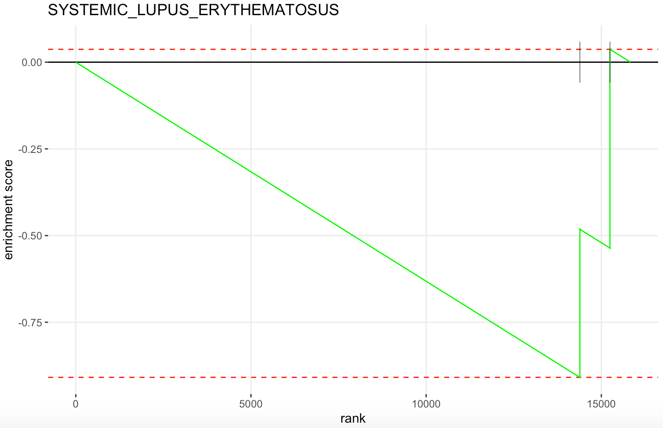
KEGG of hcq vs con
a
KEGG_SYSTEMIC_LUPUS_ERYTHEMATOSUS
NES = -1.389
FDR q-value = 0.113
P-value = 0.044
Enrichment Score
RANK
Figure 3

Slide 5
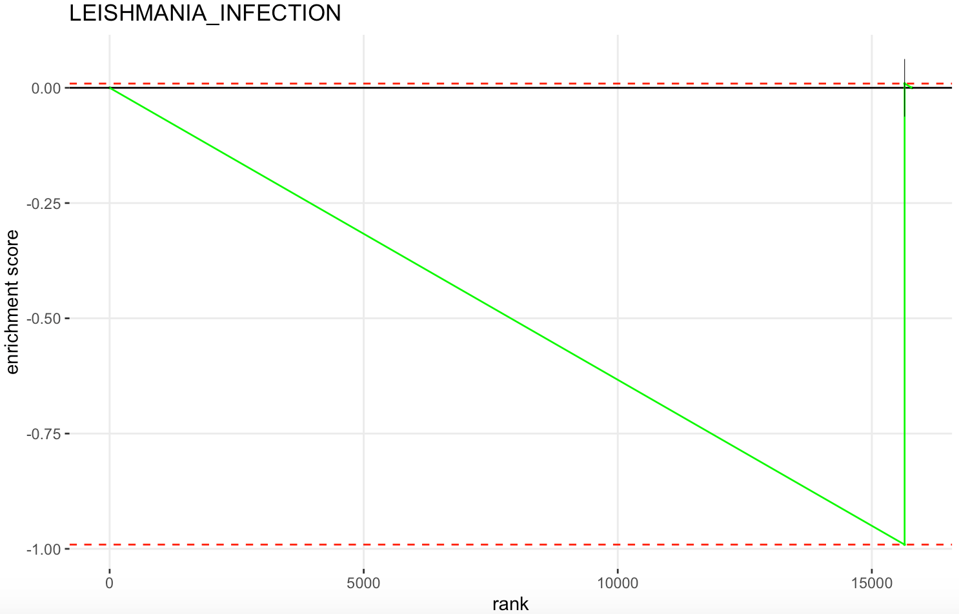
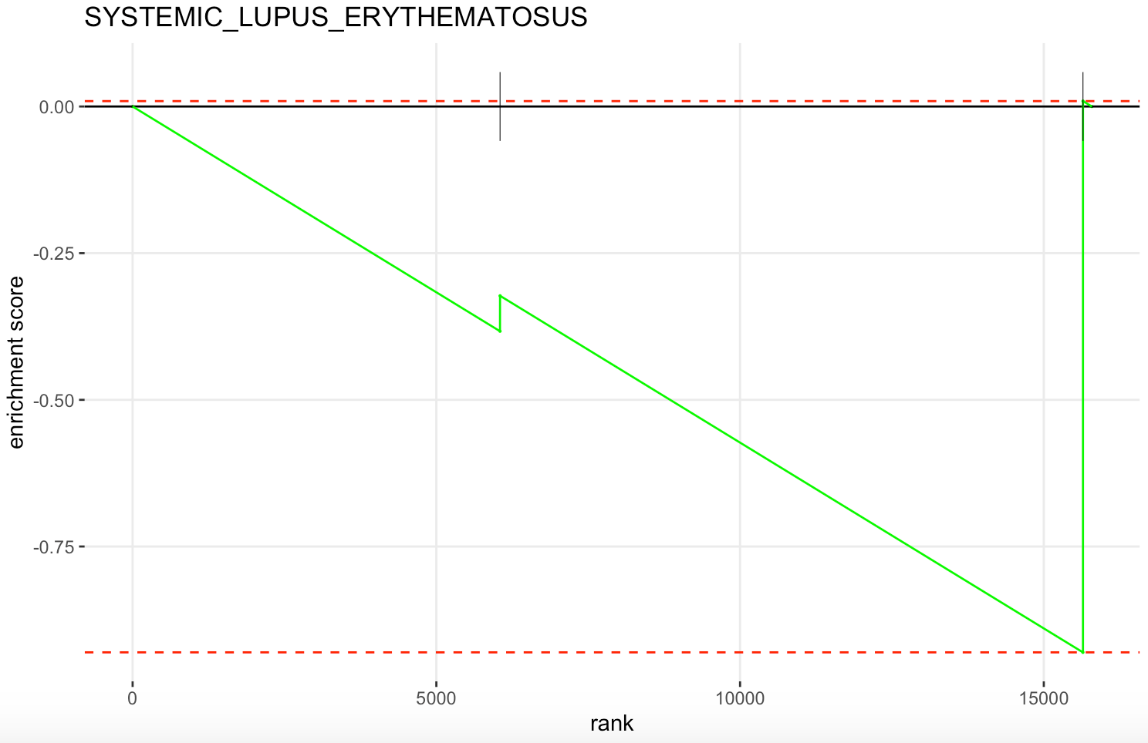
KEGG of pcq vs con
b
KEGG_LEISHMANIA_INFECTION
c
KEGG_SYSTEMIC_LUPUS_ERYTHEMATOSUS
NES = -1.327
FDR q-value = 0.045
P-value = 0.015
NES = -1.398
FDR q-value= 0.045
P-value = 0.030
Enrichment Score
Enrichment Score
RANK
RANK
Figure 3

