Slide 1
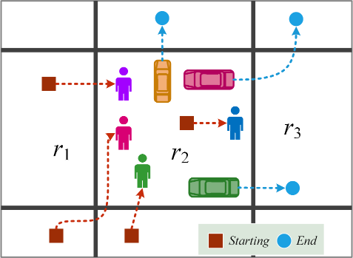
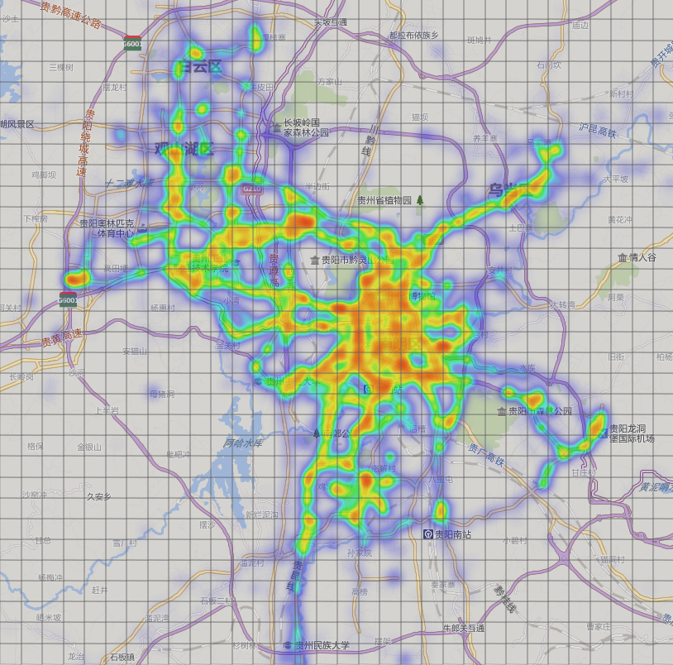
DNN-Based Urban Flow Prediction
Predict In-flow and out-flow of crowds in each region at next time interval throughout a city
Important for:
Traffic management
Risk assessment
Public safety
http://urbanflow.sigkdd.com.cn/
Junbo Zhang, Yu Zheng, et al. DNN-Based Prediction Model for Spatial-Temporal Data. ACM SIGSPAITAL 2016
Notes:
Four different flows are defined.
in-flow, the total traffic of crowds entering a region from other places during a given time interval;
out-flow, the total traffic of crowds leaving a region for other places during a given time interval;
new-flow, the traffic of crowds originating from a region at a given time interval (e.g., people start driving from a parking spot); and
end-flow, the traffic of crowds that is terminated in a region (e.g., people stop driving and park their cars).
Knowing these four types of aggregated flows is good enough for traffic management and risk assessment: new-flow and end-flow track the
start and the end of crowd movements, while in-flow and out-flow track the transition of crowds among regions.
Spatio-Temporal Sequence Prediction Problem

Slide 2
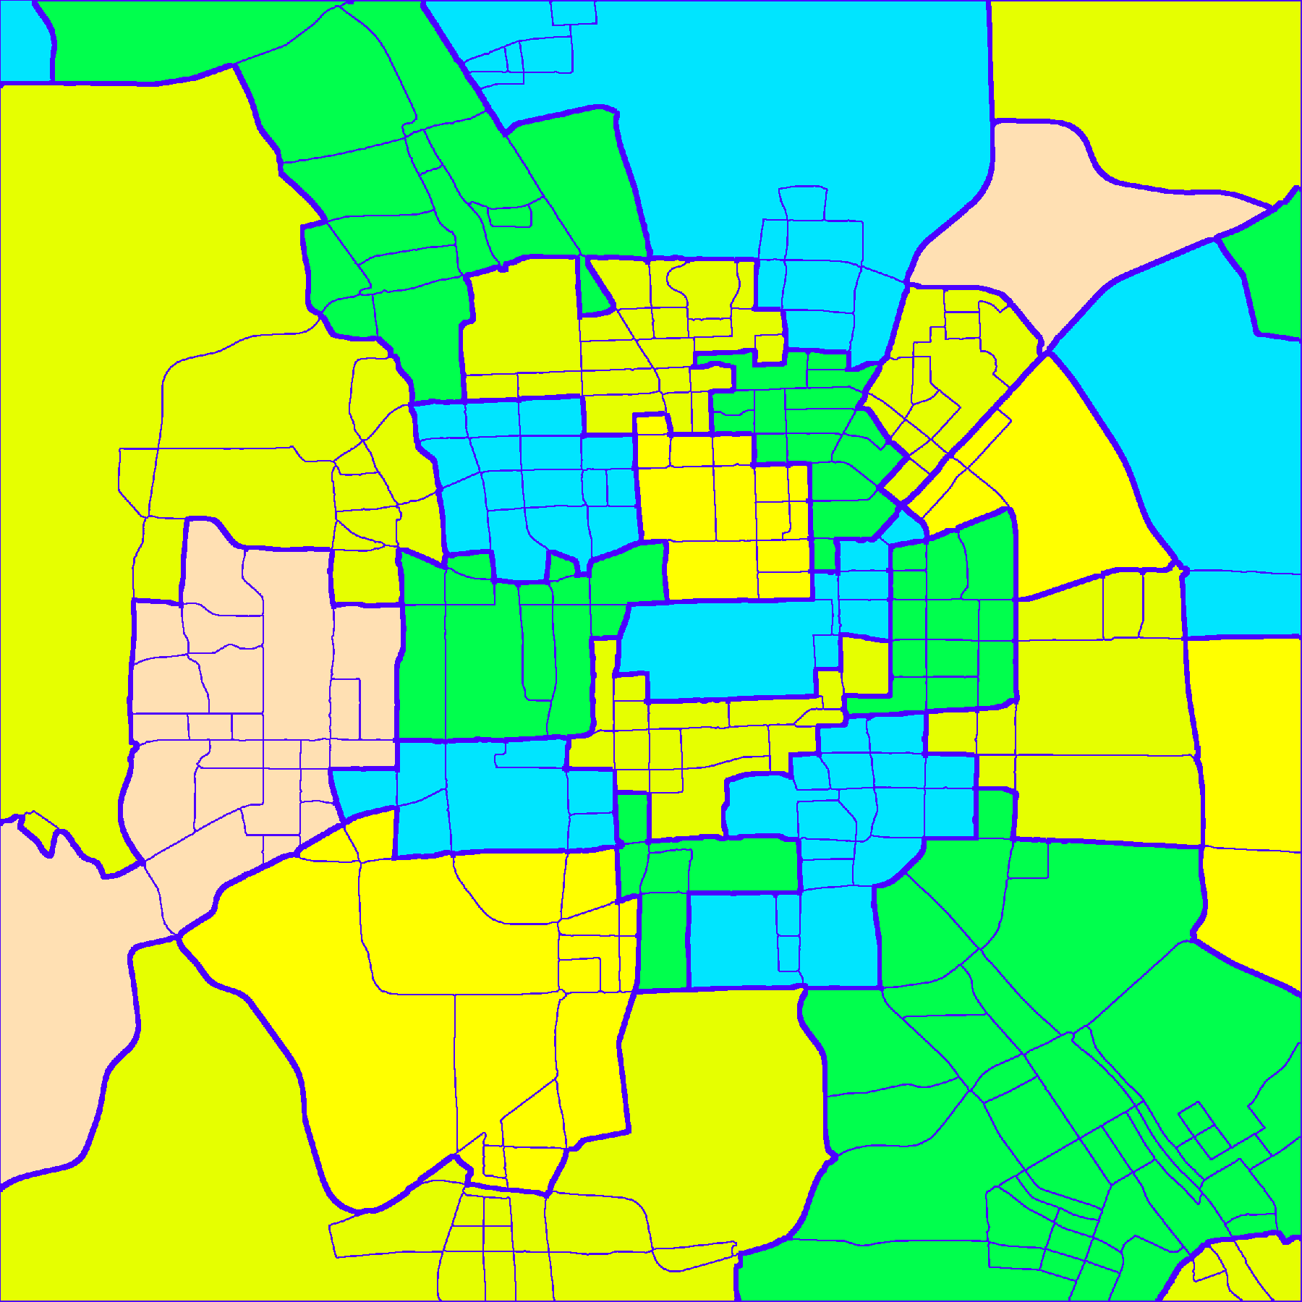
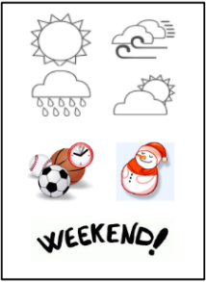
Challenges
Urban crowd flow depends on many factors
Flows of previous time interval
Flows of nearby regions and distant regions
Weather, traffic control and events
Capturing spatial properties
Spatial distance and hierarchy
Capturing temporal properties
Temporal closeness
Period and trend

Slide 3
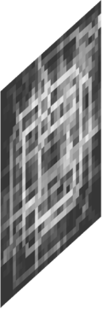
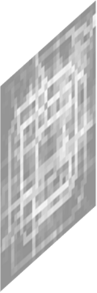

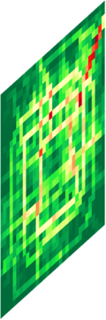
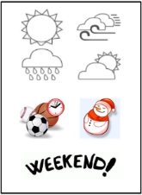
Converting Trajectories into Video-like Data
Trajectories
Junbo Zhang, Yu Zheng, et al. Deep Spatio-Temporal Residual Networks for Citywide Crowd Flows Prediction, AAAI 2017

Slide 4
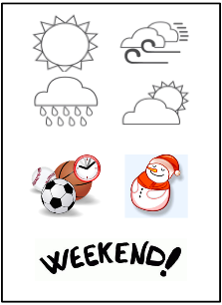
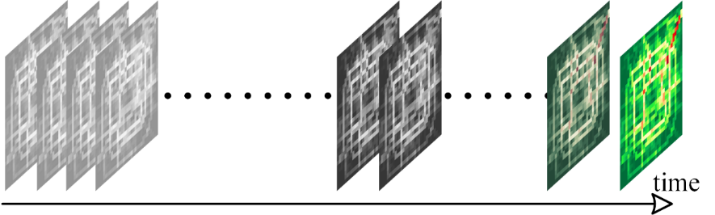
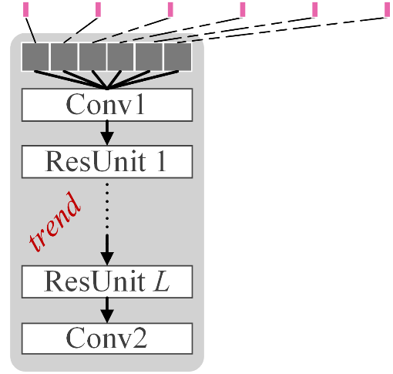
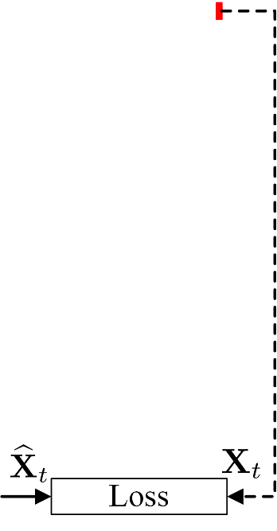
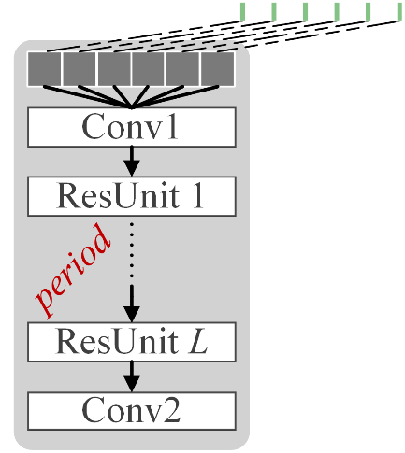
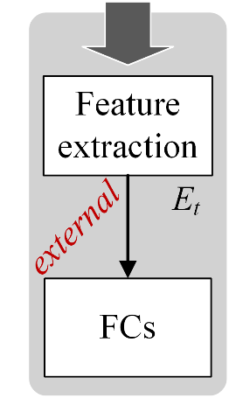
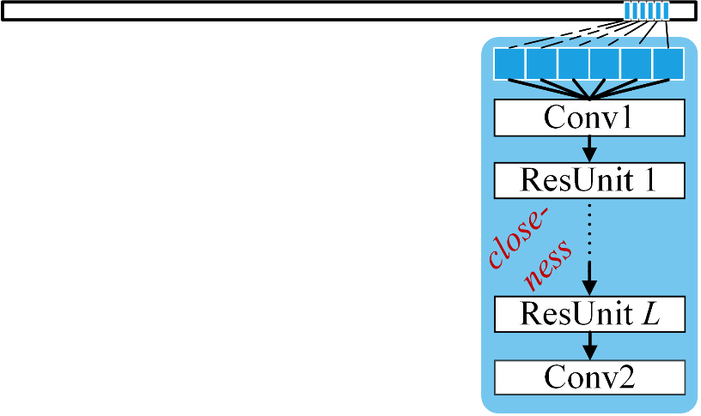
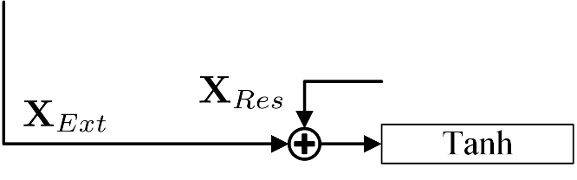

ST-ResNet Architecture: A Collective Prediction
distant
near
recent
Junbo Zhang, Yu Zheng, et al. Deep Spatio-Temporal Residual Networks for Citywide Crowd Flows Prediction, AAAI 2017

Slide 5
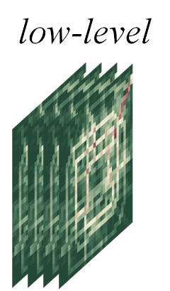
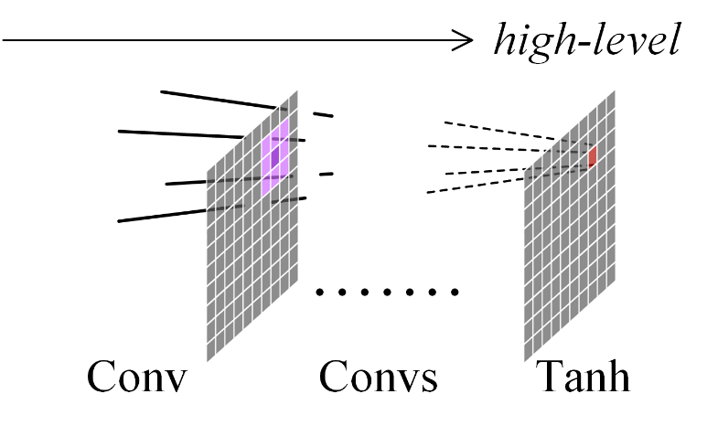
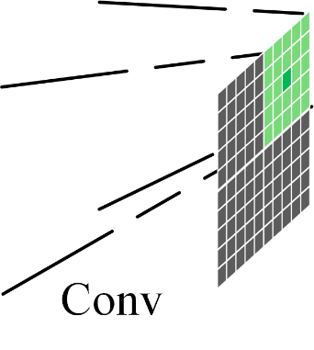
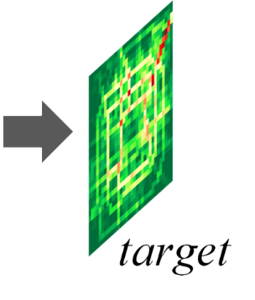
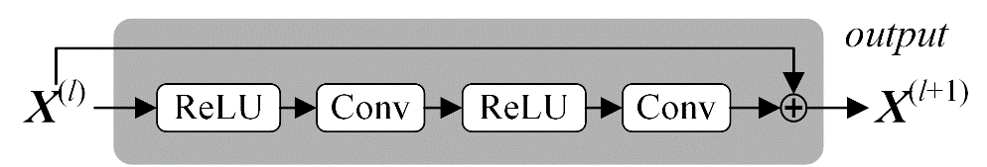
Residual Deep Convolutional Neural Network
Capturing spatial correlation of both near and far
Using residual network framework to help training
Junbo Zhang, Yu Zheng, et al. Deep Spatio-Temporal Residual Networks for Citywide Crowd Flows Prediction, AAAI 2017
Notes:
Why all layers are conv?
1.
2.

Slide 6

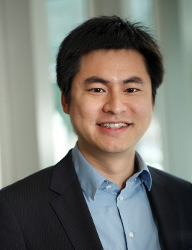
Search for “Urban Computing”
搜索“城市计算”
Thanks!
Yu Zheng
yuzheng@microsoft.com
Download Urban Air Apps
Homepage
Zheng, Y., et al. Urban Computing: concepts, methodologies, and applications. ACM transactions on Intelligent Systems and Technology.
郑宇. 城市计算概述，武汉大学学报. 2015年1月，40卷第一期
Yu Zheng. Methodologies for Cross-Domain Data Fusion: An Overview. IEEE Transactions on Big Data, 1, 1, 2015.

