Slide 1
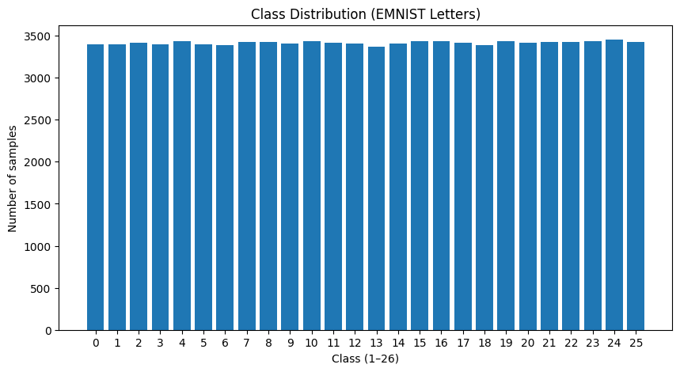
Part A — EMNIST Dataset
PROBLEM STATEMENT
Develop a CNN model to accurately classify handwritten English letters (A–Z) from grayscale image data despite challenges such as noise and inconsistent handwriting styles.
ISSUES FOUND
DATA CLEANING
DATA INSPECTION
Total: 99,040 samples
Each sample: 1 label + 784 pixel values
Flattened 28 × 28 image
~3,300–3,450 samples per class (balanced)
Invalid labels (−2, −1)
Pixel values exceed 0–255 range (up to 345)
9,465 duplicate rows
Corrupted / improperly scaled pixel data
Removed invalid label rows (−1, −2)
Removed duplicated rows
No missing values found
Dataset remains balanced after cleaning

Slide 2
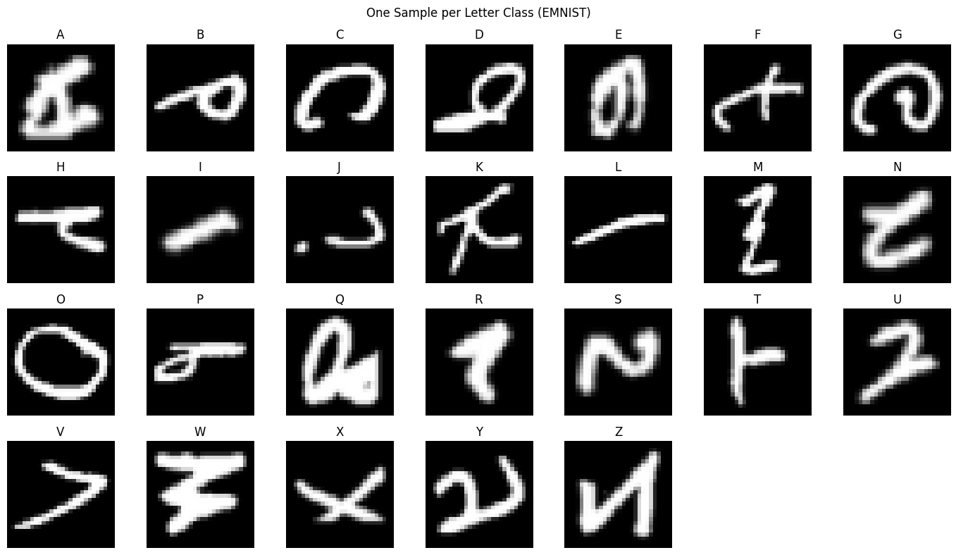
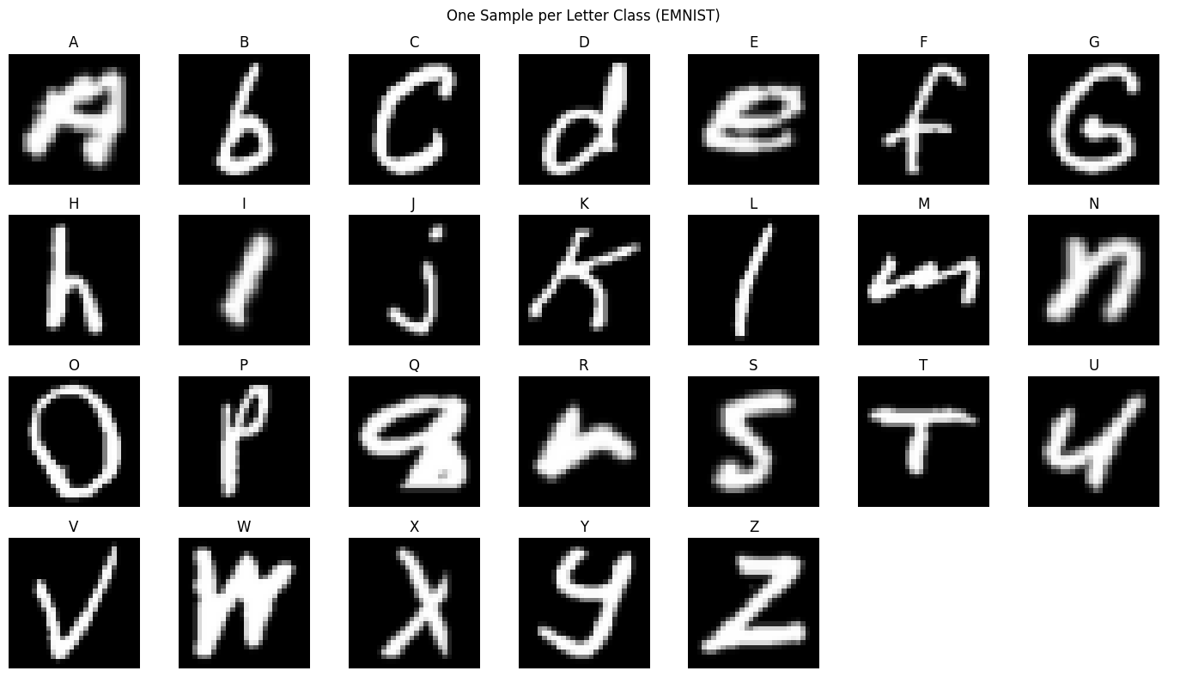
Preparing Data
Before Orientation
DATA PREPROCESSING
Pixel values retained in range 0–255
Normalised pixel values to range 0–1
Fixed image orientation using transpose
Reshaped images to 28 × 28 × 1 for CNN input
LABEL PROCESSING
Converted labels from 1–26 → 0–25
Applied one-hot encoding for multi-class classification
FINAL DATASET SHAPE
(88,798 × 28 × 28 × 1)
After Orientation
TRAIN / TEST SPLIT
Training
70% — 62,158 samples
Validation
15% — 13,320 samples
Testing
15% — 13,320 samples

Slide 3
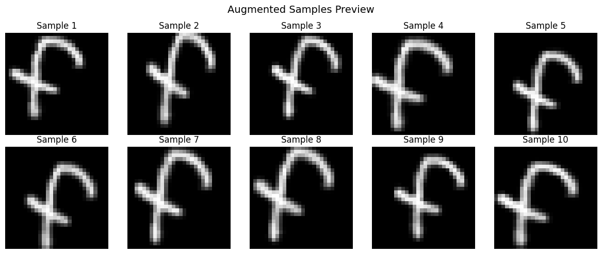
Model Architecture & Iterations
Baseline
Improved (V2)
Augmented (V3)
1 Conv layer (32 filters)
1 Dense layer (128)
No regularisation
10 epochs, Batch size: 200
3 Conv layers (32→64→128) for better feature extraction
Batch Normalisation for more stable training
Dropout (0.4) to reduce overfitting
Increased Dense Layer 256: to improve classification ability.
Used lower learning rate and smaller batch size (128)
Early Stopping to prevent excessive overfitting
Same architecture as V2
Data augmentation applied:
Rotation: ±5°
Zoom: 0.1
Width / Height shift: 0.1
No horizontal flip
PROBLEM
Overfitting — train acc (94.91%) much higher than test acc (91.13%).
GOAL
Improve generalisation by exposing model to varied input patterns.
PROBLEM
2.41% gap between train (96.00%) and test (93.59%) — slight overfitting remains.

Slide 4
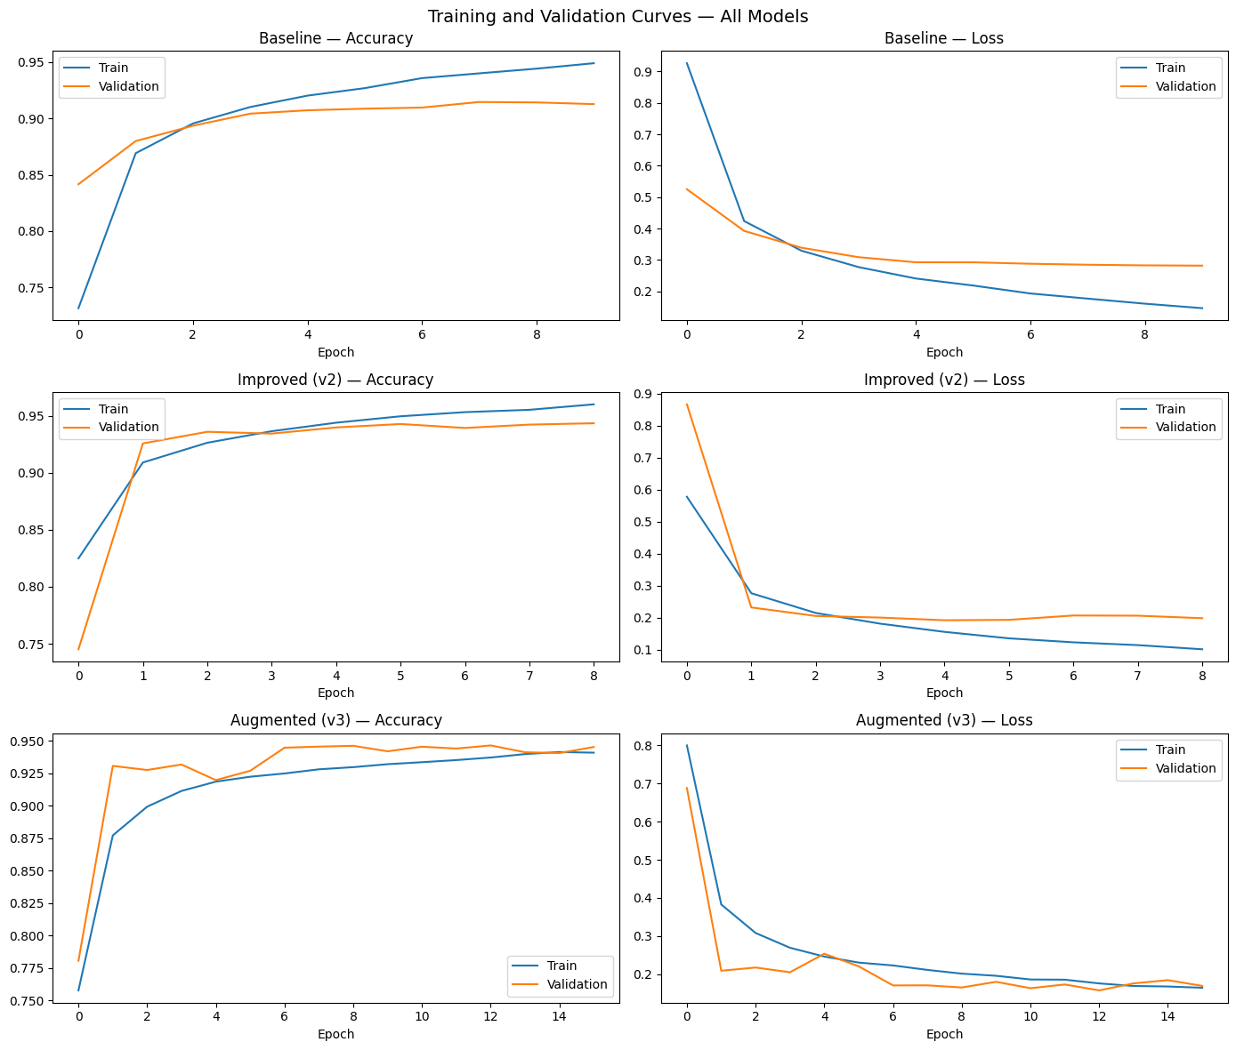
Results & Analysis
Model Performance Summary
Model | Epochs | Train Acc | Val Acc | Test Acc | Test Loss
Baseline | 10 | 94.91% | 91.28% | 91.13% | 0.2894
Improved (V2) | 9 | 96.00% | 94.34% | 93.59% | 0.1906
Augmented (V3) | 16 | 94.08% | 94.52% | 94.40% ▲ | 0.1706 ▼
Model Performance Summary
Baseline model: Good training accuracy, but lower test accuracy (91.13%), showing some overfitting
V2 model: Improved performance with higher test accuracy (93.59%) and lower loss. It shows better balance and reduced overfitting
V3 model: Best overall result with highest test accuracy (94.40%) and lowest loss (0.1706), showing better generalisation
V3 — Best

Slide 5
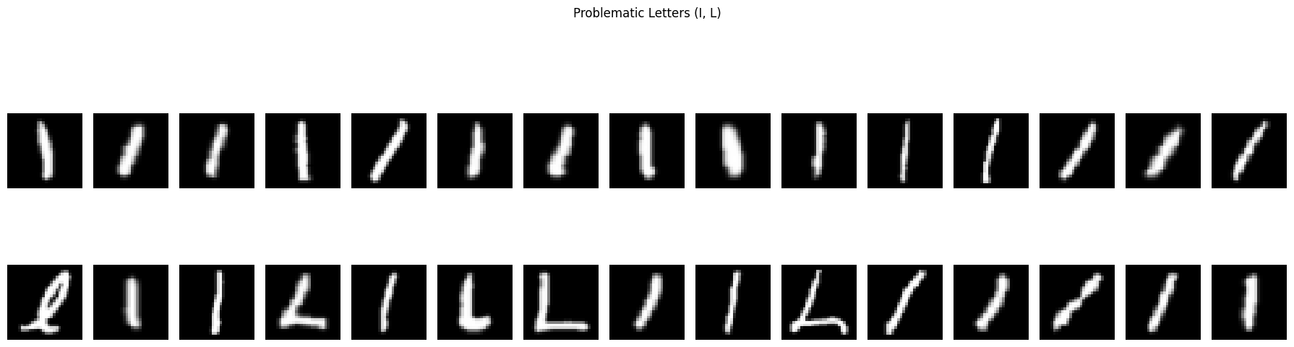
Class-Level Performance — Baseline vs V3
WEAK CLASSES (<90% ACCURACY)
I ↔ L CONFUSION (UNRESOLVED)
Why Augmentation Worsen I / L Performance
Rotation and shifting distort key features that distinguish I and L
A rotated I can resemble an L, and an L may lose its corner shape
Shifting may hide the horizontal stroke that defines L
Baseline: I, G, L, A, Q, V (6 letters)
 | Baseline | V3
I → L | 134 | 164 ↑
L → I | 87 | 65 ↓
Total | 221 | 229
V3: G, L, I (3 letters) — A, Q, V moved to strong category
LETTERS THAT IMPROVED
Letter | Baseline | V3 | Δ
E | 91.3% | 97.9% | +6.6%
A | 86.4% | 92.9% | +6.5%
R | 90.1% | 94.0% | +3.9%
V | 89.9% | 93.2% | +3.3%
J | 90.4% | 93.1% | +2.7%
Q | 89.7% | 91.5% | +1.8%
L improved — but I worsened. Single-stroke ambiguity at 28×28 px; augmentation alone cannot resolve this.
G ↔ Q CONFUSION (IMPROVED)
 | Baseline | V3
G → Q | 96 | 56 ↓
Q → G | 28 | 37
Total | 124 | 93 ✓
I vs L Confusion (Dataset Limitation)
At 28×28 resolution, I and L appear very similar
Both can look like simple strokes with minimal structural difference
Even human-level inspection finds this pair difficult to separate
This is a known limitation of low-resolution character datasets (EMNIST)
Total confusion 124 → 93. Q crossed into strong category (89.7% → 91.5%).

