Slide 1
Course Introduction
Yuemin Ding, Carlos Buchart
Tecnun, University of Navarra
Fall, 2021

Slide 2
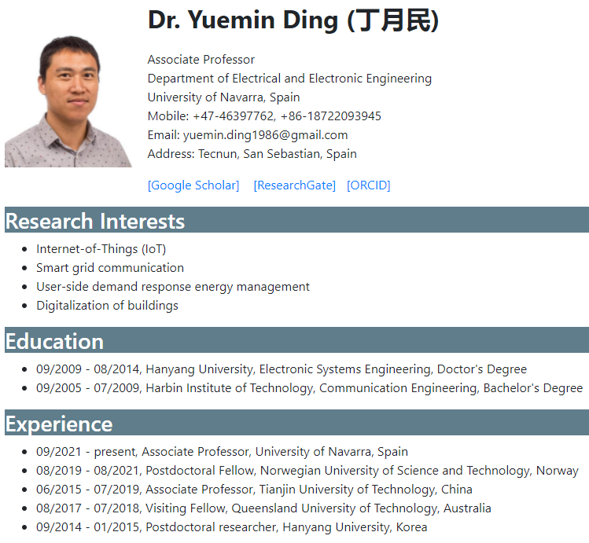
About Me
https://www.yuemin.cc/

Slide 3
Course Planning
Part I: Computer Architecture and Organization
Instructor: Prof. Yuemin Ding
20 sessions (Sept. 3 – Oct. 15)
Hardware of a computer
50% of exam and final marks
Part II: Operating system
Instructor: Prof. Carlos Buchart
19 sessions (Oct. 21 – Dec. 2)
Software of a computer
50% of exam and final marks

Slide 4
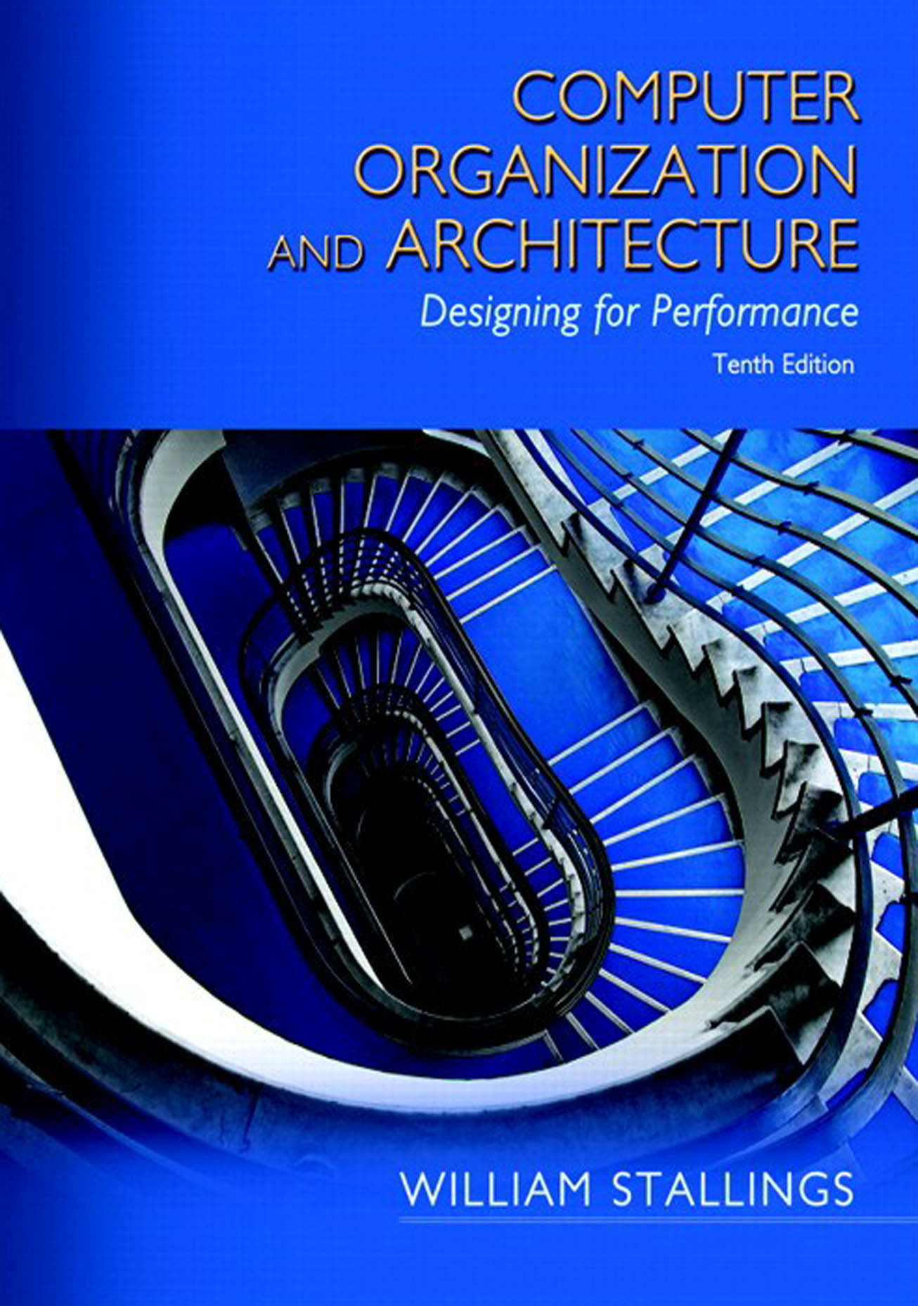
Part I: Computer Architecture and Organization
Textbook:
William Stallings, Computer Organization and Architecture: Designing for Performance, Pearson
Topics:
Basic concepts
Computer evolution
Stored-program concept and IAS computer
Computer performance
Top-level view of a computer
Cache memory
Internal memory
External memory
Input/Output
Instruction set architectures
Boolean algebra and digital logic
Data representation
Evaluation of Part I:
70% final exam
30% homework

Slide 5
Thank you!
Q&A

