Slide 1
GENOA_AA_omics_mediation_analyses
Gene_expression
16 July
Molin Yue

Slide 2
Finished SNPs extraction work
Output file is located at /home/skardia_lab/clubhouse/research/projects/GENOA_AA_omics_mediation_analyses/Gene_expression/Results/SNPs_extract_results_33195_I
result1-result22 contain all the cis-SNPs information around genes from chromosome1 to chromosome22
SNPs_extract_rs.txt shows all the results(*.gz) file

Slide 3
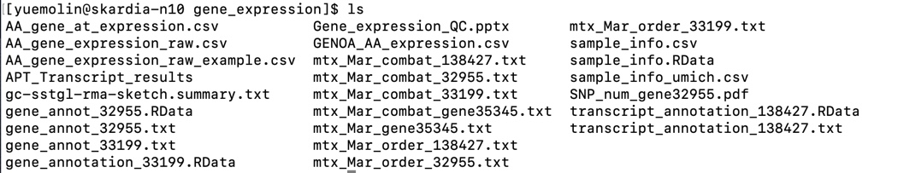
Finished SNPs extraction work
The output file format is
ID CHROM POS REF ALT Dosage(1532samples)
Problems:
There are two different annotation file which has 33199 and 32955 genes, respectively. According to Gene_expression_QC.pptx:32955 gene are used on eQTL analysis. But there is no description for 33199.

Slide 4
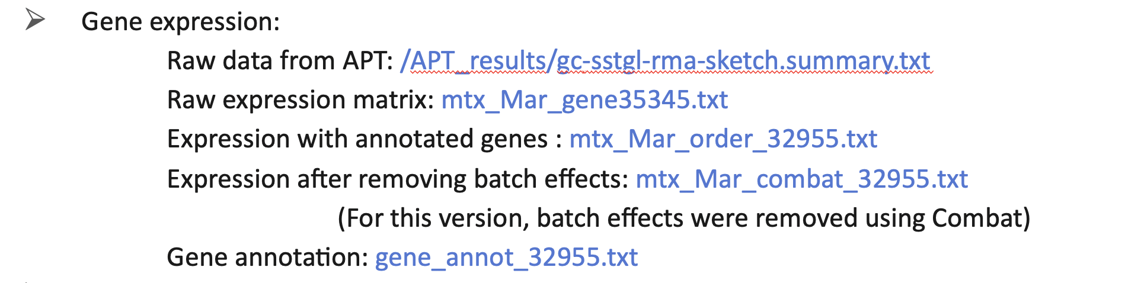
Finished SNPs extraction work
Same problems for gene expression data file

Slide 5
Preparing for GEMMA analysis
Starting from chr21
Transform VCF file into bimbam format with annotation file
The description about bimbam file is This file contains genotype information. The first column is SNP id, the second and third columns are allele types with minor allele first. For this minor allele, I took ALT to be the first column but ALT is not necessary the minor allele.

Slide 6
Preparing for GEMMA analysis
Check samples both in SNPs dataset and gene_expression dataset
There are 1532 samples in SNPs file and 1205 samples in gene_expression file. And they are 989 samples in common.
After got the 989 samples ID,
preparing SNPs file with 989 samples
and gene_expression file with 989 samples

Slide 7
Preparing for GEMMA analysis
Preparing SNPs file with 989 samples
Rerun the SNPs extract script for specified 989 samples
Check the result bimbam file has the same order with the given file
Preparing gene_expression file with 989 samples
Pair gene_expression file(mtx_Mar_combat_32955.txt) with sample_info(sample_info.csv)
select 989 samples and ordered by given ID order
transform to the GEMMA phenotype format

Slide 8
Samples confirmation
Double checked with lulu about the samples in both SNPs and gene expression. It is 989 samples in common instead of 1032, since the data we use now is different from lulu’s
Then, I finished the SNPs extraction work for all these 989 samples, finally got the BIMBAM file and annotation file of those.

Slide 9
Running BSLMM(without adjusting)
Running 1 gene ENSG00000233866(107SNPs) on chr22 for test(32955 in total)
If set –s 10000 It will take around 2min to finish
(why the computation time in log file is 10min)
If let it be default(-s 1000000), it will take about 5 min
Warning message :WARNING: Matrix G has 882 eigenvalues close to zero

Slide 10
Covariates control
Prepare data for
mod = lm(cpg ~ age +gender +PC1+PC2+PC3+PC4+PC5, data = df1)
There are 1599 samples in PC files and there are 16 samples are missing in PC file do I need take another intersection for PCs? That would be 973 samples left .
Or I just control for gender and age only for those 16 samples

Slide 11
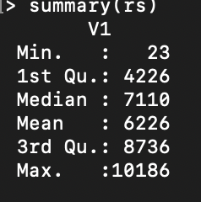
Rerun SNPs extraction
Take intersection among SNPs 1599 SNPs 1532 and gene_expression 1206, finally got 973 common samples to do analysis
Rerun SNPs extraction to get the bimbam file based on 973 samples
Got the summary statistics about the SNPs results

Slide 12
Prepare input file of BSLMM
Did the variables control by
mod = gene_ex ~ age +gender +PC1+PC2+PC3+PC4+PC5
got the residuals along with kinship matrix to fit BSLMM model
Finished chr1
About 4-5 hours per one chromosome

