Slide 1
MSP x Delphi Capstone Presentation
4 April 2022
Anirban Chowdhury, April Wang, Bhoomika Moorjani, Manna Zhao, Rosa Jin

Slide 2
Elevator Pitch

Slide 3
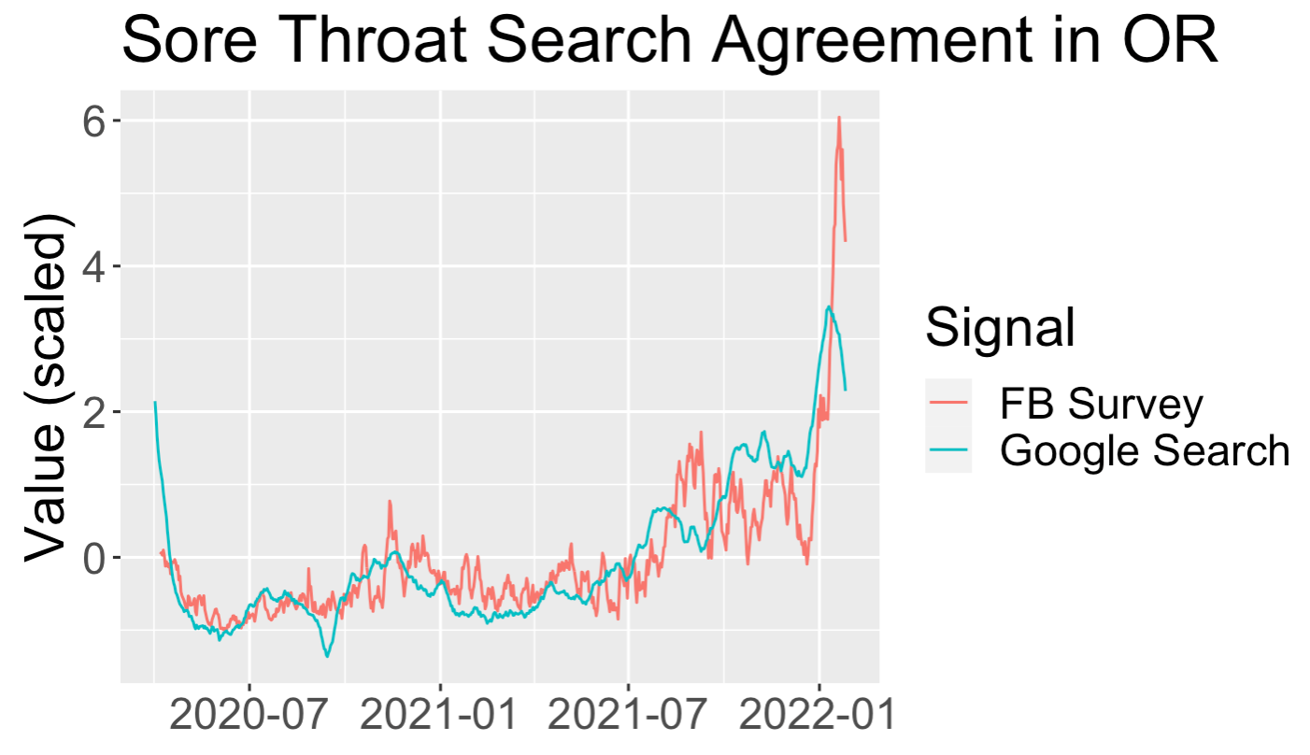
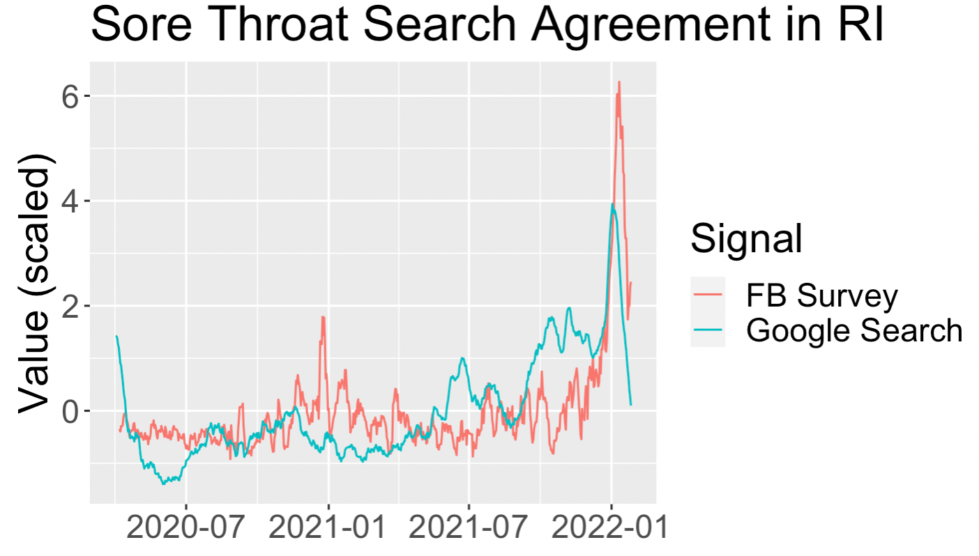
The degree of agreement between data sources depends on location

Slide 4
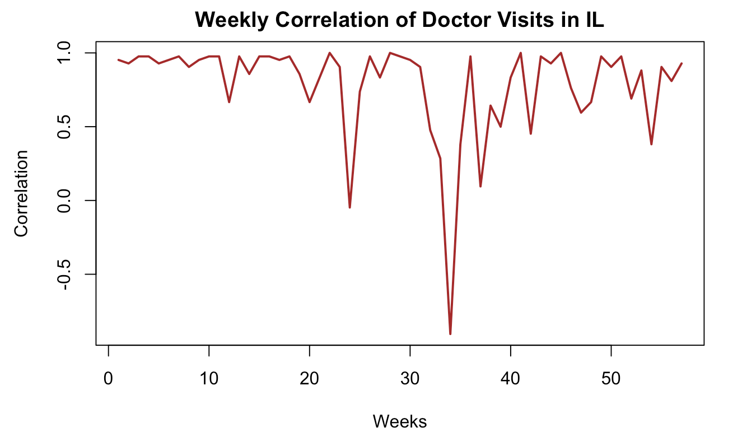
The correlation between data sources changes with time
Start Date: 2021-01-01
End Date: 2022-03-10

Slide 5
Thank You

