Slide 1
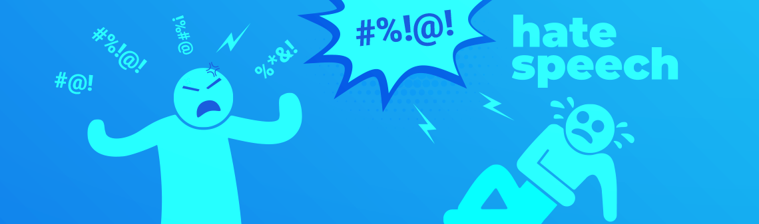
Hate Speech Detection WiSe 23-24
Image taken from https://deepsense.ai/artificial-intelligence-hate-speech/
(Dr.) Özge Alaçam
Computational Linguistics
oezge.alacam@lmu.de

Slide 2
Bird Eye View to Hate Speech & NLP methods What is hate speech? Hate Speech Definition and Terminology How can we detect it? Challenges of Hate Speech Detection

Slide 3
Hate speech
Producers/spreaders
Intent, target, severity etc.
Hate Speech Target or
Annotator,
Moderator, Judge etc.
Images taken from https://deepsense.ai/artificial-intelligence-hate-speech & https://www.eeve.ai//

Slide 4


Hate speech
Producers/spreaders
Intent, target, severity etc.
Hate Speech Target or
Annotator,
Moderator, Judge etc.
Non-hate
speech
No hate speech
Hate speech
How is it perceived?
Which part of the content
is considered critical?
And Why?
Images taken from https://deepsense.ai/artificial-intelligence-hate-speech & https://www.eeve.ai//

Slide 5
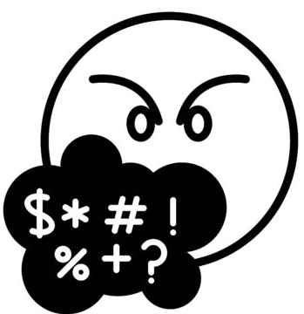
Interdisciplinary & Multi-layered
Computer Science
Linguistics
Psychology
etc.
Sociology
Law
Multilungual
Explainability
Subjectivity
Methods
Multimodal
etc...
Notes:
Research related to Computational Linguistics
Development of Language Technologies
Public Health and Security Reasons (Monitoring)
Commercial purposes (Customer Services)

Slide 6
Hate Speech
is a crime and rapidly grows…
anonymity on the internet (especially on social media)
willingness to express opinions online
Keyboard warrior/hero
A person who behaves aggressively and/or in an inflammatory manner in online text-based discussion media, but at the same time does not behave similarly in real life, potentially due to cowardice, introversion or shyness. (https://en.wiktionary.org/wiki/keyboard_warrior)
Someone who abuses/annoys/threatens/flames other people on the internet knowing that they will never have to fear retribution thanks to their anonymity. (https://www.urbandictionary.com/)

Slide 7
Hate Speech
Related Concepts;
Inappropriate language, Offensive Language
Abusive language
Cyberbullying
Derogatory language
Discrimination
Flaming
Toxic Language etc.

Slide 8
Hate Speech
These kinds of language are mostly used in online communities. It can be expressed via text, image, or video and could be ultimately handled using an automatic approach.
Offensive speech (using rude, hurtful, derogatory, obscene, or insulting language to upset or embarrass people). (Davidson et al., 2017)
Hate speech is broadly defined as a speech targeted to a given community or group with the potential of inciting violence toward them (Davidson et al., 2017; Jacobs et al., 2000; Walker, 1994).

Slide 9
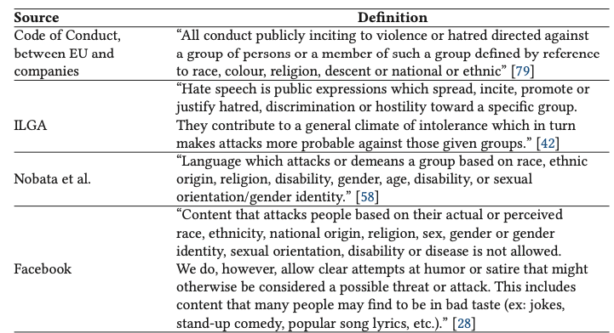
Several Hate Speech Definition (Fortuna and Nunes, 2018)

Slide 10
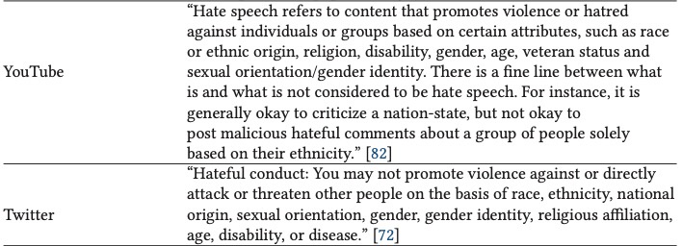
Several Hate Speech Definition (Fortuna and Nunes, 2018)

Slide 11
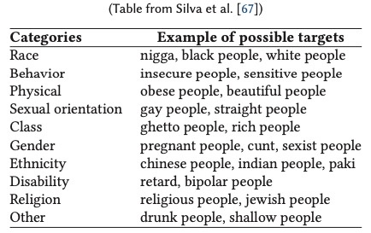
Possible Targets
It is a dynamic field;
Vaccinated people, unvaccinated people and many more

Slide 12
What is not hate speech? Hate speech – Free speech Balance
merely mentioning, or even praising, an organization associated with hate crimes
an author’s excessive pride in his own race or group
discussing offensive words (e.g., explanation of the meaning)
words used by a speaker who belongs to the targeted group
Shit still happening and no one is hearing about it, but n* living it everyday.

Slide 13
Some Important Research Questions
How can we deal with subjectivity?
How can we identify the target of hate speech?
How can we generalize the models from one language to another?
How can we generalize the models from one society to another?
How can be sure that the model decision is representative and fair?
How can we deal with the biases?
How can we detect changes in the language over course of events (temporal aspect)?
How can we deal with multimodal hate speech?
Notes:
Data-driven methods highly depend on the quality of the annotated data. However, to decide whether something is hate speech or not is a very subjective issue. Depends on the readers' background, opinion, common-sense knowledge, and awareness, it can go unnoticed or be harshly misinterpreted. How can we assure our annotation method is unbiased, representative, and fair?
It requires some understanding of society and the status of the target group/idea in this society. This is very hard to categorize and to generalize from one society to another or from one language to another. Shall we ignore this spectrum since we do not have proper tools to address it yet, or do you think data-driven approaches given enough data can handle this? What would be your position to approach this problem, given the current data-driven approaches?

Slide 14
Traditional NLP text
Social Media Text
Wiki, news, books etc.
Written form (usually formal)
No spelling errors
Usually on one language
Tweets, reviews, posts, videos etc.
Somewhere between speech and written form, sometimes only speech
Intentional spelling errors:
ki11 yrslef a$$hole
Contractions
Emojis, Hashtags
Code-mixing
Meta-information (location, social network analysis, like counts etc.)
Notes:
character n-grams (e.g. to account for spelling variation)
ki11 yrslef a$$hole
the frequency of URL mentions and punctuation,
comment and token lengths,
capitalization,
words that cannot be found in English dictionaries,
the number of non-alpha numeric characters present in tokens.

Slide 15
Datasets (cont’.)
Reddit and Gab Conversations (Qian et al., 2019)
Reddit: 5,020 conversations, including 22,324 comments (5,257 as hateful).
Gab: 11,825 conversations, consisting of 33,776 posts (14,614 as hateful)
Many emerging datasets regarding COVID and political situations
A list of some useful datasets: https://hatespeechdata.com/
Notes:
Qian et al, 2019: generative hate speech intervention, where the goal is to automatically generate responses to intervene during online conversations that contain hate speech.

Slide 16
Challenges (Definition and dataset)
Unbalanced corpora
No commonly accepted definition of hate speech
Usually low interrater agreement
Expert annotators or crowdsourcing services (find large differences in agreement)
Background knowledge ( also opinion, common-sense knowledge, and awareness)
Being a member of target group
Notes:
there are much fewer hateful than benign comments present in randomly sampled data, and therefore a large number of comments have to be annotated to find a considerable number of hate speech instances. This skewed distribution makes it generally difficult and costly to build a corpus that is balanced with respect to hateful and harmless comments.

Slide 17
Now we know
what hate speech is (a relatively clear definition)
we have a well-defined research question
type of hate speech
target group
Next step is to decide:
On the training and test data (corpora)
Collect your own data
Use publicly-available datasets
Check annotations and annotate them properly if needed

Slide 18
Collecting your own dataset/corpus

Slide 19
What is a corpus?
Corpora are "collections of language samples produced in natural contexts and without experimental interferences" (Baroni & Ueyama, 2006)
Use in linguistics and NLP:
provide evidence for theoretical and applied linguistics questions
simulate language acquisition
lexicography (write and compile dictionaries)
language modelling
and more generally, data-driven linguistics and computational linguistics
Baroni, M. & Ueyama, M. (2006), Building general- and special-purpose corpora by Web crawling, in 'Proceedings of the 13th NIJL International Symposium, Language Corpora: Their Compilation and Application', pp. 31-40.
Notes:
Because in experimental settings, in order to investigate the main effect of one condition, you usually narrow down your sample, and systematically remove variety.
When it comes to corpus, this is usually not the case, its covareg is more broader and less restricted.

Slide 20
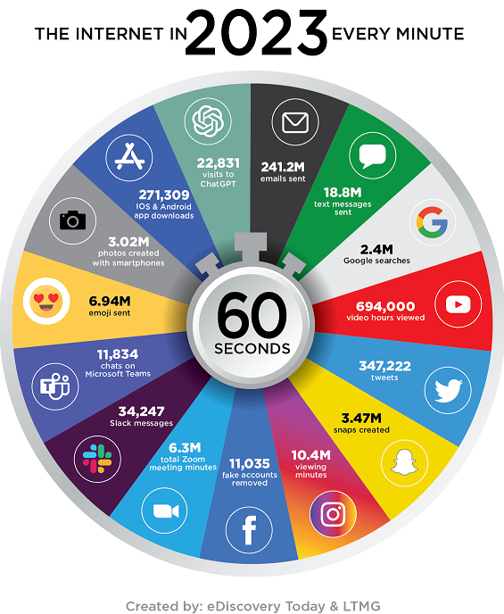
Why use the Web as corpus? (in our case “social media”)
Custom datasets through e.g. Web Scraping, APIs
huge quantity of textual data (also multimodal)
constantly evolving
many languages (perhaps even ALL written languages) and sub-languages
Vajjala et al., 2020

Slide 21

Common Social Media Platforms and their APIs
Twitter > Twitter API
Instagram > Instagram API
Facebook > Facebook API
Reddit > Reddit API or PushShift API
Also LinkedIn or Github have their own APIs to have controlled access
Many are not available right now

Slide 22
Pros and cons for using the Web as corpus
Pros:
Size
Allows fast and cheap construction of corpora
Variety of genres, including blogs, interactive communication
Cons
Noise: duplicates, non-linguistic material
Automatic corpus construction techniques make it difficult to control the composition of the corpora (lack of metadata)
Social media text style
Copyright issues
Non-native contributors
Notes:
Lets qucikly discuss the Pros and Cons.
First of all, as I have mentioned, it provides a lot of data
It is fast and cheap to get
And it represent a lot of variety
On the other hand,
It is very noisy, there are many duplicates, or irrelevant material
Since it contains a lot of data, manual constructions is not feasable, so you need to use automatic construction tecqniques, this also means less control over your data.
It might have some copyright issues
And due to non-native contributors, you may not be sure about the quality of the language.
And we are going to discuss about how to deal with those situations in the upcoming slides.

Slide 23
Key Issues with Corpus Linguistics (dataset creation) (also for Web Corpus)
Representativeness
Balance and sampling
Size
Types of Corpus
Notes:
First of all, the representativeness is really important. A corpus is not simply a collection of texts. Rather, it seeks to represent a language or some part of a language. What it represents should be made clear!
And balance and sampling issues are very closely related to the representativeness. It should not be biased towards one direction, otherwise it should be made clear! In order to provide balanced data, sampling plays an important role. You should not sample from the same nische, you need to take your data from different sources.
Corpora size is important, if you are focusing on a very specialized theme, you may not need a big corpus, but if you would like to say something about overall language, then it should certainly be large!
The last but not least is the type of the corpora! You need to define the domain of your corpora, also the modality, whether it is unimodal like only text data or multimodal, or the language; whether it is monolingual or multilingual.
For social media, whether you include emojis, hashtags, reposts etc.

Slide 24
Using existing dataset/corpus

Slide 25
a short list of some well-known datasets
Twitter (Davidson et al., 2017)
24,802 labelled tweets using crow-sourcing (hate speech, offensive but not hate speech, or neither offensive nor hate speech)
OLID Dataset SemEval 2019 and 2020 Shared Tasks
https://sites.google.com/site/offensevalsharedtask/olid
It contains a collection of 14,200 annotated English tweets following three levels:
A: Offensive Language Detection
B: Categorization of Offensive Language
C: Offensive Language Target Identification
On five languages; Arabic, Danish, English, Greek, Turkish

Slide 26
Datasets (cont’.)
HateCheck English:
Röttger, P., Vidgen, B., Nguyen, D., Waseem, Z., Margetts, H., & Pierrehumbert, J. B. (2020). HateCheck: Functional tests for hate speech detection models. https://arxiv.org/abs/2012.15606
HateCheck Multilingual:
Röttger, P., Seelawi, H., Nozza, D., Talat, Z., & Vidgen, B. (2022). Multilingual HateCheck: Functional Tests For Multilingual Hate Speech Detection Models. https://arxiv.org/abs/2206.09917
Hate Speech Dataset with Explanations
Mathew, B., Saha, P., Yimam, S. M., Biemann, C., Goyal, P., & Mukherjee, A. (2021, May). Hatexplain: A benchmark dataset for explainable hate speech detection. In Proceedings of the AAAI conference on artificial intelligence (Vol. 35, No. 17, pp. 14867-14875).
A list of some useful datasets: https://hatespeechdata.com/
THERE ARE MANY MORE!
Notes:
Qian et al, 2019: generative hate speech intervention, where the goal is to automatically generate responses to intervene during online conversations that contain hate speech.

Slide 27
Annotation Guideline -
Interrater agreement

Slide 28
it is time to set up our Python environment
and do some hands-on experience

Slide 29
Annotation Guideline
A good definition of the phenomenon, task, and labels
Hate Speech Definition:
the definition needs to establish a balance between freedom of expression and defense of human dignity
Define Annotation Scheme
Binary annotation (yes/no)
Non-binary (hate, offensive, neither) or (race, gender, ethnicity etc)
Multi-layer scheme (e.g. both type, severity and target)
The distinctions among the categories must be made clear.
How to distinguish
What are the similarities
The relations among the categories (e.g. ordinal)

Slide 30
Annotation Guideline
Positive and negative examples for each condition/label should be given
Mention possible source of disagreements
Decide what to keep and what to filter. You can give chance to your annotators to comment on “to-be-filtered” items (depends on the situation)
Plus: Confidence value for each decision

Slide 31
Annotation Guideline
Native/local speakers to annotate the data
Hate speech around the US elections should be annotated by US residents.
If possible, chose annotators with good reputation scores (e.g. in crowdsourcing platforms)
Create a clear-cut examples, and let annotators label it
inform the annotators in the guidelines, that in case of noticeable patterns of random labeling on a substantial number of tweets, their work will be rejected
Make a pilot study

Slide 32
Sample Annotation Guideline
Venue: Shared Task on the Identification of Offensive Language (GermEval Task 2018)
URL: http://www.melaniesiegel.de/publications/2018_GermEval_Guidelines.pdf

Slide 33
Interrater Agreement

Slide 34
Inter-rater and Intra-rater Agreement
Intra-rater Agreement or Reliability: The degree of agreement among repeated trials of a test performed by a single rater.
Inter-rater Agreement or Reliability: The level of agreement between raters

Slide 35
Interrater Agreement
Sources of disagreement:
Insecurity in deciding on a category
Hard/Debatable cases
Carelessness
Difficulties or differences in comprehending instructions
Openness for distractions
Tendency to relax performance standard when tired
personal opinions/values
Slides adopted from Meyer, C.M. A brief tutorial on Inter-Rater Agreement
https://dkpro.github.io/dkpro-statistics/

Slide 36
Interrater Agreement
Possible corrective actions:
Training of the annotators
Write better instructions
Provide better environment
Reduce amount of annotated data per annotator
Use more annotators
Change or merge the label types
Slides adopted from Meyer, C.M. A brief tutorial on Inter-Rater Agreement
https://dkpro.github.io/dkpro-statistics/
Notes:
Change or merge the label types: Perhaps we were fundamentally wrong about the types of labels that would be useful. Sometimes we need to modify labels to fit annotator capabilities.

Slide 37
Most common Interrater agreement metrics for Hate Speech Annotation
Joint Probability
Cohen’s kappa
Fleiss’ kappa
Krippendorf’s alpha

Slide 38
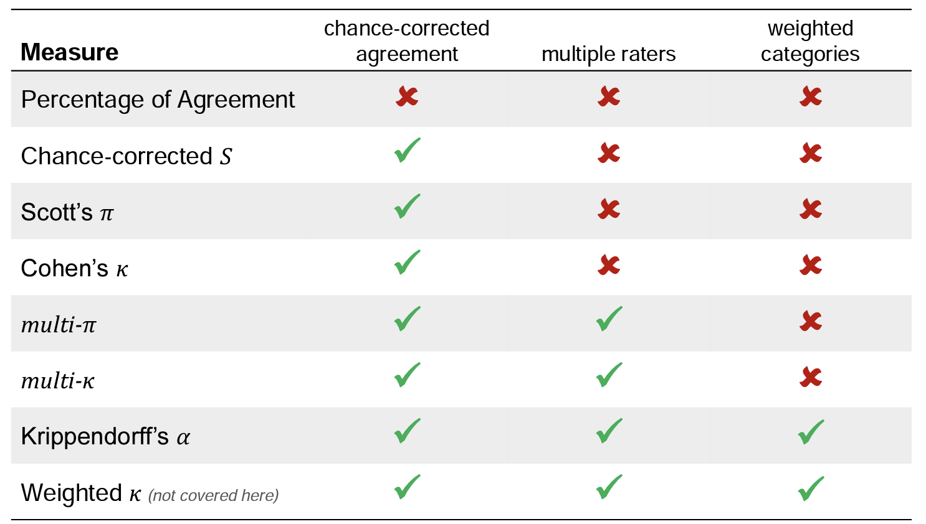
Also known as
Fleiss’ Kappa
Slides adopted from Meyer, C.M. A brief tutorial on Inter-Rater Agreement
https://dkpro.github.io/dkpro-statistics/

Slide 39
Cohen’s Kappa
2 raters – nominal values
A quantitative measure of reliability for two raters that are rating the same thing.
But it takes the probability of agreeing by chance into account.

Slide 40
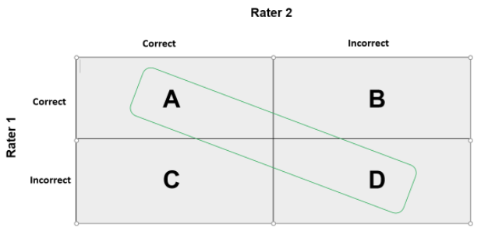
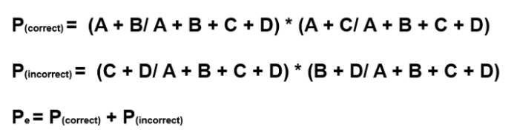

Cohen’s kappa
Contingency Table:
P_{o} = (A + D) / (A + B + C + D)
E.g.
rater1 = ['yes', 'no', 'yes', 'yes', 'yes', 'yes', 'no', 'yes', 'yes'] rater2 = ['yes', 'no', 'no', 'yes', 'yes', 'yes', 'yes', 'yes', 'yes’]

Slide 41
Fleiss’ kappa
An extension of Cohen’s kappa.
Two or more raters
Especially suitable for ranking tasks
Cohen's 𝜅 assumes that both raters are rating identical items, while Fleiss' 𝜅 allows each rater to rate different items.
While for Cohen’s kappa both judges evaluate every subject, in the case of Fleiss’ kappa, there may be many more and not every judge needs to evaluate each subject.
https://www.real-statistics.com/reliability/interrater-reliability/fleiss-kappa/

Slide 42
Fleiss’ kappa
Fleiss' kappa can range from -1 to +1.
-1 : no observed agreement (i.e., the raters did not agree on anything),
0 (zero) : agreement no better than chance.
1: perfect agreement
Κ | Interpretation
<0 | Poor agreement
0.0-0.20 | Slight agreement
0.21-0.40 | Fair agreement
0.41-0.60 | Moderate agreement
0.61-0.80 | Substantial agreement
0.81-1.0 | Almost perfect agreement
https://www.real-statistics.com/reliability/interrater-reliability/fleiss-kappa/

Slide 43
Krippendorff’s alpha
Multi-label
it supports categorical, ordinal, interval and ratio type
multi-rater annotation
Can handle incomplete data, even with relatively small data samples
Python Code:
pip install krippendorff
import krippendorff
krippendorff.alpha(reliability_data=...)

Slide 44
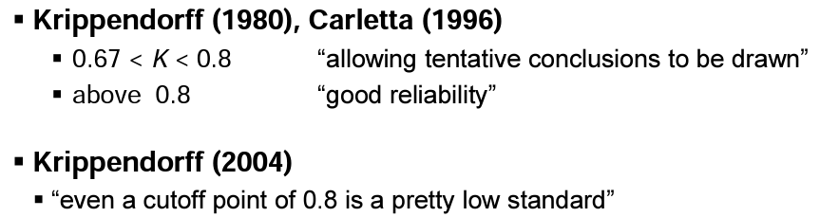
Krippendorff’ alpha Interpretation

Slide 45
Check this article for more detailed information and examples
Zapf A, Castell S, Morawietz L, Karch A. Measuring inter-rater reliability for nominal data - which coefficients and confidence intervals are appropriate?. BMC Med Res Methodol. 2016;16:93. Published 2016 Aug 5. doi:10.1186/s12874-016-0200-9

Slide 46
Sneak Peak to Mini-Projects

Slide 47
Mini-Projects
Choose a topic
Write-up blocks in every session (30 to 45 minutes)
ACL template: search for “ACL 2023 Proceedings Overleaf Template”
Programming Complexity | # | Project Name | Main Tasks
* | I | Hate Sense Classification | Annotation + running provided classifier, reporting
* | II | Implicit versus Explicit Hate Speech (Gaze4Hate) | Annotation + simple classifier
* | III | Subjective Annotation Variation (Gaze4Hate) | Linguistic and Statistical Analysis
** | IV | Explainability | Implementation of an existing model, using explainability library to extract explanations
*** | V | Curriculum Learning Regime | Implementation of an existing model, reranking the training instances, step-wise training
 |  | Your own research topic ?

Slide 48
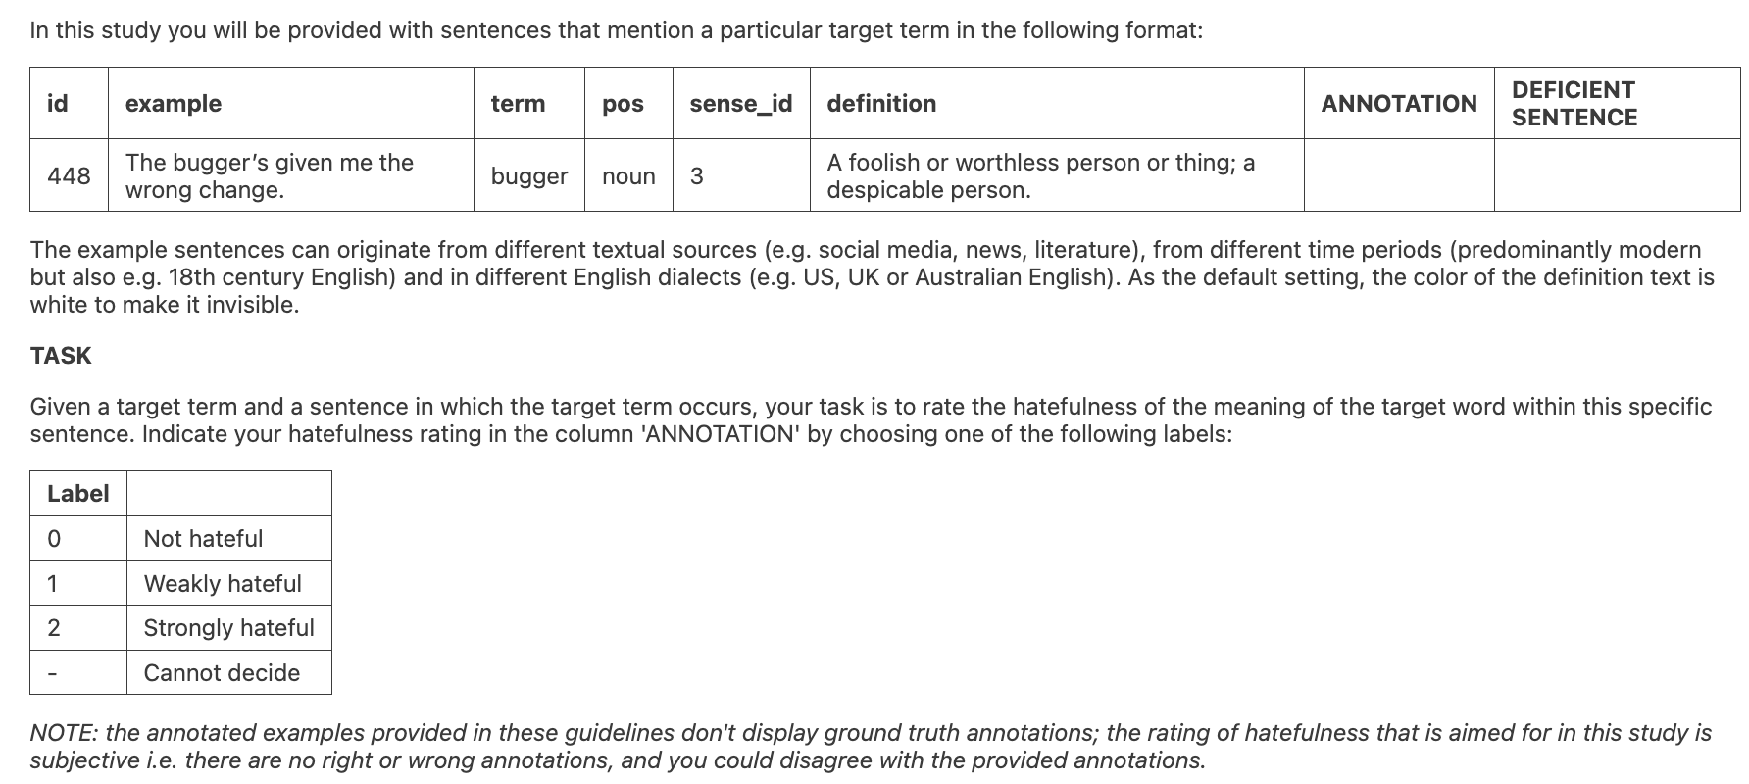
Project-I: Hate Sense Classification
Data: in-house dataset
500 English sentences in batches
the original dataset contains 4000 sentences in total
Sentences are collected from Wikipedia
Annotation Task: given the sentence and target word, annotate whether the target word carries hate! (two-step annotation)

Slide 49
Project-I: Hate Sense Classification
Needs >= 2 students, preferably 4 (for interrater agreement and sound evaluation)
 | Annotator-1 | Annotator-3 | Annotator-3 | Annotator-4
Task-1 | 500 sentence (batch-1) | 500 sentence (batch-1) | 500 sentence (batch-2) | 500 sentence (batch-2)
Task-2 | Interrater agreement |  | Interrater agreement
Task-3 | Train on 1st part, test on 2nd part (using the provided model) |  | Train on 2nd part, test on 1st part (using the provided model)
Task-4 | Report the results (discuss annotation scheme)

Slide 50
Project-I: Hate Sense Classification
A reading material:
Sanne Hoeken, Sophie Spliethoff, Silke Schwandt, Sina Zarrieß, and Özge Alacam. 2023. Towards Detecting Lexical Change of Hate Speech in Historical Data. In Proceedings of the 4th Workshop on Computational Approaches to Historical Language Change, pages 100–111, Singapore. Association for Computational Linguistics.
Source data: @scibo > Project1_HateSenseClassification

Slide 51
Project-II: Implicit versus Explicit Hate Speech (Gaze4Hate)
Test-Data: in-house dataset
Gaze4Hate Dataset (90 sentences in German)
Target Group: Women
It contains several subgroups (hate against women, positive statements about women, hate against men and neutral statements)
Annotator Task: given the sentence, annotate whether the sentence is explicitly or implicitly hateful!
ML Task: given the sentence, predict whether the sentence is hateful or not

Slide 52
Examples Sentences:
Project-II: Implicit versus Explicit Hate Speech (Gaze4Hate)
Lexical (Explicit) form:
Frauen können nichts und sind zu dumm. (Offensive Statement)
Minions können nichts und sind zu dumm. (Out-of-Context Statement)
Frauen können alles und sind sehr kreativ. (Positive Statement)
Non-lexical (Implicit) form :
Frauen gehören in die Küche. (Offensive Statement)
Töpfe gehören in die Küche. (Out-of-Context Statement)
Frauen gehören in die Regierung. (Positive Statement)

Slide 53
Project-II: Implicit versus Explicit Hate Speech (Gaze4Hate)
Some research questions could be:
Are there any differences in the dependent variables (e.g. reading time, number of selected rationales, gaze duration, pupil size etc.) between the two groups (implicit hate versus explicit hate)?
Are there differences between explicit hate and explicit positive statements?
Are there differences between implicit hate and implicit positive statements?

Slide 54
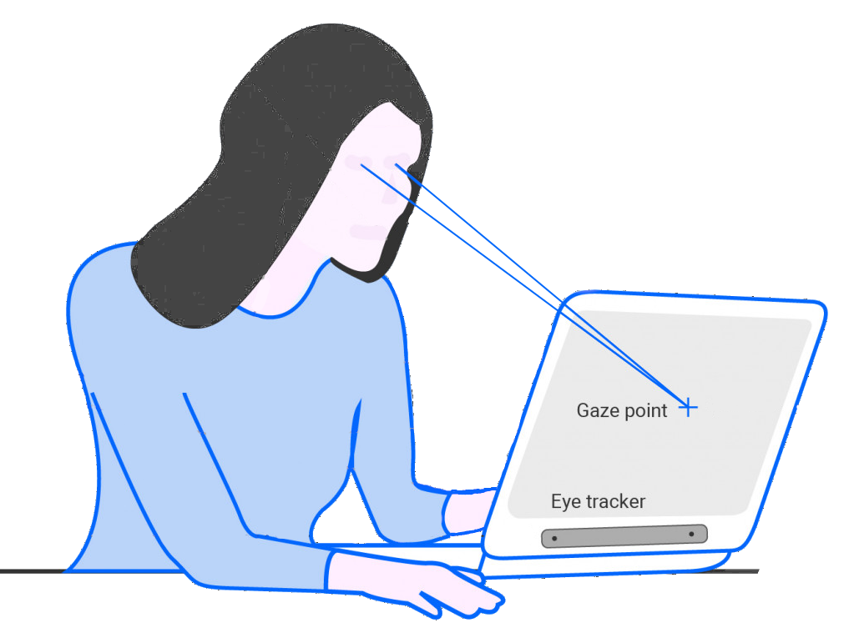
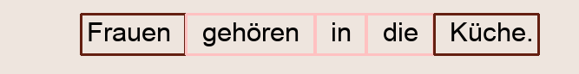
Eye-tracking experiment:
Project-II: Implicit versus Explicit Hate Speech (Gaze4Hate)
In total, 43 participants (32 female, 10 male, 1 non-binary)
1. Read the statement
2. Rate the hatefulness
(1 to 7 Likert Scale)
3. Rate the decision confidence (1 to 5 Likert Scale)
4. Select the word/phrases that contributes to the decision
Notes:
Step-1:
Read the sentence freely and press a key when you are done reading.
Step-2:
You will be asked to evaluate the sentence on a 1 to 7 Likert scale.
Step-3:
You will be asked to evaluate your certainty/confidence while giving this score.
Step-4:
In this final step, each word in the sentence is shown in a bounding box. Please click on the words that contribute to your decision. You can have multiple selections.

Slide 55
Project-II: Implicit versus Explicit Hate Speech (Gaze4Hate)
METRICS:
Sentence-level parameters:
Overall hatefulness score (how many times the sentence was annotated as hateful)
Eye-tracking parameters on the sentence (mean pupil size, fixation count etc.)
Completion times for the reading task and the annotation task
Word-level parameters:
How many times is the word selected as contributive to the decision? (hateful, out-of-context, neutral)
Gaze parameters on each word

Slide 56
Project-II: Implicit versus Explicit Hate Speech (Gaze4Hate)
Needs >= 2 students (but we also have gold label annotations)
Your tasks:
 | Annotator-1 | Annotator-2
Task-1 | 90 sentences (implicit/explicit/other) | 90 sentences (implicit/explicit/other)
Task-2 | Interrater agreement
Task-3 | Implement a simple baseline classifier (hate/nohate)
Task-4 | use the provided ML Classifier,
Task-5 | Report the results, do linguistic analysis between explicit and implicit cases

Slide 57
Project-II: Implicit versus Explicit Hate Speech (Gaze4Hate)
A preliminary reading list:
ElSherief, M., Ziems, C., Muchlinski, D., Anupindi, V., Seybolt, J., De Choudhury, M., & Yang, D. (2021). Latent hatred: A benchmark for understanding implicit hate speech. https://arxiv.org/abs/2109.05322
Ocampo, N. B., Sviridova, E., Cabrio, E., & Villata, S. (2023). An in-depth analysis of implicit and subtle hate speech messages. In Proceedings of the 17th Conference of the European Chapter of the Association for Computational Linguistics (pp. 1997-2013). Association for Computational Linguistics.

Slide 58
Project-III: Subjective Annotation Variation (Gaze4Hate)
Test-Data: in-house dataset
Gaze4Hate Dataset (90 sentences in German)
Target Group: Women
Collected from 43 participants
Word and sentence level data
Your task:
In-depth word and sentence level analysis where the annotation deviates from the majority (or from a priori labels)
Statistical analysis of hatefulness score and gaze parameters
Optional ML Task: given the results collected from 43 participants, cluster the data into meaningful chunks and explore the meaning of the clusters!

Slide 59
Project-III: Subjective Annotation Variation (Gaze4Hate)
A preliminary reading list:
Mishra, A., Dey, K., & Bhattacharyya, P. (2017). Learning cognitive features from gaze data for sentiment and sarcasm classification using convolutional neural network. In Proceedings of the 55th Annual Meeting of the Association for Computational Linguistics (Volume 1: Long Papers) (pp. 377-387). https://aclanthology.org/P17-1035/

Slide 60
Project-IV: Explainability
Reference Dataset: HateCheck or HateCheck Multilingual
(https://hatecheck.ai/download/)
ML Task: given a sentence, decide whether the sentence is hateful or not and extract explanations,
Your task:
Choose a test dataset (that exists in Hate Check or HateCheck Multilingual)
Implement an existing pretrained hate speech model from the Huggingface platform
Optional: finetune it on another suitable dataset
extract explanations using existing python libraries e.g. Captum, LIME etc.
Interpret the results with the functional categories provided in HateCheck templates
Report the results

Slide 61
Project-IV: Explainability
HateCheck English:
Röttger, P., Vidgen, B., Nguyen, D., Waseem, Z., Margetts, H., & Pierrehumbert, J. B. (2020). HateCheck: Functional tests for hate speech detection models. https://arxiv.org/abs/2012.15606
HateCheck Multilingual:
Röttger, P., Seelawi, H., Nozza, D., Talat, Z., & Vidgen, B. (2022). Multilingual HateCheck: Functional Tests For Multilingual Hate Speech Detection Models. https://arxiv.org/abs/2206.09917
Hate Speech Dataset with Explanations
Mathew, B., Saha, P., Yimam, S. M., Biemann, C., Goyal, P., & Mukherjee, A. (2021, May). Hatexplain: A benchmark dataset for explainable hate speech detection. In Proceedings of the AAAI conference on artificial intelligence (Vol. 35, No. 17, pp. 14867-14875).
Explainability Library: e.g. https://captum.ai/

Slide 62
Project-IV: Curriculum Learning Training
Reference Dataset: HateCheck or HateCheck Multilingual
(https://hatecheck.ai/download/)
ML Task: given a sentence, decide whether the sentence is hateful or not
The main task is to implement a gradual curriculum-based learning
Simple version:
re-rank the training data w.r.t. some criteria instead of shuffling
Reranking option:
Manual definition of the criteria
Based on training loss on each item

Slide 63
Project-IV: Curriculum Learning Training
Task-1 | Choose your dataset e.g. from multilingual HateCheck
Task-2 | Manually inspect the existing groups and define some complexity criteria
Task-3 | Create n complexity groups, and rank the instances w.r.t. the criteria
Task-4 | Implement an existing pretrained hatespeech model from the Huggingface platform and fine tune it step-by-step on the reranked training data
Task-5 | Optional: conduct reranking procedure based on training loss on each instance
Task-6 | Report the results
Task-7 | Discuss possible curriculums

Slide 64
Project-IV: Curriculum Learning Training
Hacohen, G., & Weinshall, D. (2019, May). On the power of curriculum learning in training deep networks. In International conference on machine learning (pp. 2535-2544). PMLR. https://proceedings.mlr.press/v97/hacohen19a.html
HateCheck English:
Röttger, P., Vidgen, B., Nguyen, D., Waseem, Z., Margetts, H., & Pierrehumbert, J. B. (2020). HateCheck: Functional tests for hate speech detection models. https://arxiv.org/abs/2012.15606
HateCheck Multilingual:
Röttger, P., Seelawi, H., Nozza, D., Talat, Z., & Vidgen, B. (2022). Multilingual HateCheck: Functional Tests For Multilingual Hate Speech Detection Models. https://arxiv.org/abs/2206.09917

Slide 65
Project-?: Custom Theme
Decide on your ML task regarding hate speech detection
Language, target, modality etc.
Research question focusing on
Dataset/annotation
Models (implementation)
Explainability
Error Analysis / Linguistic analysis
Conduct a literature search on this theme
Then follow the steps described in the basic research components slide

Slide 66
What to do now!
So, decide on your project until tomorrow's lecture time!
Don’t feel like you missed something. All project material will be available to all, so if you have an interest, you can continue on another project after the block seminar ends!

Slide 67
Before you decide, go and check the data files
Read the data as a dataframe
Explore the data, data types in each column,
Describe and visualize the columns

